Slide 1
Big Data and Consistency
Amy Babay

Slide 2
Outline
Big Data
What is it?
How is it used? What problems need to be solved?
Replication
What are the options?
Can we use this to solve Big Data’s problems?
Putting them together
What works?
What are existing tools doing?

Slide 3
Big Data: Numbers
Facebook: 100 petabytes of photos and videos
http://newsroom.fb.com/Infrastructure
Large Hadron Collider: produces 15 petabytes of data annually
http://home.web.cern.ch/about/computing
Cassandra at Netflix (as of July 2012):
472 total machine; 65 TB of data (total across 30 clusters)
72 machines; 28 TB of data (largest cluster)
http://www.slideshare.net/greggulrich/cassandra-operations-at-netflix
Ebay’s Cassandra “taste graph” (as of March 2013):
32 nodes; 5 TB (replicated twice = 10 TB), expected to quadruple in 1 year
http://www.slideshare.net/planetcassandra/e-bay-nyc
Twitter metrics in Cassandra (Cuckoo): 492 GB/day
http://www.scribd.com/doc/59830692/Cassandra-at-Twitter

Slide 4
Using Big Data – Different Use Cases
Write once
Simple key-value updates
Compound key-value updates
Database transactions

Slide 5
Accessing Big Data: Write Once/Read Many
Data never changes once it is written; new data can be added
Requirements:
Partition data
Locate/retrieve data
Cassandra Solutions:
Consistent hashing
Gossip to propagate data locations

Slide 6
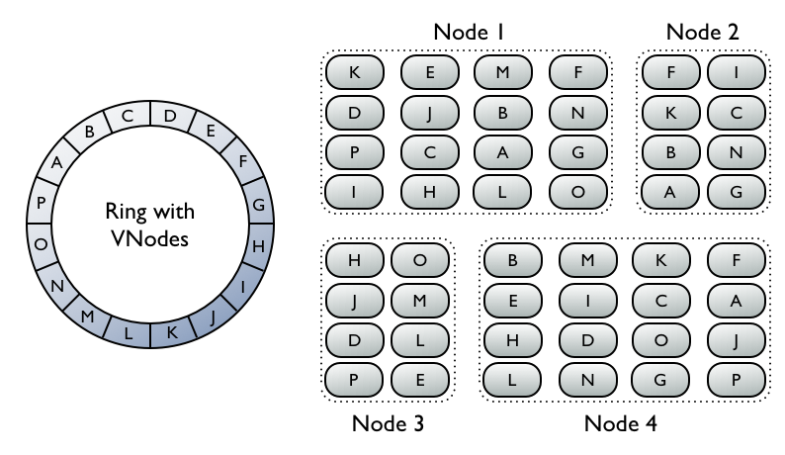
Partitioning Data: Consistent Hashing
http://www.datastax.com/dev/blog/virtual-nodes-in-cassandra-1-2

Slide 7
Locating Data: Gossip
New nodes start with the addresses of a small set of “seed” nodes, which they contact to get information about the cluster
Once per second, exchange state with up to 3 other nodes
Information about which ranges belong to which nodes is propagated by eventual path

Slide 8
Accessing Big Data: Simple Key-value Updates
Each update only affects one key-value pair
Requirements:
Get the update to all replicas
Potentially enforce guarantees on the visibility of the update
Cassandra Solutions:
Hinted handoff, read repair, anti-entropy sessions
“Tunable consistency”

Slide 9
Accessing Big Data: Compound Updates and Transactions
Updates can affect multiple key-value pairs
Updates may be conditional
Requirements:
Coordinate across replicas for different key-value pairs
Cassandra Solutions:
Adding support for atomic batches – not quite there yet
What else can we do?

Slide 10
Replication Protocols
Ensure that all replicas apply updates in the same order
A replication engine can impose a total order on all updates in the system

Slide 11
Two-phase Commit: Example 1
Coordinator
Prepare
Prepare
Prepare
Participant
Participant
Participant

Slide 12
Two-phase Commit: Example 1
Coordinator
Ready
Ready
Ready
Participant
Participant
Participant

Slide 13
Two-phase Commit: Example 1
Coordinator
Commit
Commit
Commit
Participant
Participant
Participant
Transaction Committed

Slide 14
Two-phase Commit: Example 2
Coordinator
Prepare
Prepare
Prepare
Participant
Participant
Participant

Slide 15
Two-phase Commit: Example 2
Coordinator
Ready
Ready
Abort
Participant
Participant
Participant

Slide 16
Two-phase Commit: Example 2
Coordinator
Abort
Abort
Abort
Participant
Participant
Participant
Transaction Aborted

Slide 17
Two-phase Commit: Properties
Can be used for general transactions; not only the special case of replication
Vulnerable to coordinator failure

Slide 18
Paxos: Normal Case
When the leader receives update u from some replica:
Leader
Propose(u, i)
Non-leader
Propose(u, i)
Propose(u, i)
Propose(u, i)
Non-leader
Non-leader
Non-leader

Slide 19
Paxos: Normal Case
If no replica has assigned an update u’ != u to sequence i:
Leader
Accept(u, i)
Non-leader
Accept(u, i)
Accept(u, i)
Accept(u, i)
Non-leader
Non-leader
Non-leader

Slide 20
Paxos: Normal Case
Once the leader receives “accept” from a majority:
Leader
Decide(u, i)
Non-leader
Decide(u, i)
Decide(u, i)
Decide(u, i)
Non-leader
Non-leader
Non-leader

Slide 21
Paxos: Properties
Extremely resilient: leader + any quorum can make progress
Provides strong consistency (only)
Processing many “accept” messages may limit performance

Slide 22
Ring Paxos: Normal Case
When the leader receives update u:
Coordinator, last Acceptor in ring
Propose(u, i)
Propose(u, i)
Acceptor
Spare Acceptor
Propose(u, i)
Propose(u, i)
First Acceptor in ring
Spare Acceptor

Slide 23
Ring Paxos: Normal Case
Coordinator, last Acceptor in ring
Acceptor
Spare Acceptor
Accept(u, i)
First Acceptor in ring
Spare Acceptor

Slide 24
Ring Paxos: Normal Case
Coordinator, last Acceptor in ring
Accept(u, i)
Acceptor
Spare Acceptor
First Acceptor in ring
Spare Acceptor

Slide 25
Ring Paxos: Normal Case
Coordinator, last Acceptor in ring
Decide(u, i)
Decide(u, i)
Acceptor
Spare Acceptor
Decide(u, i)
Decide(u, i)
First Acceptor in ring
Spare Acceptor

Slide 26
Ring Paxos: Properties
Improves the performance of Paxos (eliminates “accept” bottleneck)
Reduces the resiliency of Paxos (what if a member of the ring fails?)
Same semantics as Paxos—strong consistency

Slide 27
Congruity: Normal Case
Replicas send updates via a group communication service using safe delivery
While in a primary component, replicas can apply updates as soon as they are delivered (by group communication service)
While not in a primary component, updates are still exchanged but not applied (if strong consistency is needed)

Slide 28
Congruity: Properties
Flexible semantics: weak consistency queries, dirty queries, commutative updates/timestamp semantics
Allows replicas not in a primary component to respond to queries
Exchange updates while not in primary component + exchange state on membership change → Propagation by eventual path
Avoids acknowledging every update
Requires membership (reduces resiliency)

Slide 29
Revisiting Big Data
Write once
Simple key-value updates
Compound key-value updates
Database transactions

Slide 30
Replication Engines
Provide total order on updates in the system
Need to be able to handle throughput of the system
Data Store
Data Store
Data Store
Data Store
Data Store
Replication server
Replication server
Replication server
Data Store
Data Store
Replication server
Replication server
Data Store
Data Store
Data Store

Slide 31
Improving Throughput for Group-Communication-based Replication
Standard ring protocol:
Token circulates logical ring
Upon receiving the token, a participant sends all the messages it has/is allowed for that round, then passes the token to the next participant
Accelerated ring protocol:
Token circulates logical ring
Upon receiving the token, a participant sends some fraction of the messages it has/is allowed for that round, passes the token, and then sends the remaining messages it has/is allowed

Slide 32
Throughput Comparison
Clouds 1-6: 1 Gb/s Cisco switch:
700 Mb/s
400 Mb/s

Slide 33
Throughput Comparison
Rains 1-5: 1 Gb/s Cisco switch:
940 Mb/s
550 Mb/s

Slide 34
Throughput Comparison
Rains 1-5: 10 Gb/s Arista switch:

Slide 35
Throughput Comparison
Rains 9-16: 10 Gb/s Arista switch:
2.5 Gb/s
1.9 Gb/s

Slide 36
Solving the Big Data Problems
Compound key-value updates: replication engines enforce total ordering of updates across servers
Distributed transactions: is total order sufficient?
Consider update_{i}: “Read A. If A =1, write B=2”
All servers will assign the same order to the update, but if A is on server1 and B is on server2, what should server2 do when it orders update_{i}?

Slide 37
Solving the Big Data Problems
Need something more general than replication to handle distributed transactions
Two-phase commit
Three-phase commit? Enhanced three-phase commit?
Number of replicas per item is small (3-4)
More efficient to coordinate per item, rather than using a replication service for the entire system
Regular Paxos – performance optimizations aren’t relevant for this number of replicas

Slide 38
Toward Solving the Big Data Problems
Spanner: Google’s proprietary approach http://research.google.com/archive/spanner.html
Paxos between replicas; 2PC for transactions involving multiple Paxos groups

Slide 39
Big Data: Conclusions
Requirements for large-scale data stores depend on use patterns
Eventually consistent key-value store approaches work well for read only data and single-row operations
A more general and complex approach is necessary to provide transactional guarantees across rows
An open source implementation / realization may be useful

