Slide 1
K-Path Overlay Routing for Resilient Clouds
Bennett Ellis

Slide 2
Overview
Interested in ways to create additional resiliency to network faults and partitions in overlay networks
How?
Multipath routing
Notes:
Explain multipath routing

Slide 3
Agenda
K-Path Routing
My Implementation
Testing My Implementation
Demo
Practicality

Slide 4
K-Path Routing
Looking for a set of k edge or vertex disjoint paths in a graph such that the sum of the lengths of each path is the minimum of the corresponding sums of all possible sets of k edge or vertex disjoint paths for that graph.
Possible Algorithms: Suurballe’s, Algorithms from Survivable Networks by Ramesh Bhandari, Min-cost/Max-flow

Slide 5
Suurballe’s Algorithm
Run Dijkstra’s to get shortest path tree.
Use cost of each edge in tree to modify weights of every edge in the graph to get a transformed graph
Rerun Dijkstra’s to get shortest path to destination.
Repeat 2-3 as necessary (1 repetition per desired extra path)
Remove overlapping edges in paths to destination from different iterations of Dijkstra’s

Slide 6
Algorithms from Survivable Networks
Run Dijkstra’s to get shortest path
Replace each edge in path with a negative edge in the opposite direction
Rerun modified version of Dijkstra’s
Repeat steps 2-3 as many times needed (1 repetition per desired extra path)
Remove overlapping edges from paths generated by each Dijkstra’s.

Slide 7
Min Cost/Max-Flow
Recast problem as a flow network. Each edge has a capacity of 1 unit of flow and a cost has a cost per unit of flow for using that edge.
Variation of Edmonds and Karp
Only increment flow by 1 in each iteration
Use Dijkstra’s to find shortest augmenting path based on cost rather than finding shortest augmenting path based on number of hops
At the end: look at edges with positive flow
K iterations will find a minimum cost path for sending K units of flow, which is equivalent.

Slide 8
Algorithm Comparison
Each runs K iterations of Dijkstra’s
Surballe’s requires a modification of each edge in the graph after every iteration
Survivable Networks requires the reversal and negation of edges of each iteration’s path
Min-Cost/Max-Flow requires modification of flow of the path found in every iteration
Decided to go with Min-Cost/Max-Flow

Slide 9
Min-Cost/Max Flow Illustration
3
4
1
1
3
3
1
2
1

Slide 10
Edge to Vertex Disjoint

Slide 11
My Implementation
Decided to do it as a model of an overlay network written in C.
Entire network known to each server in model
N servers, each numbered 1-N
Bidirectional links (max one per pair of servers)
UDP Communication
Clients on same machines as Servers
Source Based Routing
Small buffer at exit node of model

Slide 12
Source Based Routing
Routing info stamped into packet header for packets between servers
1 bit per link in the network
Each server calculates same global ordering of each edge => same unique 1 bit mask calculated for each edge

Slide 13
Small Buffer
Potentially receiving multiple copies of each message, out of order.
Add sequence number to each packet based on source server. End server buffers packets based on source server.
Upon receiving each message If in order: deliver and then deliver contiguous buffered messages
If out of order: buffer
Flush buffer every 10 ms (or if it reaches max # of packets it will buffer from one source)

Slide 14
Testing
Implemented naiive routing algorithm as well as a chat client. Used Simple network
Implemented Min-Cost/Max-Flow algorithm and tested chat client
Implemented funnels to stream larger quantities of data over the model

Slide 15
Demo
Wrote a funnel client
On entry node in overlay: listens for outside packets on a port, encapsulates it in in appropriate header, passes to server along with request to deliver to a particular exit node using a particular number of paths
On exit node: listens for output from exit node server, strips headers, sends packets to an IP address set up in advance.
Added Statistics
Entry node: picks out paths chosen every 1000 packets
Destination node: prints path packet actually took every 100 packets and time spent in overlay in microseconds
Dr. Amir kindly let me test this on his cloud with a video stream.

Slide 16
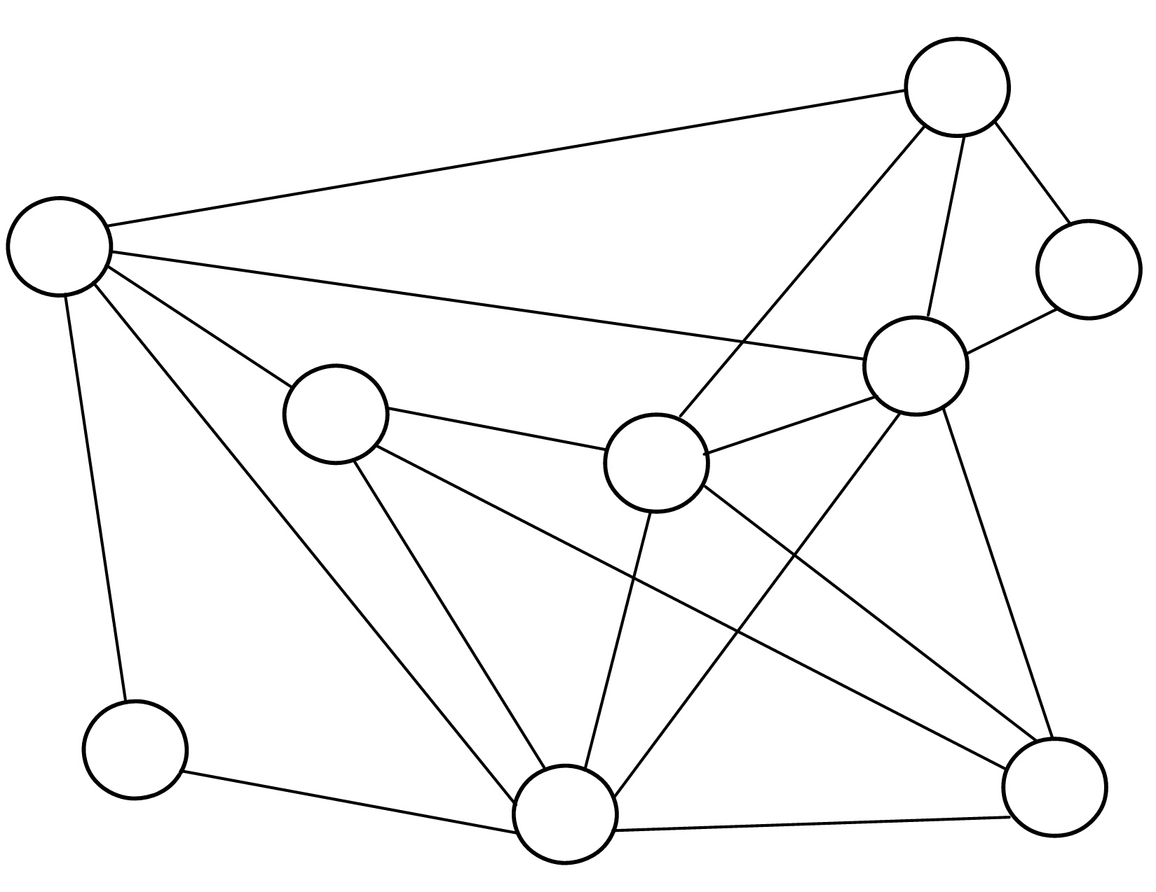


Demo Graph
1
1701
200
2
100
9
1700
5
200
3
100
100
100
4
301
130
100
150
300
6
321
220
8
Dano
100
7
100
Notes:
Funnel clipart courtesy of http://dir.coolclips.com/Household/Kitchens/Cooking_Utensils/Funnels/funnel_vc012458.html
Laptop clipart courtesy of http://www.wpclipart.com/computer/laptop/laptop_line_art.png.html

Slide 17
Practicality: Positives and Negatives
Negative | Positive
Pay K times per packet | Occasionally willing to do so for increased reliability
Requires knowledge of entire network | Common situation in Overlays
Model only recognizes clients on the same machine as servers | Only because model doesn’t have info to find appropriate exit node based on outside destination IP. Fix by porting to a real overlay.
Model doesn’t do any packet replaying between servers. | Again, only a limitation of the model. Port to a real overlay.

Slide 18
Questions?

