Slide 1
Increased Resiliency for Tor

Slide 2
Introduction
Overview of Tor
What is Tor? Why use Tor?
How Tor works
Encryption, Circuit Building, Directory Server
Drawback of Tor’s directory server
Potential solution
Using DNS Security Extension

Slide 3
What is Tor
A distributed overlay network based on voluntarily run relays around the world
Provides low latency anonymity to TCP-based applications
Protects users from being identified online
Journalists, activists, business people
Circumvents Censorship
User
Web site
censership
User
Block.com
Tor

Slide 4
Tor Network: the Basic
Directory nodes
Servers set up by Tor project
List all the nodes available in Tor network
Relay nodes
Servers run by volunteers around world
Onion proxy
Proxy running on client computer
Circuit
An encrypted virtual tunnel
Made of a chain of Tor relay nodes
Traffic routed through multiple relays from the user to the final destination

Slide 5
Overview
Tor begins building circuits as soon as it has enough information to do so.
Web site
DS
OR
OR
OR
DS
OR
OR
OR
DS
Who is in the Tor network?
OR
DS: Directory Server
OR: Onion Retours
OP: Onion Proxy
OP
Client (onion proxy) downloads the info about all the ORs from directory server.
Includes keys, ips, ports, bandwidth, etc.
OP opens a new connection, attaches to a circuit
Notes:
Preemptive circuit build:
Tor tries to maintain at least a certain number of clean circuits, so that new streams can be handled quickly.
Attach Stream:
When a client application creates a new stream (by opening a SOCKS connection or launching a resolve request),
Tor attaches it to an appropriate open circuit if one exists, or wait if an appropriate circuit is in-progress.

Slide 6
Diff-Hellman Key Exchange
Alice
Both agree on a prime number p=23 and base g=5.
Bob
chooses a secret integer x=6
chooses a secret integer y=15
g^{x} mod p =5⁶ mod 23=8
g^{y} mod p =5¹⁵ mod 23=19
key = B^{x} mod p = 19⁶mod 23 =2
key = A^{y} mod p = 8¹⁵mod 23 =2
“Two parties that have no prior knowledge of each other to jointly establish a shared secret key over an insecure communications channel”
Example from wikipedia
Notes:
Brief overview of Diff-Hellman key exchange,
Understand tor circuit build
Send ( g to the power of x ) to other
Alice receive Bob’s result and raise it to the power of his secerty value

Slide 7
How a Tor Circuit is built
Create c₂ E(g^{x2})
OR1
Created c₂, g^{y2}, H(K₂)
OR2
Created c₁, g^{y1}, H(K₁)
Relay c₁(Extended, g^{y2}, H(K₂)
Create c₁, E(g^{x1})
Relay c₁ (Extend, OR₂, E(g^{x1}))
OP
OP sends relay extend cell to OR1
Specifies that the next hop will be OR2
Contains the first half of the Diffie-Hellman handshake (g^{x2})
Encrypted with the onion key of the OR2
OR1 responds with a created cell containing g^{y}
Contains hash of the negotiated key K ( g^{xy}).
Circuit between OP and OR1 is established
OR1 copy the E(g^{x2}) into a create cell and send to OR2
OR2 returns create cell to OR1
OR1 wraps g^{y2} and K₂ and sends back to OP
OP sends a create cell to the 1st node in the path it chooses,
Contains the first half of the Diffie-Hellman handshake (g^{x1})
Encrypted with the onion key of the OR1
Notes:
Handshake message encrypted with OR key
By hashing key, OR1 proves that it was he who received g_x, and who chose y
OP and OR1 share key1, OP and OR2 share key2
Repeat the same hasdshake pattern to extend to the third OR
OR and OR2 never talk to each other

Slide 8
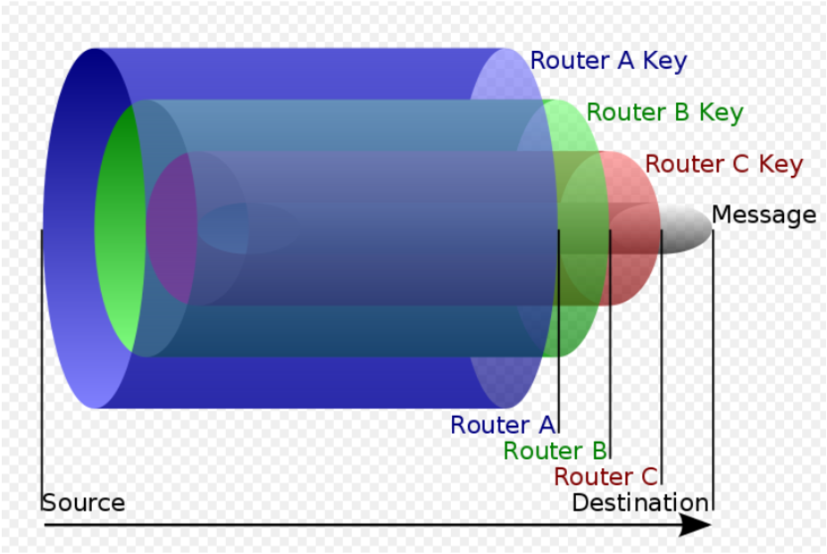
Tor’s Message
http://en.wikipedia.org/wiki/File:Onion_diagram.svg
Notes:
Each onion router removes a layer of encryption with its symmetric key to reveal routing instructions,
and sends the message to the next router where this is process is repeated.
Analogy “onion router”. This prevents these intermediary nodes from knowing the origin, destination, and contents of the message

Slide 9
How Tor Fetches a Website
Know originator
Does not know
the destination
K2
K3
msg
K3
msg
msg
OR1
OR2
OR3
K1
K2
K3
K2
K3
msg
K3
msg
msg
TCP Handshake
K1
Does not know originator
Know the destination
K2
K3
msg
msg
OP
OP iteratively encrypts the cell with the symmetric key of each hop up to that OR
Notes:
When OR replay to OP
it encrypts the cell’s relay header and payload with the single key it shares with OP, and sends the cell back toward OP
along the circuit. Subsequent ORs add further layers of encryption as they relay the cell back to OP.
OR can be malicous,
Entry node, exit node

Slide 10
How Clients Know the Topology
Each onion router periodically signs and sends its
keys, bandwidth, port, etc., to the Tor directory servers
DS
OR
OR
OR
DS
OR
OR
OR
DS
DS: Directory Server
OR: Onion Retours
OP: Onion Proxy
OP
OR
Each directory server periodically signs and sends its individual
view of the Tor network to other directory servers.
Clients (onion proxies) download the consensus file from a directory server
Notes:
Onion-key: This key is used to encrypt CREATE cells for this OR
1.It require each directory and client to know each of the relay nodes in the Tor network
2.Each relay node periodically sign and send its public key, bandwidth, port, etc.. to the Tor directory server
3.Tor directory servers periodically generate a consensus view of the current relay nodes,
by sign and send individual view of the Tor network to others.

Slide 11
A Problem with Tor Directory Servers
Tor requires each directory server and client user (onion proxy) to know all of the relay nodes in the Tor network
Clients periodically ask directory servers:
Who is there in the Tor network?
What is their status and info?
Is a relay node active? Public key, port, IP, etc.
What if the directory server is inaccessible
E.g., Blocked by ISP?
Potential solution: Ask DNS for directory server information

Slide 12


DNS Resolution
NO authentication and integrity
Root DNS server
Example.com
Refer to .com
DNS resolver
.com
TLD(Top Level Domain)
DNS server
Where is www.example.com
Refer to example.com DNS
xxx.xxx.xxx.xxx
xxx.xxx.xxx.xxx
Example.com
DNS server
Notes:
NO authentication and integrity

Slide 13
DNS Security Extension Resolution
Root DNS server
example.com
IP of .com DNS
Pub Key of .com DNS
All signed by root key
Signed(.com, key_{com})
DNS resolver
.com DNS server
Where is www.example.com
IP of example DNS
Pub Key of example DNS
All signed by .com key
Signed(example.com, key_{example.com})
xxx.xxx.xxx.xxx
Signed xxx.xxx.xxx.xxx
Example.com
DNS server
Notes:
Key_com
The public key for the .com is trusted since it is signed by the root

Slide 14
Consensus File (Partial)
network-status-version 3
vote-status consensus
consensus-method 13
valid-after 2013-04-25 19:35:00
fresh-until 2013-04-25 19:40:00
valid-until 2013-04-25 19:50:00
voting-delay 20 20
client-versions
server-versions
A document format version.
Vote status
Consensus methods that are using
Start time of the consensus
Time to produce next consensus
The time this consensus expires

Slide 15
Consensus File (Partial)
@downloaded-at 2013-04-28 06:52:04
router relay8 128.220.221.150 9000 0 9500
onion-key
signing-key
router-signature
Signature from directory servers

Slide 16
Replacing Directory Server with DNSSEC
Still not fully resilient
Adversary can simply block tordir.org
Root DNS server
TorDir.org
Signed(.org, key_{com})
DNS resolver
.orgDNS server
Where is torDir.org
Signed(tordir.org, key_{example.com})
Info about tor relay nodes
Signed Info about tor relay nodes
TorDir.org
DNS server

Slide 17
Replacing Directory Server with DNSSEC
Many random domain names
Change regularly
Generate by hash function
Each domain name is only responsible for a subset of all available Tor relay nodes.
When querying one domain, a client is only provided with a subset of relay nodes
Info about relays is encrypted using domain name’s keys
Domain name key changes regulary

Slide 18
Conclusion
Difficult to block all domain name
Thousands of domain name
Each responsible for subset of relays
As long as one domain name is not blocked
Difficult to block all IP address of relay nodes
Directory info is encrypted
Encrypted key regular change

Slide 19
References
https://www.torproject.org/
Main Tor Specification, https://gitweb.torproject.org/torspec.git?a=blob_plain;hb=HEAD;f=tor-spec.txt
Tor Version 3 Directory Server Specification, https://gitweb.torproject.org/torspec.git?a=blob_plain;hb=HEAD;f=dir-spec.txt
A New Approach to DNS Security (DNSSEC), http://www.cs.jhu.edu/~ateniese/papers/dnssec.pdf
Huston, G. 2010, DNSSEC-A Review, http://www.potaroo.net/ispcol/2010-06/dnssec.html

