Slide 1
Peer to Peer Networks on Android
Paul O'Neil and Steven Presser

Slide 2
Agenda
Motivation
Constraints
Tools and Barriers
Architecture
Demonstration

Slide 3
Agenda
Motivation
Constraints
Tools and Barriers
Architecture
Demonstration

Slide 4
Motivation
Communication Critical in Disasters
Infrastructure Networks likely damaged
However, end users likely still have battery powered wireless devices
Quickly deploy internet enabled devices in new areas
  Only the edge needs an uplink

Slide 5
Existing Solutions
Peer to Peer network
However, theoretical P2P already exists
  Let's operate with unmodified end-user devices
SMesh
  Uses a system of mobile devices and fixed routers to create a mesh network
  Requires rooting the phones
  Overlays (via Spines) running on Android

Slide 6
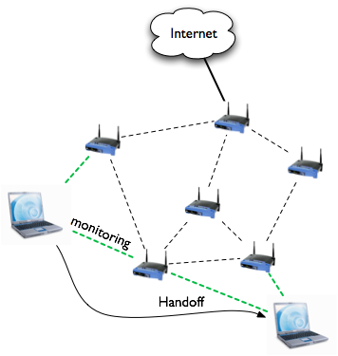
Existing Solutions
http://www.smesh.org/

Slide 7
Agenda
Motivation
Constraints
Tools and Barriers
Architecture
Demonstration

Slide 8
Constraints
Cannot:
  Root
  Require other OS
  Require different radio
  Require any modification beyond installation of an application

Slide 9
Agenda
Motivation
Constraints
Tools and Barriers
Architecture
Demonstration

Slide 10
Technology
Android
  Can have long-lasting outbound connections
  Use the VPN interface to capture packets
  Java
WiFi Direct
  Use 802.11-like protocols without an access point

Slide 11
Android Apps
Activity
  One screen of an application
  Control interface
Service
  Long lasting background worker
  Networking
Communicate using message passing
The app has to be multithreaded
  No network on the GUI thread

Slide 12
Android
iOS does not have the flexibility we need
  Can't have the persistent outgoing connections
  Can't capture packets via VPN
    Apple implements the client as part of the operating system

Slide 13
WiFi Direct
Point-to-Point connectivity
Targeted at:
  Printers
  Projectors
  Transferring photos
  Multiplayer Gaming?

Slide 14
WiFi Direct
There's no network name, so let's make one!
  Group owner acts as an access point
Pairing with another device means joining a group.
Communication goes through the owner
Everyone is told the address of the owner

Slide 15
Barriers
Android programming is conceptually challenging
WiFi Direct functions poorly

Slide 16
Android Problems
Everything is asynchronous and through callbacks
  Requesting information about the current WiFi group
  Spaghetti code
  Maybe we're just not good enough at coding
Some things can only happen on certain threads
  Toast notifications, GUI access, Network

Slide 17
Java is Not the Right Tool
No unsigned types
  Have to compute checksums
Channel
SelectableChannel
FileChannel
DatagramChannel
SocketChannel
VPN exposes
one of these
read()
read()

Slide 18
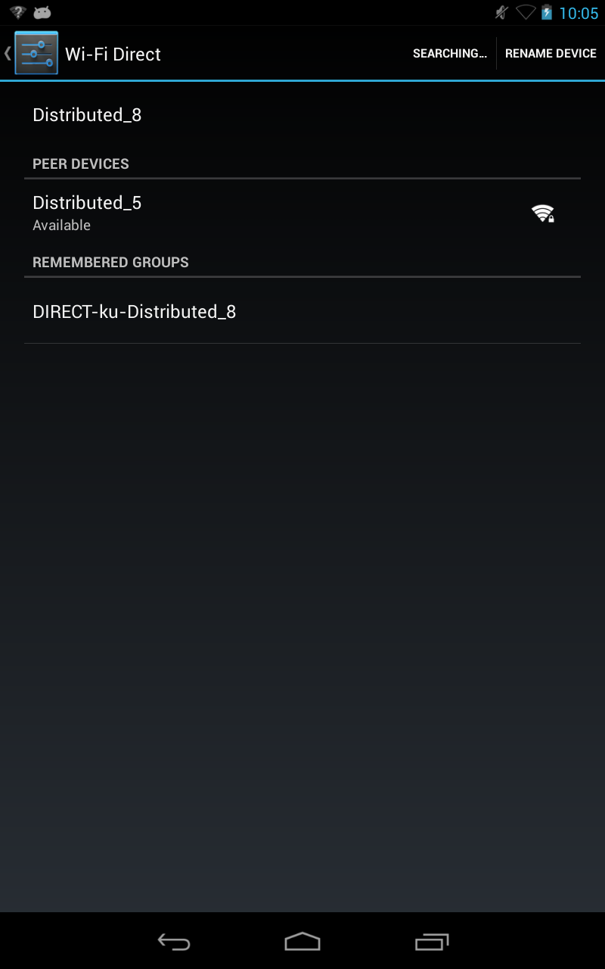
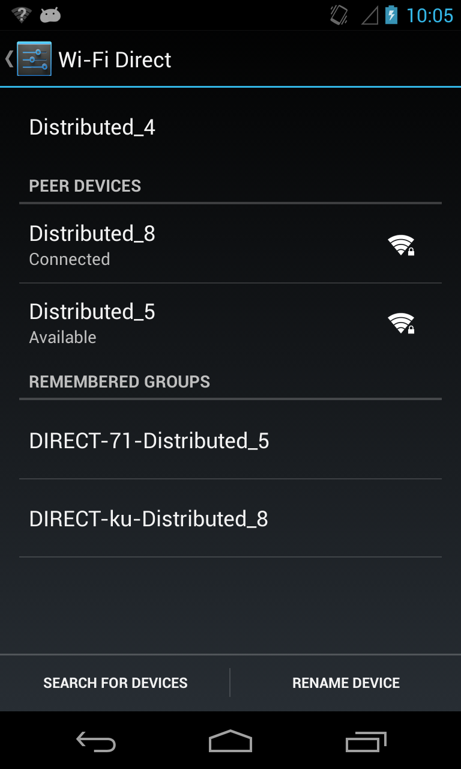
WiFi Direct Authors would fail 600.437

Slide 19
WiFi Direct Authors would fail 600.437
I/wpa_supplicant( 3714): p2p0: P2P-INVITATION-RECEIVED sa=12:68:3f:87:3a:c2 persistent=1
E/WifiP2pService( 510): Unhandled message { what=147487 when=0 obj=network: null
E/WifiP2pService( 510): isGO: false
E/WifiP2pService( 510): GO: Device:
E/WifiP2pService( 510): deviceAddress: 12:68:3f:87:3a:c2
E/WifiP2pService( 510): primary type: null
E/WifiP2pService( 510): secondary type: null
E/WifiP2pService( 510): wps: 0
E/WifiP2pService( 510): grpcapab: 0
E/WifiP2pService( 510): devcapab: 0
E/WifiP2pService( 510): status: 4
E/WifiP2pService( 510): wfdInfo: null
E/WifiP2pService( 510): Client: Device:
E/WifiP2pService( 510): deviceAddress: 12:68:3f:87:3a:c2
E/WifiP2pService( 510): primary type: null
E/WifiP2pService( 510): secondary type: null
E/WifiP2pService( 510): wps: 0
E/WifiP2pService( 510): grpcapab: 0
E/WifiP2pService( 510): devcapab: 0
E/WifiP2pService( 510): status: 4
E/WifiP2pService( 510): wfdInfo: null
E/WifiP2pService( 510): interface: null
E/WifiP2pService( 510): networkId: 1 }

Slide 20
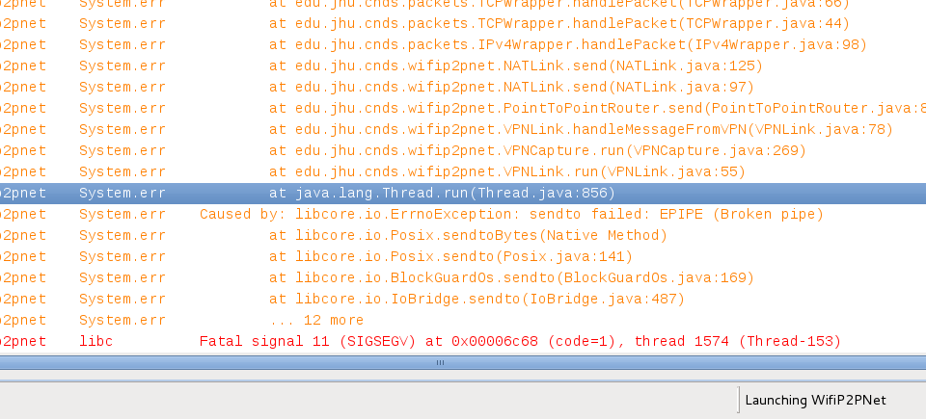
Things to Never See from a JVM...

Slide 21
Agenda
Motivation
Restrictions
Tools and Barriers
Architecture
Demonstration

Slide 22
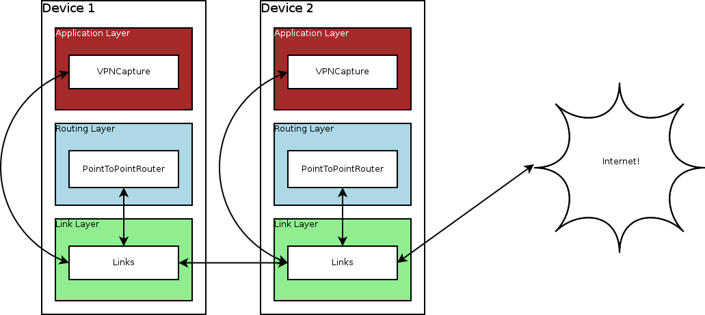
Architecture

Slide 23
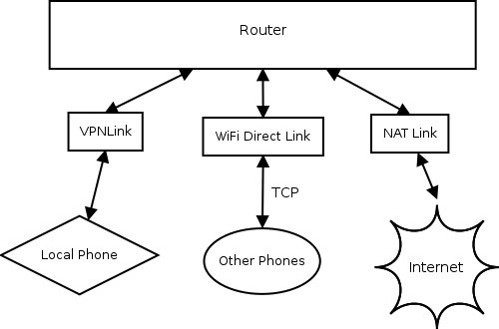
Links

Slide 24
NAT
Internet
NAT Link
UDP / TCP
Internal IPv6

Slide 25
Agenda
Motivation
Restrictions
Tools and Barriers
Architecture
Demonstration

Slide 26
Demonstration
Very Slow Browser
Text Messaging

Slide 27
Questions?

