Slide 1
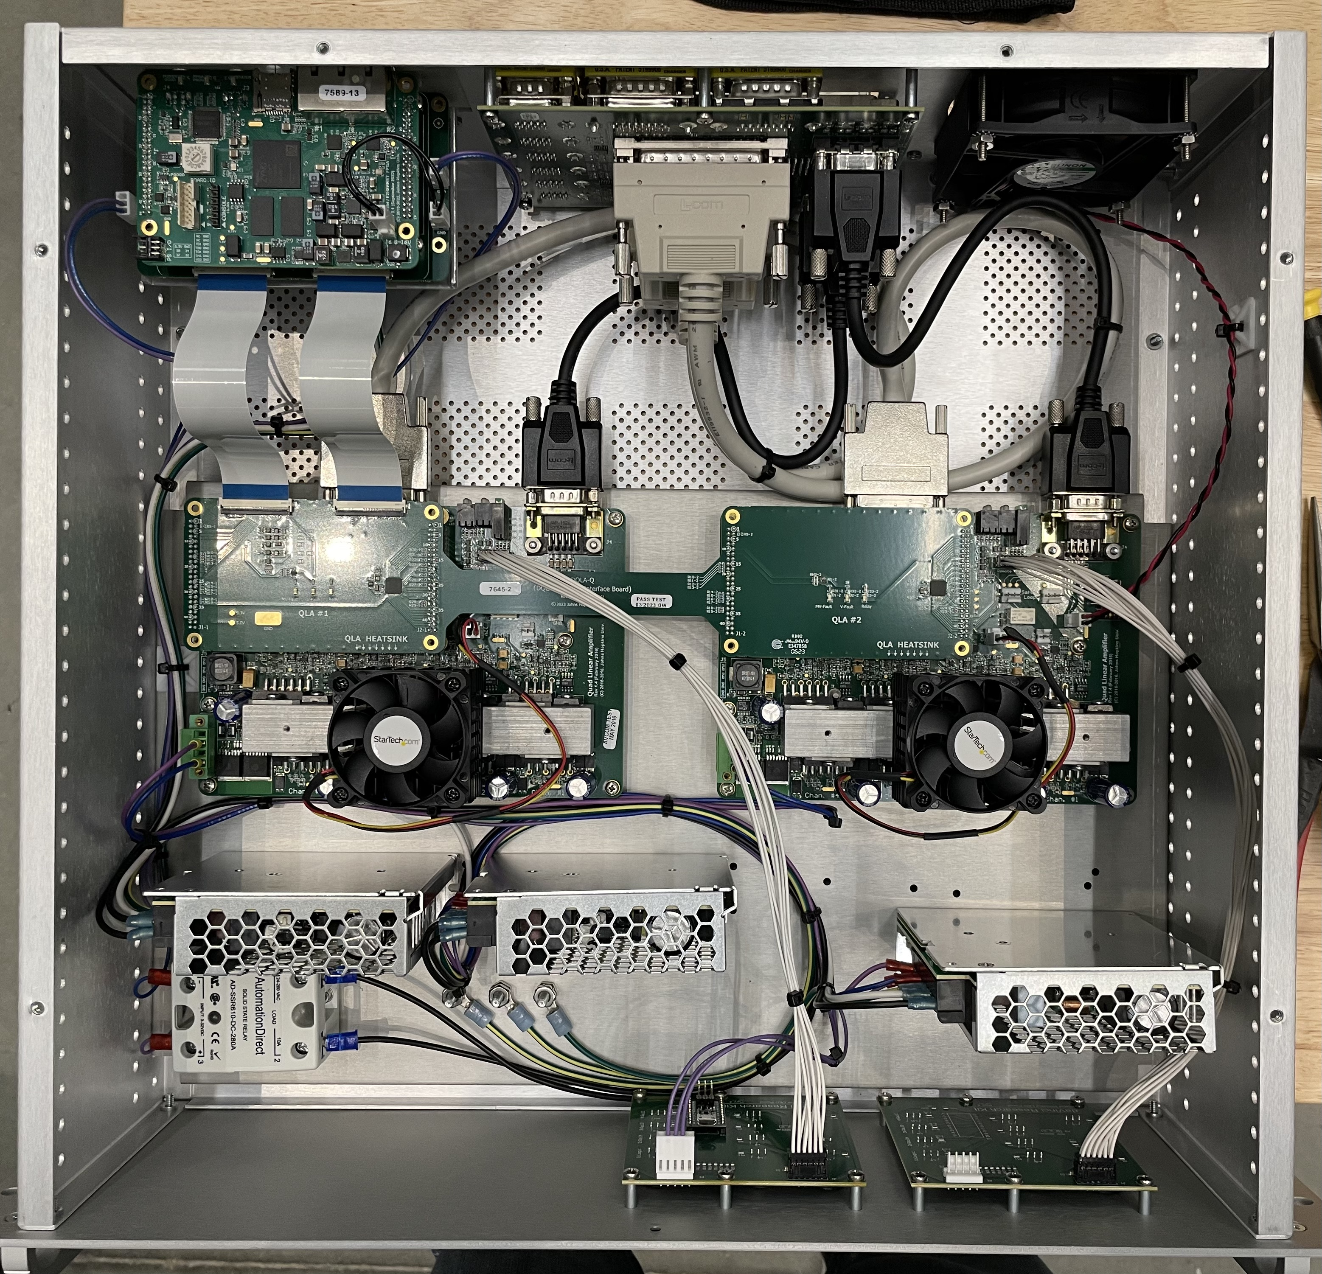
dMIB
FPGA
SCSI 68 Low voltage
DB 9 Motor
voltage
DQLA-F
DQLA-Q
QLA 1
QLA 2
Logic Power Supply
Motor Power Supply
Motor Power Supply
Safety Relay
Front LEDs

