Slide 1
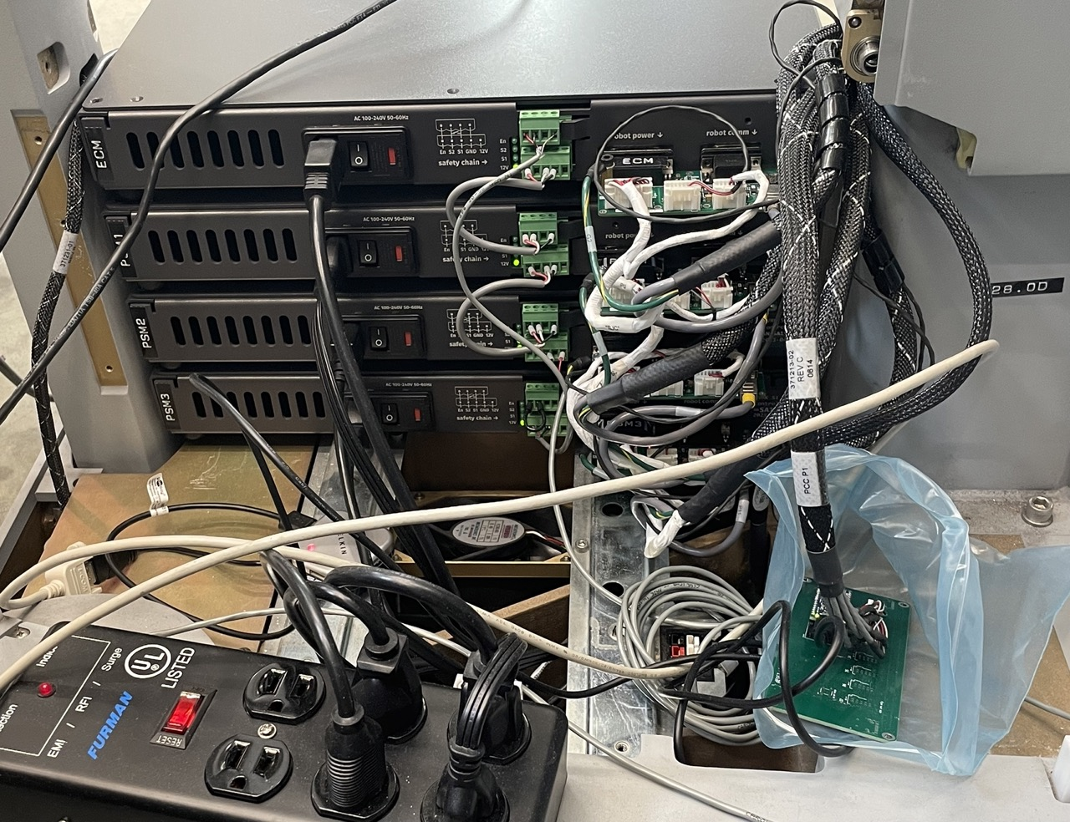
Wiring inside SUJ column from dESSJs and arms to dSIBs
Labels
SUJ column
E-Stop
dSIBs
SUJ steering column
USB Bluetooth dongle with cable to PC
Last digits 5th dESSJ
5th dESSJ
Power strip for patient cart
SUJ base

Slide 2
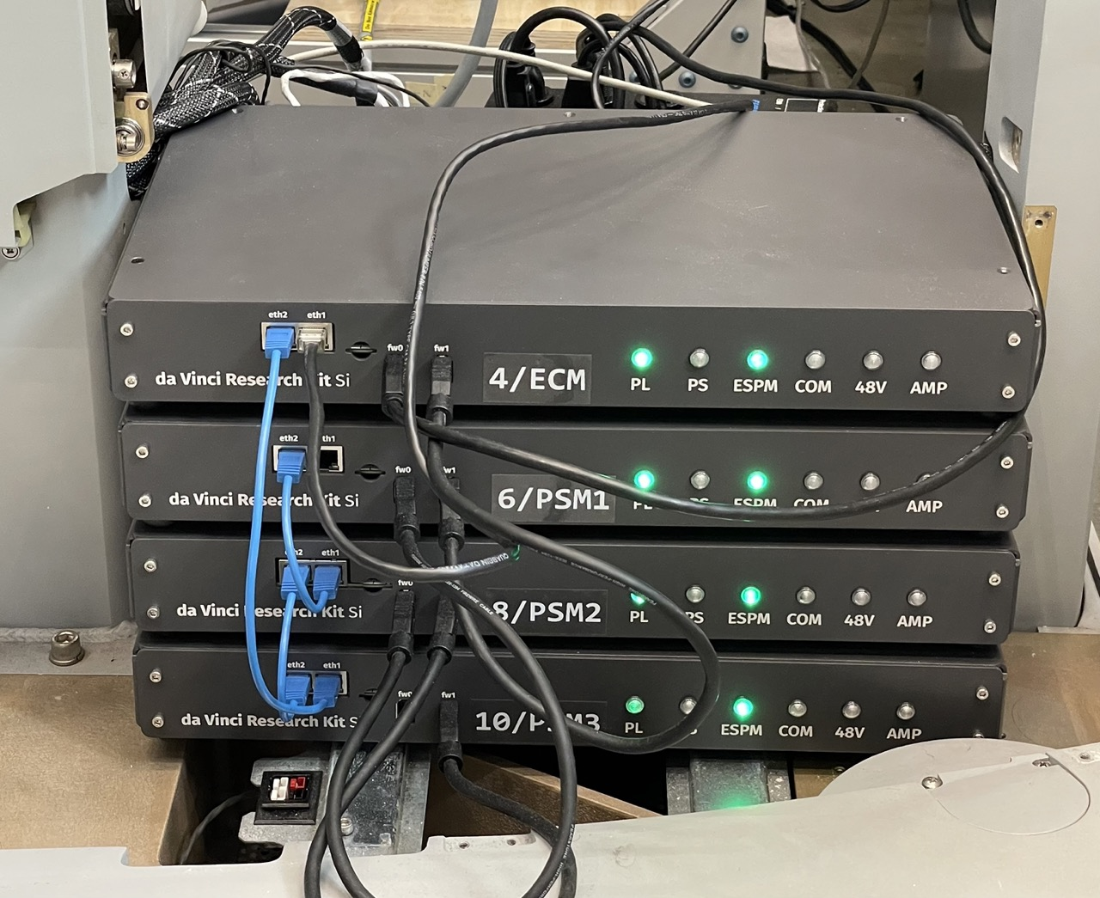
Wiring inside SUJ column from dESSJs and arms to dSIBs
SUJ steering column
Ethernet to PC
FireWire chain
Ethernet chain
FireWire to PC
SUJ column
SUJ base

Slide 3
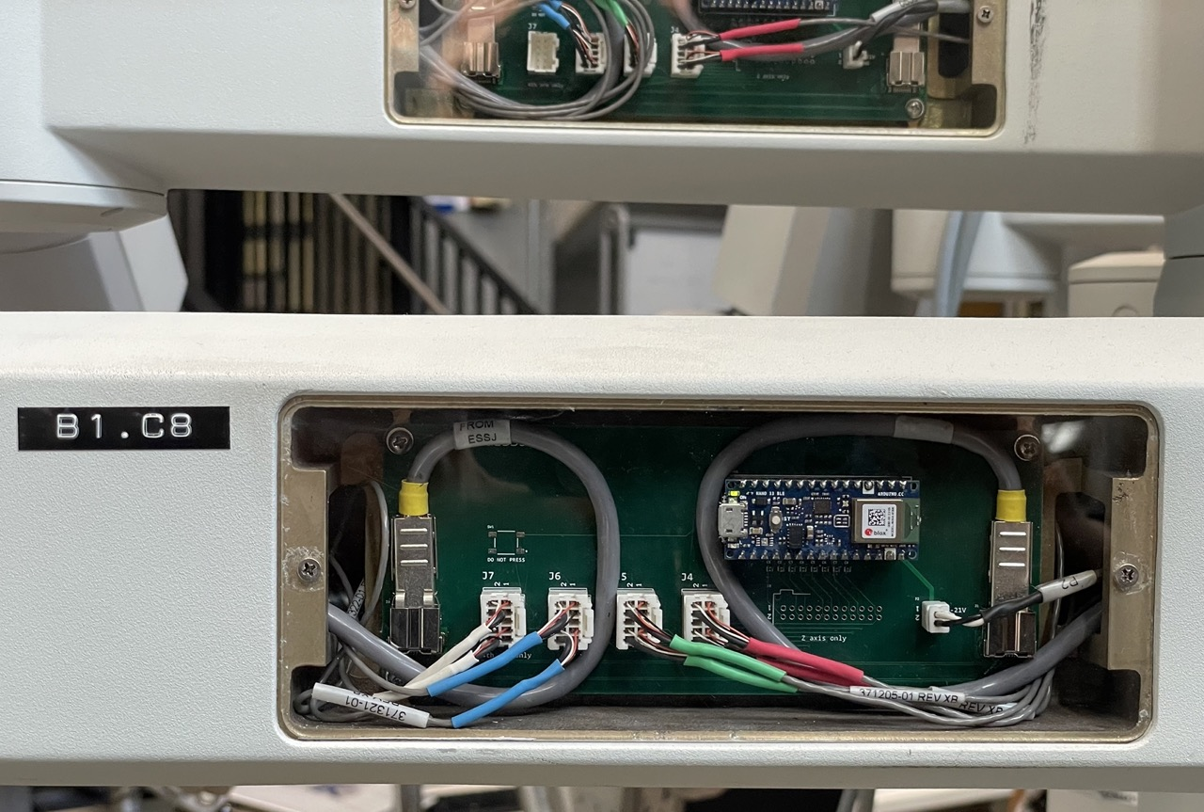
Potentiometers
dESSJ
Arduino Bluetooth
Last digits dESSJ Bluetooth
Potentiometers
LVDS

Slide 4
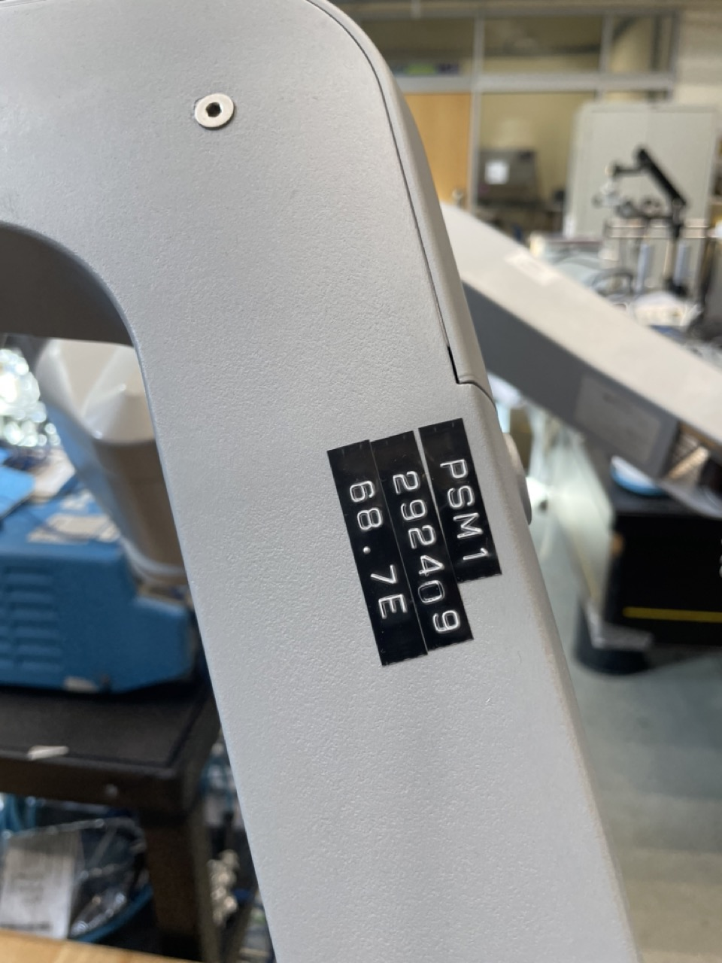
Arm name
Serial number
Last digits dESSJ Bluetooth

