Slide 1
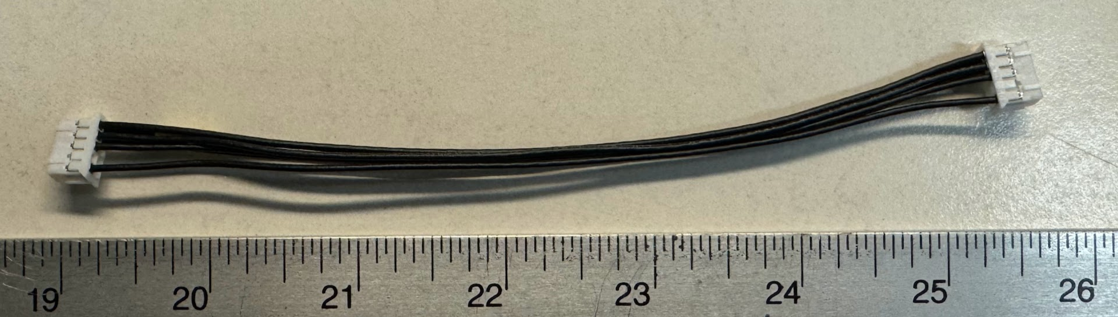
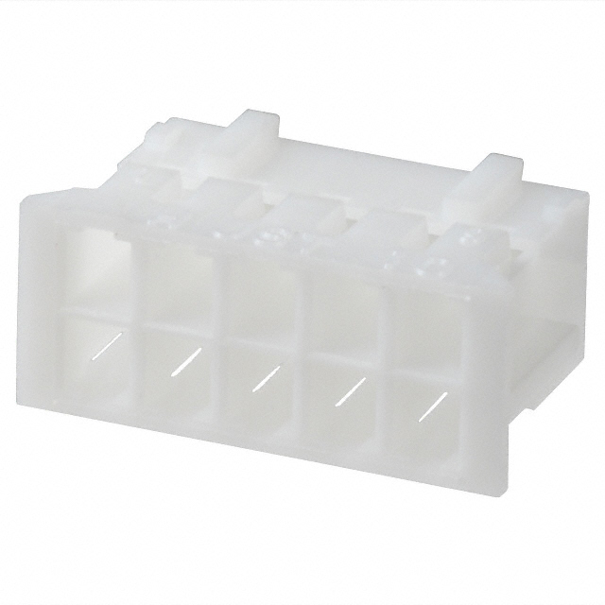
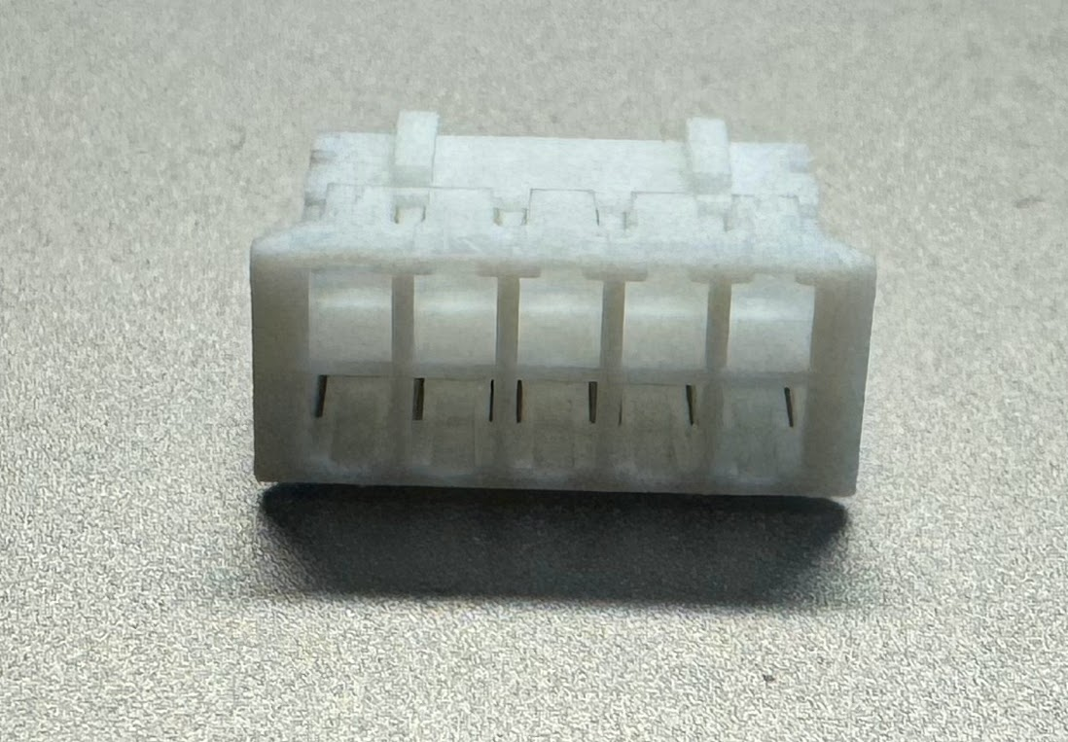
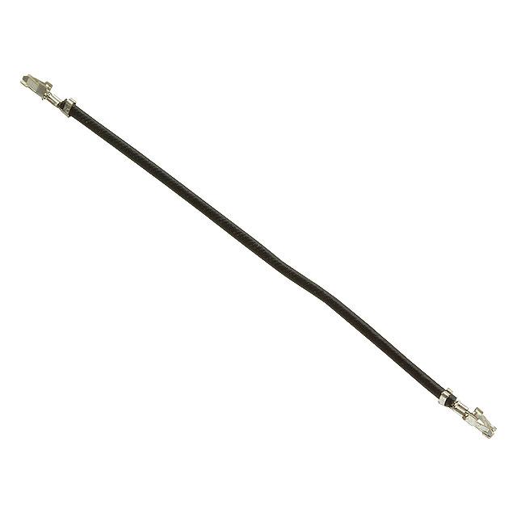
Wire harness assy, ESPM programmer
455-1158-ND
JST PHD 2x5
Qty 2
Precrimped
455-3085-ND
PHD 24 AWG
Qty 6
Apply a 10 mm section of yellow heat shrink tube on this end

