Slide 1
Speech Processing with LLMs
Matthew Wiesner

Slide 2
Speech processing with LLMs
01
Language models in ASR
P(X | W)
×
P(W)
Decoding, rescoring, and end-to-end recognition
acoustic model
language model
02
Speech pipelines with LLMs
Text-mediated understanding and speech generation
ASR
LLM
TTS
text
text
03
Whisper and multitask speech
transcribe
Whisper
translate
Transcription, translation, language ID, no-speech
language / no-speech
04
Speech representations as LLM inputs
SSL encoders, adapters, and audio tokens
SSL
adapter
LLM
speech features
05
Integrated multimodal models
audio
Gemma, Qwen-Omni, and native audio interfaces
text
model
image
06
Full-duplex spoken interaction
user
Streaming, interruptions, and backchannels
model
time
Notes:
Lecture outline. The first visual shows the acoustic likelihood and language prior used in a classical noisy-channel ASR decoder; normalization and argmax are omitted. Whisper uses special tokens for task control, language prediction, and no-speech prediction. The SSL diagram is a schematic encoder-adapter-LLM architecture. Multimodal input support does not imply speech output or full duplex for every model. The full-duplex diagram shows overlapping user and model activity on a common time axis. The last visual is an illustrative, uncertain inference from acoustic evidence, not an empirical result.
Whisper reference: https://arxiv.org/abs/2212.04356

Slide 3
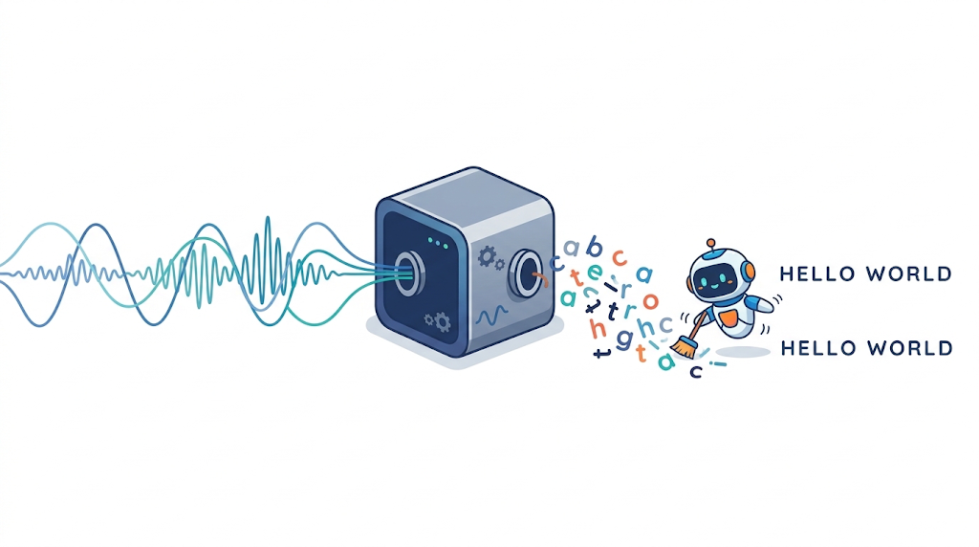
Language Models in ASR
01

Slide 4
HMM decoding with an n-gram LM
Combine acoustic evidence with a prior over word sequences during search.
n-gram LM (G)
Acoustic
features X
HMM acoustic
scores
Beam search
H ∘ C ∘ L ∘ G
Word sequence
W
H: HMM topology C: phone context L: lexicon G: language model
score(W) = log P(X | W) + λ log P(W) + β |W|
Trigram LM: P(W) ≈ ∏ᵢ P(wᵢ | wᵢ₋₂, wᵢ₋₁)
Keep the best-scoring partial paths. LM scores affect which paths survive.
Kaldi decoding-graph documentation
1
Notes:
X denotes acoustic features, W a word sequence, and |W| its word count. Decode by approximately maximizing score(W) over W. The ideal noisy-channel objective uses the HMM likelihood P(X|W); a practical Viterbi decoder uses best-path acoustic and transition scores. Acoustic scaling can be absorbed into the LM weight λ. β is a tuned word insertion reward or penalty, not a probability. The trigram expression suppresses sentence boundary terms and assumes smoothing/backoff. HCLG is a composed search graph, not four separately executed neural modules. The acoustic model supplies frame-level scores on graph transitions.
Source: Kaldi, Decoding graph construction, https://kaldi-asr.org/doc/graph.html
Source: Kaldi, Decoders used in the toolkit, https://www.kaldi-asr.org/doc/decoders.html
Teaching point: an LM contributes at every word extension, so it changes the search itself.

Slide 5
CTC decoding with n-gram shallow fusion
Transcript probabilities from CTC.
External LM helps select among CTC transcripts.
Many alignments, one transcript
∑
∏
P(y | X) =
p(πₜ | X)
c c ∅ a a t
π : B(π) = y
t
cat
Prefix beam search
c ∅ a ∅ t t
Sum alignments that share a prefix.
Score LM extensions at token or word boundaries.
Keep blank and nonblank states separate.
Merge repeats, then remove blanks (∅).
score(y) = log P(y | X) + λ log P(words(y)) + β |words(y)|
End-to-end training does not remove the option of an external language model.
Graves & Jaitly (2014) · Hannun et al. (2014) · Hannun (2017)
2
Notes:
y denotes the output token sequence. π is a frame-level CTC alignment and B merges adjacent repeated labels before removing blank. Both displayed paths collapse to cat. P_CTC(y|X) sums alignment probabilities; greedy decoding of the most likely frame path need not maximize this sum. In the scoring formula P(y|X) denotes the CTC model and P(words(y)) the external LM. The equation is shorthand for a sum over alignments π with B(π)=y and product over frames t. Prefix beam search tracks probabilities ending in blank versus nonblank to handle repeated symbols correctly. A word-level LM scores words(y); it updates when a word completes, including the final word. A token-level LM updates on output-token extensions. Never add the LM score on every acoustic frame or blank. λ and β are tuned on development data. Shallow fusion is a log-linear decoding heuristic, not an exact Bayes factorization, because CTC already models a conditional probability.
Sources:
Alex Graves and Navdeep Jaitly, Towards End-to-End Speech Recognition with Recurrent Neural Networks (ICML 2014), https://proceedings.mlr.press/v32/graves14.pdf
Awni Hannun et al., First-Pass Large Vocabulary Continuous Speech Recognition using Bi-Directional Recurrent DNNs (2014), https://arxiv.org/abs/1408.2873
Awni Hannun, Sequence Modeling With CTC (2017), https://distill.pub/2017/ctc/

Slide 6
Second-pass LM rescoring
Decode first, then spend a larger language model on the surviving hypotheses.
First-pass ASR
N-best / lattice
Larger LM
Select a path
S(W) = A(W) + λ log P(W) + β |W|
Illustrative N-best scores: λ = 0.5, β = 0. Higher is better.
Candidate transcript | ASR A(W) | LM log P(W) | Combined
wreck a nice beach | −3.0 | −7.0 | −6.5
recognize speech | −4.0 | −2.0 | −5.0
recognize peach | −4.5 | −6.0 | −7.5
If the first-pass score already includes an LM, remove or retune that contribution.
Fixed N-best rescoring cannot beat its oracle WER: it only selects from that list.
Kaldi decoder documentation · Chen et al., Large-scale LM Rescoring (2023)
3
Notes:
All numbers and transcripts in the table are invented teaching examples, not model outputs or measured results. A(W) here is an acoustic/ASR-only score. P(W) denotes the larger language model. At λ=0.5 and β=0 the combined scores are −3+0.5(−7)=−6.5, −4+0.5(−2)=−5, and −4.5+0.5(−6)=−7.5. Thus the ASR-only winner is wreck a nice beach, whereas the combined-score winner is recognize speech. In practice length terms and the scale of the ASR and LM scores must be tuned. If S_first already includes μ log P_old(W), a replacement form is S_new=S_first−μ log P_old(W)+λ log P_new(W), with any other terms retained or retuned. An autoregressive neural LM or LLM can assign log P(W) by summing token log probabilities. Instruction-based candidate selection is a related reranking alternative, but not the same scoring rule. A lattice compactly represents many word paths and is not restricted to an extracted N-best list, although paths pruned from the lattice are unavailable. For a fixed N-best list, the oracle WER is the minimum reference WER among its candidates and bounds any single-candidate selection rule. It is an evaluation diagnostic requiring a reference, not a deployable selector.
Sources:
https://www.kaldi-asr.org/doc/decoders.html
Tongzhou Chen et al., Large-scale Language Model Rescoring on Long-form Data (2023), https://arxiv.org/abs/2306.08133

Slide 7
LLMs as transcript editors
Generative error correction models the clean transcript given ASR hypotheses.
Instructions + context C
ASR N-best list H
Possible edited output Y
please send the report to kate
please send a report to nate
LLM
editor
please send the
report to nate
Illustrative target absent from the input list
Y* = arg max
P(Y | H, C)
Y
The editor can combine fragments, delete errors, or generate new tokens.
It can escape the N-best oracle bound, but plausible rewrites can introduce errors.
Ma et al. (2023) · Chen et al., HyPoradise (NeurIPS 2023)
4
Notes:
This slide uses edit language model to mean conditional transcript correction, not knowledge editing of LLM weights. P_edit(Y|H,C) is a generative distribution over output transcripts conditioned on one or multiple ASR hypotheses H plus optional context C and instructions. Rescoring instead evaluates existing candidate strings and selects one. The two supplied hypotheses, target, and output are invented to demonstrate recombination, not actual LLM predictions. The example target is please send the report to nate, which is absent from the two-item list but can be constructed from it. Each candidate differs from that target by one word, so the fixed N-best oracle WER is 1/6, while a perfect edited output would have 0 WER. A generator may also introduce tokens absent from all hypotheses, but this makes acoustic fidelity important. Do not interpret plausibility as evidence of what was spoken.
Sources:
Rao Ma et al., Can Generative Large Language Models Perform ASR Error Correction? (2023), https://arxiv.org/abs/2307.04172
Chen Chen et al., HyPoradise: An Open Baseline for Generative Speech Recognition with Large Language Models (NeurIPS 2023), https://papers.neurips.cc/paper_files/paper/2023/hash/6492267465a7ac507be1f9fd1174e78d-Abstract-Datasets_and_Benchmarks.html

Slide 8
Training and using an LLM editor
Prompt a pretrained model, or teach it the error patterns made by ASR.
Prompt a frozen LLM
Fine-tune an editor
Provide 1-best or N-best text and relevant context.
Ask for minimal corrections that preserve the words spoken.
Train on (ASR hypotheses, reference transcript) pairs.
Use supervised fine-tuning, including LoRA.
Synthetic supervision: the Denoising LM recipe
Clean text
TTS + noise
ASR
Noisy hypotheses
Pair the hypotheses with the original clean text to train the correction model.
Constrain or check proposed edits against ASR evidence. Measure errors introduced, too.
HyPoradise (2023) · Gu et al., Denoising LM (2024) · Ma et al. (2024/2025)
5
Notes:
Prompting and supervised adaptation are two distinct ways of using a large pretrained text model for correction. N-best inputs expose alternative interpretations, but larger lists may require more context and computation. HyPoradise studies prompt-based correction and parameter-efficient adaptation. Denoising LM is a scaled task-specific correction model, not simply a prompted general chat model: it synthesizes speech from text using multispeaker TTS, adds noise/augmentation, decodes with ASR, and uses original text as the training target. This produces many noisy-hypothesis/clean-transcript pairs. The diagram summarizes data creation, not the complete model architecture.
A text-only editor cannot directly inspect the waveform. To retain acoustic support, options include constraining output to an ASR N-best list or lattice, or checking generated candidates with an acoustic/ASR model. Constraining to the original list restores its oracle limit; lattice constraints retain only allowed lattice paths. Supplying speech-encoder representations is a further extension, e.g. Whispering LLaMA. Evaluate on held-out domains with WER, error corrections versus newly introduced errors, and separate checks for names and numbers. The latter checks are teaching recommendations, not reported experimental claims. Preserve a verbatim target convention instead of silently making prose grammatical.
Sources:
HyPoradise (2023), https://arxiv.org/abs/2309.15701
Zijin Gu et al., Denoising LM: Pushing the Limits of Error Correction Models for Speech Recognition (2024), https://arxiv.org/abs/2405.15216
Rao Ma et al., ASR Error Correction using Large Language Models (2024, revised 2025), https://arxiv.org/abs/2409.09554
Srijith Radhakrishnan et al., Whispering LLaMA (EMNLP 2023), https://aclanthology.org/2023.emnlp-main.618/

Slide 9
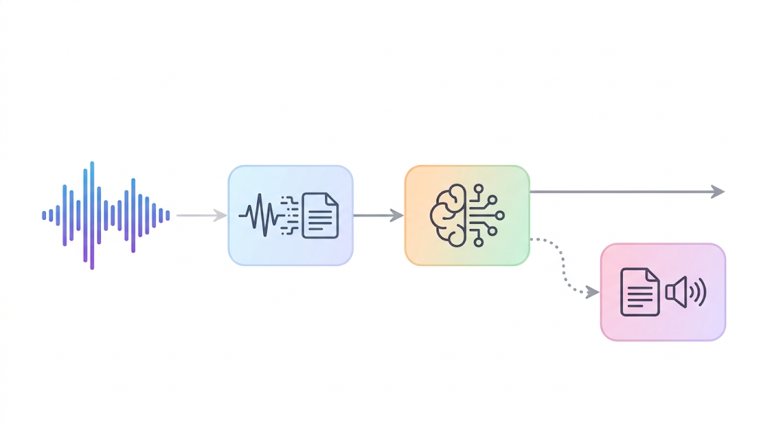
Speech Pipelines with LLMs
02

Slide 10
ChatGPT Voice before GPT-4o (2023–24)
A shipped consumer assistant built from three separately trained models.
ASR
GPT-3.5 / GPT-4
text dialogue
OpenAI TTS
spoken reply
transcript
response text
Architectural strengths
Documented limitations
Reuse an existing conversational LLM.
Give users a hands-free speech interface.
Develop recognition and voice generation separately.
The text LLM could not directly hear tone, multiple speakers, or background sounds.
The handoffs also added response delay.
Reported average latency: GPT-3.5 2.8 s GPT-4 5.4 s
A text transcript carries the words, but leaves out much of how they were spoken.
OpenAI: ChatGPT voice launch (Sep 2023) and Hello GPT-4o (May 2024)
1
Notes:
Historical architecture only, covering the original voice product launched in September 2023 and described before GPT-4o in May 2024. It is not a description of current ChatGPT Voice. The launch post explicitly names Whisper and a new TTS model. The GPT-4o announcement identifies GPT-3.5 or GPT-4 as the middle model. Its 2.8 s and 5.4 s figures are provider-reported averages for that earlier system, with no common benchmarking protocol supplied here. Do not compare these directly with component latency or modern vendor medians. Reuse and independent development are architectural interpretations. Tone/speaker/background-sound loss is an explicitly reported limitation of the old text-only middle stage.
Sources:
https://openai.com/index/chatgpt-can-now-see-hear-and-speak/
https://openai.com/index/hello-gpt-4o/

Slide 11
Deepgram Voice Agent: a streaming cascade
Production API with separate Listen, Think, and Speak stages.
Flux
streaming ASR
Text LLM
e.g. GPT-4.1
Aura-2
streaming TTS
transcript
response text
One supported configuration. Nova-3 and other LLM / TTS options are also available.
Strengths
Documented tradeoffs
Model-integrated turn detection.
Prepare an LLM reply before the turn fully ends.
Managed orchestration with configurable model choices.
Earlier turn guesses can create false starts.
If speech resumes, cancel the draft reply.
Speculation adds LLM calls, cost, and state handling.
Streaming reduces delay, while turn detection decides when a reply is safe to play.
Deepgram Voice Agent model docs and Flux eager-end-of-turn guide · checked Nov 3, 2026
2
Notes:
This is a supported configuration of a production API, not a claim that every customer uses this exact stack. Deepgram documents Flux and Nova ASR families, configurable text LLMs including GPT-4.1, and Aura-2 among its TTS options. Its GA article names teams building on the API; no independent deployment performance is asserted here. EagerEndOfTurn starts speculative LLM generation. TurnResumed cancels it, while EndOfTurn permits delivering the prepared response. Lower eager thresholds increase false starts, and speculation increases calls. Streaming cascades can overlap work and support barge-in; they are not inherently whole-utterance batch systems.
Sources:
https://developers.deepgram.com/docs/voice-agent-stt-models
https://developers.deepgram.com/docs/voice-agent-llm-models
https://developers.deepgram.com/docs/voice-agent-tts-models
https://developers.deepgram.com/docs/flux/voice-agent-eager-eot
https://deepgram.com/blog/voice-agent-api-generally-available
Documentation checked November 3, 2026.

Slide 12
ElevenAgents: voice support at Revolut (Banking)
Scribe v2 Realtime
ASR
Configurable LLM
+ business tools
Eleven v4 Turbo
TTS
transcript
response text
Current platform example (Nov 2026). Revolut’s exact model configuration is undisclosed.
Strengths
Documented platform issues
Keep existing business logic and tool integrations.
Use multilingual voices and language switching.
Add prosodic cues to turn-taking and expressive delivery.
Background voices can corrupt transcripts or cause false interruptions.
Expressiveness varies by voice and language.
Response timing still needs tuning.
Modern cascades can carry prosodic and timing signals alongside the transcript.
ElevenLabs: Revolut case study (Jan 2026), Expressive mode and Conversation flow docs
3
Notes:
The January 28, 2026 ElevenLabs customer story reports that Revolut deployed Agents for live UK/European support, including account-specific information and disputes. Revolut retained its orchestration and business logic. This is a provider-published customer report. The illustrated November 2026 model combination comes from current Expressive mode documentation and is not claimed to be Revolut's private configuration. ElevenAgents also supports realtime-model configurations; this slide covers its cascaded option. The docs describe Scribe v2 Realtime signals for turn-taking and Eleven v4 Turbo for TTS. They acknowledge variation in expressive output across voices and languages. Conversation-flow docs identify background voices as a source of incorrect transcripts and false interruptions. These are platform-level limitations, not allegations of specific failures at Revolut.
Sources:
https://elevenlabs.io/blog/revolut
https://elevenlabs.io/docs/eleven-agents/overview
https://elevenlabs.io/docs/eleven-agents/customization/voice/expressive-mode
https://elevenlabs.io/docs/eleven-agents/customization/conversation-flow
Documentation checked November 3, 2026.

Slide 13
Pipeline strengths and failure modes
The interfaces between models provide useful controls
Design choice | Production strength | Failure mode / cost
Text between stages | Inspect transcripts and responses. Connect retrieval and business tools. | ASR errors propagate. Plain text omits prosody and other sounds.
Separate models | Choose or upgrade the LLM, recognizer, and voice independently. | Coordinate services, failures, cancellation, and playback state.
Streaming + early drafts | Overlap stages to reduce the delay before a response. | A premature turn boundary can waste work or interrupt.
Dedicated TTS | Control the voice and spoken delivery separately. | Wording and delivery need coordination across models.
ASR mistakes and LLM hallucinations are different errors. A fluent voice can conceal both.
Measure turn-end to first audible reply, including tools, network, and playback.
Synthesis of the three systems · Deepgram and ElevenLabs runtime / latency documentation
4
Notes:
This comparison is an architectural synthesis, not a benchmark or an assertion that every pipeline has every limitation. A plain transcript drops nonlexical evidence; prosody side channels, diarization, or acoustic representations can reduce that loss. Modularity allows inspectable intermediate outputs, provider/model choice, and independent optimization. It also requires coordinating streaming, failures, and cancellation. LLM hallucinations are not unique to cascades. TTS can make an erroneous answer sound fluent without verifying it.
Latency should be measured at a consistent user-visible boundary, for example actual end of user speech to first audible agent response, plus interruption-stop latency and tail percentiles. TTS server time to first audio excludes upstream LLM/tool work, transport, and playback. Streaming overlaps stages, so isolated component timings should not be naively added or equated with full-turn latency.
Sources:
https://openai.com/index/hello-gpt-4o/
https://deepgram.com/blog/voice-agent-api-generally-available
https://developers.deepgram.com/docs/flux/voice-agent-eager-eot
https://elevenlabs.io/docs/eleven-agents/overview
https://elevenlabs.io/docs/eleven-api/concepts/latency-methodology
Documentation checked November 3, 2026.

Slide 14
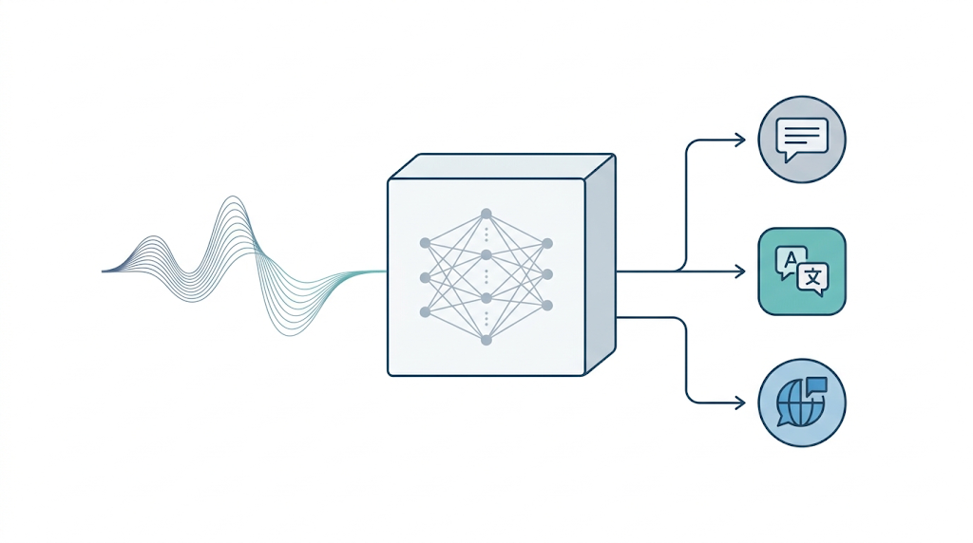
Whisper: A bridge from ASR to Natural Language Audio Interface
03

Slide 15
Whisper: one model, a fixed set of tasks
Multilingual speech tasks share an encoder–decoder and a token vocabulary.
Task / language prefix
log-Mel
features
Transformer
encoder
Autoregressive
decoder
Language token
or text
audio representations
LID
ASR
Translation
Which language is spoken?
Transcribe in that language.
Translate speech into English.
P(output tokens | audio, decoder prefix)
Task specification becomes part of the sequence the decoder reads.
Radford et al., Robust Speech Recognition via Large-Scale Weak Supervision (2022)
1
Notes:
Scope: original multilingual Whisper, introduced in 2022. Its encoder and autoregressive decoder are trained jointly with multilingual and multitask weak supervision. Cross-attention carries audio representations to the decoder. Special tokens specify tasks or serve as classification targets. LID predicts a language token. ASR preserves the source language, while the translation task targets English. Other outputs, including timestamps and no-speech, are omitted here to focus on three tasks. Whisper is a useful pedagogical bridge to audio LLMs, not a claim about the first such model.
Source: Radford et al. (2022), sections 2.2–2.3, https://arxiv.org/abs/2212.04356

Slide 16
Three tasks, three decoding setups
Same illustrative Spanish audio: “El tren sale a las ocho.”
Purple: supplied prefix
Teal: predicted output
LID
<|startoftranscript|>
<|es|> (Spanish)
ASR
<|startoftranscript|> <|es|> <|transcribe|> <|notimestamps|>
El tren sale a las ocho.
Translation
<|startoftranscript|> <|es|> <|translate|> <|notimestamps|>
The train leaves at eight.
LID predicts <|es|>. ASR and translation then use it as a conditioning token.
OpenAI Whisper reference implementation: tokenizer.py and decoding.py
2
Notes:
Purple text is supplied decoder context and teal text is predicted output. These are schematic expected outputs, not a run on an attached recording. The official detect_language routine passes only startoftranscript, masks non-language tokens, and chooses among the language logits. There is no separate LID task token. For ASR or translation, the spoken-language token may be supplied or detected first. The translate task still uses the source-language token es, even though its output is English. notimestamps requests output without timestamps. End tokens and text subword boundaries are omitted for clarity. Literal token names follow the released code.
Sources:
https://github.com/openai/whisper/blob/main/whisper/tokenizer.py
https://github.com/openai/whisper/blob/main/whisper/decoding.py

Slide 17
Natural-language instructions for audio
Keep audio-conditioned generation. Broaden how the user describes the task.
Whisper: fixed task vocabulary
Audio LLM: task described in words
<|es|> <|translate|>
“Translate this speech into English.”
“What time does the train leave?”
Select a task learned during training.
Free-text prompts provide transcript context.
Illustrative instructions for the next model family
Natural-language instruction
Audio encoder
Adapter
Pretrained text LLM
Response
A common audio-LLM architecture
Broader instructions require audio–text alignment and instruction training.
Whisper reference implementation · Tang et al., SALMONN (2023/2024)
3
Notes:
This is a conceptual transition, not a claim that a new Whisper prefix unlocks arbitrary tasks. In the reference implementation, prompt supplies previous transcript context and prefix supplies current transcript context. The fixed task field selects transcribe or translate.
A common next step attaches audio encoders through an adapter to a pretrained text LLM, then trains the model to follow instructions using audio evidence. SALMONN is an example of this pattern, with speech and general-audio encoders and a trainable connector. The diagram abstracts those details and does not claim all audio LLMs use this architecture. Natural-language task descriptions allow a richer interface, but success on unseen tasks remains empirical and training-dependent. The two displayed instructions are illustrative. The train-time question could also be answered through an ASR-to-LLM pipeline. Direct audio access becomes important for questions requiring information that a transcript omits.
Sources:
https://github.com/openai/whisper/blob/main/whisper/decoding.py
Tang et al., SALMONN: Towards Generic Hearing Abilities for Large Language Models, https://arxiv.org/abs/2310.13289

Slide 18
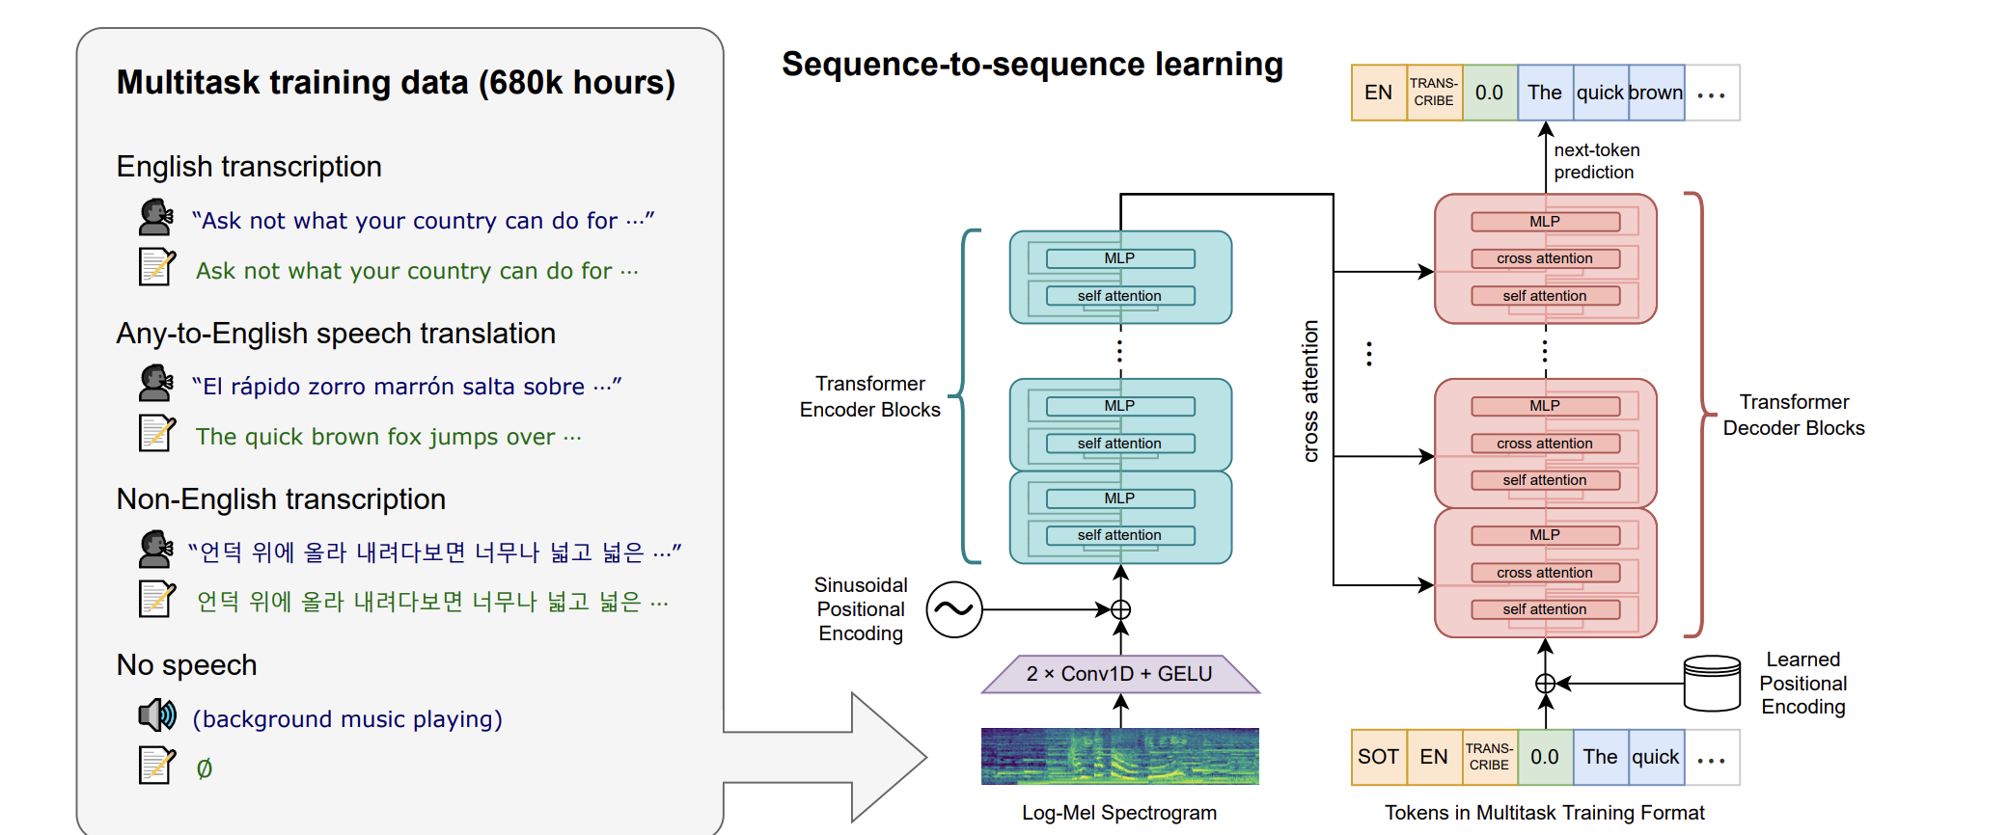
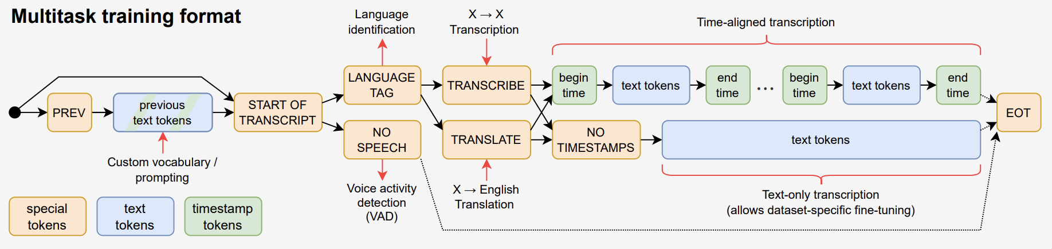
Whisper
900M
Parameters
630M
Parameters
3
Notes:
This is a conceptual transition, not a claim that a new Whisper prefix unlocks arbitrary tasks. In the reference implementation, prompt supplies previous transcript context and prefix supplies current transcript context. The fixed task field selects transcribe or translate.
A common next step attaches audio encoders through an adapter to a pretrained text LLM, then trains the model to follow instructions using audio evidence. SALMONN is an example of this pattern, with speech and general-audio encoders and a trainable connector. The diagram abstracts those details and does not claim all audio LLMs use this architecture. Natural-language task descriptions allow a richer interface, but success on unseen tasks remains empirical and training-dependent. The two displayed instructions are illustrative. The train-time question could also be answered through an ASR-to-LLM pipeline. Direct audio access becomes important for questions requiring information that a transcript omits.
Sources:
https://github.com/openai/whisper/blob/main/whisper/decoding.py
Tang et al., SALMONN: Towards Generic Hearing Abilities for Large Language Models, https://arxiv.org/abs/2310.13289

Slide 19
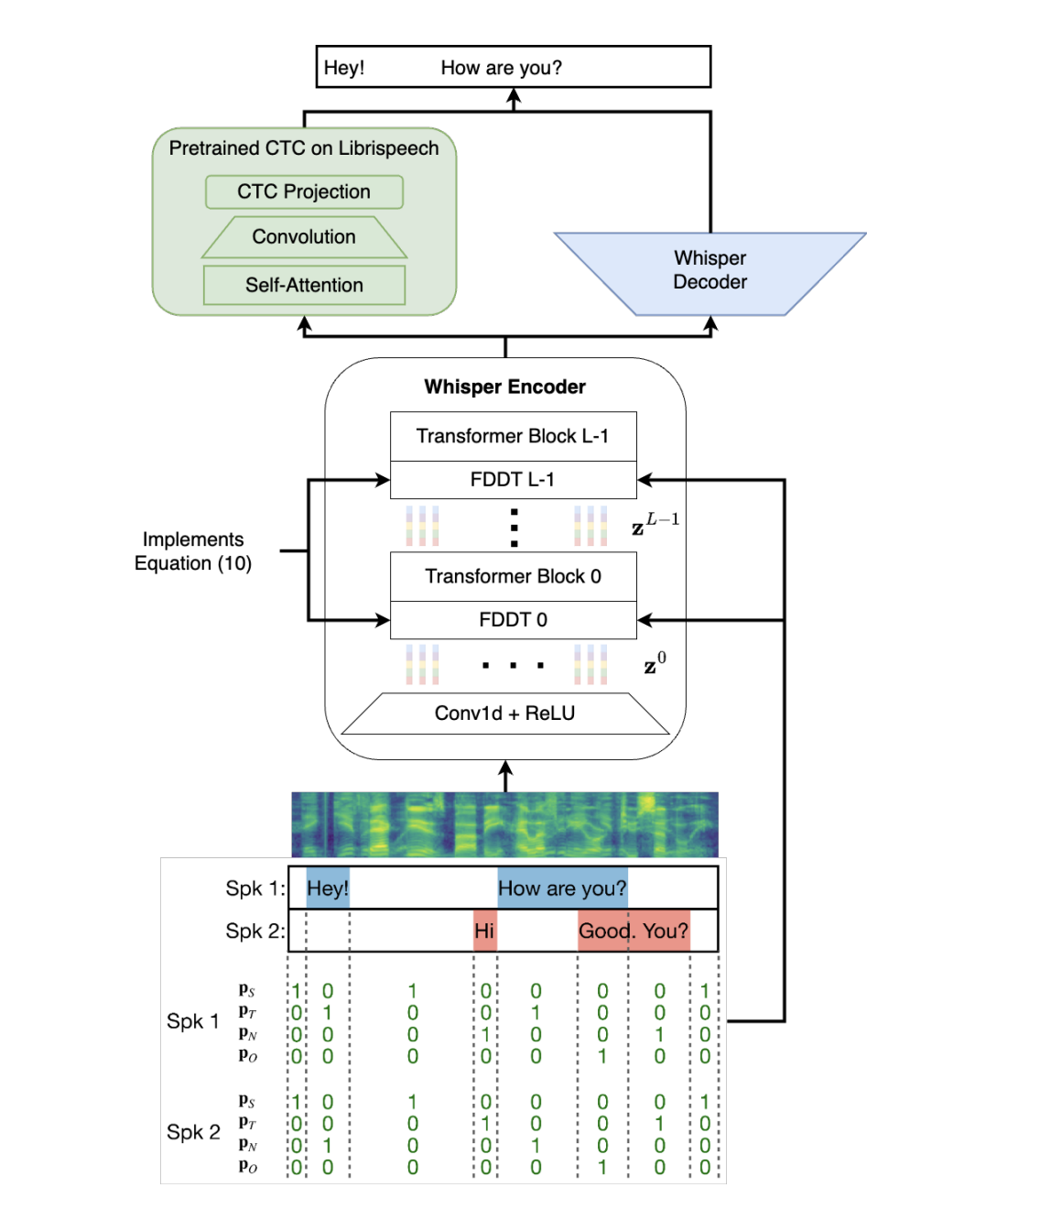
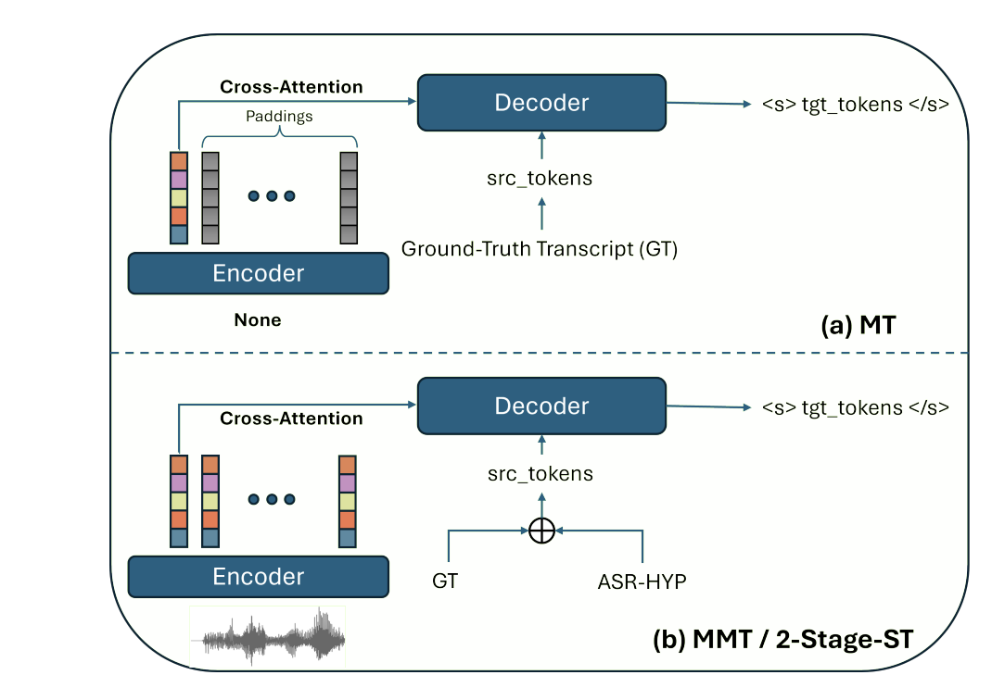
Whisper-UT: Speech and Text Translation from Speech Models
Whisper
DiCoW: Multi-talker ASR
Components are still heavily used.
A really good encoder, and a good decoder
Notes:
This is a conceptual transition, not a claim that a new Whisper prefix unlocks arbitrary tasks. In the reference implementation, prompt supplies previous transcript context and prefix supplies current transcript context. The fixed task field selects transcribe or translate.
A common next step attaches audio encoders through an adapter to a pretrained text LLM, then trains the model to follow instructions using audio evidence. SALMONN is an example of this pattern, with speech and general-audio encoders and a trainable connector. The diagram abstracts those details and does not claim all audio LLMs use this architecture. Natural-language task descriptions allow a richer interface, but success on unseen tasks remains empirical and training-dependent. The two displayed instructions are illustrative. The train-time question could also be answered through an ASR-to-LLM pipeline. Direct audio access becomes important for questions requiring information that a transcript omits.
Sources:
https://github.com/openai/whisper/blob/main/whisper/decoding.py
Tang et al., SALMONN: Towards Generic Hearing Abilities for Large Language Models, https://arxiv.org/abs/2310.13289

Slide 20
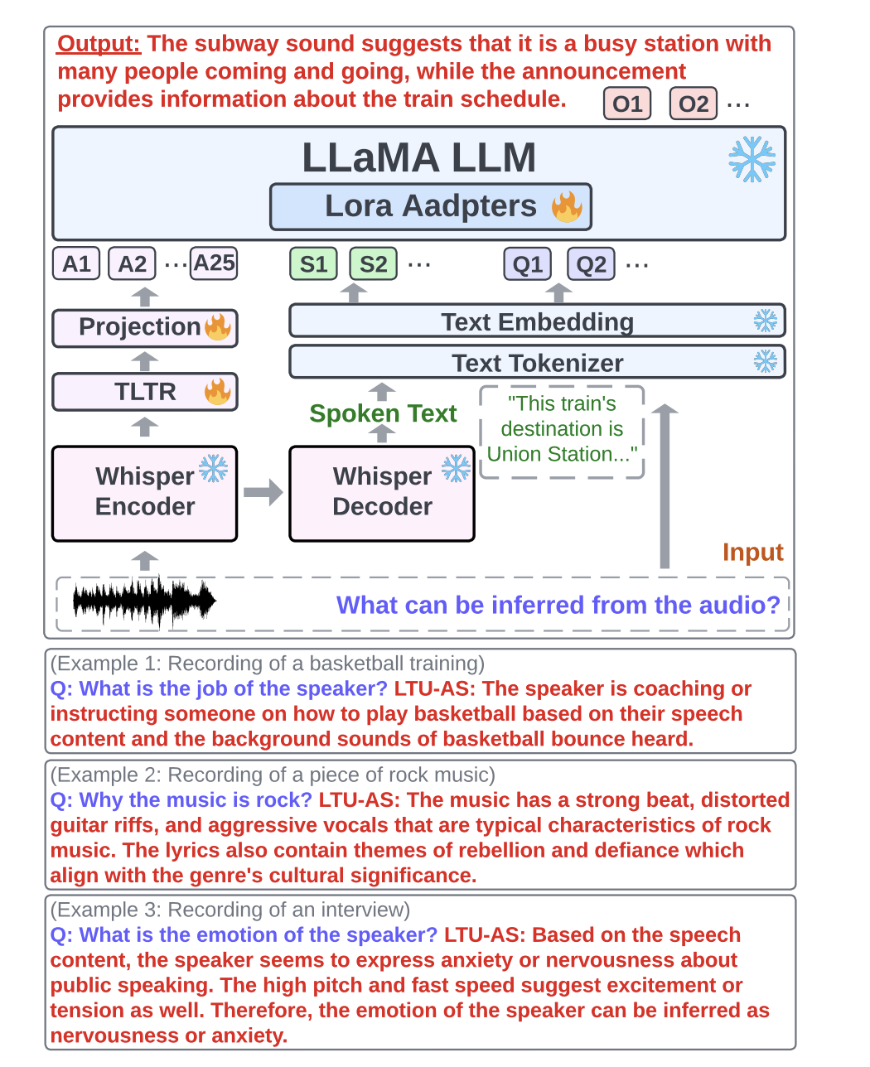
Speech Representations as LLM Inputs
04

Slide 21
Speech representations as LLM inputs
An audio encoder supplies continuous features that a learned adapter maps into the LLM.
Audio
Pretrained
audio encoder
Pool / downsample
+ projection
LLM
+ text prompt
acoustic input
hidden-state sequence
continuous input embeddings
text answer
Self-supervised speech encoders
Whisper encoder
wav2vec 2.0: contrastive masked prediction
HuBERT: predict clustered speech targets
WavLM: masked prediction + denoising
Weakly supervised ASR / translation training
Reuse features without decoding a transcript
Layer choice affects the information retained
The adapter must learn alignment. Audio features are not text-token IDs.
Baevski et al. (2020), Hsu et al. (2021), Chen et al. (2022), Radford et al. (2022)
1
Notes:
Continuous features enter the language model at its embedding interface. A common recipe trains the connector first, then adds LoRA or tunes more of the model using paired audio, instructions, and answers. Frozen encoders reduce training cost, but do not guarantee that all acoustic details remain accessible. Downsampling trades temporal detail for context length and compute. These choices differ by model. Whisper is weakly supervised, rather than an SSL encoder.
Sources:
https://arxiv.org/abs/2006.11477
https://arxiv.org/abs/2106.07447
https://arxiv.org/abs/2110.13900
https://cdn.openai.com/papers/whisper.pdf
https://arxiv.org/html/2404.00656v2

Slide 22
WavLLM: two complementary speech encoders
Hu et al. (2024) combine Whisper features with self-supervised WavLM features.
Whisper-large-v2
encoder
Semantic
adapter
LLaMA-2
7B-chat
+ LoRA
Speech
content-oriented features
Concat
+ project
WavLM-base
encoder
Acoustic
adapter
learned mixture of WavLM layers
Training
Tasks
Freeze both encoders and base LLM.
Train modality adapters and LoRA.
A prompt adapter scales LoRA by task.
ASR, translation, speaker verification,
emotion recognition, and speech QA.
Then train on combinations of tasks.
Complementary training objectives motivate the two branches. Their information overlaps.
Hu et al., WavLLM, Findings of EMNLP 2024
2
Notes:
Each modality adapter downsamples to an 80 ms stride and 2048 dimensions. Their outputs concatenate before a final projection into the LLM. WavLM features combine all hidden layers with learned weights. The prompt-aware adapter is introduced for the advanced multitask stage. The paper motivates Whisper for content and WavLM for speaker cues. This is a useful inductive bias, not a strict separation of what the encoders contain. This is a research model, not a claim of production deployment.
Source:
https://arxiv.org/html/2404.00656v2

Slide 23
AST and LTU: sound features as language-model input
Yuan Gong and collaborators extend sound classification to questions about audio.
AST: Audio Spectrogram Transformer
Log-Mel
spectrogram
16 × 16
patch embeddings
Transformer
encoder
Sound-label
classifier
Original AST transfers a vision Transformer and learns from audio labels.
SSAST is the related self-supervised variant.
LTU: Listen, Think, and Understand
AST features
Pool + project
Audio + question
embeddings
LLaMA-7B
with LoRA
LTU uses CAV-MAE pretraining + AudioSet tuning for its AST encoder.
32 audio embeddings represent a 10-second clip. Training uses audio-question-answer pairs.
A learned connector lets an LLM answer open-ended questions about non-speech sounds.
Gong et al., AST (Interspeech 2021), LTU (2023 / ICLR 2024), SSAST (AAAI 2022)
3
Notes:
AST applies Transformer attention to spectrogram patches. Its original supervised transfer recipe differs from SSAST masked-patch pretraining. LTU uses an AST encoder pretrained with CAV-MAE and then tuned on AudioSet, so the diagram describes the family rather than claiming identical AST checkpoints. LTU projects pooled features into the LLaMA embedding dimension and uses Vicuna instruction tuning plus LoRA. It targets general sound understanding. Spoken-content understanding motivates LTU-AS on the next slide.
Sources:
https://sls.csail.mit.edu/publications/2021/YuanGong_Interspeech-2021.pdf
https://arxiv.org/abs/2110.09784
https://arxiv.org/html/2305.10790v3

Slide 24
Whisper features beyond transcription
Whisper-AT and LTU-AS reuse acoustic information that the transcript can omit.
Whisper-AT: supervised audio-event tagging
Frozen Whisper
encoder layers
Time / layer
Transformer (TLTR)
Trained tag head
AudioSet labels
Intermediate layers retain background-sound information.
Train a lightweight tagging branch while preserving the original ASR model.
LTU-AS: joint audio and speech understanding
Whisper + TLTR
continuous features
Features + transcript
+ text question
LLaMA-7B
with LoRA
The frozen Whisper decoder also supplies the transcript.
The LLM can combine spoken content with sounds and paralinguistic cues.
Whisper-AT learns sound labels. LTU-AS learns answers from audio features and text.
Gong et al., Whisper-AT (Interspeech 2023) and Joint Audio and Speech Understanding (ASRU 2023)
4
Notes:
Whisper-AT probes and aggregates intermediate Whisper representations. It trains its tagging head with sound labels while freezing Whisper. Its main method uses temporal and layer attention. The published task is audio tagging, so this does not imply zero-shot event labels from standard Whisper or precise event onset/offset detection. LTU-AS combines all-layer Whisper features via TLTR with a decoded transcript and question. Whisper stays frozen; TLTR, projection and LLM LoRA are trainable. Its reported representation uses 25 audio embeddings for 10 seconds.
Sources:
https://www.isca-archive.org/interspeech_2023/gong23d_interspeech.pdf
https://sls.csail.mit.edu/archives/root/publications/2023/YuanGong_ASRU-2023.pdf

Slide 25
Qwen and Gemma: concrete encoder-based models
A multimodal model can still use a dedicated audio encoder before its language backbone.
Model | Audio encoder | Representation / design
Qwen2-Audio (2024) | Whisper-large-v3 initialization | Pooled audio features 25 embeddings / second
Qwen2.5-Omni (2025) | Whisper-derived encoder | Blockwise audio processing Thinker consumes features
Qwen3-Omni (2025) | AuT encoder, about 0.6B | New supervised audio model 12.5 embeddings / second
Gemma 3n E2B / E4B | USM-based audio encoder | Designed for device use 6.25 embeddings / second
Gemma 4 E2B / E4B | 12-layer Conformer, ~300M | Dedicated audio front end for the small model variants
Whisper initialization describes the starting weights. Subsequent training changes the encoder.
A contrasting direction: Gemma 4 12B uses direct audio projection, without a separate encoder.
Qwen technical reports (2024–25), Google model documentation (2025–26). Checked Nov 3, 2026.
5
Notes:
These are selected released architectures, not a complete list or claim of latest models. Qwen2-Audio initializes from Whisper-large-v3 and pools to a 40 ms stride. Qwen2.5-Omni retains a Whisper-derived audio front end with blockwise processing. Qwen3-Omni instead trains AuT from scratch on supervised audio and uses its approximately 0.6B encoder at 12.5 Hz. Gemma 3n uses a USM-based encoder at 160 ms per embedding. E2B/E4B names refer to effective model sizes, not total stored parameters. Google's Gemma 4 documentation identifies 300M, 12-layer Conformer audio encoders in E2B/E4B. The 12B Unified variant replaces this encoder with projections of 40 ms waveform frames. Audio support and encoder designs are variant-specific.
Sources:
https://arxiv.org/html/2407.10759v1
https://arxiv.org/html/2503.20215v1
https://arxiv.org/html/2509.17765v1
https://developers.googleblog.com/en/introducing-gemma-3n-developer-guide/
https://ai.google.dev/gemma/docs/gemma-3n
https://developers.googleblog.com/gemma-4-12b-the-developer-guide/
https://ai.google.dev/gemma/docs/core

Slide 26

Integrated Multimodal Models
05

Slide 27
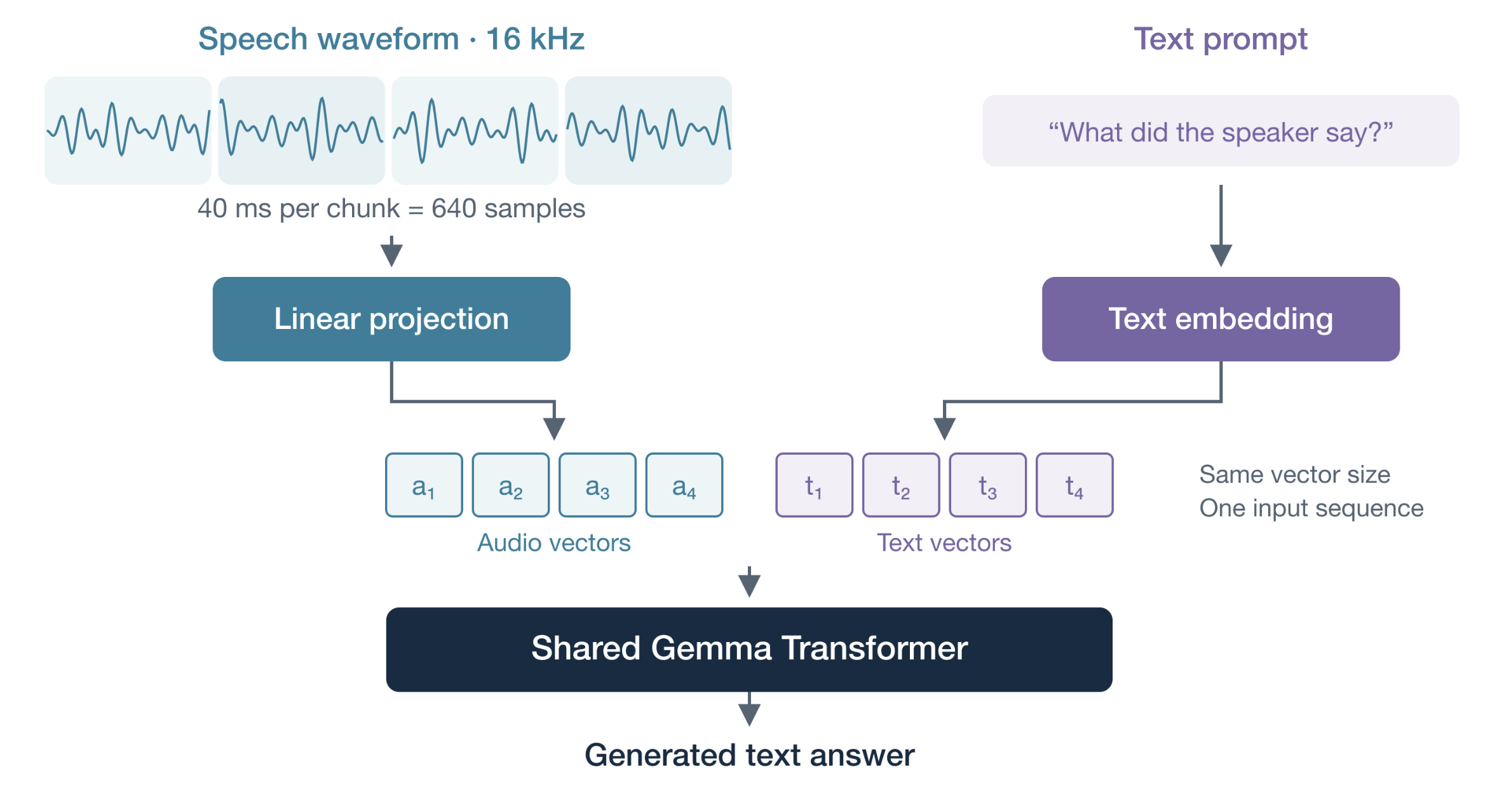
Integrated Models
Speech and text are treated almost identically!

Slide 28
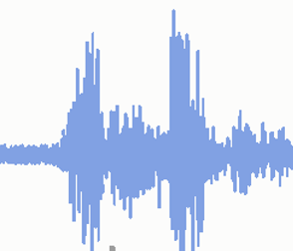
Integrated Models
All of the work is on creating interesting training examples.
My name is George Washington. I picked up an ax one day.
What is the gender of the speaker who picked up the axe?

Slide 29
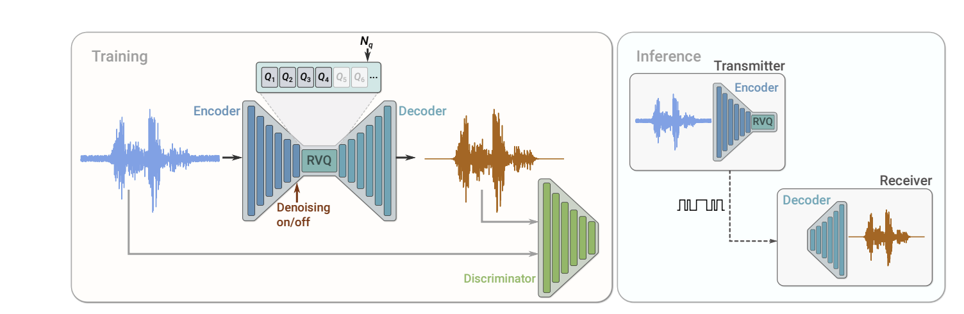
Full Duplex Model (and Audio Codecs First)
06a

Slide 30
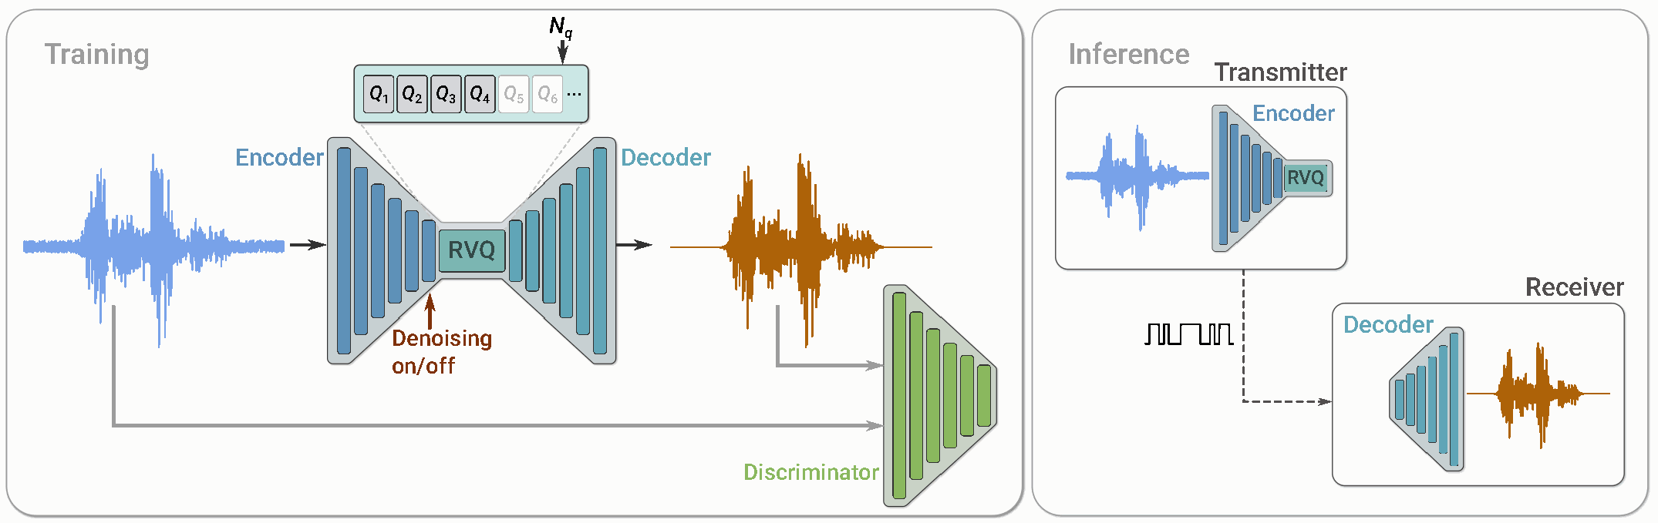
SoundStream: a learned audio codec
Joint training teaches the encoder, RVQ and decoder to reconstruct sound.
During training, losses compare real and reconstructed audio. At inference, only the codec is needed.
24 kHz waveform → encoder → 75 latent frames/s → RVQ indices → decoder → waveform
Figure: Zeghidour et al., SoundStream (2021), Fig. 2
1
Notes:
Original paper figure, cropped from page 2 without redrawing. Left: encoder, RVQ and decoder train with reconstruction and adversarial losses. Right: the transmitter sends code indices; the receiver reconstructs audio. The denoising switch is an optional enhancement feature, not a required part of quantization. The standard encoder stride is 320: 24,000/320 = 75 frames/s.
Figure source: https://arxiv.org/pdf/2107.03312 (Figure 2).

Slide 31
Vector quantization: replace a vector with an index
Learn a finite dictionary of vectors; choose the nearest entry for each encoder frame.
Encoder vector
z = [2.1, 0.9]
Nearest code vector
e₁₇ = [2.0, 1.0]
Transmit
index 17
Look up
e₁₇
k = arg minⱼ ‖z − eⱼ‖² ẑ = eₖ
The codebook is shared
An index has a bit cost
The encoder and decoder know the same
K learned vectors. Only the selected
index must be transmitted.
K = 1,024 entries → 10 bits per index.
These IDs are learned acoustic symbols;
they are not words or phonemes.
Quantization trades exact reconstruction for a finite vocabulary of reusable audio codes.
van den Oord et al., Neural Discrete Representation Learning (2017); SoundStream (2021)
2
Notes:
The two-dimensional vector and index 17 are a toy illustration. Nearest-neighbor assignment selects the learned codebook vector with minimum squared Euclidean distance. For a power-of-two codebook, a fixed-width index uses log2(K) bits. A decoder retrieves the selected vector and uses it to reconstruct audio. Real codec vectors have many dimensions. Quantizer training typically uses a straight-through gradient estimator; the hard assignment is not ordinarily differentiable.
Sources:
https://proceedings.neurips.cc/paper/2017/file/7a98af17e63a0ac09ce2e96d03992fbc-Paper.pdf
https://arxiv.org/pdf/2107.03312

Slide 32
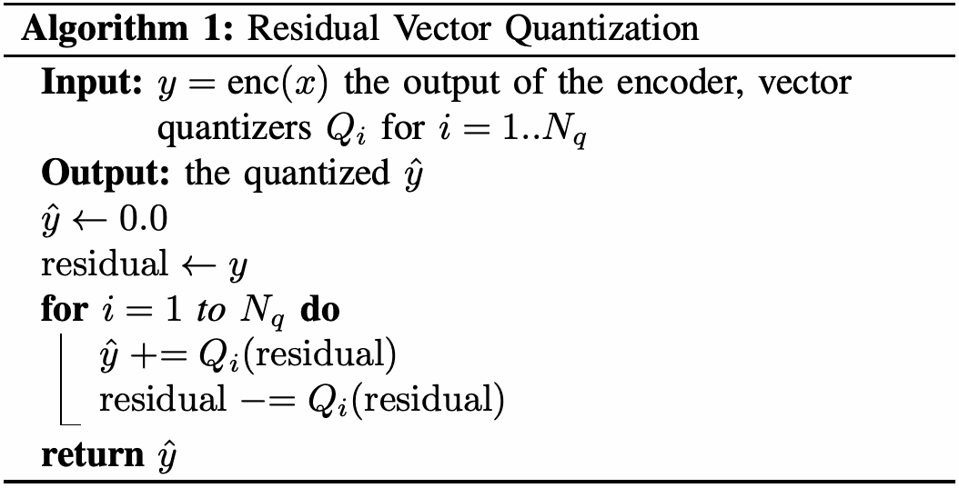
Residual vector quantization, one stage at a time
Each codebook approximates the residual left by the previous codebooks.
SoundStream’s algorithm
Scalar example: z = 3.70
target
1 Q₁(3.70) = 3.00
3.00
r₁ = 3.70 − 3.00 = 0.70
2 Q₂(0.70) = 0.50
3.00
0.50
r₂ = 0.70 − 0.50 = 0.20
3 Q₃(0.20) = 0.25
Encode: send one index per codebook.
Decode: retrieve the vectors and add.
3.00
0.50
r₃ = 0.20 − 0.25 = −0.05
Reconstruction: 3.00 + 0.50 + 0.25 = 3.75 Final error: 3.70 − 3.75 = −0.05
Source: SoundStream (2021), Algorithm 1. Colored bars: illustrative scalar example.
3
Notes:
SLIDE SHOW: four clicks. 1 reveals the first approximation, 2 adds the second residual code, 3 adds the third residual code, and 4 reveals the reconstruction sum. All rows use the same scale. The dashed target marks 3.70. Blue, orange and purple segments are codebook vectors in a scalar toy example, not the code IDs themselves. The red horizontal marks show remaining error; the last stage overshoots slightly. Actual RVQ quantizes multidimensional vectors. Each displayed selected value is assumed to be the nearest entry in its stage's codebook. Left: the original algorithm from SoundStream.
Source: https://arxiv.org/pdf/2107.03312 (Algorithm 1, page 4).

Slide 33
SoundStream: train for quality, choose a bitrate
Joint training makes the discrete bottleneck useful; quantizer dropout enables variable rates.
Training the codec
Fixed-width bitrate
Reconstruction / spectral losses
keep the decoded signal close to the input.
R = frames/s × Q × log₂ K
Adversarial + feature-matching losses
encourage perceptually realistic sound.
RVQ stages Q | Bits/frame | Bitrate
4 | 40 | 3 kb/s
8 | 80 | 6 kb/s
16 | 160 | 12 kb/s
Straight-through gradients train the encoder;
codebook vectors use moving-average updates.
Quantizer dropout trains with a variable
prefix of RVQ stages: 1, …, Q.
Here: 75 frames/s, K = 1,024 per stage.
Rates exclude headers and entropy coding.
Quantizer dropout lets one model support several bitrates using different RVQ prefixes.
SoundStream (2021); Google Research, SoundStream overview; VQ-VAE (2017)
4
Notes:
The bitrate table is arithmetic for a 75 Hz codec with 1,024-entry codebooks, not a claim that every released checkpoint supports all rows. A usable prefix must be covered during training. SoundStream trains the encoder, quantizer and decoder together, using reconstruction and adversarial objectives; its codebooks use exponential moving averages. Straight-through estimation is the usual VQ mechanism for passing gradients to the encoder. The discrete argmin itself has no useful ordinary derivative. Quantizer dropout removes later stages while preserving the prefix.
Sources:
https://arxiv.org/pdf/2107.03312
https://research.google/blog/soundstream-an-end-to-end-neural-audio-codec/
https://proceedings.neurips.cc/paper/2017/file/7a98af17e63a0ac09ce2e96d03992fbc-Paper.pdf

Slide 34
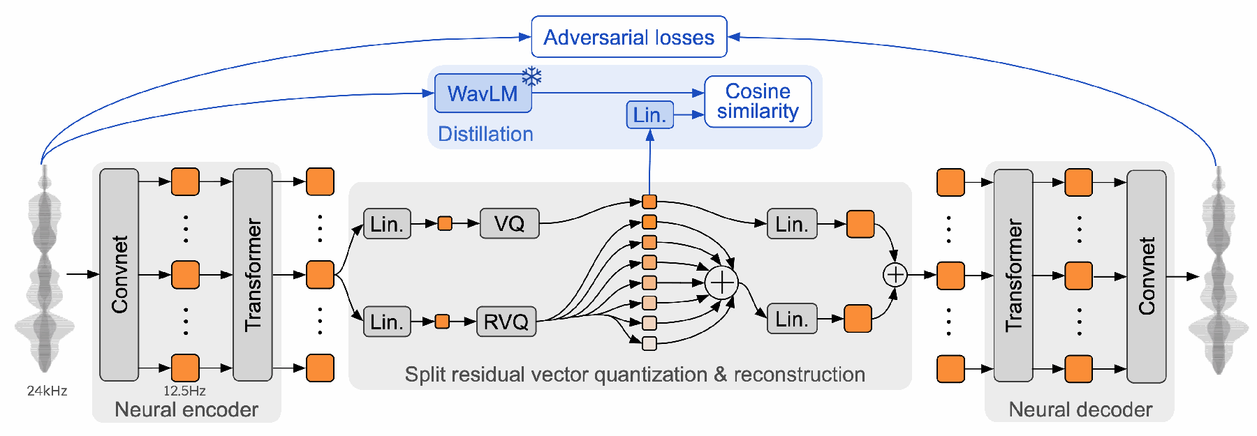
Mimi: semantic and acoustic codes
The semantic branch learns from WavLM while the codec learns to reconstruct audio.
Moshi configuration: 1 semantic + 7 acoustic codes per 80 ms frame, at 1.1 kb/s
Figure: Défossez et al., Moshi (2024), Fig. 2. Blue paths operate during training.
5
Notes:
Original Mimi architecture and training figure, cropped from page 10 of the Moshi paper without redrawing. Read left to right along the black arrows for inference. Read blue arrows for training-only losses and the frozen WavLM teacher. Both quantizer branches receive the encoder representation through separate projections. The acoustic branch has its own residual stack; it does not quantize the error left by the semantic branch. Their reconstructed vectors are added. The number of blocks in the paper figure is schematic; Moshi uses eight total codebooks (one semantic and seven acoustic), each with 2,048 entries, at 12.5 frames/s. This gives 12.5 × 8 × 11 = 1,100 bits/s. Semantic supervision does not guarantee perfect disentanglement.
Figure source: https://kyutai.org/Moshi.pdf (Figure 2). Implementation: https://github.com/kyutai-labs/moshi

Slide 35
Mimi turns speech into targets an LM can predict
Each 80 ms frame carries a small bundle of discrete codes, including a semantic code.
Code / frame | t | t + 1 | t + 2
Semantic | sₜ | sₜ₊₁ | sₜ₊₂
Acoustic 1 | aₜ,₁ | aₜ₊₁,₁ | aₜ₊₂,₁
… | … | … | …
Acoustic 7 | aₜ,₇ | aₜ₊₁,₇ | aₜ₊₂,₇
Frames ≠ code indices
12.5 frames/s × 8 codes/frame
= 100 code IDs/s per audio stream.
2,048 entries/codebook → 11 bits/ID
100 × 11 = 1.1 kb/s.
Mimi encoder
reference audio → IDs
Speech LM
predict code IDs
Mimi decoder
generated IDs → audio
Moshi: a temporal Transformer models frames; a depth Transformer predicts codes within each frame.
Train the codec to represent sound; train the speech LM to predict sequences of those codes.
Moshi (2024), §§3–4; Kyutai Moshi / Mimi documentation; 8-codebook configuration
6
Notes:
The grid shows one audio stream. At 12.5 Hz, frames are 80 ms apart; eight code indices per frame gives 100 indices per second. With 2,048 entries in each codebook, fixed-width bitrate is 1,100 bits/s. This is the eight-codebook Moshi configuration, not a universal limit on Mimi configurations. The 80 ms frame duration is not total conversational latency. Moshi's temporal Transformer advances per frame; its depth Transformer generates the codebook predictions within that frame, alongside an aligned text stream. This avoids requiring the large temporal model to take a separate temporal step for every code ID. The codec is pretrained separately; the speech model learns token distributions with token-prediction losses.
Sources:
https://github.com/kyutai-labs/moshi
https://arxiv.org/html/2410.00037v2

Slide 36
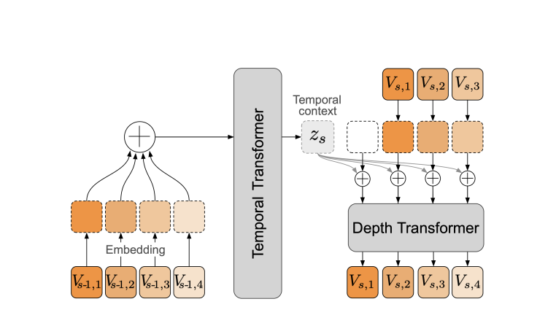
Full Duplex Spoken Interaction (Moshi)
06b

Slide 37
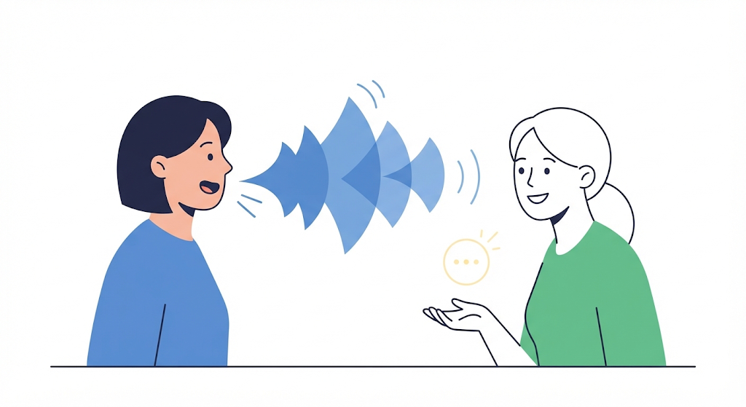
Problems with the ASR - LLM – TTS Pipeline
Why should I have to wait for the TTS to synthesize a giant block of text?
How do I know the LLM is listening?
We want a model that actually mimics human conversations!

Slide 38
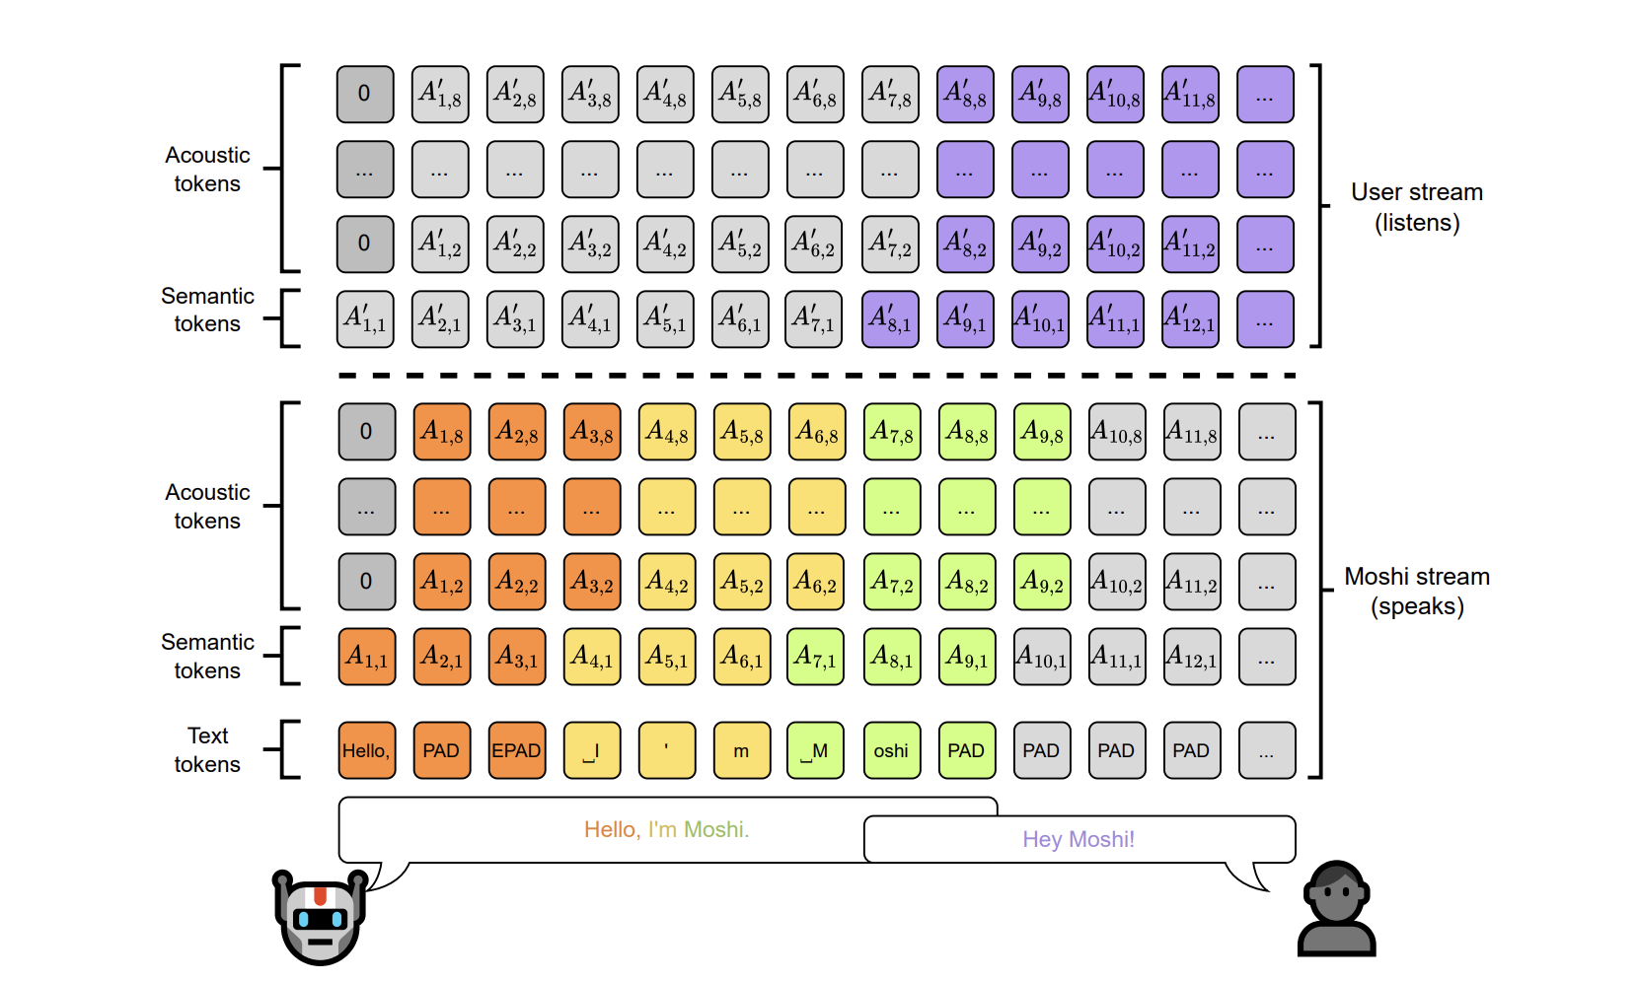
Full Duplex

