Slide 1
Media Interest and Stock Prizes: Building a Predictive Model with Machine Learning Methods
Mitali Joshi, Camila Restrepo Cerón, Mateo Bandala Jacques

Slide 2
Research Question
"Can machine learning methods be used to build an equation that accurately predicts variation in stock prices based on hits to a related Wikipedia page?"

Slide 3
Rationale/Motivation
Predicting stock movement based on digital engagement is an important financial objective
Previous work has been done in the area
Practical implications for multiple stakeholders
Wikipedia provides free, user-friendly API access, and is widely used
Reflects public interest and sentiment
Historical stock data is easy to access and can be used to train predictive models

Slide 4
Comparison to Previous Work
Similar work has been used, mostly using Google data [1-2] as a predictor
Authors used machine learning to compare Google hits with stock prices
Google data is expensive to access
This Google strategy outperformed buy-and-hold strategies by 40%
Media interest is a strong predictor of stock price movements.
Increased media attention often precedes significant stock price changes.
Alternative data sources could result as effective, but easier to access

Slide 5
Summary of Work: RShiny App
Built and tested machine learning methods
Input: Wikipedia Page (E.g: Elon Musk),Yahoo Finance stock price data(E.g: TSLA), and Date Range (E.g 2021-01-01 to 2024-06-30)
Used functional programming to create a longitudinal data set with Wiki hits and stock price in range
Used machine learning with logistic regression to predict stock change (UP or DOWN) in final day of range, based on lagged values
Cross-validated model
Tested with 20 different Wiki sites and stocks (Accuracy 60%)
Deployed as RShiny app
Designed a user interface that took previous inputs
Provided reactive output with plots and prediction

Slide 6
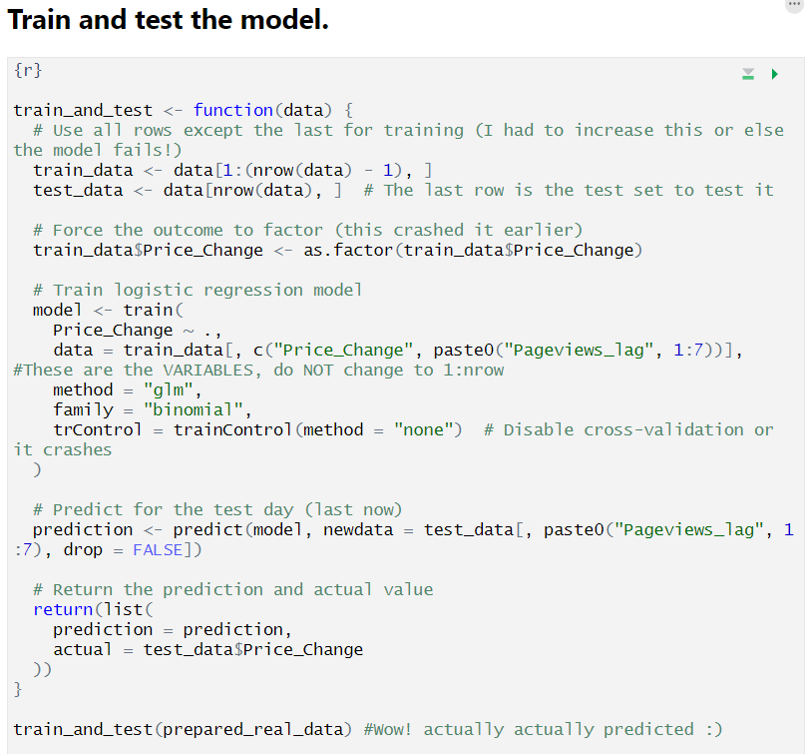
Programming Paradigms Used:
Functional programming
& machine learning
Notes:
Explain why we used them: machine learning was part of our initial question. Functional programming was intuitive since the get go to accommodate the inputs from the Rshiny app

Slide 7
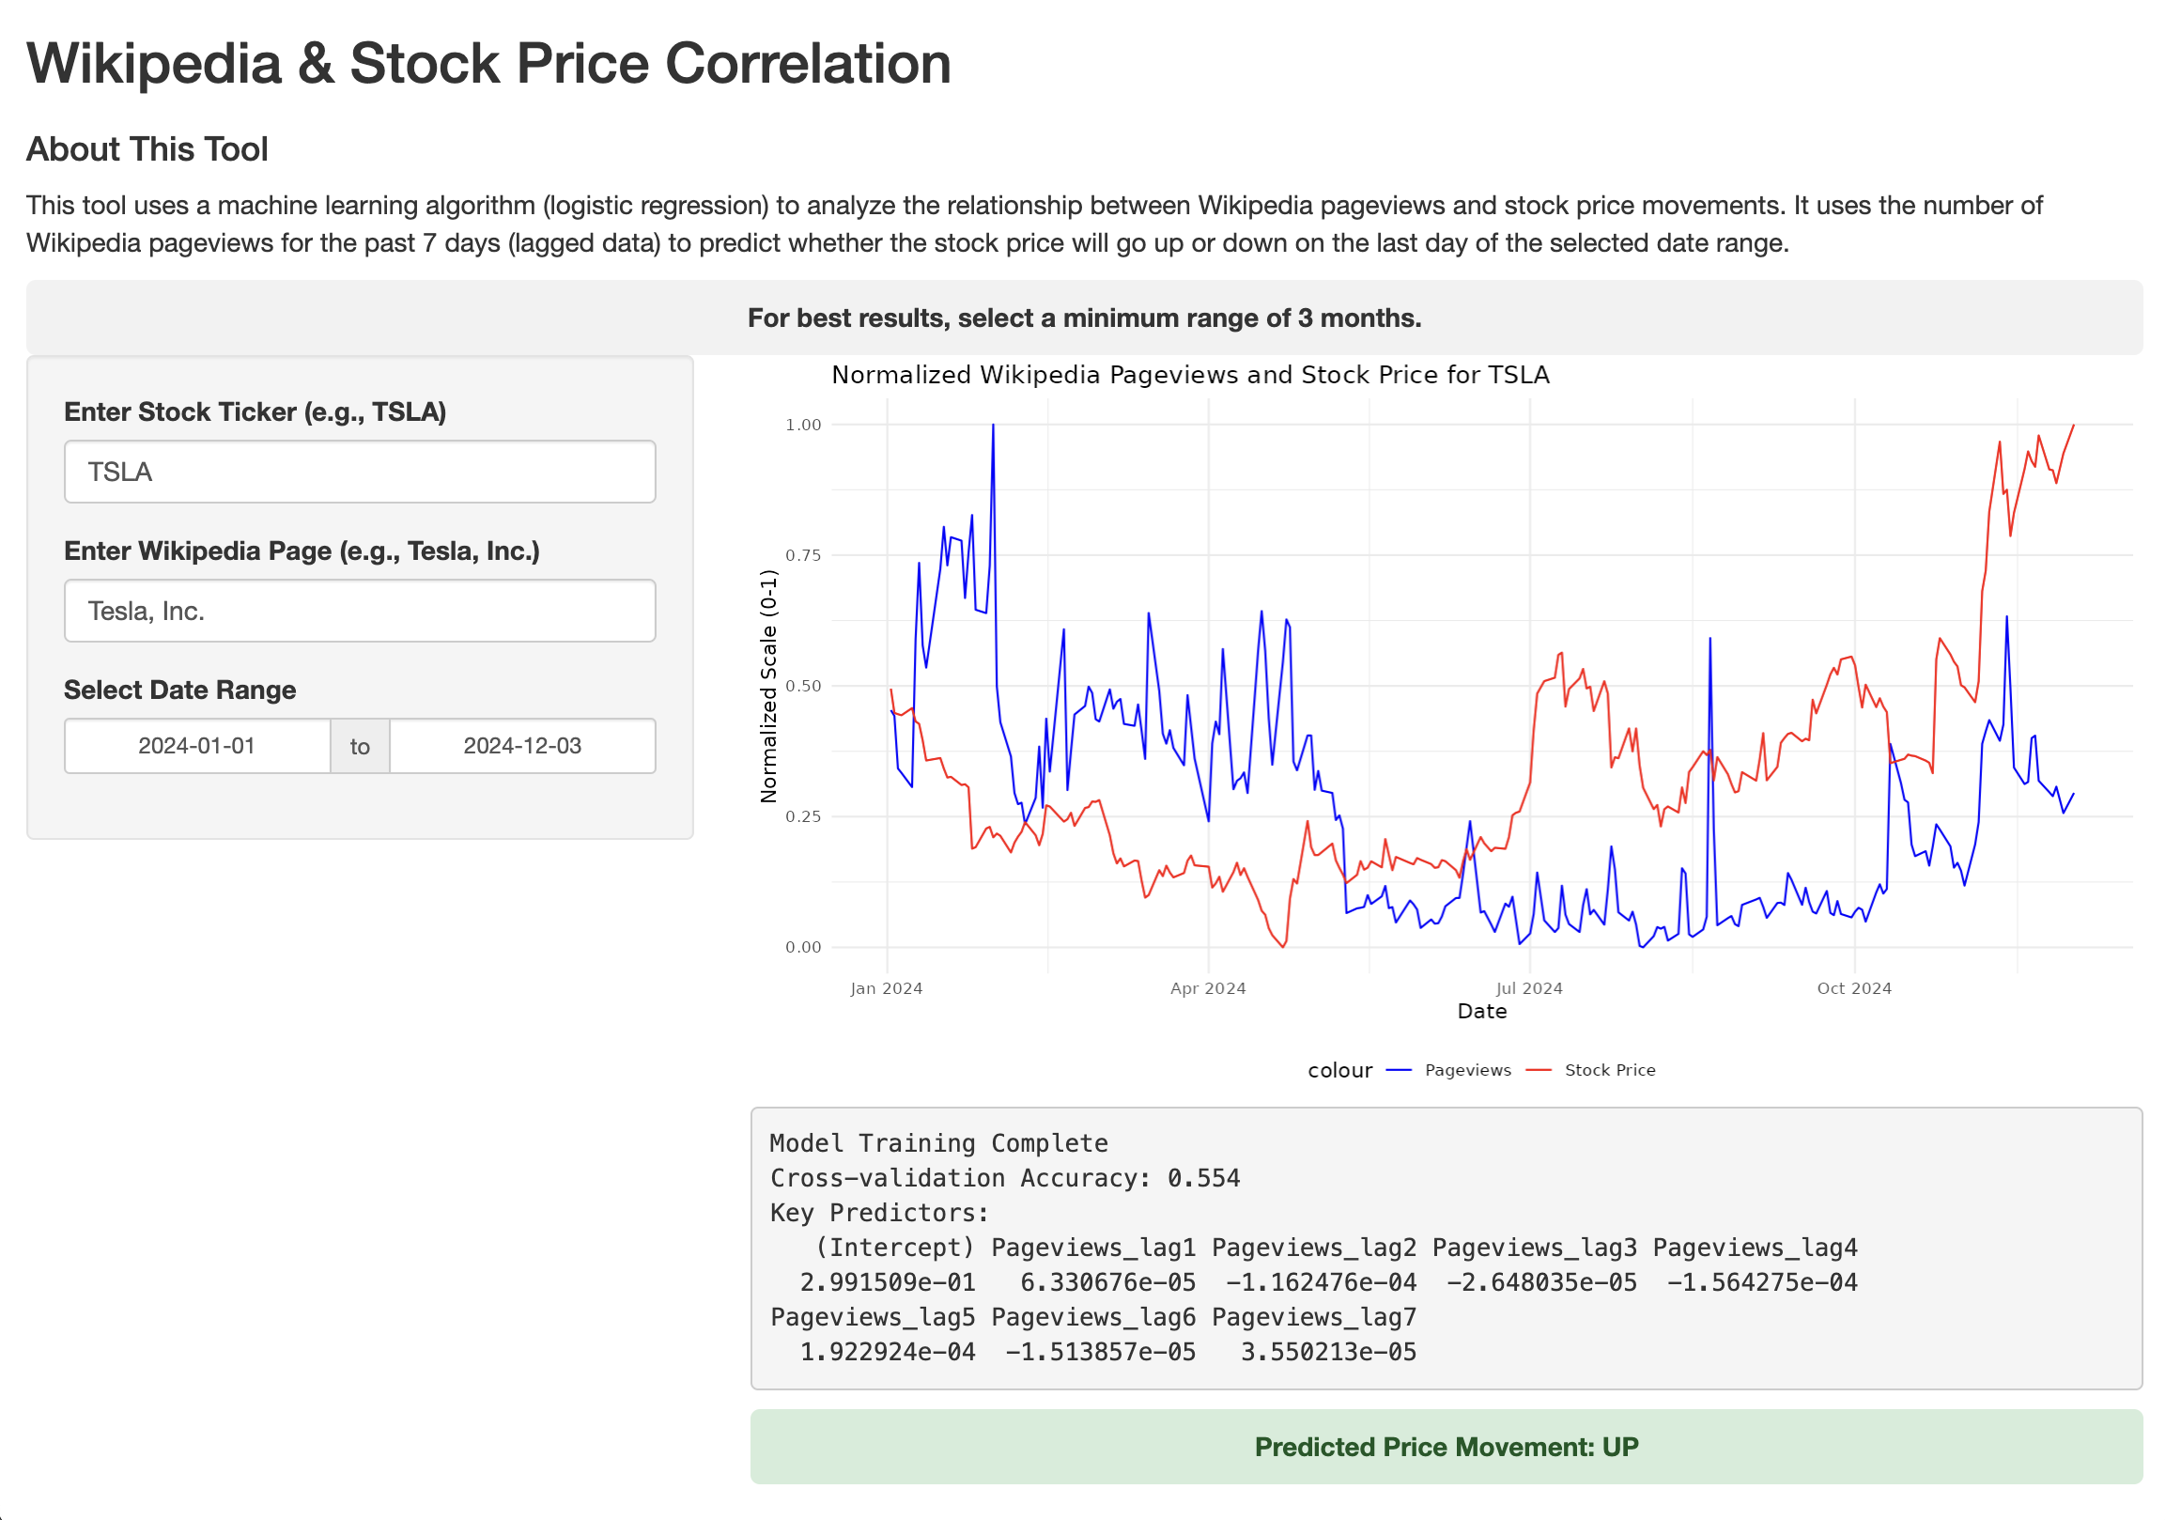
Our Product/ Demo
https://mabj4815.shinyapps.io/project4/

Slide 8

Importance of the Product
Main Importance: Predicting Stock Prices with Digital Engagement Metrics
Wikipedia Page Views as a Proxy:
Tracks public interest and sentiment toward companies or sectors.
Smaller variations in page views could predict future price changes.
Advantages of Using Wikipedia:
Transparent and easily accessible metadata.
Simpler data extraction compared to platforms like Google, TikTok, or Twitter (aka X).
Significance of Research:
Advances understanding of unconventional data in financial modeling.
Offers practical applications for investors, analysts, and companies.
Workshop #1
Workshop #2

Slide 9
Limitations and Future Work
LIMITATION
Only predicts what happens the following day
Requires statistical knowledge to interpret specific outputs
The stock is volatile, and changes occur unexpectedly
FUTURE WORK
If resources allow, refine data with source that better explores sentiment
The app formerly known as Twitter
Test more accurately predictive capability

Slide 10

Thanks!
Any questions?
Special shoutout to Dr. Hicks for teaching us so much in this course!

Slide 11
References
Shivers D. Exploring the Relationship between Google Trends Data and Stock Price Data. UCSD. Available at: https://www.ccom.ucsd.edu/~cdeotte/papers/GoogleTrends.pdf.
Jan Jakub Szczygielski, Ailie Charteris, Princess Rutendo Bwanya, Janusz Brzeszczyński. Google search trends and stock markets: Sentiment, attention or uncertainty? International Review of Financial Analysis, Volume 91,2024, https://doi.org/10.1016/j.irfa.2023.102549.
Wikimedia Foundation. Wikimedia REST API. Available at: https://wikimedia.org/api/rest_v1/.
Yahoo. Yahoo Finance. Available at: https://finance.yahoo.com/?guccounter=1.

