Slide 1
Forecasting the Effect of Climate Change on Energy Demand
Adam, Daniel, Alex, Bob, Jack

Slide 2
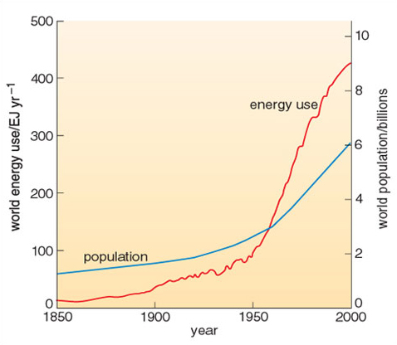
Introduction: Power and Population
Power is the rate at which energy is transferred, measured in watts.
Under the National Electricity Market, it provides energy to around 80% of Australians
As the years pass, individual households used more energy per capita.
Notes:
Bob

Slide 3
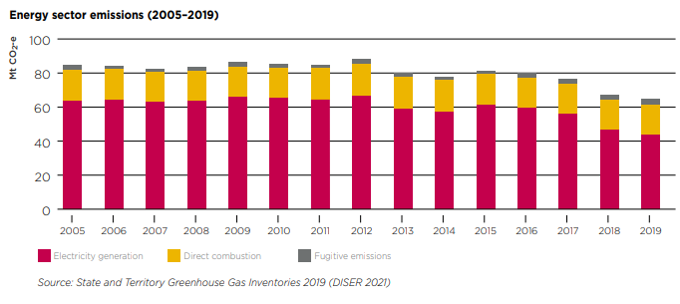
Introduction: Policies on Energy Demand
Under the Energy Sector Emissions Reduction Pledge, the Victorian Government details their action plans for the future.
The Solar Homes Program aims to increase usage of renewable energy to build a decarbonised energy system.
The Victorian Energy Upgrade Program will install energy-saving items to help Victorians save on their energy bills.

Slide 4
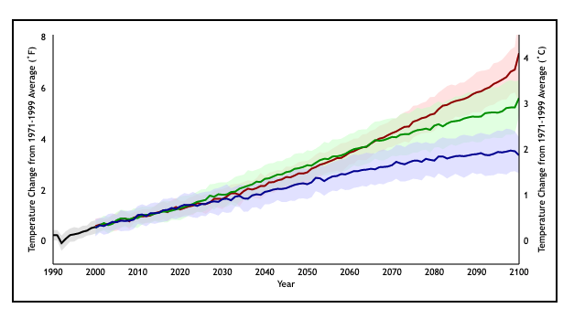
Introduction: Research Question and Project Plan
“Through plotting local temperature against energy demand in MW, how accurately can we predict the expected energy demand in a chosen year assuming a 2 degree increase in global temperatures by 2050 due to climate change?”
Looking at climate model simulations, the project will follow the green model line as it would reflect humanity’s most realistic carbon emissions path in the future.

Slide 5
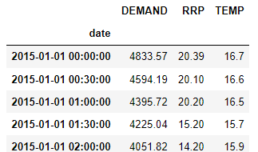
Pre-Processing : Input Data
The raw data came in the form of 1146 .csv documents, containing an observation for every half-hour for 20 years (2000 → 2020).
This data was compiled into a single dataframe per state, each containing ~350,000 datapoints. This dataframe used a datetime variable as its index, allowing us to easily manipulate the data based on time.
Missing variables were imputed based on their 2 nearest neighbours, and missing variables with no neighbours were dropped from the data.
After pre-processing, we are left with a single dataframe with the following variables:
The date and time of the observation (index)
Energy demand
Energy price
Air temperature
Only Victorian data from 2015-2020 was used for analysis.
Notes:
The raw data came in the form of 1146 .csv documents, containing an observation for every half-hour for 20 years (2000 → 2020). Dan
This data contained many superfluous columns and differing standards of data-collection. For instance, the temperature data featured separate columns for year, month, day, hour, minute, while the demand data featured a single column for the entire date string.

Slide 6
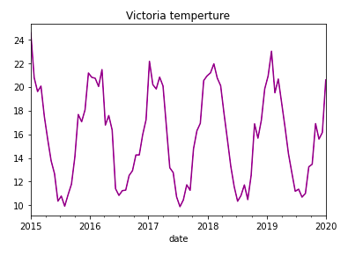
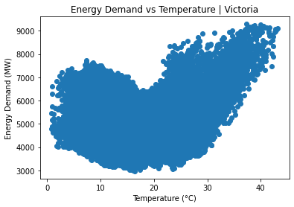
Exploratory Data Analysis
Through inspection of the rolling means graph, we see that both temperature and energy demand follow a seasonal trend.
Demand is high when temperature is extremely high or extremely low. Interestingly, demand is higher when temperatures are extremely high than when temperatures are extremely low.
While the correlation between temperature and energy demand is only 0.135, the non-linear relationship between the 2 variables means that the linear correlation does not give a true indicator of their relationship.
Notes:
Alex the above graph provide the temperature between 2015 to 2020. in the graph, it clearly shows that in the January of 2015 to March of 2015, it has the higher temperature,, which is 35 degrees. this graph provide the same thing that I mention on the previous Demand graph, in January to March, Australia is in Summer, which means the temperature is more higher that the other month, which represents people use more energy demand, since they need to open the air condition. And after March to May, the temperture keep decrease, but the range of the air temperture is between 25-15 Calcium, which means that the temperture is fine for people to live. After May, Australia enter Winter seeason, which represents that the temperture decrease very fast, and the lowerst temperture is 4 Calcium. When Australia enter Winter, the energy demand has strictly increase, which means that people need to open heater. so after the Winter season, which is after august, the temperture of Australia is fine for people to live. the Same situationwill happen after Octorbor, since Australia has enter Summer. The graph will provide the same trent since the season is almost same.

Slide 7
Normalization
Normalisation occurs to account for the differences in the scale for each variable.
In this project, linear regression and support vector regression are the models that require normalization
Random Forests do not require normalisation because the domain of data that determines the outcome for each new decision tree is localised, minimising the effect that the magnitude of feature variables has on the final prediction.
Notes:
Alex The goal of normalization is to change the values of numeric columns in the dataset to a common scale, without distorting differences in the ranges of values. For example, from the victoria data set that we do, which containing two features, TEMP, and Demand. Where Temp ranges from 5-35, while Remand ranges from 3500–7500 and higher. Demand is about 100 times larger than Temp and ranges from 3500-7500. So, these two features are in very different ranges. When we do further analysis, like multivariate linear regression, for example, the attributed income will intrinsically influence the result more due to its larger value.

Slide 8
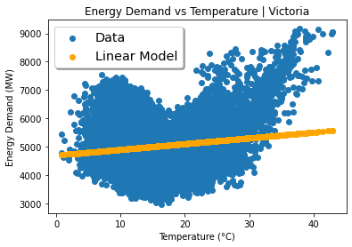
Model 1: Simple Linear regression
A simple linear model was fit to the normalised data, resulting in the following relationship:
Demand = 20.30 × Temperature + 4697.78
This model had very low testing scores and high error metrics, indicating that a linear model does not fit our data well.
Training score: 0.0176
Testing score: 0.0207
Root mean square error: 859.86
Mean absolute error: 696.63

Slide 9
Model 2: Random Forests Regression
A ‘greedy’ algorithm that minimises the sum of squared errors at each ‘decision tree’ regardless of overall effect to accuracy, precision or other metrics. Thus, cross validation is unnecessary.
Advantages: Regularisation is not necessary because there is no penalty cost function. Optimises cross validation parameters automatically such that variance is reduced as much as possible without increasing bias.
Disadvantages: Since at each local region of data values, the average of regressed values is taken, the model is limited to the range of fitted training set values, preventing extrapolation and creating irregularities in the extreme minimum and maximum range of the observed temperatures.
Why RFR may be a good fit for data: Works when data is non-linear and ‘irregular’.
Notes:
Adam

Slide 10
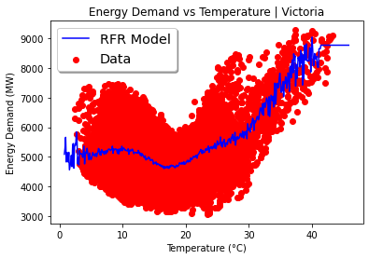
Results of Random Forest Regression
Data from 1st Jan 2015 to 1st Jan 2020.
80/20 train-test split.
Note the oscillations on the tail ends of the model.
Root Mean Square Error: 773.603
Mean Absolute Error: 635.443
R²: 0.222
Notes:
Adam

Slide 11
Model 3: Support Vector Regression
This algorithm uses support vector machine techniques to fit a regression model onto the data.
Advantages: SVR modelling is easy to generalise to many use-cases, and provides multiple kernel options to customise models. It is not overly influenced by outlier data.
Disadvantages: It is computationally intensive and struggles with datasets with large amounts of observations.
Notes:
Daniel

Slide 12
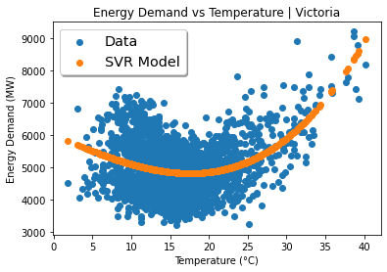
Results of Support Vector Regression
10,000 data points were sampled from 1st Jan 2015 to 1st Jan 2020.
An 80/20 train-test split was constructed and used to fit a cubic polynomial SVR model, with optimal parameters given by cross validation.
A cubic kernel was used in order to avoid fluctuations in the tail ends of the model.
Root Mean Square Error: 791.459
Mean Absolute Error: 656.451
R²: 0.181
Notes:
Daniel

Slide 13
Forecasting Climate Change’s Impact on Energy Demand
Each of the two non-linear models were used to forecast the changes in energy demand that might be observed under the effects of climate change.
Research indicates that global temperatures will increase by 2°C by 2050 due to climate change. Incorporating this effect into our model allows us to predict how the demand for energy will be affected by these more extreme temperatures.
Notes:
Daniel

Slide 14
Forecasting Climate Change’s Impact on Energy Demand
The random forest regression model predicted a 2.93% increase in total energy demand as a result of the more extreme temperatures.
The SVR model also produced a 2.46% increase in the total annual energy demand.
Despite the differences in the models’ error metrics and goodness of fit (as evidenced by the R-squared values of each model), both appear to predict somewhat similar effects on energy consumption in the future.
Notes:
Adam

Slide 15
Conclusion & Improvements
Our models predicted a 2-3% increase in demand when factoring in the effects of rudimentary climate change.
Assumptions: this project used an extremely simple model for climate change effects, taking only temperature into account. Future work could use a more rigorous approach to this aspect of the forecasting.
Inaccuracies: all models included significant noise, this could be reduced through more tuning of the models’ parameters.
Techniques: other techniques could be employed such as Gaussian processes (excluding those being implemented in SVMs), powerful unsupervised machine learning techniques used for forecasting
Notes:
Bob

