Slide 1
CYCLONE PREDICTION SYSTEM
Name: JIAWEI HUANG
Student ID: 26447509

Slide 2
Background
Natural Disaster!
With the climate change in recent years, more and more natural disaster appears. Cyclone is one of these natural disaster appears in Australia.

Slide 3
Factors of Cyclone
1.The two main factors: Wind Speed and Sea-surface Temperature. Minimum wind speed is 63km/h and minimum sea-surface temperature is 26.5 °C
2.Data that cyclone system needs are wind speed data and temperature data.

Slide 4
Topic
Big data
It is is a term for data sets that are so large or complex that traditional data processing application software is inadequate to deal with them. Big data challenges include capturing data, data storage, data analysis, searching….

Slide 5
Existing Techniques for big data:
Linear Regression
Logical Regression
Text Analysis
Time Series Analysis
......

Slide 6
Technique in This project
Technique: Neural Network Algorithm.

Slide 7
Key Challenges
Finding a suitable data which can be used in neural network.
Knowing how neural network work.

Slide 8
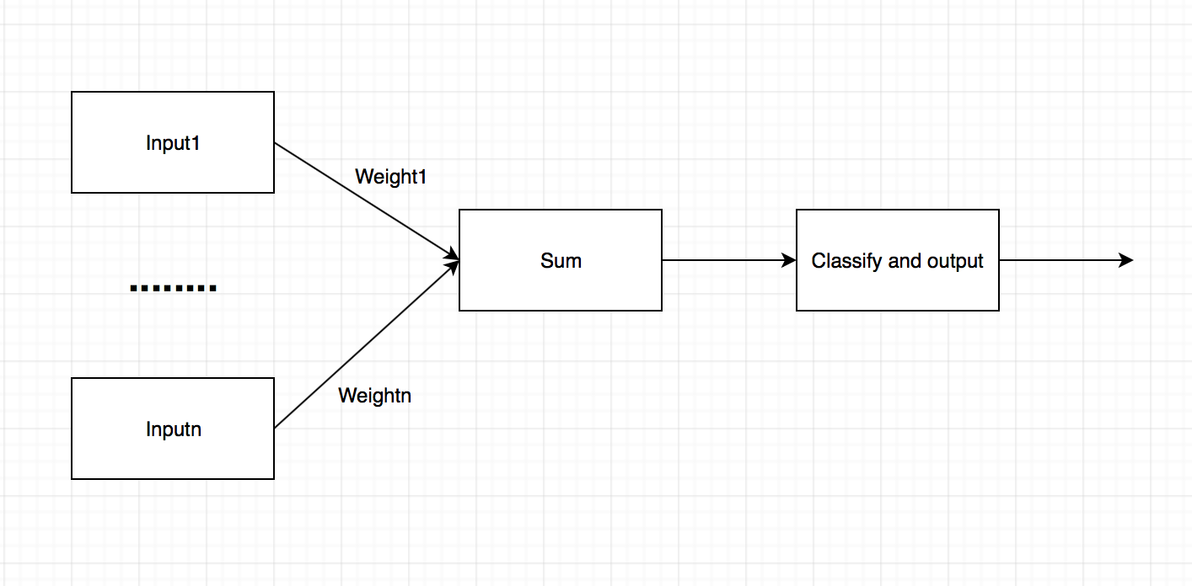
Neural Network
Formula: Input1*weight1+ input2*weight2+….+ inputn*weightn+ constant.
Constantly deep learning to adjust value of each weight
then result will be more accurate.

Slide 9
How to adjust weight
Normal formula:
newWeight=OldWeight – learning_Rate*Derivative_of_Oldweight.
Why?
Reducing error rate.
If error rate is decreased, accuracy of result will be improved.

Slide 10
Project Aim
Create and implement successfully a cyclone prediction system.

Slide 11
Three Outcomes
Error rate histogram
Probability when input wind speed data and sea-surface data
Send analysis result to user by sending email.

Slide 12
DEMO TIME

Slide 13
Limitations
Insufficient real cyclone data
Sometime system learns wrong but probability is low.

Slide 14
Future Work
Find more factors of cyclone
Improving the accuracy of system.

Slide 15
Reference
https://www.youtube.com/playlist?list=PLxt59R_fWVzT9bDxA76AHm3ig0Gg9S3So
http://www.bom.gov.au/climate/data/

Slide 16
Thank You For Listening!

