Slide 1
thesis plots

Slide 2
P₁
P
P₂
L
Ω
T₁
PSUP
sphere
θ
source
offset
O
time of flight
T₂
Ω'
L'
P'₁
P'₂
P'

Slide 3
PMT
ray-tracer
PMT
vertex
PMT
PMT
vertex
vertex

Slide 4
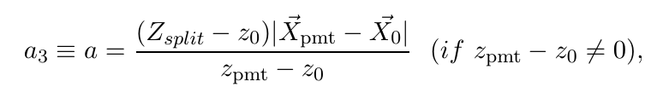
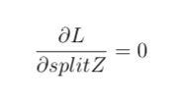
a₃
PMT
vertex
vertex
PMT
vertex
PMT
vertex
PMT

Slide 5

SkyShine

Slide 6

PMT
panel
Uniform Selector
PMT sphere
http://www.downloadclipart.net/download/5816/big-blue-wire-globe-svg

Slide 7
drive correction
early hits
late hits
u
pulled event position
PMT sphere
actual event position

Slide 8
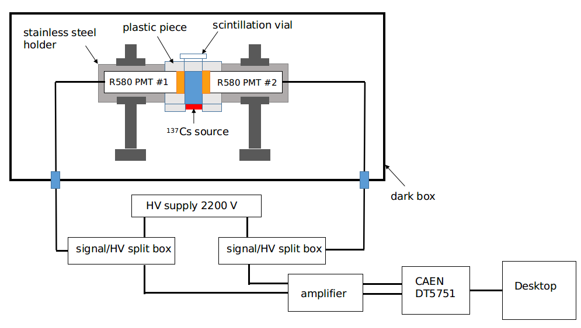
amplifiers

