Slide 1
thesis plots
2019

Slide 2
P₁
P
P₂
L
Ω
T₁
PSUP
sphere
θ
source
offset
O
time of flight
T₂
Ω'
L'
P'₁
P'₂
P'

Slide 3
PMT
ray-tracer
PMT
vertex
PMT
PMT
vertex
vertex

Slide 4
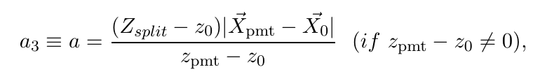
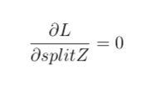
a₃
PMT
vertex
vertex
PMT
vertex
PMT
vertex
PMT

Slide 5

SkyShine

Slide 6
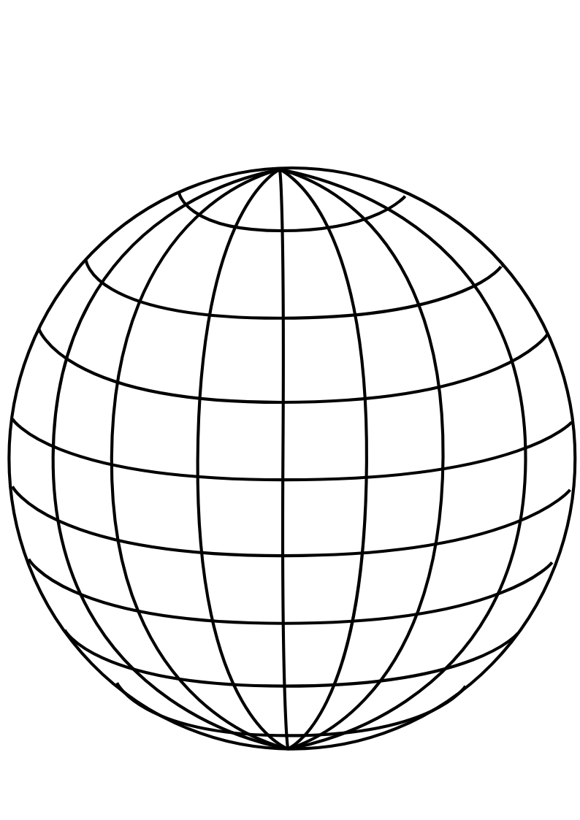
PMT
panel
Uniform Selector
PMT sphere
http://www.downloadclipart.net/download/5816/big-blue-wire-globe-svg

Slide 7
drive correction
early hits
late hits
u
pulled event position
PMT sphere
actual event position

Slide 8


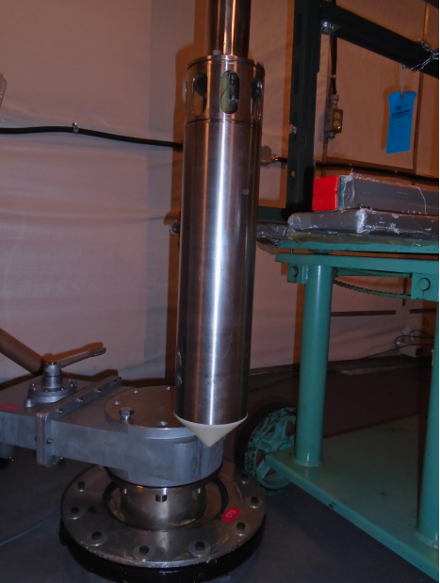
25.3 cm
Stainless steel
container
PMT for tagging
¹⁶N decay chamber

Slide 9
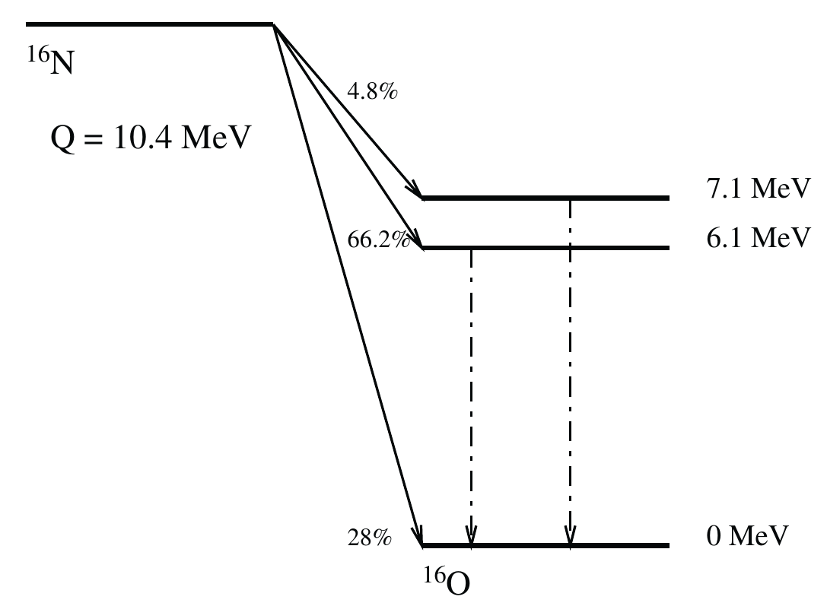
γ-rays

Slide 10
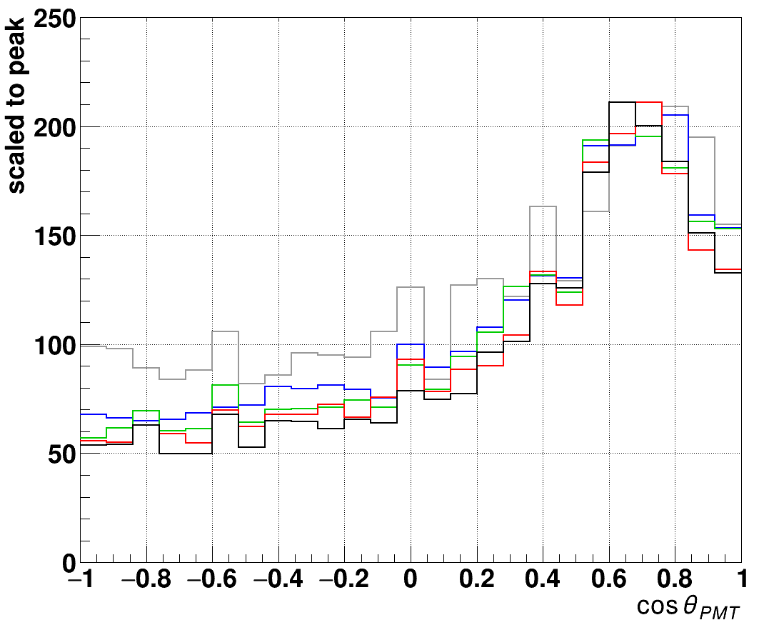
— 5 MeV
— 4 MeV
— 3 MeV
— 2.5 MeV
— 1 MeV

Slide 11
¹⁶N source
distance
γ-rays
reconstructed
event position
Compton
scattering
e⁻
θ_{PMT}
PMT

Slide 13
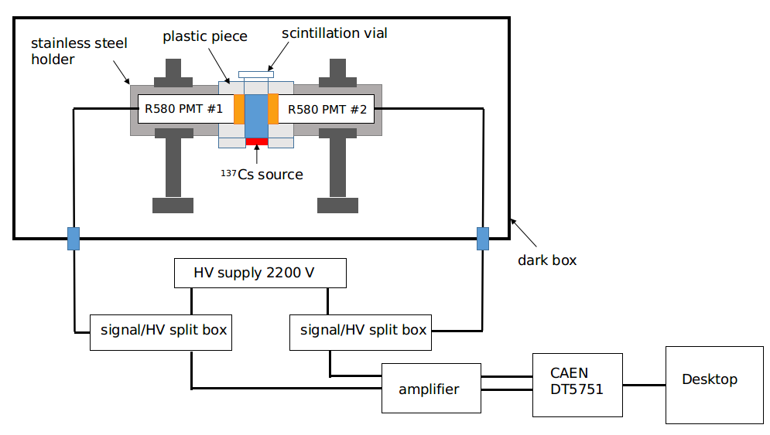
High voltage
connector
amplifier
amplifier

Slide 14
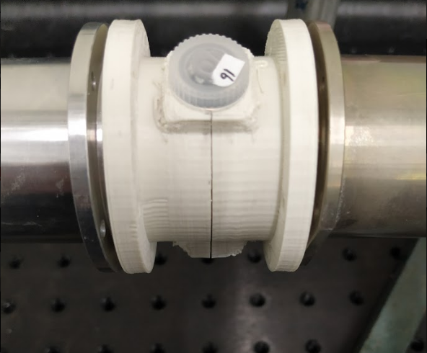
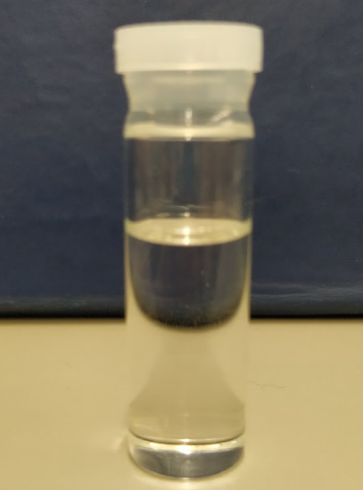
49.4 mm
14.3 mm
scintillation
vial
stainless steel
PMT holder
30 mm
plastic holder

Slide 15
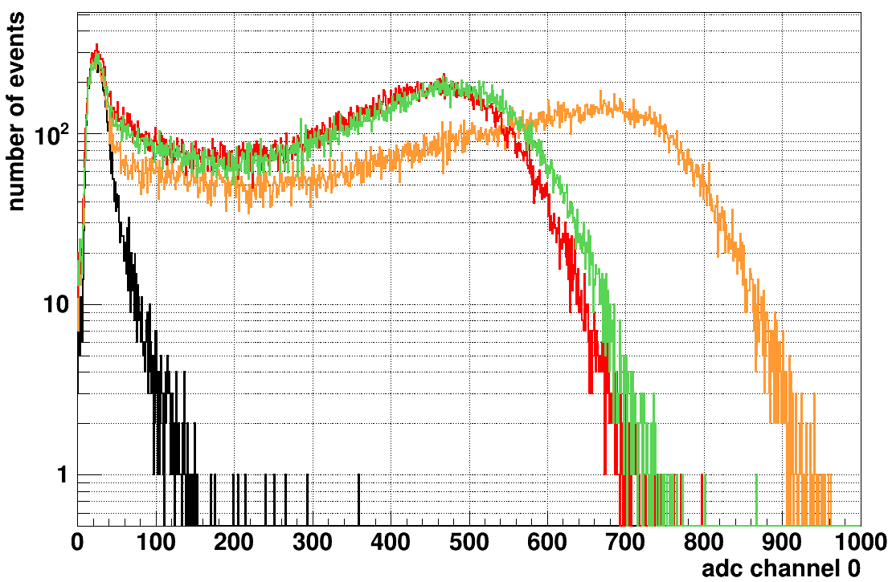
— LAB-PPO
— TeSOP
— TeDDA
— background

Slide 16
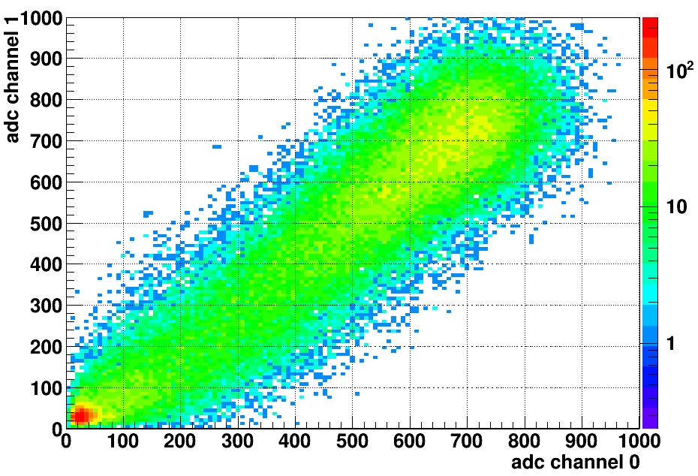
LAB-PPO
multiple p.e.
peak
single p.e.
peak

Slide 18
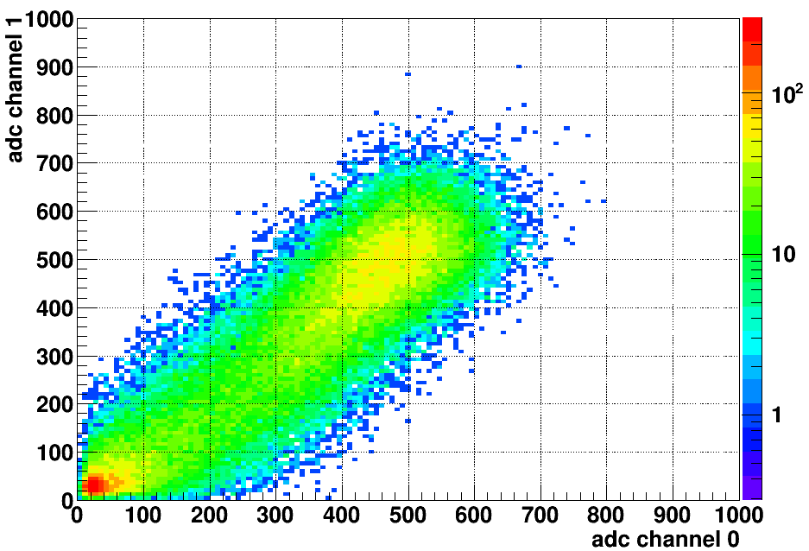
TeDDA

Slide 19
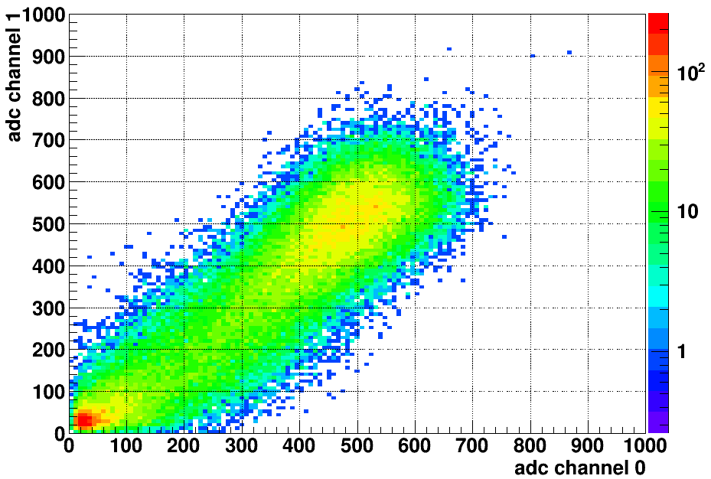
TeSOP

Slide 20
(a)
(b)
LAB-PPO
Te_P1
single p.e. peak
multiple p.e. peak
(c)
(d)
Te_P3
— LAB-PPO
— Te_P1
— Te_P3
— background

Slide 21
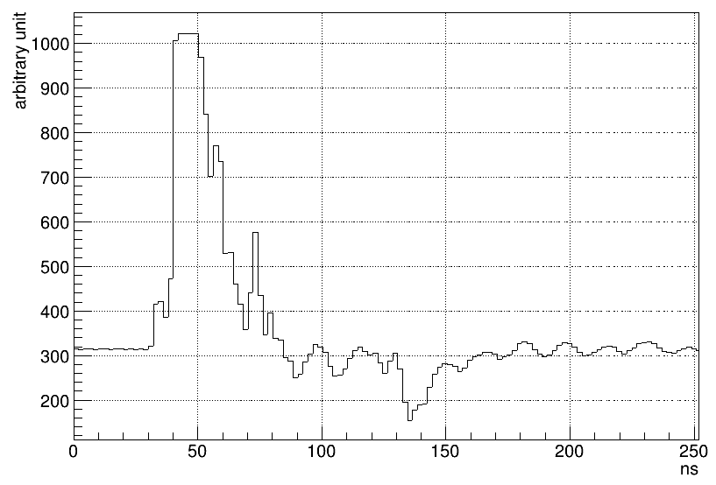
trigger
trigger
hold-off
integral
time window
pre-gate
threshold
baseline

Slide 22
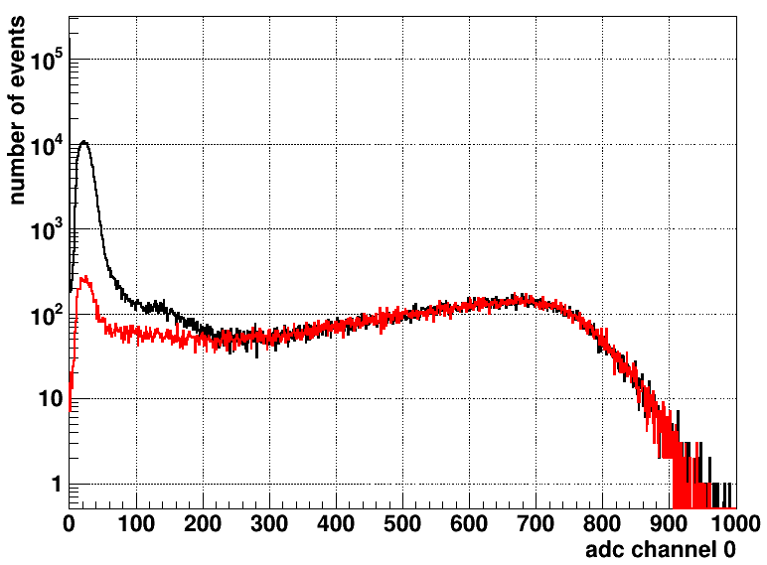
zero peak
— LAB-PPO without coincidence cut
— LAB-PPO with coincidence cut
single p.e. peak
threshold for counting
multiple p.e. peak

Slide 23
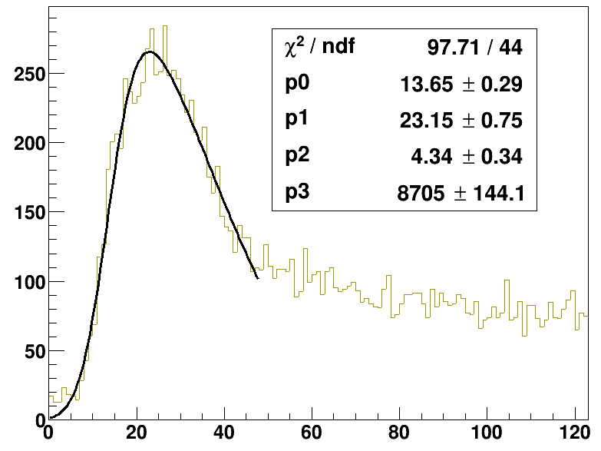
21 Mar 2019

