Slide 1
thesis plots
2019

Slide 2
P₁
P
P₂
L
Ω
T₁
PMT sphere
θ
source
offset
O
time of flight
T₂
Ω'
L'
P'₁
P'₂
P'

Slide 3
a₊
PMT
a₊
PMT
ray-tracer
a₋
vertex
(a)
vertex
(b)
a₋
PMT
PMT
vertex
vertex
(c)
(d)

Slide 4
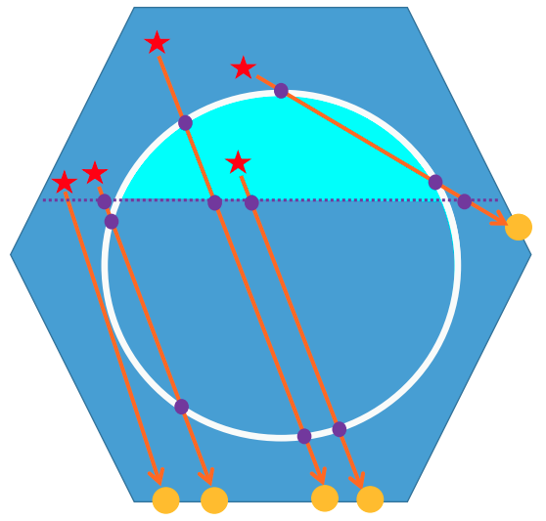
vertex
vertex
vertex

Slide 5
vertex
vertex
C

Slide 6
PMT
PMT
a₊
vertex
vertex
a₃
vertex
a₃
a₃
a₊
a₊
a₃
a₊
PMT
vertex
(a)
(b)
(c)
(d)
PMT
PMT
PMT
vertex
a₃
z₊
a₊
z₊
a₋
z₋
z₋
a₋
vertex
a₃
a₊
a₊
z₋
a₋
z₊
(e)
(f)
(g)
vertex
PMT

Slide 7
a'₊
a'₊
a₊
a'₊
a₊
a'₋
a₋
(a)
(b)
a'₋
a'₊
a₋
a'₊
a₊
a'₋
a'₊
a₊
a₊
a'₋
a₋

Slide 8
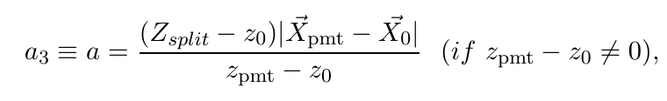
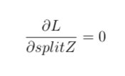
a₃
PMT
vertex
vertex
PMT
vertex
PMT
vertex
PMT

Slide 9

d_{neck}
d_{AV}

Slide 12
SkyShine

Slide 13
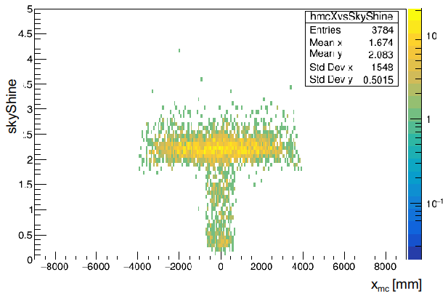
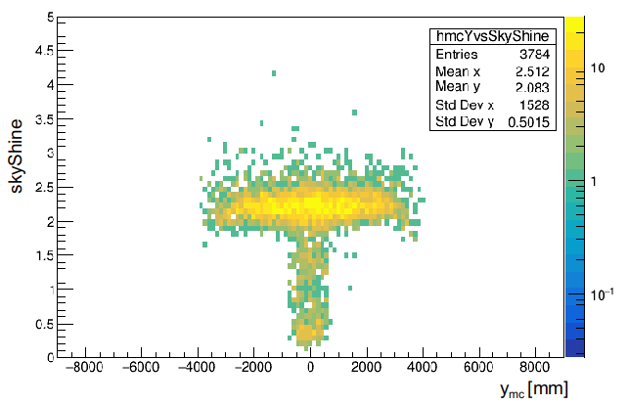

Slide 14
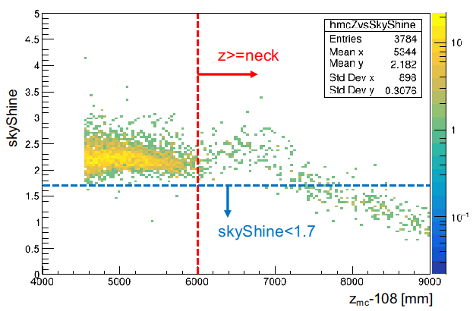

Slide 15
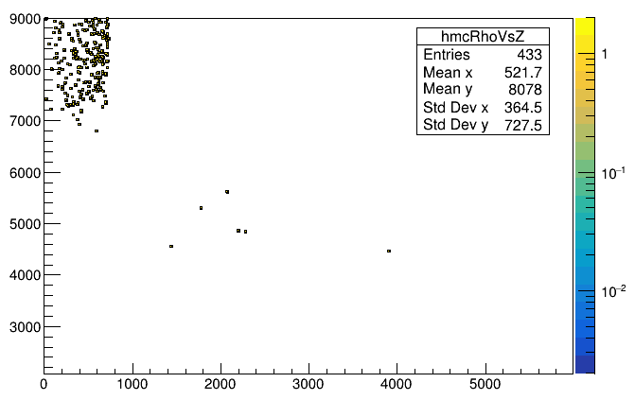
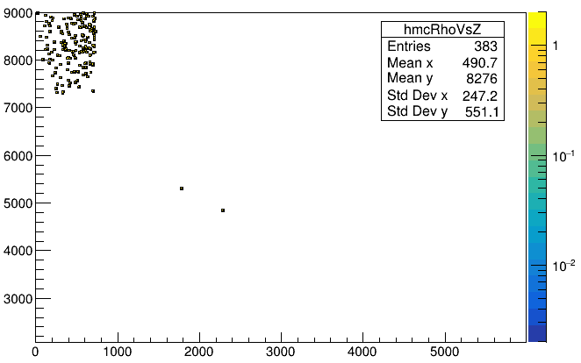
skyShine<1.7
Mostly are high neck region events
z_{mc}-108 [mm]
mis-tagged events
skyShine<1.5
Mostly are high neck region events
sqrt(x²_{mc}+y²_{mc}) [mm]
z_{mc}-108 [mm]
mis-tagged events
sqrt(x²_{mc}+y²_{mc}) [mm]

Slide 16
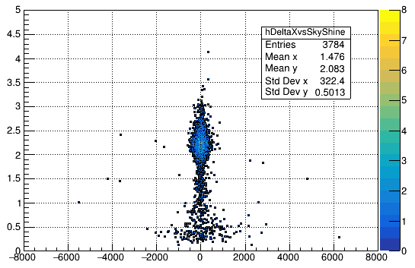
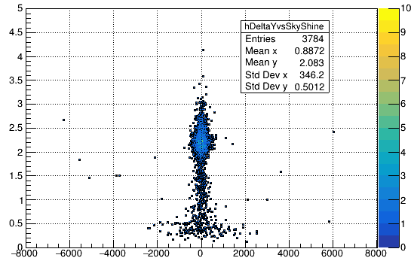
skyShine
skyShine
x_{fit} - x_{mc} [mm]
y_{fit} - y_{mc} [mm]

Slide 17
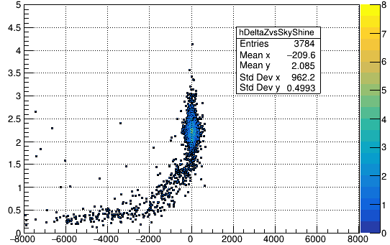
skyShine
z_{fit} - z_{mc} [mm]

Slide 18
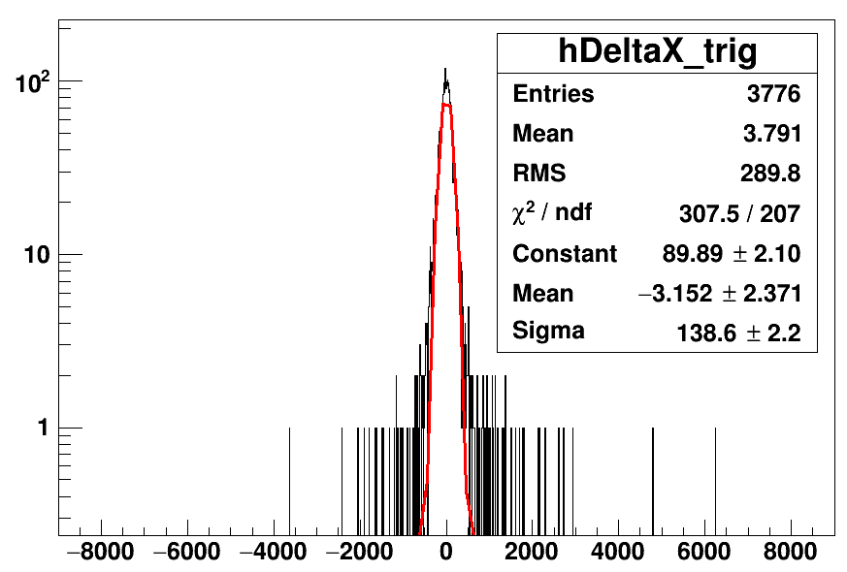
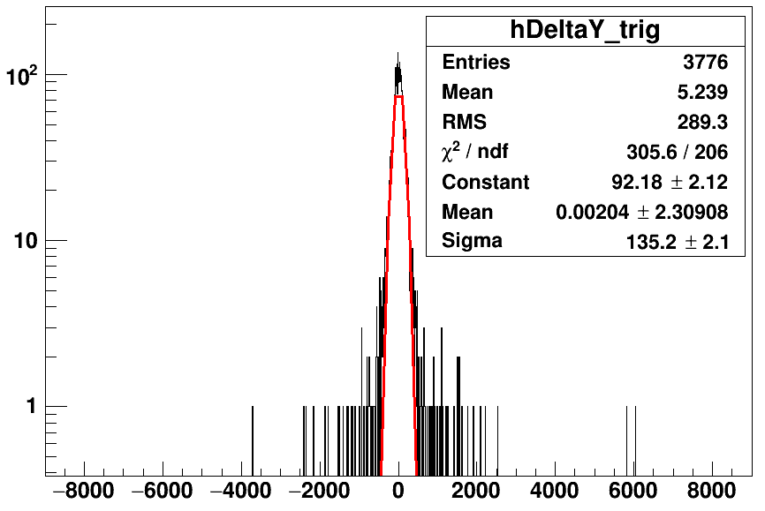
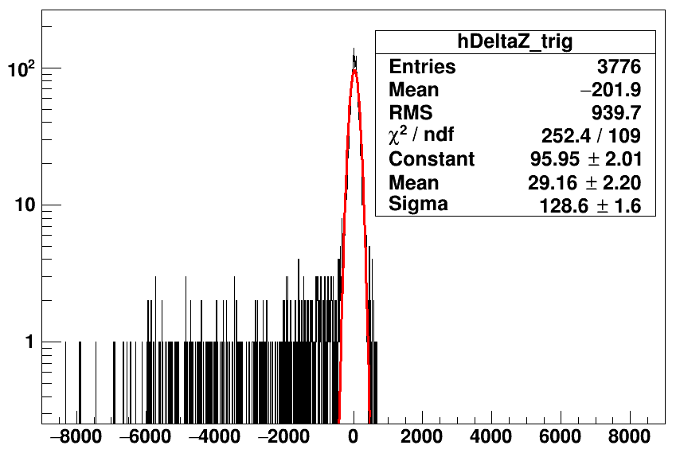
counts
counts
x_{fit} - x_{mc} [mm]
y_{fit} - y_{mc} [mm]
counts
Tl208 partialFill without cuts
z_{fit} - z_{mc} [mm]

Slide 19
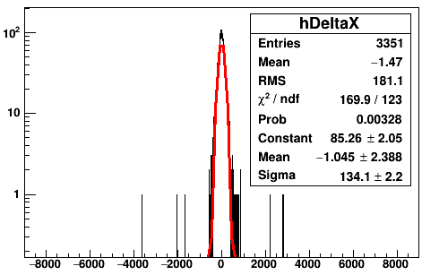
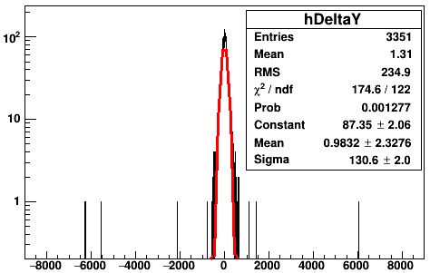
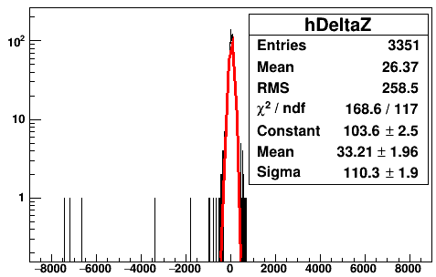
counts
counts
skyShine>1.7
skyShine>1.7
x_{fit} - x_{mc} [mm]
y_{fit} - y_{mc} [mm]
counts
skyShine>1.7
z_{fit} - z_{mc} [mm]

Slide 20
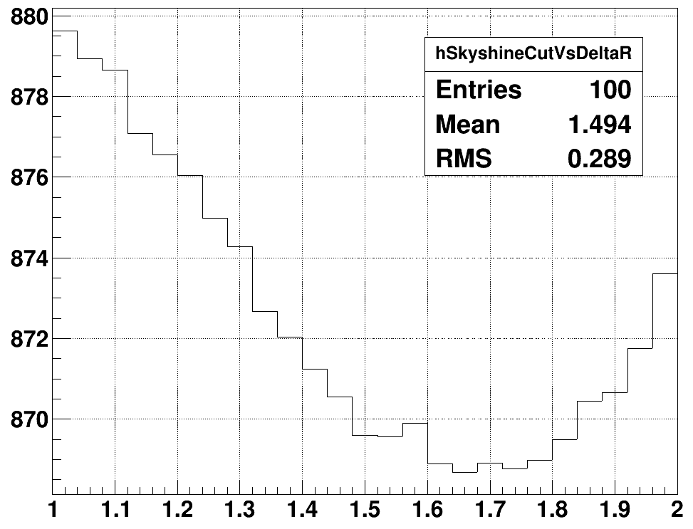
ΔR [mm]
1.65 (minimum)
1.75
skyShine

Slide 21
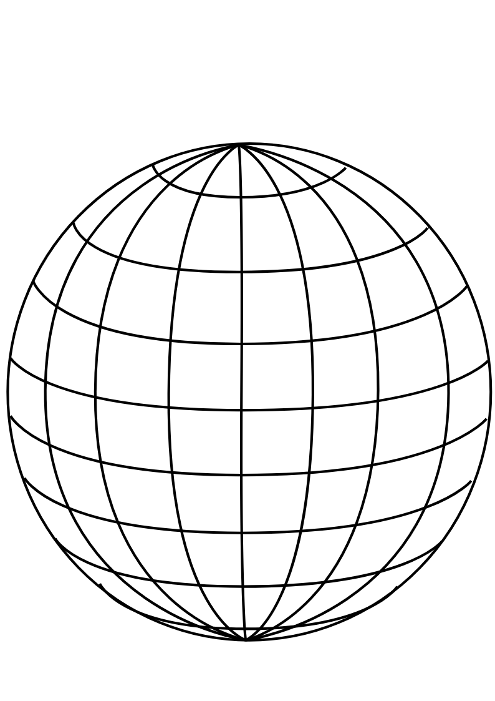
PMT
panel
Uniform Selector
PMT sphere
http://www.downloadclipart.net/download/5816/big-blue-wire-globe-svg

Slide 22
tuning group velocity
PMT hits
Cherenkov
cone
u
PMT sphere
actual event position
pulled event position

Slide 23
drive correction
early hits
late hits
Cherenkov
cone
u
PMT sphere
pulled event position
actual event position

Slide 24
u_{fit}
p₁
X_{fit}
X_{cor}
p₀
O
PMT sphere

Slide 25
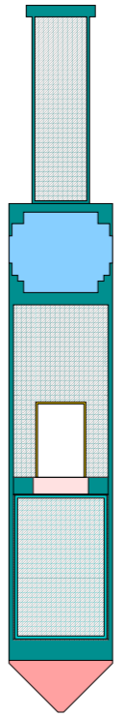

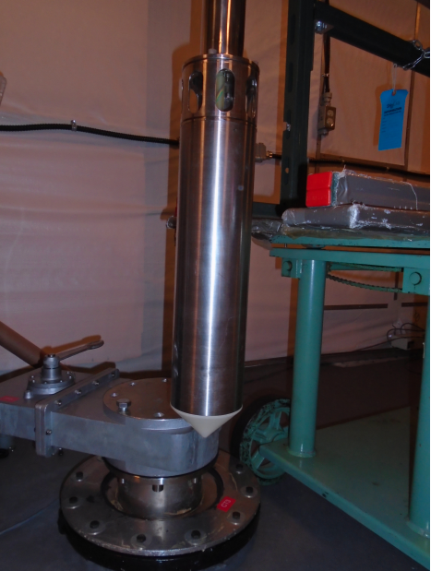
Stainless steel weight cylinder
“Lighthouse” gap, contains
material from scintillator volume
25.3 cm
Stainless steel container
PMT for tagging
Acrylic window
¹⁶N gas decay chamber
Plastic scintillator
Polyethelene bumper cone
5.7 cm

Slide 26
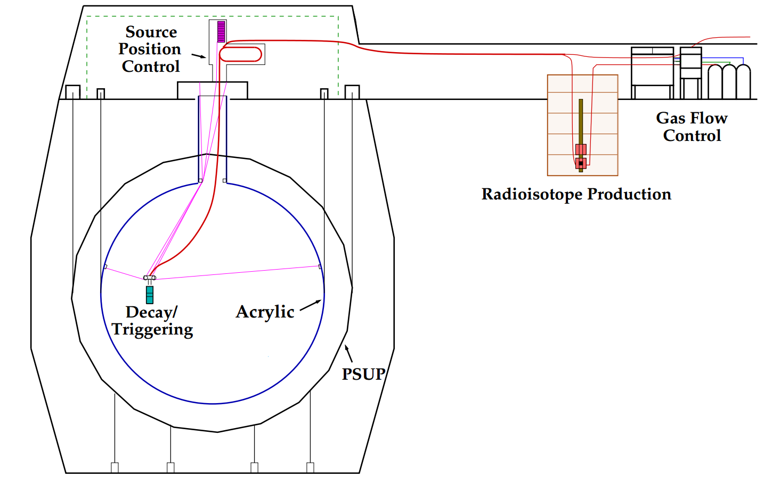
H₂O
H₂O
H₂O
hamer

Slide 27
β₁₄
fitted event position
r_{i}
fitted event direction
θ_{ij}
r_{j}

Slide 28
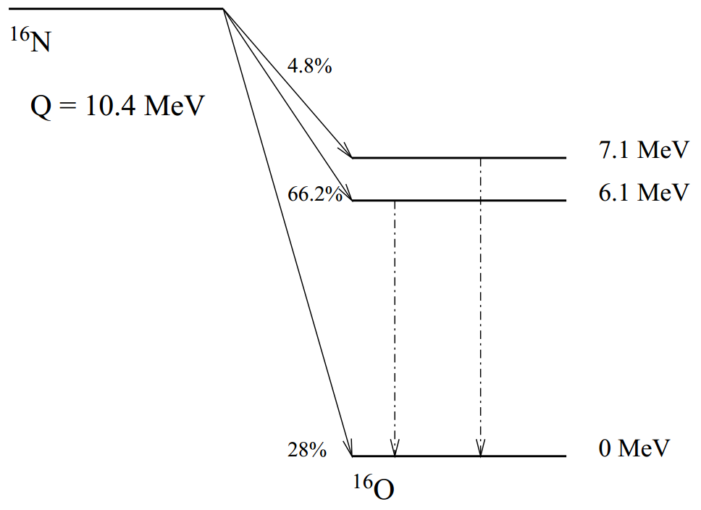
γ-rays

Slide 29
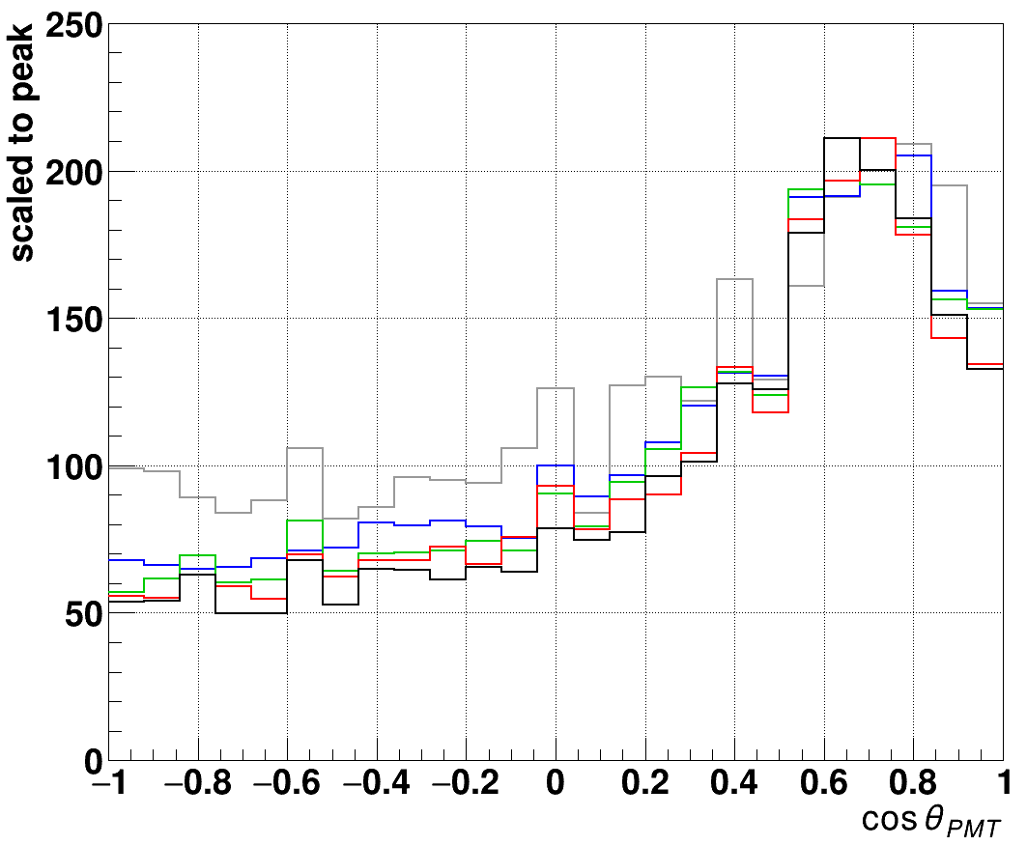
— 5 MeV
— 4 MeV
— 3 MeV
— 2.5 MeV
— 1 MeV

Slide 30
¹⁶N source
distance
γ-rays
reconstructed
event position
Compton
scattering
e⁻
θ_{PMT}
PMT

Slide 31
stainless steel
container
scintillation vial
PMT #1
PMT #2
plastic piece
stainless steel stand
¹³⁷Cs source
dark box
HV
connector
HV supply
computer
signal/HV
split box
signal/HV
split box
amplifier
amplifier
CAEN
digitizer

Slide 32
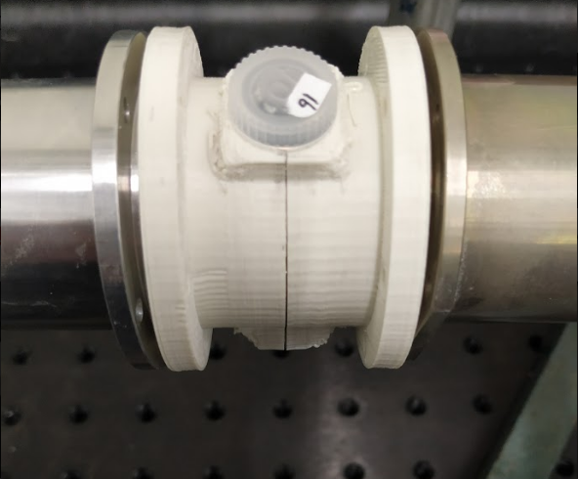
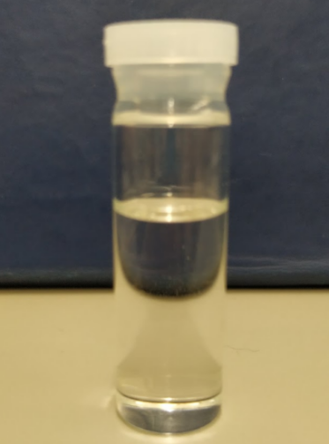
scintillation
vial
49.4 mm
14.3 mm
stainless steel
PMT container
plastic holder
30 mm

Slide 33
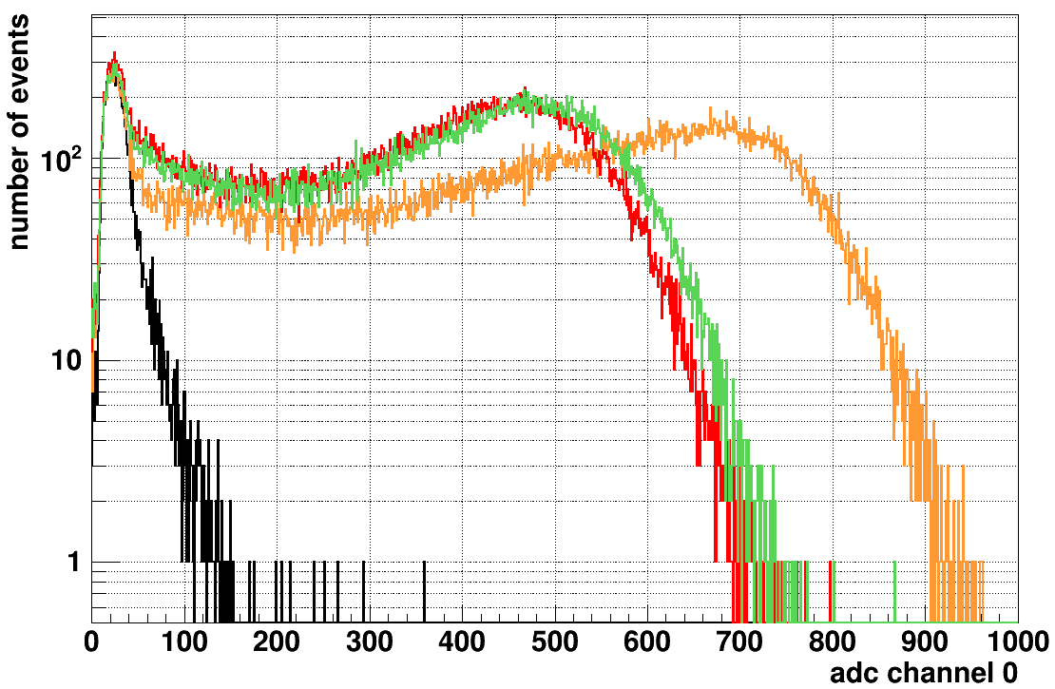
— LAB-PPO
— TeSOP
— TeDDA
— background

Slide 34
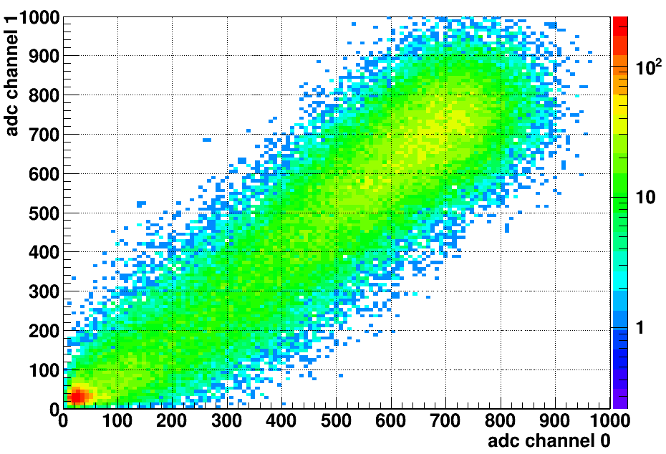
LAB-PPO
multiple p.e.
peak
single p.e.
peak

Slide 36
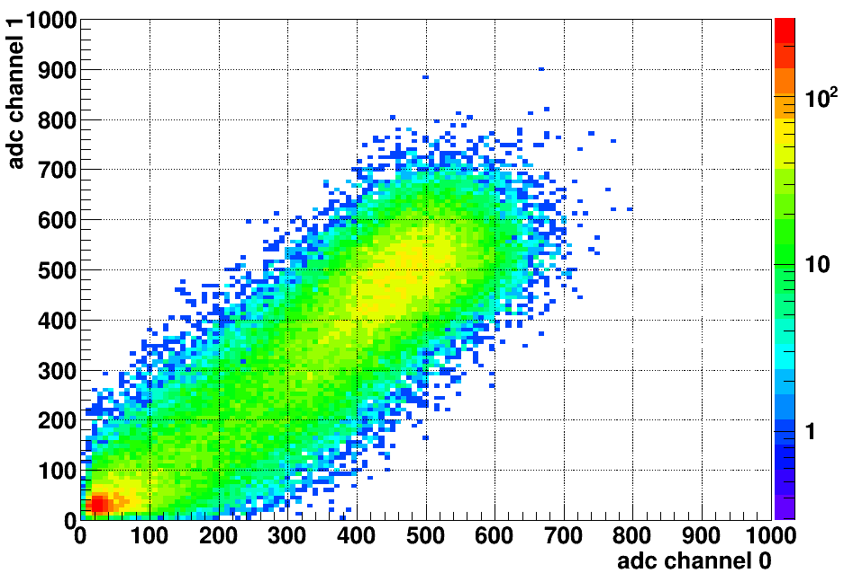
TeDDA

Slide 37
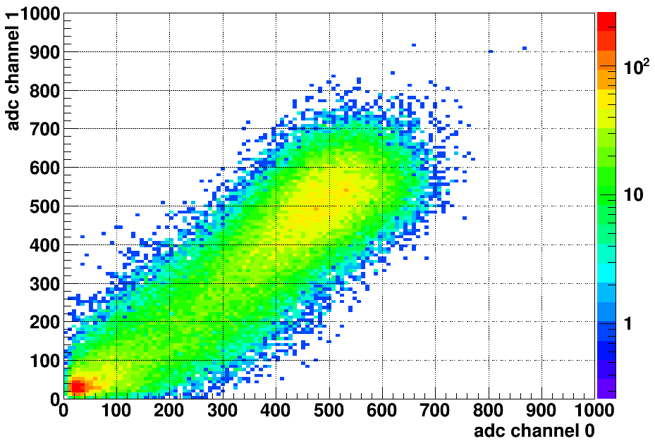
TeSOP

Slide 38
(a)
(b)
LAB-PPO
TeSOP
single p.e. peak
multiple p.e. peak
(c)
(d)
TeDDA
— LAB-PPO
— TeSOP
— TeDDA
— background

Slide 39
(a)
(b)
LAB-PPO
Te_P1
single p.e. peak
multiple p.e. peak
(c)
(d)
Te_P3
— LAB-PPO
— Te_P1
— Te_P3
— background
This is for publish paper

Slide 40
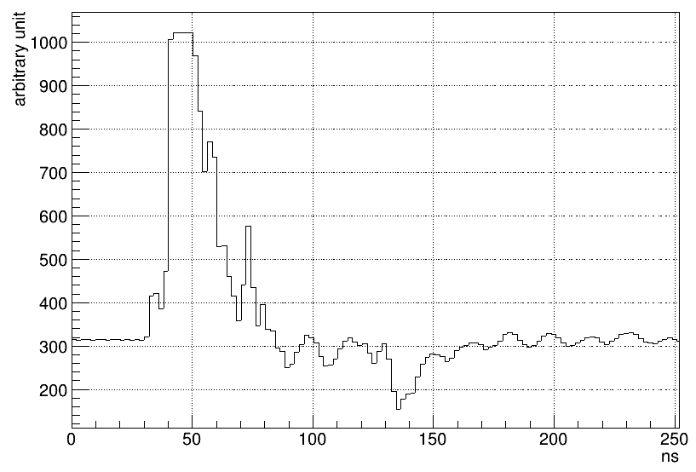
trigger
trigger
hold-off
integral
time window
pre-gate
threshold
baseline

Slide 41
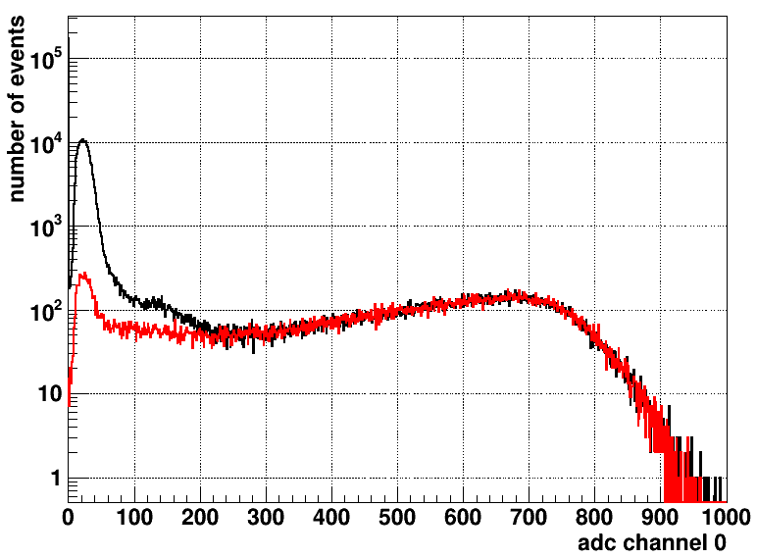
zero peak
— LAB-PPO without coincidence cut
— LAB-PPO with coincidence cut
single p.e. peak
threshold for counting
multiple p.e. peak

Slide 42
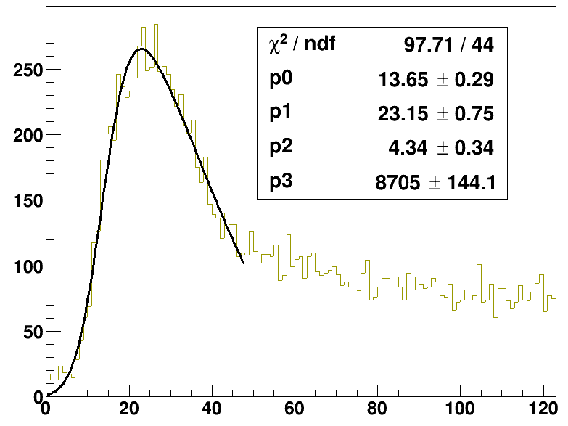
21 Mar 2019

