Slide 1
thesis plots
2019

Slide 2
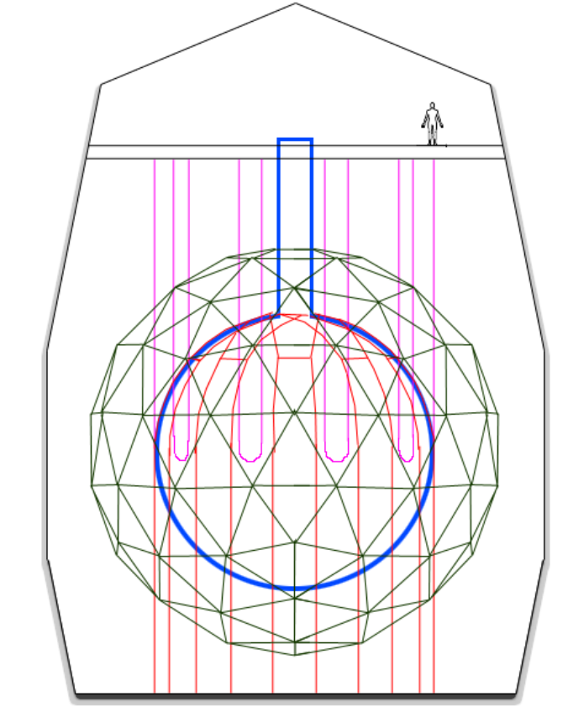
Deck
Neck
Hold-up ropes
PMT support structure
Rock cavity
Acrylic vessel
Hold-down ropes

Slide 3
pp
pep
p + p → ²H + e⁺ + ν_{e}
p + e⁻ + p → ²H + ν_{e}
99.76%
0.24%
²H + p → ³He + γ
84.6%
15.4%
2.5x10⁻⁵%
hep
³He + ³He → ⁴He + 2p
³He + ⁴He → ⁷Be + γ
³He + p → ⁴He + e⁺ + ν_{e}
pp-I
99.89%
⁷Be
0.11%
⁷Be + e⁻ → ⁷Li + ν_{e}
⁷Be + p → ⁸B + γ
⁸B
⁷Li + p → 2 ⁴He
⁸B → ⁸Be* + e⁺ + ν_{e}
pp-II
pp-III

Slide 4
¹³C
¹³C + p → ¹⁴N + γ
¹⁴N
¹⁷O + p → ¹⁴N + ⁴He
¹⁷O
¹³N → ¹³C + e⁺ + ν_{e}
¹⁴N + p → ¹⁵O + γ
¹⁷F → ¹⁷O + e⁺ + ν_{e}
CN
NO
¹²C + p → ¹³N + γ
¹⁵O→ ¹⁵N + e⁺ + ν_{e}
¹⁶O + p → ¹⁷F + γ
¹²C
¹⁵N + p → ¹²C + ⁴He
¹⁵N
¹⁵N + p → ¹⁶O + γ
¹⁶O

Slide 6
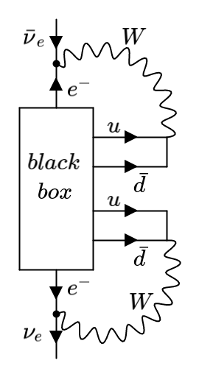
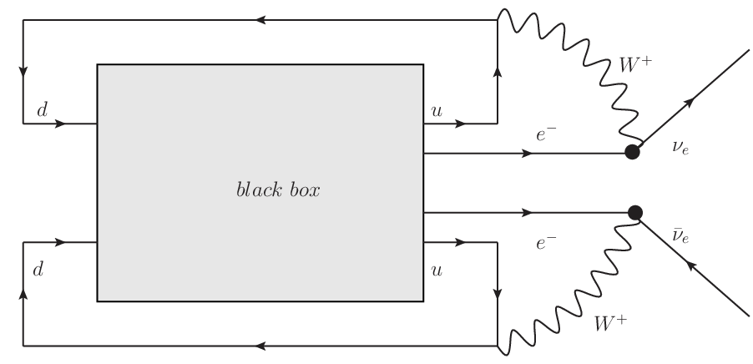

Slide 7
P₁
P
P₂
L
Ω
T₁
PMT sphere
θ
source
offset
O
time of flight
T₂
Ω'
L'
P'₁
P'₂
P'

Slide 8
a₊
PMT
a₊
PMT
ray-tracer
a₋
vertex
(a)
vertex
(b)
a₋
PMT
PMT
vertex
vertex
(c)
(d)

Slide 9
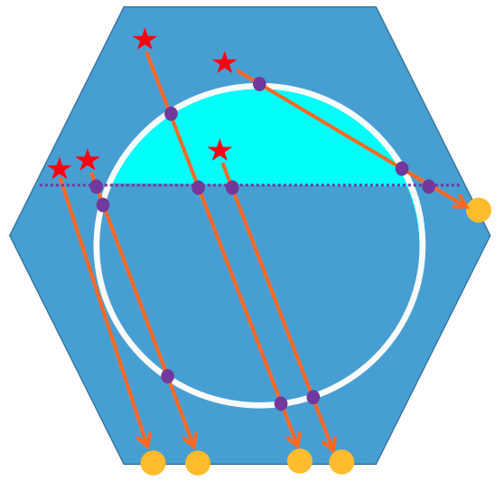
vertex
vertex
vertex

Slide 10

d_{neck}
d_{AV}

Slide 11
PMT
PMT
a₊
vertex
vertex
a₃
vertex
a₃
a₃
a₊
a₊
a₃
a₊
PMT
vertex
(a)
(b)
(c)
(d)
PMT
PMT
PMT
vertex
a₃
z₊
a₊
z₊
a₋
z₋
z₋
a₋
vertex
a₃
a₊
a₊
z₋
a₋
z₊
(e)
(f)
(g)
vertex
PMT

Slide 12
a'₊
a'₊
a₋
a'₊
a₊
a'₋
a₊
a'₊
(a)
(b)
(c)
(d)
a₊
a'₋
a'₊
a'₊
a'₊
a₊
a'₋
a₋
a₋
a'₋
a'₊
a₊
a₊
a'₋
a₋
(e)
(f)
(g)
(h)

Slide 13
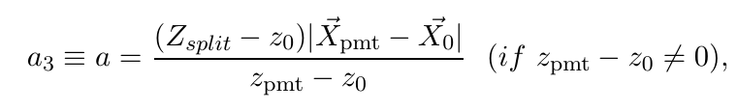
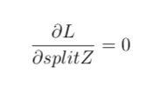
a₃
PMT
vertex
vertex
PMT
vertex
PMT
vertex
PMT

Slide 14
Hough transformation
X_{PMT}
θ_{Ch}
X₀
X₀

Slide 15
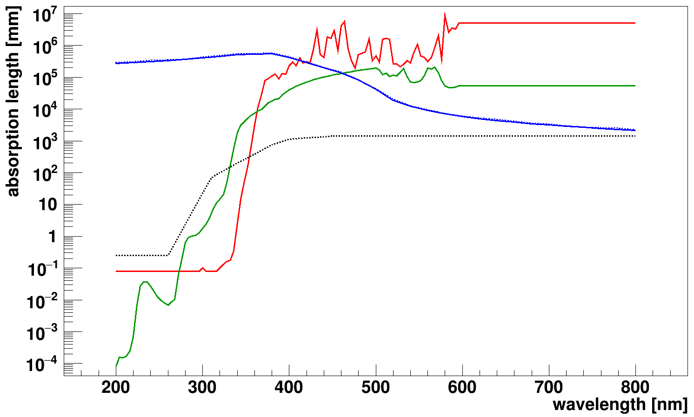
ＬＡＢＰＰＯ
— LAB
— PPO
--- Acrylic
— SNO+ internal water
--- SNO+ external water

Slide 17
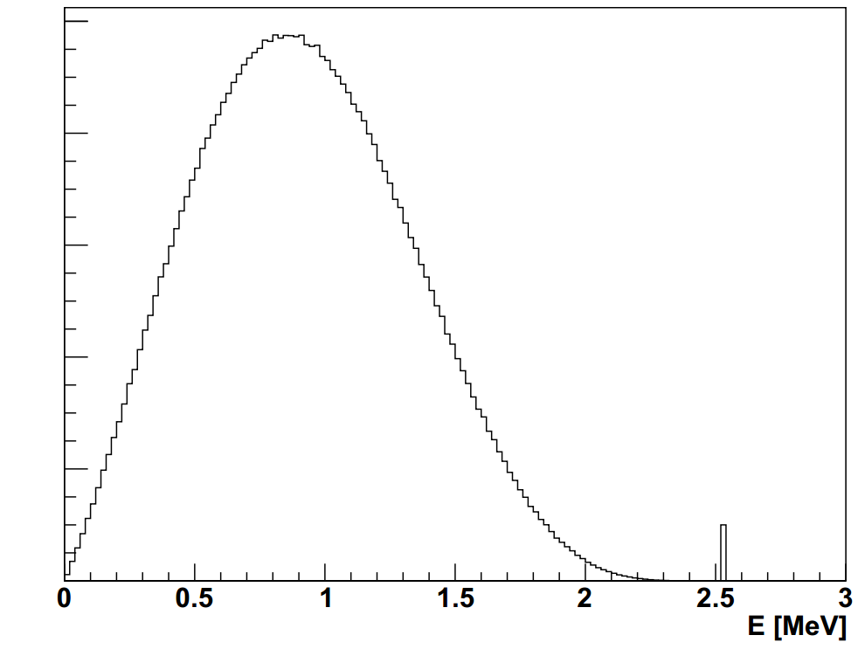
2νββ
counts
0νββ

Slide 18
SkyShine

Slide 19
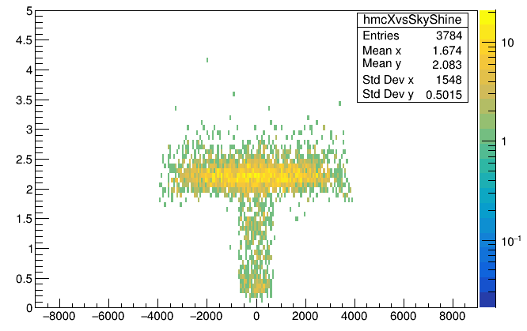
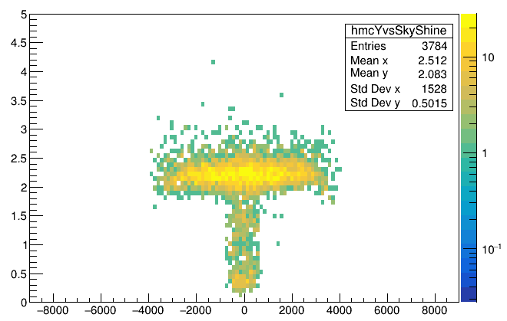
skyShine
x_{mc} [mm]
skyShine
y_{mc} [mm]

Slide 20
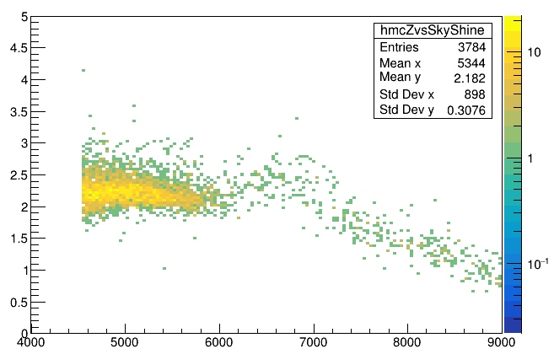
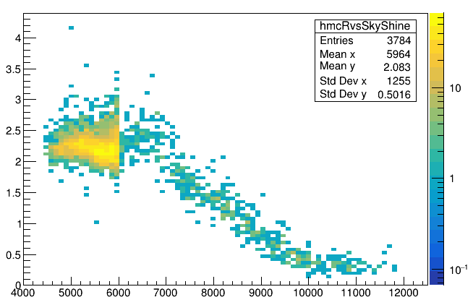
z>=neck
skyShine
skyShine<1.7
z_{mc}-108 [mm]
skyShine
skyShine<1.7
sqrt(x²_{mc}+y²_{mc}+(z_{mc}-108)²) [mm]

Slide 21
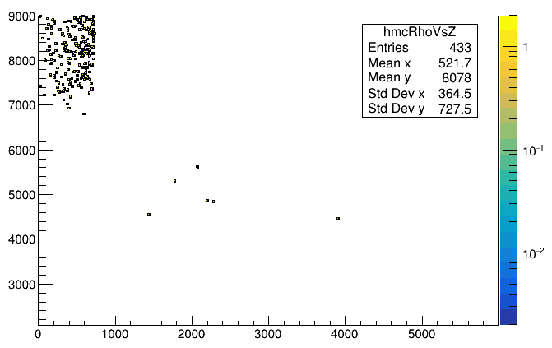
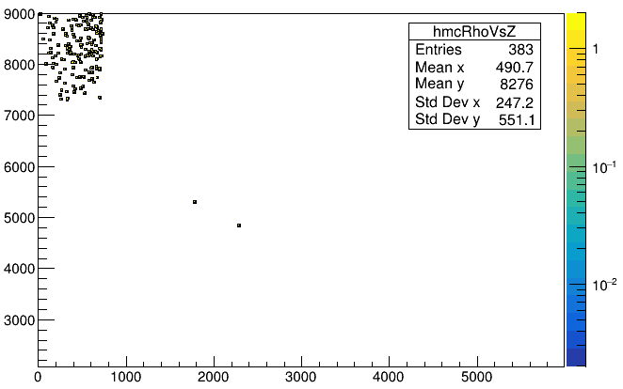
skyShine<1.7
Mostly are high neck region events
z_{mc}-108 [mm]
mis-tagged events
skyShine<1.5
Mostly are high neck region events
sqrt(x²_{mc}+y²_{mc}) [mm]
z_{mc}-108 [mm]
mis-tagged events
sqrt(x²_{mc}+y²_{mc}) [mm]

Slide 22
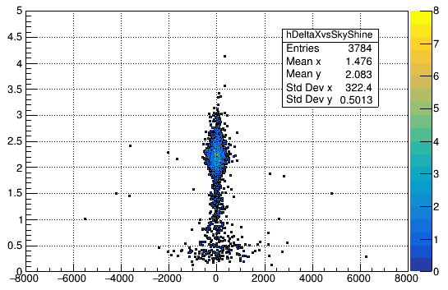
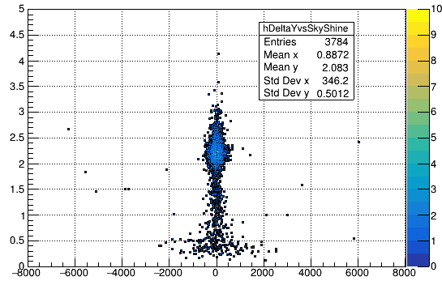
skyShine
skyShine
x_{fit} - x_{mc} [mm]
y_{fit} - y_{mc} [mm]

Slide 23
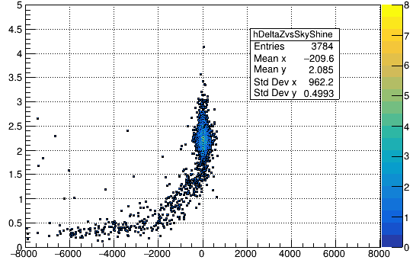
skyShine
z_{fit} - z_{mc} [mm]

Slide 24
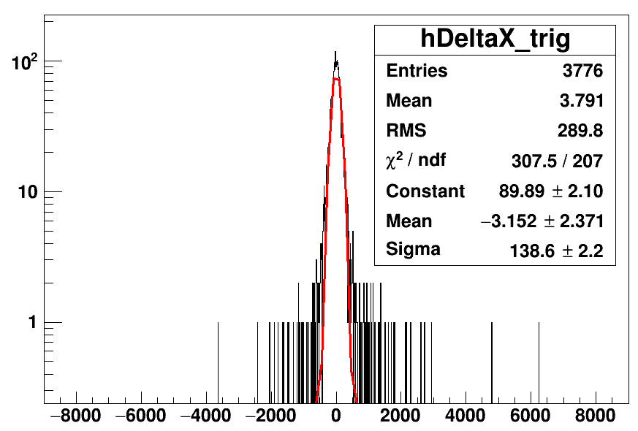
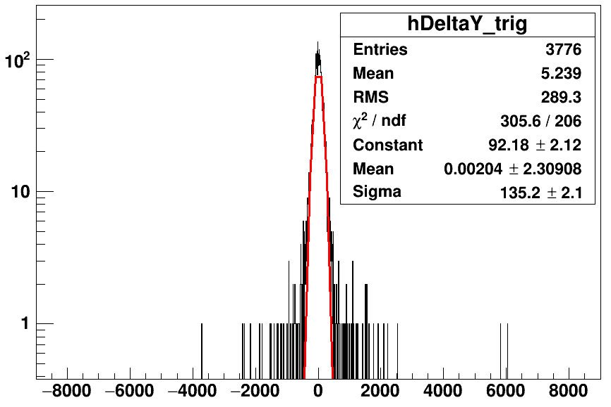
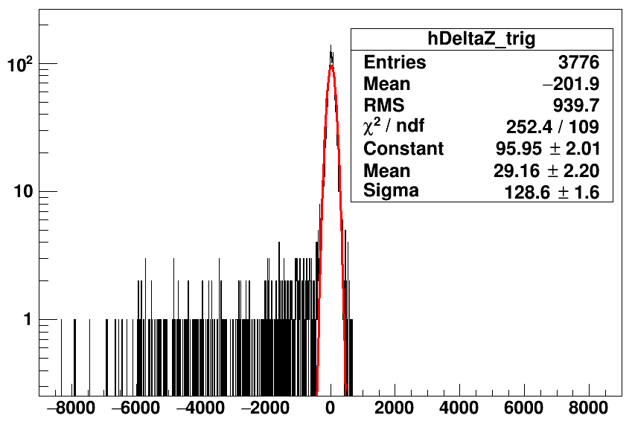
counts
counts
x_{fit} - x_{mc} [mm]
y_{fit} - y_{mc} [mm]
counts
Tl208 partialFill without cuts
z_{fit} - z_{mc} [mm]

Slide 25
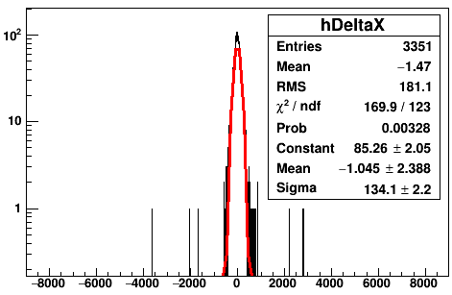
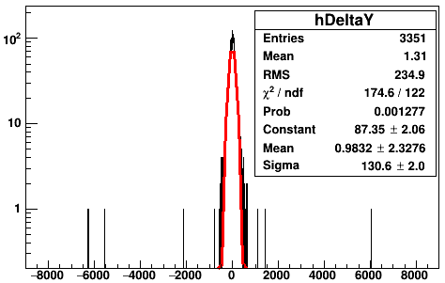
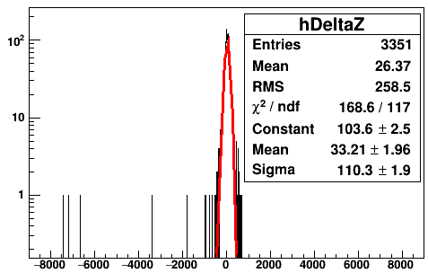
counts
counts
skyShine>1.7
skyShine>1.7
x_{fit} - x_{mc} [mm]
y_{fit} - y_{mc} [mm]
counts
skyShine>1.7
z_{fit} - z_{mc} [mm]

Slide 26
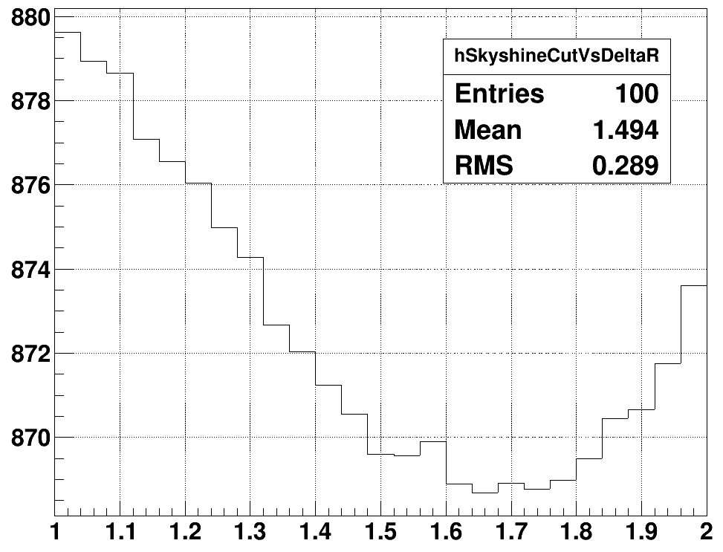
ΔR [mm]
1.65 (minimum)
1.75
skyShine

Slide 27
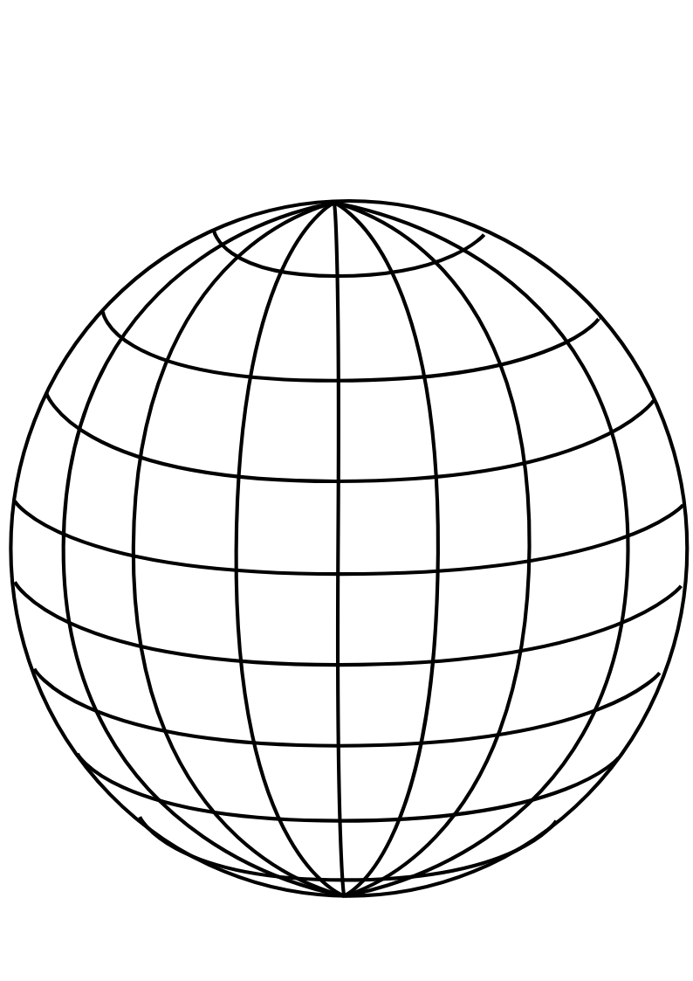
PMT
panel
Uniform Selector
PMT sphere
http://www.downloadclipart.net/download/5816/big-blue-wire-globe-svg

Slide 28
tuning group velocity
PMT hits
Cherenkov
cone
u
PMT sphere
actual event position
pulled event position

Slide 29
drive correction
early hits
late hits
Cherenkov
cone
u
PMT sphere
pulled event position
actual event position

Slide 30
u_{fit}
p₁
X_{fit}
X_{cor}
p₀
O
PMT sphere

Slide 31
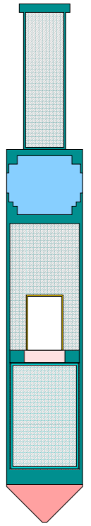

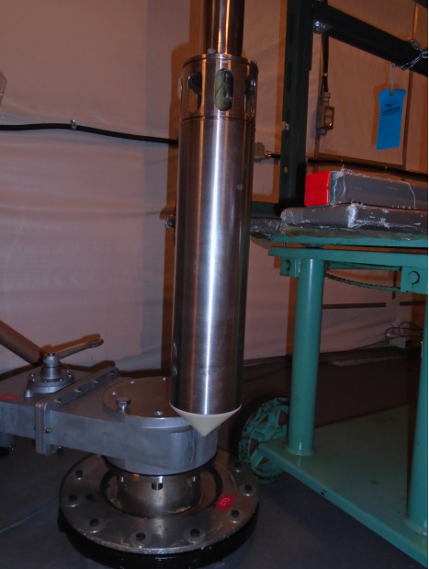
Stainless steel weight cylinder
“Lighthouse” gap, contains
material from scintillator volume
25.3 cm
Stainless steel container
PMT for tagging
Acrylic window
¹⁶N gas decay chamber
Plastic scintillator
Polyethelene bumper cone
5.7 cm

Slide 32
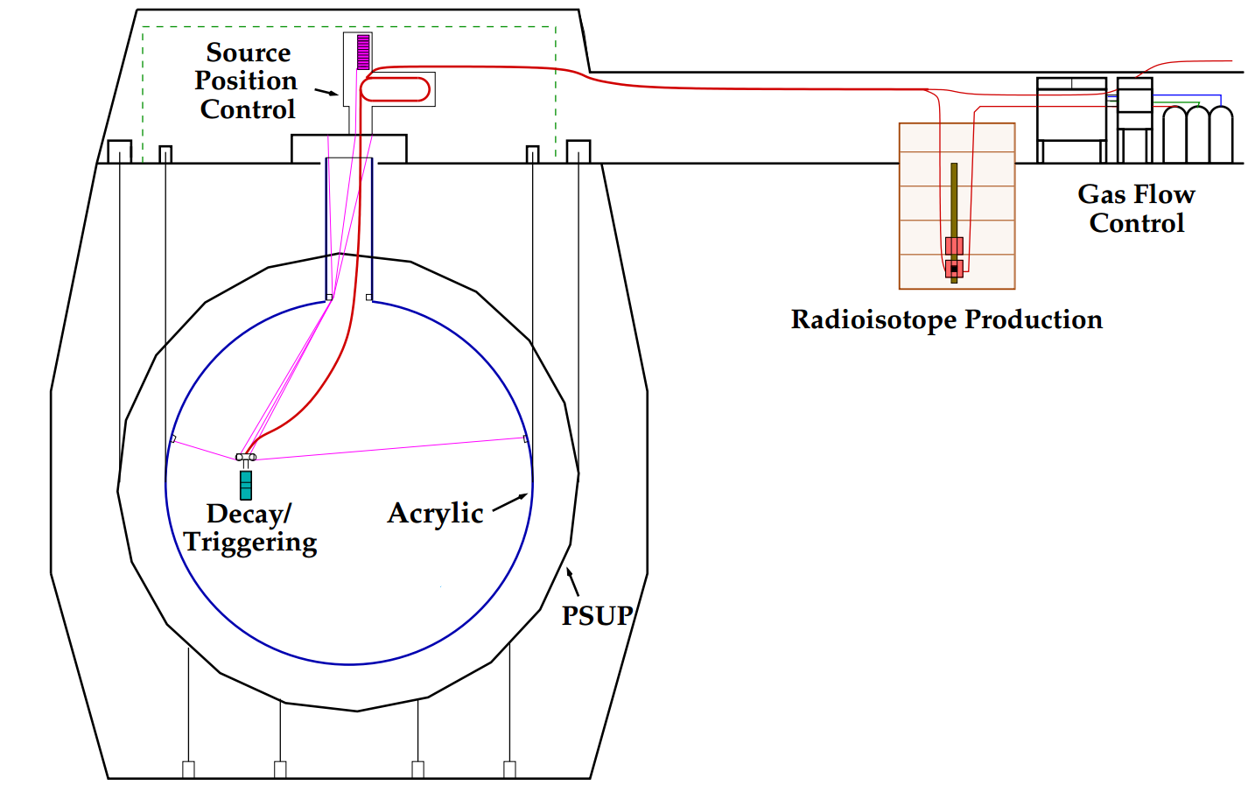
H₂O
H₂O
H₂O
hamer

Slide 34
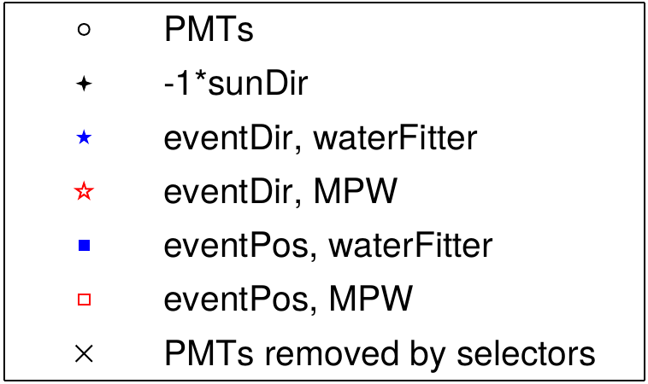

Slide 35
β₁₄
fitted event position
r_{i}
fitted event direction
θ_{ij}
r_{j}

Slide 36
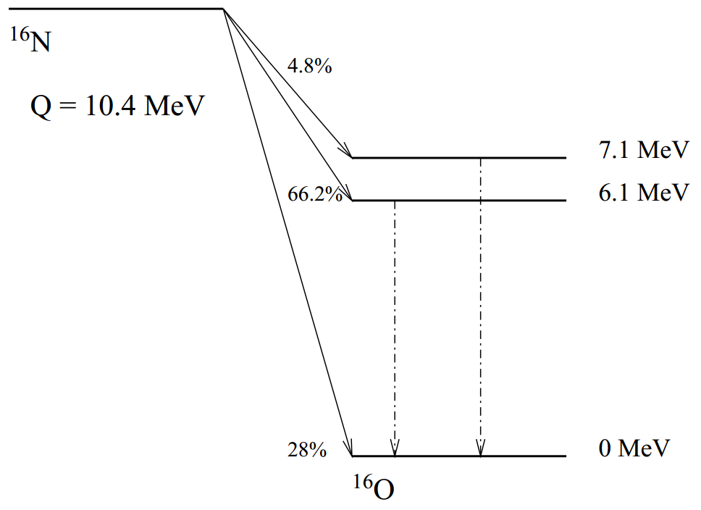
γ-rays

Slide 37
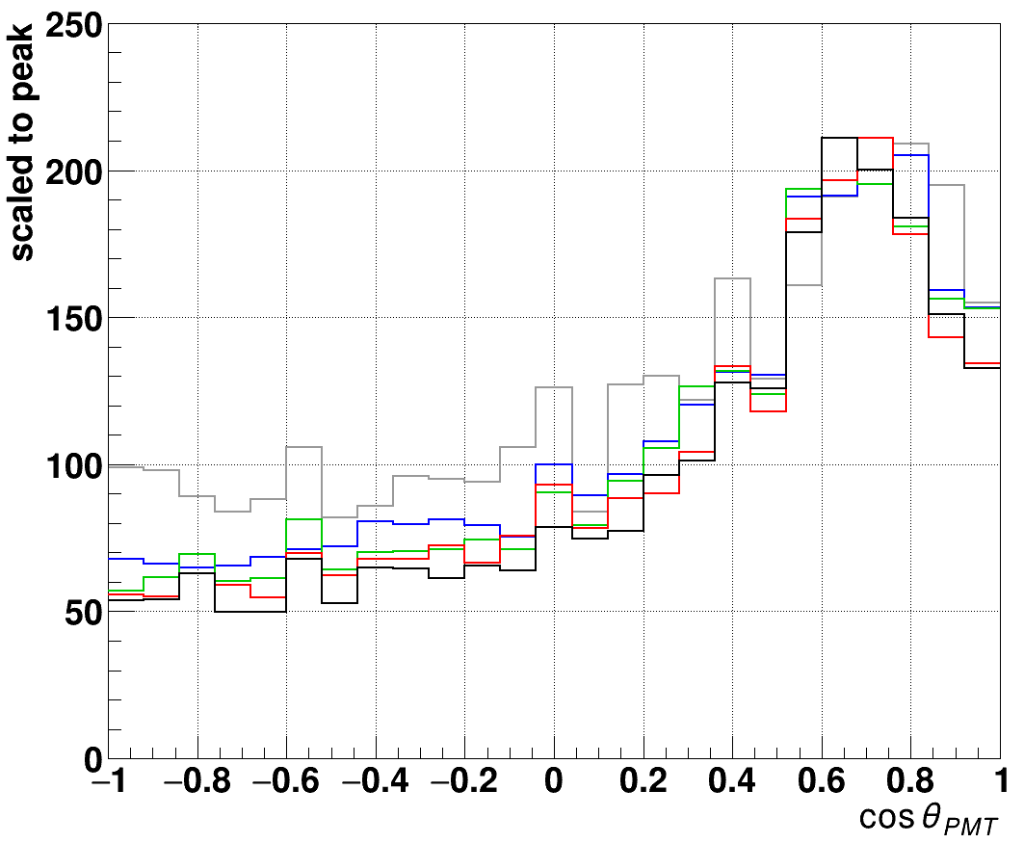
— 5 MeV
— 4 MeV
— 3 MeV
— 2.5 MeV
— 1 MeV

Slide 38
¹⁶N source
distance
γ-rays
reconstructed
event position
Compton
scattering
e⁻
θ_{PMT}
PMT

Slide 39
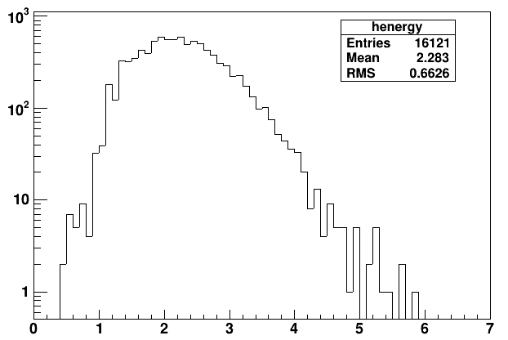
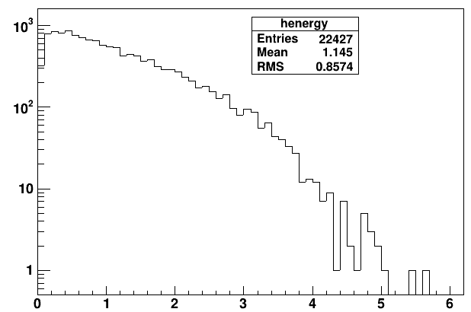
6.17.6
6.5.2
output->Draw("energy>>henergy","waterFit && ( ((dcApplied & 0xFB0000017FFE) & dcFlagged) == (dcApplied & 0xFB0000017FFE) )")

Slide 40
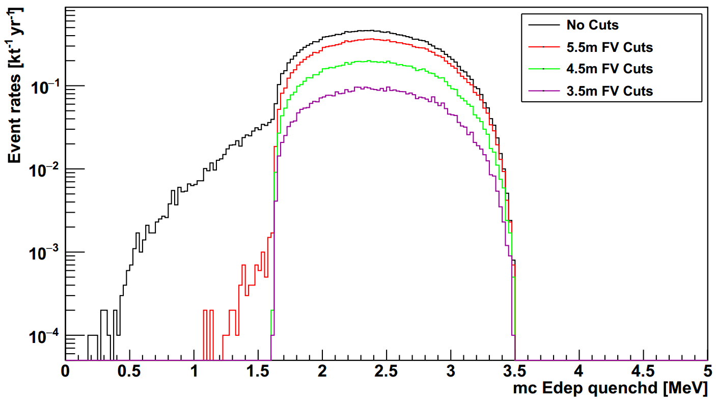
muon induced
10C

Slide 41
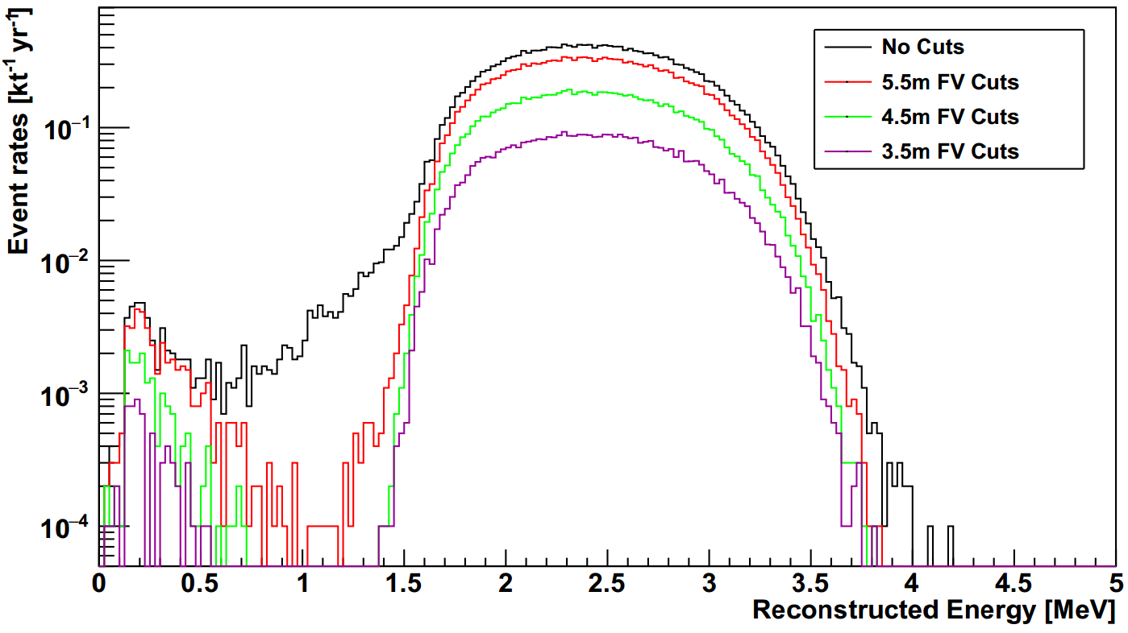
10C

Slide 42
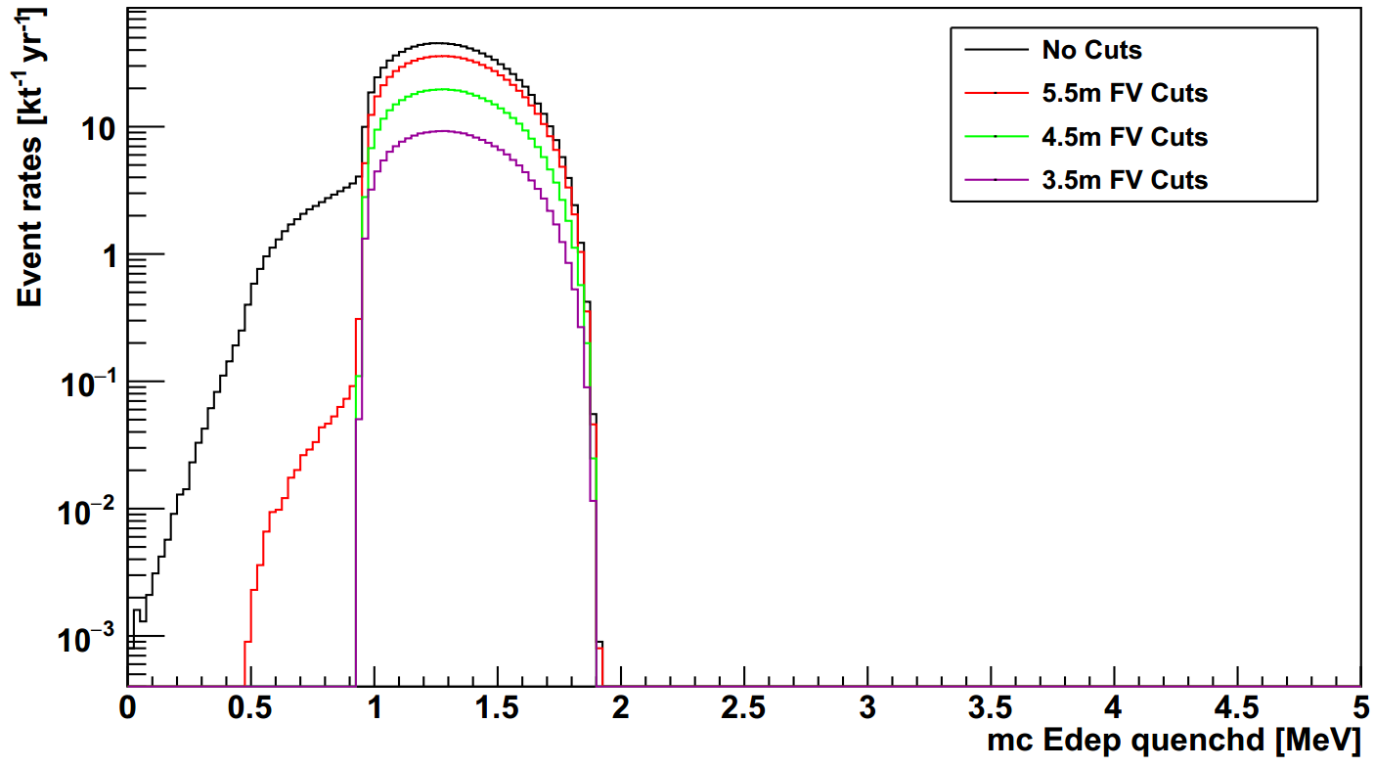
11C

Slide 43
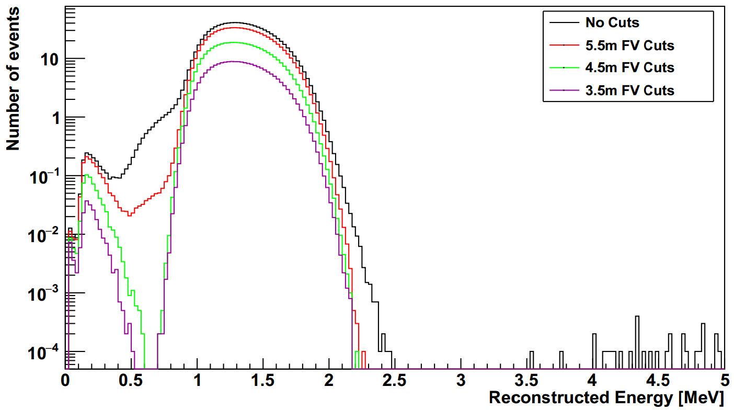
11C

Slide 44
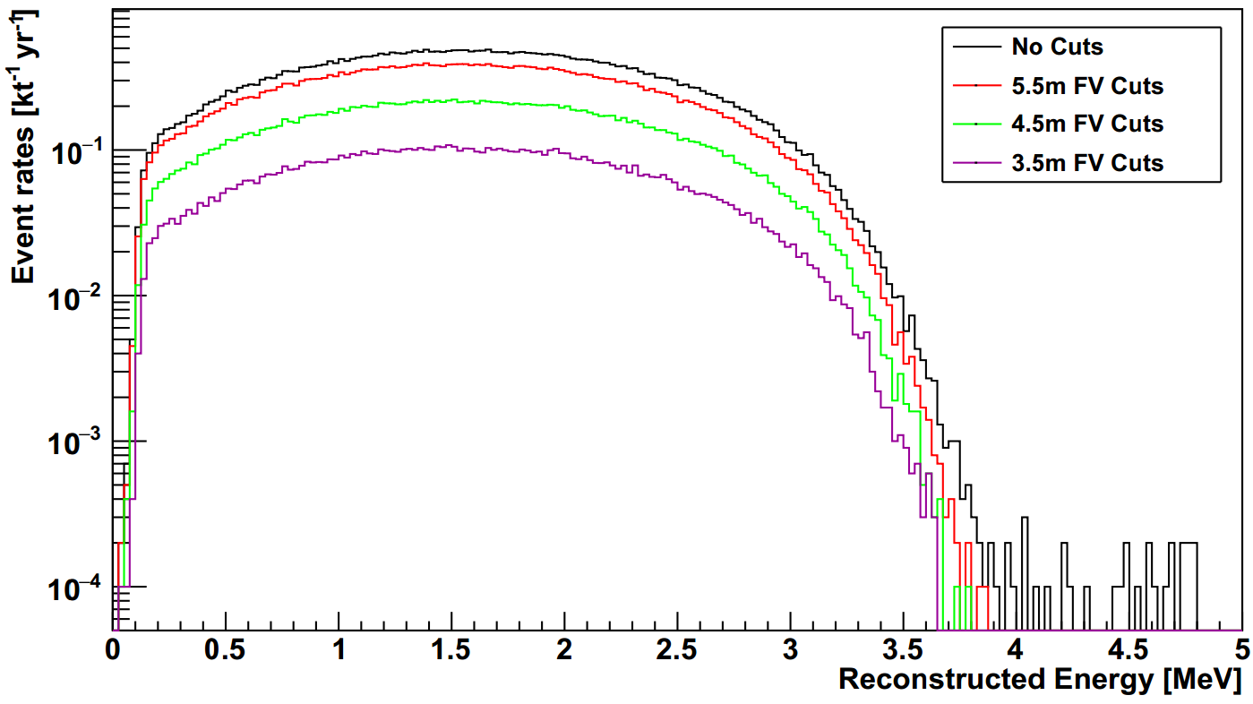
6He

Slide 45
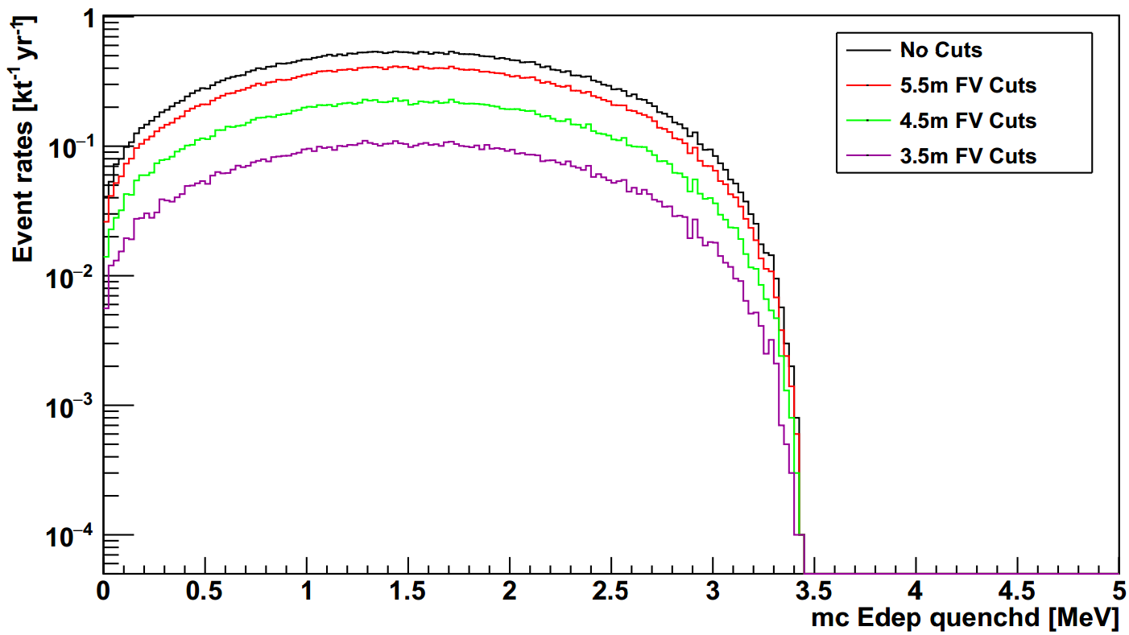
6He

Slide 46

Solar phase
11C

Slide 47
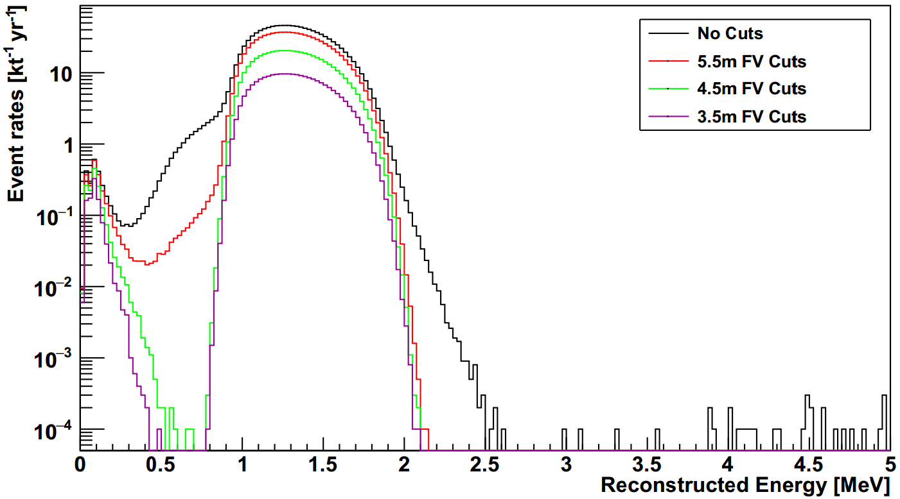

Slide 48
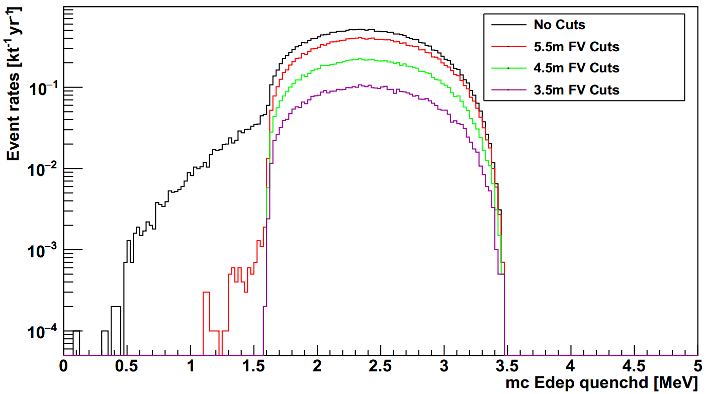

Slide 49
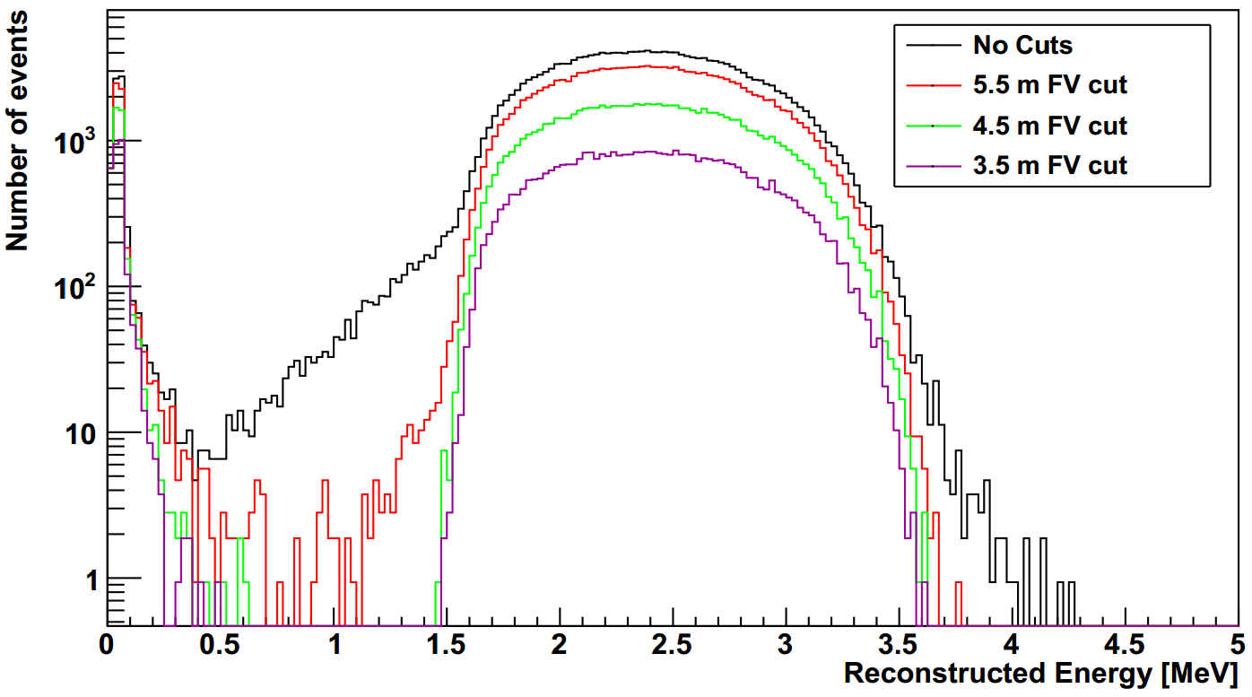

Slide 50
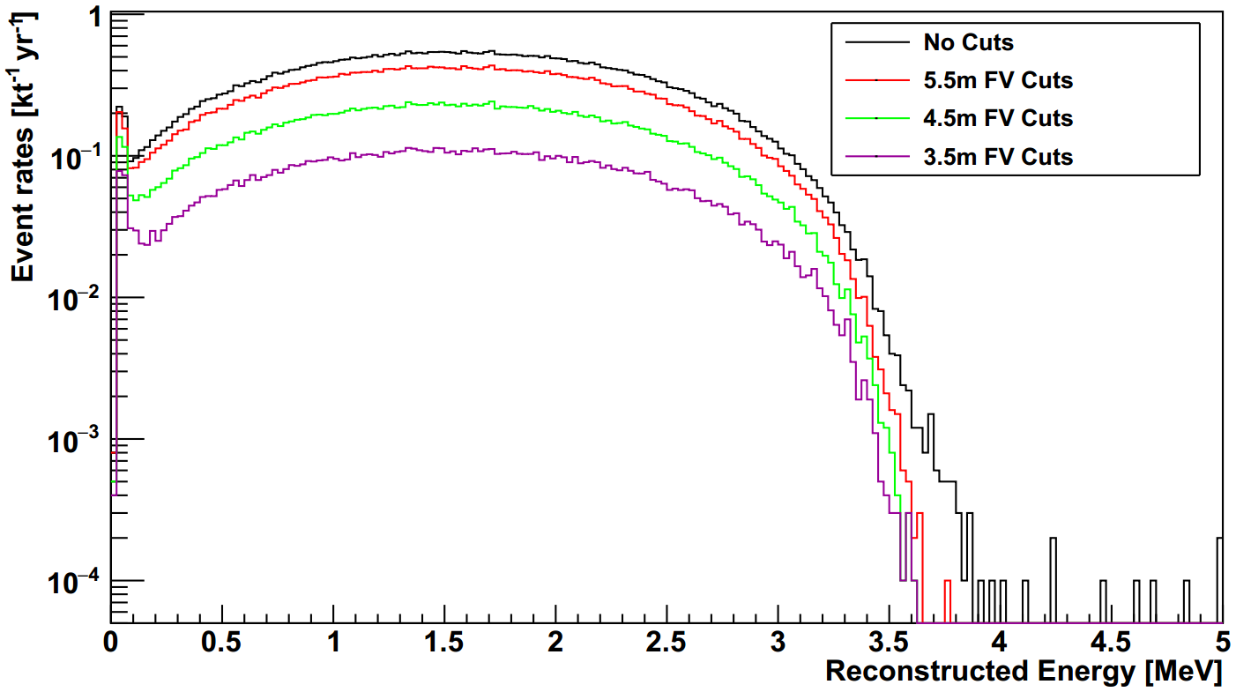

Slide 51
stainless steel
container
scintillation vial
PMT #1
PMT #2
plastic piece
stainless steel stand
¹³⁷Cs source
dark box
HV
connector
HV supply
computer
signal/HV
split box
signal/HV
split box
amplifier
amplifier
CAEN
digitizer

Slide 52
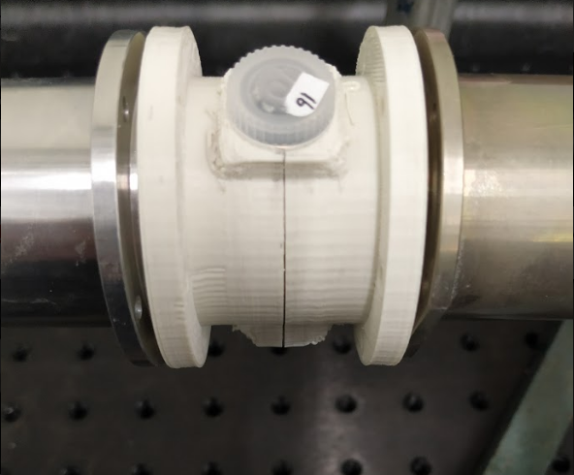
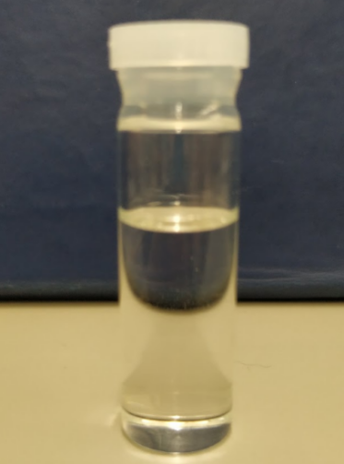
scintillation
vial
49.4 mm
14.3 mm
stainless steel
PMT container
plastic holder
30 mm

Slide 53
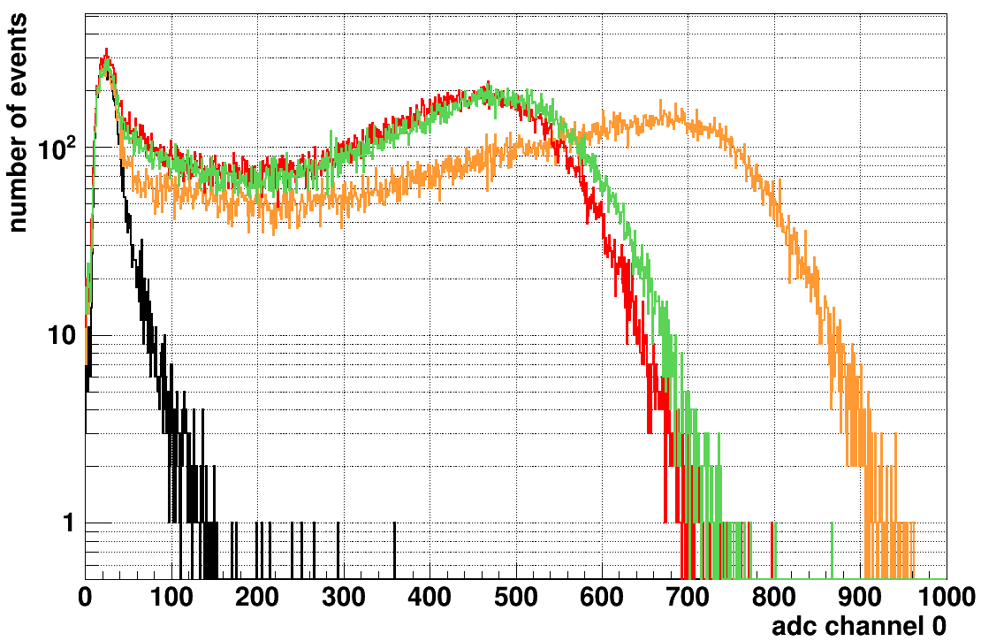
— LAB-PPO
— TeSOP
— TeDDA
— background

Slide 54
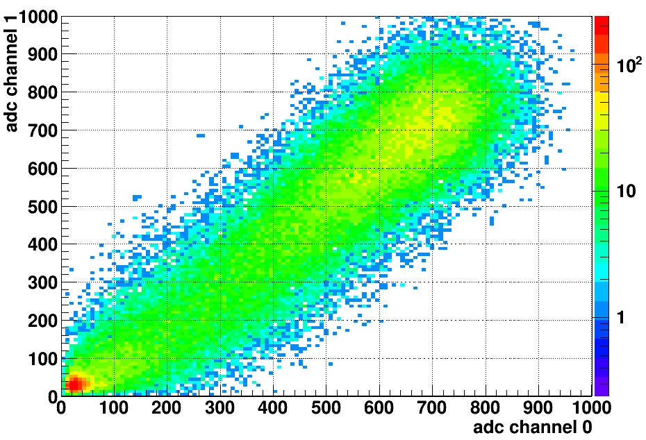
LAB-PPO
multiple p.e.
peak
single p.e.
peak

Slide 56
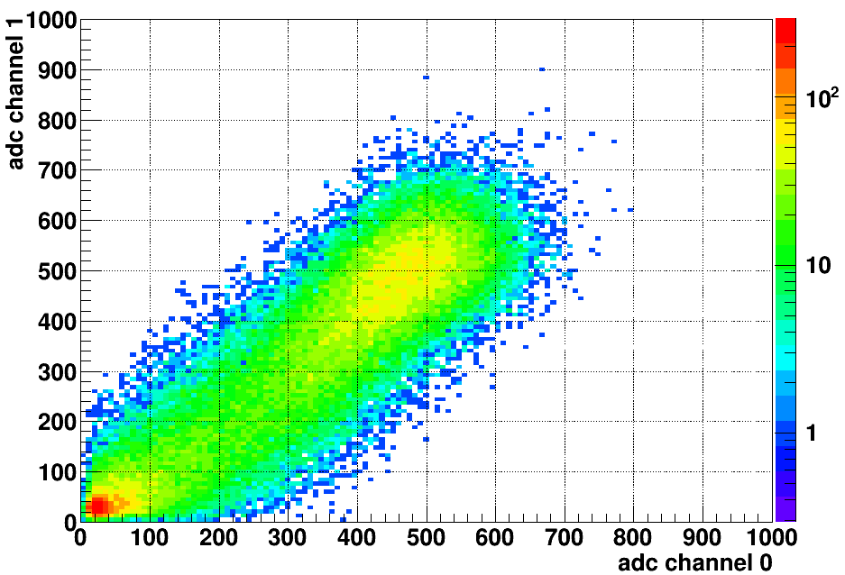
TeDDA

Slide 57
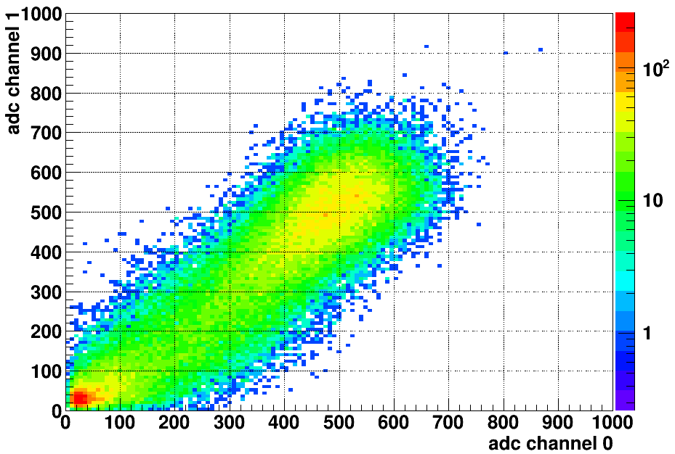
TeSOP

Slide 58
(a)
(b)
LAB-PPO
TeSOP
single p.e. peak
multiple p.e. peak
(c)
(d)
TeDDA
— LAB-PPO
— TeSOP
— TeDDA
— background

Slide 59
(a)
(b)
LAB-PPO
Te_P1
single p.e. peak
multiple p.e. peak
(c)
(d)
Te_P3
— LAB-PPO
— Te_P1
— Te_P3
— background
This is for publish paper

Slide 60
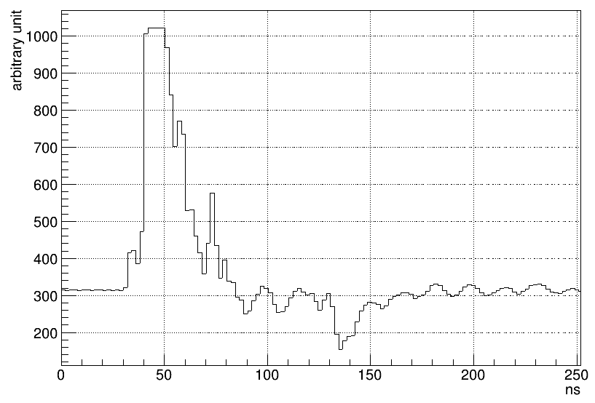
trigger
trigger
hold-off
integral
time window
pre-gate
threshold
baseline

Slide 61

zero peak
— LAB-PPO without coincidence cut
— LAB-PPO with coincidence cut
single p.e. peak
threshold for counting
multiple p.e. peak

Slide 62

21 Mar 2019

