Slide 1
thesis plots
2019

Slide 2
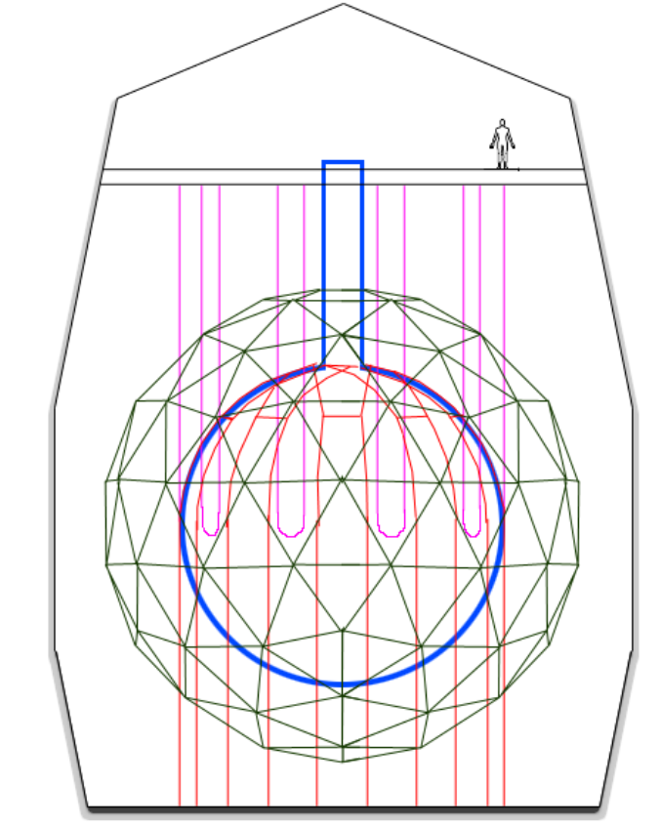
Deck
Neck
Hold-up ropes
PMT support structure
Rock cavity
Acrylic vessel
Hold-down ropes

Slide 3
pp
pep
p + p → ²H + e⁺ + ν_{e}
p + e⁻ + p → ²H + ν_{e}
99.76%
0.24%
²H + p → ³He + γ
84.6%
15.4%
2.5x10⁻⁵%
hep
³He + ³He → ⁴He + 2p
³He + ⁴He → ⁷Be + γ
³He + p → ⁴He + e⁺ + ν_{e}
pp-I
99.89%
⁷Be
0.11%
⁷Be + e⁻ → ⁷Li + ν_{e}
⁷Be + p → ⁸B + γ
⁸B
⁷Li + p → 2 ⁴He
⁸B → ⁸Be* + e⁺ + ν_{e}
pp-II
pp-III

Slide 4
¹³C
¹³C + p → ¹⁴N + γ
¹⁴N
¹⁷O + p → ¹⁴N + ⁴He
¹⁷O
¹³N → ¹³C + e⁺ + ν_{e}
¹⁴N + p → ¹⁵O + γ
¹⁷F → ¹⁷O + e⁺ + ν_{e}
CN
NO
¹²C + p → ¹³N + γ
¹⁵O→ ¹⁵N + e⁺ + ν_{e}
¹⁶O + p → ¹⁷F + γ
¹²C
¹⁵N + p → ¹²C + ⁴He
¹⁵N
¹⁵N + p → ¹⁶O + γ
¹⁶O

Slide 5
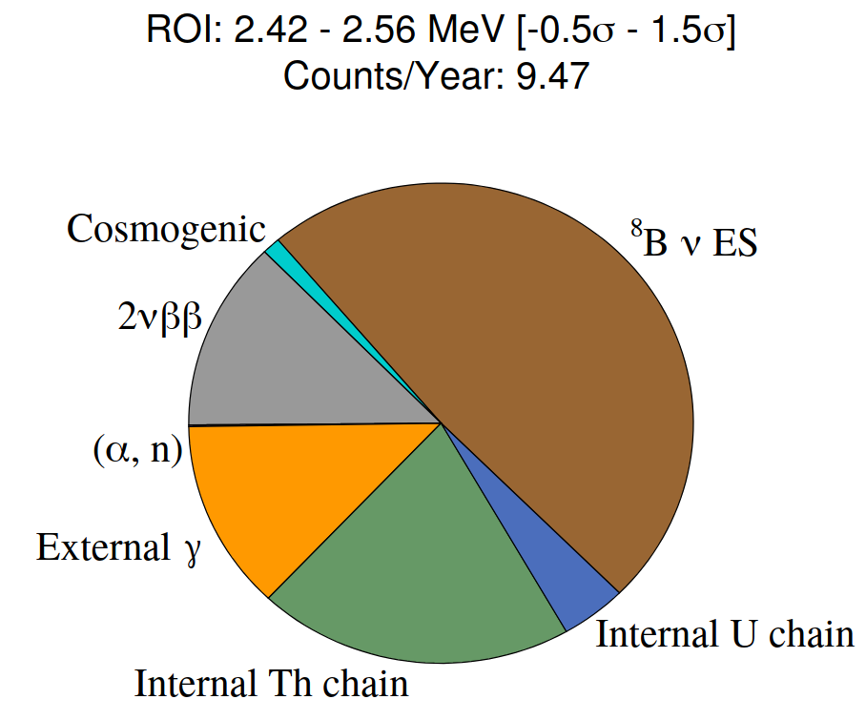
Double Beta Official Plots. Using Te+DDA Optics.
docDB-5681-v3
LAB+PPO+bisMSB+Te(0.5%)+Diol+DDA.

Slide 6
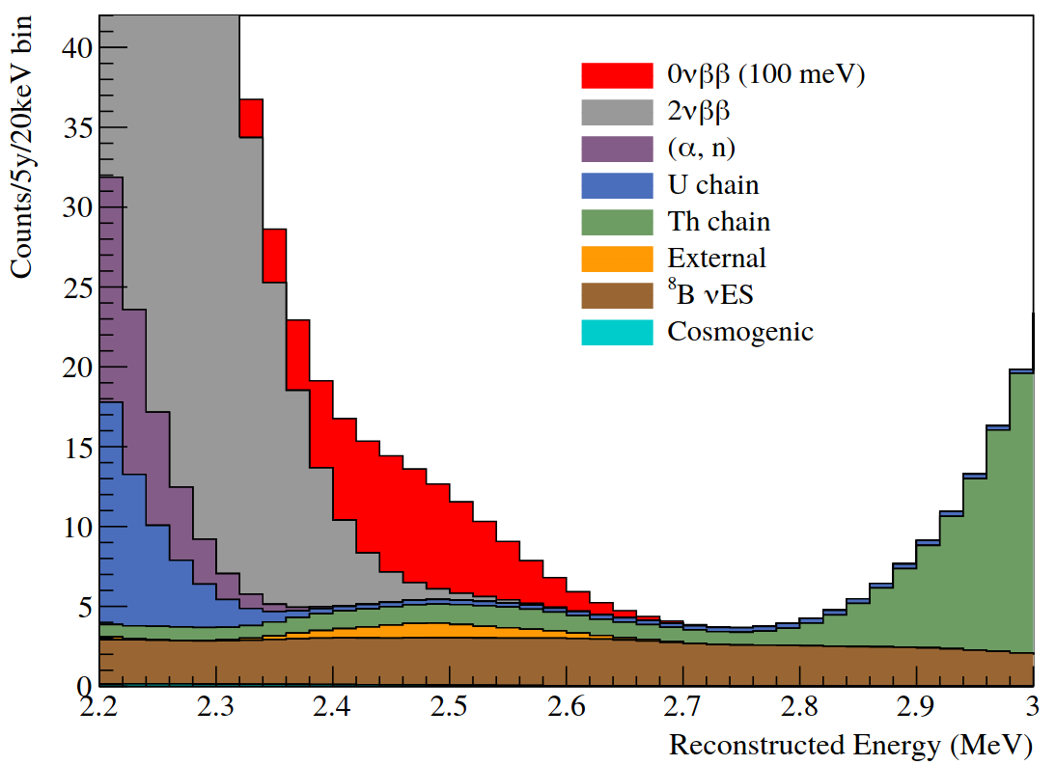

Slide 7
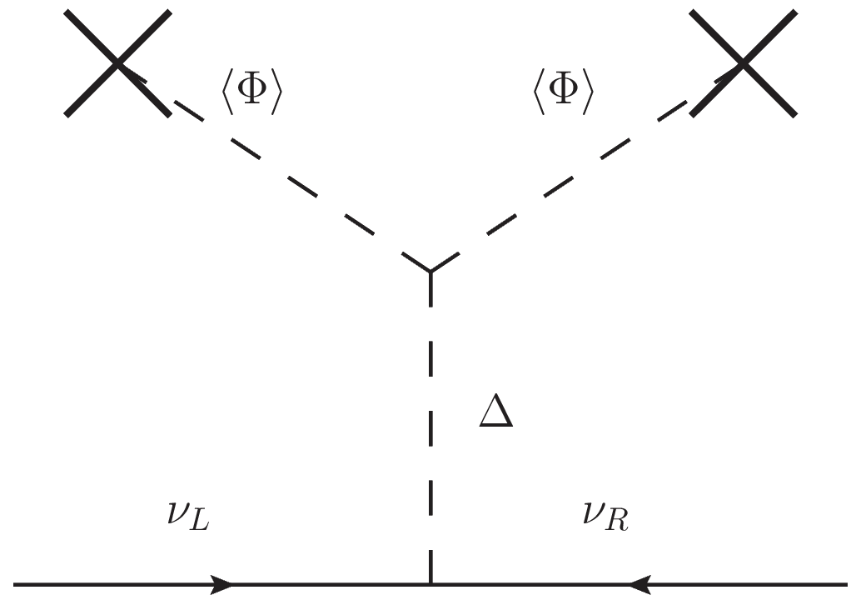
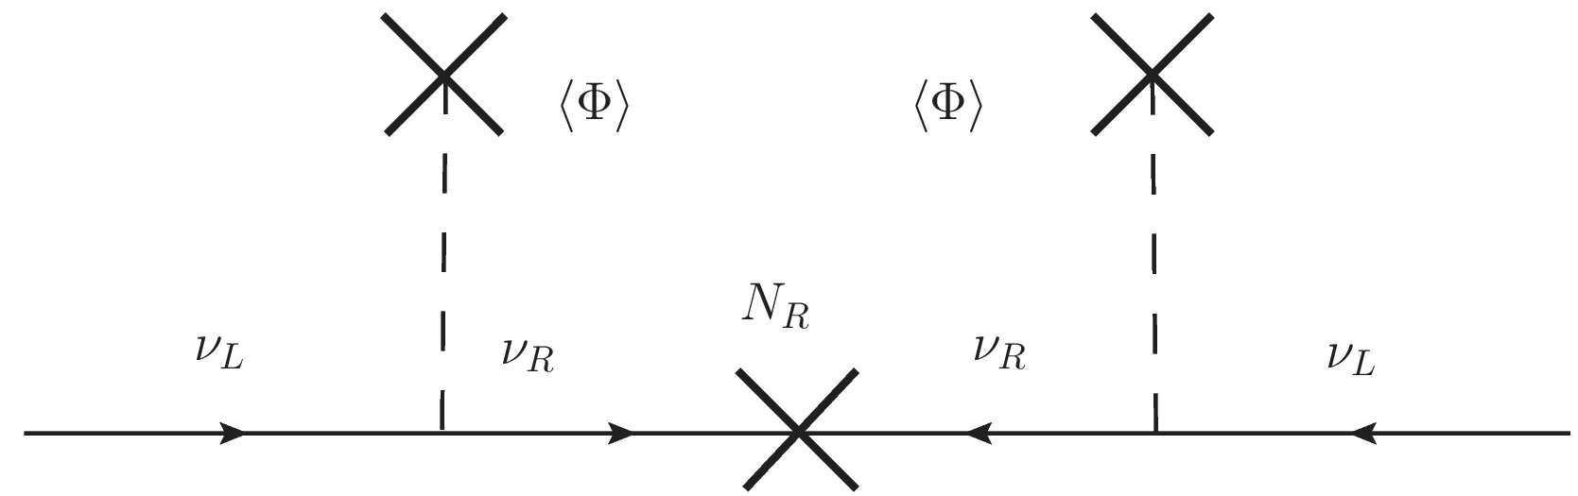

Slide 8
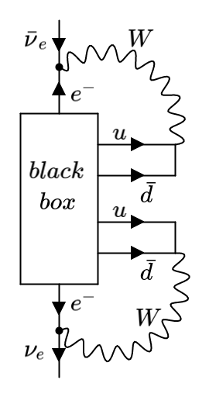
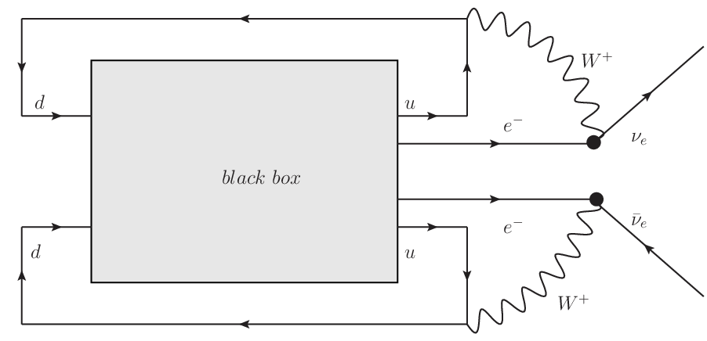

Slide 9
P₁
P
P₂
L
Ω
T₁
PMT sphere
θ
source
offset
O
time of flight
T₂
Ω'
L'
P'₁
P'₂
P'

Slide 10
a₊
PMT
a₊
PMT
ray-tracer
a₋
vertex
(a)
vertex
(b)
a₋
PMT
PMT
vertex
vertex
(c)
(d)

Slide 11
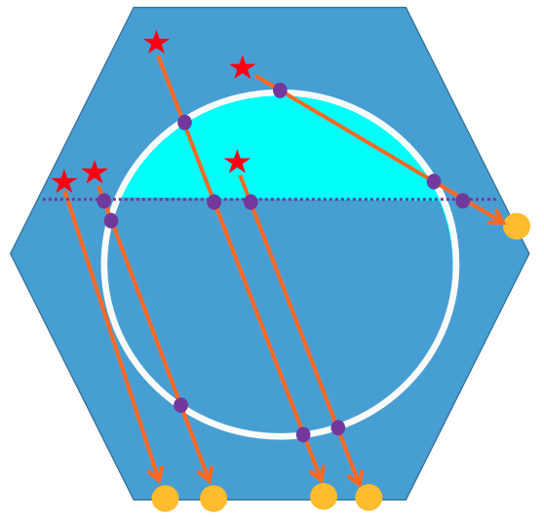
vertex
vertex
vertex

Slide 12

d_{neck}
d_{AV}

Slide 13
PMT
PMT
a₊
vertex
vertex
a₃
vertex
a₃
a₃
a₊
a₊
a₃
a₊
PMT
vertex
(a)
(b)
(c)
(d)
PMT
PMT
PMT
vertex
a₃
z₊
a₊
z₊
a₋
z₋
z₋
a₋
vertex
a₃
a₊
a₊
z₋
a₋
z₊
(e)
(f)
(g)
vertex
PMT

Slide 14
a'₊
a'₊
a₋
a'₊
a₊
a'₋
a₊
a'₊
(a)
(b)
(c)
(d)
a₊
a'₋
a'₊
a'₊
a'₊
a₊
a'₋
a₋
a₋
a'₋
a'₊
a₊
a₊
a'₋
a₋
(e)
(f)
(g)
(h)

Slide 15
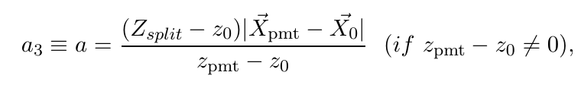
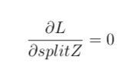
a₃
PMT
vertex
vertex
PMT
vertex
PMT
vertex
PMT

Slide 16
Hough transformation
X_{PMT}
θ_{Ch}
X₀
X₀

Slide 17
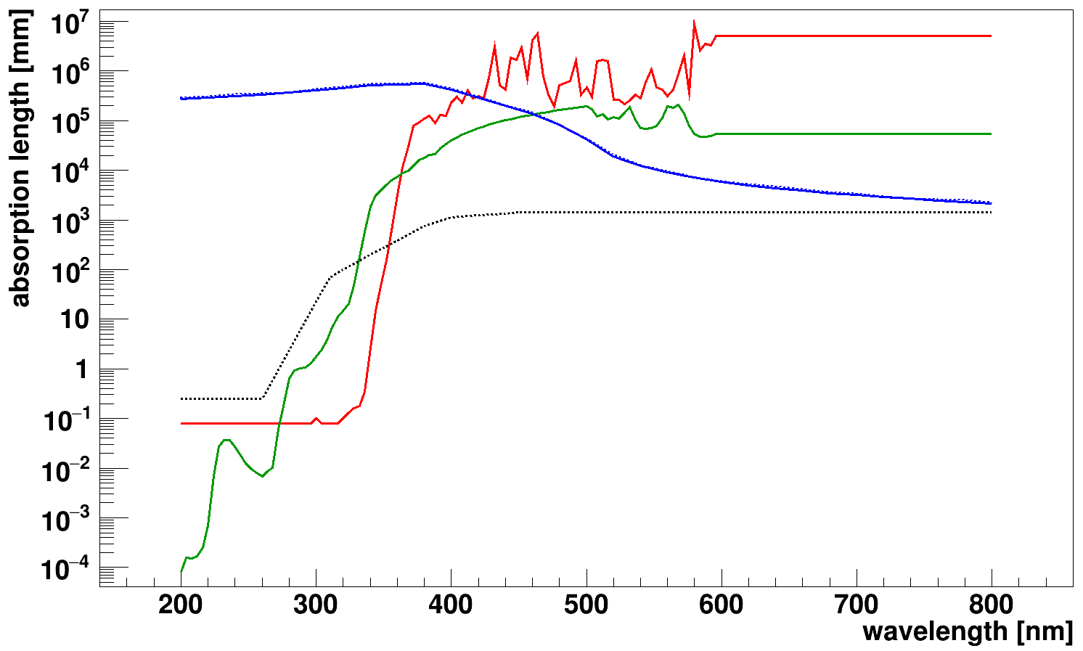
ＬＡＢＰＰＯ
— LAB
— PPO
--- Acrylic
— SNO+ internal water
--- SNO+ external water

Slide 19
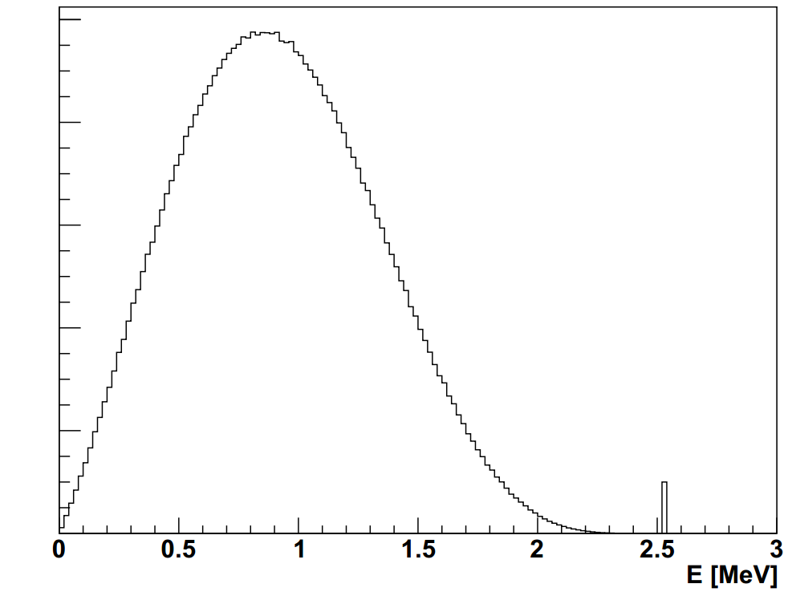
2νββ
counts
0νββ

Slide 20
SkyShine

Slide 21
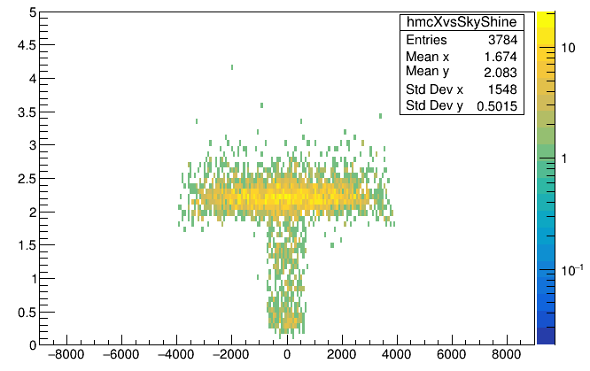
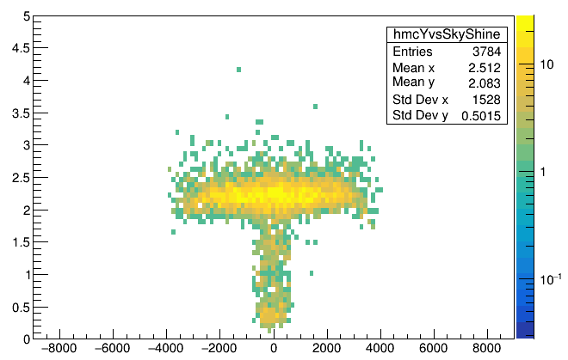
skyShine
x_{mc} [mm]
skyShine
y_{mc} [mm]

Slide 22
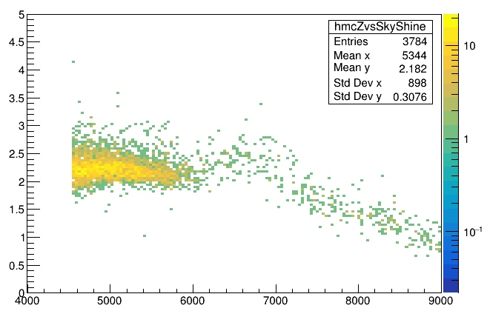
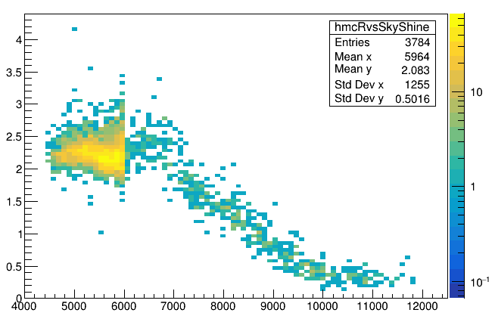
z>=neck
skyShine
skyShine<1.7
z_{mc}-108 [mm]
skyShine
skyShine<1.7
sqrt(x²_{mc}+y²_{mc}+(z_{mc}-108)²) [mm]

Slide 23
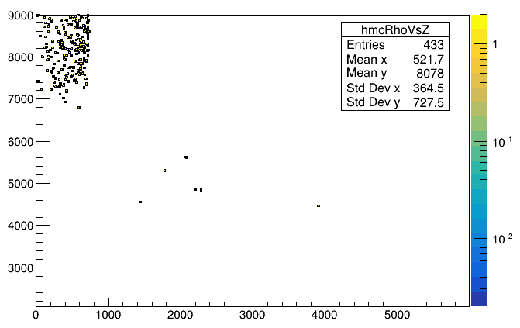
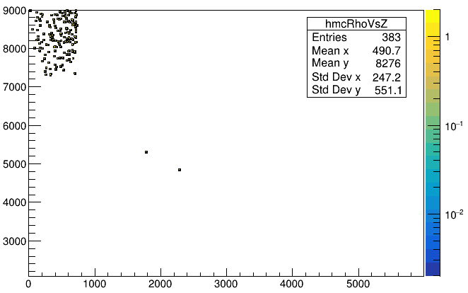
skyShine<1.7
Mostly are high neck region events
z_{mc}-108 [mm]
mis-tagged events
skyShine<1.5
Mostly are high neck region events
sqrt(x²_{mc}+y²_{mc}) [mm]
z_{mc}-108 [mm]
mis-tagged events
sqrt(x²_{mc}+y²_{mc}) [mm]

Slide 24
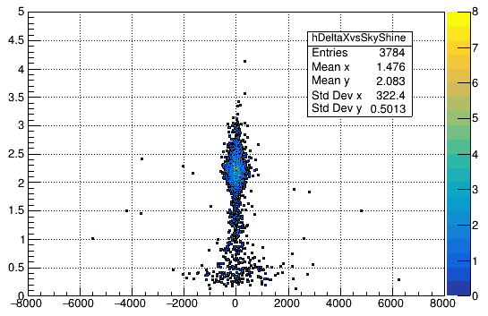
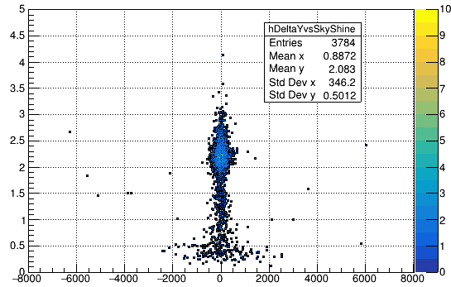
skyShine
skyShine
x_{fit} - x_{mc} [mm]
y_{fit} - y_{mc} [mm]

Slide 25
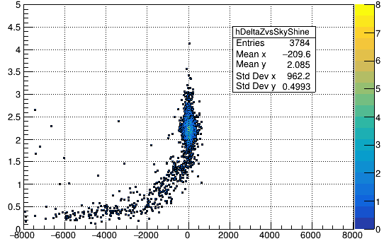
skyShine
z_{fit} - z_{mc} [mm]

Slide 26
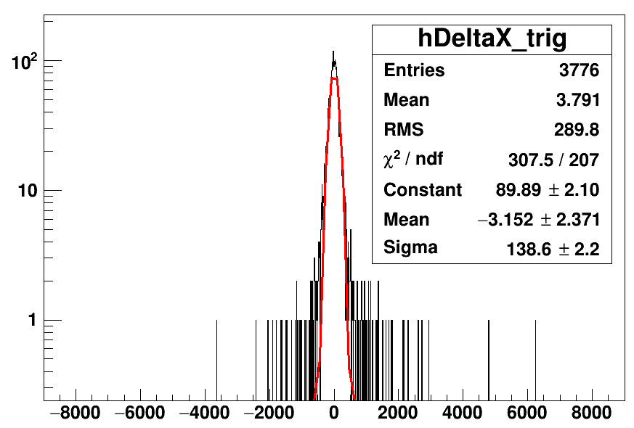
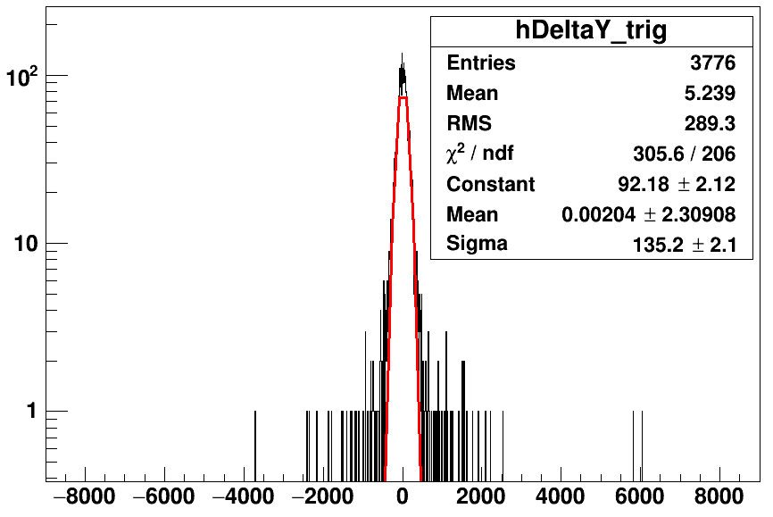
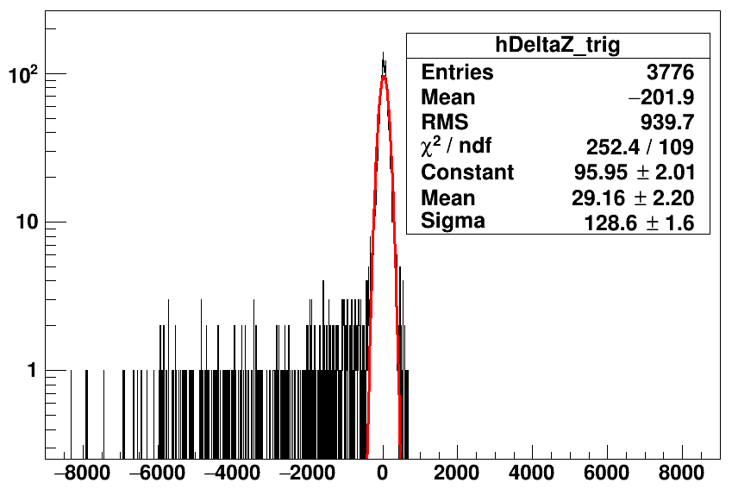
counts
counts
x_{fit} - x_{mc} [mm]
y_{fit} - y_{mc} [mm]
counts
Tl208 partialFill without cuts
z_{fit} - z_{mc} [mm]

Slide 27
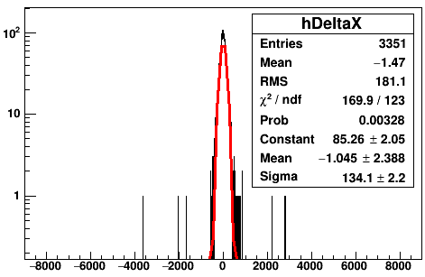
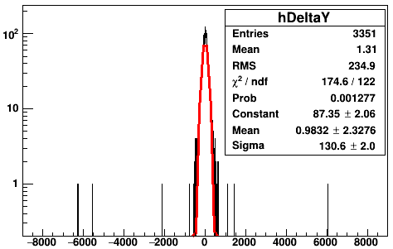
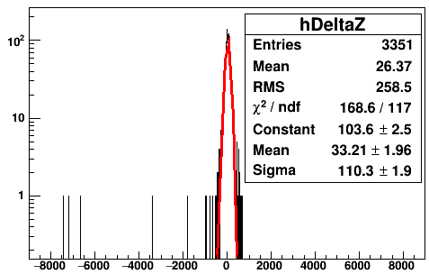
counts
counts
skyShine>1.7
skyShine>1.7
x_{fit} - x_{mc} [mm]
y_{fit} - y_{mc} [mm]
counts
skyShine>1.7
z_{fit} - z_{mc} [mm]

Slide 28
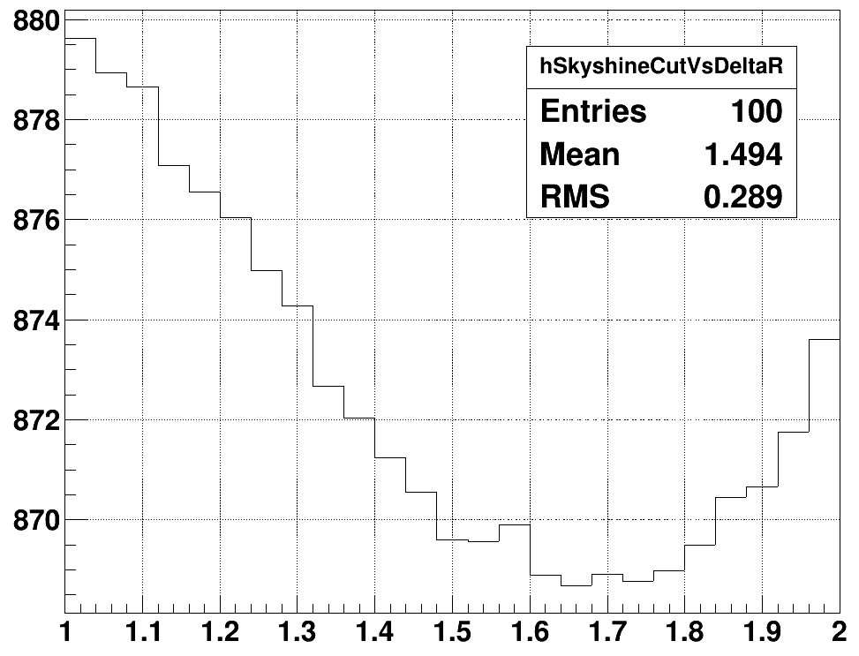
ΔR [mm]
1.65 (minimum)
1.75
skyShine

Slide 29
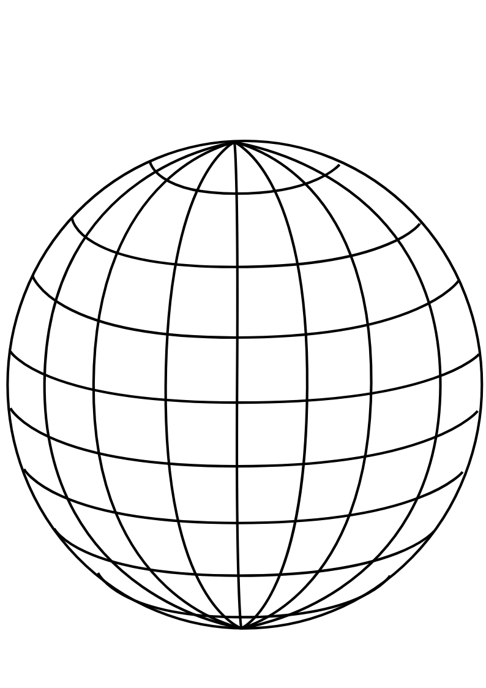
PMT
panel
Uniform Selector
PMT sphere
http://www.downloadclipart.net/download/5816/big-blue-wire-globe-svg

Slide 30
tuning group velocity
PMT hits
Cherenkov
cone
u
PMT sphere
actual event position
pulled event position

Slide 31
drive correction
early hits
late hits
Cherenkov
cone
u
PMT sphere
pulled event position
actual event position

Slide 32
u_{fit}
p₁
X_{fit}
X_{cor}
p₀
O
PMT sphere

Slide 33
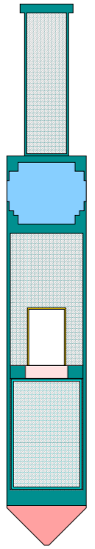

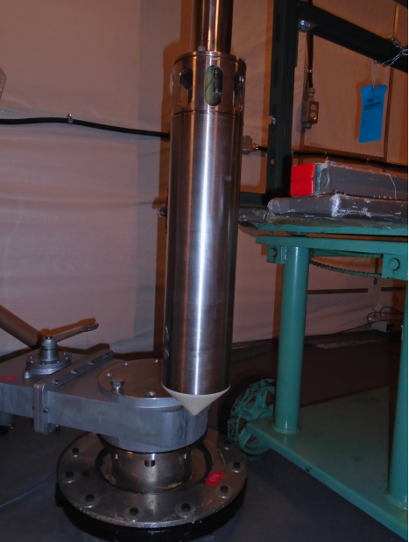
Stainless steel weight cylinder
“Lighthouse” gap, contains
material from scintillator volume
25.3 cm
Stainless steel container
PMT for tagging
Acrylic window
¹⁶N gas decay chamber
Plastic scintillator
Polyethelene bumper cone
5.7 cm

Slide 34
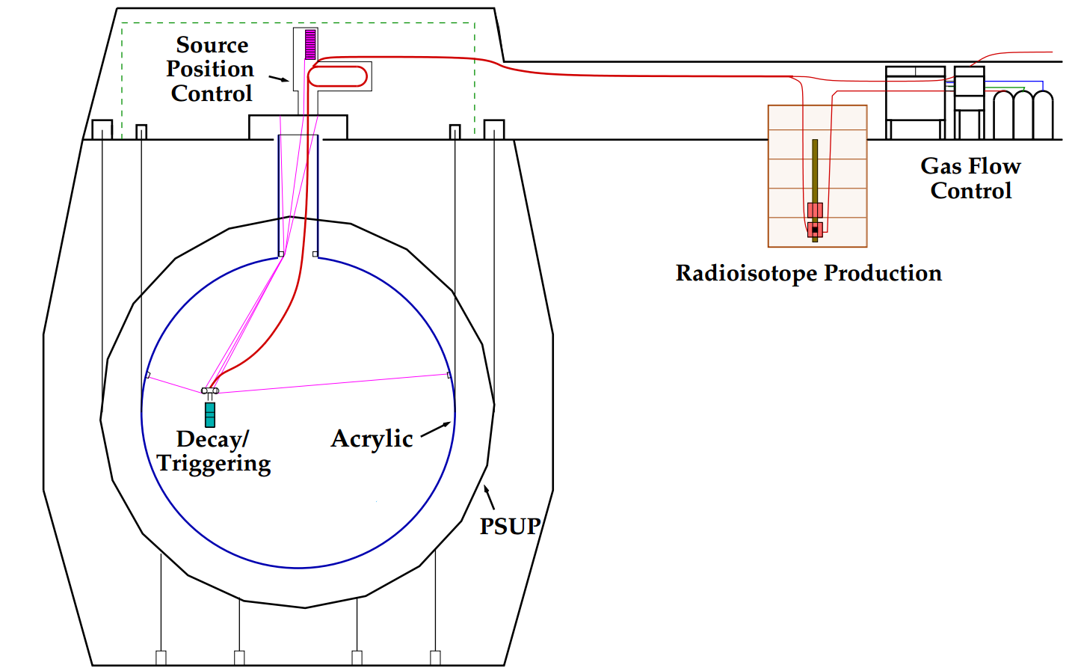
H₂O
H₂O
H₂O
hamer

Slide 35
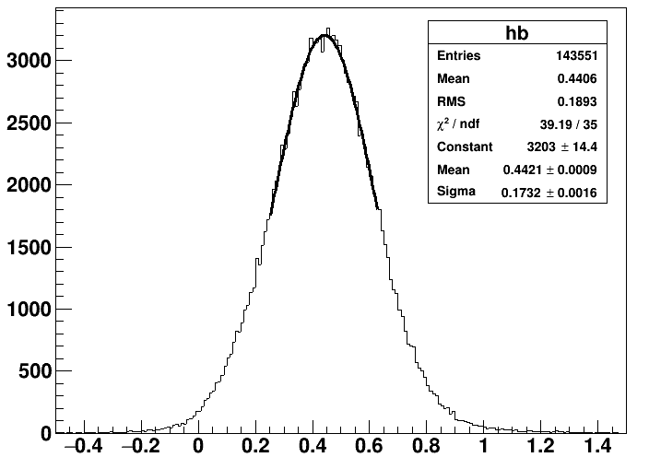
water analysis
fit in 1 sigma

Slide 36
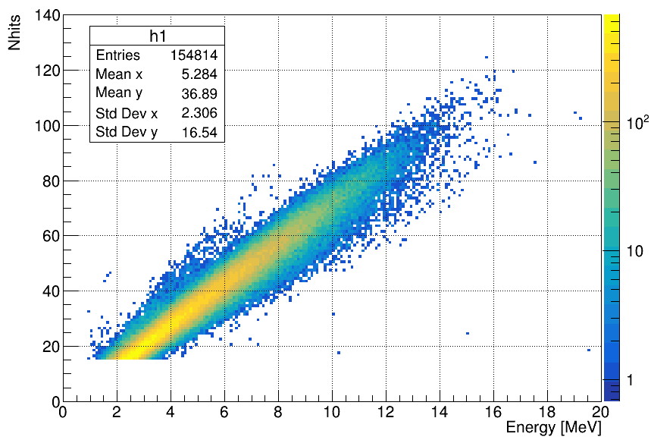
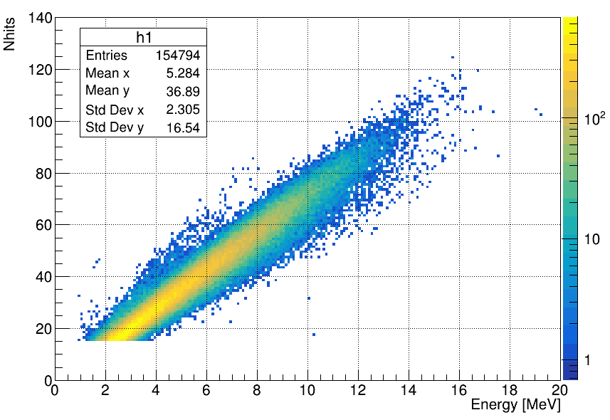
Merged_MPWsolarTest_WaterMP6176_nhit6_GeneralPhysicsMC_WaterSolar_NueRun_r200004to200781.root
T->Draw("nhits:energy>>h","Gtest>0","colz")
Gtest>0
185639/185410
Gtest>0

Slide 37
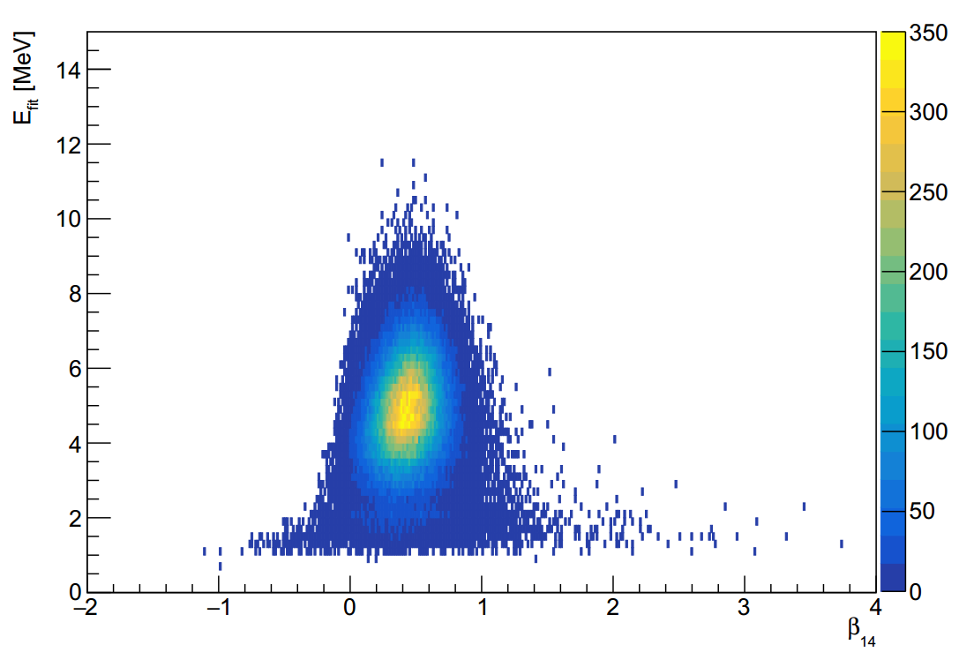

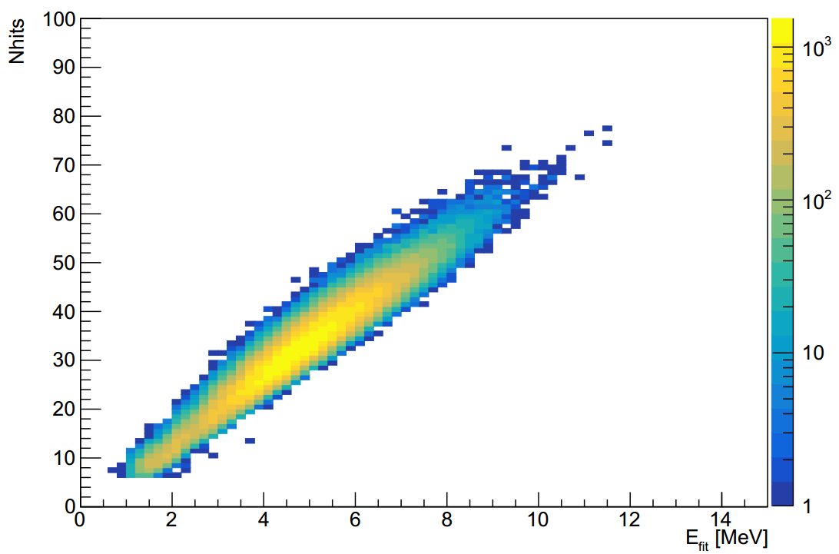
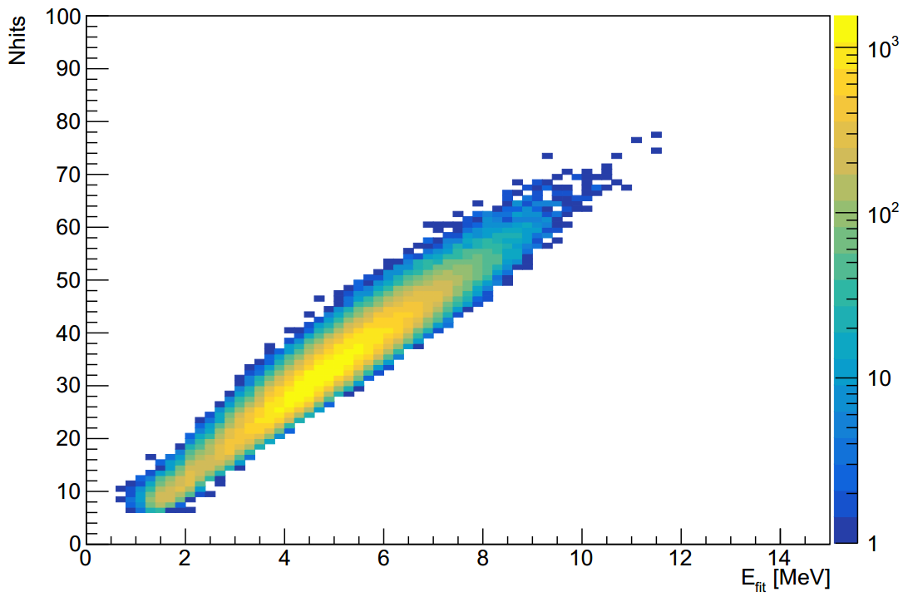
MPW MC
RAT MC
MPW MC
RAT MC

Slide 38
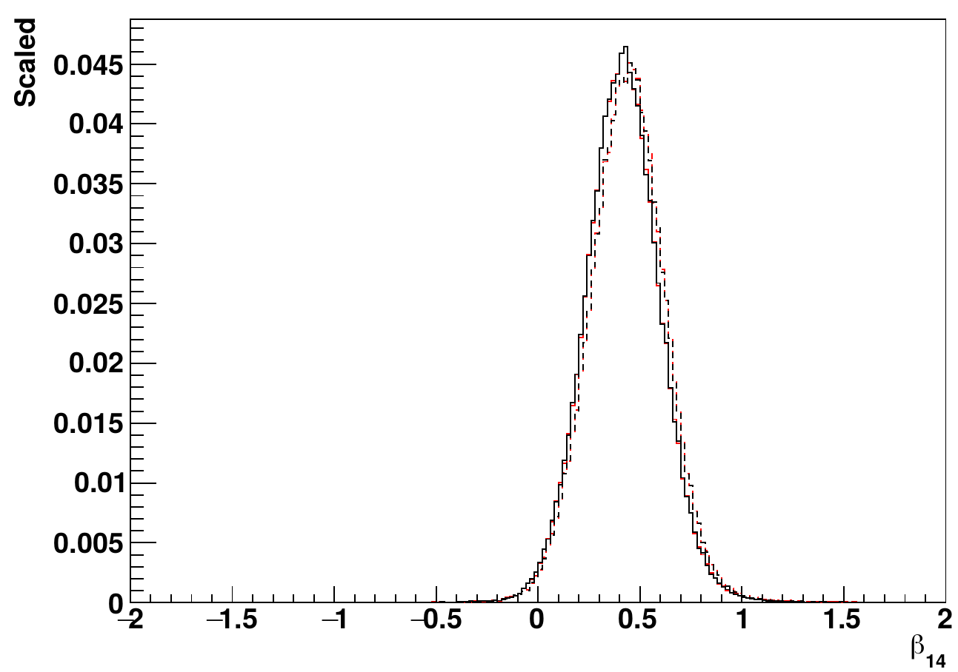
¹⁶N source
central run-107055
— RAT data
— MPW data
--- RAT MC
--- MPW MC

Slide 39
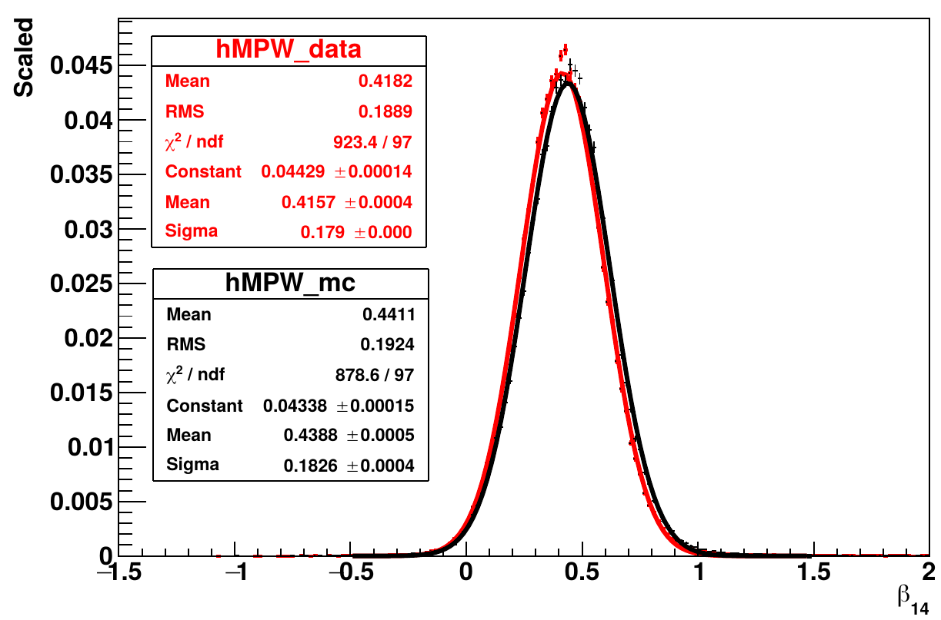
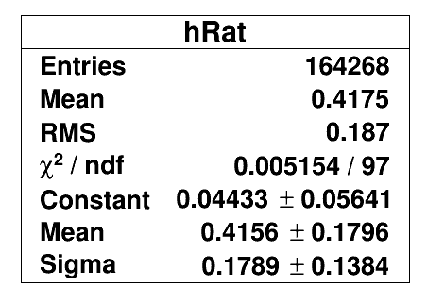
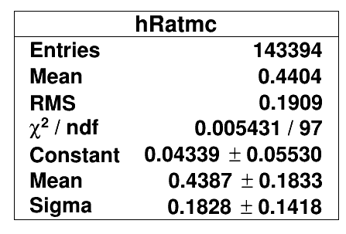
— MPW data
— MPW MC

Slide 40
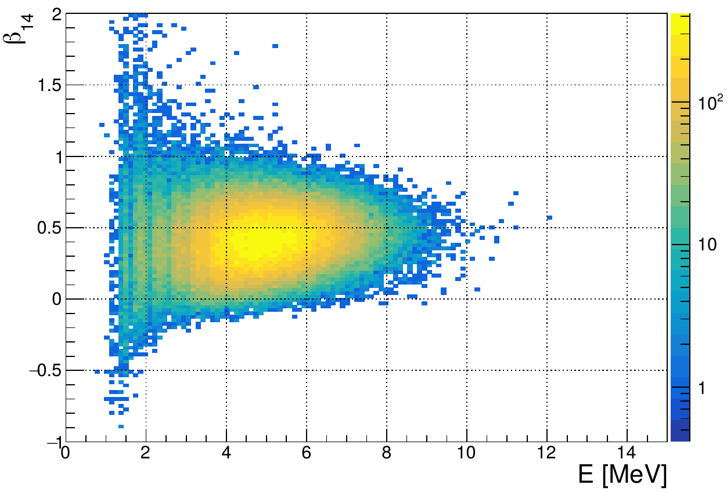
MPW data
107055

Slide 41
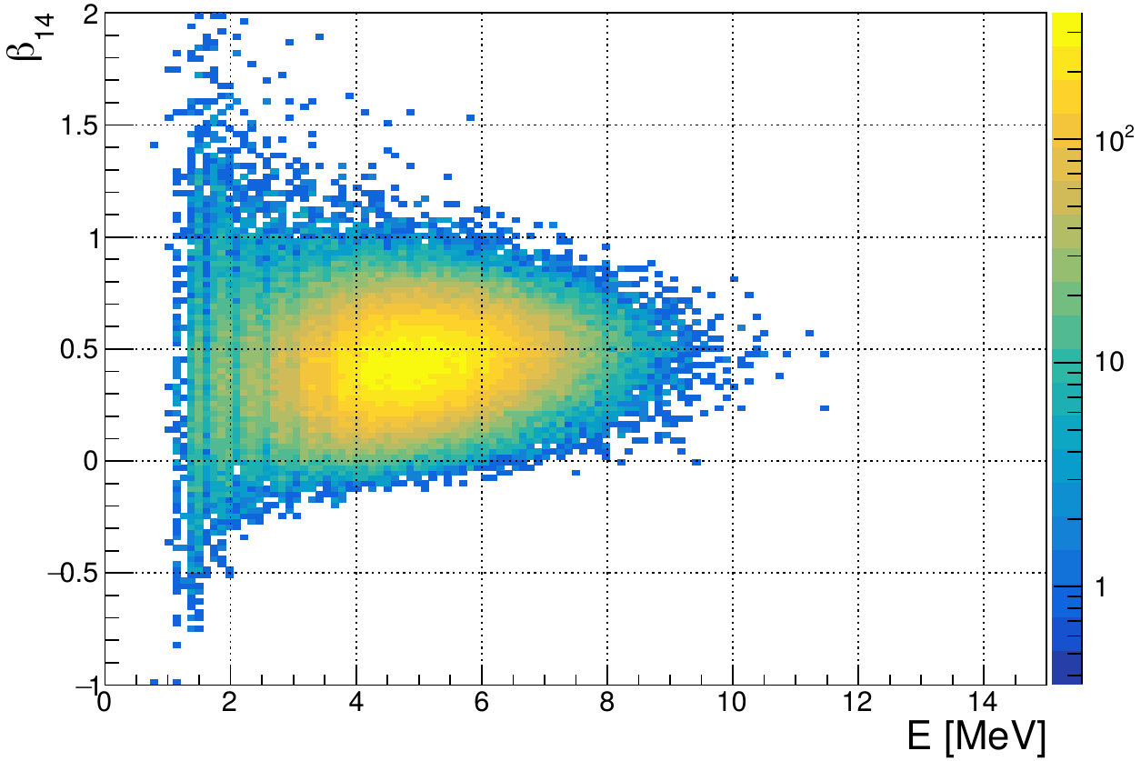
MPW MC
107055

Slide 42
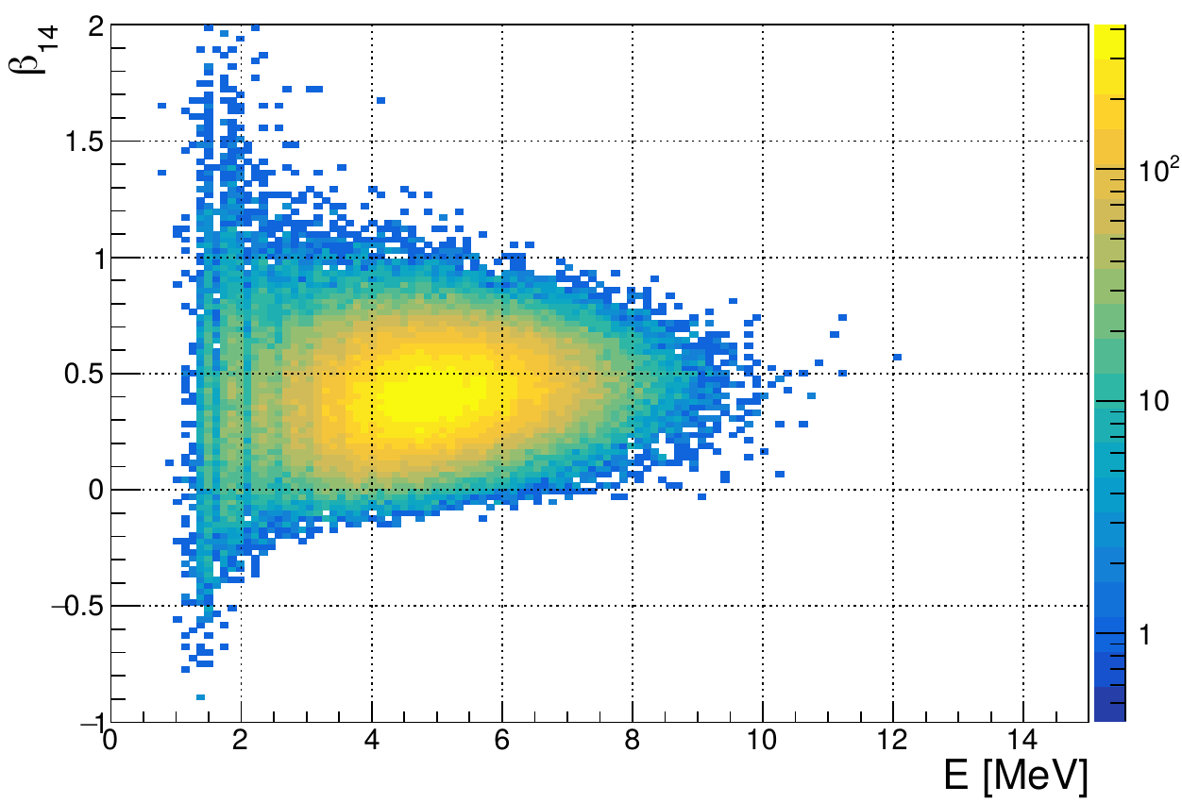
RAT data
107055

Slide 43
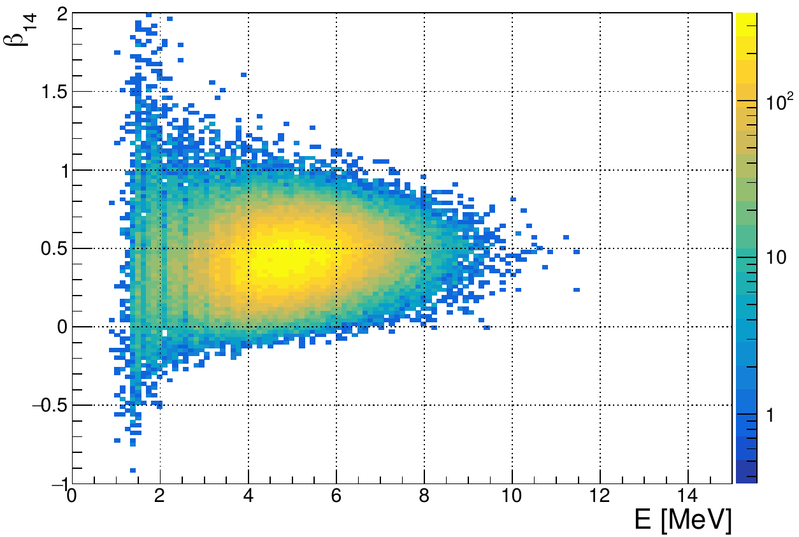
RAT MC
107055

Slide 44
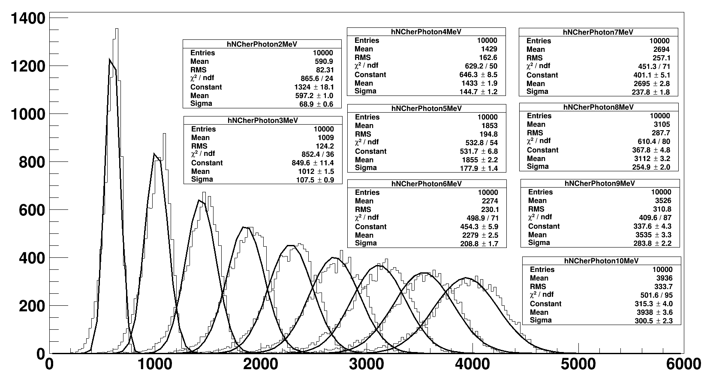
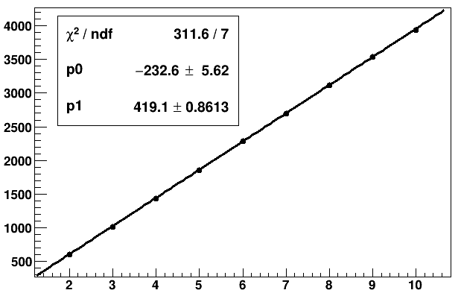

Slide 46
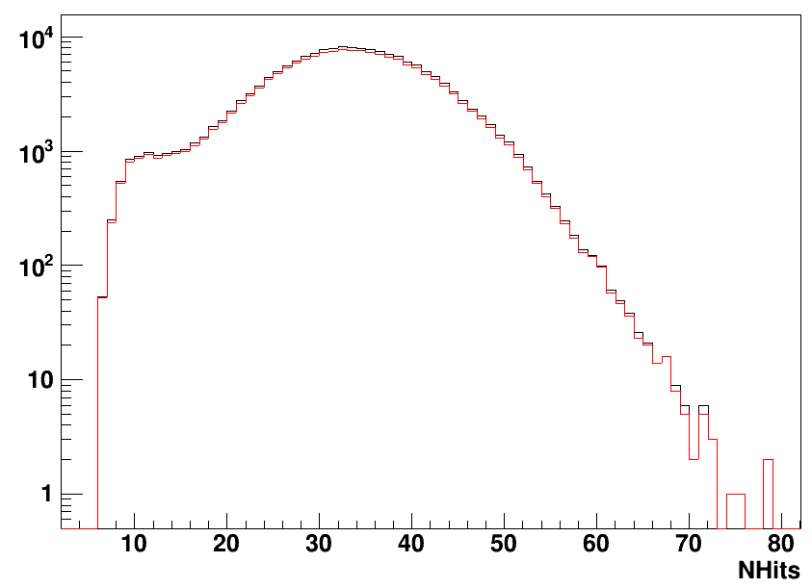
¹⁶N source
central run-107055
— RAT data, uncleaned
— Rat data, cleaned
164268/172408
data clean removes ~4.72% of the events

Slide 47
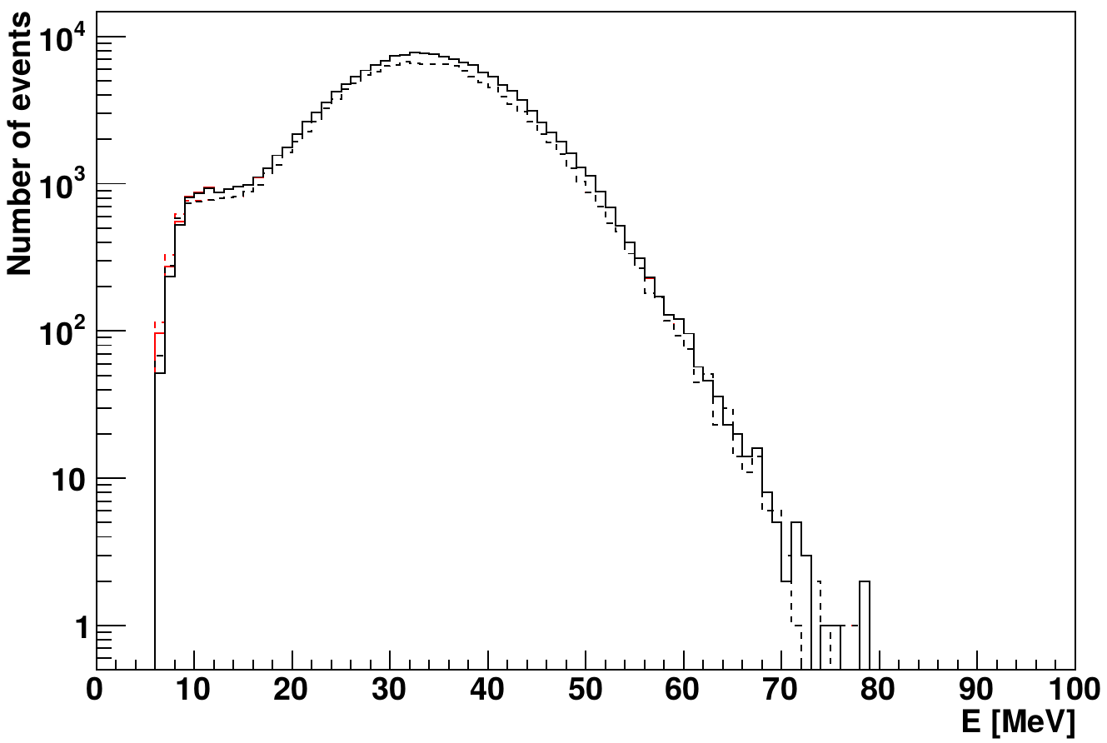
¹⁶N source
central run-107055
— RAT data
— MPW data
--- RAT MC
--- MPW MC
NHits

Slide 48

¹⁶N source
central run-107055
— RAT data
— MPW data
--- RAT MC
--- MPW MC

Slide 49

¹⁶N source
central run-107055
r<5.3 m
— RAT data
— MPW data
--- RAT MC
--- MPW MC
¹⁶N source
central run-107055
r<5.3 m
— RAT data
— MPW data
--- RAT MC
--- MPW MC

Slide 50


Slide 51
β₁₄
fitted event position
r_{i}
fitted event direction
θ_{ij}
r_{j}

Slide 52

γ-rays

Slide 53

— 5 MeV
— 4 MeV
— 3 MeV
— 2.5 MeV
— 1 MeV

Slide 54
¹⁶N source
distance
γ-rays
reconstructed
event position
Compton
scattering
e⁻
θ_{PMT}
PMT

Slide 55


6.17.6
6.5.2
output->Draw("energy>>henergy","waterFit && ( ((dcApplied & 0xFB0000017FFE) & dcFlagged) == (dcApplied & 0xFB0000017FFE) )")

Slide 56

muon induced
10C

Slide 57

10C

Slide 58

11C

Slide 59

11C

Slide 60

6He

Slide 61

6He

Slide 62

Solar phase
11C

Slide 63


Slide 64


Slide 65


Slide 66


Slide 67
stainless steel
container
scintillation vial
PMT #1
PMT #2
plastic piece
stainless steel stand
¹³⁷Cs source
dark box
HV
connector
HV supply
computer
signal/HV
split box
signal/HV
split box
amplifier
amplifier
CAEN
digitizer

Slide 68


scintillation
vial
49.4 mm
14.3 mm
stainless steel
PMT container
plastic holder
30 mm

Slide 69

— LAB-PPO
— TeSOP
— TeDDA
— background

Slide 70

LAB-PPO
multiple p.e.
peak
single p.e.
peak

Slide 72

TeDDA

Slide 73

TeSOP

Slide 74
(a)
(b)
LAB-PPO
TeSOP
single p.e. peak
multiple p.e. peak
(c)
(d)
TeDDA
— LAB-PPO
— TeSOP
— TeDDA
— background

Slide 75
(a)
(b)
LAB-PPO
Te_P1
single p.e. peak
multiple p.e. peak
(c)
(d)
Te_P3
— LAB-PPO
— Te_P1
— Te_P3
— background
This is for publish paper

Slide 76

trigger
trigger
hold-off
integral
time window
pre-gate
threshold
baseline

Slide 77

zero peak
— LAB-PPO without coincidence cut
— LAB-PPO with coincidence cut
single p.e. peak
threshold for counting
multiple p.e. peak

Slide 78

21 Mar 2019

