Slide 1
MinuteMan 4 StackExchange.Redis
Javier Hualpa

Slide 2
Agenda
Concepts
Expectations
Design Considerations
Implementation Details
Demo

Slide 3
Concepts
Library for high performance Redis based analytics
Uses bitmaps operations over Redis strings : GETBIT, SETBIT and BITOP => extremely fast
Uses bits to track activity => data consumption is very low.
Uses Hashes: HINCRBY, HMGET
100% async

Slide 4
Concepts
Strings → Activity Tracking
Hashes → Event Tracking
Redis String → max 512 MB → 2³² bits settable

Slide 5
Expectations
Not a new library
MinutemanDotNet + support for StackExchange.Redis

Slide 6
Design
Core classes: UserActivity and EventActivity classes to track and report user and application events.
UserActivity is best to track Booleans, whether an event occurred.
EventActivity when need to track how many times a certain event has occurred

Slide 7
Implementation
UserActivity keys
Key for UserActivity: “minuteman:UserActivity”
Key for UserActivity timeframes: “ts:UserActivity:{ActivityName}”
Keys for timeframe fields:
“ts:UserActivity:{ActivityName}:{Timeframe}”
EventActivity keys
Key for EventActivity: “minuteman:EventActivity”
Key for EventActivity timeframes: “ts:EventActivity:{EventName}”
Key for timeframe fields:
“ts:EventActivity:{EventName}:{Timeframe}”
Subscription
failed

Slide 8
Implementation
Timeframe fields
Year
Month
Day
Hour
Minute
Second
Subscription
Inference
failed

Slide 9
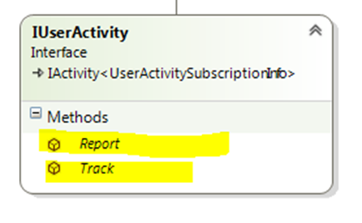
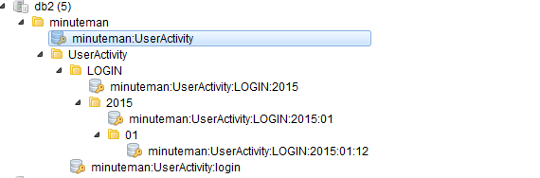
Demo >> UserActivity
Multiple User Ids can be passed in the last argument
UserActivity
Track when a user logs into the system:
Timeframe ranges from second to year, default is hour
var userActivity = new UserActivity(new AnalyticsSettings(AnalyticsTimeframe.Day), redisClient);
userActivity.Track(“login", DateTime.UtcNow, 1, 2, 3, 4);
Set = {login}
Strings
Set = {Day}

Slide 10
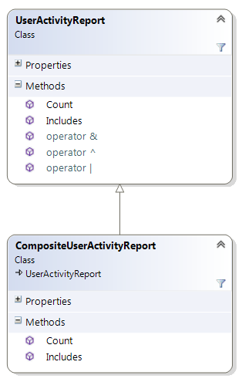
Demo >> UserActivity
UserActivityReport
Wrapper for Redis key NOT Redis string
Allows to perform bitwise operations: AND, OR, XOR
Track when a user logs into the system:
Total number of bits set to 1
long count = userActivity.Report("login", DateTime.UtcNow).Count()
Task<bool[]> result = userActivity.Report("login", DateTime.UtcNow).Includes(1,2,3)
Only exclusive bits, not reasonable to get all

Slide 11
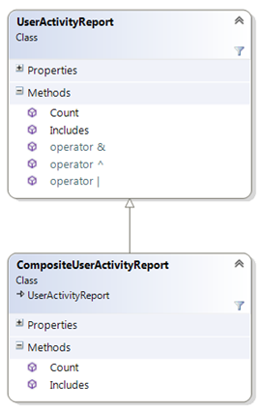
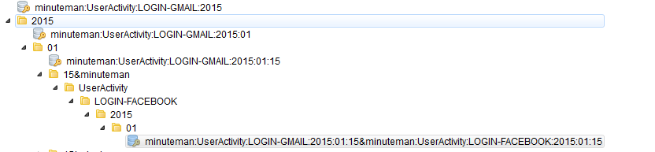
Demo >> UserActivity
Track when a user logs into Facebook/Gmail:
userActivity.Track("login-gmail", DateTime.UtcNow, 1, 2);
userActivity.Track("login-facebook", DateTime.UtcNow, 1, 3);
var logGmail = userActivity.Report("login-gmail", DateTime.UtcNow);
var logFb = userActivity.Report("login-facebook", DateTime.UtcNow);
var both = (logGmail & logFb).Count();
var eitherOrBoth = (logGmail | logFb).Count();
var eitherNotBoth = (logGmail ^ logFb).Count();
Operator overloadig

Slide 12
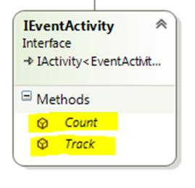
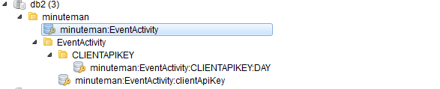
Demo >> EventActivity
EventActivity
Track API usage:
Increment the Hash fields
var eventActivity = new EventActivity(new AnalyticsSettings(AnalyticsTimeframe.Day), redisClient);
eventActivity.Track("clientApiKey");
Set = {clientApiKey}
Hash
Set = {Day}

Slide 13
Demo >> EventActivity
EventActivity
Count API calls during last hour
var count = eventActivity.Count("clientApiKey",
startTimestamp: DateTime.Now.AddHours(-1), endTimestamp: DateTime.Now).First();
Time Range

Slide 14
Demo
Project: Minuteman.Tests
Files: UserActivityTestConsole.cs, EventActivityTestConsole.cs

Slide 15
Questions
?

Slide 16
Thank you

