Slide 1
Abstract shapes for RNA structure prediction
Ole Schulz-Trieglaff
Journal Club 17.02.06

Slide 2
Outline
Introduction
Definition of Abstract Shapes
Applications
(Suboptimal folding, consensus structure prediction)
Summary
Talk based on
Giegerich et al. (2004) “Abstract Shapes of RNA” Nucleic Acids Research Vol. 32 No. 16

Slide 3
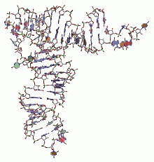
Introduction
Role of RNA in higher organisms is broader than
considered a few years ago.
Examples:
RNA molecules regulate gene expression in plants and animals by binding at promoter regions.
microRNA interferes with mRNA and initiates its degradation.

Slide 4
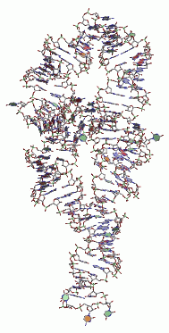
Introduction
The function of non-coding RNA is often
determined by its (tertiary) structure.
But its experimental determination is
tedious and expensive.
Computational approaches focus on
secondary structure prediction.
Many algorithms are based on a
thermodynamic energy model (Zuker et al. 1981)
Notes:
Insert additional slide for zukers algorithm

Slide 5
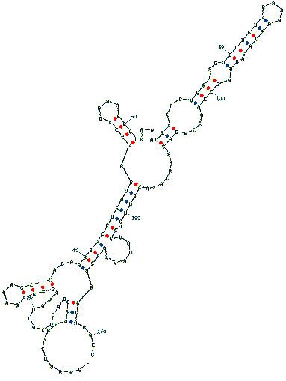
Structural components of RNA
RNA has different structural
components:
single-stranded regions (SS)
hairpin loops (HL)
stacking regions (SR)
bulges on 5´(BL) or 3´ side (BR)
internal loops (IL)
multiloops (ML).
Notes:
Maybe some images here…

Slide 6
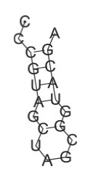
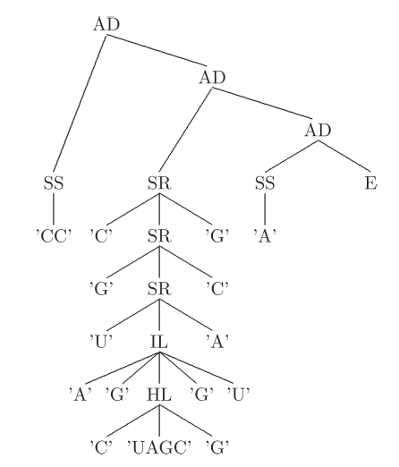
Visualisation of structures
CCCGUAGCUAGCGGUACGA
squiggle plot
tree

Slide 7
Suboptimal structures
But the „true“ structure is not always the one with
the lowest predicted free energy.
So what to do?
(1) Enumerate suboptimal structures within a given energy range R.
(2) Hope to find a structure fulfilling your expectation
or coming close to experimental results.
But the number of suboptimal structures grows
exponentially with the energy range considered.

Slide 8
Introducing abstract shapes
Solution: Use abstract shapes to describe a set of structures.
An abstract shape represents a class of similar structures
sharing a common pattern of helix nesting and adjacency.
“Abstract” since we do not care about all details
of the structures.
Each shape class has a representative structure
called shrep (with minimum folding energy).

Slide 9
Introducing abstract shapes
In the domain of shapes, we care only about
open structures (OP)
closed structure (CP)
branching (“fork”, FK) and
adjacency of structures (AD).
Level of detail is defined by an abstraction function π.
The abstraction function can be defined on the level of the
structural components.

Slide 10
Defining abstract shapes
A (very abstract) abstraction function :
π(SS(l)) = OP (single-stacked region)
π(HL(a,l,b) = CL (hairpin)
π(SR(a,x,b)) = π(x) (stacked region)
π(IL(a,l,x,l´,b)) = π(x) (interior loop)
π(ML(a,c,b)) = FK(π(x)) (multiloop)
E represents the “empty structure”.
where a, b = nucleotides, l = loop, c = list of adjacent
components and x = arbitrary structure elements.

Slide 11
Example
CCCGUAGCUAGCGGUACGA
AD
CL
E
squiggle plot
tree
abstract shape

Slide 12
Computing abstract shapes
Abstract shapes are a homomorphic image of the folding
space of a RNA sequence (same as mfe or base pair
maximization).
They can therefore be computed using Dynamic
Programming (DP).
Giegerich et al. use an extension of DP called
Algebraic Dynamic Programming (ADP).
ADP offers some interesting aspects (separation of
recognition and evaluation, pair algebras).

Slide 13
Computing abstract shapes
Algebraic Dynamic Programming defines the set of all possible solutions (e.g. foldings) using a context-free grammar.
Candidate solutions are generated by parsing the input
sequences.
Evaluation of candidate solutions is performed by defining
an evaluation algebra on the grammar.
Polynomial efficiency is achieved by incremental evaluation
candidate solutions by the parses.

Slide 14
First summary
One abstract shape represents a family of
similar RNA structures.
Shapes are defined by an abstraction function
that maps from structure to shape space.
Shapes can be used to represent a large number of (suboptimal) foldings to obtain an holistic view of the folding space.

Slide 15
Applications of abstract shapes
Suboptimal Folding
Out of 99 tRNA sequences in Rfam only 30 had the typical cloverleaf structure as predicted mfe folding.
Example: tRNA of Natronobacterium pharaonis:
mfe structure is a hairpin with internal loops, cloverleaf structure occurs at position 104 of 199
suboptimal structures.
All these suboptimal folding can be represented by three abstract shapes.

Slide 16
Applications of abstract shapes
Suboptimal Folding
(demo)

Slide 17
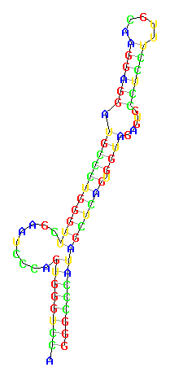
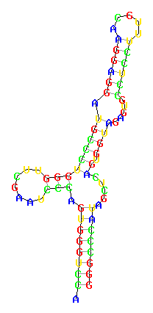
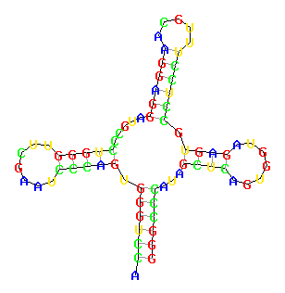
Applications of abstract shapes
Shrep of shape 1
mfe: -35.90
Shrep of shape 2
mfe: -32.20
Shrep of shape 3
mfe: -31.70

Slide 18
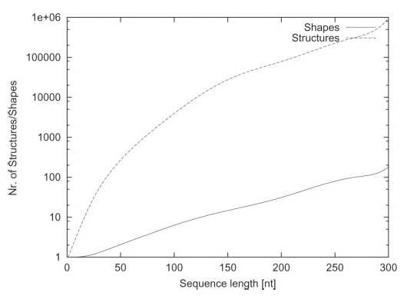
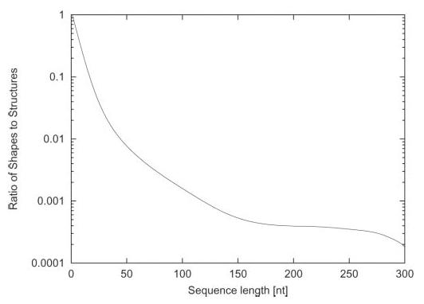
Suboptimal folding
Growth of structure and shape space
size of folding + shape space
(log scale)
shape / structure ratio
Energy range R = 5 kcal / mol

Slide 19
Applications of abstract shapes
Better structure prediction (than mfe folding) can
be obtained using comparative approaches:
Fold a family of homologous sequences using
conserved sequence and structure information.
As an example, Sankoffs algorithm (1985) performs sequence alignment and free energy folding simultaneously and yields good results.
Time complexity O(n⁶) with space O(n⁴).

Slide 20
Applications of abstract shapes
A possible resort :
Abstract shapes !
But we need to reformulate the task of consensus structure
prediction:
(1) Drop sequence alignment step !
(2) Compute a consensus shape for a set of sequences and
obtain an individual shrep for each sequence.

Slide 21
Applications of abstract shapes
Consensus structures with abstract shapes
(1) For a set of sequences, compute a set of abstract shapes for each sequence.
(2) Find the set of common abstract shapes.
(3) Return the best common shape w.r.t. some scoring function ( = consensus shape).
Time complexity: O[ n * Σ N_{i} ] for n = sequence length
and N_{i} = number of foldings of sequence i

Slide 22
Applications of abstract shapes
Possible scoring functions:
Sum of the ranks of the individual shapes.
(b) Sum of the individual energies.
(c) Sum of the shape probabilities.
Prediction accuracy does not differ much using
any of these scoring functions.

Slide 23
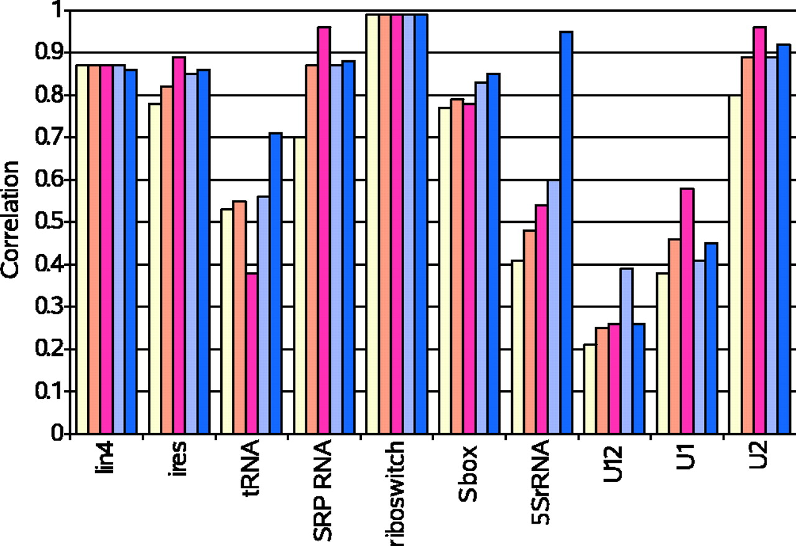
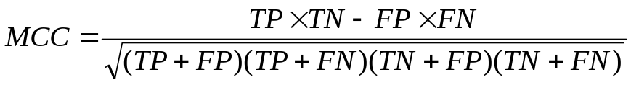
Going comparative pays off
Evaluation in terms of
Matthews Correlation Coefficient:
-1 ≤ MCC ≤ 1
Bars correspond to RNAfold, RNAcast pairs / family (π₅) and RNAcast pairs / family (π₃) in this order.

Slide 24
Comparison with Sankoff
Evaluation on a set of 5S rRNA sequences
Program | Sensitivity | Selectivity | Matthews Correlation
RNAfold | 43.08 | 41.2 | 0.41
Dynalign | 84.20 | - | -
RNAcast (pair, π₃) | 59.10 | 64.20 | 0.60
RNAcast (family, π₃) | 91.98 | 97.82 | 0.95

Slide 25
Summary
Abstract shapes represent disjoint classes of RNA foldings.
Shapes are computed using (Algebraic) Dynamic Programming.
Inspecting the abstract shape space of a sequence
can give a quick overview of the folding space.
Consensus folding with abstract shapes performs well.
Choice of best abstraction function and energy range
is important but difficult.

Slide 26
Conclusions and Outlook
Other approaches to suboptimal folding exist such as statistical sampling of the folding space.
Text representations of shapes could be used as index in structure databases to classify non-coding RNA.
Extensions to the shape formalisms are under work
( e.g. computation of shape probabilities, de novo prediction of non-coding RNA genes )

Slide 27
End
Thanks a lot for your attention !
Questions ?

