Slide 1
SOURCES OF GEOGRAPHIC VARIATION IN HEALTH CARE: EVIDENCE FROM PATIENT MIGRATION
Amy Finkelstein
Matthew Gentzkow
Heidi Williams
Summarized by Joshua Huang

Slide 2
Research Question
Understanding the drivers of geographic variation in US health care utilization.
Health care spending varies, e.g., $14,423 for the average Medicare enrollee in Miami, FL versus $7,819 in Minneapolis, MN in 2010.
Supply factors: doctors’ incentives or beliefs, physical capital, and hospital market structure.
Demand factors: patient characteristics (health and preferences).
Policy implication

Slide 3
Literature Review
Majority of recent work concludes that the role of patients is limited, and that most of the variation likely originates on the supply side
Past studies infer the role of demand-side factors from the explanatory power of patient observables.
E.g., Skinner (2011); Chandra et al. (2012); Cutler et al. (2013); Baker et al. (2014).

Slide 4
Literature Review
This study has two important advantages:
Capture the effect of both observed and unobserved patient characteristics.
Correctly isolates variation arising from differences in patient health, even if observable measures of these factors are endogenous to supply-side measurement differences.

Slide 5
Approach
Investigate the spending pattern of patients before and after migration (e.g., move from high-spending area to low-spending area).

Slide 6


Method
i: patient, j: area, t: year
y: log of total health care utilization
α, γ, τ: fixed effects for patient, area, and year
ρ: fixed effect for movers in relative year r
x: time-varying patient characteristics
Combined effect of patient characteristics:

Slide 7



Method
Decompose variation in average log utilization across regions into a demand-side component attributable to patients and a supply-side component attributable to place.

Slide 8

Method
The relative-year specific coefficients θ are the parameters of interest: they measure changes in y in years around the move scaled relative to δ.
The plot of θ should be flat before and after move, and jump on move.

Slide 9

Identification
Need “movers” to separate differences in the area fixed effects from differences in the average patient characteristics.
Need movers from both directions (e.g., from area j’ to j and j to j’) to estimate $γ_{j}−γ_{j′}$

Slide 10
Data
20% sample of Medicare beneficiaries from 1998 to 2008, about 13 million patients.
Final sample includes 2:5 million patients, of whom approximately 0:5 million are movers.
Medicare claims for inpatient care, outpatient care, and physician services.
Demographic information for each patient: age, gender, race, zip code of residence.

Slide 11
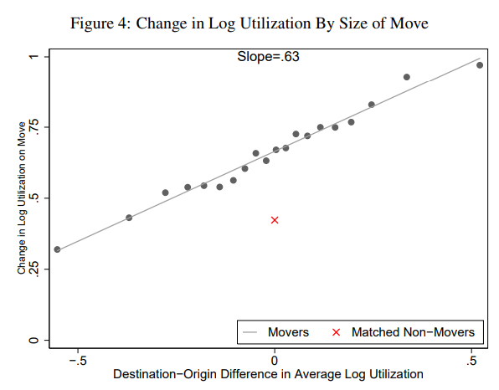
Results
An average patient share of roughly 0:37
Linearity support for the additively separable model

Slide 12
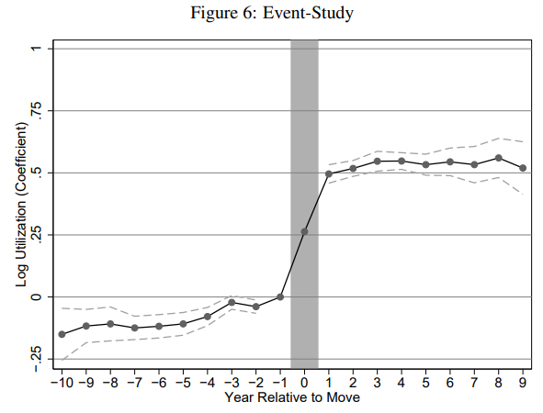
Coefficient 0.5 implies a patient share of roughly a half
A small but statistically significant pre-trend. This trend could reflect systematic changes in utilization of movers relative to non-movers.

Slide 13
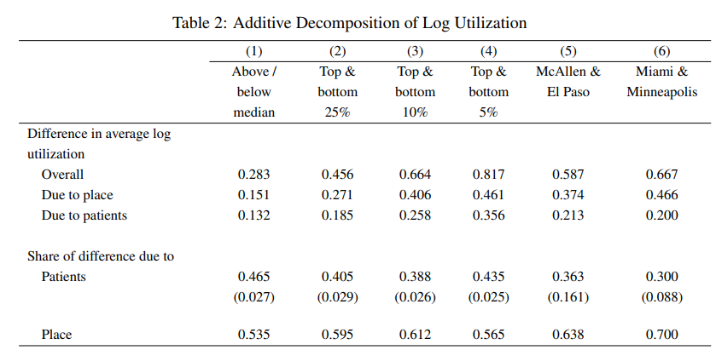

Slide 14
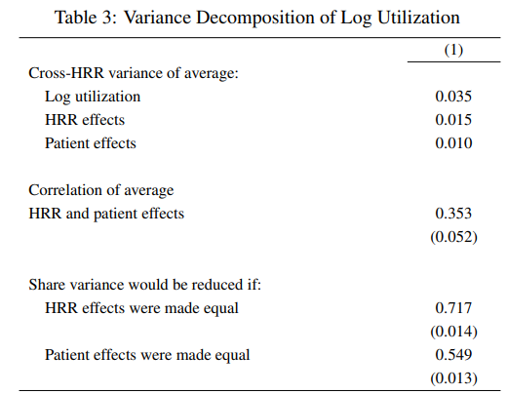

Slide 15
Other outcomes
Relative importance of patients may be somewhat smaller when we focus on levels.
Patient share varies from a low of 0.09 for diagnostic tests to a high of 0.71 for emergency room visits.

Slide 16
Robustness
A central assumption of our baseline model is that there are no differential trends in the log utilization of movers that vary systematically with their origin or destination.
A second important assumption is that place and patient differences in log utilization are constant over time, up to the variation allowed by the age controls and by the relative year fixed effects.
A third important assumption is that c and γ enter the equation for log utilization additively.
A fourth important assumption is that the errors in our model are not correlated with entering or exiting the sample due to death, HMO status, or failure to enroll for a complete year in Medicare Part A or B.
A final assumption is that HRRs are an adequate market definition.

Slide 17
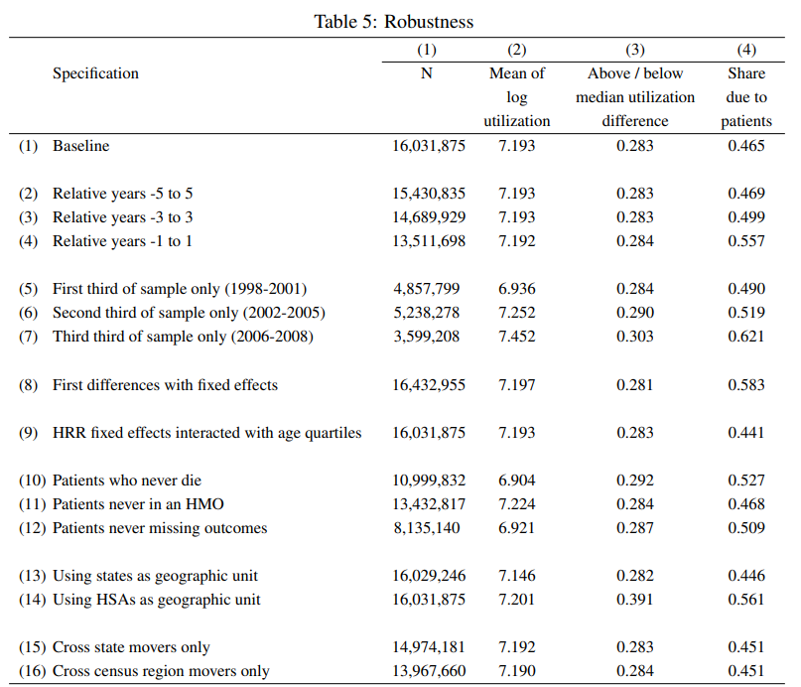

Slide 18
Mechanisms
Patient Demographics
Persistent Treatment
Habit Formation
Patient Health
Examination of mechanisms suggests that a large part of this demand-side heterogeneity may be due to patient health.
Demand-side differences may not be easily affected by policies aimed at changing patients’ information or beliefs.

Slide 19
Conclusion
Robust evidence that 40 to 50 percent of geographic variation in the log of health care utilization is due to fixed characteristics of patients that they carry with them when they move.
The remaining 50 to 60 percent of variation is due to place-specific factors, possibly including doctor practice patterns and characteristics of health care organizations.
Demand-side differences may not be easily affected by policies aimed at changing patients’ information or beliefs.
The sharp adjustment we observe around moves suggests policies that affect the supply-side can have immediate impacts.

Slide 20
Limitations
Not sufficient to draw strong conclusions about the efficiency of observed geographic variation. Though it may be tempting to see supply-driven heterogeneity as evidence of waste, such variation could reflect different allocations of physical or human capital, and so be consistent with efficiency.
Conversely, demand-driven heterogeneity could reflect patient misinformation, and so contribute to inefficiency.
A more careful examination of the efficiency implications of the geographic variation is an important direction for further work.

