Slide 1
Data Mining Term Project Presentation
資工碩二 611121213 莊雅卉 資工碩二 611121214 施芃如

Slide 2
CONTENT
資料集的介紹
描述問題
研究方法
研究結果
結論

Slide 3
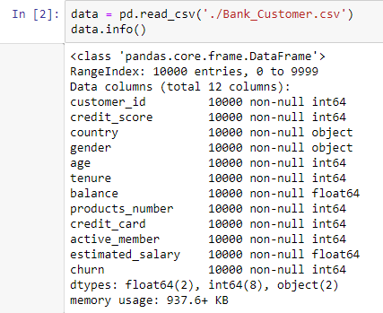
資料集的介紹

Slide 4
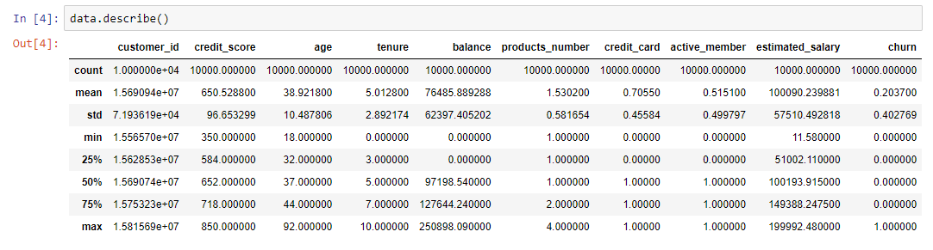
資料集的介紹

Slide 5
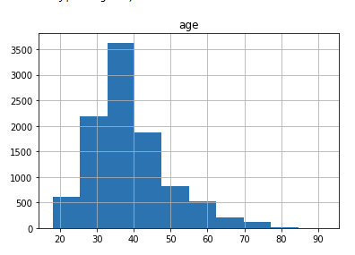
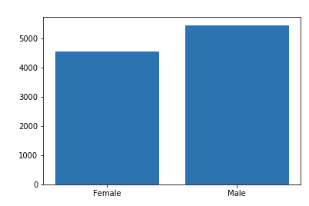
資料集分析

Slide 6
CONTENT
資料集的介紹
描述問題
研究方法
研究結果
結論

Slide 7
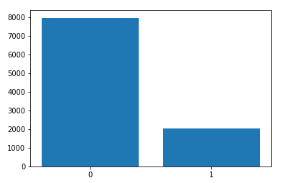

描述問題
利用10個特徵 判定該USER是否會留下

Slide 8
CONTENT
資料集的介紹
描述問題
研究方法
研究結果
結論

Slide 9
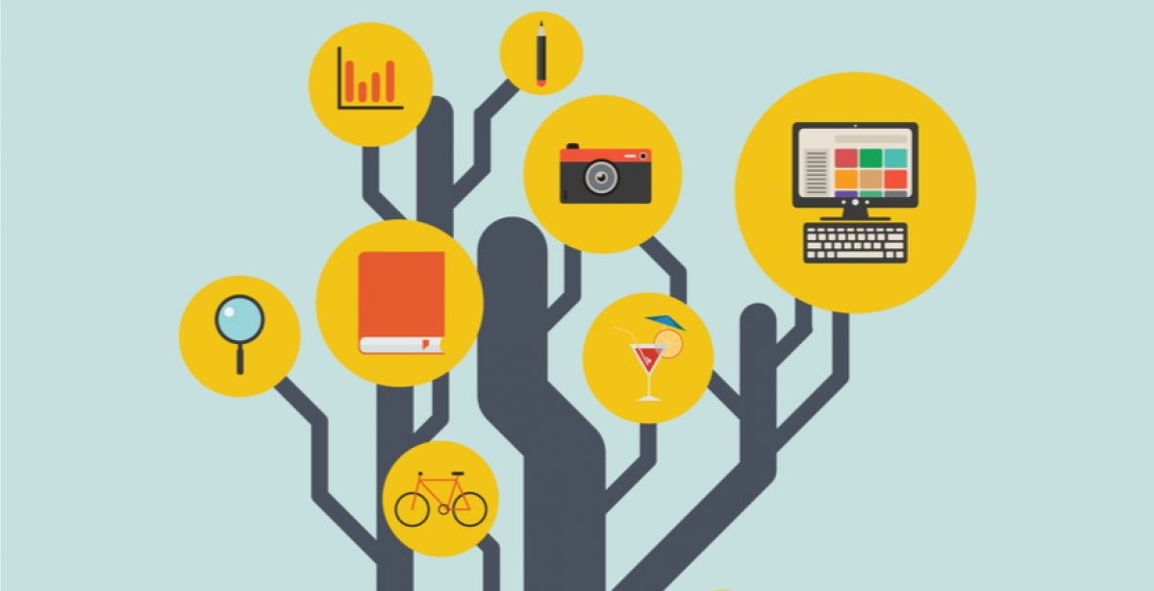
Decision Tree
決策樹會根據訓練資料產生一棵樹，依據訓練出來的規則來對新樣本進行預測。決策樹演算法可以使用不同的方式來評估分枝的好壞(亂度)，例如像是 Information gain、Gain ratio、Gini index。依據訓練資料找出合適的規則，最終生成一個規則樹來決策所有事情，其目的使每一個決策能夠使訊息增益最大化。
(photo from :https://studyonline.unsw.edu.au/blog/decision-trees)

Slide 10

SVM
SVM就是將在低微度空間線性不可分的樣本映射到高維度空間去，找到一個超平面將這些樣本做有效
(photo from : https://www.javatpoint.com/machine-learning-support-vector-machine-algorithm

Slide 11
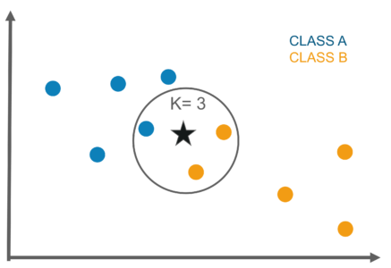
KNN
KNN屬於機器學習中的監督式學習(Supervised learning)，不過一般來說監督式學習是透過資料訓練(training)出一個model，但是在KNN其實並沒有做training的動作。KNN一般用來做資料的分類，如果你已經有一群分好類別的資料，後來加進去點就可以透過KNN的方式指定新增加資料的分類。

Slide 12
CONTENT
資料集的介紹
描述問題
研究方法
研究結果
結論

Slide 13
Gini決策樹
Age<=42.5
gini = 0.322
Samples = 8000
Value = [6387,1613]
Class = 1
products_number <= 2.5
gini = 0.209
samples = 5688
value = [5014,674]
Class = 1
activate_member<= 0.5
gini = 0.482
samples = 2312
value = [1373,939]
Class = 1
products_number <= 1.5
gini = 0.186
samples = 5556
value = [4979,577]
Class = 1
balance <= 57003.365
gini = 0.39
samples = 132
value = [35,97]
Class = 0
age <= 50.5
gini = 0.485
samples = 1033
value = [426,607]
Class = 0
products_number <= 2.5
gini = 0.384
samples = 1279
value = [947,332]
Class = 1
country <= 1.5
gini = 0.281
samples = 2744
value = [2281,463]
Class = 1
balace <= 1884.34
gini = 0.078
samples = 2812
value = [2698,114]
Class = 1
estimated_salary <= 132695.484
gini = 0.499
samples = 54
value = [26,28]
Class = 0
estimated_salary <= 193039.227
gini = 0.204
samples = 78
value = [9,69]
Class = 0
products_number <= 1.5
gini = 0.498
samples = 701
value = [375,326]
Class = 1
age <= 73.5
gini = 0.26
samples = 332
value = [51,281]
Class = 0
products_number <= 1.5
gini = 0.359
samples = 1230
value = [942,288]
Class = 1
age <= 65.5
gini = 0.183
samples = 49
value = [5,44]
Class = 0

Slide 14
Entropy 決策樹
Age<=42.5
entropy = 0.73
Samples = 8000
Value = [6369,1631]
Class = 1
products_number <= 2.5
entropy = 0.527
samples = 5701
value = [5022,679]
Class = 1
activate_member<= 2.5
entropy = 0.527
samples = 5701
value = [5022,679]
Class = 1
products_number <= 1.5
entropy = 0.484
samples = 5574
value = [4990,584]
Class = 1
Balance <= 57003.365
entropy = 0.814
samples = 127
value = [32,95]
Class = 0
age <= 50.5
entropy = 0.976
samples = 1042
value = [426,616]
Class = 0
products_number <= 2.5
entropy = 0.838
samples = 1257
value = [921,336]
Class = 1
country <= 1.5
entropy = 0.653
samples = 2765
value = [2301,464]
Class = 1
balace <= 1884
entropy = 0.255
samples = 2809
value = [2689,120]
Class = 1
estimated_salary <= 167555.125
entropy = 1.0
samples = 51
value = [25,26]
Class = 0
estimated_salary <= 193039.227
entropy = 0.443
samples = 76
value = [7,69]
Class = 0
products_number <= 2.5
entropy = 0.996
samples = 694
value = [374,320]
Class = 1
age <= 73.0
entropy = 0.608
samples = 348
value = [52,296]
Class = 0
products_number <= 1.5
entropy = 0.785
samples = 1196
value = [916,280]
Class = 1
age <= 65.5
entropy = 0.409
samples = 61
value = [5,56]
Class = 0

Slide 15
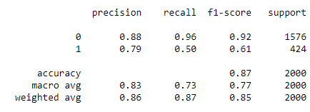
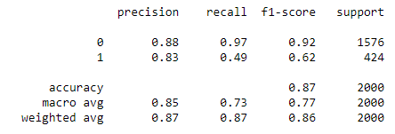
Classification Report
gini
entropy

Slide 16
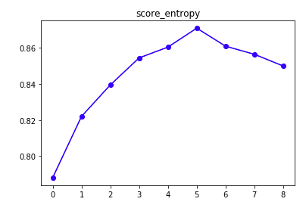
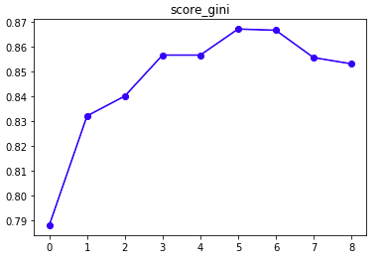
決策樹結果
gini
entropy
max_depth=5

Slide 17
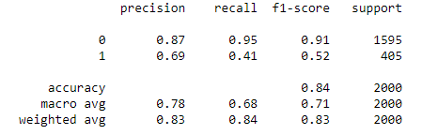
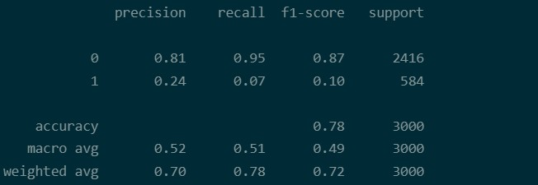
其他方法及結果
SVM
KNN

Slide 18
CONTENT
資料集的介紹
描述問題
研究方法
研究結果
結論

Slide 19
結論
對於此資料集，相較於SVM、KNN，利用Decision Tree 所訓練出來的模組，準確度較高。
利用gini、entropy計算純度，Max_depth=5時達到最高的準確度。
透過決策樹可以透過特徵去進行決策，盡量使性質相像的資料，被分到同一個類別。
SVM透過降維的方式可以訓練出較好的模組。
KNN可透過調整K值來達到較好的準確率，但K值過大時會造成過度擬合。

