Slide 1

Online Voting System using Blockchain
K.SHIVANI(17RH1A05B1)
K.KEERTHI PRIYA(17RH1A05C0)
K.PRASHANTHI(17RH1A0584)
K.RAMYA SRI(17RH1A0591)

Slide 2

Contents
Problem
Solution
Technology Used
Use case
Dependency
Conclusion

Slide 3
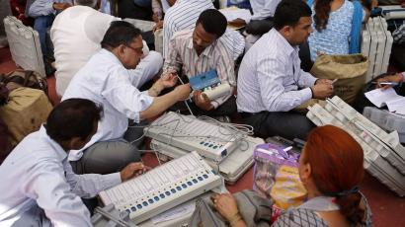
Problem
Transparency
Anonymity
Verifiability
Accuracy

Slide 4
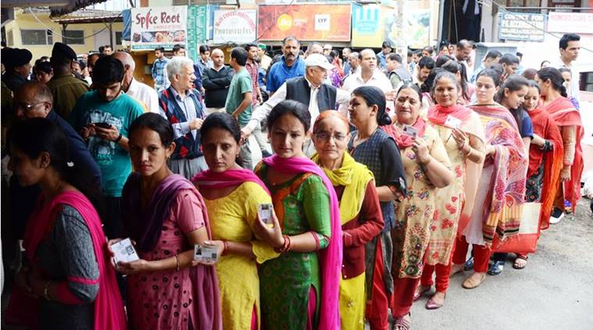
Problem
Security
Time management
Political Privacy

Slide 5

Solution
Voter privacy
Election integrity
End-to-end security
Full verifiability
Vote correctness

Slide 6

Solution
Online voting enables voters to cast their vote privately and easily from any location and on any device with internet access.
This enables election officials to assure that their votes remain cast-as-intended , recorded-as-cast and counted-as-recorded.

Slide 7

Technology
HTML
Java Script
CSS
PHP
Python
Block chain
Image Processing

Slide 8
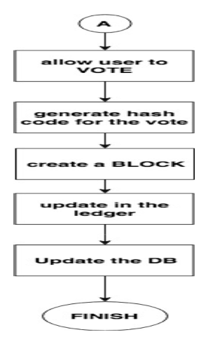
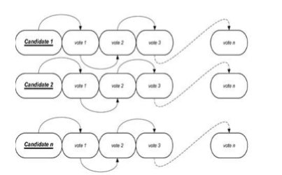
Use case

Slide 9
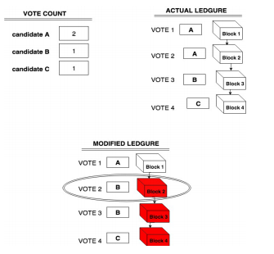

Slide 10

Dependency
E-voting is secure: votes are saved in encrypted and anonymized form. It prevent votes from being manipulated without being detected.
Voters can cast their vote irrespective of their place of residence.
It is platform independent. voters can cast their vote from any devices with internet facility.

Slide 11
Conclusion
We have proposed an online voting system based on the Blockchain technology. This approach increases the voting percentage overall and gives a more accurate, transparent and fair election system. This proposed system ensure tamper proof and also ensure that electoral frauds do not happen in the process. There would be no conflict in the process for calculating and declaring result.

Slide 12

Thank you

