Slide 1
Screenshots of AnVIL Homepage

Slide 2

Terms of Use
Notes:
Except where otherwise indicated, this content is available for use under CC B Y 4.0.

Slide 3
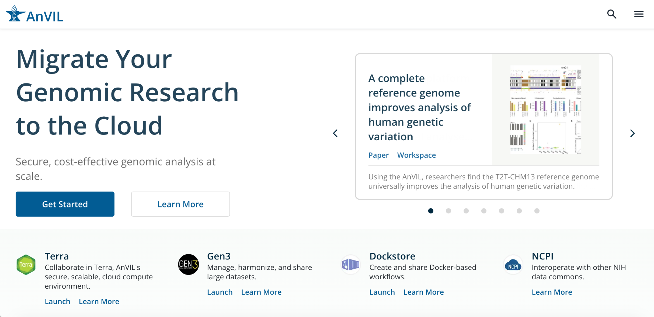
Notes:
No highlight

Slide 4
Notes:
Highlight Terra

