Slide 1
Add Members to
Billing Project
Notes:
This video will show you how to add members to a Terra Billing Project. Adding someone to a Billing Project allows them to use the Billing Project to fund their work on AnVIL. Note that you must be an “Owner” of the Billing Project before you can add someone to it.

Slide 2

Terms of Use
Notes:
Except where otherwise indicated, this content is available for use under CC B Y 4.0.

Slide 3

https://anvil.terra.bio/ homepage screenshot by Katherine Cox. CC-BY-4.0
Notes:
To get started, log in to Terra.

Slide 4
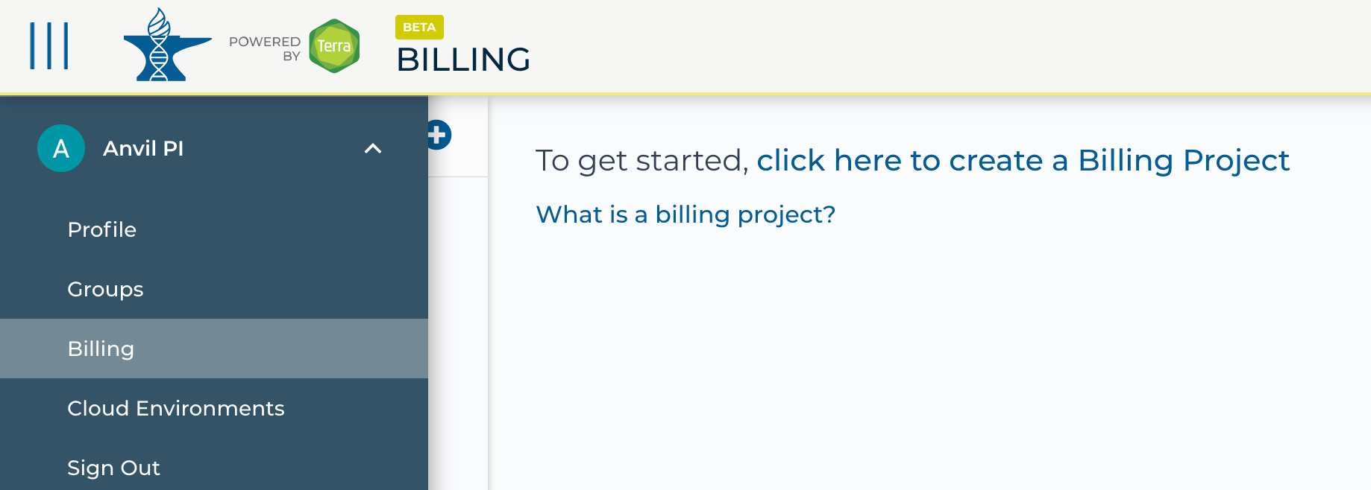
https://anvil.terra.bio/ select Billing from drop-down menu screenshot by Katherine Cox. CC-BY-4.0
Notes:
Click the triple bar in the top left corner to access the drop-down menu. Click the arrow next to your name to expand the menu, then click “Billing”.

Slide 5
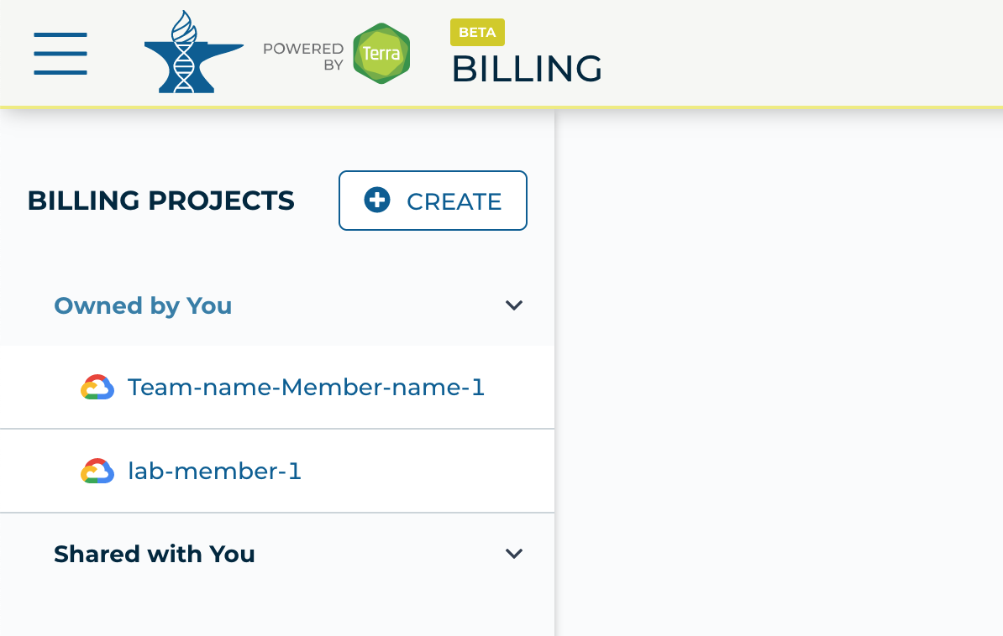
https://anvil.terra.bio/#billing Billing Projects screenshot by Katherine Cox. CC-BY-4.0
Notes:
On the Billing page, click “Owned by You” and find the Billing Project. If you do not see the Billing Project in this list, then you are not an Owner and do not have permission to add members.

Slide 6
https://anvil.terra.bio/#billing Billing Projects screenshot by Katherine Cox. CC-BY-4.0
Notes:
Click on the name of the Billing Project.

Slide 7
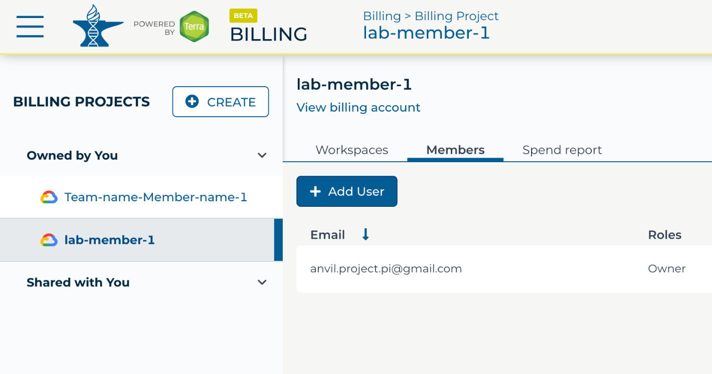
https://anvil.terra.bio/#billing Billing Project member management page screenshot by Katherine Cox. CC-BY-4.0
Notes:
Click on the “Members” tab to view and manage members. Then click the “Add User” button.

Slide 8
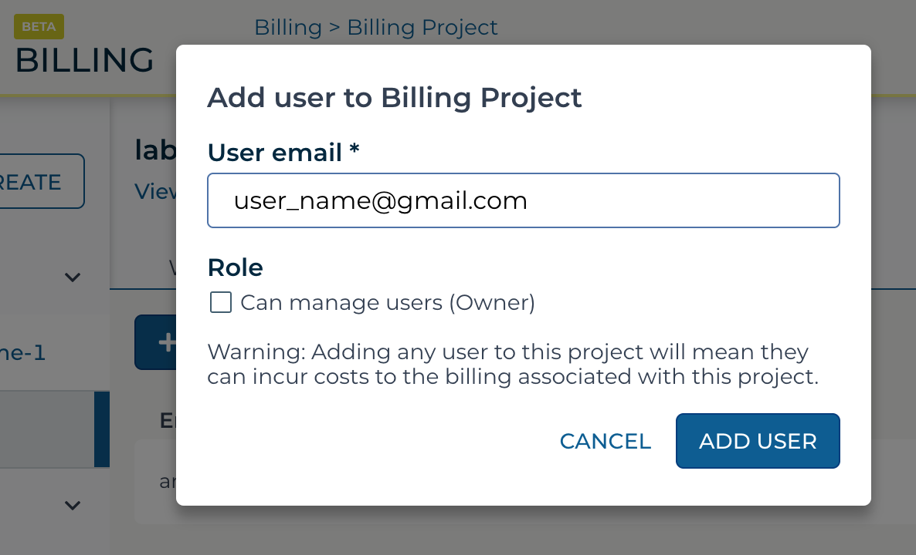
https://anvil.terra.bio/#billing add user to Billing Project dialog box screenshot by Katherine Cox. CC-BY-4.0
Notes:
Enter the email address of the user you’d like to add the the Billing Project. Make sure this is the account that they use to access AnVIL.

Slide 9
https://anvil.terra.bio/#billing add user to Billing Project dialog box screenshot by Katherine Cox. CC-BY-4.0
Notes:
If this user will need to add and remove other users of the Billing Project, check the Owner box. Otherwise leave it unchecked. It’s often a good idea to have at least one other Owner of a Billing Project in order to avoid getting locked out, in case the original owner leaves or loses access to their account.

Slide 10
https://anvil.terra.bio/#billing add user to Billing Project dialog box screenshot by Katherine Cox. CC-BY-4.0
Notes:
Click “ADD USER”.

Slide 11
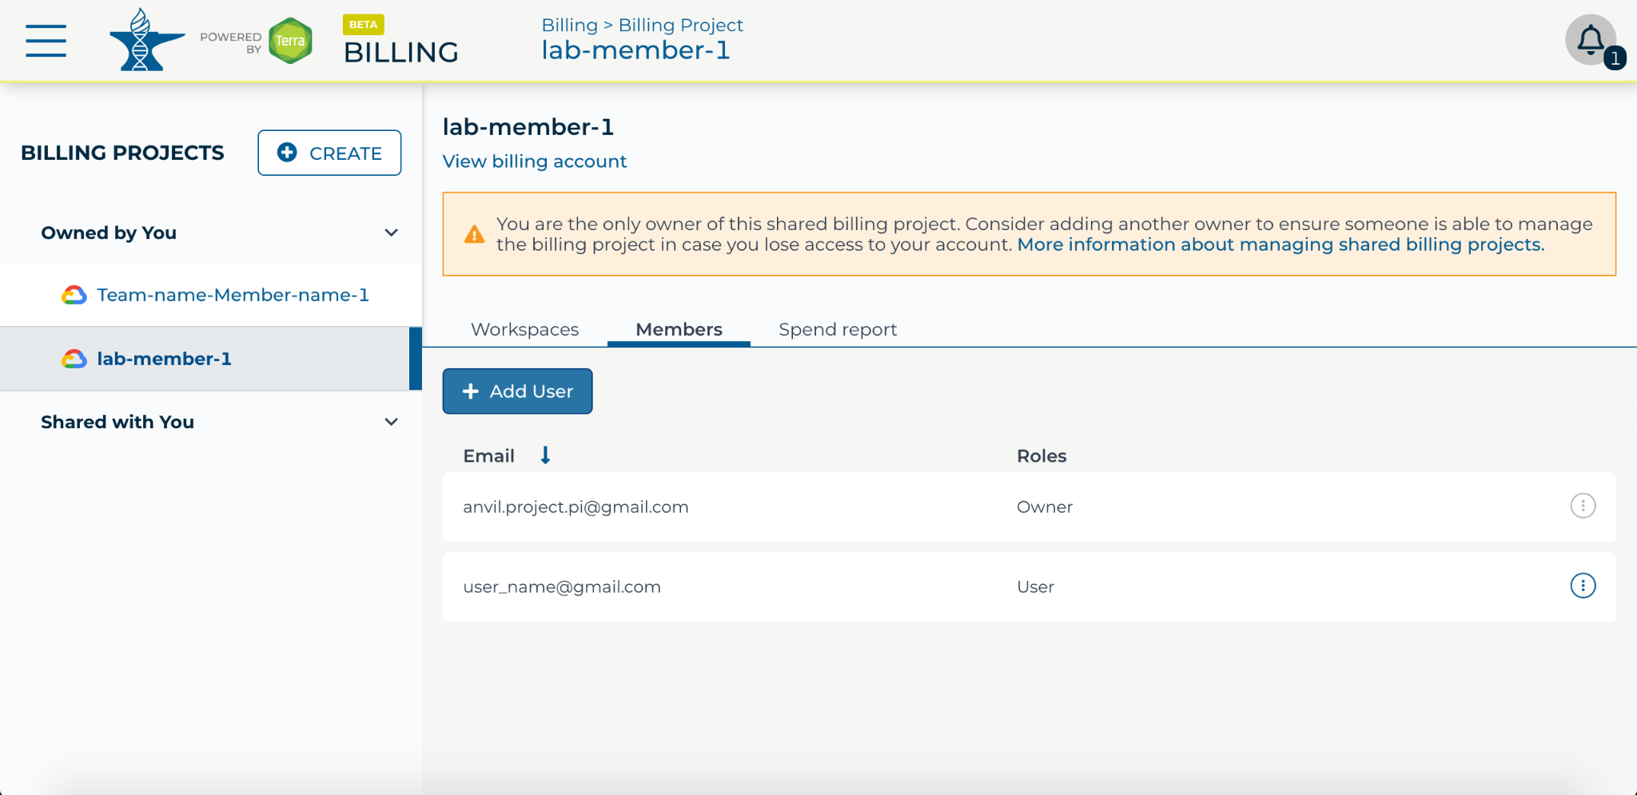
https://anvil.terra.bio/#billing Billing Project member management page screenshot by Katherine Cox. CC-BY-4.0
Notes:
They should now show up in the list of Billing Project members, along with the appropriate role. They can now use the Billing Project to fund work on AnVIL.

Slide 12
https://anvil.terra.bio/#billing Billing Project member management page screenshot by Katherine Cox. CC-BY-4.0
Notes:
If you need to remove members or modify their roles, you can do so at any time by clicking the teardrop button next to their name.

Slide 13
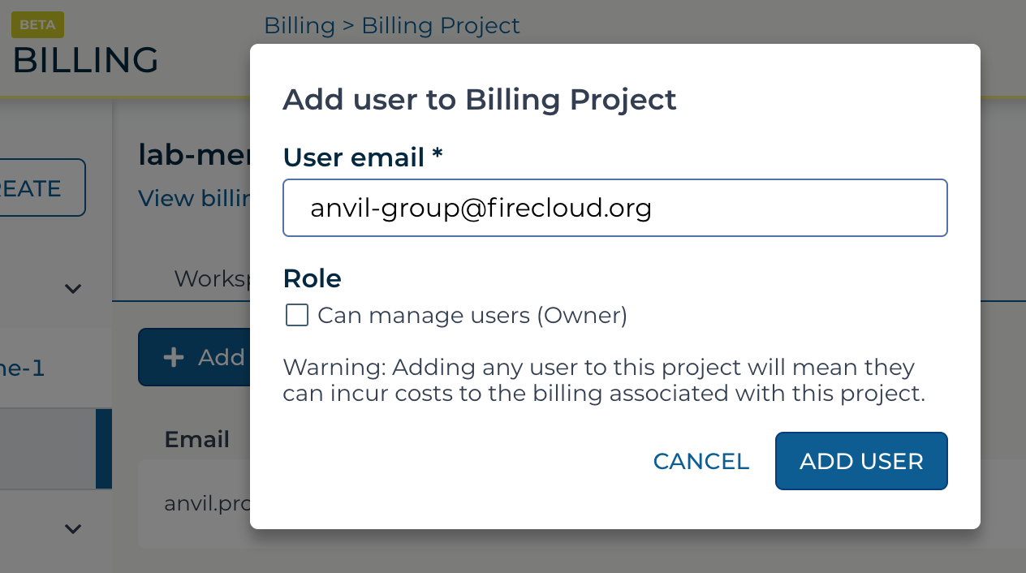
Notes:
Note that you can also add Terra Groups to a Billing Project. Adding a Terra Group will add all Group members with whatever role you grant the Group. To add a Terra Group, enter the Group email address as the user email. You can find the Group email address on the Terra Group management page.

Slide 14
Contributions
Katherine Cox
Ava Hoffman
Frederick Tan
Notes:
Thank you to everyone who contributed!

