Slide 1
Set Budget Alerts for GCP
Notes:
This video will show you how to set up budget alerts for your Google Cloud Platform expenses.

Slide 2
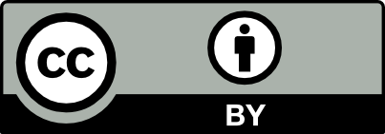
Terms of Use
Notes:
Except where otherwise indicated, this content is available for use under CC B Y 4.0.

Slide 3
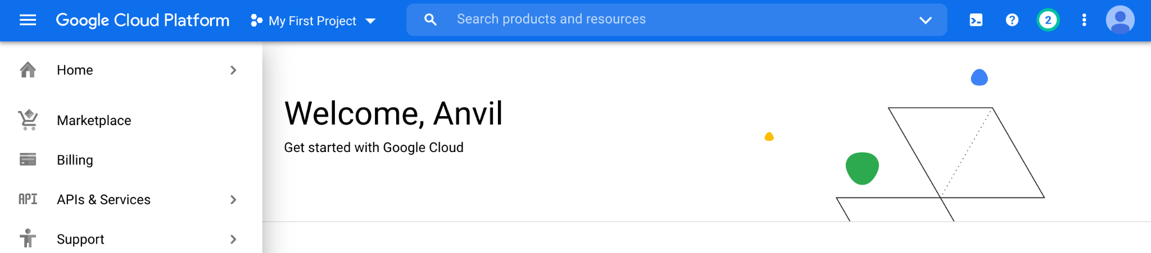
https://console.cloud.google.com/ menu screenshot by Katherine Cox. CC-BY-4.0
Notes:
To get started, log in to Google Cloud Platform using the Google ID associated with your Google Cloud Billing Account.

Slide 4
https://console.cloud.google.com/ select billing from menu screenshot by Katherine Cox. CC-BY-4.0
Notes:
Open the dropdown menu on the top left and click on Billing.

Slide 5
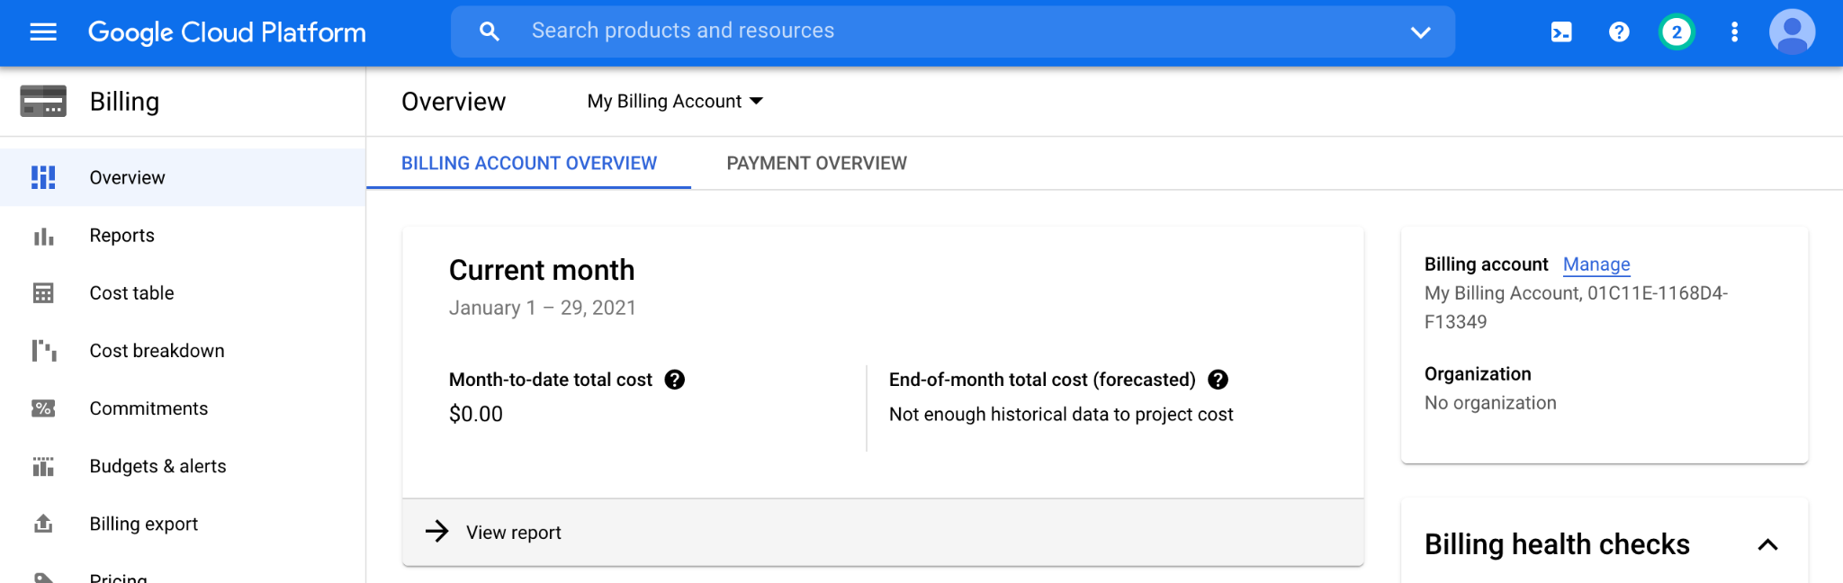
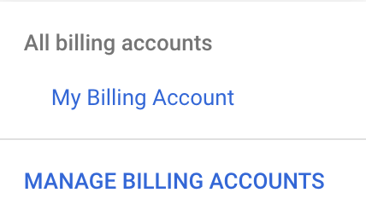
https://console.cloud.google.com/billing/ dropdown menu for an individual billing account screenshot by Katherine Cox. CC-BY-4.0
Notes:
You may be automatically directed to view a specific Billing Account. If you see information about a single account (and it’s not the one you’re interested in), you can get back to the list of all your Billing Accounts by clicking “Manage Billing Accounts” from the drop-down menu.

Slide 6
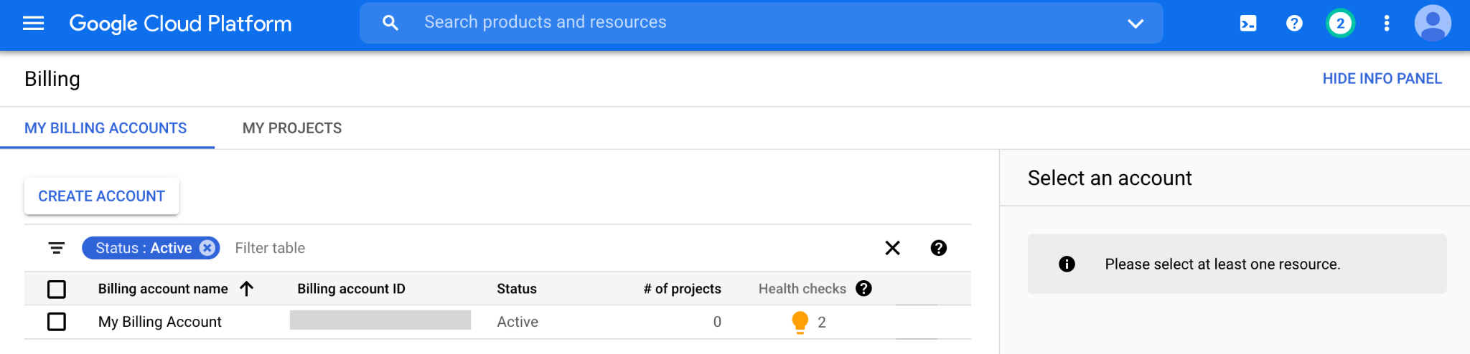
https://console.cloud.google.com/billing screenshot by Katherine Cox. CC-BY-4.0
Notes:
Click on the name of the Billing Account you want to set alerts for.

Slide 7
https://console.cloud.google.com/billing/ select budgets and alerts screenshot by Katherine Cox. CC-BY-4.0
Notes:
In the left-hand menu, click “Budgets & alerts”.

Slide 8
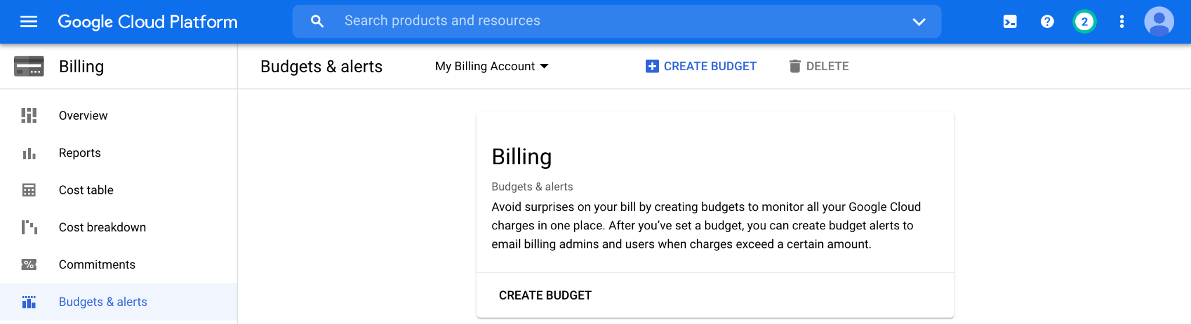
https://console.cloud.google.com/billing/ create budget screenshot by Katherine Cox. CC-BY-4.0
Notes:
Click the “Create Budget” tab.

Slide 9
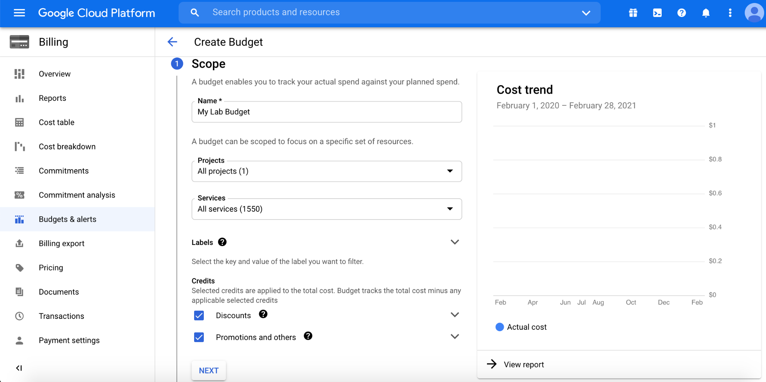
https://console.cloud.google.com/billing/ set budget scope screenshot by Katherine Cox. CC-BY-4.0
Notes:
Enter a name for your budget, and then choose which projects you want to monitor. Then click “Next”.

Slide 10
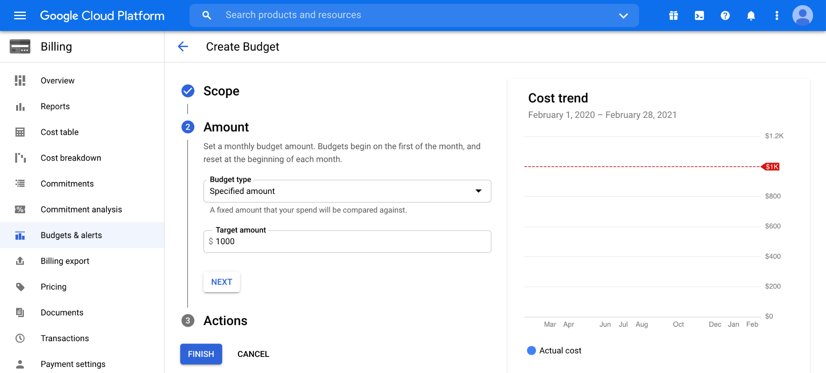
https://console.cloud.google.com/billing/ set budget amount screenshot by Katherine Cox. CC-BY-4.0
Notes:
For Budget Type, select “Specified amount”. Enter the total budget amount for the month (you will set alerts at different thresholds in the next step). Click “Next” (do not click “Finish”).

Slide 11
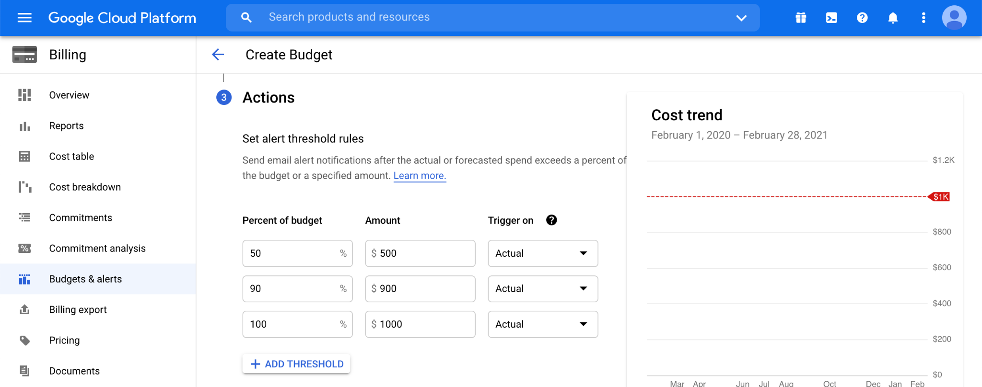
https://console.cloud.google.com/billing/ set budget action thresholds screenshot by Katherine Cox. CC-BY-4.0
Notes:
Enter the threshold amounts where you want to receive an alert. We recommend starting with 50% and 90%. You can set other alerts if you prefer.

Slide 12
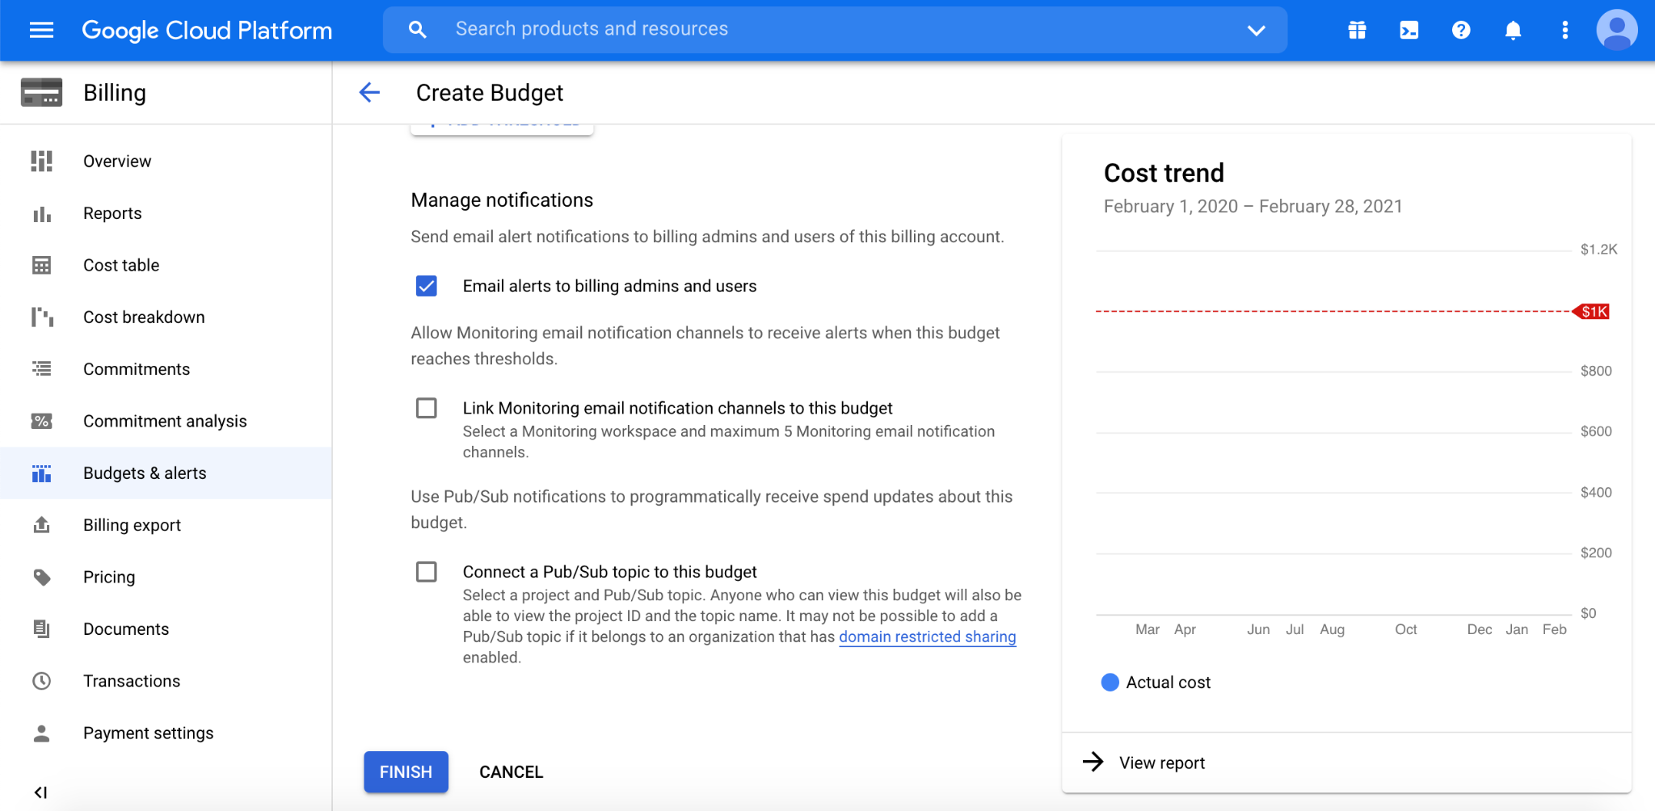
https://console.cloud.google.com/billing/ set budget notifications screenshot by Katherine Cox. CC-BY-4.0
Notes:
Check the box for “Email alerts to billing admins and users”, then click “Finish”. Now you (as the owner and admin), along with anyone you added with admin or user privileges (e.g. lab managers) will receive alerts when your lab members reach the specified spending thresholds. These emails will be sent to the Gmail accounts associated with the Billing Account.

Slide 13
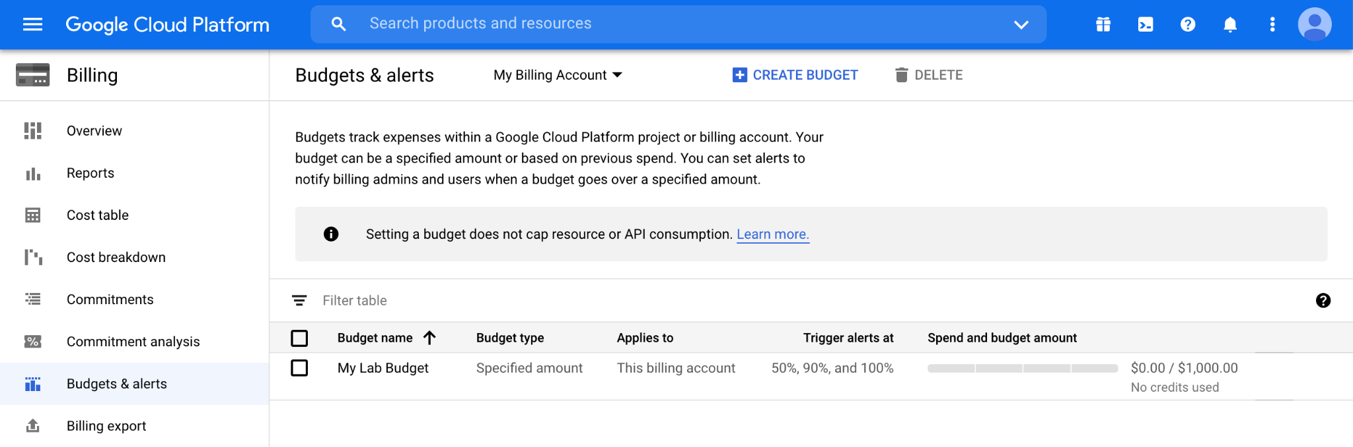
https://console.cloud.google.com/billing/ view and edit budget alerts screenshot by Katherine Cox. CC-BY-4.0
Notes:
You can edit your budget alerts at any time by going to Billing, then Budgets & alerts, then clicking on the name of the budget you want to edit.

