Slide 1
Clone a Workspace
Notes:
This video will show you how to clone a Terra Workspace. Workspaces are where analyses takes place on AnVIL. Cloning an existing Workspace allows you to copy existing documentation, code, and/or data into your own experimental space so that you can use it yourself.

Slide 2

Terms of Use
Notes:
Except where otherwise indicated, this content is available for use under CC B Y 4.0.

Slide 3
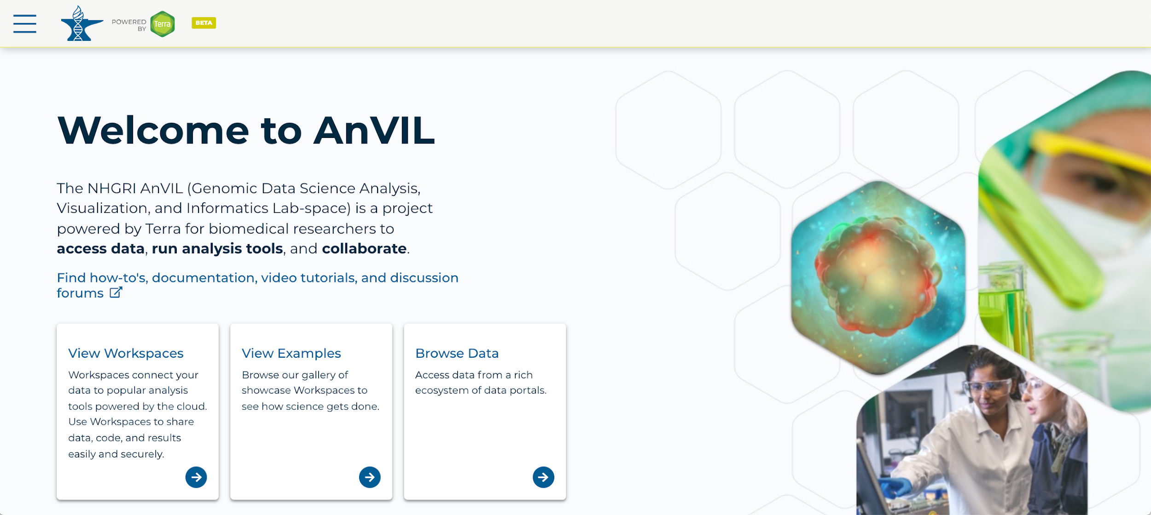
https://anvil.terra.bio/ homepage screenshot by Katherine Cox. CC-BY-4.0
Notes:
To get started, log in Terra using your Google ID.

Slide 4
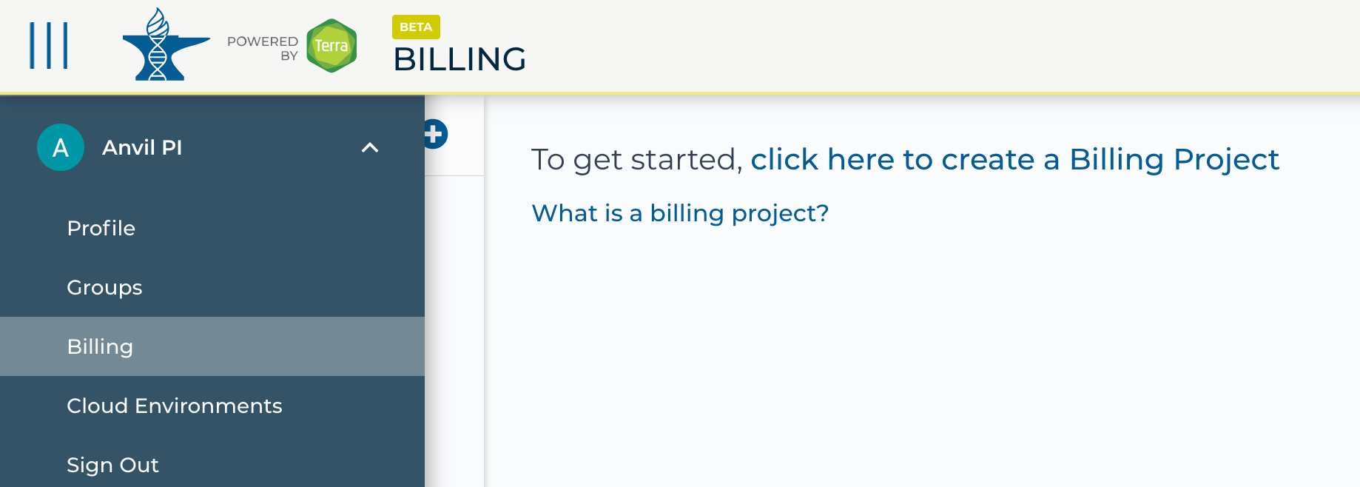
https://anvil.terra.bio/ select Billing from drop-down menu screenshot by Katherine Cox. CC-BY-4.0
Notes:
In order to clone a Workspace, you must be a member of a Terra Billing Project. To see whether you belong to any Terra Billing Projects, click the triple bar in the top left corner to access the drop-down menu, then click the arrow next to your name to expand the menu, and click “Billing”. If you are not a member of an active Billing Project, you will need to either be added to an existing Billing Project or set one up yourself before you can clone a Workspace.

Slide 5
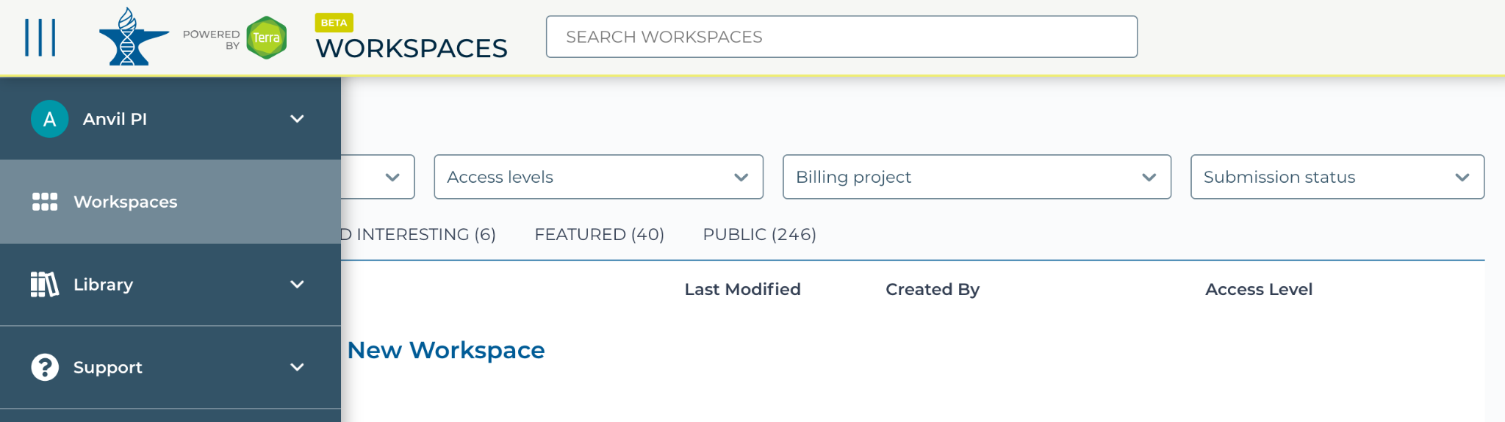
https://anvil.terra.bio/#workspaces navigate to workspaces screenshot by Katherine Cox. CC-BY-4.0
Notes:
To create a Workspace, click the triple bar in the top left corner to access the drop-down menu, then click “Workspaces”.

Slide 6
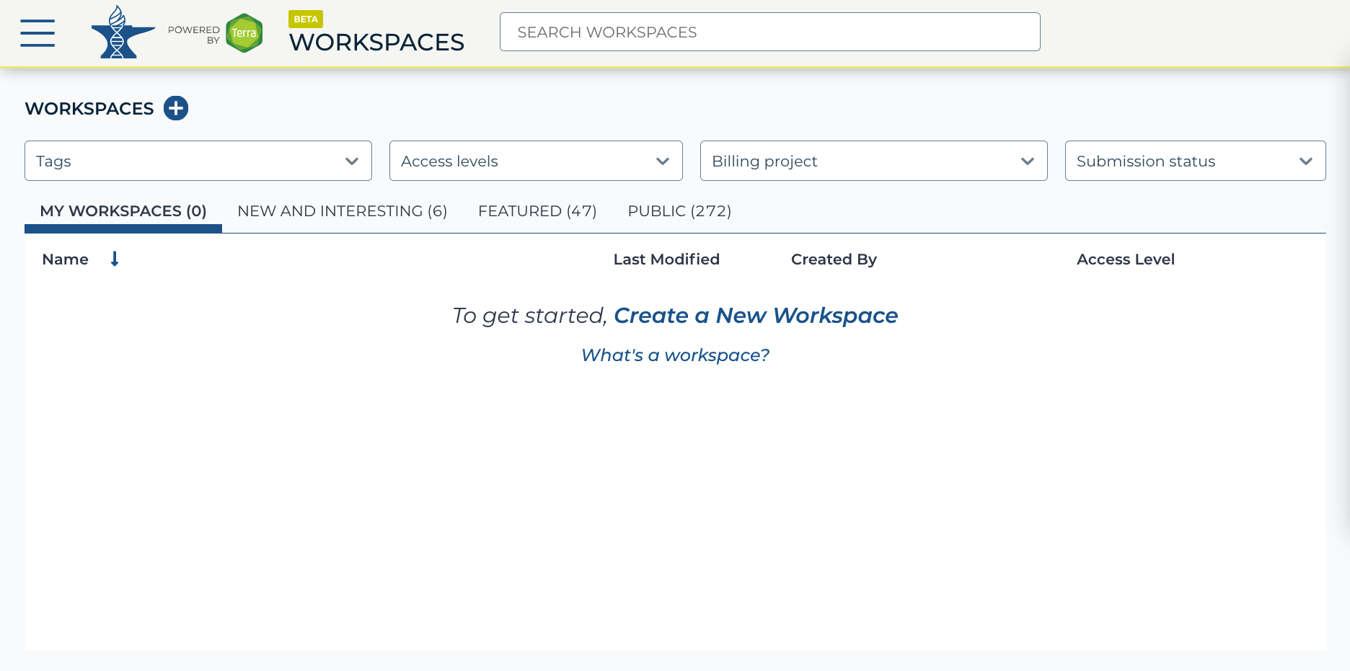
https://anvil.terra.bio/#workspaces Workspaces screenshot by Ava Hoffman. CC-BY-4.0
Notes:
Locate the Workspace you want to clone. If a Workspace has been shared with you ahead of time, it will appear in “MY WORKSPACES”. In this screenshot, no Workspaces have been shared.

Slide 7
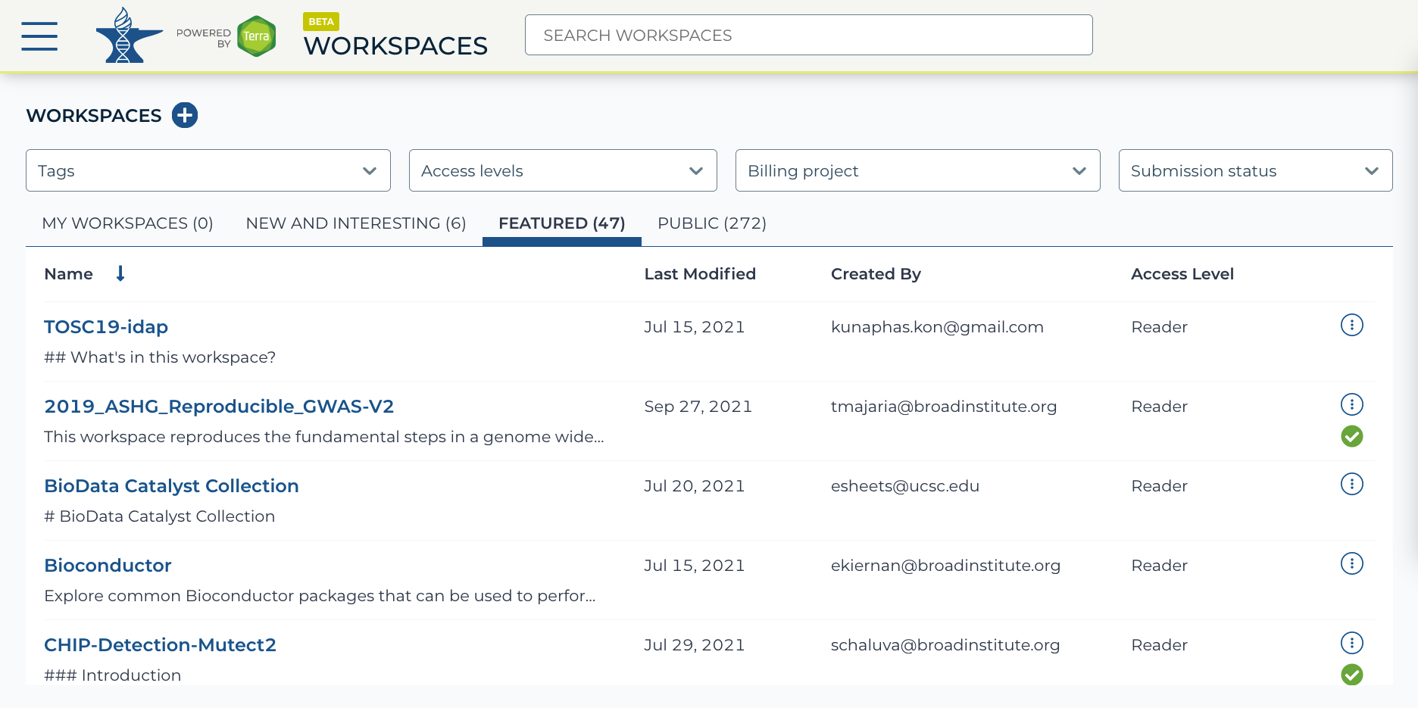
https://anvil.terra.bio/#workspaces Workspaces screenshot by Ava Hoffman. CC-BY-4.0
Notes:
If a Workspace has not been shared with you, navigate to the “FEATURED” or “PUBLIC” Workspace tabs.

Slide 8
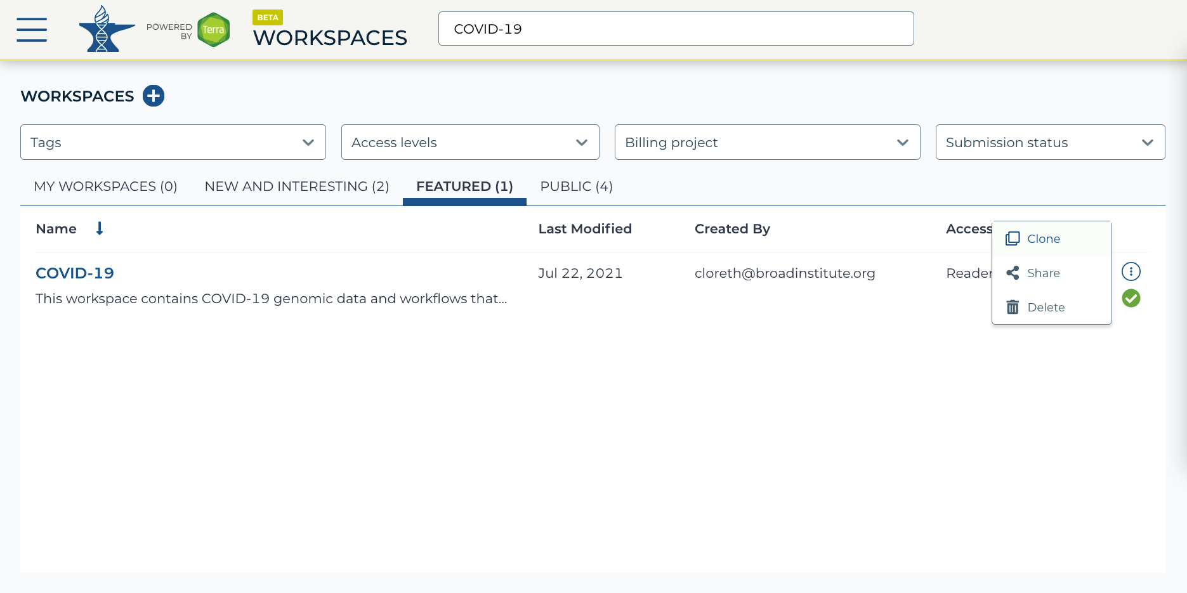
https://anvil.terra.bio/#workspaces Workspaces screenshot by Ava Hoffman. CC-BY-4.0
Notes:
Use the search box to find the Workspace you want to clone.

Slide 9
https://anvil.terra.bio/#workspaces Workspaces screenshot by Ava Hoffman. CC-BY-4.0
Notes:
Click the teardrop button on the far right next to the Workspace you want to clone. Click “Clone”.

Slide 10
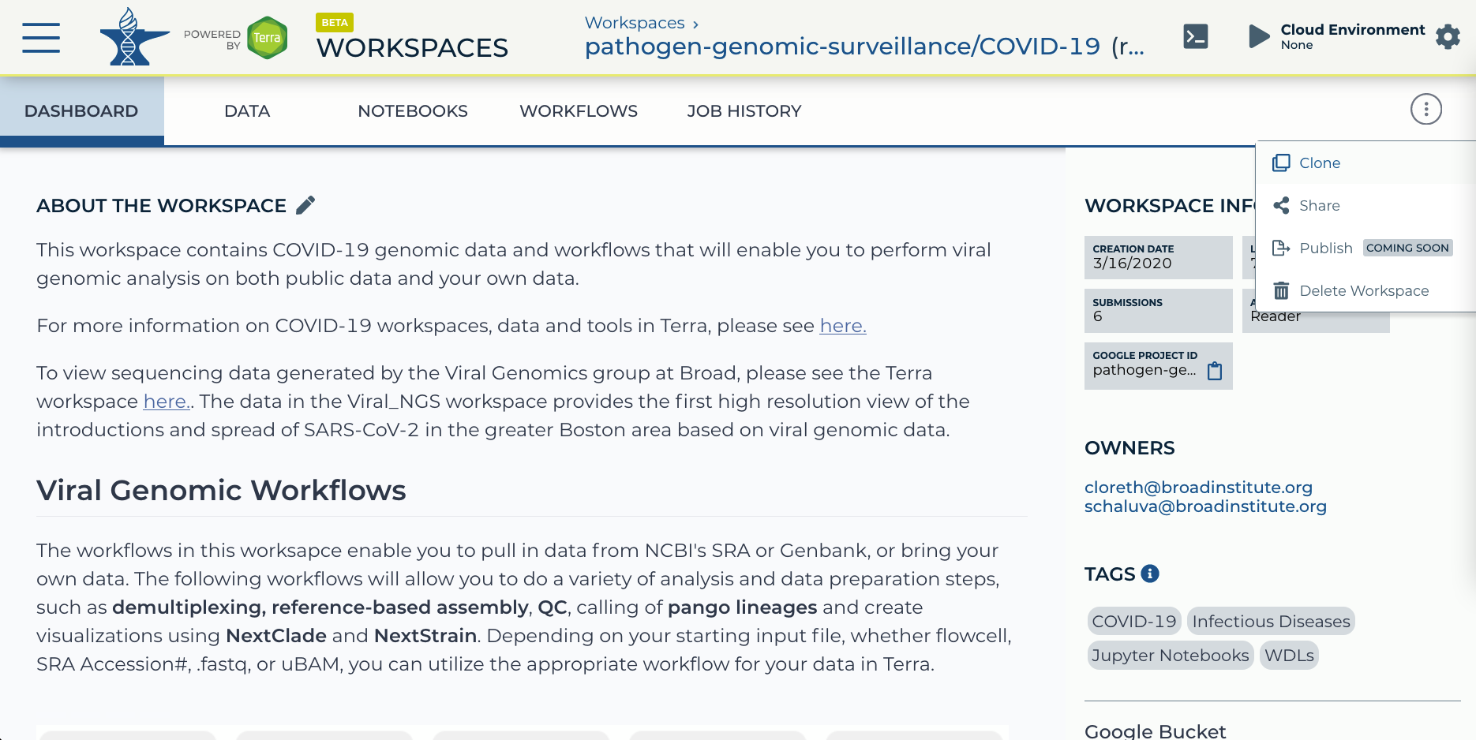
https://anvil.terra.bio/#workspaces/pathogen-genomic-surveillance/COVID-19 Workspace screenshot
by Ava Hoffman. CC-BY-4.0
Notes:
Alternatively, you can clone the Workspace from within the Workspace Dashboard instead of the search results.

Slide 11
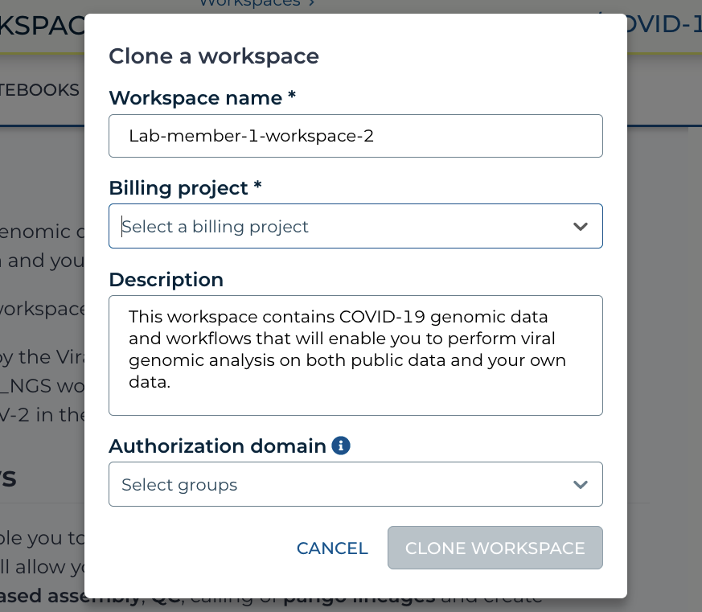
https://anvil.terra.bio/#workspaces/pathogen-genomic-surveillance/COVID-19 clone a Workspace popout screenshot
by Ava Hoffman. CC-BY-4.0
Notes:
In the popup box, name your Workspace and select the appropriate Billing Project. Note that all activity in the Workspace will be charged to this Billing Project, regardless of who conducts it.

Slide 12
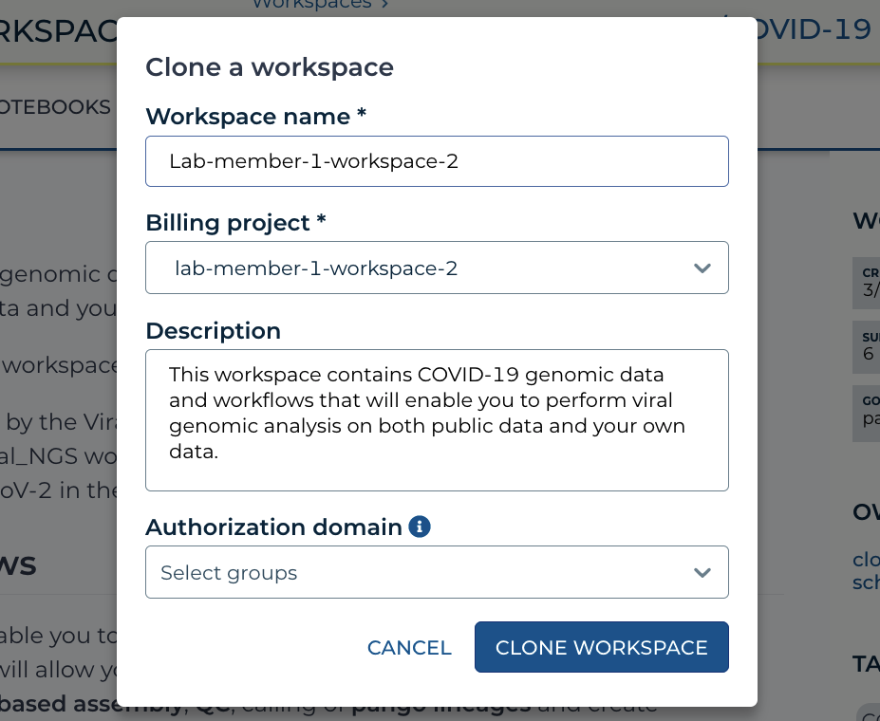
https://anvil.terra.bio/#workspaces/pathogen-genomic-surveillance/COVID-19 clone a Workspace popout screenshot
by Ava Hoffman. CC-BY-4.0
Notes:
If you are working with protected data, you can set an Authorization Domain to limit who can be added to your Workspace. Note that the Authorization Domain cannot be changed after the Workspace is created, which can make it difficult if you later need to share your Workspace more broadly. When cloning a Workspace, the new Workspace will automatically inherit any Authorization Domains that were applied to the original Workspace.
Authorization domains add an extra layer of enforcement over privacy, but by nature make sharing more complicated. We generally recommend using Authorization Domains only in cases where it is extremely important or legally required that the data be kept private, such as protected patient data or confidential industry data.

Slide 13
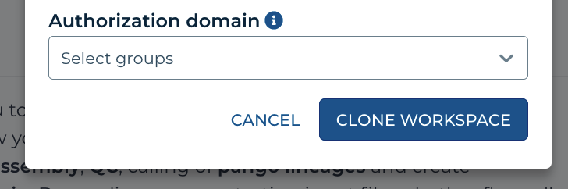
https://anvil.terra.bio/#workspaces/pathogen-genomic-surveillance/COVID-19 clone a Workspace popout screenshot
by Ava Hoffman. CC-BY-4.0
Notes:
Click “CLONE WORKSPACE”. The new Workspace should now show up under your Workspaces. Congratulations! You have cloned a Workspace and can now use and modify your copy of the Workspace’s content. Note that when cloning, AnVIL makes a copy of the documentation, notebooks and code for you to modify, but data is linked back to the original Workspace, which saves space!

Slide 14
Workspace Access Levels
Access Level | Permissions | Billable Activities | Data Access
Owners | import / edit data run analyses manage other user permissions | Yes | Yes
Writers | import / edit data run analyses | Yes | Yes
Readers | view data and workflows (can’t run or edit) copy contents into their own Workspace (if e.g. they wish to run the analysis in a Workspace associated with their own Billing Project) | No | Yes
Table summarizing Terra Workspace permission levels by Katherine Cox. CC-BY-4.0
Notes:
When managing your Workspace, it’s important to remember that all activity in the Workspace will be charged to the Workspaces’ Billing Project, regardless of who conducts it, and to exercise caution when sharing your Workspace. You can safely add people as Readers, but you should only add people as Writers or Owners if their activity should be funded by your Billing Project. Adding someone as a Reader enables them to make their own clone of your Workspace, which can be useful if they need to conduct activity funded by a different Billing Project.

