Slide 1
Find email for Terra Group
Notes:
This video will show you how to find the email address associated with a Terra Group. If you want to grant a Terra Group access to Terra resources such as Billing Projects or Workspaces, you will need the email address associated with the Group.

Slide 2

Terms of Use
Notes:
Except where otherwise indicated, this content is available for use under CC B Y 4.0.

Slide 3
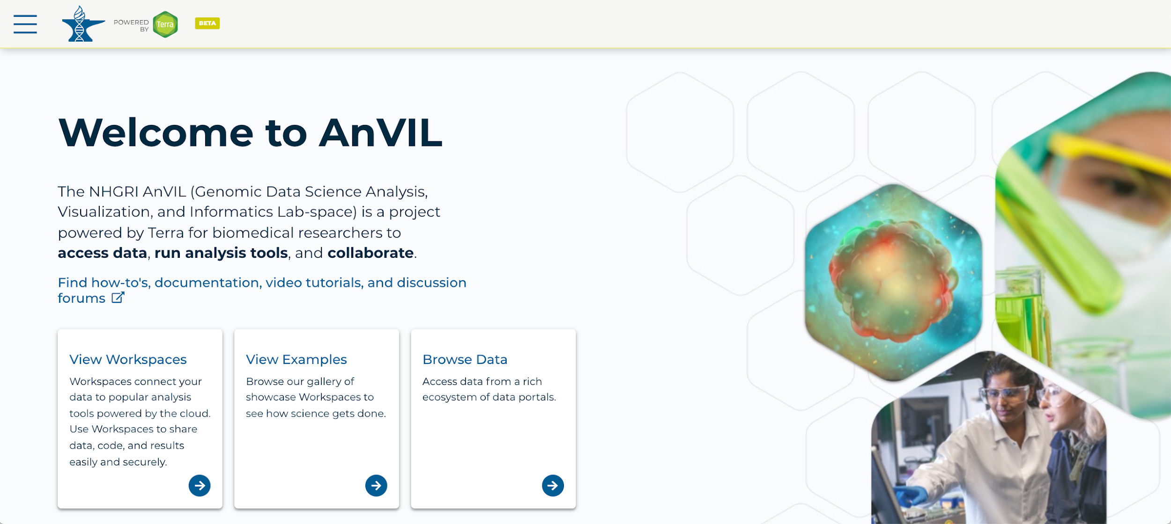
https://anvil.terra.bio/ homepage screenshot by Katherine Cox. CC-BY-4.0
Notes:
First, log in to Terra.

Slide 4
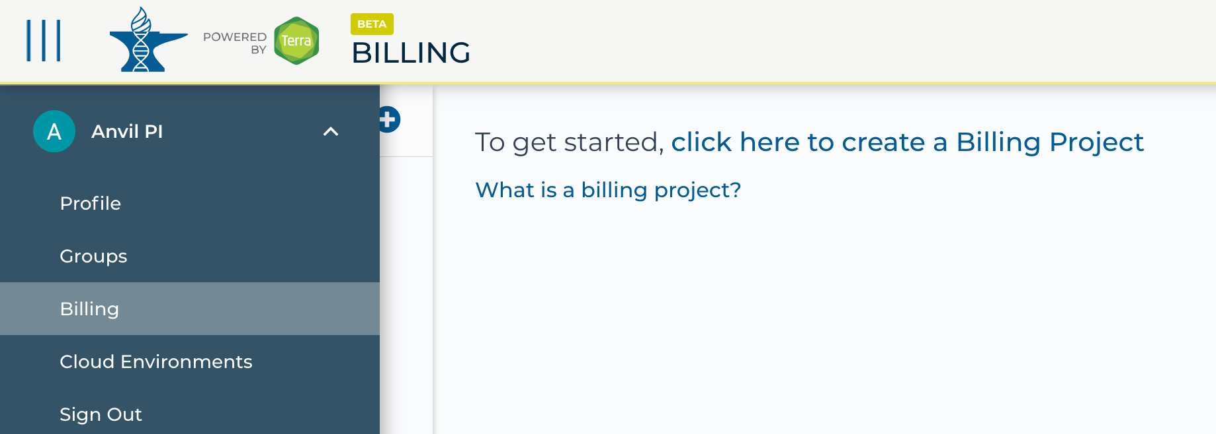
https://anvil.terra.bio/ select Groups from drop-down menu screenshot by Katherine Cox. CC-BY-4.0
Notes:
Click the triple bar in the top left corner to access the drop-down menu. Click the arrow next to your name to expand the menu, then click “Groups”.

Slide 5
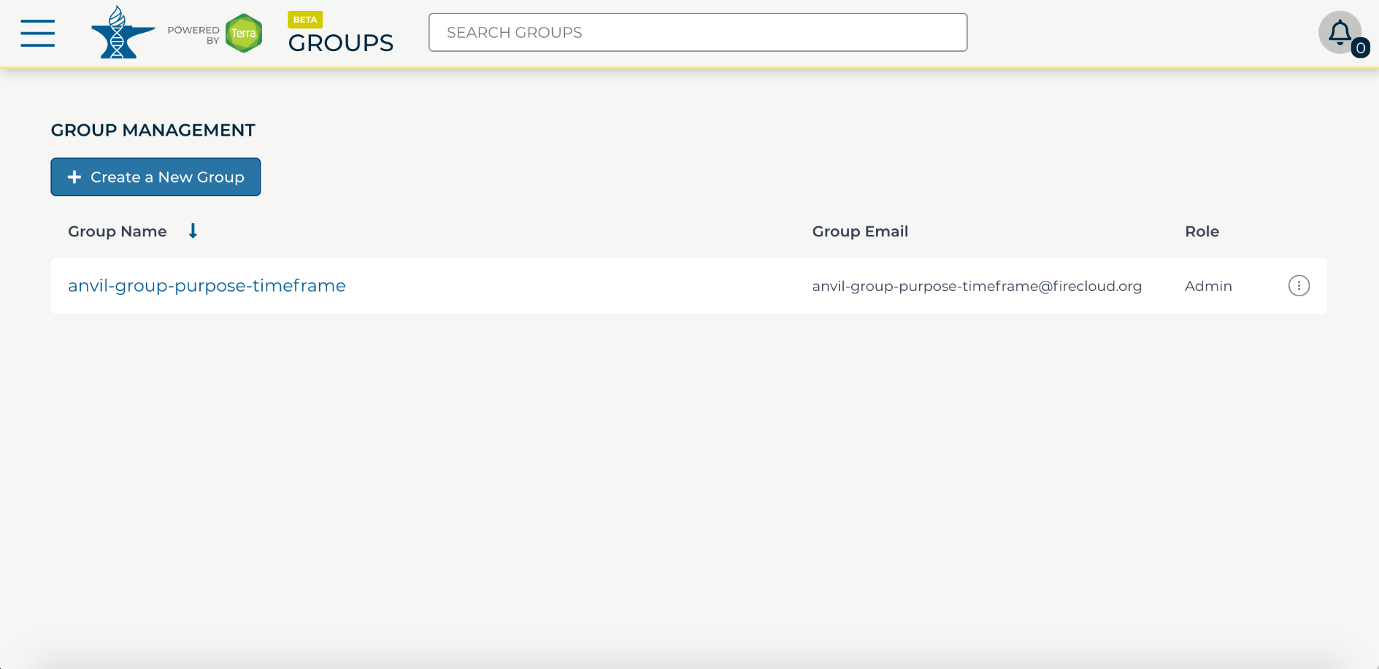
https://anvil.terra.bio/#groups Group management in AnVIL screenshot by Katherine Cox. CC-BY-4.0
Notes:
Find the name of your group, then look in the “Group Email” column to find the email address associated with your group. Copy this email address.

Slide 6
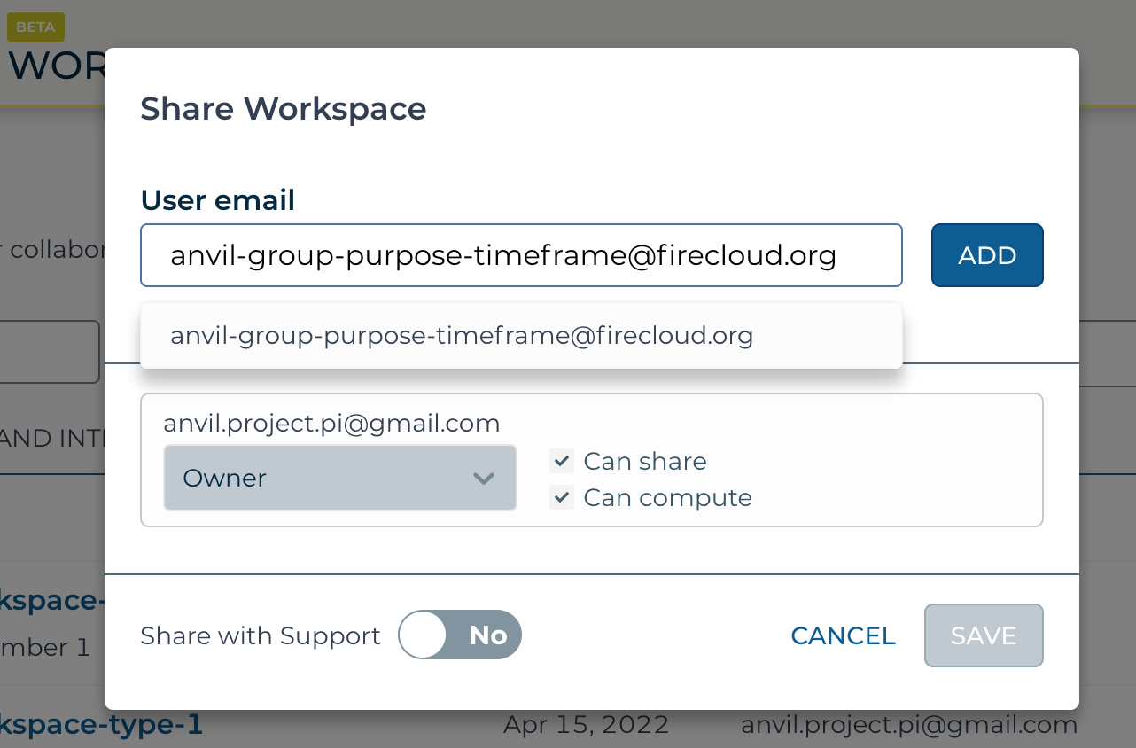
https://anvil.terra.bio/#workspaces share workspace dialog box screenshot by Katherine Cox. CC-BY-4.0
Notes:
Paste the email in as the username when adding people to Billing Projects and Workspaces. This will grant everyone in the Group access to the Billing Project or Workspace.

Slide 7
Contributions
Ava Hoffman
Katherine Cox
Frederick Tan
Notes:
Thank you to everyone who contributed!

