Slide 1
Add Members to Terra Group
Notes:
This video will show you how to add members to a Terra Group. Adding someone to a Group gives them access to everything the group can access in one easy step. This prevents you from having to add new members to your team’s Workspaces and Billing Projects one-by-one.

Slide 2

Terms of Use
Notes:
Except where otherwise indicated, this content is available for use under CC B Y 4.0.

Slide 3
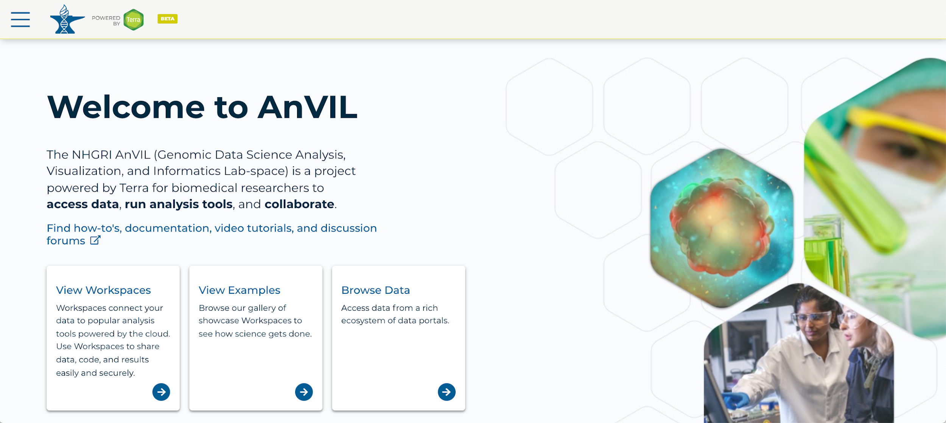
https://anvil.terra.bio/ homepage screenshot by Katherine Cox. CC-BY-4.0
Notes:
To get started, log in to Terra.

Slide 4
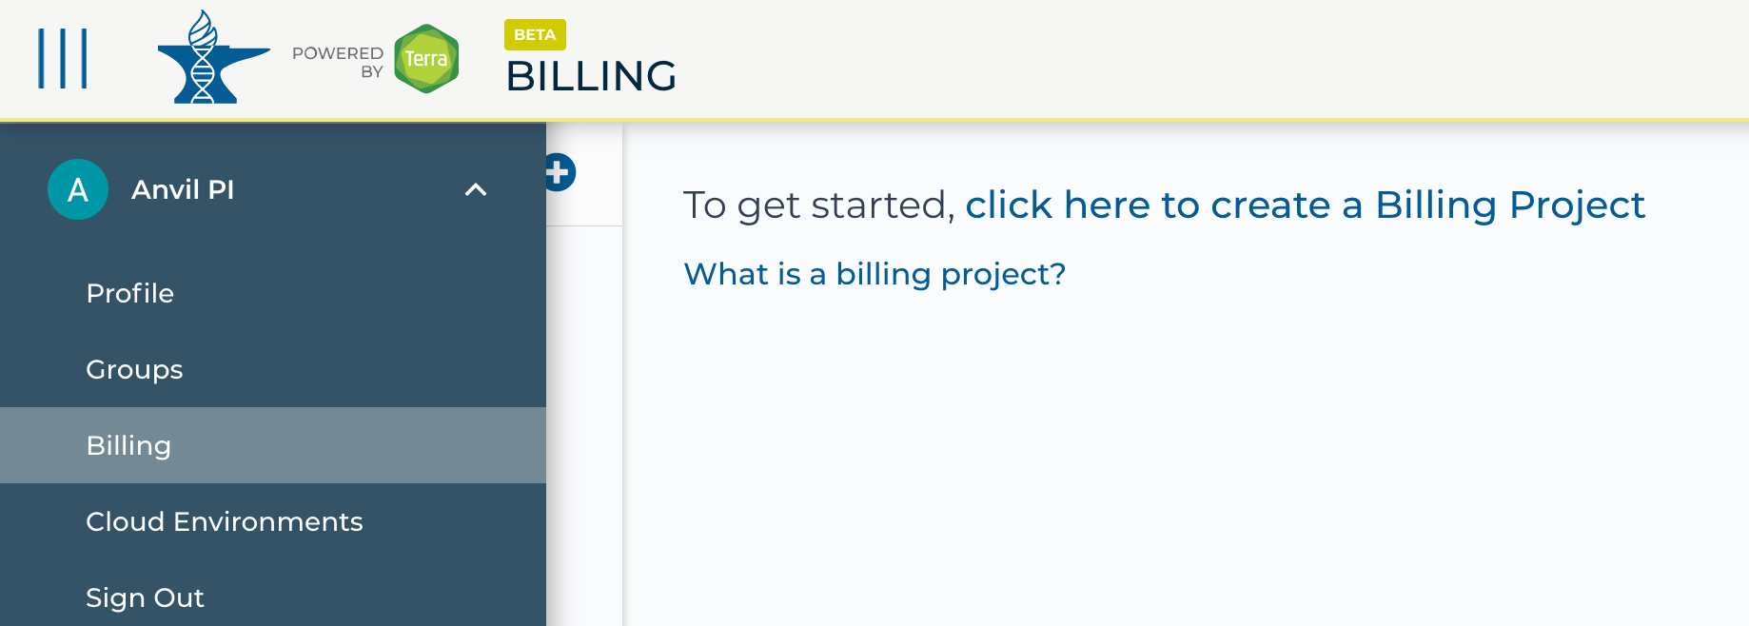
https://anvil.terra.bio/ select Groups from drop-down menu screenshot by Katherine Cox. CC-BY-4.0
Notes:
Click the triple bar in the top left corner to access the drop-down menu. Click the arrow next to your name to expand the menu, then click “Groups”.

Slide 5
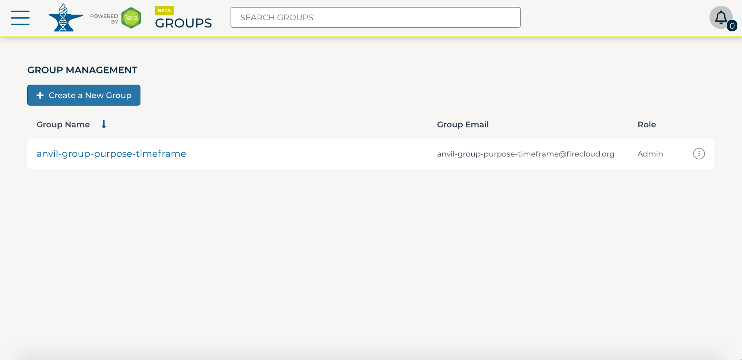
https://anvil.terra.bio/#groups Group management in AnVIL screenshot by Katherine Cox. CC-BY-4.0
Notes:
Find the name of the Group you want to add someone to. Confirm that you have Admin privileges for the group. You can only add and remove members to Groups if you are an admin. Click on the name of the Group to view and manage members.

Slide 6
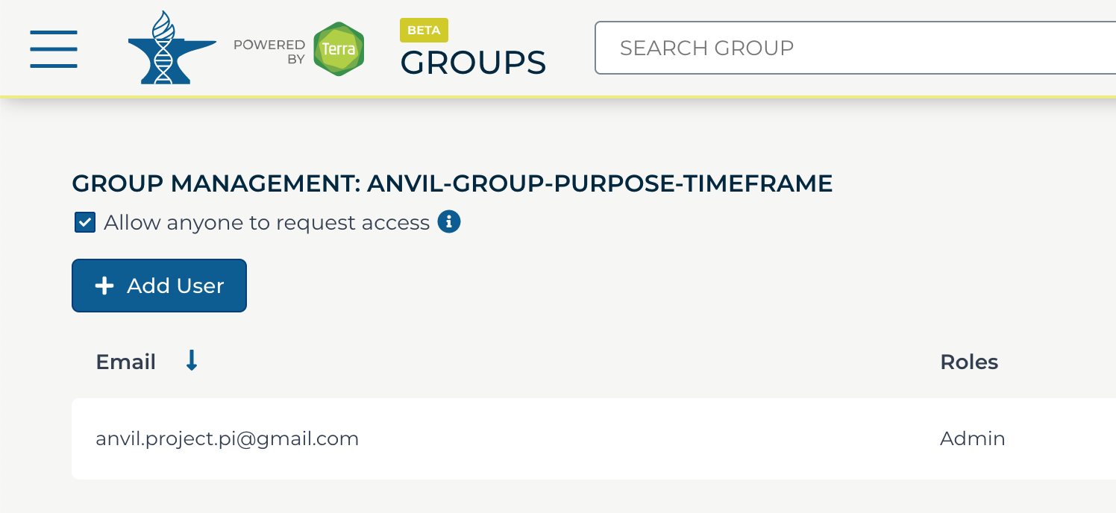
https://anvil.terra.bio/#groups/ Group management in AnVIL screenshot by Katherine Cox. CC-BY-4.0
Notes:
Click the Add User button to add members to your group.

Slide 7
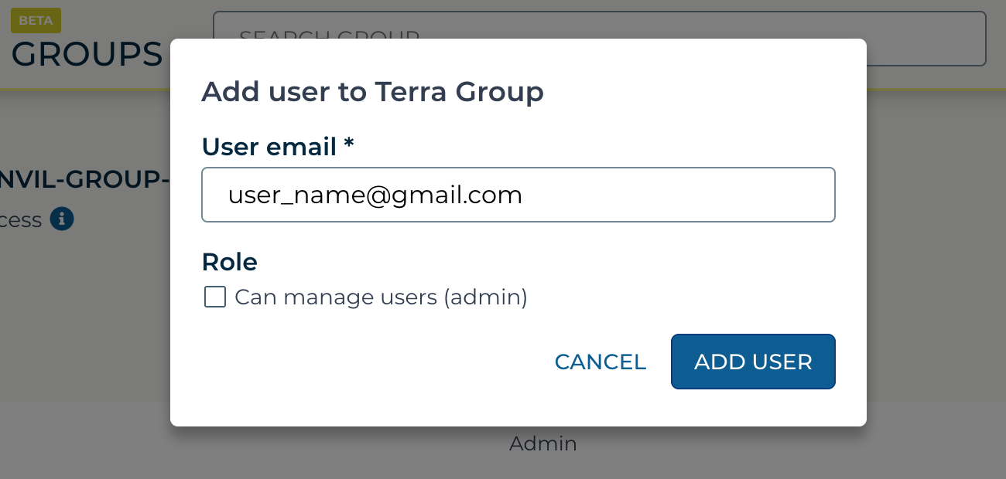
https://anvil.terra.bio/#groups/ Add group member dialogue screenshot by Katherine Cox. CC-BY-4.0
Notes:
Enter the email address for the member you want to add to your group. Make sure this is the account that they use to access AnVIL.

Slide 8
https://anvil.terra.bio/#groups/ Add group member dialogue screenshot by Katherine Cox. CC-BY-4.0
Notes:
If this member will need to add and remove other members of the group, check the admin box. Otherwise leave it unchecked.

Slide 9
https://anvil.terra.bio/#groups/ Add group member dialogue screenshot by Katherine Cox. CC-BY-4.0
Notes:
Click “ADD USER”.

Slide 10
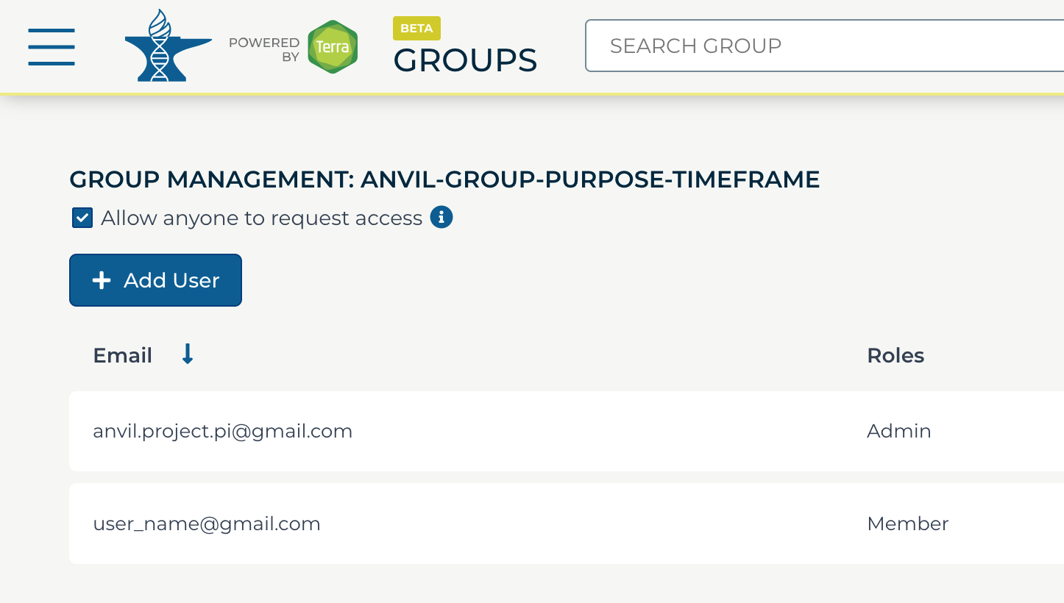
Notes:
They should now show up in the list of group members, along with the appropriate role. They now have access to anything that the group has been given access to.

Slide 11
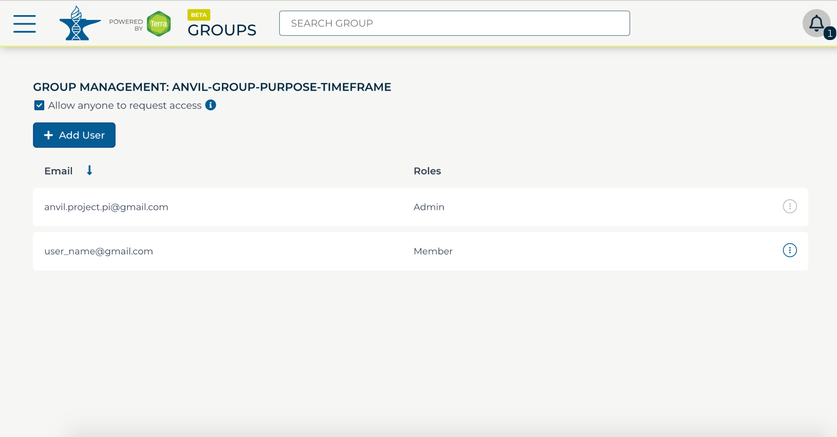
Notes:
If you need to remove members or modify their roles, you can do so at any time by clicking the teardrop button next to their name.

Slide 12
Contributions
Ava Hoffman
Katherine Cox
Frederick Tan
Notes:
Thank you to everyone who contributed!

