Slide 1
View Spend in GCP console
Notes:
This video will show you how to view spending reports for your Google Cloud Platform expenses.

Slide 2

Terms of Use
Notes:
Except where otherwise indicated, this content is available for use under CC B Y 4.0.

Slide 3
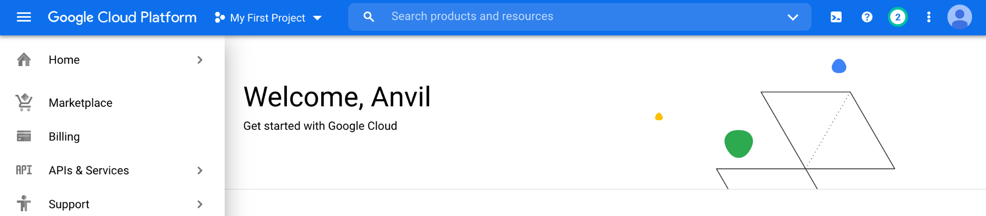
https://console.cloud.google.com/ menu screenshot by Katherine Cox. CC-BY-4.0
Notes:
To get started, log in to Google Cloud Platform using the Google ID associated with your Google Cloud Billing Account.

Slide 4
https://console.cloud.google.com/ select billing from menu screenshot by Katherine Cox. CC-BY-4.0
Notes:
Open the dropdown menu on the top left and click on Billing.

Slide 5
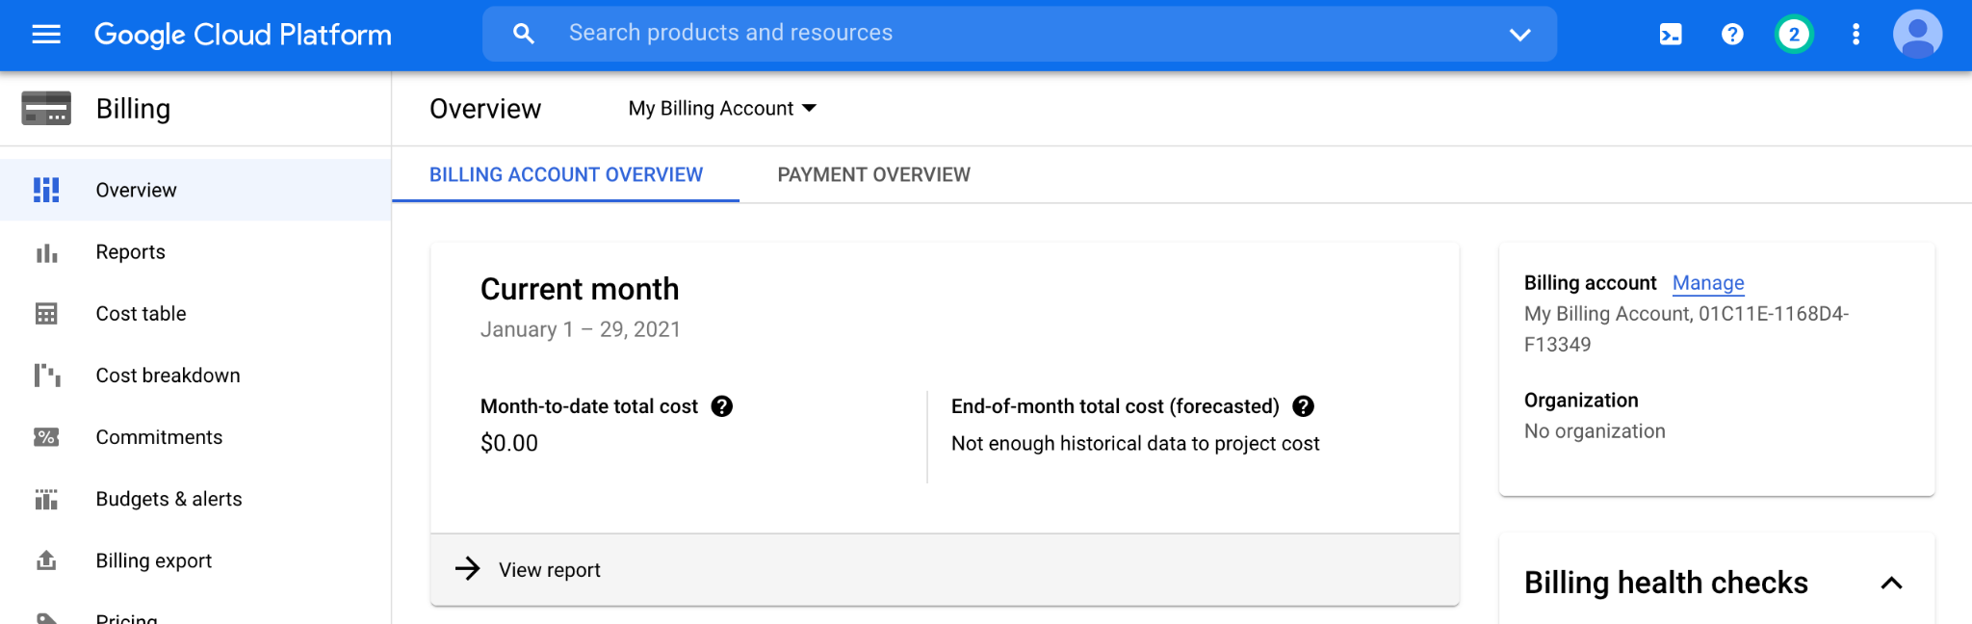
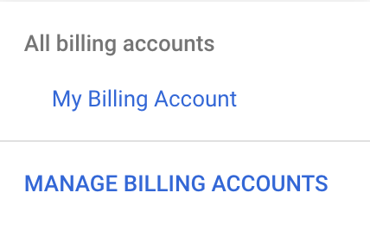
https://console.cloud.google.com/billing/ dropdown menu for an individual billing account screenshot by Katherine Cox. CC-BY-4.0
Notes:
You may be automatically directed to view a specific Billing Account. If you see information about a single account (and it’s not the one you’re interested in), you can get back to the list of all your Billing Accounts by clicking “Manage Billing Accounts” from the drop-down menu.

Slide 6
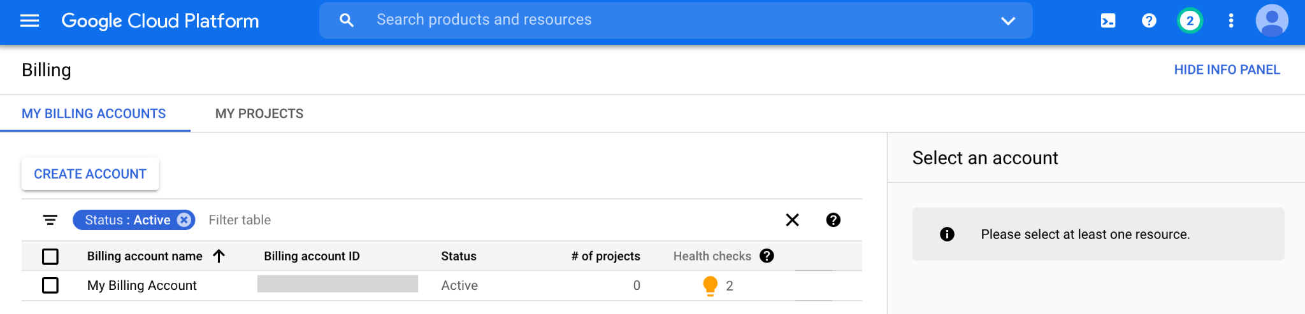
https://console.cloud.google.com/billing screenshot by Katherine Cox. CC-BY-4.0
Notes:
Click on the name of the Billing Account you want to view spending for.

Slide 7
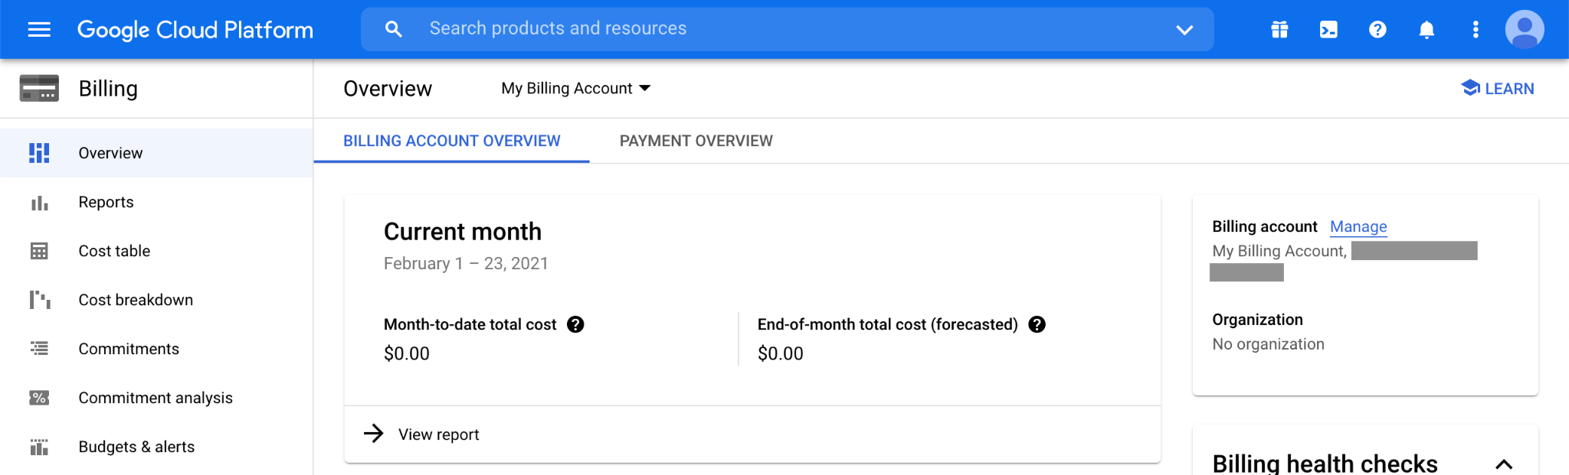
https://console.cloud.google.com/billing/ billing overview screenshot by Katherine Cox. CC-BY-4.0
Notes:
Look at the top of the Overview tab to see your month-to-date spending.

Slide 8
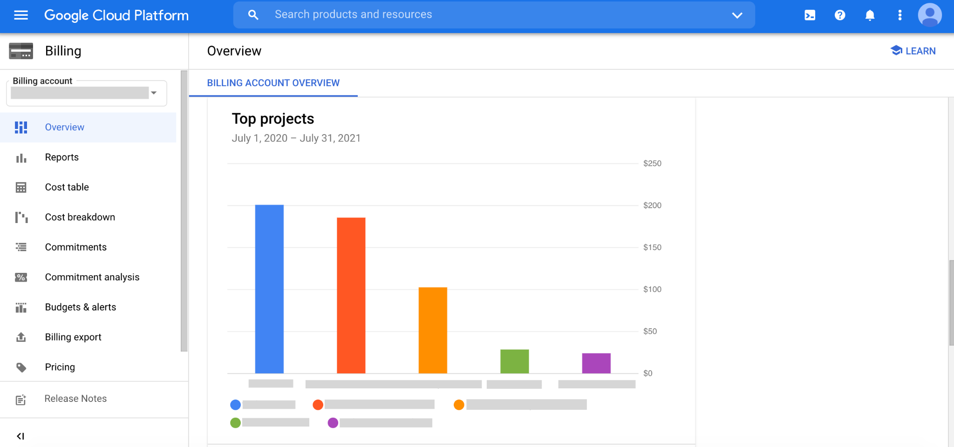
https://console.cloud.google.com/billing/ view top projects screenshot by Katherine Cox. CC-BY-4.0
Notes:
Scroll further down the Overview tab to show your top projects.

Slide 9
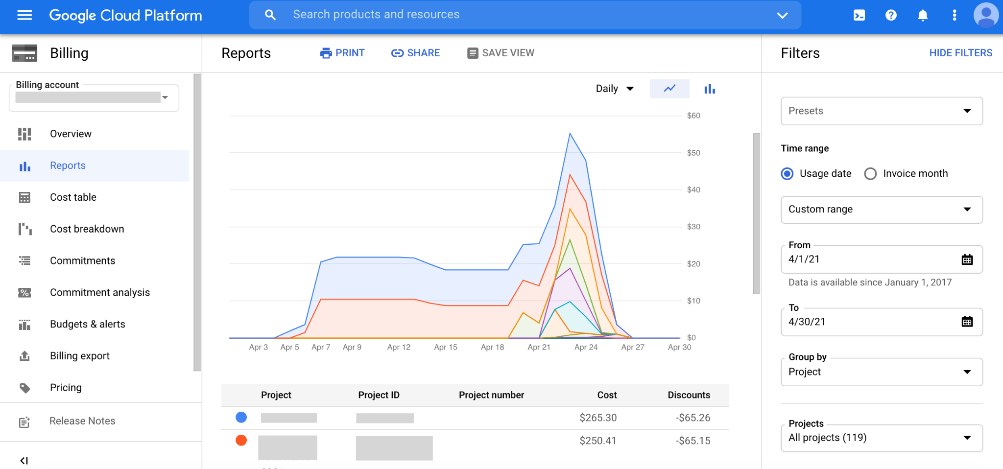
https://console.cloud.google.com/billing/ view reports screenshot by Katherine Cox. CC-BY-4.0
Notes:
Click on the Reports tab to see more detailed information about each of your billing projects. This is probably the most useful tab for exploring costs of individual projects over time.

Slide 10
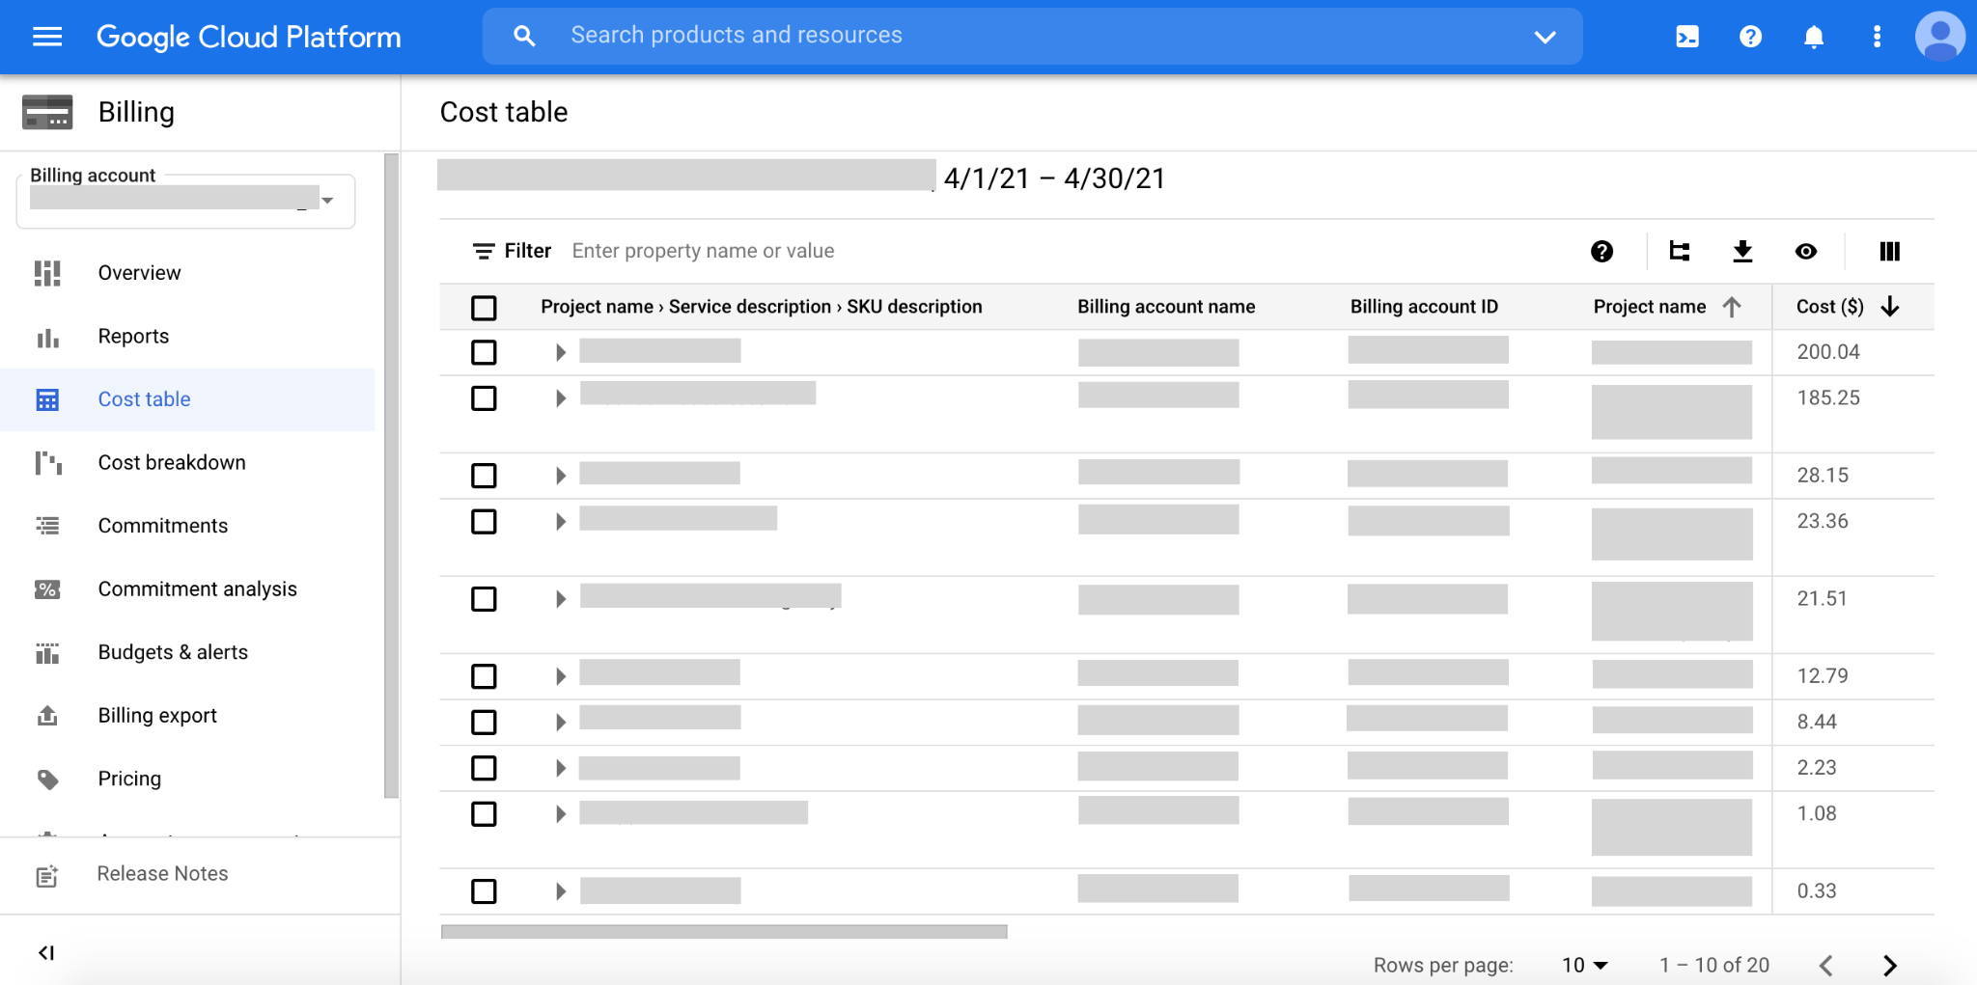
https://console.cloud.google.com/billing/ view cost table screenshot by Katherine Cox. CC-BY-4.0
Notes:
Click on the Cost table tab to obtain a convenient table of spending per project.

