Slide 1
Add Terra to
GCP Billing
Notes:
This video will show you how to add Terra to your Google Cloud Platform Billing Account. This gives Terra permission to create projects and send charges to the Google Billing Account, which is necessary for you to start working on AnVIL. If you have not already created a GCP Billing Account, go ahead and do that first.

Slide 2

Terms of Use
Notes:
Except where otherwise indicated, this content is available for use under CC B Y 4.0.

Slide 3
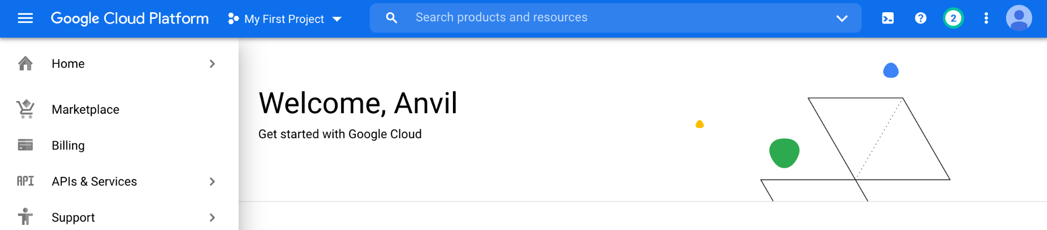
https://console.cloud.google.com/ menu screenshot by Katherine Cox. CC-BY-4.0
Notes:
To get started, log in to the Google Cloud Platform console using the Google ID associated with your Billing Account.

Slide 4
https://console.cloud.google.com/ select billing from menu screenshot by Katherine Cox. CC-BY-4.0
Notes:
Open the dropdown menu on the top left and click on Billing.

Slide 5
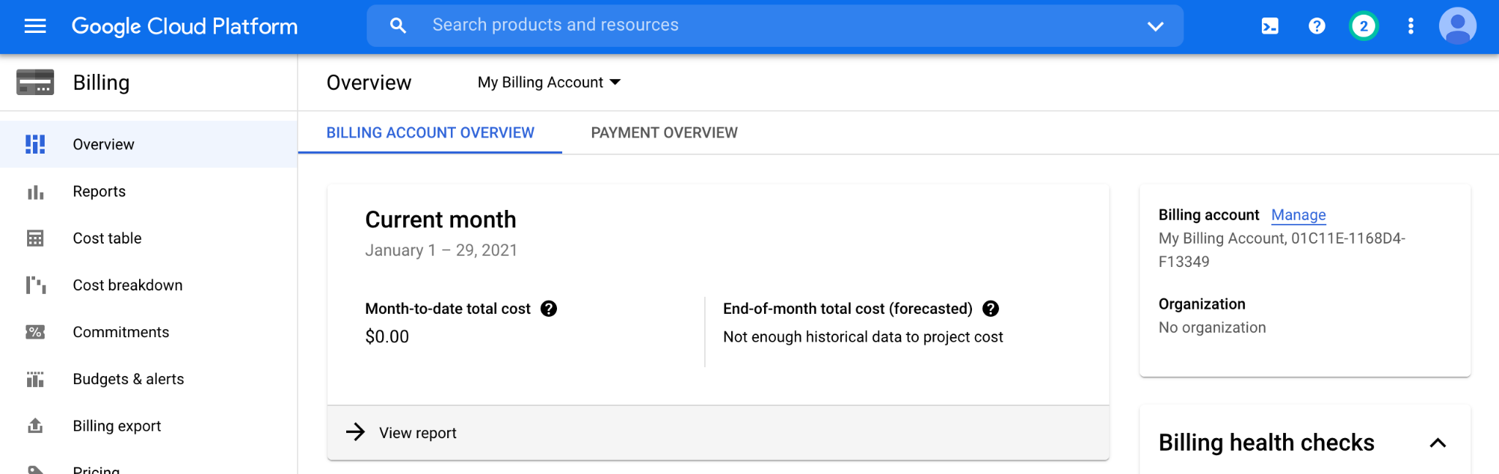
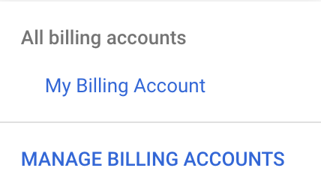
https://console.cloud.google.com/billing/ dropdown menu for an individual billing account screenshot by Katherine Cox. CC-BY-4.0
Notes:
You may be automatically directed to view a specific Billing Account. If you see information about a single account, you can get back to the list of all your Billing Accounts by clicking “Manage Billing Accounts” from the drop-down menu.

Slide 6
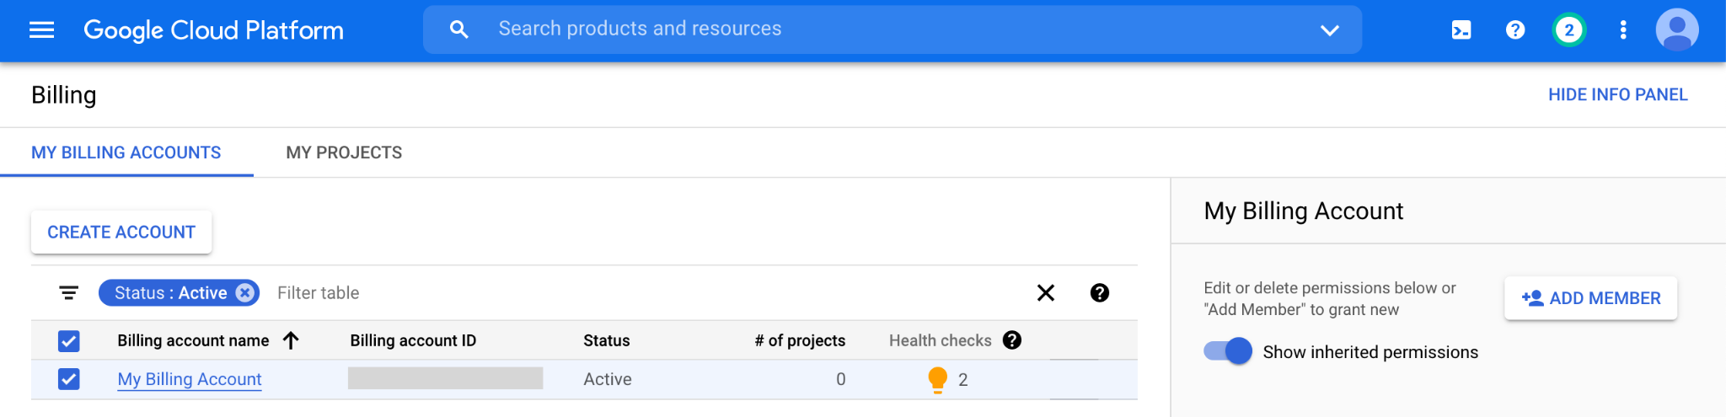
https://console.cloud.google.com/billing/ add member to billing account screenshot by Katherine Cox. CC-BY-4.0
Notes:
Check the box next to the Billing Account you wish to add a member to, then click “ADD MEMBER” on the right.

Slide 7
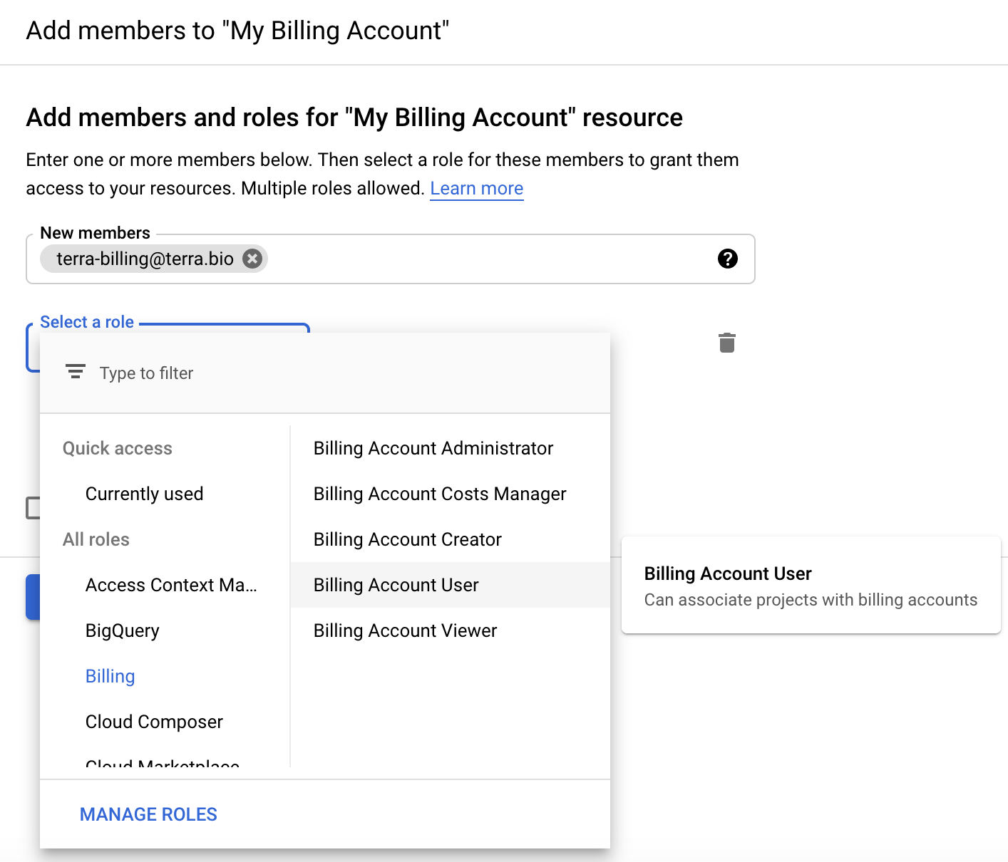
https://console.cloud.google.com/billing/ add Terra as Billing Account User screenshot by Katherine Cox. CC-BY-4.0
Notes:
Enter terra-billing@terra.bio in the text box. In the drop-down menu, mouse over Billing, then choose “Billing Account User”.

Slide 8
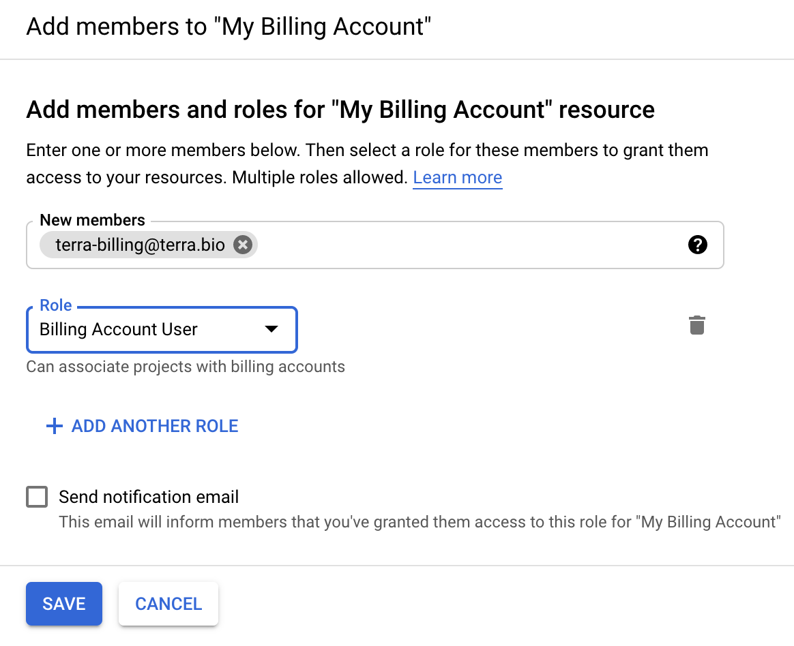
https://console.cloud.google.com/billing/ save Terra as Billing Account User screenshot by Katherine Cox. CC-BY-4.0
Notes:
Click “Save” to complete the process. Terra should now be able to create projects associated with your Google Billing Account.

