Slide 1
Create Terra
Billing Project
Notes:
This video will show you how to create a Billing Project on Terra. Creating a Billing Project on Terra will allow you to add Terra users to your project so they can start working on AnVIL. If you have not already created a GCP Billing Account and added Terra as a User, go ahead and do that first.

Slide 2

Terms of Use
Notes:
Except where otherwise indicated, this content is available for use under CC B Y 4.0.

Slide 3

https://anvil.terra.bio/ homepage screenshot by Katherine Cox. CC-BY-4.0
Notes:
To get started, log in Terra using the Google ID associated with your Google Cloud Billing Account. If this is your first time logging in to Terra, you will need to accept the Terms of Service.

Slide 4
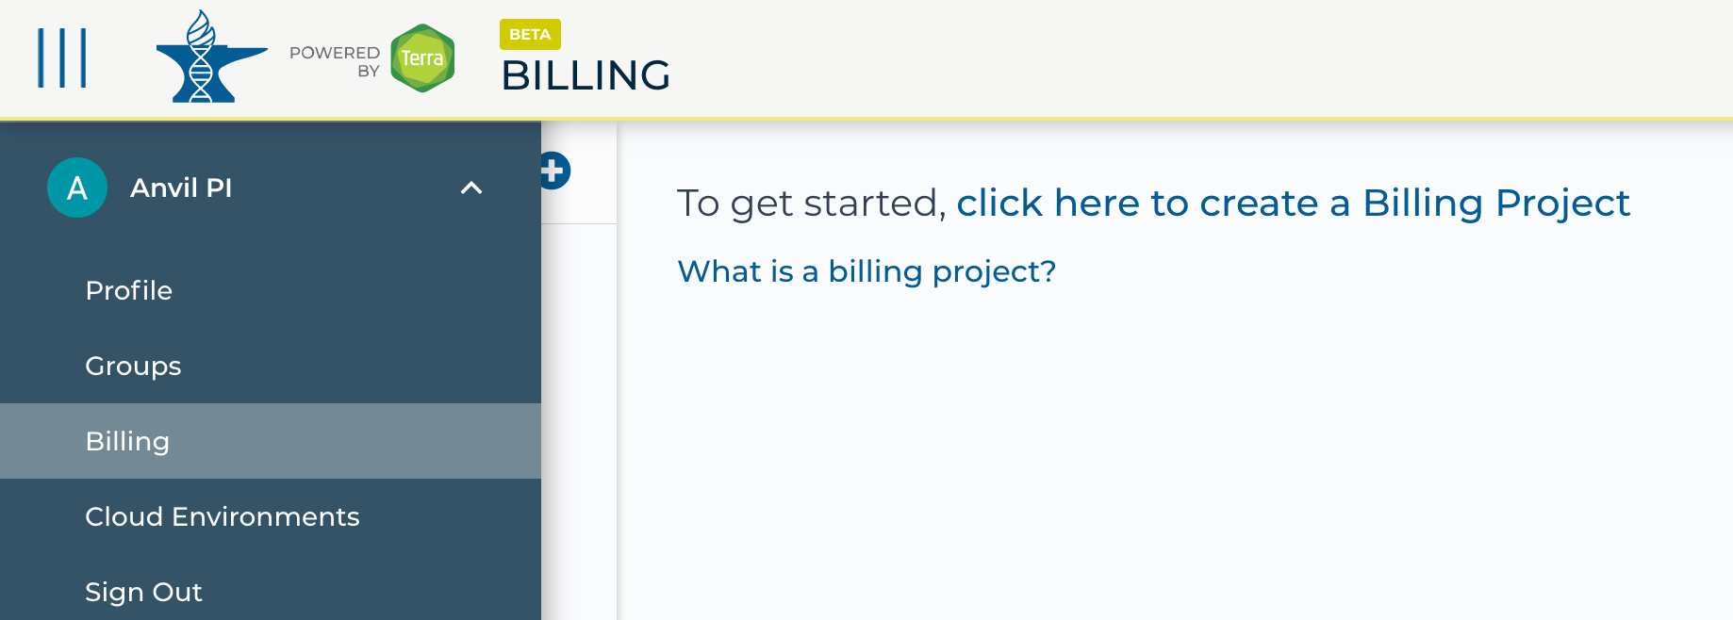
https://anvil.terra.bio/ select Billing from drop-down menu screenshot by Katherine Cox. CC-BY-4.0
Notes:
Click the triple bar in the top left corner to access the drop-down menu. Click the arrow next to your name to expand the menu, then click “Billing”.

Slide 5
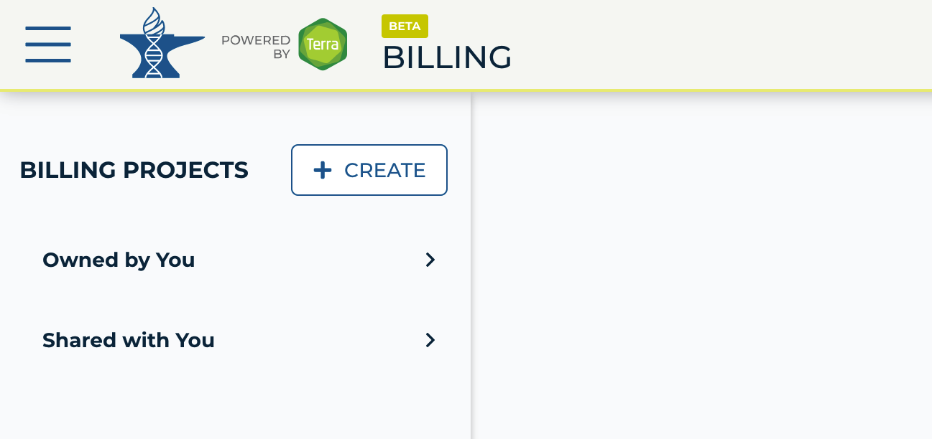
https://anvil.terra.bio/#billing add a Billing Project screenshot by Ava Hoffman. CC-BY-4.0
Notes:
On the Billing page, click the “+ CREATE” button to create a new Billing Project. If prompted, select the Google account to use. Make sure to use the same Google account that you used to set up Google Billing. If prompted, give Terra permission to manage Google Cloud Platform billing accounts.

Slide 6
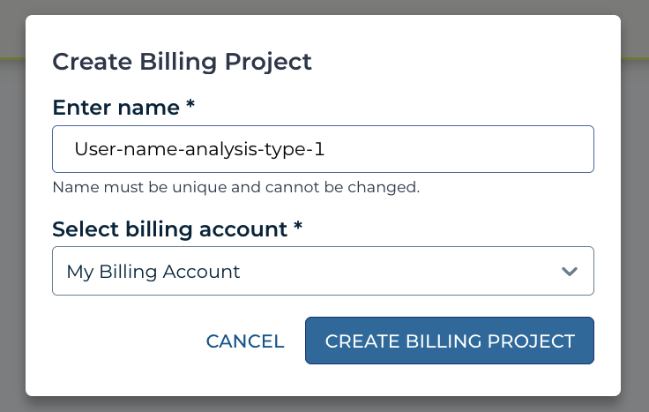

https://anvil.terra.bio/#billing add a Billing Project dialog box screenshot by Ava Hoffman. CC-BY-4.0
Notes:
Enter a unique name for your Terra Billing Project.

Slide 7
Billing Project Name
Only contain lowercase letters, numbers and hyphens
Start with a lowercase letter
Not end with a hyphen
Be between 6 and 30 characters
Notes:
Note the requirements for Terra Billing Project names. Because names must be unique, it can be useful to include your team name and/or team members’ names or initials, along with the purpose or timeframe of the project.

Slide 8
https://anvil.terra.bio/#billing add a Billing Project dialog box screenshot by Ava Hoffman. CC-BY-4.0
Notes:
Select the appropriate Google Billing Account. All activities conducted under your new Terra Billing Project will charge to this Google Billing Account.

Slide 9
https://anvil.terra.bio/#billing add a Billing Project dialog box screenshot by Ava Hoffman. CC-BY-4.0
Notes:
Click “Create Billing Project” to complete the process. Note that the page may not update as soon as the billing project is created. If it’s been a couple of minutes and you don’t see a change, try refreshing the page.

Slide 10
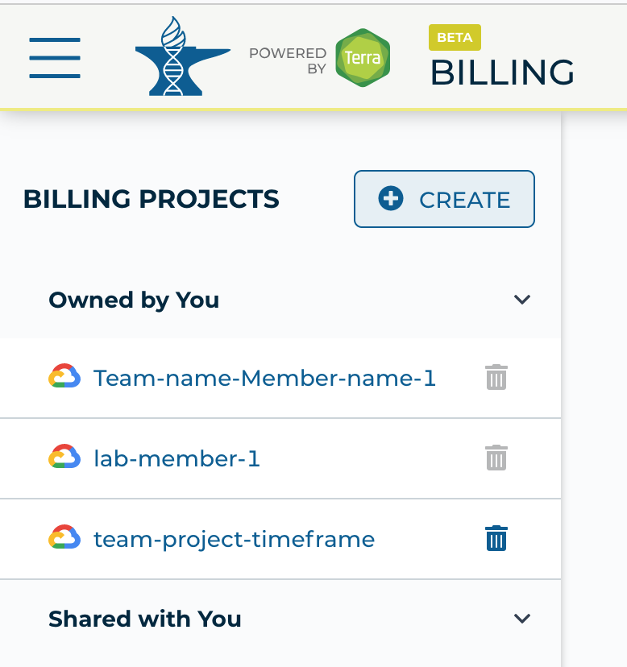
Notes:
It should now show up in the list of Billing Project owned by you. You can add additional members or can modify or deactivate the Billing Project at any time by clicking on its name in this list.

