Slide 1
Create Terra
Group
Notes:
This video will show you how to create a Group on Terra. Creating a Group make it easier to manage multiple users by enabling you to grant and revoke permissions to the group as a whole.

Slide 2

Terms of Use
Notes:
Except where otherwise indicated, this content is available for use under CC B Y 4.0.

Slide 3
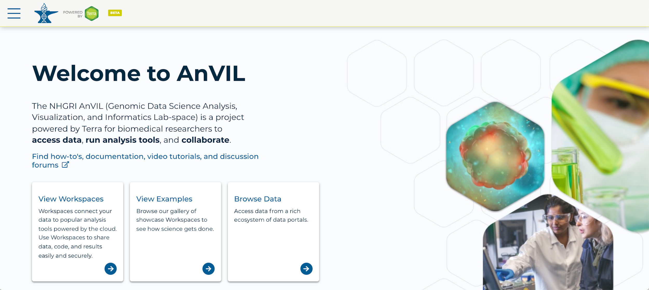
https://anvil.terra.bio/ homepage screenshot by Katherine Cox. CC-BY-4.0
Notes:
To get started, log in to Terra.

Slide 4
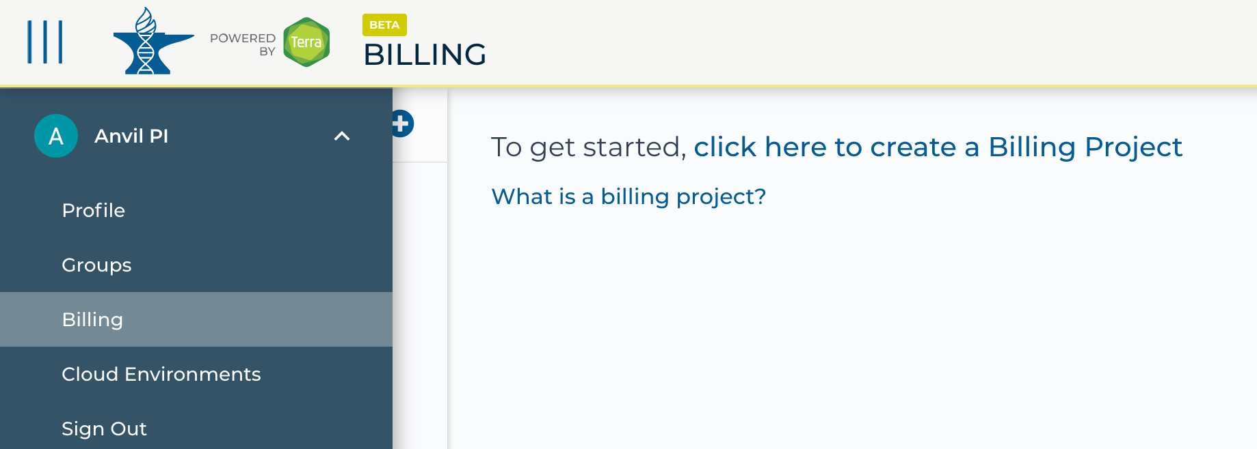
https://anvil.terra.bio/ select Groups from drop-down menu screenshot by Katherine Cox. CC-BY-4.0
Notes:
Click the triple bar in the top left corner to access the drop-down menu. Click the arrow next to your name to expand the menu, then click “Groups”.

Slide 5
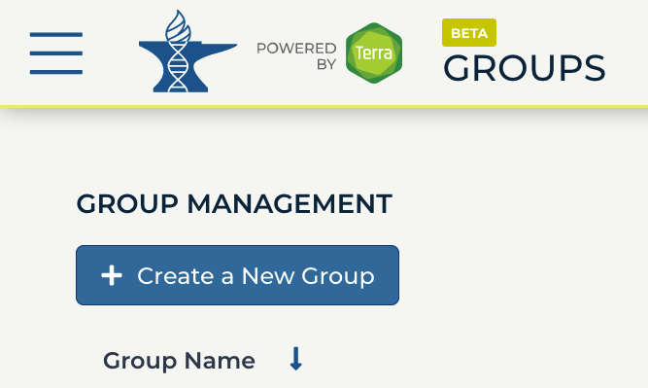
https://anvil.terra.bio/#groups Create a New Group in AnVIL screenshot by Ava Hoffman. CC-BY-4.0
Notes:
Click “Create a New Group”

Slide 6
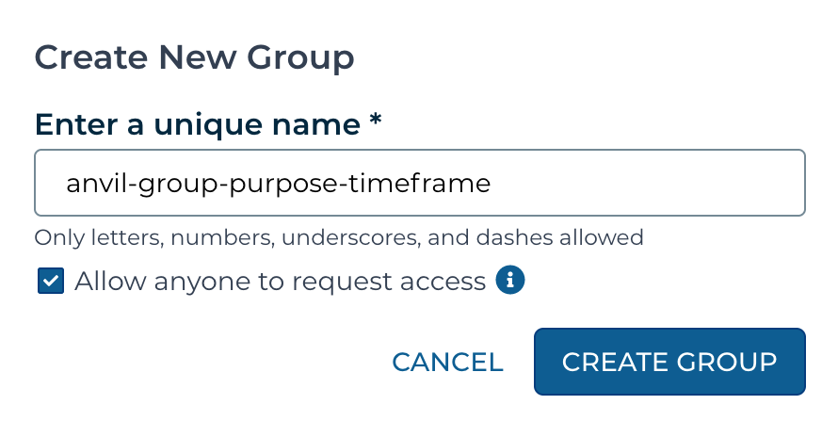
https://anvil.terra.bio/#groups Create a New Group in AnVIL screenshot by Katherine Cox. CC-BY-4.0
Notes:
Enter a name for your group. Names must be unique, so it’s often helpful to include your team’s name, the purpose of the group, and optionally the timeframe, if you will have similar groups in the future.

Slide 7
https://anvil.terra.bio/#groups Create a New Group in AnVIL screenshot by Katherine Cox. CC-BY-4.0
Notes:
Click “CREATE GROUP”.

Slide 8
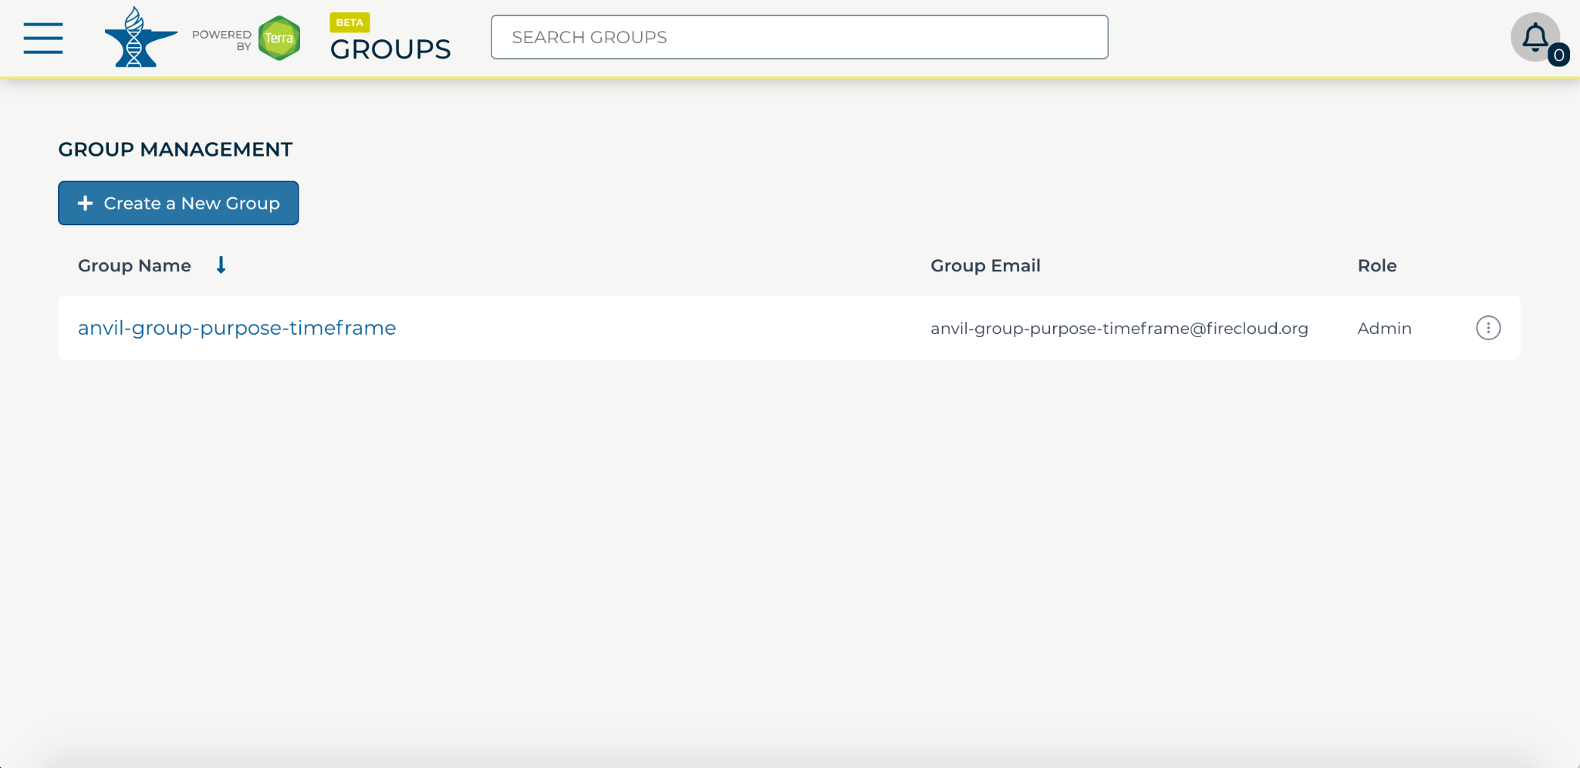
https://anvil.terra.bio/#groups Group management in AnVIL screenshot by Katherine Cox. CC-BY-4.0
Notes:
Your new group should now show up in your Groups list.

Slide 9
https://anvil.terra.bio/#groups Group management in AnVIL screenshot by Katherine Cox. CC-BY-4.0
Notes:
Take note of the email address associated with your group. You will use this email to grant the group access to Billing Projects and Workspaces.

Slide 10
Contributions
Ava Hoffman
Katherine Cox
Frederick Tan
Notes:
Thank you to everyone who contributed!

