Slide 1
Clone a Workspace
Notes:
This video will show you how to clone a Terra Workspace. Workspaces are where analyses takes place on AnVIL. Cloning an existing Workspace allows you to copy existing documentation, code, and/or data into your own experimental space so that you can use it yourself. Note that, before you can clone a Workspace, your instructor must first add you to a Billing Project, thereby granting you permission to rent computers through AnVIL.

Slide 2

Terms of Use
Notes:
Except where otherwise indicated, this content is available for use under CC B Y 4.0.

Slide 3
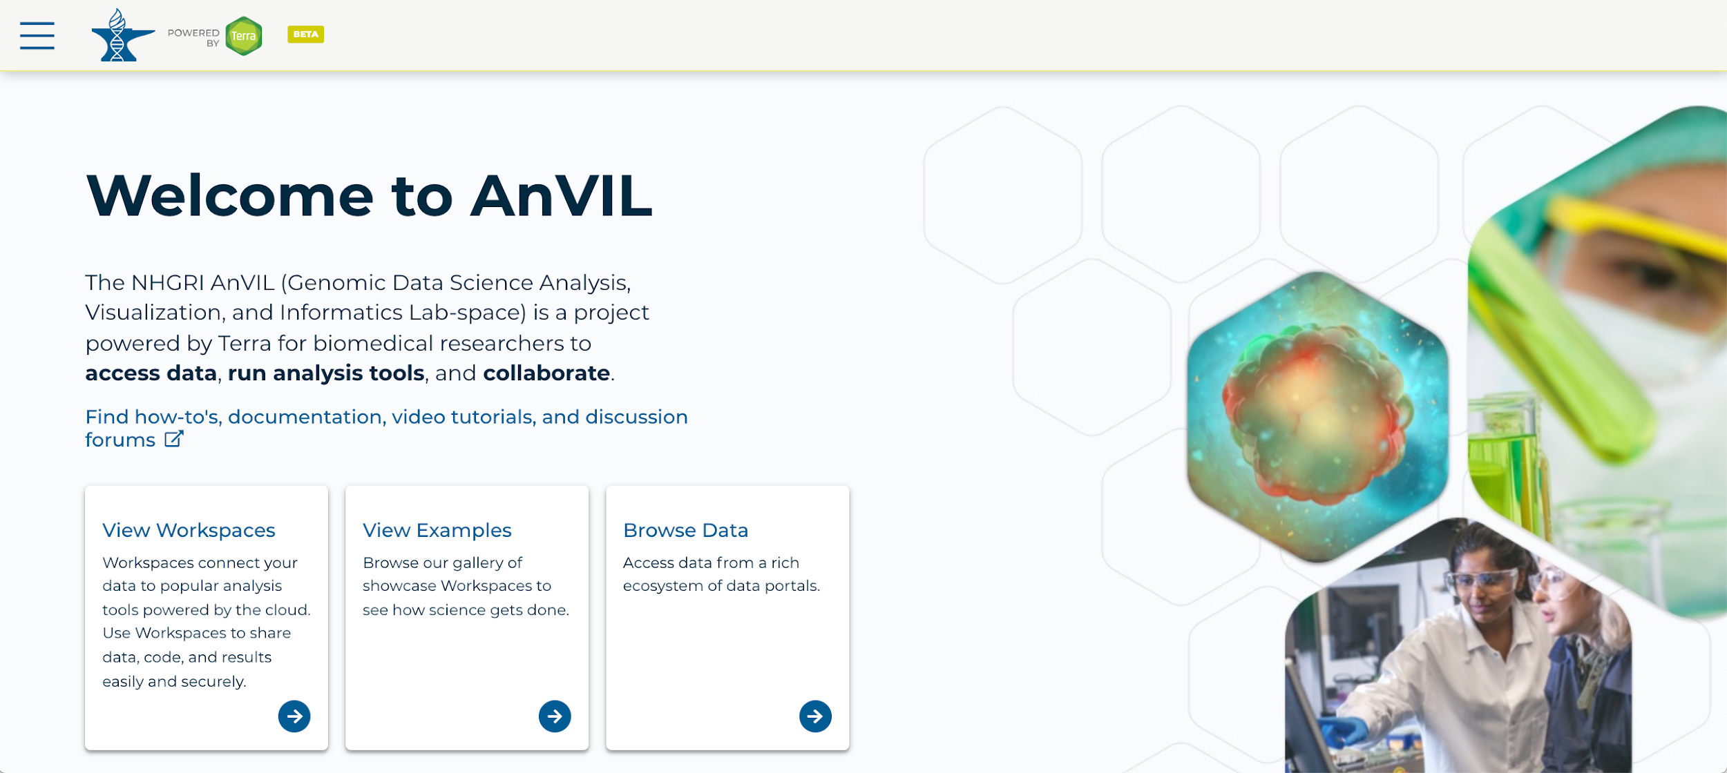
https://anvil.terra.bio/ homepage screenshot by Katherine Cox. CC-BY-4.0
Notes:
To get started, log in Terra using your Google ID.

Slide 4
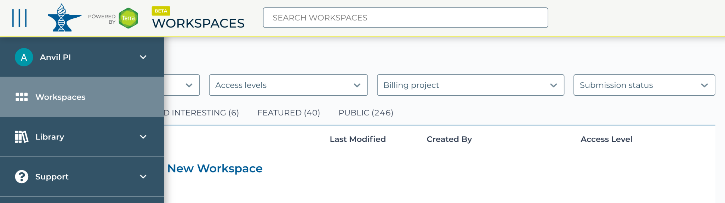
https://anvil.terra.bio/#workspaces navigate to workspaces screenshot by Katherine Cox. CC-BY-4.0
Notes:
Navigate to Workspaces by clicking the triple bar in the top left corner to access the drop-down menu, then clicking “Workspaces”.

Slide 5
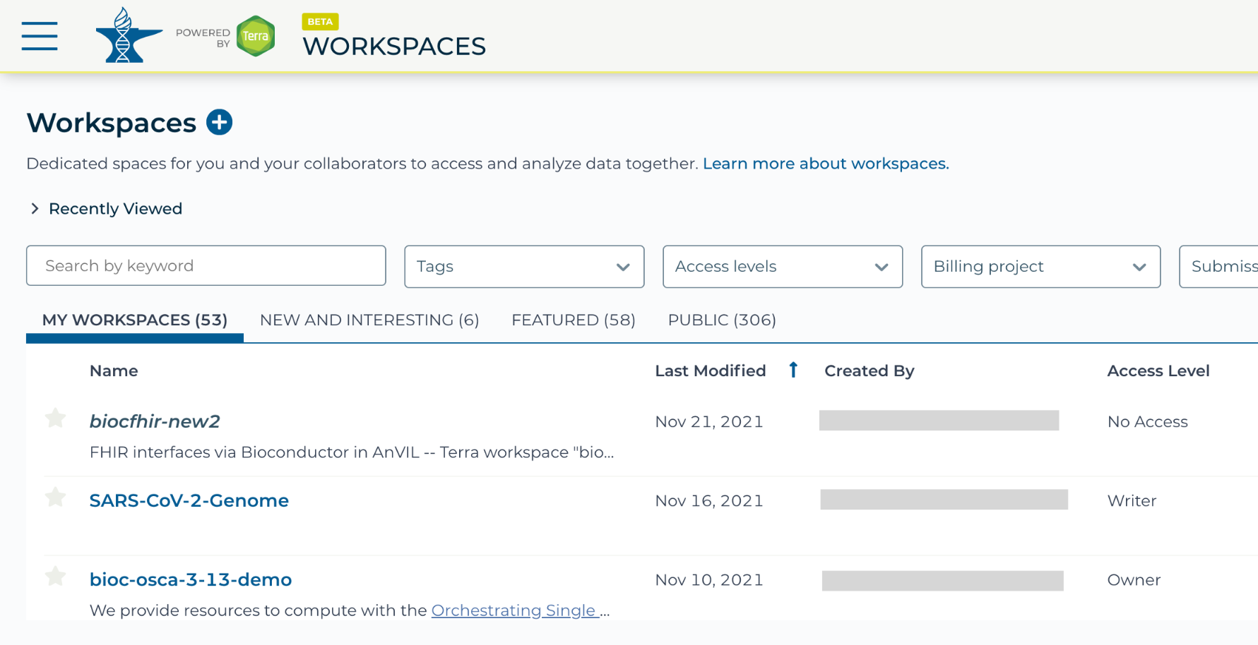
https://anvil.terra.bio/#workspaces my workspaces permissions screenshot by Katherine Cox. CC-BY-4.0
Notes:
You will be automatically directed to the “My Workspaces” tab. Here you can see any Workspaces that have been shared with you, along with your permission level. Depending on how your instructor has set things up, you may or may not see any Workspaces in this tab.

Slide 6
https://anvil.terra.bio/#workspaces my workspaces tab, selecting SARS-CoV-2 Genome workspace screenshot by Katherine Cox. CC-BY-4.0
Notes:
If your instructor has shared the Workspace with you directly, look for the Workspace name under “My Workspaces”.

Slide 7
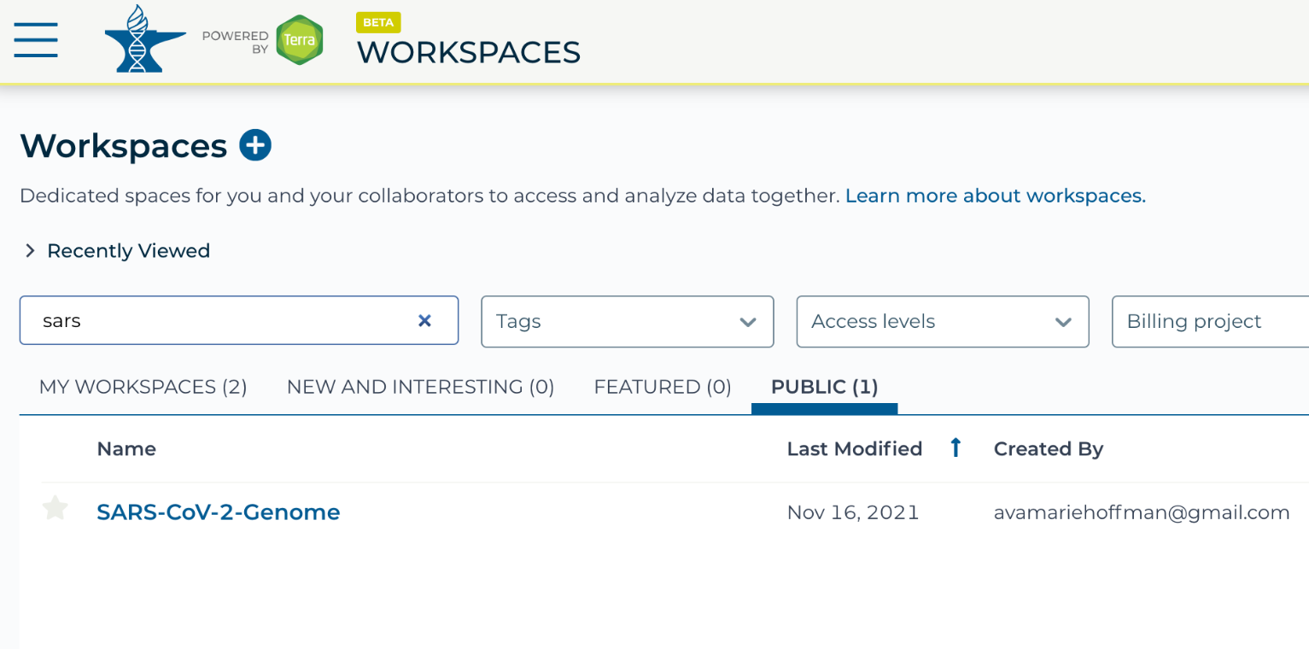
https://anvil.terra.bio/#workspaces public tab, searching for SARS-CoV-2 Genome workspace screenshot by Katherine Cox. CC-BY-4.0
Notes:
Otherwise, switch to the “Public” tab, and start typing the name of the Workspace into the search bar.

Slide 8
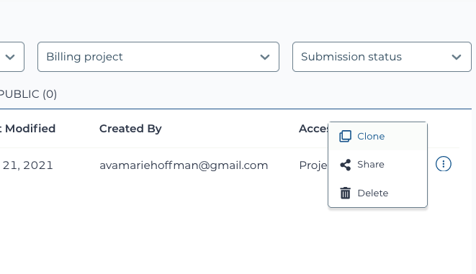
https://anvil.terra.bio/#workspaces
Notes:
Click the teardrop button on the righthand side of the Workspace and then click “Clone”.

Slide 9
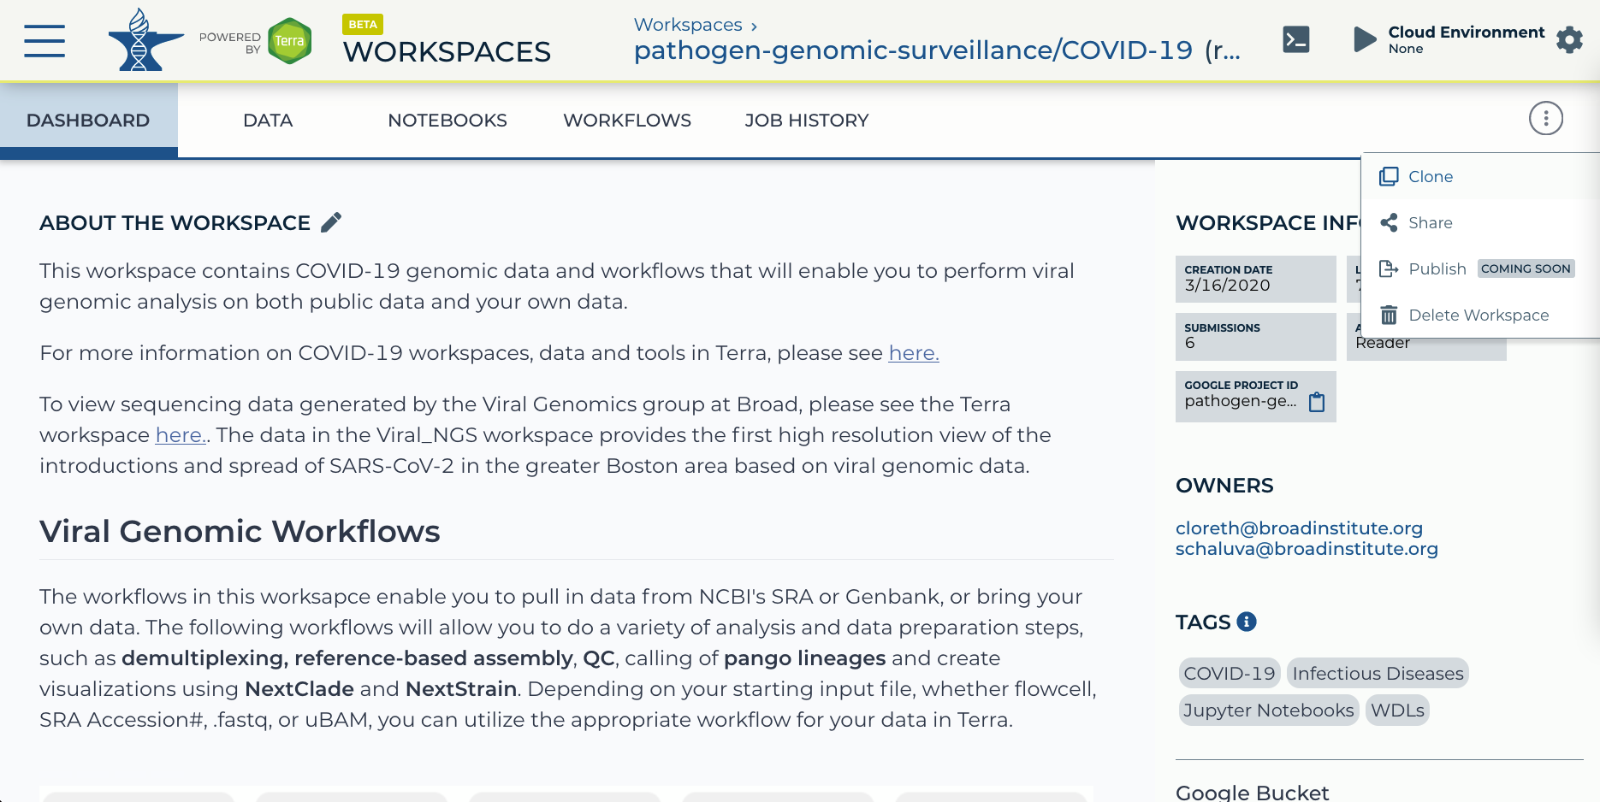
https://anvil.terra.bio/#workspaces/pathogen-genomic-surveillance/COVID-19 Workspace screenshot
by Ava Hoffman. CC-BY-4.0
Notes:
Alternatively, you can clone the Workspace from within the Workspace Dashboard instead of the search results by clicking on the teardrop button in the upper right.

Slide 10
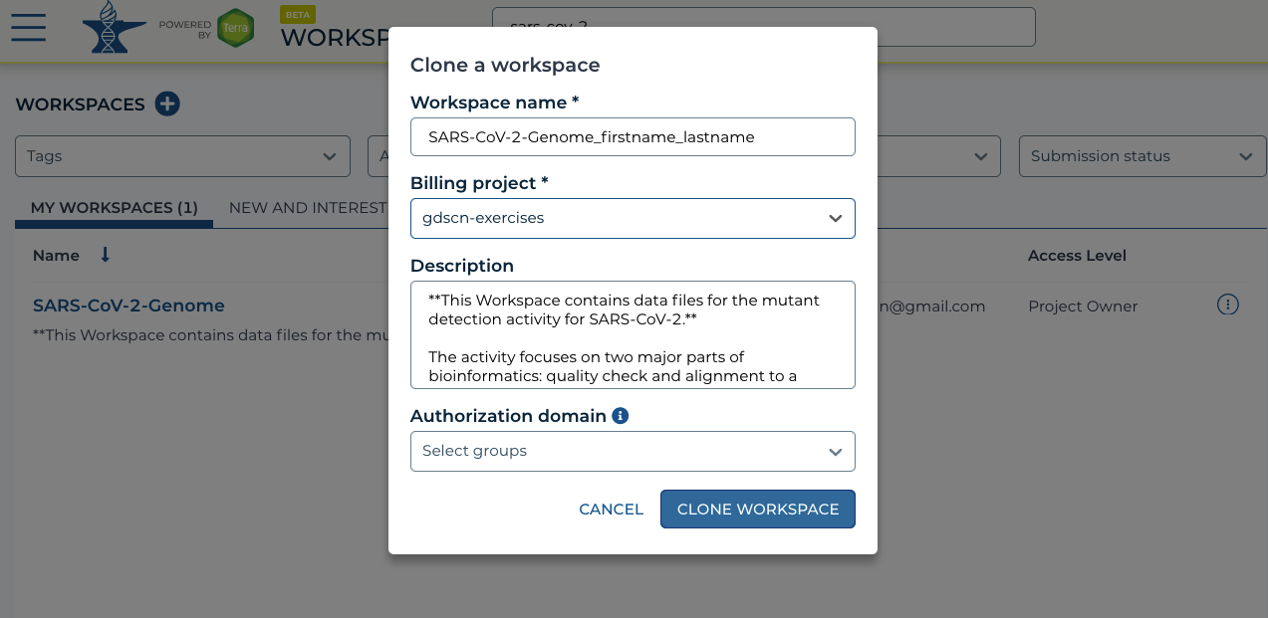
https://anvil.terra.bio/#workspaces
Notes:
Rename the copy to include your name. From the Billing project dropdown, make sure you select the billing project specified by your instructor. Check in with your instructor if you aren’t sure about this. Then select “Clone Workspace”.

Slide 11
Contributions
Katherine Cox
Ava Hoffman
Elizabeth Humphries
Frederick Tan
Notes:
Thank you to everyone who contributed!

