Slide 1
Add Members to Workspace
Notes:
This video will show you how to add collaborators to your Terra Workspace. Adding members allows them to see everything in your Workspace, and if you give them permission, they can also run analyses and edit the Workspace.

Slide 2

Terms of Use
Notes:
Except where otherwise indicated, this content is available for use under CC B Y 4.0.

Slide 3
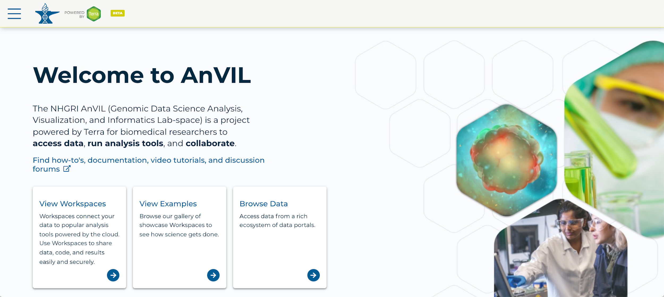
https://anvil.terra.bio/ homepage screenshot by Katherine Cox. CC-BY-4.0
Notes:
To get started, log in Terra using your Google ID.

Slide 4
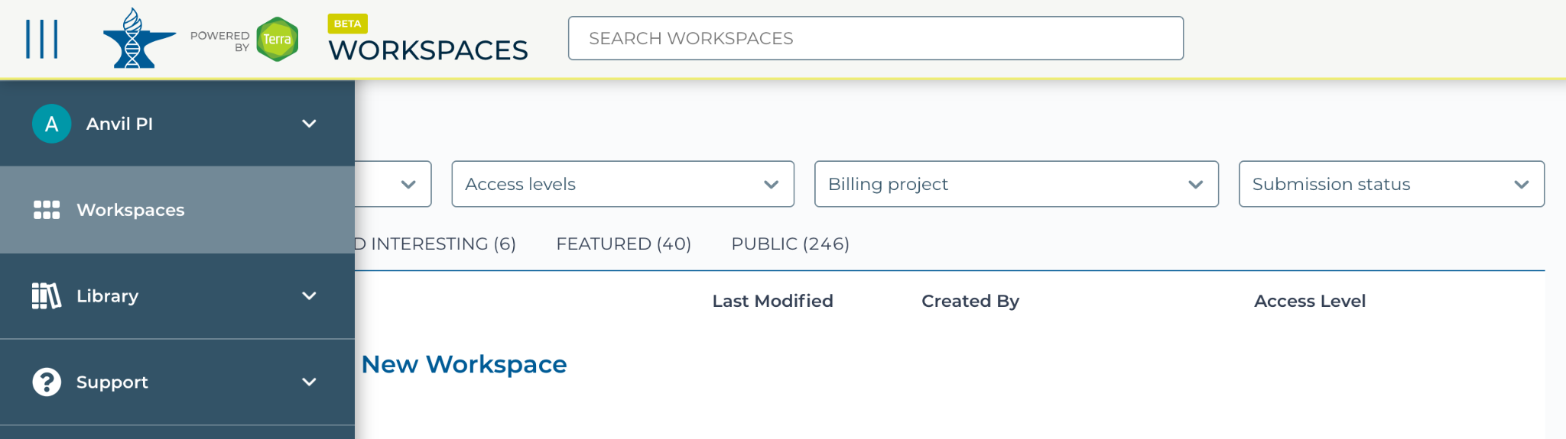
https://anvil.terra.bio/#workspaces navigate to workspaces screenshot by Katherine Cox. CC-BY-4.0
Notes:
Click the triple bar in the top left corner to access the drop-down menu, then click “Workspaces”.

Slide 5
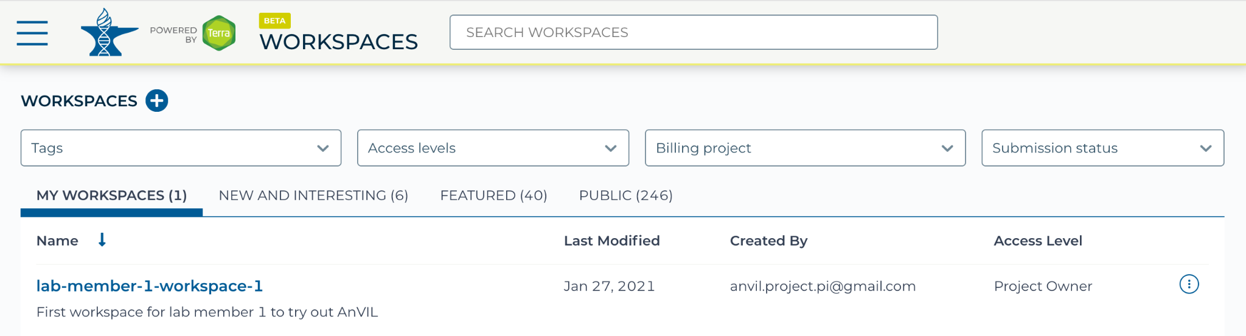
https://anvil.terra.bio/#workspaces select workspace screenshot by Katherine Cox. CC-BY-4.0
Notes:
Under “My Workspaces”, find the Workspace you want to share. In order to add people to a Workspace, you must be an owner of the Workspace.

Slide 6
https://anvil.terra.bio/#workspaces select workspace screenshot by Katherine Cox. CC-BY-4.0
Notes:
Click on the name of the Workspace to open the Workspace. Opening a Workspace does not cost anything.

Slide 7
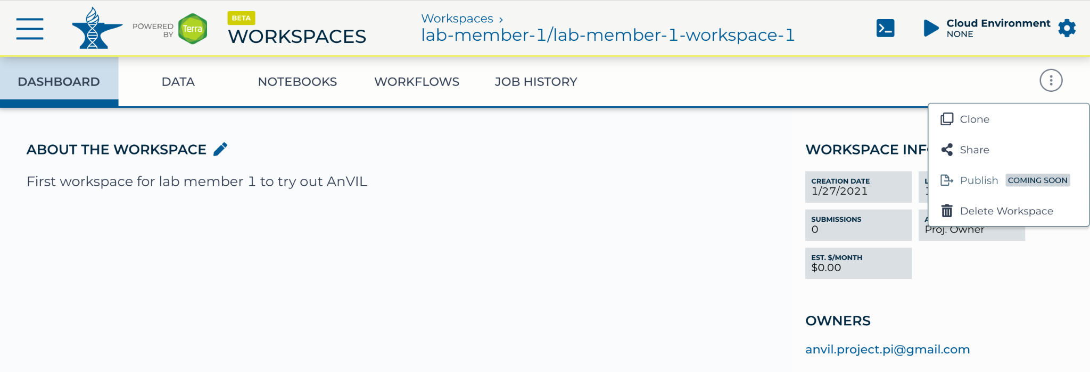
https://anvil.terra.bio/#workspaces share workspace screenshot by Katherine Cox. CC-BY-4.0
Notes:
Click the circle with 3 dots on the right hand side to open the Workspace management menu. Click “Share”

Slide 8
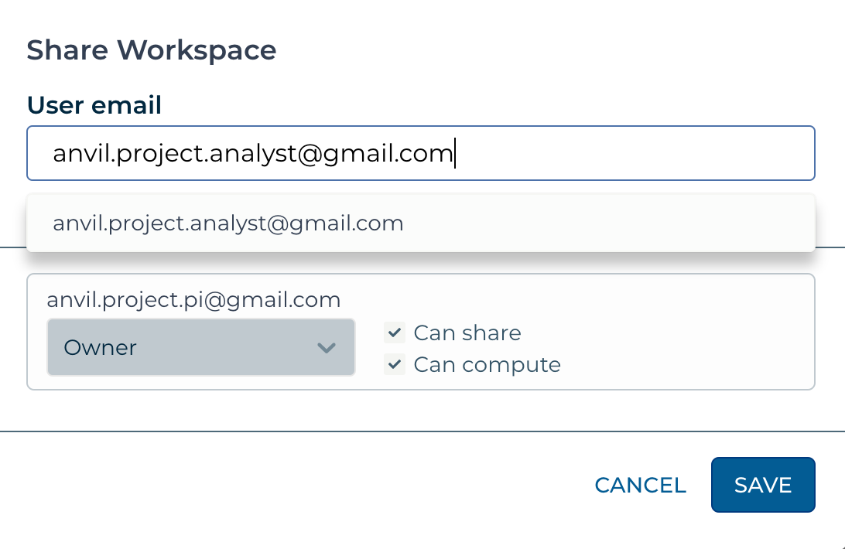
https://anvil.terra.bio/#workspaces share workspace dialog box screenshot by Katherine Cox. CC-BY-4.0
Notes:
Enter the email address of the user you want to share the Workspace with. This must be the address associated with the account they are using to access Terra.

Slide 9
Workspace Access Levels
Access Level | Permissions | Billable Activities | Data Access
Owners | import / edit data run analyses manage other user permissions | Yes | Yes
Writers | import / edit data run analyses | Yes | Yes
Readers | view data and workflows (can’t run or edit) copy contents into their own Workspace (if e.g. they wish to run the analysis in a Workspace associated with their own Billing Project) | No* | Yes
Table summarizing Terra Workspace permission levels by Katherine Cox. CC-BY-4.0
Notes:
Decide what role you want to give to the new member of your Workspace. Remember that all activity in the Workspace will be charged to the Workspaces’ Billing Project, regardless of who conducts it.

Slide 10
Workspace Access Levels
Access Level | Permissions | Billable Activities | Data Access
Owners | import / edit data run analyses manage other user permissions | Yes | Yes
Writers | import / edit data run analyses | Yes | Yes
Readers | view data and workflows (can’t run or edit) copy contents into their own Workspace (if e.g. they wish to run the analysis in a Workspace associated with their own Billing Project) | No* | Yes
Table summarizing Terra Workspace permission levels by Katherine Cox. CC-BY-4.0
Notes:
If you want them to be able to view your project but not spend your money, add them as a Reader.

Slide 11
Workspace Access Levels
Access Level | Permissions | Billable Activities | Data Access
Owners | import / edit data run analyses manage other user permissions | Yes | Yes
Writers | import / edit data run analyses | Yes | Yes
Readers | view data and workflows (can’t run or edit) copy contents into their own Workspace (if e.g. they wish to run the analysis in a Workspace associated with their own Billing Project) | No* | Yes
Table summarizing Terra Workspace permission levels by Katherine Cox. CC-BY-4.0
Notes:
If you want them to be able to use the Workspace to run analyses, add them as a "Writer".

Slide 12
Workspace Access Levels
Access Level | Permissions | Billable Activities | Data Access
Owners | import / edit data run analyses manage other user permissions | Yes | Yes
Writers | import / edit data run analyses | Yes | Yes
Readers | view data and workflows (can’t run or edit) copy contents into their own Workspace (if e.g. they wish to run the analysis in a Workspace associated with their own Billing Project) | No* | Yes
Table summarizing Terra Workspace permission levels by Katherine Cox. CC-BY-4.0
Notes:
If they need to work on the analyses but are funded by a different funding source, you can add them as a Reader and they can clone their own copy of the Workspace where they can conduct activity on their own Billing Project.

Slide 13
Workspace Access Levels
Access Level | Permissions | Billable Activities | Data Access
Owners | import / edit data run analyses manage other user permissions | Yes | Yes
Writers | import / edit data run analyses | Yes | Yes
Readers | view data and workflows (can’t run or edit) copy contents into their own Workspace (if e.g. they wish to run the analysis in a Workspace associated with their own Billing Project) | No* | Yes
Table summarizing Terra Workspace permission levels by Katherine Cox. CC-BY-4.0
Notes:
Finally, if you want them to be able to add other members, add them as an Owner. Exercise caution here; by adding someone as an owner, they have the ability to enable others to spend money in the Workspace.

Slide 14
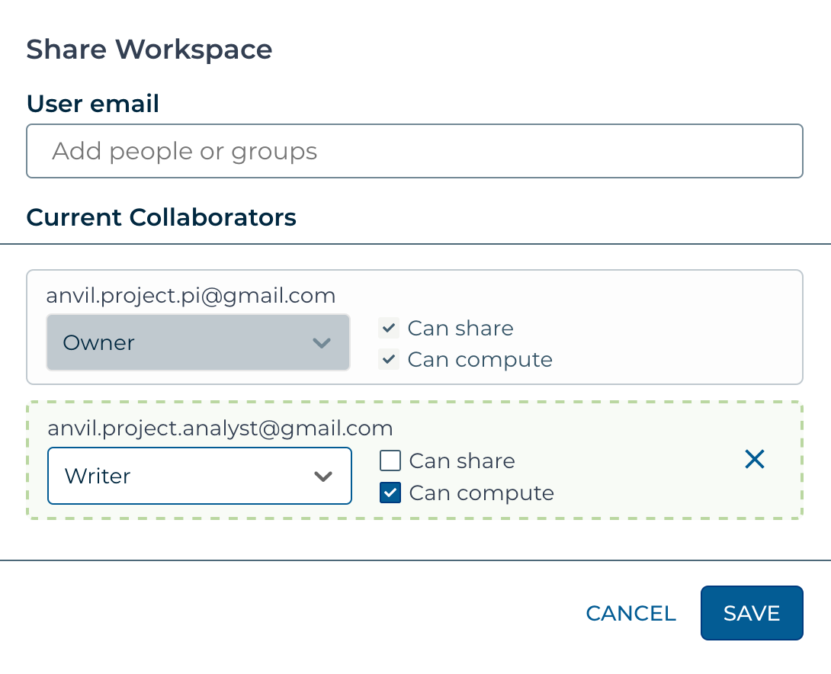
https://anvil.terra.bio/#workspaces set workspace permissions screenshot by Katherine Cox. CC-BY-4.0
Notes:
Select your desired role for the new member.

Slide 15
https://anvil.terra.bio/#workspaces save workspace permissions screenshot by Katherine Cox. CC-BY-4.0
Notes:
Click “Save”. This user should now be able to access the Workspace when logged in to Terra.

