Slide 1
Disable Terra
Billing Project
Notes:
This video will show you how to disable a Terra Billing Project. Disabling a Billing Project will remove funding from all Workspaces associated with the Billing Project, as well as prevent any new Workspaces from being created with the Billing Project.

Slide 2

Terms of Use
Notes:
Except where otherwise indicated, this content is available for use under CC B Y 4.0.

Slide 3
Unfunded Workspace
Compute
Access files and data
Notes:
As you might expect, disabling funding to a Workspace means you can no longer compute in the Workspace. However, it also means that you will be unable to access any files in the Workspace bucket. If you wish to retain access to any files and data from the Workspace, it is important to make sure you transfer them to another location before disabling the Billing Project that funds the Workspace.

Slide 4

https://anvil.terra.bio/ homepage screenshot by Katherine Cox. CC-BY-4.0
Notes:
To disable billing, first log in to Terra.

Slide 5
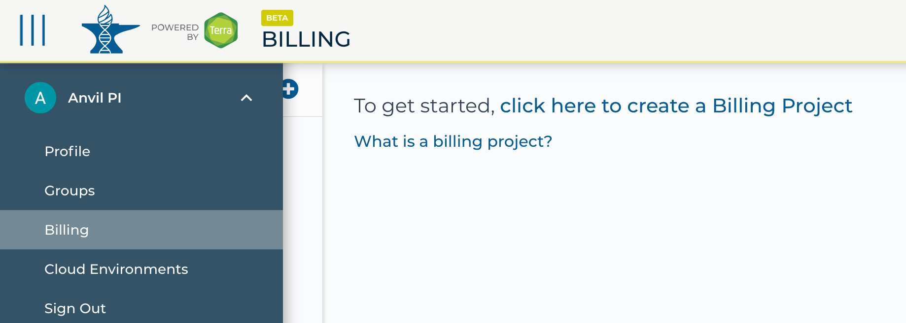
https://anvil.terra.bio/ select Billing from drop-down menu screenshot by Katherine Cox. CC-BY-4.0
Notes:
Click the triple bar in the top left corner to access the drop-down menu. Click the arrow next to your name to expand the menu, then click “Billing”.

Slide 6
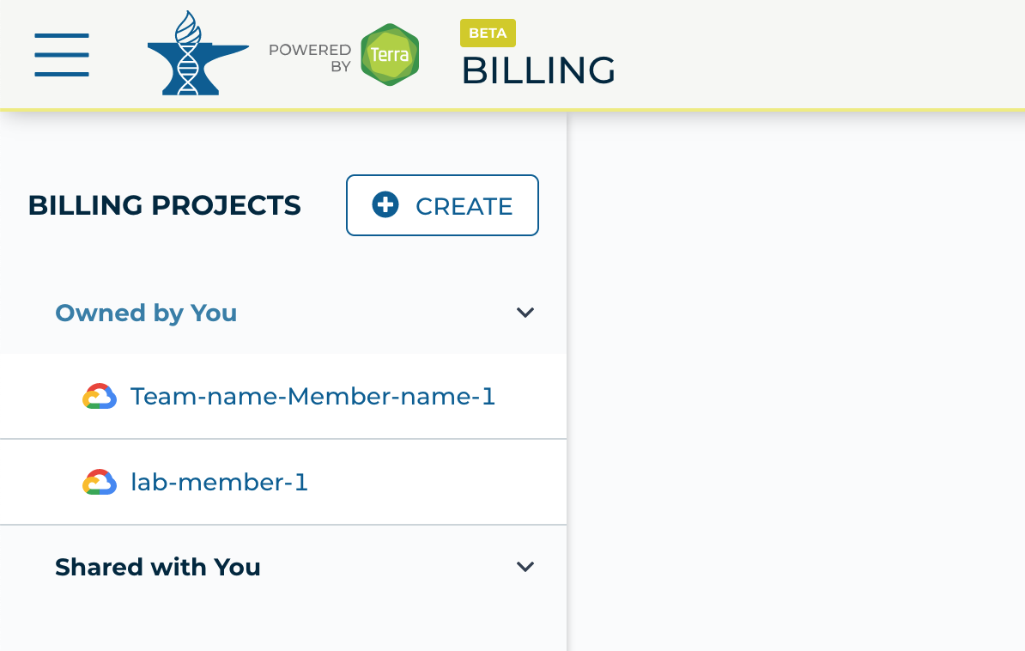
https://anvil.terra.bio/#billing Billing Projects screenshot by Katherine Cox. CC-BY-4.0
Notes:
On the Billing page, click “Owned by You” and find the Billing Project. If you do not see the Billing Project in this list, then you are not an Owner and do not have permission to disable the Billing Project.

Slide 7
https://anvil.terra.bio/#billing Billing Projects screenshot by Katherine Cox. CC-BY-4.0
Notes:
Click on the name of the Billing Project.

Slide 8
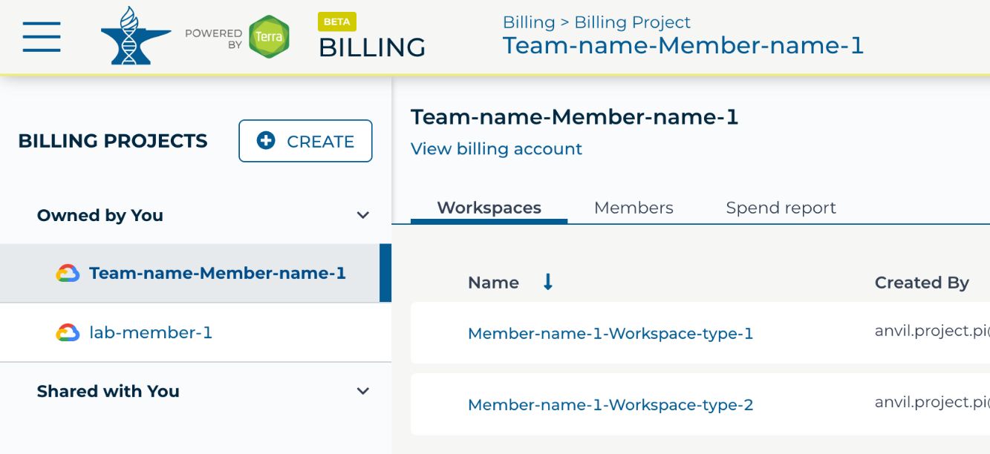
https://anvil.terra.bio/#billing Billing Project overview page screenshot by Katherine Cox. CC-BY-4.0
Notes:
If needed, click on “View billing account” to expand the billing account information. You may be prompted to enter your login information again.

Slide 9
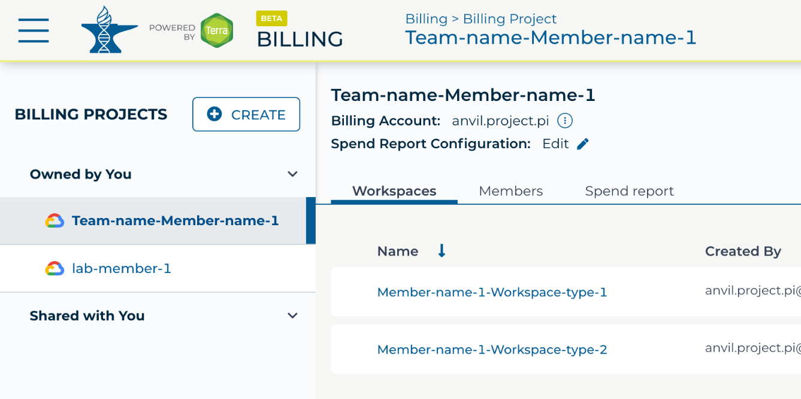
https://anvil.terra.bio/#billing Billing Project manage Billing Account screenshot by Katherine Cox. CC-BY-4.0
Notes:
You should see the name of the Google Billing Account that is funding this Billing Project. Click on the teardrop icon next to the name of the Billing Account.

Slide 10
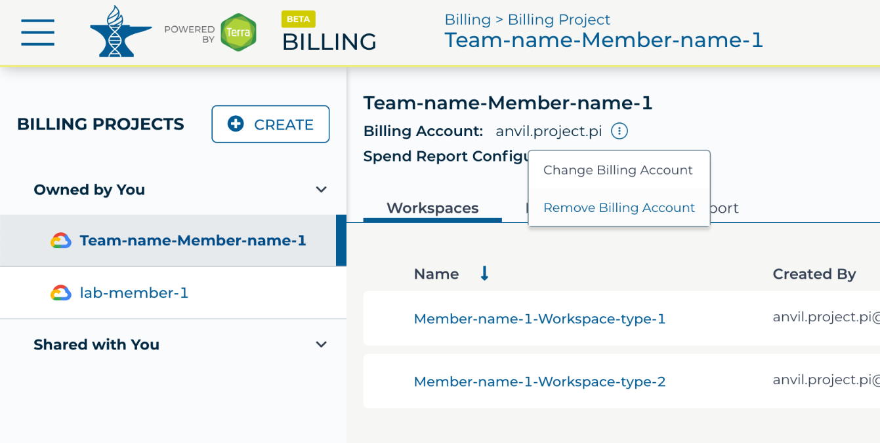
https://anvil.terra.bio/#billing Billing Project Remove Billing Account screenshot by Katherine Cox. CC-BY-4.0
Notes:
Click “Remove Billing Account”.

Slide 11
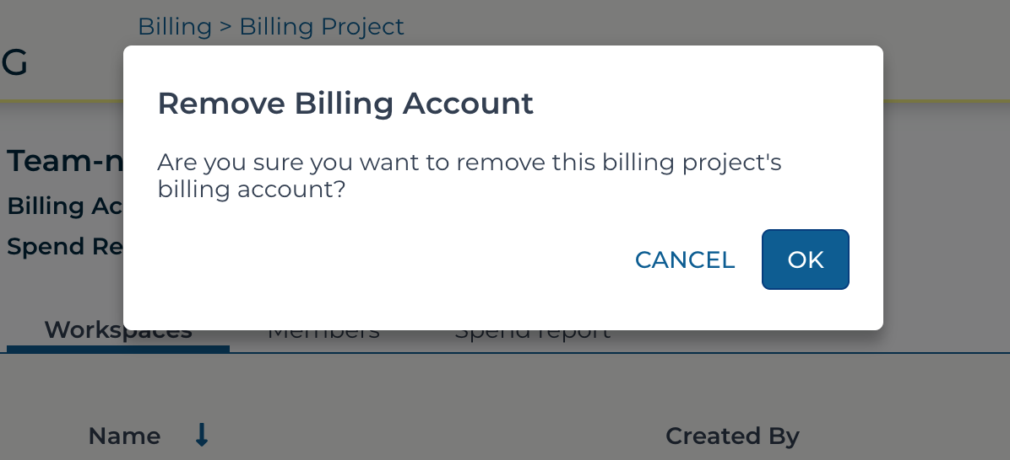
https://anvil.terra.bio/#billing Billing Project Remove Billing Account confirmation screenshot by Katherine Cox. CC-BY-4.0
Notes:
Click OK to confirm that you want to disable funding for this Billing Project.

Slide 12

https://anvil.terra.bio/#billing Billing Project with no Billing Account screenshot by Katherine Cox. CC-BY-4.0
Notes:
The page should now indicate that there is no linked billing account.

Slide 13
https://anvil.terra.bio/#billing Billing Project manage Billing Account screenshot by Katherine Cox. CC-BY-4.0
Notes:
If necessary, you can restore funding to the Billing Project and associated Workspaces by clicking the teardrop icon and selecting “Change Billing Account”. However, Google makes no promises about how long the Workspace contents will remain available after you disable funding, so it is best not to rely on them.

Slide 14
Contributions
Katherine Cox
Ava Hoffman
Allie Cliffe
Frederick Tan
Notes:
Thank you to everyone who contributed!

