Slide 1
Workspaces Figures
Notes:
Welcome to Introduction to Workspaces on AnVIL!

Slide 2
Terms of Use

Slide 3
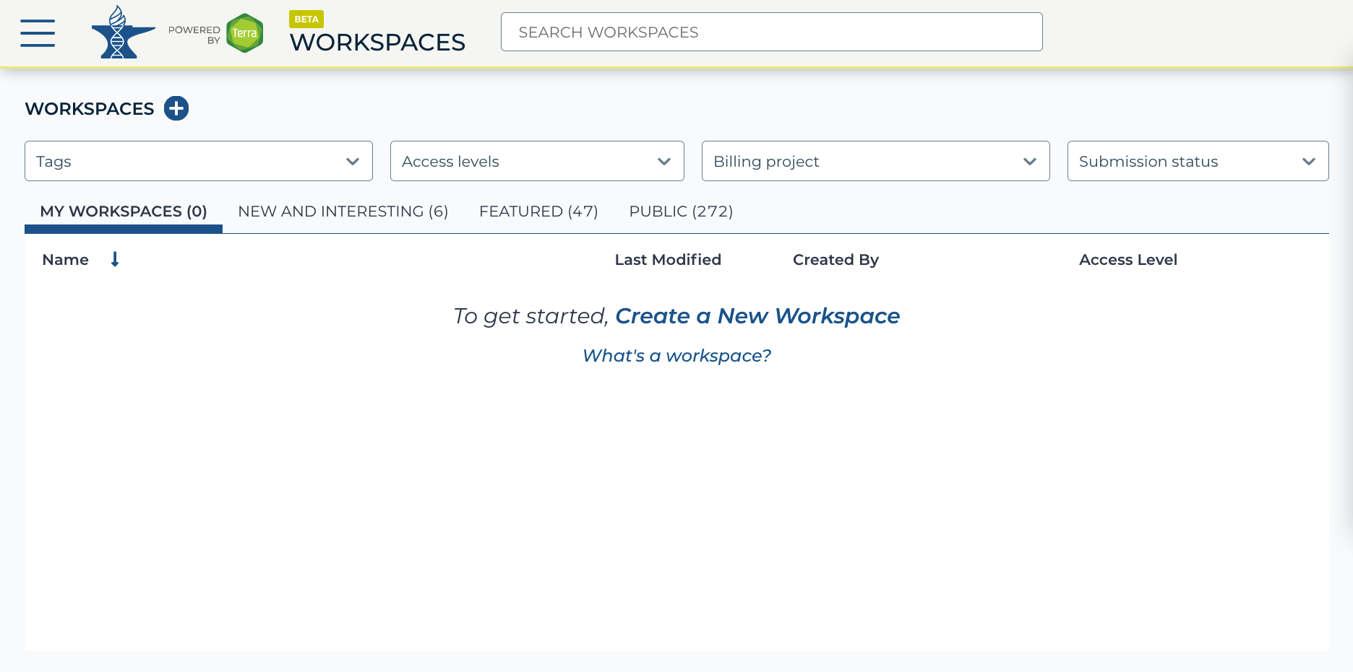
https://anvil.terra.bio/#workspaces Workspaces screenshot by Ava Hoffman. CC-BY-4.0

Slide 4
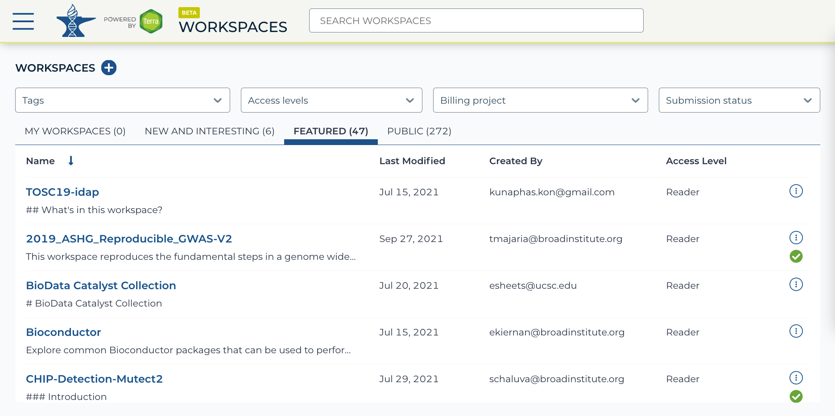
https://anvil.terra.bio/#workspaces Workspaces screenshot by Ava Hoffman. CC-BY-4.0

Slide 5
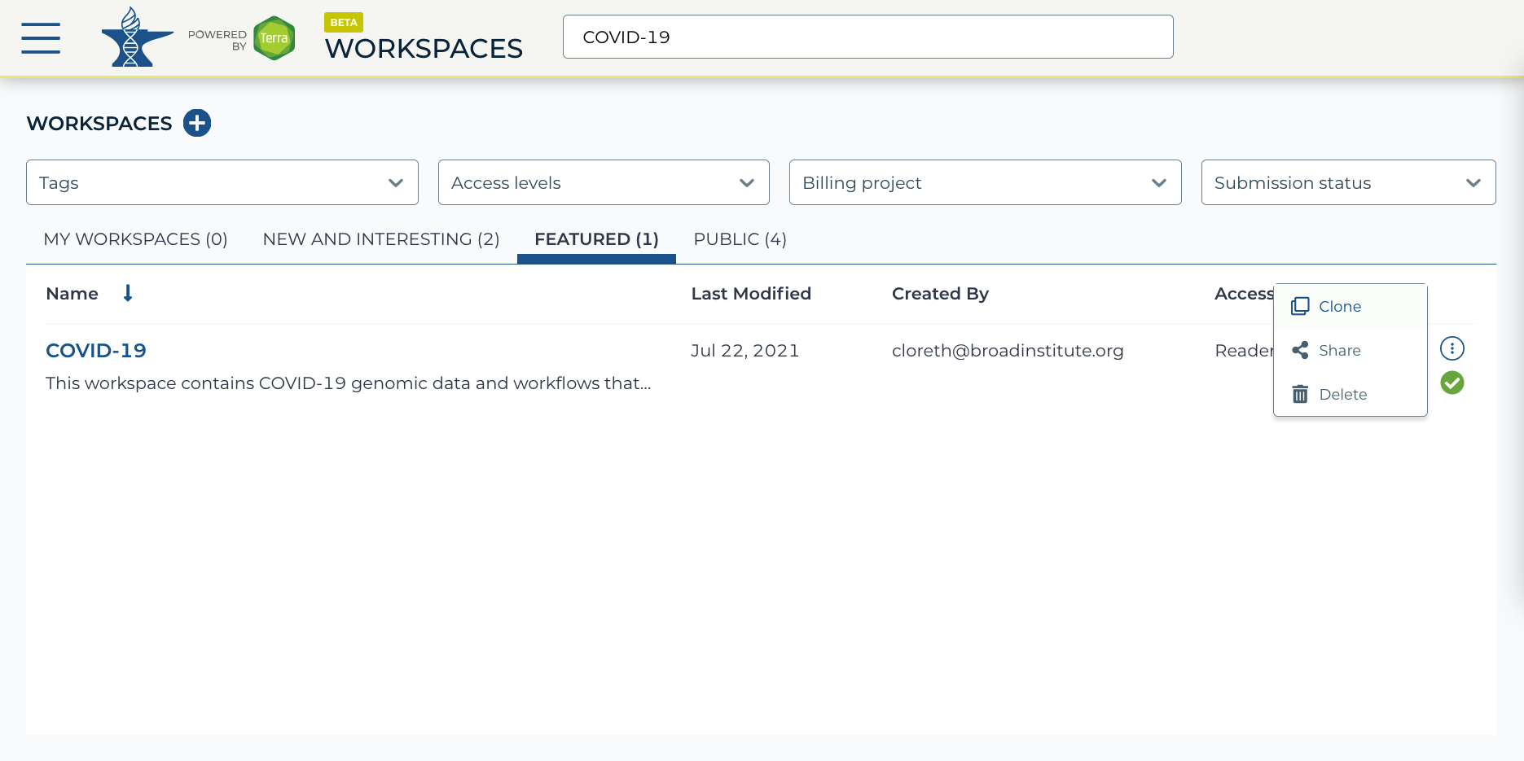
https://anvil.terra.bio/#workspaces Workspaces screenshot by Ava Hoffman. CC-BY-4.0

Slide 6
https://anvil.terra.bio/#workspaces Workspaces screenshot by Ava Hoffman. CC-BY-4.0

Slide 7
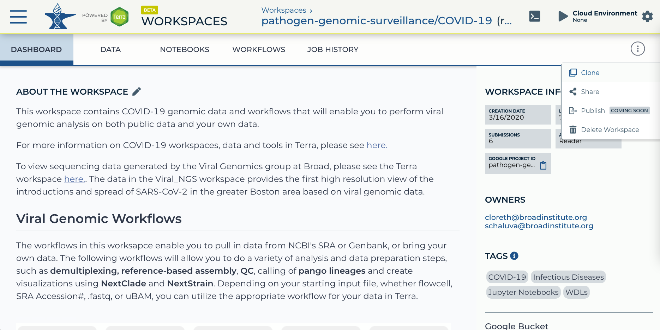
https://anvil.terra.bio/#workspaces/pathogen-genomic-surveillance/COVID-19 Workspace screenshot
by Ava Hoffman. CC-BY-4.0

Slide 8
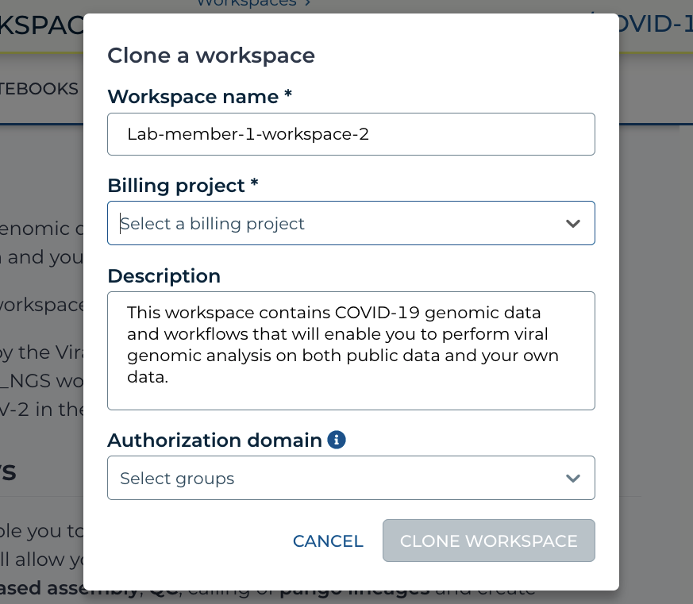
https://anvil.terra.bio/#workspaces/pathogen-genomic-surveillance/COVID-19 clone a Workspace popout screenshot
by Ava Hoffman. CC-BY-4.0

Slide 9
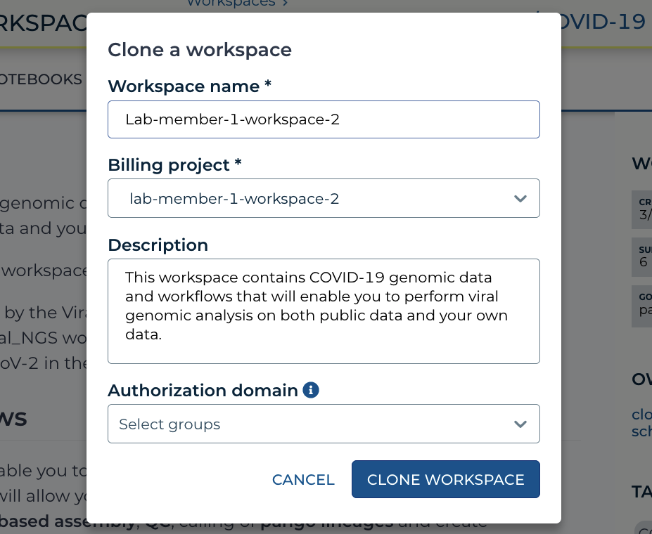
https://anvil.terra.bio/#workspaces/pathogen-genomic-surveillance/COVID-19 clone a Workspace popout screenshot
by Ava Hoffman. CC-BY-4.0

Slide 10
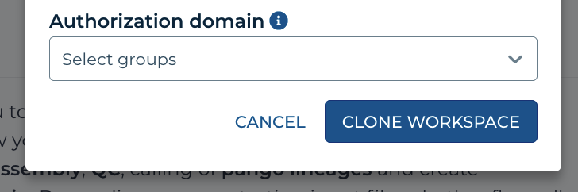
https://anvil.terra.bio/#workspaces/pathogen-genomic-surveillance/COVID-19 clone a Workspace popout screenshot
by Ava Hoffman. CC-BY-4.0

Slide 11
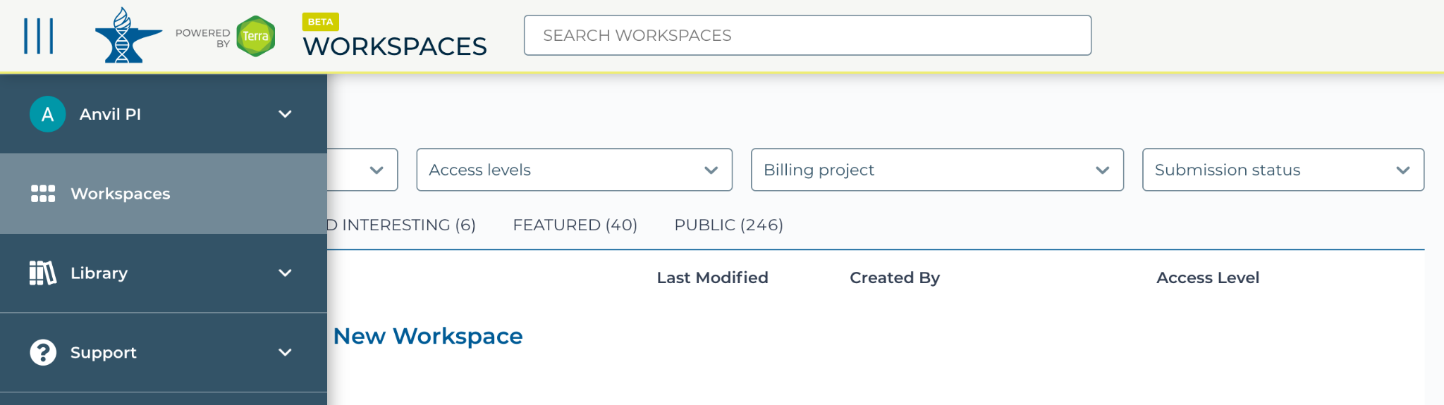
https://anvil.terra.bio/#workspaces navigate to workspaces screenshot by Katherine Cox. CC-BY-4.0

Slide 12
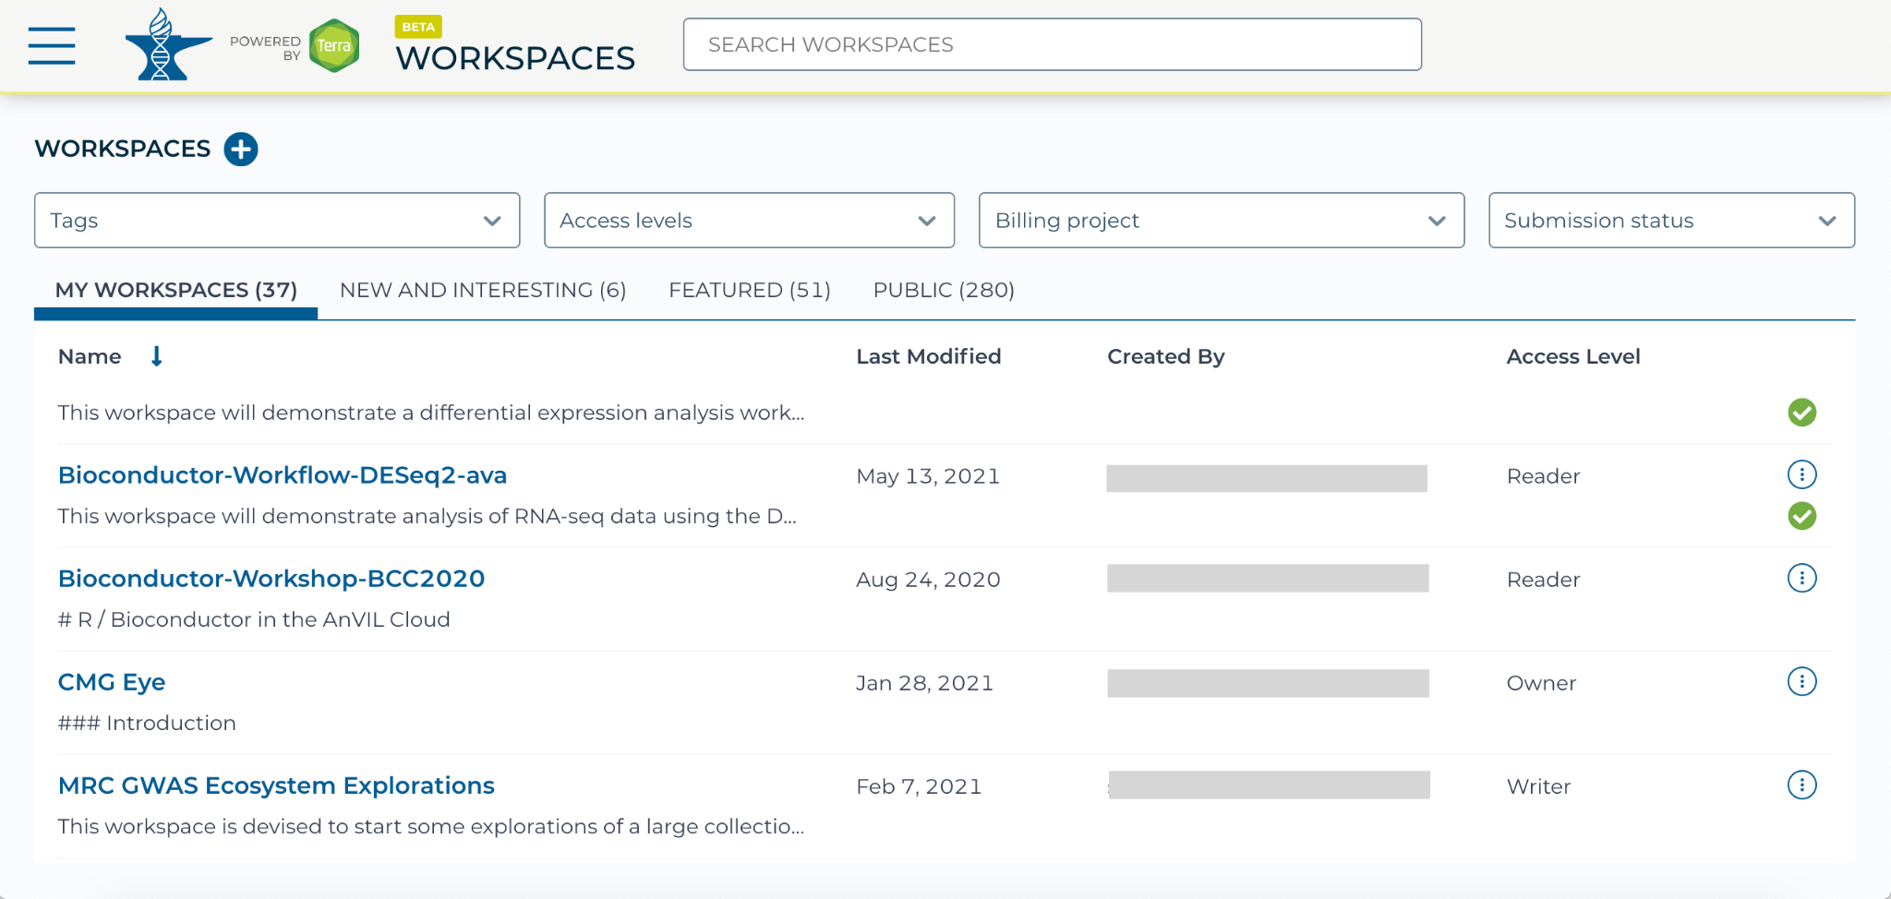
https://anvil.terra.bio/#workspaces view My Workspaces screenshot by Katherine Cox. CC-BY-4.0

Slide 13
https://anvil.terra.bio/#workspaces Workspace name screenshot by Katherine Cox. CC-BY-4.0

Slide 14
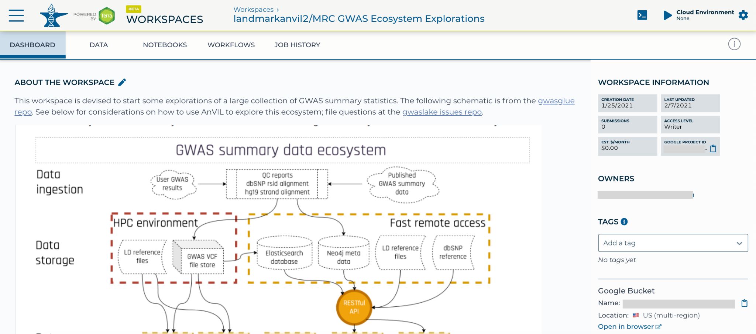
https://anvil.terra.bio/#workspaces example Terra Workspace screenshot by Katherine Cox. CC-BY-4.0

