Slide 1
Add Members to
GCP Billing
“Users” and “Viewers”
Notes:
This video will show you how to add members to your Google Cloud Platform Billing Account. If you have not already created a GCP Billing Account, go ahead and do that first.

Slide 2

Terms of Use
Notes:
Except where otherwise indicated, this content is available for use under CC B Y 4.0.

Slide 3
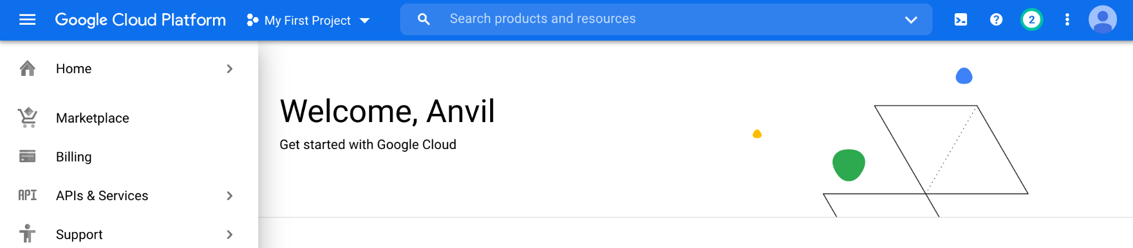
https://console.cloud.google.com/ menu screenshot by Katherine Cox. CC-BY-4.0
Notes:
To get started, log in to the Google Cloud Platform console using the Google ID associated with your Billing Account.

Slide 4
https://console.cloud.google.com/ select billing from menu screenshot by Katherine Cox. CC-BY-4.0
Notes:
Open the dropdown menu on the top left and click on Billing.

Slide 5
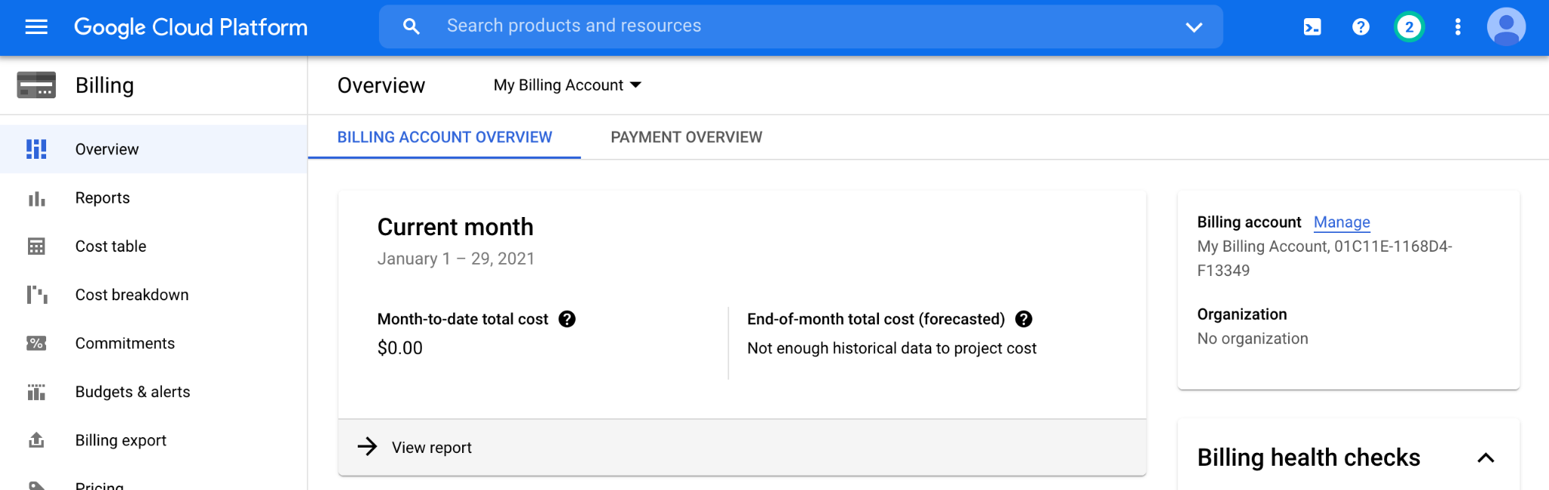
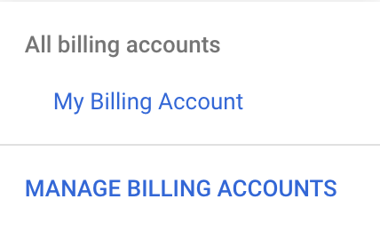
https://console.cloud.google.com/billing/ dropdown menu for an individual billing account screenshot by Katherine Cox. CC-BY-4.0
Notes:
You may be automatically directed to view a specific Billing Account. If you see information about a single account, you can get back to the list of all your Billing Accounts by clicking “Manage Billing Accounts” from the drop-down menu.

Slide 6
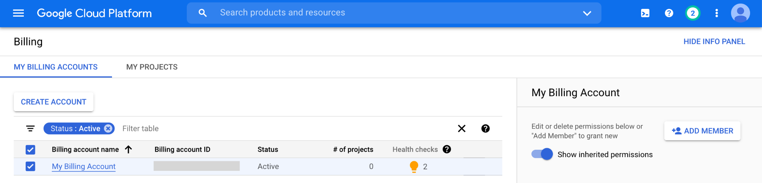
https://console.cloud.google.com/billing/ add member to billing account screenshot by Katherine Cox. CC-BY-4.0
Notes:
Check the box next to the Billing Account you wish to add a member to, then click “ADD MEMBER” on the right.

Slide 7
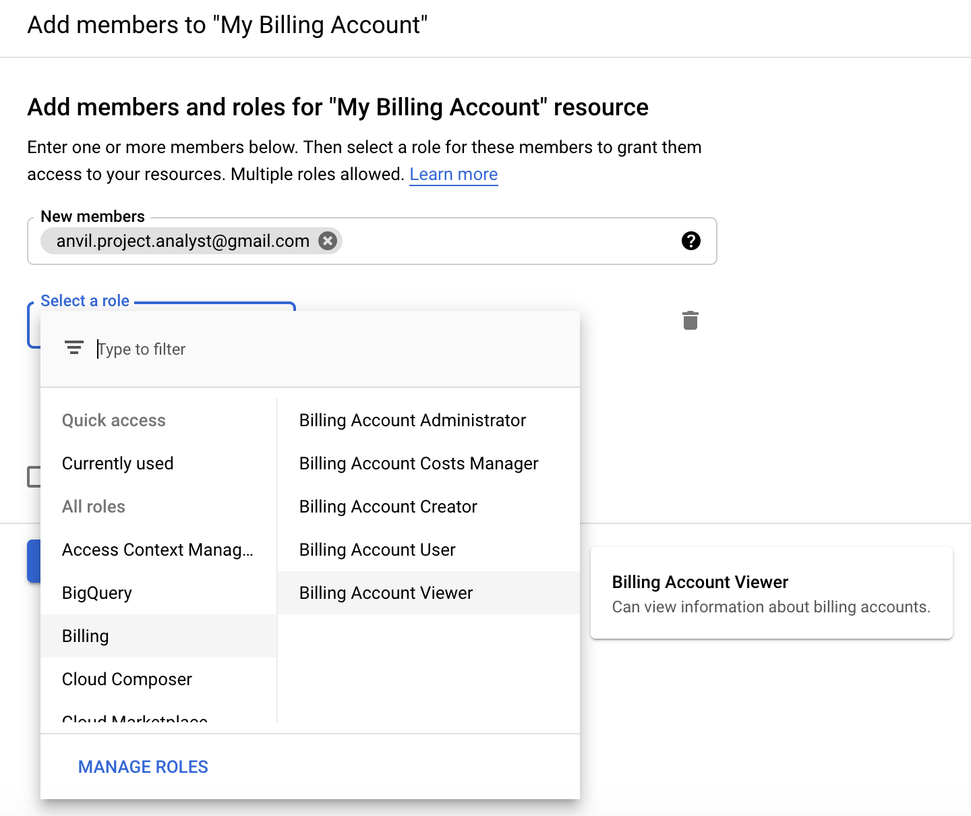
https://console.cloud.google.com/billing/ add billing account viewer screenshot by Katherine Cox. CC-BY-4.0
Notes:
Enter their Google ID in the text box. In the drop-down menu, mouse over Billing, then choose the appropriate role.

Slide 8
Roles
Users
create new “Billing Projects”
control who can spend money on those projects
Useful for: lab or accounts manager
Viewers
see activity but can’t make any changes
Useful for: finance staff, lab members to monitor spending
All members need their own Google ID.
Notes:
Members can be added with a few different permission levels, but generally the most useful are “User” and “Viewer”.
Users have a great deal of power over spending - they can create new “Billing Projects” and control who can spend money on those projects. If there is a lab or accounts manager responsible for expenses, it may make sense to add them as a Billing Account User. If you wish to retain full control over who can spend money on GCP, you should not add any Users.
Viewers can see the activity in the Billing Account but can’t make any changes. This can be useful for finance staff who need access to the reports, or for lab members to monitor their own spending.
Anyone you wish to add to the Billing Account will need their own Google ID.

Slide 9
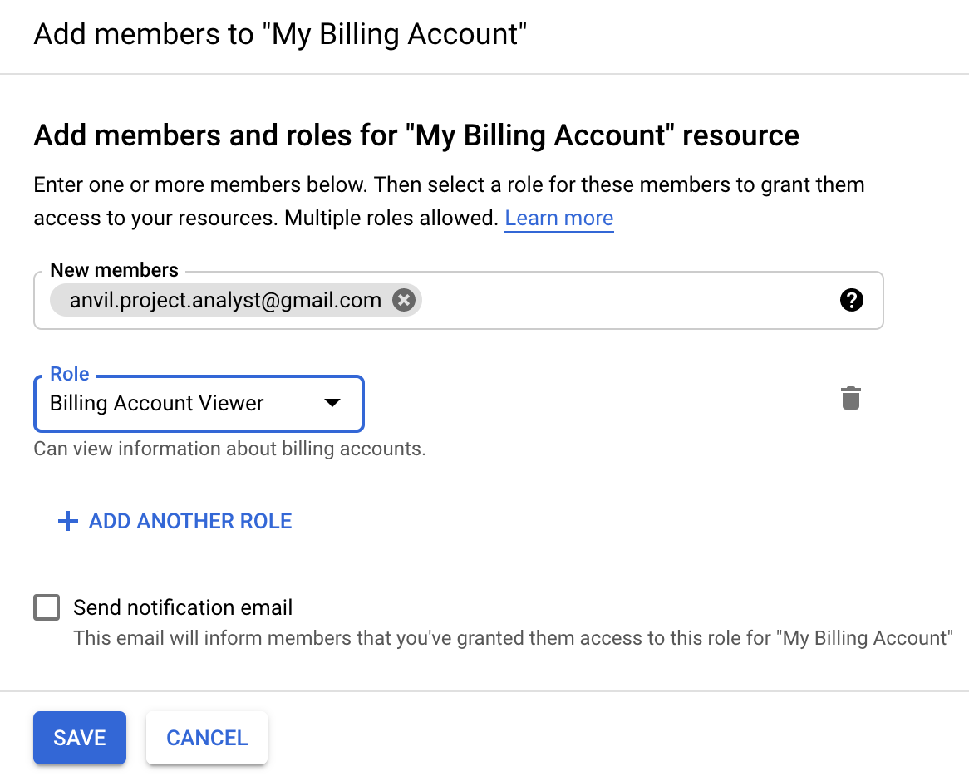
https://console.cloud.google.com/billing/ save billing account viewer screenshot by Katherine Cox. CC-BY-4.0
Notes:
Once you have selected a role, click “Save” to complete the process. The new member should now be able to access this Billing Account through Google Cloud Platform.

