Slide 1
Create GCP
Billing Account
Notes:
This video will show you how to create a Billing Account on Google Cloud Platform. A GCP Billing Account is necessary to run analyses on AnVIL.

Slide 2

Terms of Use
Notes:
Except where otherwise indicated, this content is available for use under CC B Y 4.0.

Slide 3
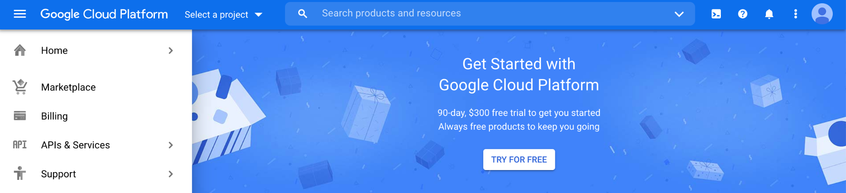
https://console.cloud.google.com/ free trial screenshot by Katherine Cox. CC-BY-4.0
Notes:
To get started, log in to the Google Cloud Platform console using your Google ID. Make sure to use the same Google account ID you use to log into Terra. If you are a first time user, don’t forget to claim your free credits! If you haven’t been to the console before, once you accept the Terms of Service you will be greeted with an invitation to “Try for Free.”

Slide 4
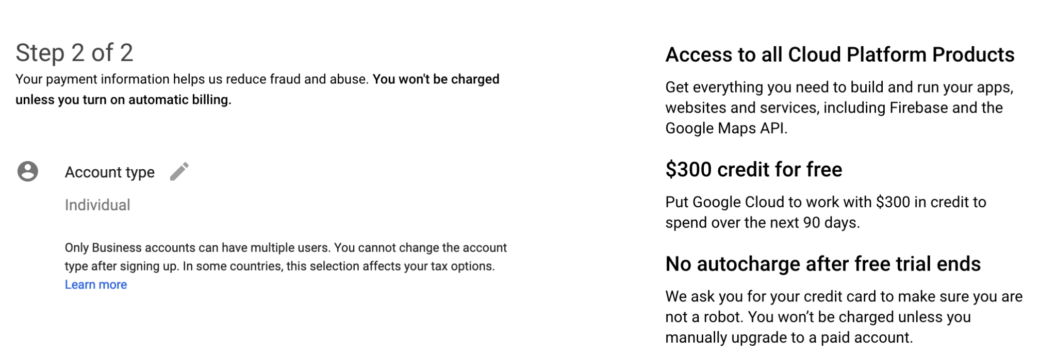
https://console.cloud.google.com/ free trial setup screenshot by Katherine Cox. CC-BY-4.0
Notes:
Follow the instructions to sign up for a Billing Account and get your cloud credits. Select “Individual Account”. This “billing account” is just for managing billing, so you don’t need to be able to add your lab members. You will need to give either a credit card or bank account for security. Don’t worry! You won’t be billed until you explicitly turn on automatic billing.

Slide 5
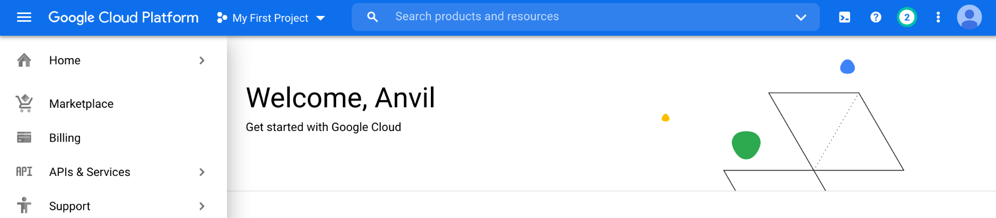
https://console.cloud.google.com/ select billing from menu screenshot by Katherine Cox. CC-BY-4.0
Notes:
You can view and edit your new Billing Account by selecting “Billing” from the left-hand menu.

Slide 6
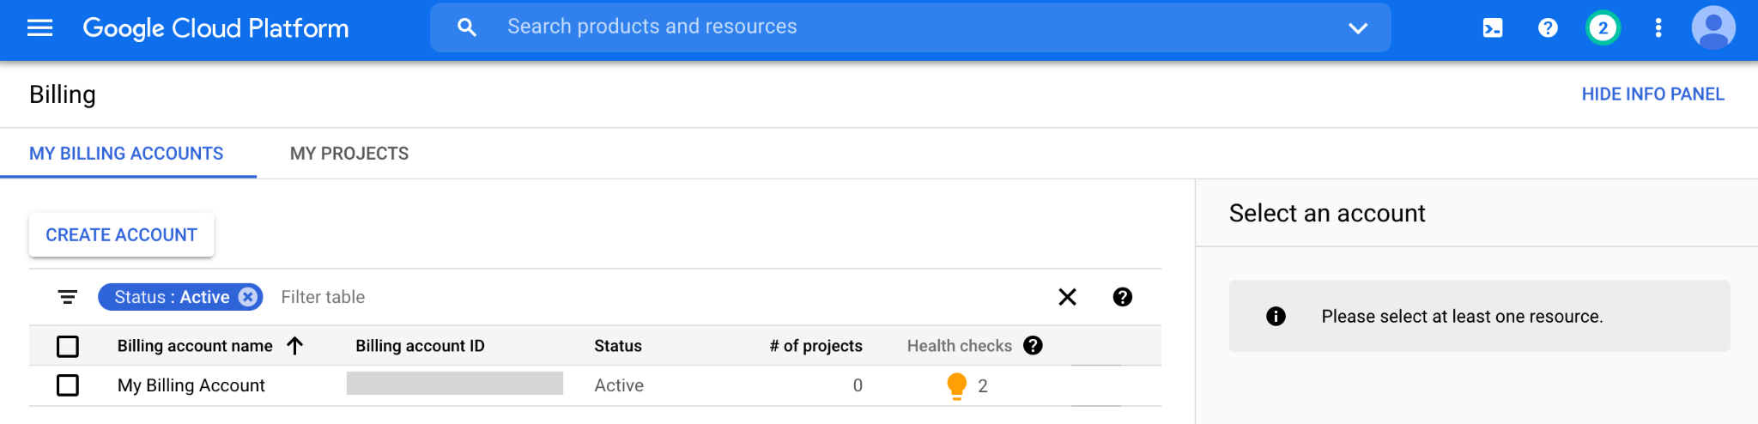
https://console.cloud.google.com/billing screenshot by Katherine Cox. CC-BY-4.0
Notes:
Clicking on the Billing Account name will allow you to manage the account, including accessing reports, setting alerts, and managing payments and billing. You can create additional Billing Accounts at any point using the Create Account button. We generally recommend creating a new Billing Account for each funding source.

