Slide 1
Create a Workspace
Notes:
This video will show you how to create a Terra Workspace. Workspaces are where analyses takes place on AnVIL.

Slide 2

Terms of Use
Notes:
Except where otherwise indicated, this content is available for use under CC B Y 4.0.

Slide 3
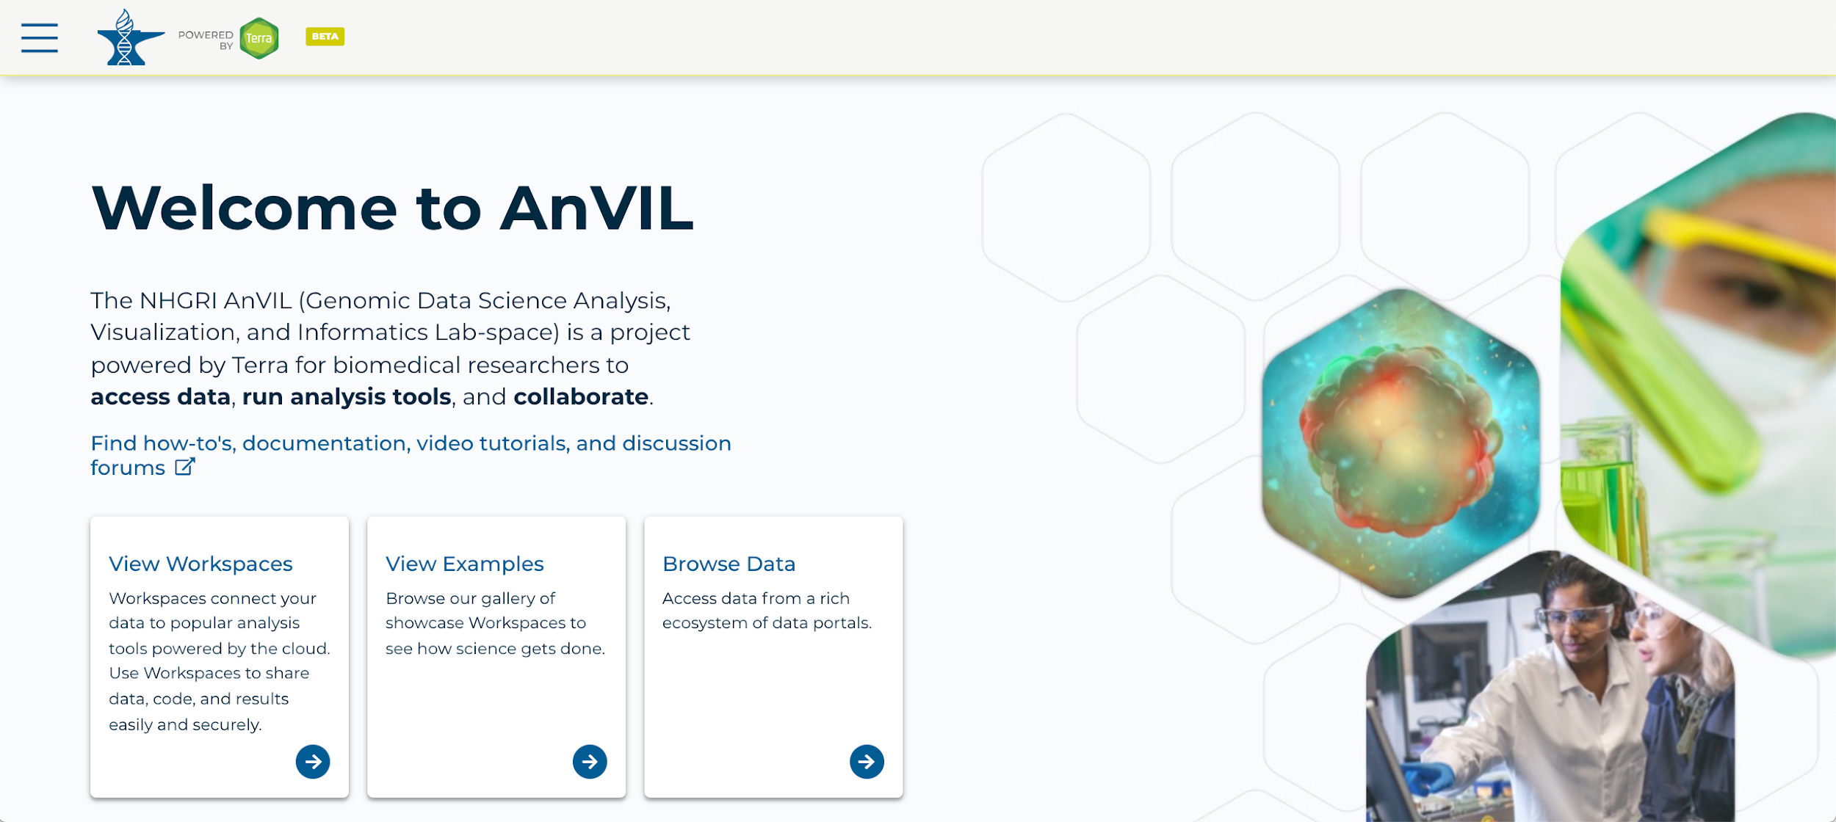
https://anvil.terra.bio/ homepage screenshot by Katherine Cox. CC-BY-4.0
Notes:
To get started, log in Terra using your Google ID.

Slide 4
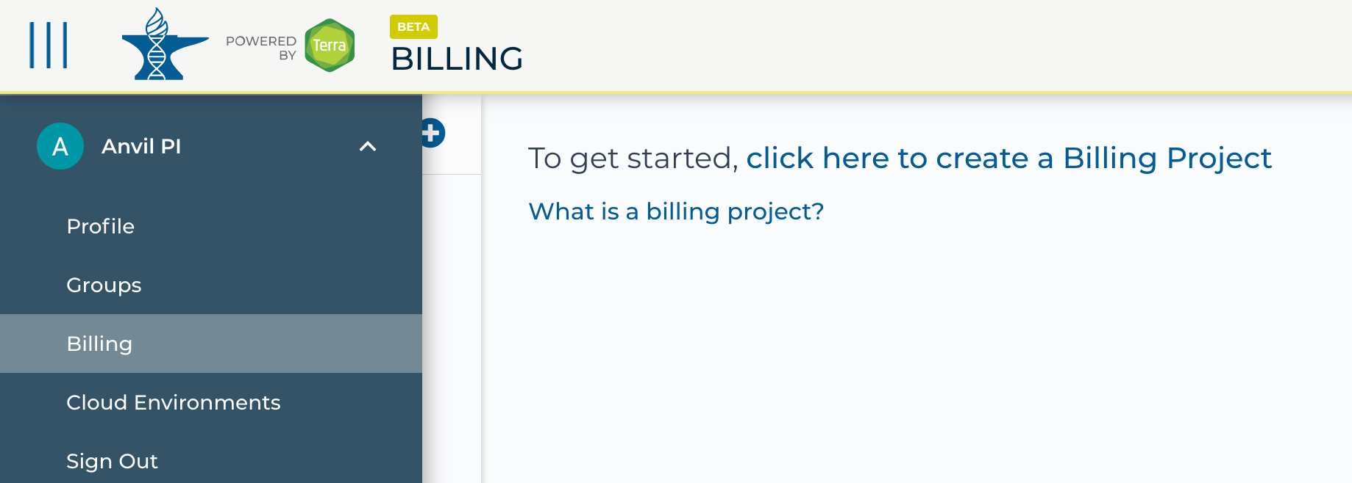
https://anvil.terra.bio/ select Billing from drop-down menu screenshot by Katherine Cox. CC-BY-4.0
Notes:
In order to create a Workspace, you must be a member of a Terra Billing Project. To see whether you belong to any Terra Billing Projects, click the triple bar in the top left corner to access the drop-down menu, then click the arrow next to your name to expand the menu, and click “Billing”. If you are not a member of an active Billing Project, you will need to either be added to an existing Billing Project or set one up yourself before you can create a Workspace.

Slide 5
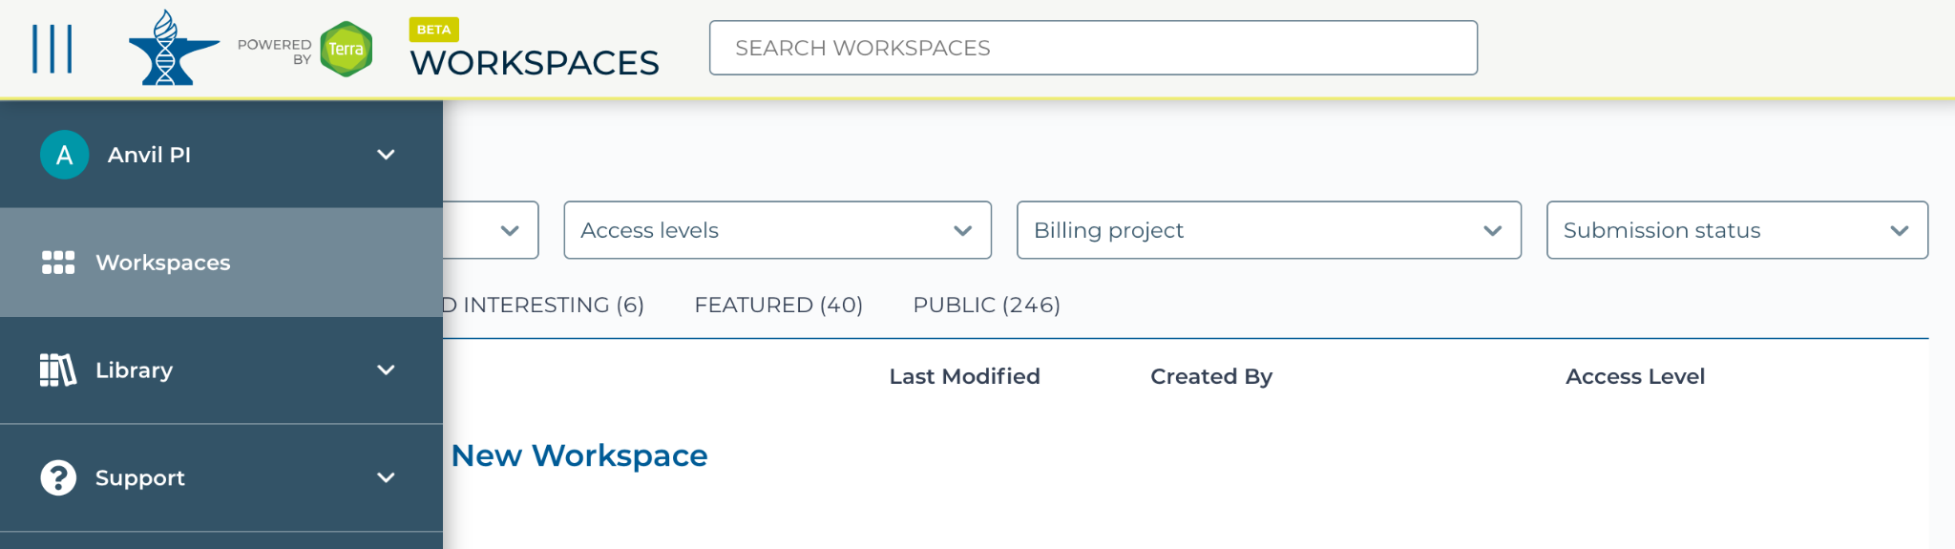
https://anvil.terra.bio/#workspaces navigate to workspaces screenshot by Katherine Cox. CC-BY-4.0
Notes:
To create a Workspace, click the triple bar in the top left corner to access the drop-down menu, then click “Workspaces”.

Slide 6
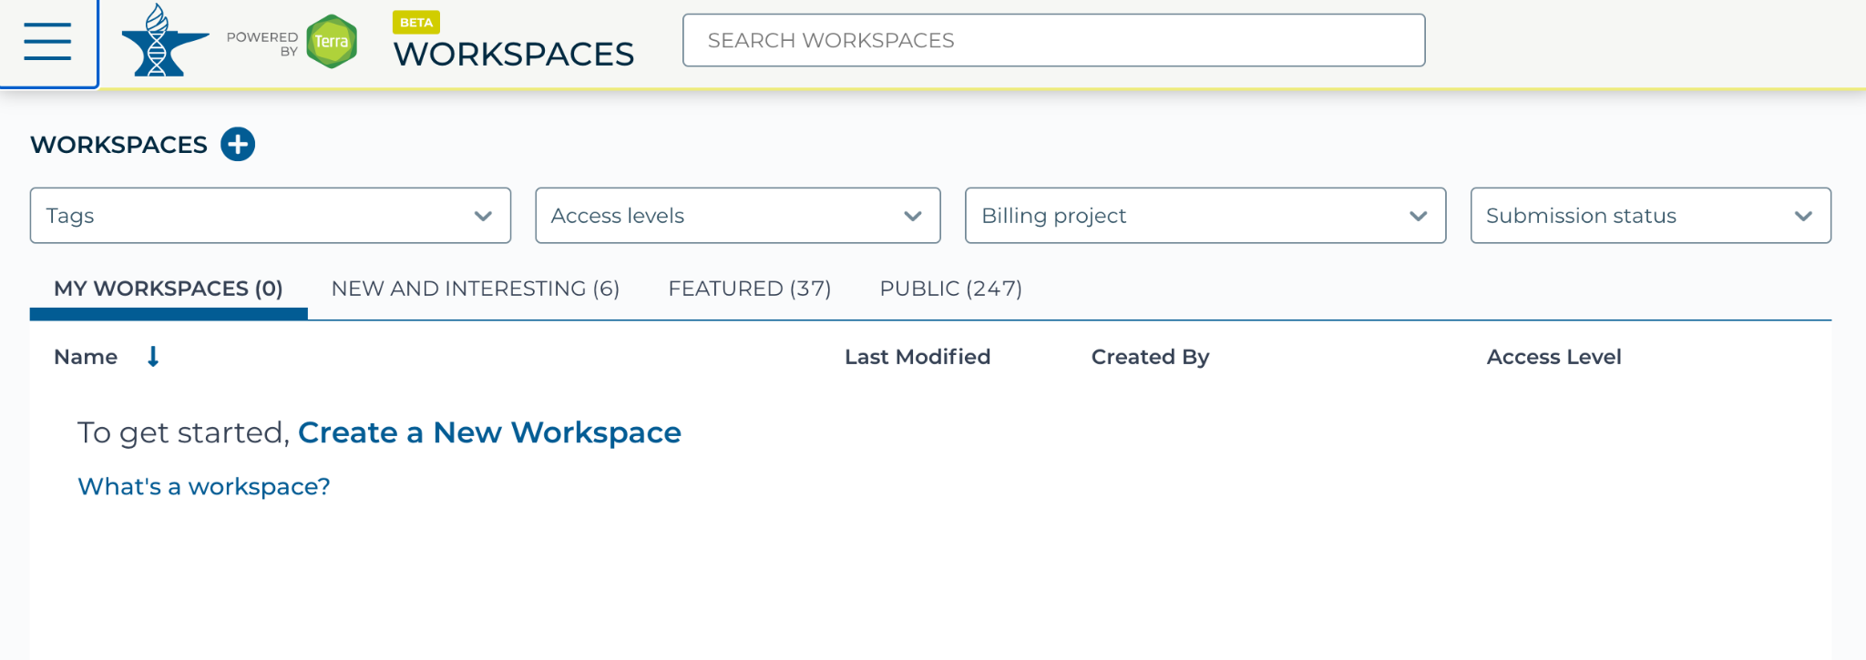
https://anvil.terra.bio/#workspaces create new workspace screenshot by Katherine Cox. CC-BY-4.0
Notes:
Click on the plus icon near the top of left of the page.

Slide 7
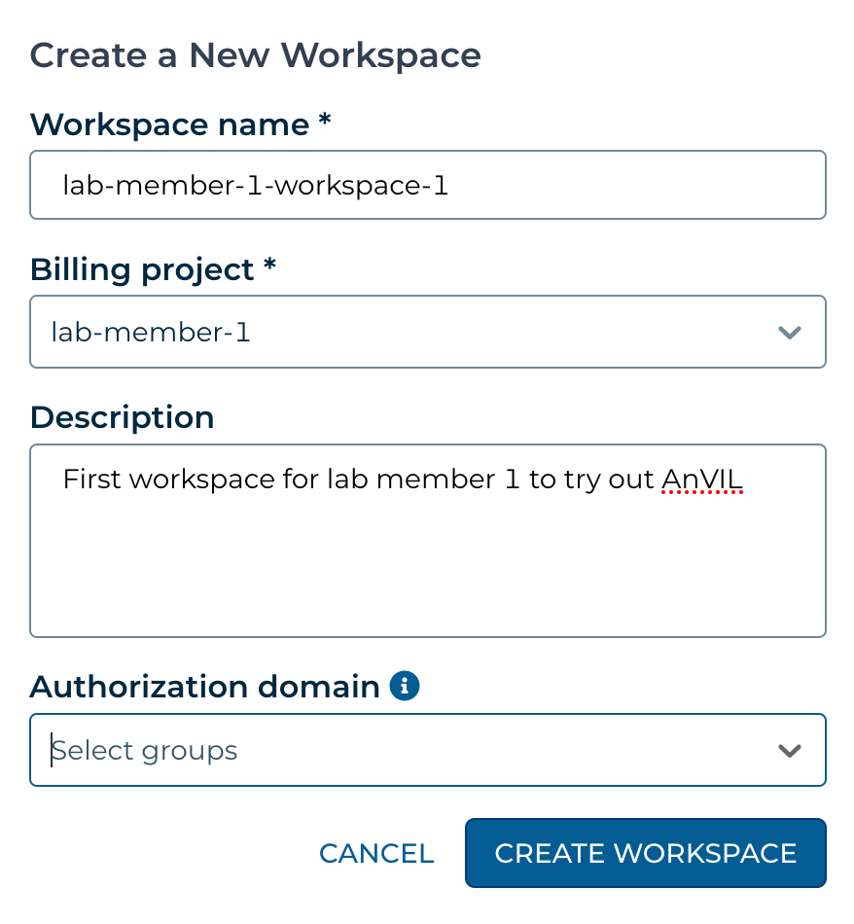
https://anvil.terra.bio/#workspaces name workspace and select billing project screenshot by Katherine Cox. CC-BY-4.0
Notes:
In the popup box, name your Workspace and select the appropriate Billing Project. Note that all activity in the Workspace will be charged to this Billing Project, regardless of who conducts it.

Slide 8
https://anvil.terra.bio/#workspaces select authorization domain screenshot by Katherine Cox. CC-BY-4.0
Notes:
If you are working with protected data, you can set an Authorization Domain to limit who can be added to your Workspace. Note that the Authorization Domain cannot be changed after the Workspace is created, which can make it difficult if you later need to share your Workspace more broadly. Authorization domains add an extra layer of enforcement over privacy, but by nature make sharing more complicated. We generally recommend using Authorization Domains only in cases where it is extremely important or legally required that the data be kept private, such as protected patient data or confidential industry data.

Slide 9
https://anvil.terra.bio/#workspaces create workspace screenshot by Katherine Cox. CC-BY-4.0
Notes:
Click “CREATE WORKSPACE”.

Slide 10
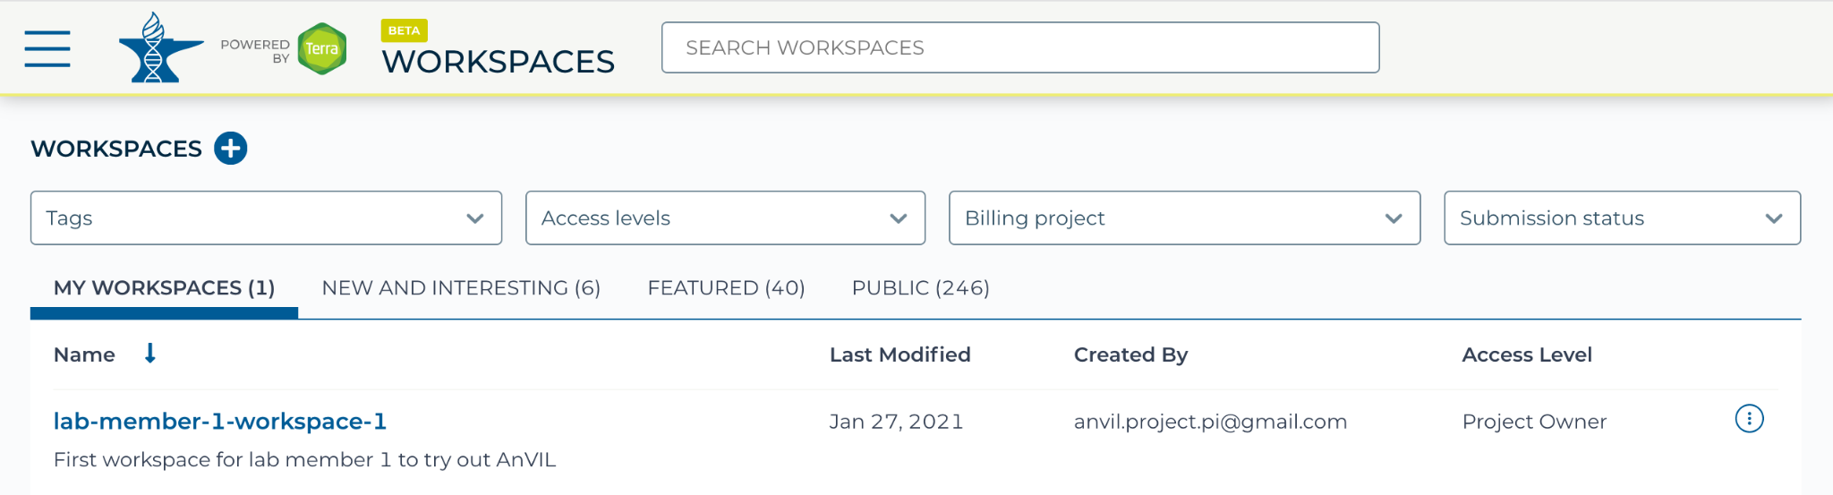
https://anvil.terra.bio/#workspaces select workspace screenshot by Katherine Cox. CC-BY-4.0
Notes:
The new Workspace should now show up under your Workspaces. Congratulations! You have created a Workspace and can begin running analyses on AnVIL.

Slide 11
Workspace Access Levels
Access Level | Permissions | Billable Activities | Data Access
Owners | import / edit data run analyses manage other user permissions | Yes | Yes
Writers | import / edit data run analyses | Yes | Yes
Readers | view data and workflows (can’t run or edit) copy contents into their own Workspace (if e.g. they wish to run the analysis in a Workspace associated with their own Billing Project) | No | Yes
Table summarizing Terra Workspace permission levels by Katherine Cox. CC-BY-4.0
Notes:
When managing your Workspace, it’s important to remember that all activity in the Workspace will be charged to the Workspaces’ Billing Project, regardless of who conducts it, and to exercise caution when sharing your Workspace. You can safely add people as Readers, but you should only add people as Writers or Owners if their activity should be funded by your Billing Project.

