Slide 1





Benefits of Collaboration
Shared Cost
Shared Expertise
Shared Burden
Shared Reliability
Shared Credibility

Slide 2






Overcoming Challenges
Communication Differences
Take care, educate each other, consider co-mentoring trainees or hiring experts that speak your collaborator’s language
Different Styles and
Goals
Make unified standards and discuss what success means early and often
Different Capabilities
Make sure everyone has defined roles/tasks that use their expertise
Reduced Sense of Responsibility
Keep each other motivated with defined due dates (discuss dates to make sure they make sense!)
Research is Dynamic
Expect change and occasional failure
Different Resources
Be mindful of potential budget and resource differences

Slide 3
Overcoming Challenges
Communication Differences
Take care, educate each other, consider co-mentoring trainees or hiring experts that speak your collaborator’s language
Different Research Styles and Goals
make unified standards and discuss what success means to each collaborator early and often
Different Capabilities
make sure everyone has defined roles/tasks that use their expertise
Reduced Sense of Responsibility
Keep each other motivated with defined due dates
(discuss these with everyone to make sure they make sense!)
Research is Dynamic
Expect change and occasional failure
Different Resources
Be mindful of potential budget and resource differences

Slide 4
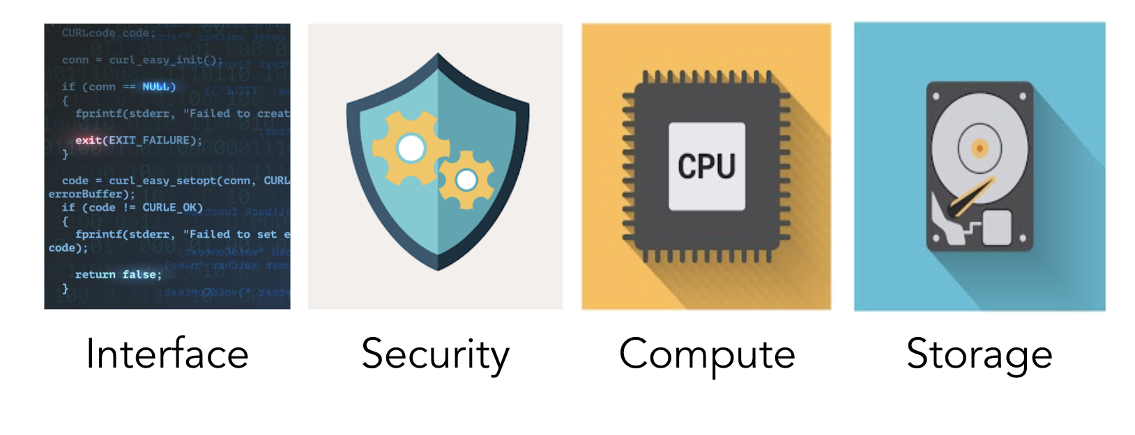
Image created by macrovector - www.freepik.com

Slide 5
Image created by macrovector - www.freepik.com

Slide 6
Image created by macrovector - www.freepik.com

Slide 7
Image created by macrovector - www.freepik.com

Slide 8
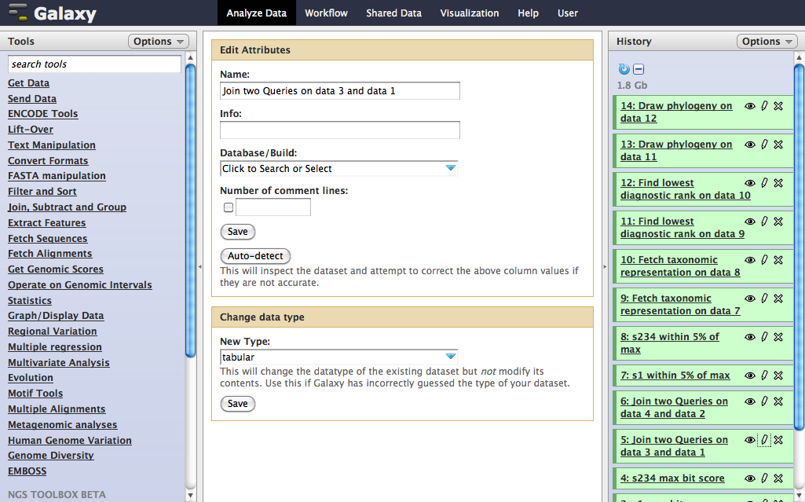

Slide 9
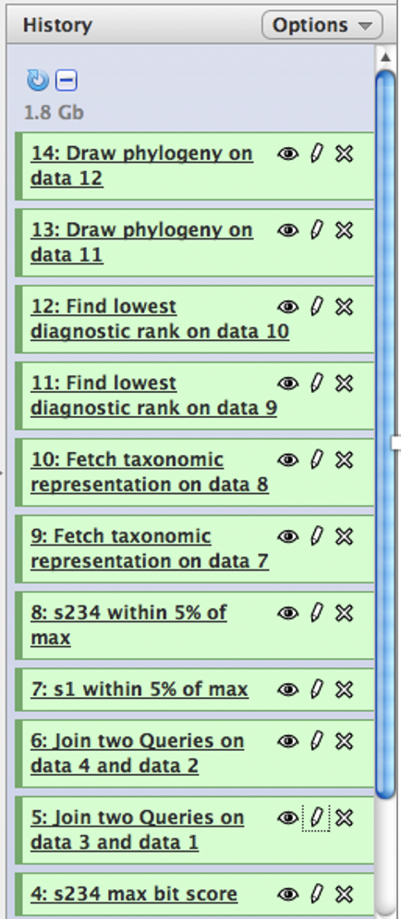

Slide 10
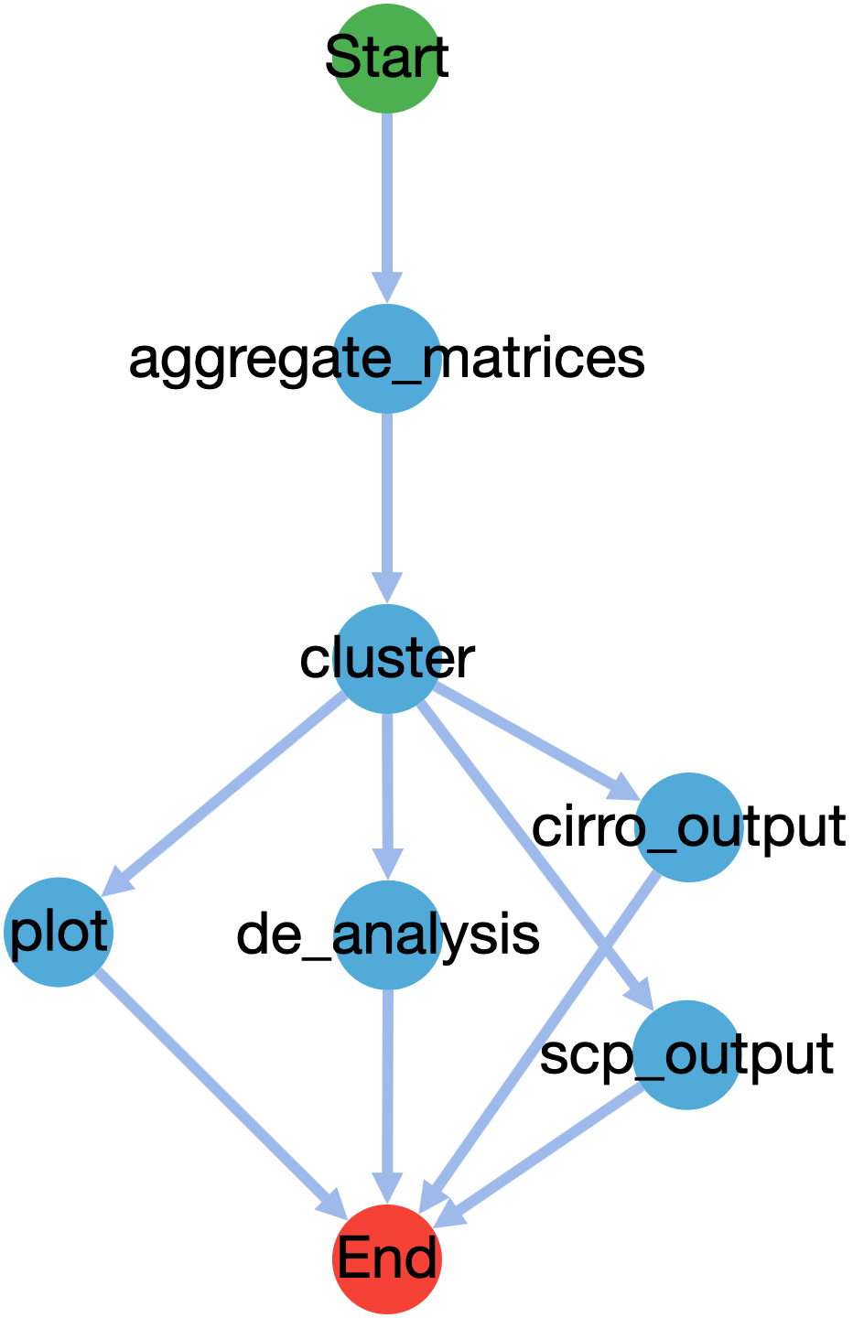

Slide 11


Slide 12

Image created by macrovector - www.freepik.com

Slide 13


Slide 14


Slide 15
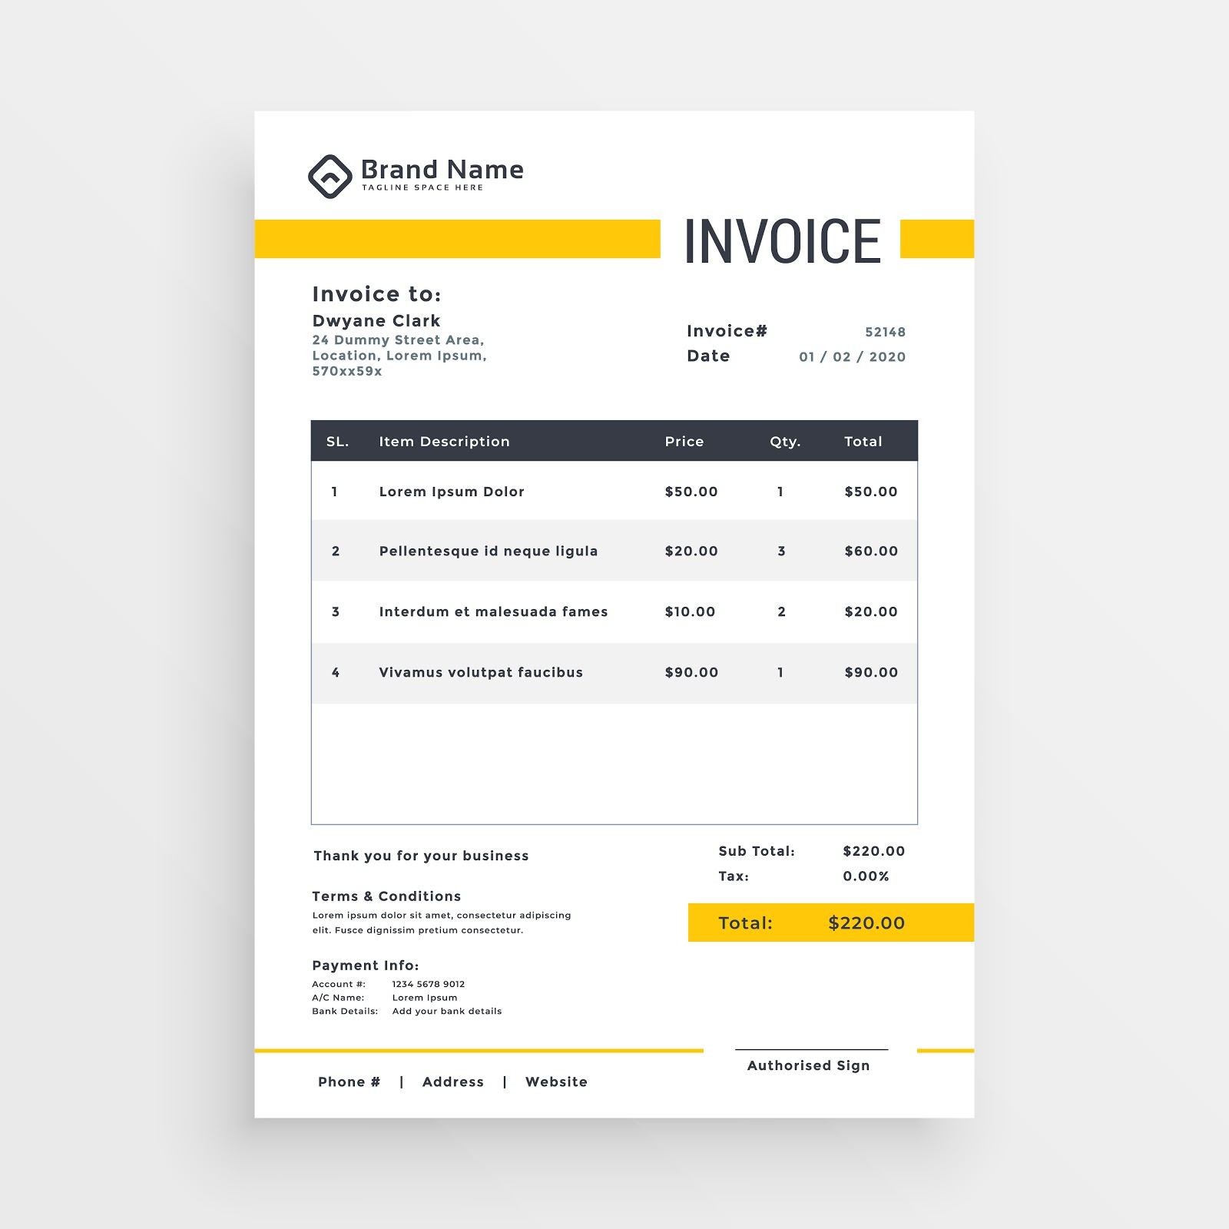

Slide 16


Slide 17


Image created by macrovector - www.freepik.com

Slide 18
Image created by macrovector - www.freepik.com

