Slide 1
Consistent exposure stacks in the presence of motion, under-exposure, and saturation
Jun Hu Orazio Gallo
Xiaobai Sun Kari Pulli
Duke Univ. NVIDIA Research

Slide 2
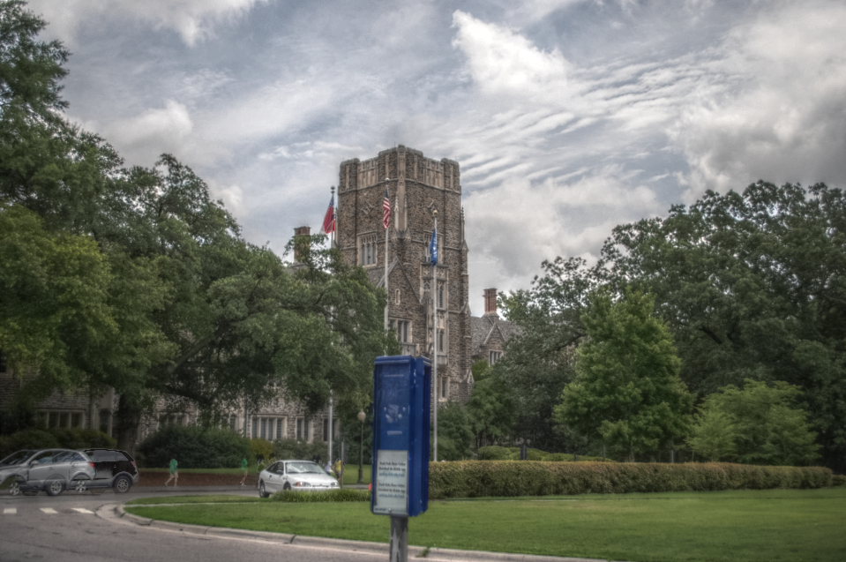
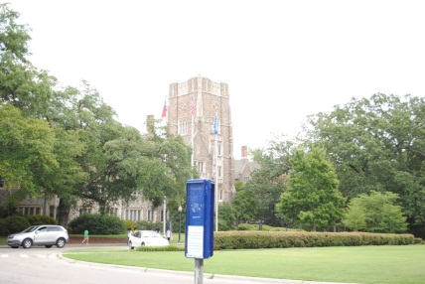
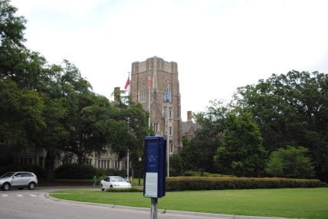
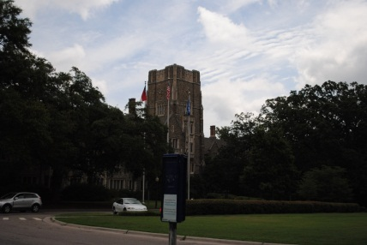
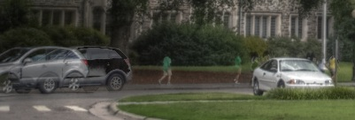
HDR is awesome but …

Slide 3
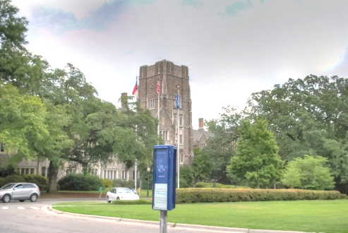
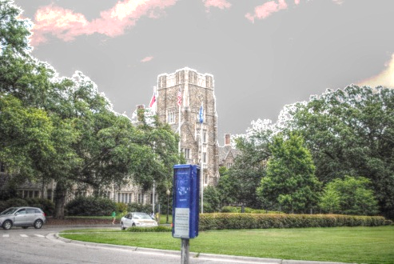
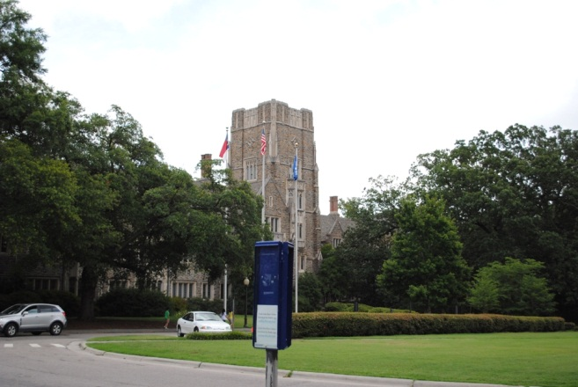
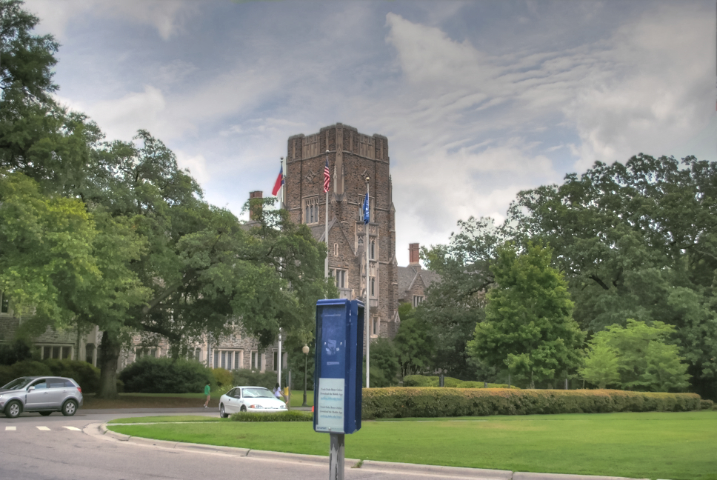
Motion and saturation of the reference image is not a problem anymore!
Hu et al. ECCV 2012
Sen et al. SIGGRAPH ASIA 2012
Our Method CVPR 2013

