Slide 1
Trends in Racial/Ethnic disparities in waitlisting for KT
Mary Grace Bowring, MPH
MD-PhD Candidate, JHUSOM
2/9/2023

Slide 2
Motivation
For patients with end-stage renal disease (ESRD), kidney transplantation provides the greatest survival benefit (1).
Demonstrated across patient subgroups of comorbidities and disease severity (2).
Despite this, access to the listing and transplantation has historically been inequitable across patient demographics and characteristics, including race, age, sex, and socioeconomic status (3-7).
Furthermore, structural changes in policy (KAS), protocols (center-wide), and clinical guidelines (GFR estimation) can influence clinical care in ways that either exacerbate or mitigate disparities
It remains unclear how efforts to mitigate disparities at the patient, provider, center, and national level have impacted differential access to care over time, if at all.
Given that there should be no differences in access to life-saving treatments across patient demographics and given the past 22 years of changes in policy, guidelines, and clinical advancement, we aimed to understand how disparities have changed over time for patients on dialysis
Notes:
Original motivation: did policy/equation modify changes in listing/Timing of race modifiers in gfr equation
-more broadly: temporal trends, changes in racial disparities and waitlisting, and introduction of multiple things that MAY have influenced it – but save that for discussion
-Other UNOS changes over time, KAS, GFR
-if we say looking at race/age -> then we can look at timing as policies as secondary thing
-if looking at race in policy and clinical changes as primary, then age/gender could be moreso the secondary thing
-what theoretical reason would we have – changes in magnitude of disparities -> whether the extent to which time influenced disparities
-second thing then becomes: what do we expect to have happened and why (why would we see changes in magnitude of disparities)
-UNOS policies are public information – look at around 99-2000, 2009 window, go back and look for other major changes
-might have influenced waitlisting to make it make sense
-needs to make sense (if equation didn’t do anything- what else might have happened around then, or if not then when) were there other key years we could compare
-what if we don’t see a major shift around introduction of CKD-EPI/MDRD
-but we do see shift early- what happened then that may have influenced waitlisting
-living donor paper not looking explicitly at policy – DID go back and say what was happening, why pick those time cohorts, 2004-ish -> decline in living donor/donation
-might see more ppl adding to the list then
-mortality established
-age-specific policies are happening (age trend, Mara)
-for race paper- if we can find reasonable explanations for why we believe there would be a shift at that time point
-still present age/gender to demonstrate robustness or test whether findings were consistent across those groups
-there is a way to know if ppl got
-
-preemptive living -> competing event
-could get a live donor without being added to the list (transplant date and donor type)
-living donor and not waitlisting date – recipients of LD without waitlisting, include preemptive and not preemptive
-first transplants
-preemptive, deceased donor
-

Slide 3
Methods
Data source: USRDS 1996-2018
Study population: 2,297,492 patients who initiated dialysis during this time
Primary exposures
Race/Ethnicity categories
Non-Hispanic Black, Non-Hispanic White, Non-Hispanic Asian, Hispanic ethnicity (all races)
Excluding 53,103 patients of other Races (2.3%)
Calendar time: 1996-1999, 2000-2004, 2005-2009, 2010-2015
Primary outcome: being waitlisted for KT while on dialysis
Effect modifier: age in categories 18-34, 35-64, >64
Notes:
Trends in racial disparities
Introduction of equations + other closely related policy changes
Influence of these in access to waitlisting over time
Treating LD and mortality as competing risks
Outcomes: waitlisting and receipt of DD
Trends in waitlisting and what ultimately happens wrt DD KT (secondary)
Primary –getting on the waitlist (KAS, we know whats happened for candidats in terms of receipt)
What about receipt of DD (have it in subgroup- and this is what happened)
What has happened wrt race over time-
Age – subgroup analysis

Slide 4
Methods
Describe 3yr cumulative incidence of waitlisting by Race/Ethnicity over time
Follow patients from first dialysis treatment until the first of listing, death, censoring on 12/31/2018 or three years from dialysis initiation
Estimate magnitude of disparity in waitlisting for KT across Race/Ethnicity within each era
Adjusted for biologically plausible confounders: age, sex, BMI, cause of ESRD, blood type
Potential mediators: employment, medical insurance coverage, neighborhood poverty, non-profit vs for profit center
Main analysis: Cox regression, cause-specific hazard of listing
Censors for death
Sensitivity analysis: competing risks regression, death on dialysis as competing event

Slide 5
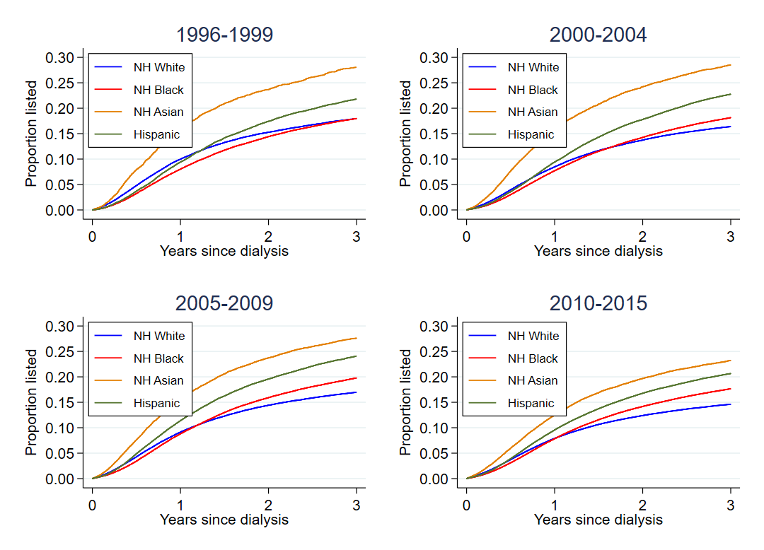
Cumulative incidence of waitlisting for KT while on dialysis, over time by Race/Ethnicity

Slide 6
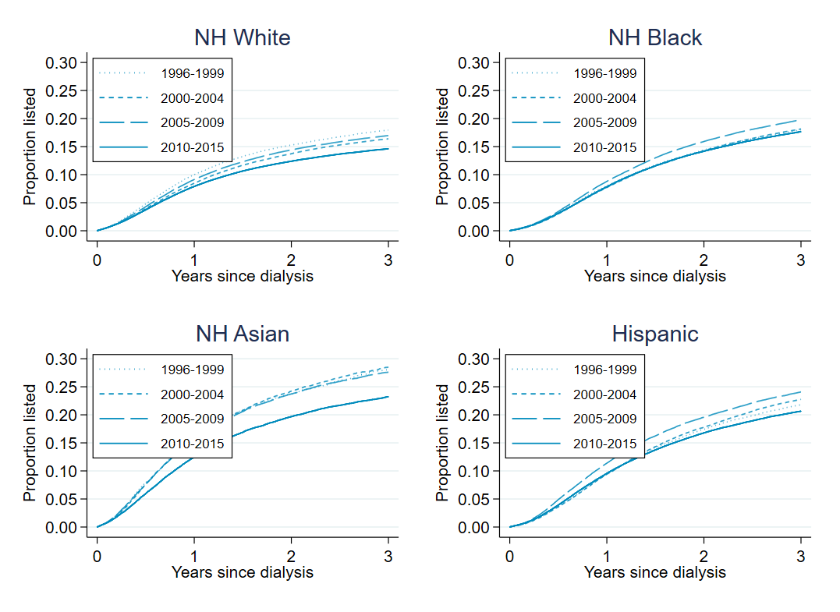
Cumulative incidence of waitlisting for KT while on dialysis, over time by Race/Ethnicity

Slide 7
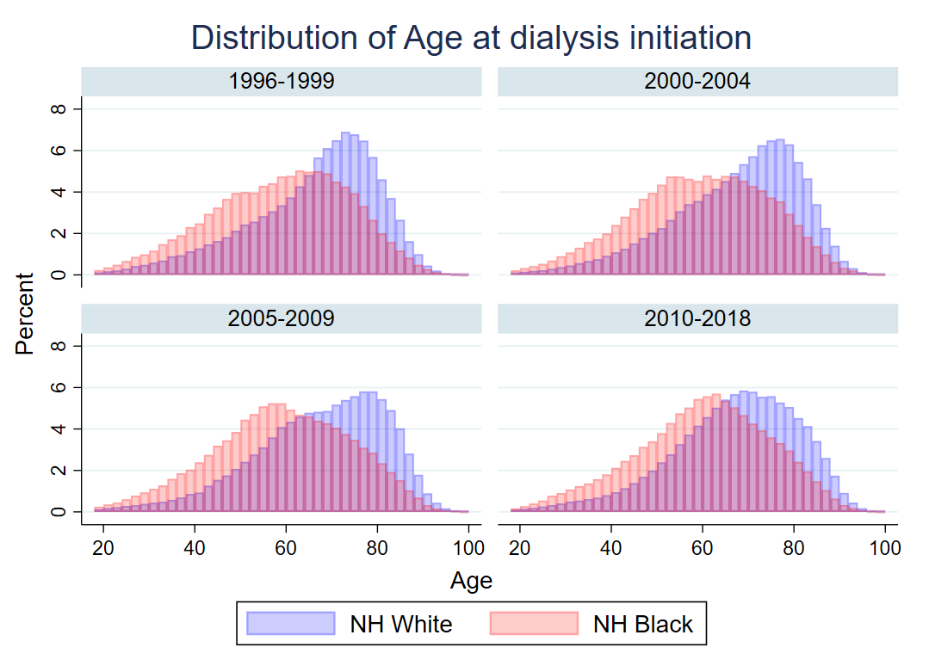
Age at dialysis initiation

Slide 8
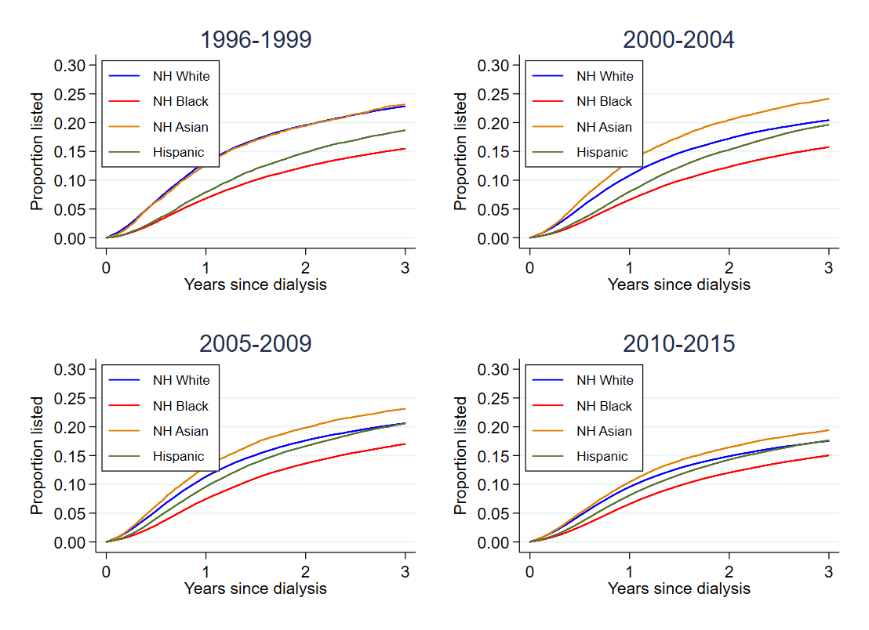
Inverse-probability weighted cumulative incidence of waitlisting for KT while on dialysis, over time by Race/Ethnicity
*using inverse probability weights -> for each race, the distributions of for age, sex, cause of ESRD, BMI, cardiovascular disease, COPD, HTN, DM, drug or alcohol dependence are weighted to be more similar to that of the NH white patients, so the KM curves can be interpreted as standardized or adjusted for these factors

Slide 9
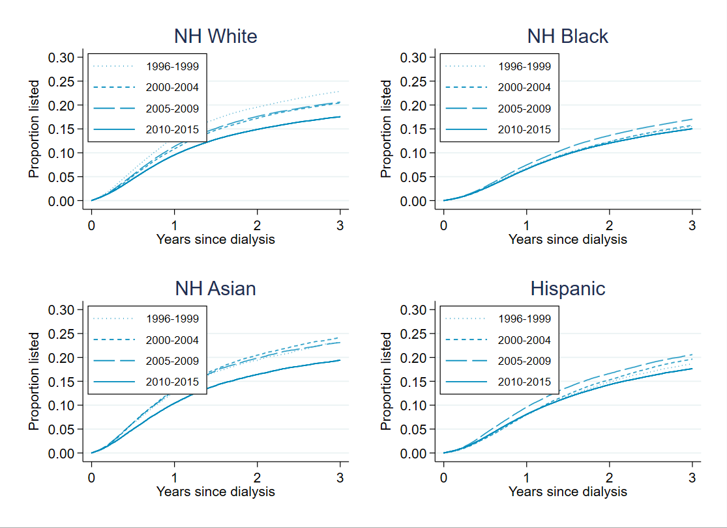
Inverse-probability weighted cumulative incidence of waitlisting for KT while on dialysis, over time by Race/Ethnicity
*using inverse probability weights -> for each race, the distributions of for age, sex, cause of ESRD, BMI, cardiovascular disease, COPD, HTN, DM, drug or alcohol dependence are weighted to be more similar to that of the NH white patients, so the KM curves can be interpreted as standardized or adjusted for these factors

Slide 10
Inverse-probability weighted cumulative incidence of waitlisting for KT while on dialysis, over time by Race/Ethnicity
However- KM curves can overestimate cumulative incidence in the presence of competing risks
- I need to produce weighted cumulative incidence curves accounting for death as competing event
*using inverse probability weights -> for each race, the distributions of for age, sex, cause of ESRD, BMI, cardiovascular disease, COPD, HTN, DM, drug or alcohol dependence are weighted to be more similar to that of the NH white patients, so the KM curves can be interpreted as standardized or adjusted for these factors

Slide 11
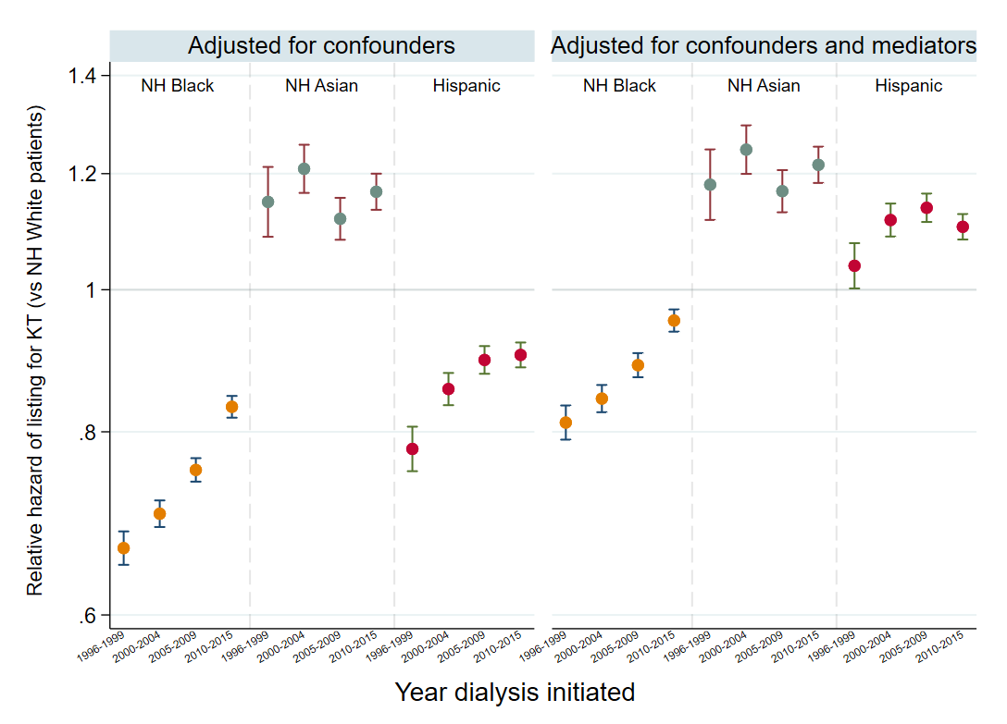
Magnitude of racial/ethnic disparities in waitlisting for KT within each era

Slide 12
Magnitude of racial/ethnic disparities in waitlisting for KT within each era

Slide 13
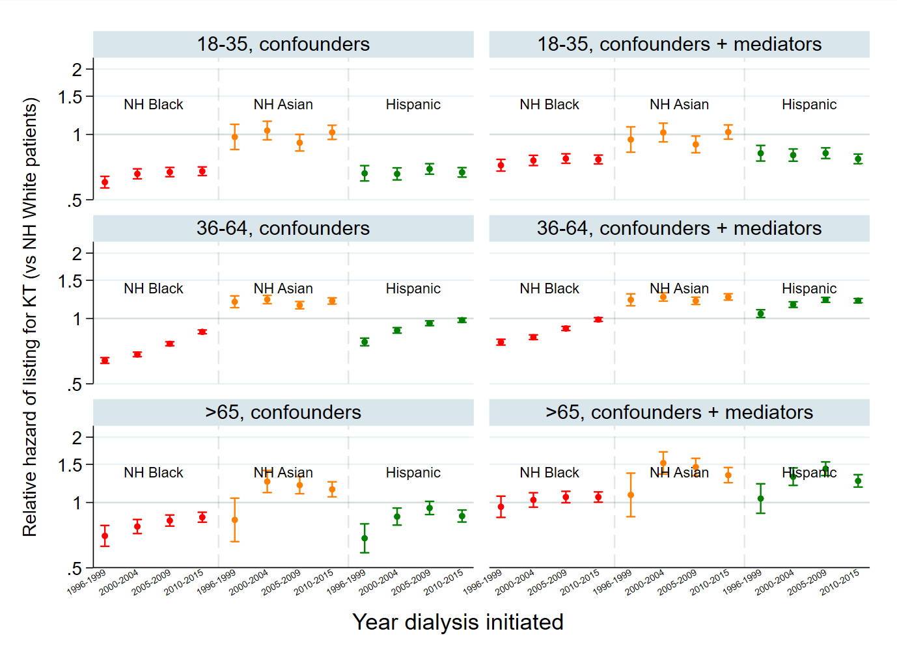
Stratified by age at dialysis initiation

Slide 14
Stratified by age at dialysis initiation

Slide 15
Stratified by age at dialysis initiation

Slide 16
There is an event that precludes event of interest, changes the probability of having event of interest

Slide 17
There is an event that precludes event of interest, changes the probability of having event of interest
Cause-specific approach
-censors for that other event, but it
-violates non-informative censoring
-estimate relative hazards, HRs

Slide 18
There is an event that precludes event of interest, changes the probability of having event of interest
Cause-specific approach
-censors for that other event, but it
-violates non-informative censoring
-estimate relative hazards, HRs
Subdistribution approach
-does not censor if they have competing event, but they remain in the at-risk population, because they still have not had the primary event
-relative differences in cumulative incidence functions
-estimate sub-hazard ratios, direction of effect of risk factor on incidence of the outcome

Slide 19
There is an event that precludes event of interest, changes the probability of having event of interest
Cause-specific approach
-censors for that other event, but it
-violates non-informative censoring
-estimate relative hazards, HRs
Subdistribution approach
-does not censor if they have competing event, but they remain in the at-risk population, because they still have not had the primary event
-relative differences in cumulative incidence functions
-estimate sub-hazard ratios, direction of effect of risk factor on incidence of the outcome
Do you care more about the etiology of disease/death, factors associated with the primary event only?

Slide 20
There is an event that precludes event of interest, changes the probability of having event of interest
Cause-specific approach
-censors for that other event, but it
-violates non-informative censoring
-estimate relative hazards, HRs
Subdistribution approach
-does not censor if they have competing event, but they remain in the at-risk population, because they still have not had the primary event
-relative differences in cumulative incidence functions
-estimate sub-hazard ratios, direction of effect of risk factor on incidence of the outcome
Do you care more about the etiology of disease/death, factors associated with the primary event only?
-Sometimes more about prognosis, experience of patients
-if youre trying to estimate long-term risk of ESRD, you need to account for competing risk of death, if youre trying to estimate short-term risk of ESRD in young patients, maybe you DON’T need death as competing event

Slide 21
There is an event that precludes event of interest, changes the probability of having event of interest
Cause-specific approach
-censors for that other event, but it
-violates non-informative censoring
-estimate relative hazards, HRs
Subdistribution approach
-does not censor if they have competing event, but they remain in the at-risk population, because they still have not had the primary event
-relative differences in cumulative incidence functions
-estimate sub-hazard ratios, direction of effect of risk factor on incidence of the outcome
Do you care more about the etiology of disease/death, factors associated with the primary event only?
-Sometimes more about prognosis, experience of patients
-if youre trying to estimate long-term risk of ESRD, you need to account for competing risk of death, if youre trying to estimate short-term risk of ESRD in young patients, maybe you DON’T need death as competing event
-Cox regression (cause-specific, continuous survival time)
-KM curves overestimate cumulative incidence in presence of competing risks
-Multinomial logistic regression (cause-specific, discrete survival time, person-period data, assumes constant hazard within period)

Slide 22
There is an event that precludes event of interest, changes the probability of having event of interest
Cause-specific approach
-censors for that other event, but it
-violates non-informative censoring
-estimate relative hazards, HRs
Subdistribution approach
-does not censor if they have competing event, but they remain in the at-risk population, because they still have not had the primary event
-relative differences in cumulative incidence functions
-estimate sub-hazard ratios, direction of effect of risk factor on incidence of the outcome
Do you care more about the etiology of disease/death, factors associated with the primary event only?
-Sometimes more about prognosis, experience of patients
-if youre trying to estimate long-term risk of ESRD, you need to account for competing risk of death, if youre trying to estimate short-term risk of ESRD in young patients, maybe you DON’T need death as competing event
-Cox regression (cause-specific, continuous survival time)
-KM curves overestimate cumulative incidence in presence of competing risks
-Multinomial logistic regression (cause-specific, discrete survival time, person-period data, assumes constant hazard within period)
-Fine & Gray method (subdistribution, continuous survival time)
-Estimate cumulative incidence curves accounting for competing events
-Subdistribution discrete-time approach – weights patients who have the competing event based on the censoring survival function, kept in the study but weighted based on their probability of being at risk if they hadn’t had competing event (discSurv in R)

Slide 23
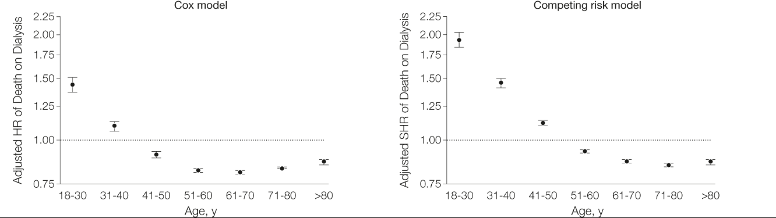
How inferences can change
Kucirka LM, Grams ME, Lessler J, et al. Association of Race and Age With Survival Among Patients Undergoing Dialysis. JAMA. 2011

Slide 24
How inferences can change
Kucirka LM, Grams ME, Lessler J, et al. Association of Race and Age With Survival Among Patients Undergoing Dialysis. JAMA. 2011

Slide 25
How inferences can change
Goal: understand racial disparity in death on dialysis
Causes specific risk of death is high among young Black patients
But in the left analysis, patients are censored for KT, this validates non-informative censoring assumption, and censoring (ie KT) rates vary by Race
Treat KT as competing event, the subhazard ratio of death is higher for Black patients, ie, the disparity is worse when you also account for their lower risk of transplant
Kucirka LM, Grams ME, Lessler J, et al. Association of Race and Age With Survival Among Patients Undergoing Dialysis. JAMA. 2011

Slide 26
How inferences can change
If the two cause-specific HR are in the same direction, sub-HR will be towards the null
If the two cause-specific HR are in the opposite direction, sub-HR will go away from the null
Think about the goal of the question, run and include both to address the question
Even more in word-document

