Slide 1
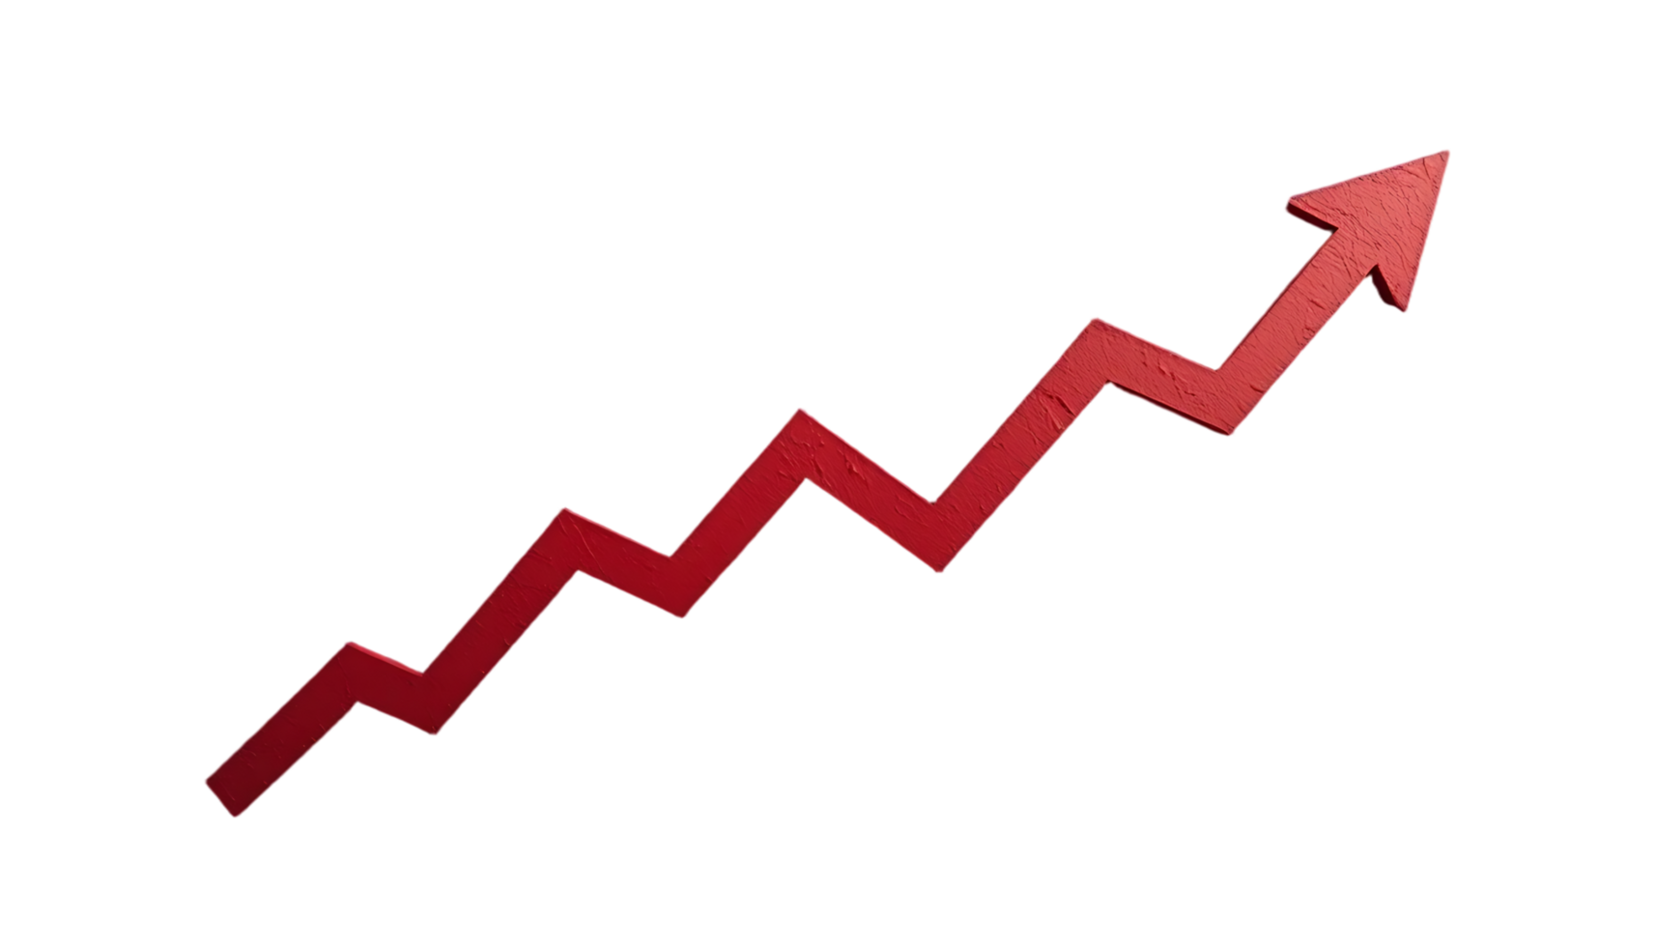
S&P 500 Dashboard and Stock Price Predictions
By: Jacob Hughes

Slide 2
Project Overview
Goal: visualize stock trends and predict next-day prices
Tools: R Shiny, ggplot2, random forest
Data: S&P500 data (last 5 years)
Dashboard: prices, returns, sector trends, volatility, predictions

Slide 3
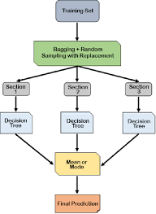
Data & Preparation
Source: BatchGetSymbols package- historical prices for S&P 500
Model featured engineering
  Lag values: lag1, lag5
  Moving averages: ma5, ma10
  Target: next day adjusted price
Notes:
BatchGetSymbols- common package you can use to get S&P500 data
Lagx- previous days returns(x), percentage
Moving averages- previous x(5,10) days price average
-predicts shifts(momentum) of stock. Up or down
Next day adjusted price- prior days closing price

Slide 4
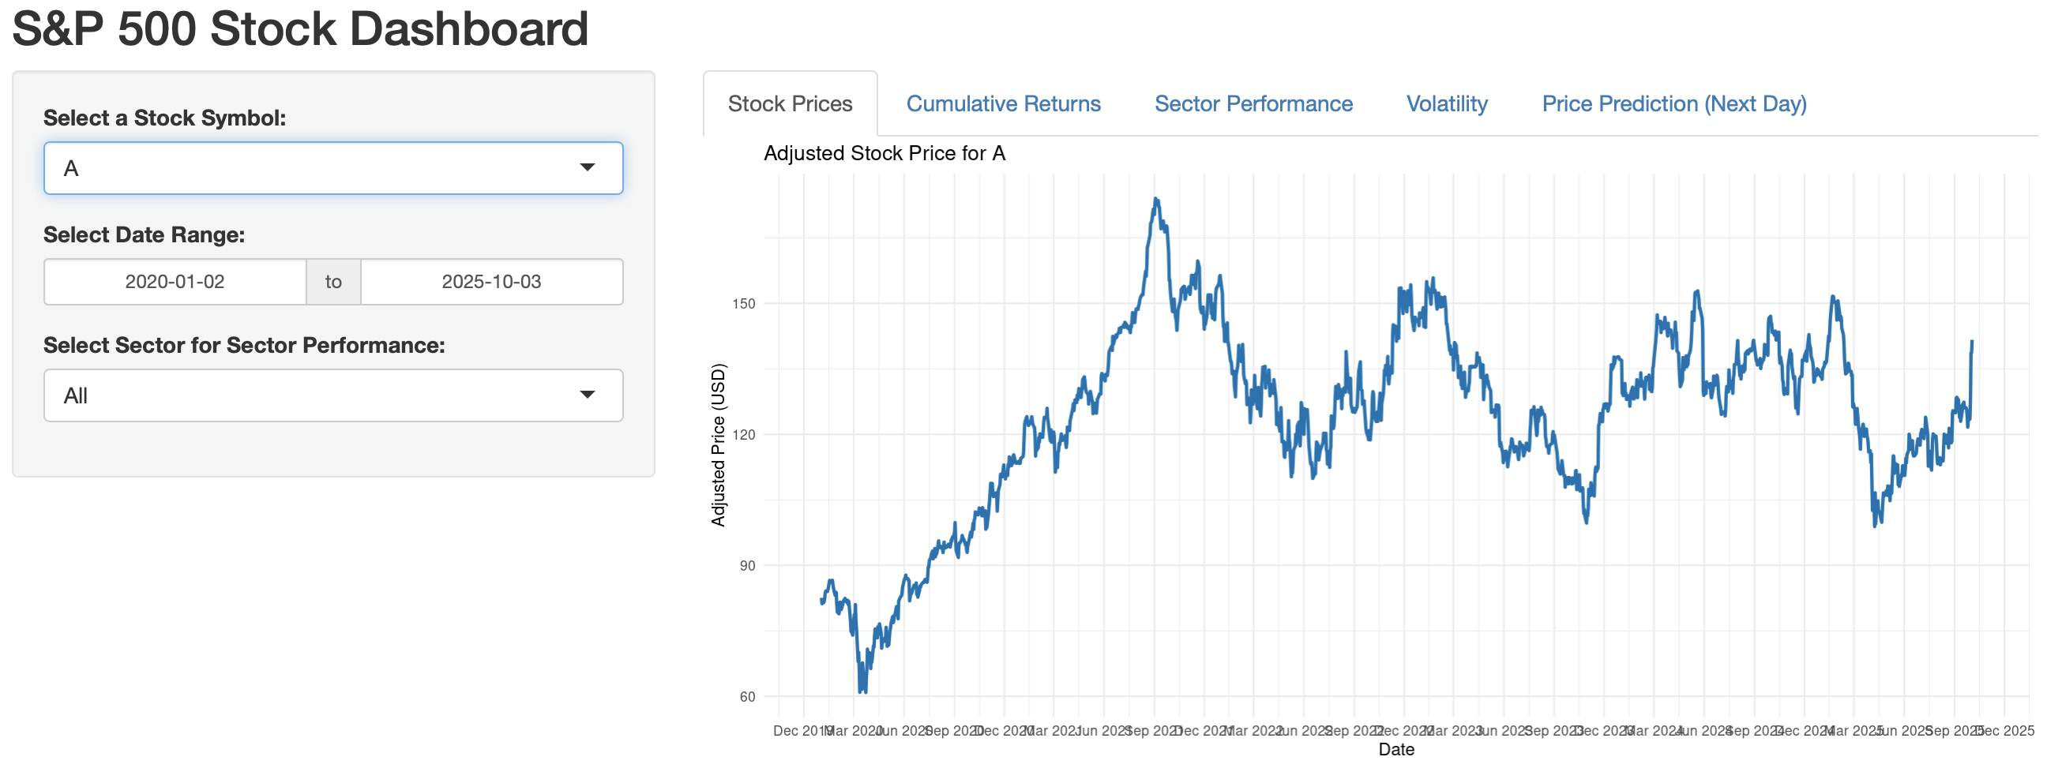
Dashboard Overview
Stock Prices: Daily adjusted price trend
Cumulative Returns: Percentage growth visualization
Sector Performance: Compare sector averages
Volatility: Standard deviation of returns
Prediction Tab: Actual vs predicted next-day prices
Notes:
All interactive with date
All inetactive with stock symbol ACCEPT Sector Perfomance

Slide 5
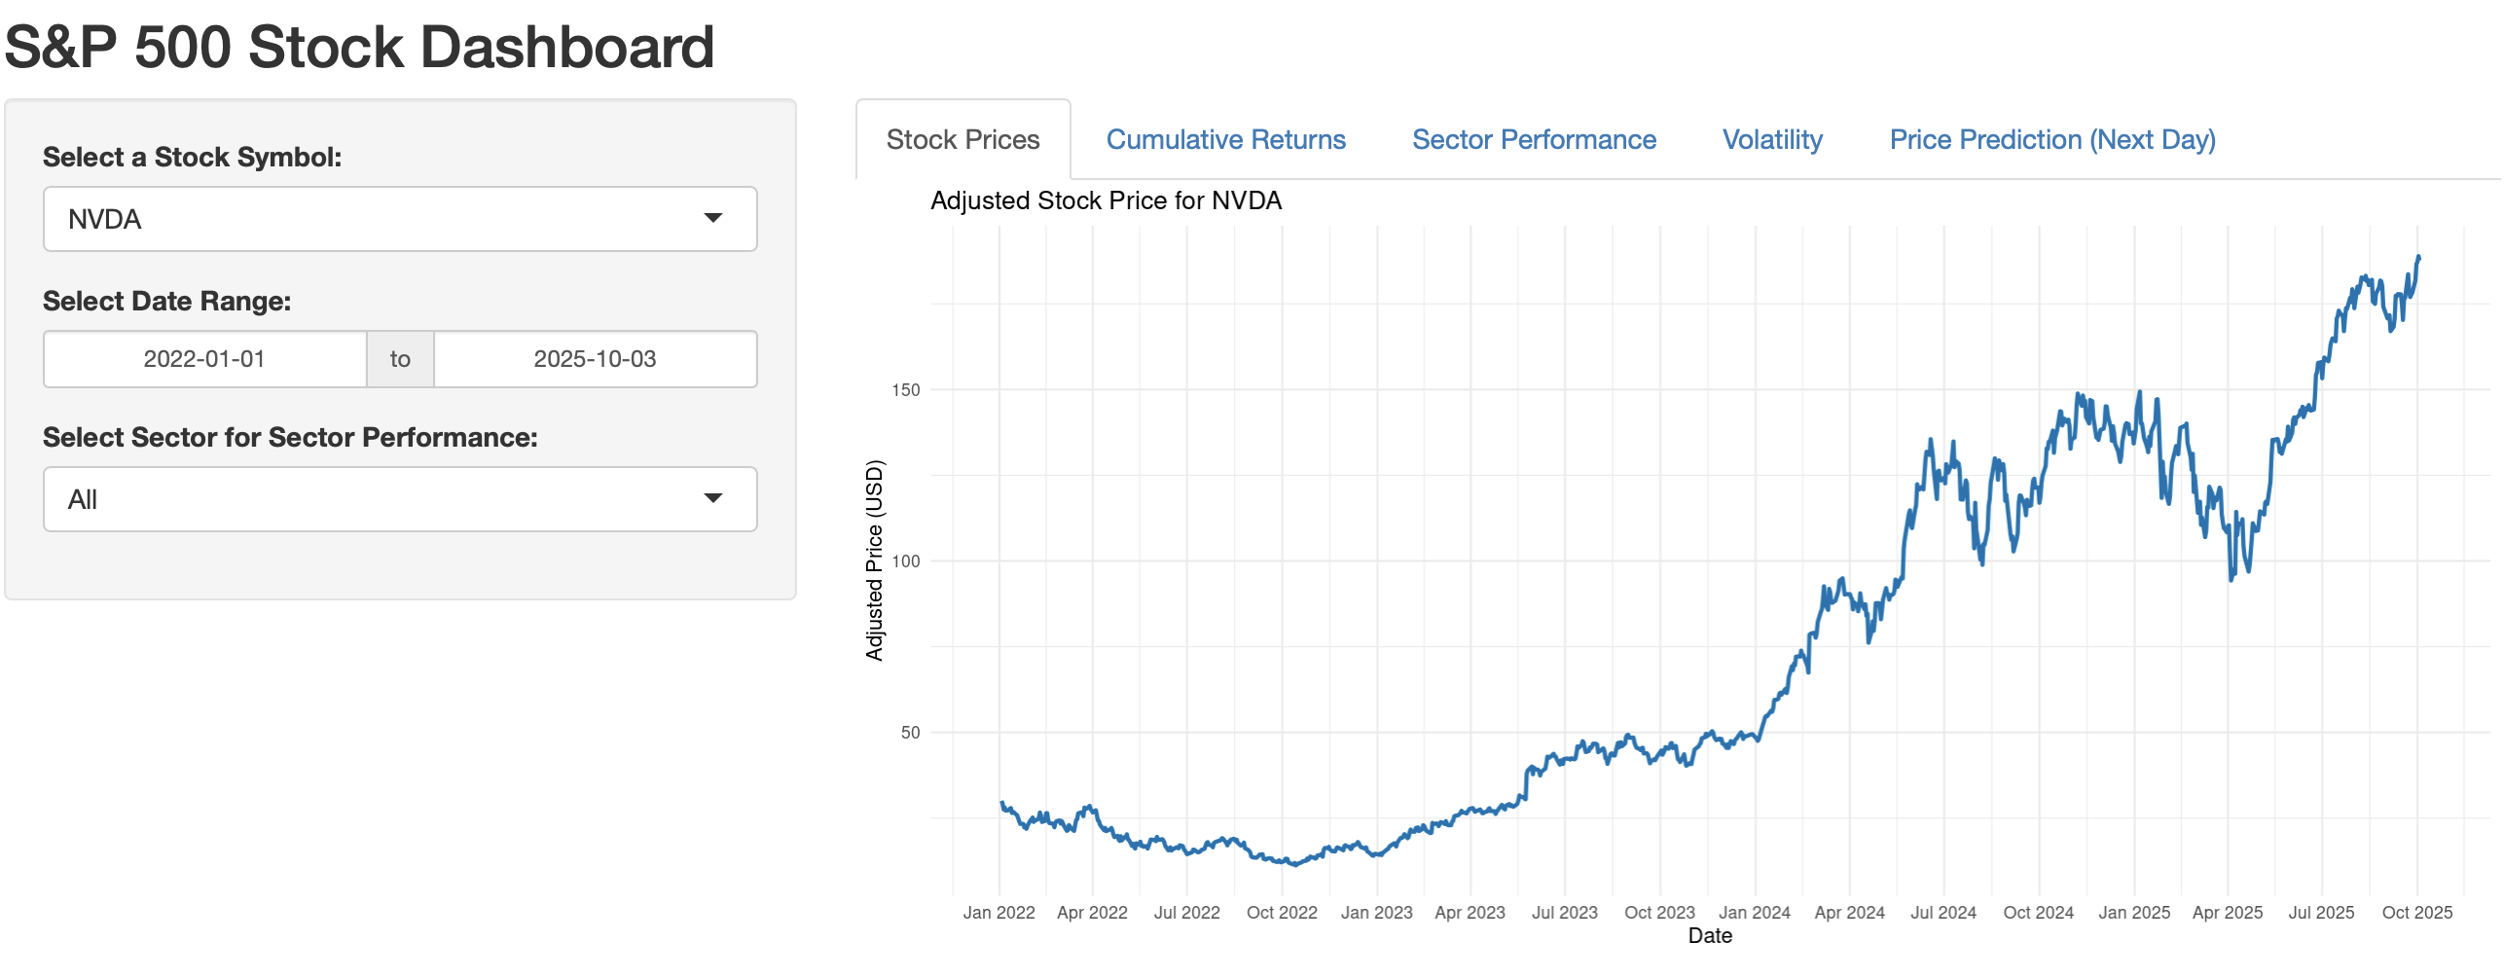
Insights: Stock Prices
2022
Typical Stock
2023
Start of AI (exponential growth)
Apr.–June
(2025)
Export bans on AI chips
September
(2025)
Partnership with Intel (AI company)
Notes:
2022: Performance is steady, but look at 2023
Look to date: Even higher ( )
- Announced a 5.5 billion dollar write off

Slide 6
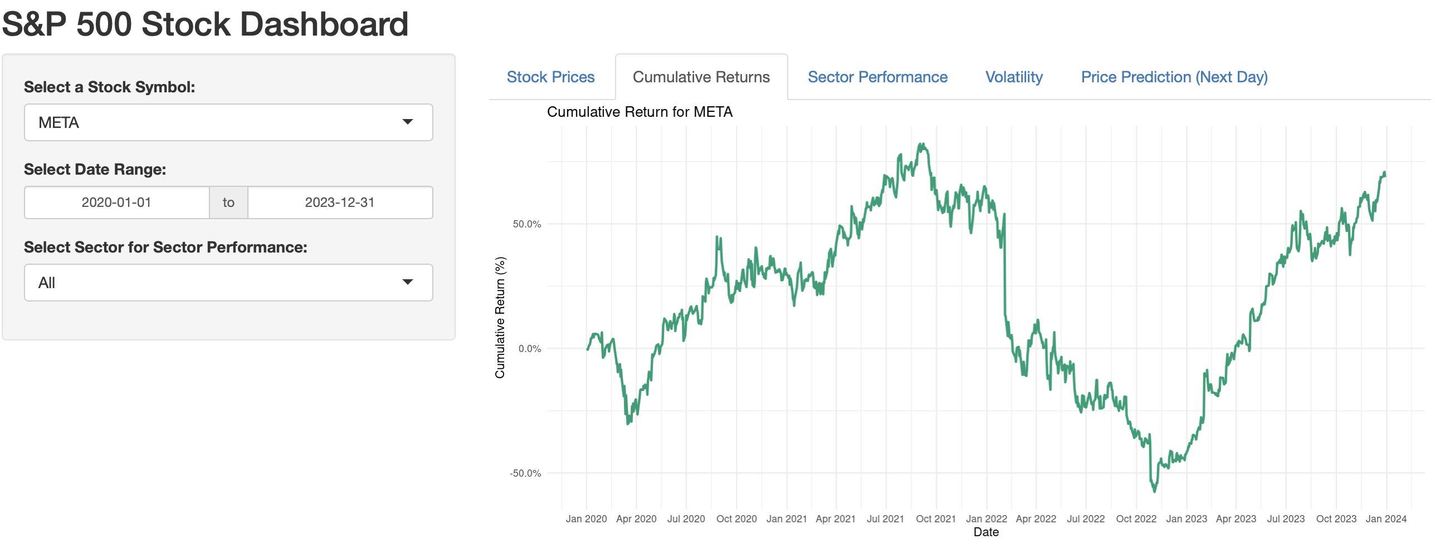
Insights: Cumulative Returns
Mar. 2020
Pandemic Shutdown
June 2020
Starts to rebound
Dec. 2022
Drops again
Jan. 2023
Stock on the rise
Notes:
This show S&P500 pattenr very well and why you should stick thourgh downs in stocks sometimes
People let go when trend wasn’t great but went bought back months later

Slide 7
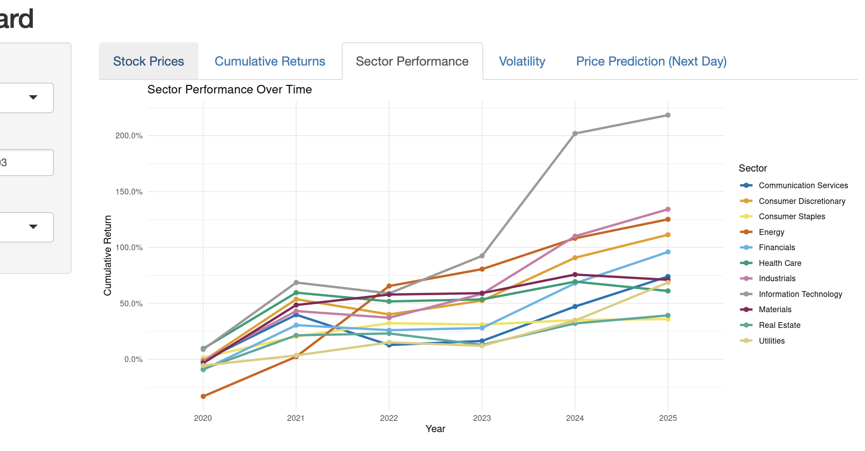
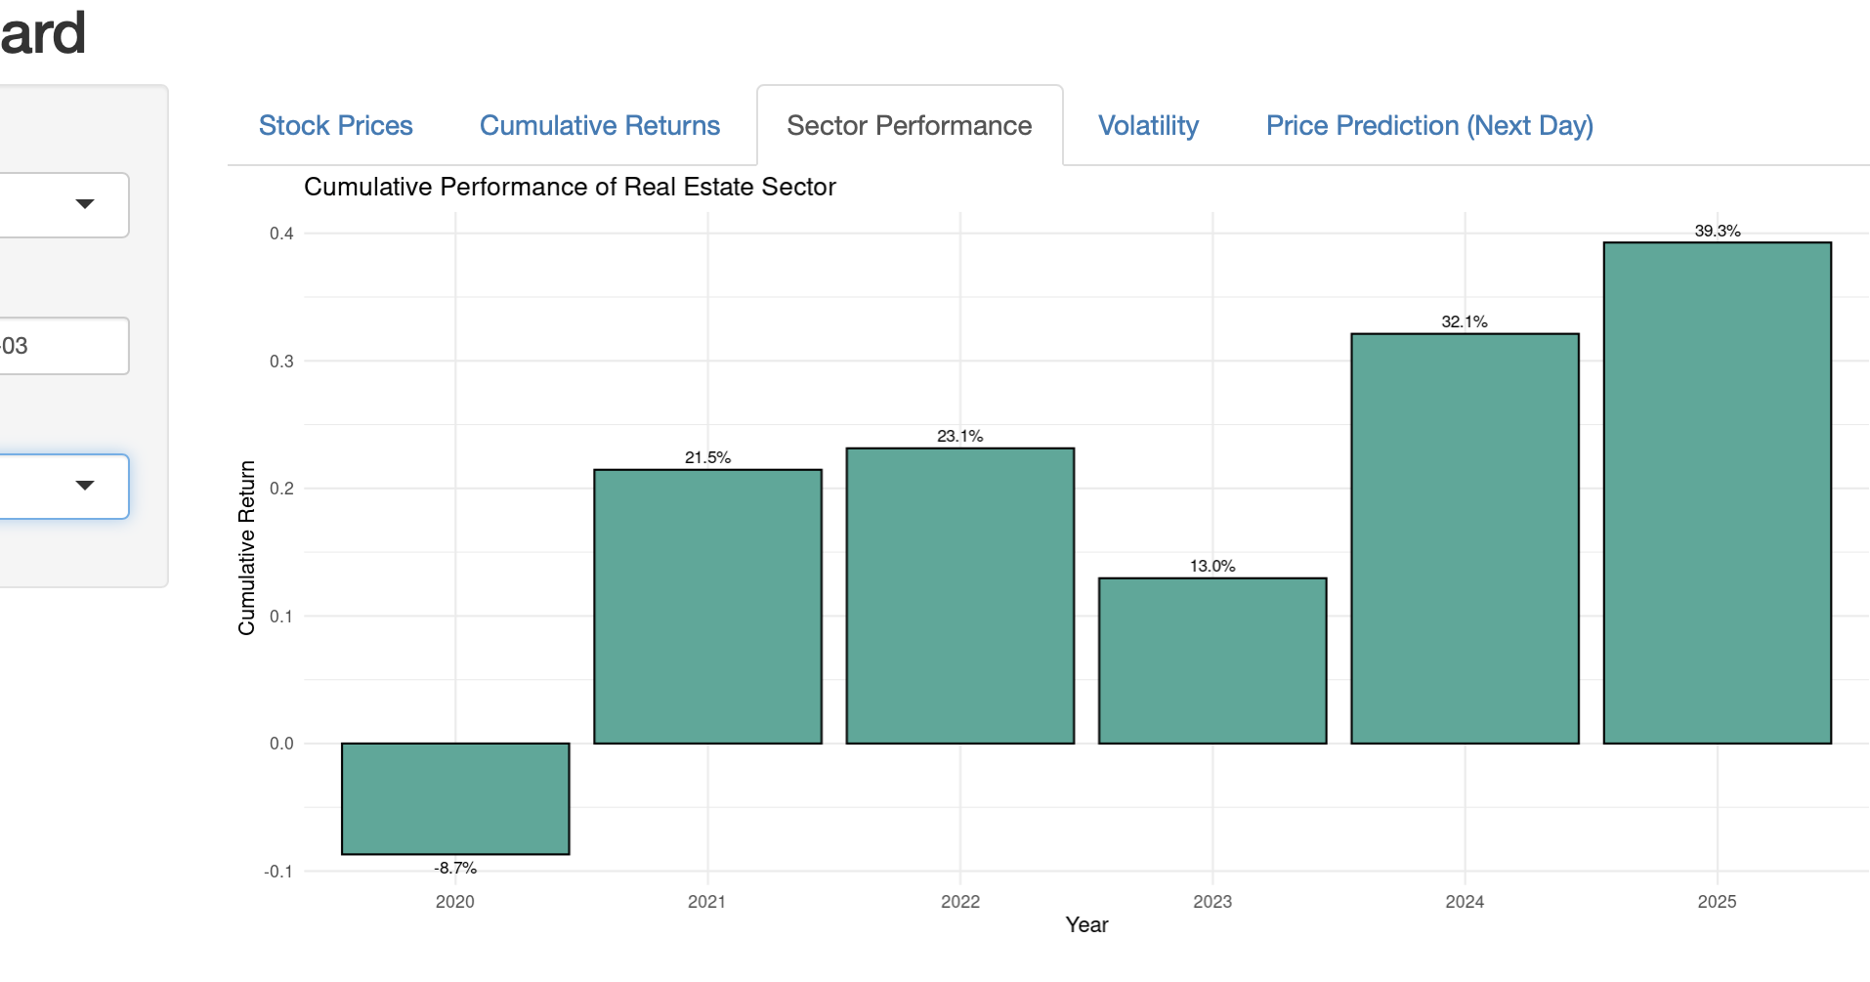
Sector performance
If/else statement plots all vs single
Real Estate drops during covid
Notes:
Real estate sector represents renting more than home buying.
People wanted to buy homes during covid not rent
Following houses got so epxosne average americna was having to rent

Slide 8
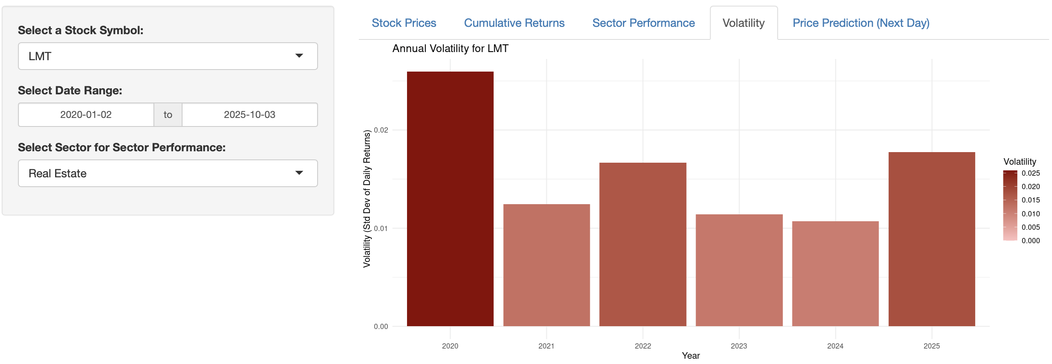
Stock Volatility
Lockheed Martin
  Defense and Aerospace
The 2020 pandemic shutdown
Cutting the defense budget was a presidential debate topic
Market stable following
Notes:
Great time to buy into some stocks during election
Shocking people actually believed the canidates

Slide 9
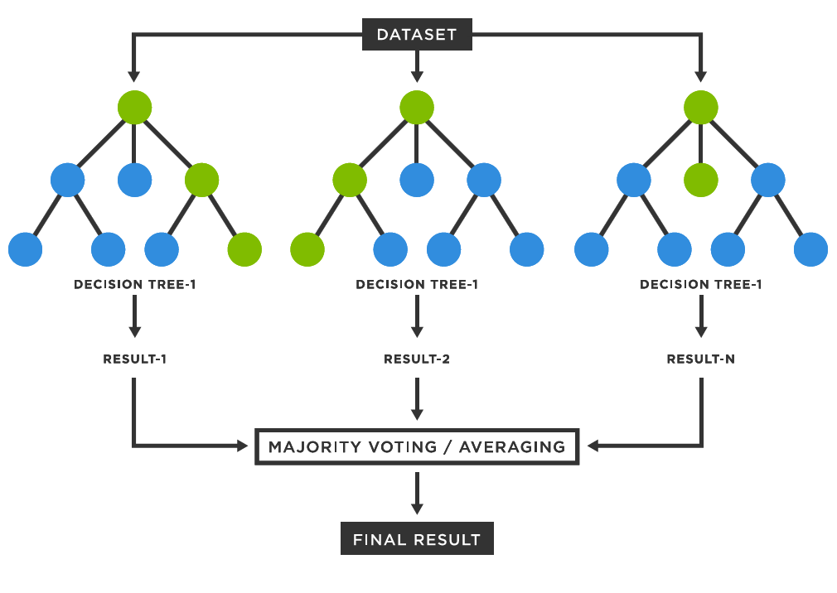
Predictive Modeling
Model: Random Forest
Inputs: lag1, lag5, ma5, ma10
Output: next-day adjusted price
Train/Test split: 80/20
Key metrics (AAPL):
  Training R² = 0.998
  Test R² = 0.412
Notes:
Overfitting, struggling on unseen data
lets look at random forest next day prediction plots to explain

Slide 10
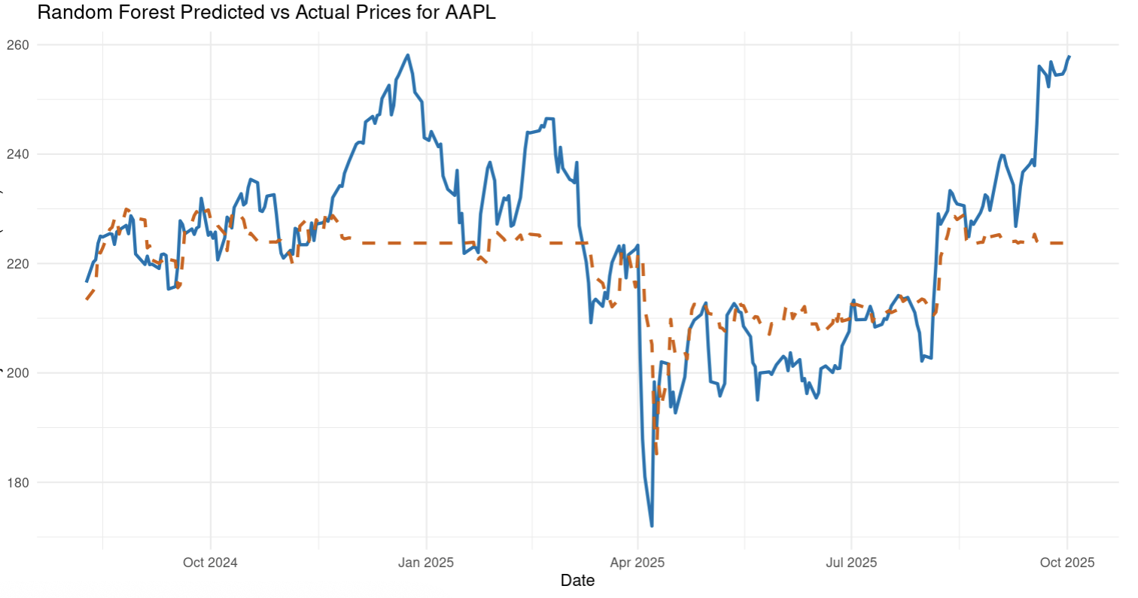
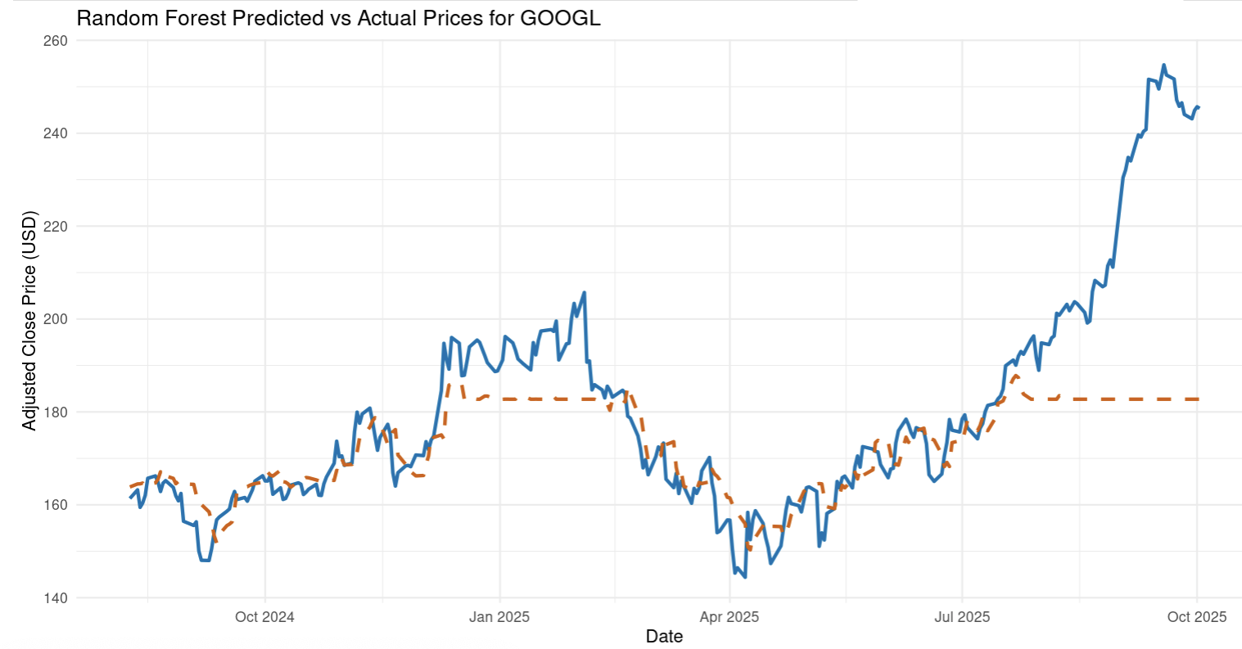
Model Visualization
Apple vs Google
Follows the trend during stable periods
Poor performance during high volatility
Tree-based models average next day stock price
Notes:
Images: Apple vs Google Predicted
KEYPOINT: In high voltilaty periods it has poor performances
Why? Tree based models average prices at the end, struggle when data is high volatility (not well reflected in average)

Slide 11
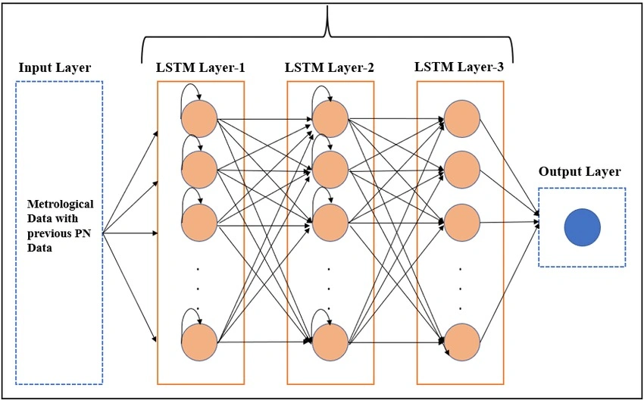
Future Improvements
Include More Data
macroeconomic indicators (interest rates, inflation, etc.)
Test More Models
LSTM (Long Short-Term Memory)
Incorporate
hyperparameter tuning
Notes:
Option 1: These are not in the dataset I worked with, could help decision trees predict the stock price in those volatile periods
Option 2: Other mdoesl with my data:
What is LSTM: Complex Neural Network build for sequential data: past obs. Matter for future
When test and compare models: could hyperparmetre tune for efficnet results

Slide 12
R Shiny Link
https://jacob-hughes.shinyapps.io/FP_Data_Vis_R/

