Slide 1
Unit 7
Mid-term design process

Slide 2
Process for the mid-term
Defining your audience/tone
What existing websites out there were you most inspired by
Parts of your design you're most proud of
The struggles you encountered in your design process
Parts of the development process that you overcame
The struggles you encountered when developing the page
What you learned from working through this mid-term project

Slide 3
Step 1: Define Your Audience/Tone
Who will visit your site?
Artists, galleries, auction houses, distributors, and artwork collectors
What can make you and/or your product stand out against your competitors?
I provide a variety of Chinese artworks that is full of oriental flavor.
How would you speak to your clientele if you were communicating in person?
Professional, Trustworthy, classy- a tone of high art, yet welcoming (certain warm color)
How could you translate that style and tone digitally?
Using clean, flat, minimal design to convey the tone of high art; font- serif,
What colors represent you or your product?
Black, white/gold to reflect professionalism; bold colors from artwork for liveliness; yellow, brown, red to reflect the oriental artsy flavor.

Slide 4
What existing websites out there were you most inspired by
I’m inspired by http://www.hem.com/, and http://www.fiftythree.com/.
How do they exhibit effective use of space, size or balance?
Hem.com:
Space: it has large negative (white) space so people’s eyes can focus on the products
Size: the size of each product/furniture is quite large- indicating the importance.
Balance: elements are balanced horizontally, which make hem.com a symmetrical design.
Fiftythree.com:
Space: the page is dominated by a hero image, on which the positive space is occupied by an “ipad” to illustrate the product- fiftythree app.
Size: the size of image obviously emphasizes its importance- it wants people to focus on this image and understand what 53 is about.
Balance: fiftythree.com also use symmetrical design- the “watch video” and “visit mix” buttons are horizontally balanced; while logo and the social media icons are also horizontally balanced.

Slide 5
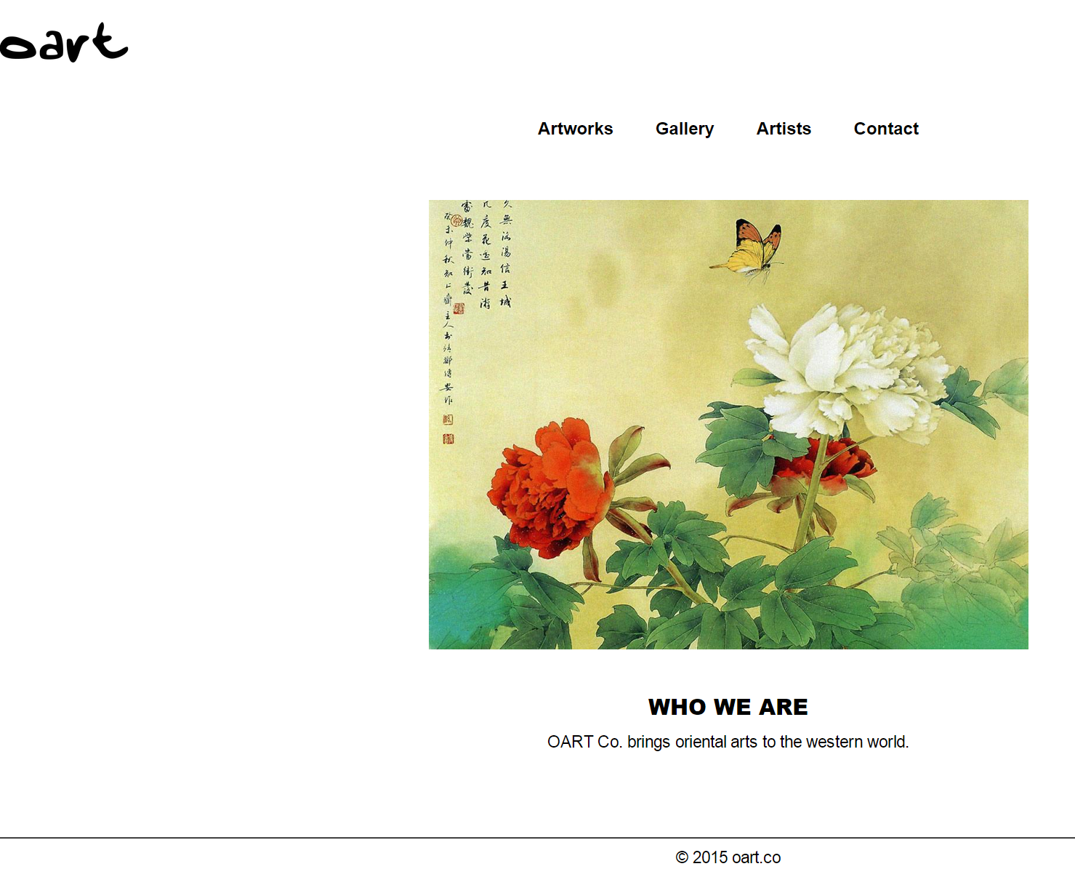
Parts of your design you're most proud of
I like my logo, which looks quite like Chinese calligraphy.
I also like the simple, clean and elegant layout.

Slide 6
The struggles you encountered in your design process
1. the logo: for a moment, I didn’t know which tool to use to create a logo as a transparent file- .png. Later on, I searched and learned on YouTube.
2. the structure of the website
I think this part is very important: a great website must have clear message, logic, and appealing visual elements/graphics. So I had to browse quite a few websites to learn from.

Slide 7
Parts of the development process that you overcame
This is my development process:
1. thought about the name of the web, what I wanted to build
2. created a logo for it.
3. set a structure/wireframe for the page
4. looked for the right hero image to be included on the site
5. put up the site using code
Among the above, the last part took longest time, as I need to review all the past video and put into real code.

Slide 8
The struggles you encountered when developing the page
I was struggling how to center my navigation bar, and I searched on stackoverflow for a relatively easy solution. But I had to remove float, which I need to discuss with mentor further.

Slide 9
What you learned from working through this mid-term project
I learned the process of a web design project, what it takes to build a great website- which I still have a long way to go.

