Slide 1
Calibration Reference Data System Design Perry Greenfield Science Software Branch

Slide 2
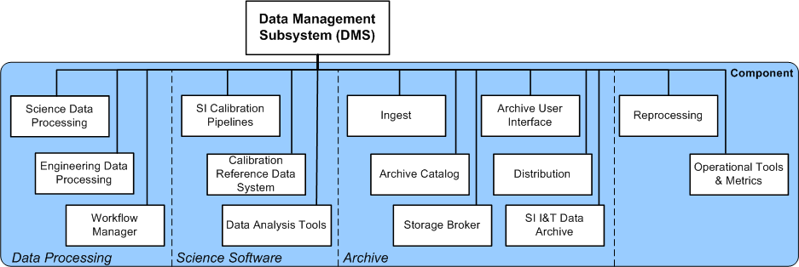
Calibration Pipeline Component
You are here

Slide 3
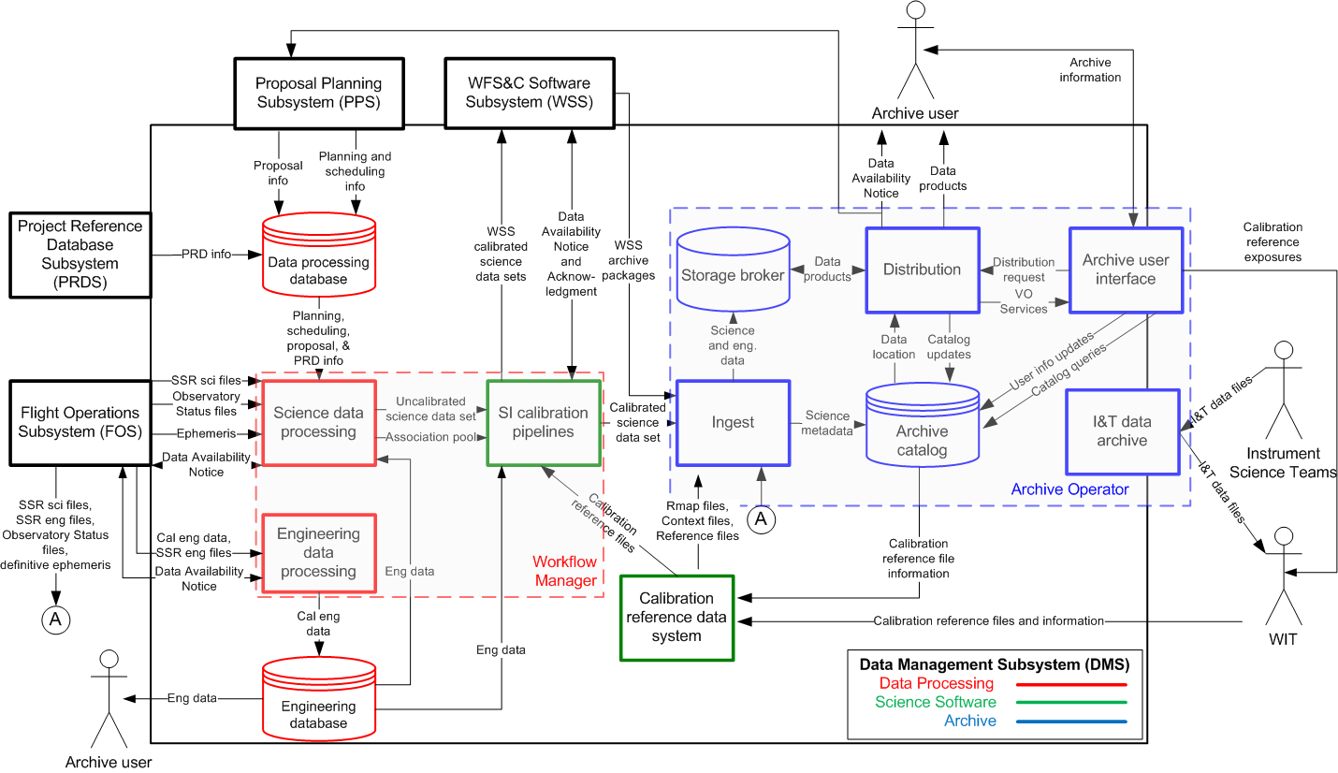
DMS Data Flow Diagram

Slide 4
Key Requirements

Slide 5
Original CRDS Key Requirements (1/2)
ID | Requirement
DMS-535 | The CRDS shall ensure that all reference files and information regarding the rules for mapping data to reference files are archived before the reference files or rules may be used. [level 4 req 6.4.2.2]
DMS-536 | The CRDS shall identify the most appropriate reference data to use for the calibration pipelines. [req 6.4.3.1]
DMS-537 | The CRDS shall support multiple versions of the calibration pipeline simultaneously. [6.4.3.2]
DMS-538 | The CRDS shall commit new reference files without requiring their use in operations.[6.4.3.3]
DMS-539 | The CRDS shall have a common software interface for both local and remote users.[6.4.3.4]
DMS-540 | Outside users shall be able to query the CRDS through a web interface for the most appropriate reference files for the specific version of a calibration pipeline and a particular data set. [req 6.4.3.5]
DMS-541 | The CRDS shall have the capability to recreate the list of appropriate calibration reference files for any point in the past given the date of the query, version of software, and a specific data set. [req 6.4.3.6]
DMS-542 | The CRDS shall record meta data about the reference files and all information regarding how data sets are matched to reference files including (but not limited to): [req 6.4.3.7] 1) How the reference file was generated (or links to documents regarding that), 2) Who created the reference file, 3) Who committed the reference file, 4) Information about the significance of the change.

Slide 6
Original Key CRDS Requirements (2/2)
ID | Requirement
DMS-543 | It shall be possible to mark committed reference files as bad so they will no longer be selected by CRDS. [req 6.4.3.8]
DMS-544 | Rules describing how reference files are matched to data and software versions shall be separate from the reference files. [req 6.4.3.9]
DMS-545 | A tool shall be provided that will list where differences exist for recommended reference files between two rules and list of data sets. [req 6.4.3.10]
DMS-546 | Reference files shall include in their headers information in the form of header comments that describe the procedure for making the reference file or point to a reference that describes that procedure. [ref 6.4.3.13]
DMS-547 | CRDS shall provide a tool to show the set of active reference files being used for all supported versions of the software, or a specific version of the software. [ref 6.4.3.14]
DMS-548 | CRDS shall provide a tool to show active files associated with specific instrument observing modes. [ref 6.4.3.15]
DMS-641 | CRDS shall have the capability to mark a specific rule as bad so as to prevent its use by the CRDS. [ref 6.4.3.12]
DMS-642 | CRDS shall have the capability to undo the use of a specific rule mapping data to a reference file. [ref 6.4.3.11]

Slide 7
Operations Concept

Slide 8
CRDS Ops Concept
Key CRDS functionality
Identify the most appropriate calibration reference data for a data set based on science instrument, mode, and date.
Check the validity of calibration reference data files
Track when and why calibration reference data have been entered into the system.
Ensure that calibration reference data are appropriately archived.
Provide user access to calibration reference data information.
Analog to HST CDBS
CDBS design precludes easy implementation of all desired requirements.
New architecture required.

Slide 9
Glossary
DMS pipelines: The sequence of operations DMS applies to all data, starting with telemetry
Calibration pipelines: One of the tasks part of the DMS pipelines specifically for the purposes of calibrating the data.
Reference Files: Files used by calibration pipelines to apply calibration corrections. Examples:
Flat fields
Darks
Geometric distortion model

Slide 10
Glossary (cont.)
Mapping rule: The specification of how a data set is matched to a specific reference file for a specific kind of reference file. Only one used per reference file type (at a time). Depends on:
Instrument configuration
Proposal and engineering information
Date
…
Context: The set of all rules in effect for a given pipeline environment.

Slide 11
CRDS Operational Goals
Allow Calibration pipelines to use directly
Do not require user to edit data file headers to update recommended reference files
Allow Calibration pipelines to use remotely by observers at their home institutions [DMS-539]
Make mapping rules explicit to Instrument Scientists
To make effect of changes clear
Support multiple versions of system simultaneously [DMS-537]
Aids testing
Required for distributed use of calibration pipelines

Slide 12
CRDS Operational Goals (cont.)
Separate reference file deliveries from mapping rules.
Deliver reference files without any regard for how datasets are mapped to them. [DMS-544]
Deliveries do not trigger use in pipeline or anywhere else. [DMS-538]
Entirely different approach for mapping rules.
Must edit mapping rules in their entirety
Minimize redundancy of information
Examples are the best way to explain
But first, examples of use cases…

Slide 13
Use Case Drivers
Default pipeline access is through web service
Allows pipelines run remotely (e.g., astronomer’s home institution) using exactly the same mechanism to get reference file recommendations.
Remote (Astronomer-run) pipelines may use different pipeline versions or contexts
Multiple versions of contexts for operational pipelines can be tested simultaneously
Sometimes necessary since instrument teams often have asynchronous schedules (use of a common test system is not adequate)
Projects can use rmap engine locally (I.e., not the web service) to:
Use customized rmaps (e.g., they have their own reference files or different rules they prefer to use)
E.g. Legacy projects or IDTs
To eliminate network dependency

Slide 14
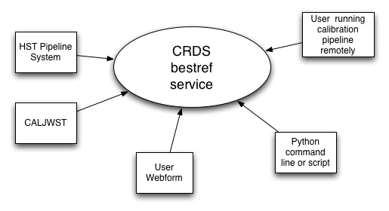
bestref Clients

Slide 15
Bestref Use Case 1: Operations Pipelines
Can be used for both HST and JWST operational pipelines
HST OPUS uses bestref before calling calibration pipelines
Preloads data headers with recommended files
JWST Calibration Pipelines will interact directly with CRDS
No pre-loading headers with reference file names

Slide 16
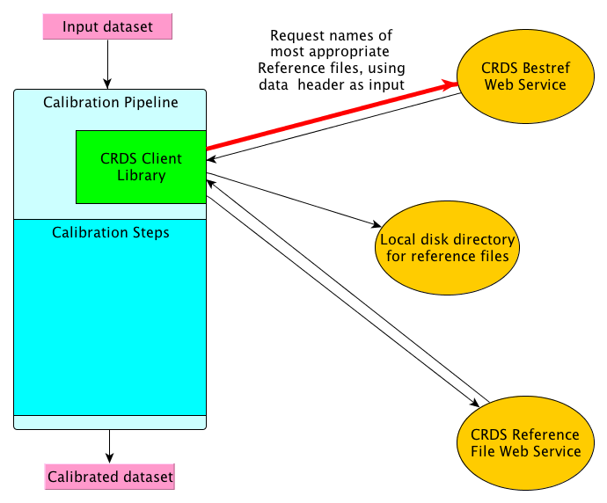
xxx
xxxx

Slide 17
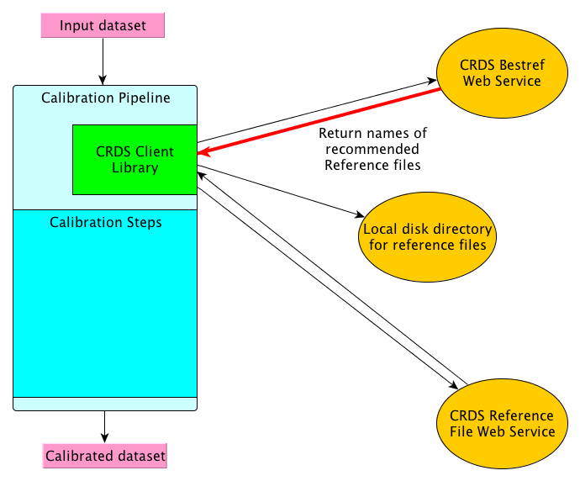
xxx
xxxx

Slide 18
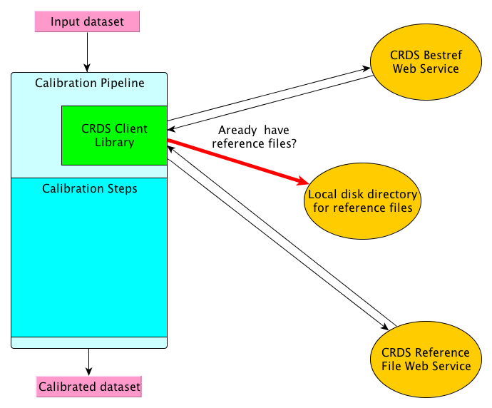
xxx
xxxx

Slide 19
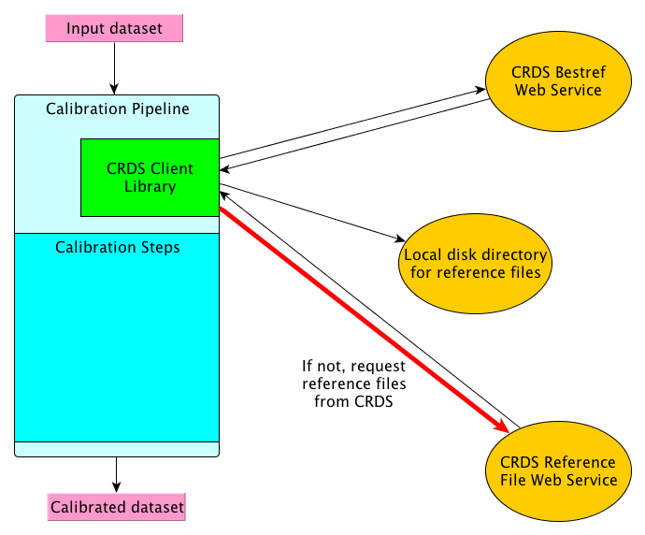
xxx
xxxx

Slide 20
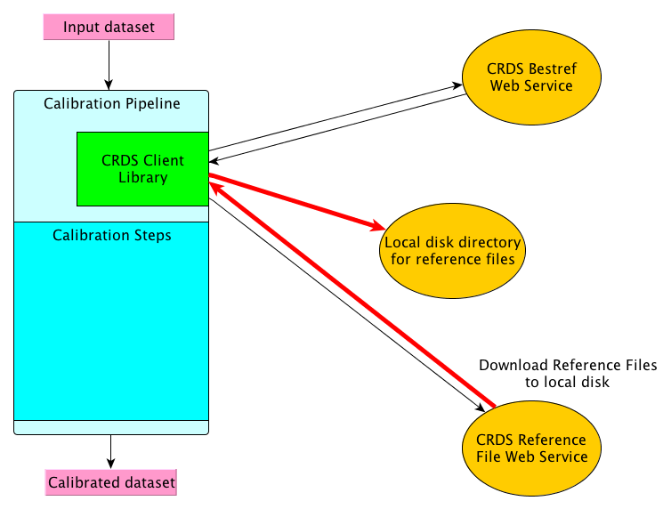
xxx
xxxx

Slide 21
Bestref Use Case 2: Astronomer-run Pipeline
Astronomer runs pipeline at home institution
Works exactly the same way as for pipeline in operations by default
More options available:
User may select different context than current operations use
User may run with different version of calibration pipeline than current operations uses
User may preload header with reference files to use
Using a different tool that updates headers with information obtained from CRDS
If desire is to override some CRDS choices, or run pipelines with no web access
User may use command line switches to override CRDS recommended reference files

Slide 22
Details of Use in Calibration Pipeline (cont.)
Calibration Pipeline/CRDS high-level protocol:
Calibration Pipeline passes augmented data header to CRDS through a web-service mechanism
We are trying to avoid explicit coupling of specific required selection criteria in the interface. Just give it the whole header
Augmented info includes software version and other processing environment details that are relevant; just add as extra keywords to the header passed.
CRDS returns list of recommended reference files to calibration pipeline.
Calibration pipeline checks to see if these reference files are present on local system.
If not, it uses a different CRDS web service to retrieve needed files.
Calibration pipeline opens appropriate reference file when relevant calibration step runs.

Slide 23
Bestref Use case 3: Web Form Access
User accesses web page to obtain CRDS recommended reference files
User supplies either:
Data file name
Data file itself (through upload)
Specified selection parameters (instrument, mode, date , etc)
Action is to return (depending on selected option):
Web page with results listed
Text file with results
Emailed results
Data file with updated header

Slide 24
Bestref Use case 4: Script Access
User writes Python script (though web service will support any language) to obtain dictionary of reference files returned.
Easy way for user to customize pipeline software reference file handling

Slide 25
Bestref Use case 5: Local CRDS service
A project wants to use CRDS with their own rules or reference files.
They install the CRDS bestref service software locally
Bestref software is compact and portable
They obtain relevant rmap/context files from STScI
They modify or add their own reference/rmap/context files to have the recommendations run the way they wish
Useful for large legacy projects or IDTs that have custom pipelines

Slide 26
Defining Mapping Rules
A rules file (called “rmap”) defines all the rules in effect for a specific kind of reference file.
E.g., MIRI nonlinearity
Aside from the software that interprets the rules, the rmap file is entirely self-contained
No dependencies on information elsewhere
All referenced reference files are explicitly listed in rmap files
If it isn’t there, it doesn’t get used
Because it is self-contained, simple to support many versions of the rules
Each version is simply a different file
rmap files are simple ascii files, human readable
E.g., not xml!
Types of possible rules limited only by the software that interprets them
Current set based on experience with what is needed to support HST reference files

Slide 27
Example rmap file
header = {
'mapping' : 'reference',
'observatory' : 'HST',
'instrument' : 'ACS',
'reftype' : 'IDCTAB',
'parkey' : (('DETECTOR',),('DATE-OBS', 'TIME-OBS')),
}
selector = Match({
('HRC',) : UseAfter({
'2002-03-01 00:00:00' : 'p7d1548qj_idc.fits',
'2002-10-21 00:00:00' : 'q692007bj_idc.fits',
}),
('SBC',) : UseAfter({
'2002-03-01 00:00:00' : 'o911150jj_idc.fits',
'2002-10-21 00:00:00' : 's5d1409dj_idc.fits',
'2007-07-17 00:00:00' : 's5f1959lj_idc.fits',
}),
('WFC',) : UseAfter({
'2002-03-01 00:00:00' : 'v4115408j_idc.fits',
'2002-10-21 00:00:00' : 'u7n18502j_idc.fits',
'2009-01-01 00:00:00' : 'u7n18501j_idc.fits',
}),
})

Slide 28
Manageability of Rules Files
Past experience with HST indicates that most reference file types have very few active reference files
Typically less than 20 per instrument reference file type for the great majority.
No need for a complicated system to handle mapping these.
What about the exceptions?
A few HST cases number > 500 active files
All these are time-dependent data (e.g., daily darks or bias)
For these lookups are simple (ordered data)
For these changes are usually simple appends to the rmap file (most lines don’t change between versions)
Even for daily reference files, updates are typically done much more infrequently (weekly at most).
The space taken up by having 500 such updates (the approximate number of weeks in 10 years) will not lead to significant storage issues
The elimination of OTFR means that there is not a strong need for a high update frequency as well.
In conclusion:
There is no good reason not to save all previous mapping rules
There is no good reason not to have instrument scientists edit the rules directly

Slide 29
Testing against HST Reference Files
HST provides a good test of practicality
Lots of reference file types to test against
Developed code to generate rmaps automatically from currently active files
Uncovered a few cases not handled well in initial set of selecting functions
Mainly bias files
Developed new selector constructs as a result:
Aliases for lists of matching modes
Pattern matching against modes
E.g., all mode strings that contain “subarray”
Goal of new constructs is to minimize multiple appearances of reference file names in rmaps

Slide 30
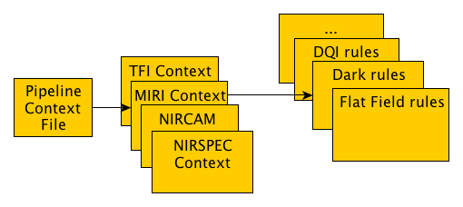
Managing CRDS Versions
Hierarchical dependency structure
Pipeline context file lists which instrument context files are being used.
Instrument context files list which reference file mapping rules files are being used
Specifying a unique pipeline context file and version of the CRDS software, defines everything about what CRDS will use, and how it uses it.

Slide 31
Example Pipeline Context File
header = {
'mapping': 'pipeline',
'observatory':'HST',
'parkey' : ('INSTRUME',),
}
selector = {
'ACS':'hst_acs_010.imap',
'COS':'hst_cos_034.imap',
'STIS':'hst_stis_004.imap',
'WFC3':'hst_wfc3_017.imap',
}

Slide 32
Example Instrument Context File
header = {
'mapping' : 'instrument',
'observatory' : 'HST',
'instrument' : 'ACS',
}
selector = {
'idctab' : ('idc', 'hst_acs_idctab_003.rmap'),
'darkfile' : ('drk', 'hst_acs_darkfile_115.rmap'),
'atodtab' : ('a2d', 'hst_acs_atodtab_002.rmap'),
'biasfile' : ('bia', 'hst_acs_biasfile_217.rmap'),
'spottab' : ('csp', 'hst_acs_spottab_001.rmap'),
'mlintab' : ('lin', 'hst_acs_mlintab_005.rmap'),
'dgeofile' : ('dxy', 'hst_acs_dgeofile_008.rmap'),
'bpixtab' : ('bpx', 'hst_acs_bpixtab_003.rmap'),
'oscntab' : ('osc', 'hst_acs_oscntab_022.rmap'),
'ccdtab' : ('ccd', 'hst_acs_ccdtab_005.rmap'),
'crrejtab' : ('crr', 'hst_acs_crrejtab_011.rmap'),
'pfltfile' : ('pfl', 'hst_acs_pfltfile_013.rmap'),
'cfltfile' : ('cfl', 'hst_acs_cfltfile_009.rmap'),
'mdriztab' : ('mdz', 'hst_acs_mdriztab_027.rmap'),
}

Slide 33
Capabilities Permitted
Easy to add new kinds of mapping rules
Mapping rules are explicit and all in one place
Simple to compare different versions
Supports multiple contexts
Different pipelines can run different versions of CRDS simultaneously
Bestref functionality is portable
Easily distributed and run by users or other institutions

Slide 34
Process for Delivering and Using New Reference Files
Make new reference file(s)
Validate/deliver reference files
Update corresponding reference mapping file
Validated/deliver new mapping file
Update/deliver context files:
corresponding instrument context file
pipeline context file
Test new pipeline context file in operations test environment
Update pipeline to use new pipeline context file

Slide 35
Delivering Reference/rmap/context Files
Deliveries involve:
Providing necessary provenance information [DMS-542]
Validation of reference/rmap/context files
Assigning/validating a name for the file
Archiving the file
Updating the catalog of reference/rmap/context files with all relevant information.

Slide 36
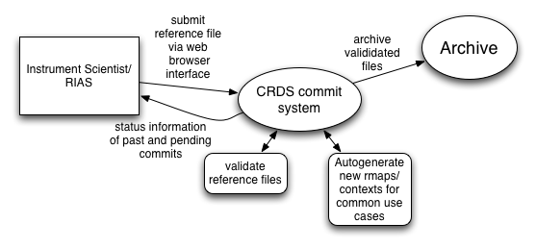
Commiting Files to CRDS
xxxx

Slide 37
Commit Use Case 1: General Case
IS/RIA/RIS:
commits new reference files
edits rmap to use new reference files
commits new rmap file
edits instrument context file to use new rmap file
commits new instrument context file
edits pipeline context file to use new instrument context file
commits new pipeline context file
requests operations test new pipeline context
Operations:
sets test version of operational environment to use new pipeline context, runs regression tests
on approval from WIT, sets operations environment to use new pipeline context

Slide 38
Commit Use Case 2: File replacement
Used when there is one-for-one file replacement (reference, rmap or instrument context) for any number of files listed within one file.
Web form allows entering in replacements for listed files.
One button submit handles chain of commits. E.g.,
Commits all reference files
When reference file commits complete, creates new rmap, then commits that
Replaces old rmap entry reference file names with the identified committed reference files
When rmap commit completes, creates new instrument context, commits that
Replaces old instrument context rmap reference with new rmap name generated
When instrument context completes, creates new pipeline context, commits that
Replaces old pipeline context instrument context reference with new instrument context name generated
Returns names of all committed files

Slide 39
Commit Use Case 3: time-dependent changes
Adding new time-dependent reference files to existing list in rmap
Web form provides place to make additions to existing rmap file
Goes through same process as Use Case 2 to edit/commit all chained files
One step for the user

Slide 40
Validation of CRDS Files
For all types of files:
Name must be unique and obeys naming conventions
CRDS supplies name, retains original name in catalog and header
Information must be provided to document provenance: [DMS-542]
Who made the file, who committed the file
How the file was made, etc
Significance of change
Reference Files:
Verify file is conformant with required format (e.g. valid FITS file)
Verify file contains necessary information on how the file was generated [DMS-546]
Verify file has necessary structure and content
Very open ended
Lots of rules on content make for harder maintenance
Rules Files:
All reference files referred to must be in CRDS [DMS-535]
Syntax is correct
All previous modes covered remain covered [provide warning]
No identical selection sets can appear twice in the file.
Context Files:
All context or rules files referred to must be in CRDS [DMS-535]
Syntax is correct

Slide 41
Requirements CRDS places on Archive
The archive shall be able to archive the following kinds of files:
Calibration Reference Files
Rules Files that define how data should be mapped to Calibration Reference Files
Context Files that define which Rules Files should be used for a given instance of calibration pipeline execution
The Archive shall accept any name supplied for such files, and any format provided.
The Archive shall be able to apply a set of rules for the acceptable name and format of the file to be archived. These rules shall be configurable to handle new naming schemes or a new file format if one is added to the supported list
The archive shall provide a mechanism to prevent the overwriting of a reference/rmap/context file with the same name by CRDS when CRDS submits such a file to the archive to be archived

Slide 42
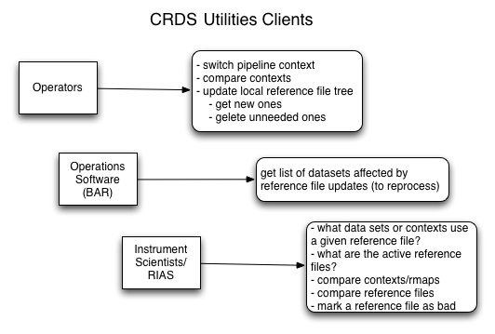
Utilities Use Categories
xxxx

Slide 43
Software Design

Slide 44
CRDS Design: Languages/Tools
CRDS will be written entirely in Python with the following exceptions:
Any C code needed to enhance performance (viewed as unlikely)
Javascript and related tools needed within web forms for user interface interactivity
Jquery
DHTML
Web interactions will use the Django web framework
Most widely used Python web framework
django-json-rpc module
Will use Apache as web server
MySQL will be the database used for the file catalog
Integrates well with Python, and already used by ETCs, will share same database server

Slide 45
Areas of Design/Development
Bestref service
Basic capability implemented
Basic functionality running on test web server
Performance capable of handling hundreds of requests (all reference files) per second on HST examples
Commit functionality
Utilities for
Operators
Operational Software
Instrument scientists

Slide 46
Coordinated Development with HST
HST project has approved adoption of CRDS for HST use within the next two years
Providing funding for implementation and testing
HST needs closely aligned with JWST
Requirements effort underway
Almost all proposed HST generated requirements useful for JWST as well
HST rules and reference files have already been used for initial testing
JWST will benefit from near-term testing in a production environment
Biggest additional effort will come from software needed to automatically generate rmaps from existing CDBS information
Main testing will be to compare CDBS bestref results with CRDS bestref results on large numbers of data sets

Slide 47
Bestref Design Decisions
Design very straightforward
Provide pipeline context as top-level pointer to nested file dependencies.
Use these to load all relevant rmap files
Each rmap file is parsed to build data structure that is used to successively select subgroups of reference files until all selection criteria are used to isolate to one reference file.
Service is always provided “dictionary-like” input data (e.g., keyword/value pairs)
FITS headers for example
Avoid defining specific selection parameter lists for each instrument
Makes changing selection criteria easier if whole headers are submitted to service
Data file headers will likely need a few extra items inserted for proper lookup.
E.g, version of calibration pipeline software
Wildcard matches may overlap with more specific matches. More specific match is always chosen over wildcard match
Uses Python dictionary structure heavily for implementation (high performance lookup)

Slide 48
Commit Design Decisions
Web interface requires authentication
Not just anyone should be able to commit files!
Streamlined commit facility requires significant interactivity on web form
Hence javascript technology
Adoption of CDBS TPN files for validation
These files describe properties of reference files that should be met
Can use these (or something similar) for JWST validation information
Includes expected data structure (for tables), data type, required keywords, columns in tables, etc.
Interface issues with Archive
How to submit files to the Archive (current and future)
How to monitor process in archiving files

Slide 49
Commit Design Decisions (cont)
File naming issues
Ensuring unique names
Naming convention for reference/rmap/context files
Favor automatically sequentially generated filenames
Show current and recent pipeline context in user interface choices of contexts to base changes on
Requires Operational system to maintain history of contexts used and provide interface to CRDS (and other systems) for obtaining the history
Detect and warn when rmap update eliminates a previously existing selection case
Likely a user error
Listed under utilities as well

Slide 50
Utilities Design
(Not a complete list)
General Utilities (useful for more than one category)
Synchronize local reference file directories to contain all reference files required by given list of pipeline contexts
Useful for Operations, WIT, and other projects (e.g., IDTs)
Highlight all differences in rules and reference files between rmaps, instrument contexts or pipeline contexts

Slide 51
Utilities Design (cont)
Operational System Utilities
Detection of reversion of reference, rmap, or instrument context files when changing pipeline context
Prevents inadvertent undoing of previous updates by uncoordinated modifications
Get list of datasets affected by pipeline context change
Useful for identifying data sets needing reprocessing
Design Issue: Some table reference files have rows selected by additional selection criteria. A change to the file does not necessarily affect all data sets that use that reference table. This utility must examine the contents of these tables to determine which data sets are affected (and store the selection criteria for the rows in rmaps for this utility to use in doing such checks)
Design Issue: Selection based on severity of change of reference file change. Some desire the ability of selecting only data sets for which the change in reference files is considered to be above some specified threshold (e.g., moderate, or severe).
Very difficult problem to do correctly and make practical
Few successful examples in past
Actually, none (?)
Still an open issue
Awaiting well defined concept for how this should work before accepting as a requirement

Slide 52
Utilities Design (cont.)
WIT Utilities
What data sets or contexts use a given reference file
Mark reference file as bad
Show what selection criteria use a given reference file
Show if an rmap update doesn’t cover a selection case covered in the previous version of the rmap (likely folded into commit user interface), or changes the set of selection criteria
Show current operational configuration
More sophisticated reference file comparison tool
E.g., capable of detecting insertions or deletions of rows in tables between two versions

