Slide 1
Title Page
Calibration Reference Data System Design Todd Miller
Science Software Branch

Slide 2
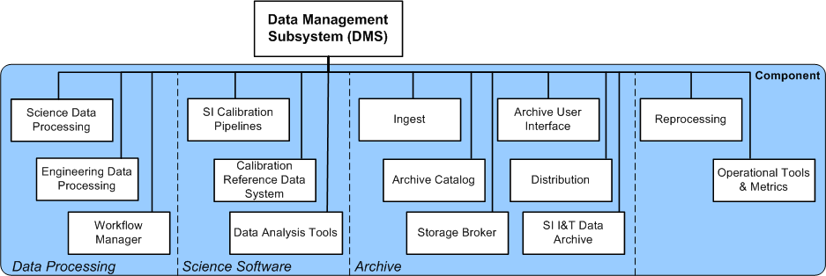
Calibration Pipeline Component
You are here
Notes:
CRDS is part of the science software dedicated to managing reference files.

Slide 3
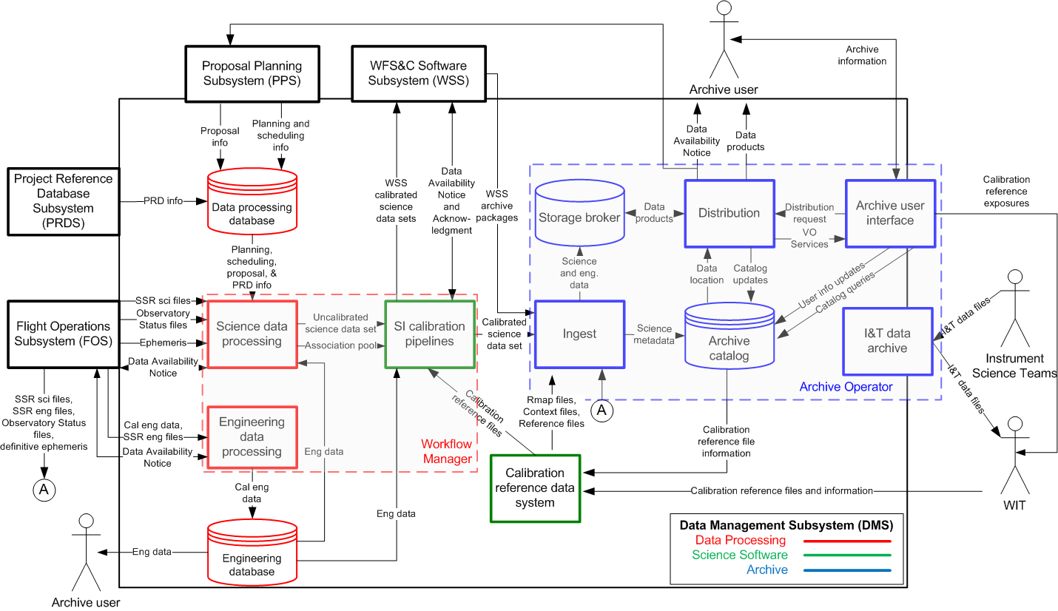
DMS Data Flow Diagram

Slide 4
CRDS Background (what it is)
Assigns reference files to specific datasets based on an instrument configuration and date.
CRDS is planned to replace CDBS for HST
CRDS is the baseline best reference system for JWST
Parallel schedule
JWST build-1 (Sept 2012) best reference computation and file delivery to pipeline. Directly integrated with stpipe.
HST CRDS build-2a (Sept 2012) real HST rules
HST CRDS build-2b (Sept 2012) web site new reference file submission process.
CRDS has generally common code between projects
Different rules hierarchies, instruments, types, parameters
Notes:
CRDS is a dual project system planned for both HST and JWST.
CRDS assigns reference files to datasets based on instrument configuration and date.
CRDS will replace CDBS for HST. CRDS is the baseline reference system for JWST.
The parallel schedules emphasized different aspects of the system for different projects.
JWST is in limited operations now for determining best references for build 1 using mock rules and reference files.
HST just released a set of real rules and a file submission web site.

Slide 5
CRDS Background (how it works)
CRDS Concept
Versioned text files (rules) replace CDBS database
Python( dataset, rules ) → best reference for dataset
Advantages:
Transparent: requires no database account or tool to view rules.
Repeatable: past results are determined by archived rules files
Core library does not require network or database access to compute best references.
Use a web interface to streamline new reference delivery tasks.
Offer best references as a web service.
Transparent delivery of needed reference files for JWST.
Notes:
CRDS replaces the CDBS database with Python code and simple text-based versioned rules files.
Python code evaluates the rules with respect to dataset parameters to determine best references.
Past CRDS results are determined by archived rules files and can be repeated. In contrast the database was for practical purposes a single state system which can only produce the current results, not past results.
CRDS has a website to support the submission of new references and rules.
CRDS offers best reference determination as a web service.
CRDS can transparently fetch references for JWST on demand.

Slide 6
CRDS Rules File Hierarchy
Pipeline
Context
(.pmap)
Configuration entire system (versioned)
Instrument
Context
(.map)
Instrument
Context
(.map)
One per instrument (versioned)
One per instrument configuration (often dated)
Instrument
Context
(.imap)
Reference Files
(.fits)
Reference Files
(.fits)
Reference Files
(.fits)
Reference Files
(.fits)
Reference Files
(.fits)
Reference Files
(.fits)
Reference Files
(.fits)
Reference Files
(.fits)
Reference Files
(.fits)
Reference
Type Mapping
(.map)
Reference Files
(.fits)
Reference
Type Mapping
(.map)
Reference Files
(.fits)
Reference Files
(.fits)
Reference
Type Mapping
(.map)
Reference Files
(.fits)
Reference Files
(.fits)
One per reference type (versioned)
(~ Pipeline Step)
Reference
Type Mapping
(.map)
Reference Files
(.fits)
Reference Files
(.fits)
Reference
Type Mapping
(.map)
Reference
Type Mapping
(.rmap)
Reference Files
(.fits)
Reference Files
(.fits)
Reference
Type Mapping
(.map)
Reference Files
(.fits)
Reference
Type Mapping
(.map)
Reference Files
(.fits)
Reference
Type Mapping
(.rmap)
Reference Files
(.fits)
Reference Files
(.fits)
Notes:
CRDS has a four tiered file hierarchy, with three tiers of rules at the top and reference files at the bottom.
References are assigned by descending the hierarchy, starting with the pipeline rules, or pmap, continuing with instrument specific rules, or imap, and finally using type specific rules, or rmap, to locate an appropriate reference file.
At each step dataset parameters are used to determine where to branch next.
HST has 6 instrument mappings and 110 types. There are currently 14000 reference files.
JWST has 5 instruments and 27 types and 167 references. More references will accrue over time.
Both projects currently have only one version of rules. Individual instruments and types can have many different versioned copies.

Slide 7
Pipeline Context (jwst_0000.pmap)
For all instruments
header = {
'derived_from' : 'cloning tool 0.03b (2012-09-11)',
'description' : 'rules from clone_directive.txt',
'mapping' : 'PIPELINE',
'name' : 'jwst_0000.pmap',
'observatory' : 'JWST',
'parkey' : ('META.INSTRUMENT.TYPE',),
'sha1sum' : '57523113da9ca4493e54ebe87d8621d9581d706b',
}
selector = {
'FGS' : 'jwst_fgs_0000.imap',
'MIRI' : 'jwst_miri_0000.imap',
'NIRCAM' : 'jwst_nircam_0000.imap',
'NIRISS' : 'jwst_niriss_0000.imap',
'NIRSPEC' : 'jwst_nirspec_0000.imap',
}
All CRDS rules files have versioned names: e.g. jwst_0000.pmap
One Pipeline Context file (and the set of referred mappings) defines the configuration of CRDS
Replaces the state of the CDBS database.
Notes:
Here’s an example pipeline context file.
Based on the dataset instrument parameter, it can select a corresponding instrument mapping, here for MIRI, version 0.

Slide 8
Instrument Context (jwst_miri_0000.imap)
For all reference types of MIRI
header = {
'derived_from' : 'cloning tool 0.03b (2012-09-11)',
'instrument' : 'MIRI',
'mapping' : 'INSTRUMENT',
'name' : 'jwst_miri_0000.imap',
'observatory' : 'JWST',
'parkey' : ('REFTYPE',),
'sha1sum’: '08e984a020ad8b617904b6bf18c6a1864f365270',
}
selector = {
'AMPLIFIER' : 'jwst_miri_amplifier_0000.rmap',
'DARK' : 'jwst_miri_dark_0000.rmap',
'FLAT' : 'jwst_miri_flat_0000.rmap',
'LINEARITY' : 'jwst_miri_linearity_0000.rmap',
'MASK' : 'jwst_miri_mask_0000.rmap',
'PHOTOM' : 'jwst_miri_photom_0000.rmap',
}
Notes:
Based on the type, the instrument mapping is used to select a reference mapping.
Here we select the rmap for DARK files.

Slide 9
Reference Mapping (jwst_miri_dark_0000.rmap)
Matching MIRI DARK to specific reference files
header = {
'derived_from' : 'cloning tool 0.03b (2012-09-11)',
'filekind' : 'DARK',
'instrument' : 'MIRI',
'mapping' : 'REFERENCE',
'name' : 'jwst_miri_dark_0000.rmap',
'observatory' : 'JWST',
'parkey' : (('META.INSTRUMENT.DETECTOR', 'META.INSTRUMENT.FILTER', 'META.EXPOSURE.READPATT'),),
'sha1sum' : '2535d3be806c6e7f5f0da1f2dce64034f9028ddc',
}
selector = Match({
('MIRIFULONG', 'ANY', 'FAST') : 'jwst_miri_dark_0000.fits',
('MIRIFULONG', 'ANY', 'SLOW') : 'jwst_miri_dark_0001.fits',
('MIRIFUSHORT', 'ANY', 'FAST') : 'jwst_miri_dark_0002.fits',
('MIRIFUSHORT', 'ANY', 'SLOW') : 'jwst_miri_dark_0003.fits',
('MIRIMAGE', 'ANY', 'FAST') : 'jwst_miri_dark_0004.fits',
('MIRIMAGE', 'ANY', 'SLOW') : 'jwst_miri_dark_0005.fits',
})
Notes:
Based on tertiary parameters, the rmap is used to select a specific reference file. Here we use DETECTOR, FILTER, and READPATT to find DARK instance 3.
For references, the serial number indicates both a particular instance category and the version of the file in that category.
The parkey header field defines the JWST data model parameter names used to perform each lookup.

Slide 10
Selectors
Typical HST Pattern:
Match parameters to rules, then use useafter to resolve which match
Automated generation of Initial CRDS rules from CDBS database
Baseline HST rules only use Match(), UseAfter()
Future expansion of selectors is possible if needed
Results of each Selector presented to next until one possibility is chosen
Basic Selectors (emulate CDBS)
Match
UseAfter
Other Selectors (new possibilities)
SelectVersion
ClosestTime
GeometricallyNearest
Bracket
Notes:
CRDS rules files are broken down into a header section and a section of nested selectors.
HST has a single canonical pattern, a parameter Match followed by a date based UseAfter lookup.
Rules files in general support arbitrary selector nesting. There are different kinds of selectors of which HST only uses two.
During a lookup, each selection stage either returns the final answer or delegates the lookup to a nested selector.

Slide 11
Selectors Nest
header = {
'derived_from' : 'generated from CDBS database 2012-10-24 17:13:14.151232',
'filekind' : 'DARKFILE',
'instrument' : 'STIS',
'mapping' : 'REFERENCE',
'name' : 'hst_stis_darkfile.rmap',
'observatory' : 'HST',
'parkey' : (('DETECTOR', 'CCDAMP', 'CCDGAIN'), ('DATE-OBS', 'TIME-OBS')),
}
selector = Match({
('CCD', 'A|B|C|D', '1|2|4|8') : UseAfter({
'1996-10-01 00:00:00' : 'h1v1208eo_drk.fits',
'1997-03-03 00:00:00' : 'hcg1440so_drk.fits',
'1997-03-13 00:00:00' : 'hcg1440to_drk.fits',
'1997-03-21 00:00:00' : 'hcg14410o_drk.fits',
'1997-03-24 00:00:00' : 'hcg14411o_drk.fits',
'1997-04-14 00:00:00' : 'hcg14412o_drk.fits',
'1997-04-29 00:00:00' : 'hcg1452lo_drk.fits',
'1997-05-05 00:00:00' : 'hcg14537o_drk.fits',
'1997-05-12 00:00:00' : 'hcg14538o_drk.fits',
'1997-05-19 00:00:00' : 'hcg14539o_drk.fits',
}),
(‘CCD’, ‘AC’, ‘16’) : UseAfter({
'1997-04-14 00:00:00' : 'hcg14712p_drk.fits',
'1997-04-29 00:00:00' : 'hcg14529q_drk.fits',
}),
….
Match
(instrument configuration)
UseAfter
(exposure date)
Notes:
This shows a typical HST reference mapping with the nesting of Match followed by UseAfter.
It first matches the datasets DETECTOR, CCDAMP, and CCDGAIN, and then does a date based lookup based on DATE-OBS and TIME-OBS. You can see that the parkey field is specified in two groups which are used in sequence as we descend the Selector hierarchy.
HST specifies parameters as FITs keywords. JWST uses STPIPE data model names.

Slide 12
Match() Parameter Expressions
Each Match() choice can specify multiple parameters
(’ABCD’, ‘*’, ‘1|2|3’, ‘N/A’, 1)
Individual parameters can be specified in several forms:
Parkey Expression Type | Example | Weight | Matches (e.g.)
Simple | 42 | highest | 42
Glob | “*” “F*22” | highest | “Anything” “FW122”
OR | “A|B|C|D” “1|2|3” | highest | “B”
N/A | “N/A” | lowest | “Anything”
Match weights resolve ambiguities from multiple pattern matches.
N/A parameter values in dataset or rmap don’t affect matching.
Notes:
Match selectors can be intricate, with each choice matching multiple parameters.
Each individual parameter can be matched in several ways.
Matching generally works by winnowing out choices which cannot match the dataset and returning what’s left over.
Matches are ranked by adding up the number of parameters which match.
Parameters can be ignored by some choices by marking them as N/A. Those parameters don’t add to the weight or strength of the match.
For HST, when multiple matches of the same rank remain, they are merged together to mimic CDBS semantics.

Slide 13
Changes Since Last Year
Best References
Integration with stpipe
Interface to CRDS common across all stpipe Steps
Stpipe calls crds.getreferences()
Command line specification of reference file overrides bestref value
Use STPIPE data model vocabulary for JWST CRDS rules
Web service also supports FITS keywords and maps to data model
Elaboration of CRDS client configurations
Support for reference
Relevance Expressions (Rmap, Parkey)
Web service is language agnostic
File Submission Refinements
Rmap Editing
Batch Submission
HST Catalog driven best reference testing
CRDS matches all CDBS recommendations: ~100%
Notes:
These are the big changes since last year:
We integrated CRDS with STPIPE using a common interface for all steps. Our main innovation was to provide a common approach for forcing the reference selection on the command line, a CRDS override.
CRDS also incorporated the JWST data model parameter naming system for JWST rules. The CRDS web service accepts either FITS or JWST data model parameter names for JWST.
We spelled out some specific system configurations.
HST lead to the addition of so-called “relevance expressions” in the rules headers.
We added systems for submitting files to the website.
There was a lot of work on generating and testing HST rules. HST rules were checked against CDBS for all the datasets in the HST catalog. Anomalies were tracked down and eliminated and the current results. Generating the references was somewhat hard, but checking them against CDBS was the hardest; unless you’re the pipeline, it’s hard to get CDBS to tell you unambiguously what it recommends.

Slide 14
Changes Since Last Year (cont)
Archiving
CRDS now handles unique file naming for
Rules
References
CRDS server has file storage for rules and references
Necessary for CRDS development and early STPIPE operations
CRDS client *must* have file storage, so might as well share.
CRDS : Archive interfaces discussed for:
Distributing references and rules from the archive via simple URL’s.
Ingesting reference files into the archive using existing CDBS/OPUS file exchange protocols.
Notes:
There have been a few developments with respect to the archive interfaces:
CRDS will be responsible for assigning unique filenames for rules and references.
The initial CRDS servers have direct access most or all existing reference files and rules, essentially a checkout of all files. This is significant but makes a lot of sense within an Institution since it saves users from copying the data or waiting for downloads.
We’ve nailed down the baseline CRDS interfaces for getting files into an out of the archive:
CRDS will be able to pull references and mappings using simple HTTP GET.
CRDS will meet the same interface to OPUS used by CDBS, and OPUS will complete file deliveries to the archive as it does now.
These protocols are implemented now in CRDS so we can start testing as the two teams are ready and have time.

Slide 15
Rmap Relevance
header = {
’filekind' : 'CCDTAB',
'instrument' : 'ACS',
'mapping' : 'REFERENCE',
'parkey' : (('DETECTOR',), ('DATE-OBS', 'TIME-OBS')),
'rmap_relevance' : '(DETECTOR != "SBC")',
}
selector = Match({
('HRC',) : UseAfter({
'1991-01-01 00:00:00' : 'j4d1435kj_ccd.fits',
'1992-01-01 00:00:00' : 'm711125gj_ccd.fits',
}),
('WFC',) : UseAfter({
'1991-01-01 00:00:00' : 'lch1556bj_ccd.fits',
'1992-01-01 00:00:00' : 'm1e1043gj_ccd.fits',
'2001-03-01 00:00:00' : 'm2j1057qj_ccd.fits’,
}),
})
Reference required
for this dataset?
or N/A?
Not all reference types are relevant to all instrument modes
If DETECTOR == “SBC” then reference type CCDTAB is N/A
Added for HST, useful in general
Prevents conflating irrelevant results with errors
Resolves ambiguity in testing
Notes:
From testing with HST two refinements to rmap’s have been added.
The first is the ability to discern what instrument modes an rmap is relevant for.
Based on the dataset parameters, CRDS can evaluate an expression that says a recommendation is expected for this mode, or not.
In this case, you can see from the Match choices that if the DETECTOR is SBC, it will fail. So what the expression does is answer the question of whether we should even look, whether the failure is a real error or not.

Slide 16
Parykey Relevance
header = {
'filekind' : 'DARKFILE',
'instrument' : 'STIS',
'mapping' : 'REFERENCE',
'parkey' : (('DETECTOR', 'CCDAMP', 'CCDGAIN'), ('DATE-OBS', 'TIME-OBS')),
'parkey_relevance' : {
'ccdamp' : '(DETECTOR == "CCD")',
'ccdgain' : '(DETECTOR == "CCD")',
},
}
selector = Match({
('CCD', 'A|B|C|D', '1|2|4|8') : UseAfter({
'1996-10-01 00:00:00' : 'h1v1208eo_drk.fits',
'1997-03-03 00:00:00' : 'hcg1440so_drk.fits',
'1997-03-13 00:00:00' : 'hcg1440to_drk.fits',
'1997-03-21 00:00:00' : 'hcg14410o_drk.fits',
'1997-03-24 00:00:00' : 'hcg14411o_drk.fits',
'1997-04-14 00:00:00' : 'hcg14412o_drk.fits',
'1997-04-29 00:00:00' : 'hcg1452lo_drk.fits',
'1997-05-05 00:00:00' : 'hcg14537o_drk.fits',
'1997-05-12 00:00:00' : 'hcg14538o_drk.fits',
'1997-05-19 00:00:00' : 'hcg14539o_drk.fits',
Does parameter matter
for this dataset / mode
or N/A?
Prevents irrelevant parameter values from affecting matching:
During best reference lookups
During automatic rules updates
Notes:
Parkey relevance is similar.
There are expressions which can be evaluated to determine when a parameter matters for a particular instrument mode. The rmap can describe multiple modes, and sometimes a parameter matters, and sometimes it doesn’t.
The thing is, when a parameter doesn’t matter, you can’t rely on what value it will be set to in a dataset.
So the relevance expressions are used to remove irrelevant information from the dataset header, and map irrelevant parameters to N/A so there are no incidental matches or mismatches.
So here, when the DETECTOR is not CCD, then CCDAMP will be ignored by the matcher, set to N/A.
Refinements like these are how we get CRDS to match CDBS very close to 100% of the time across all datasets of modern instruments.

Slide 17
Cache Configurations divider
Cache Configurations
And
File Service

Slide 18
Server Side File Supply
Transparent file delivery in STPIPE w/ CRDS client/server
Files are cached client-side to avoid repeat network transfers
Network fallback mode supports “server-less mode”
CRDS Browse-able File Access
Browse reference metadata and CRDS rules
Browse-able best references
CRDS serves or redirects references and rules files only: no datasets

Slide 19
Client/Server
Input Dataset
STPIPE
Default context
CRDS Server
JSONRPC
Rules Files
Web Functions
Master
Reference
File Cache
Working Set
Cache
Dataset Parameters
Best Reference Names
CRDS
CRDS
Best Reference Files
Calibrated Dataset
% setenv CRDS_PATH $HOME/crds
% setenv CRDS_SERVER_URL http://jwst-crds.stsci.edu

Slide 20
Remote Fallback (laptop mode)
Input Dataset
User
STPIPE
Pre-synced
User
Cache
References,
Rules,
Default Context
CRDS
Best References Names
Calibrated Dataset
% setenv CRDS_PATH $HOME/crds
% setenv CRDS_SERVER_URL http://not-a-crds-server.stsci.edu

Slide 21
Server-less Configuration
Locally Computed Bestrefs
Same CRDS core library used in STPIPE and CRDS Server
Best references can be computed directly by the STPIPE process by calling a local CRDS library function rather than a network service.
Shared Local File Cache
CRDS clients cache reference files to avoid repeat network transfers.
CRDS configuration defines the cache directory for each client/user.
Localized CRDS clients can share a single read only “master” cache which contains all files.
Since the shared cache has all files, no explicit network transfers occur.
Requires access to Central Store /grp/crds/jwst
Only one copy of reference files needed
The CRDS Server does not have to be running for this configuration
No remote bestrefs + no explicit file transfers = no server required

Slide 22
Server-less Configuration
Input Dataset
STPIPE
CRDS Server
JSONRPC
Default context
Master
CRDS
Cache
Default context
/grp/crds/jwst
Web Functions
Rules Files
Rules Files
Reference Files
Reference Files
CRDS
Best Reference Names
CRDS
optional
Calibrated Dataset
% setenv CRDS_PATH /grp/crds/jwst
% setenv CRDS_SERVER_URL http://not-a-crds-server.stsci.edu

Slide 23
Web Reference File Submission
Web File
Browsing and
Submission

Slide 24
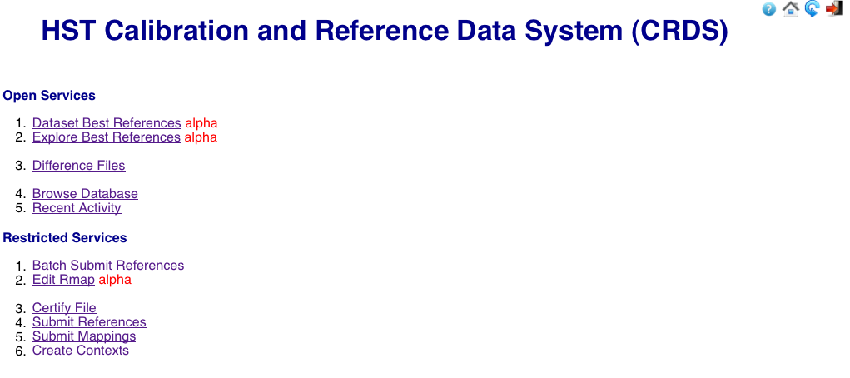
Website (home)
Informational
File Submission

Slide 25
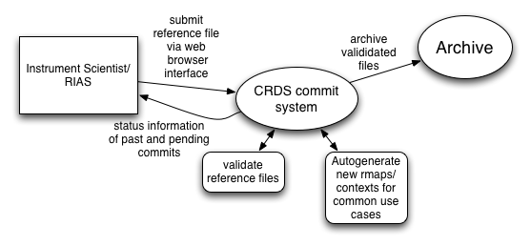
Committing Files to CRDS

Slide 26
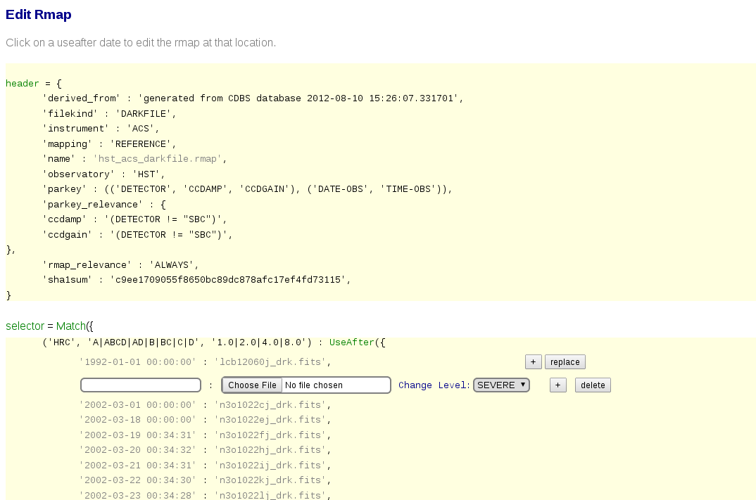
Rmap Editor
Predecessor to batch submission

Slide 27
Batch Submission
Intended for routine reference file submissions:
File replacements
Date specific insert/appends
Steps of File Submission
Upload new reference files for one type, e.g. MIRI DARK
Check new references
Allowed parameter values
FITS table mode coverage: mode additions and removals
Automatically update rules hierarchy
Insert / replace files in existing .rmap Match() cases
Currently limited to Match() -> UseAfter()
Update higher level contexts to refer to new rmaps
Present results for review and confirmation
Prototyped for HST build-2
Needs generalization to support all JWST Selectors

Slide 28
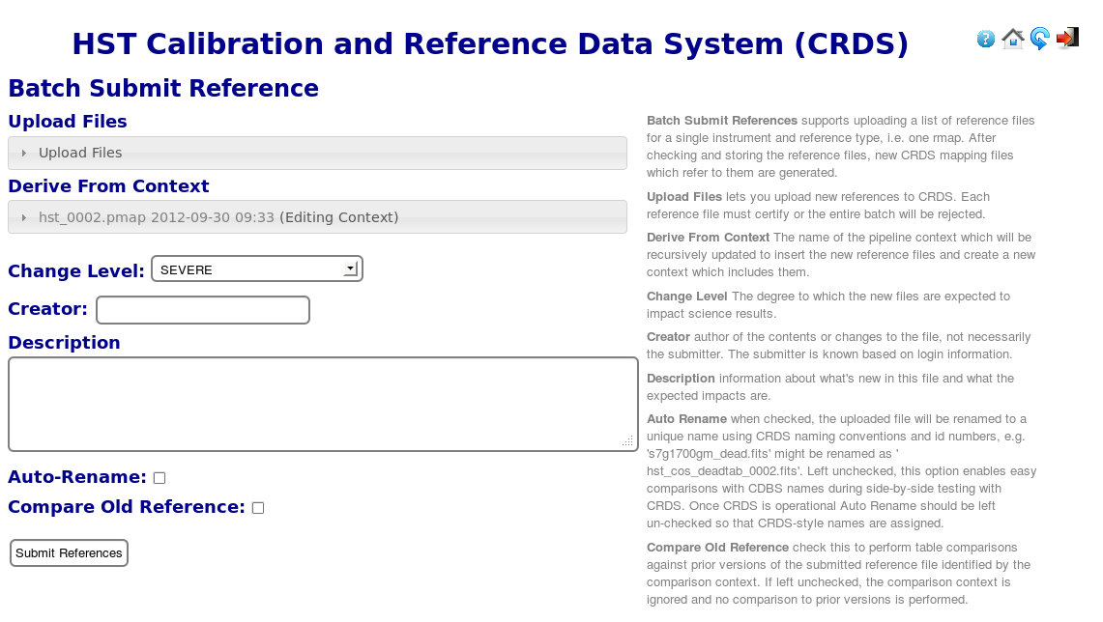
Batch Submission Inputs

Slide 29
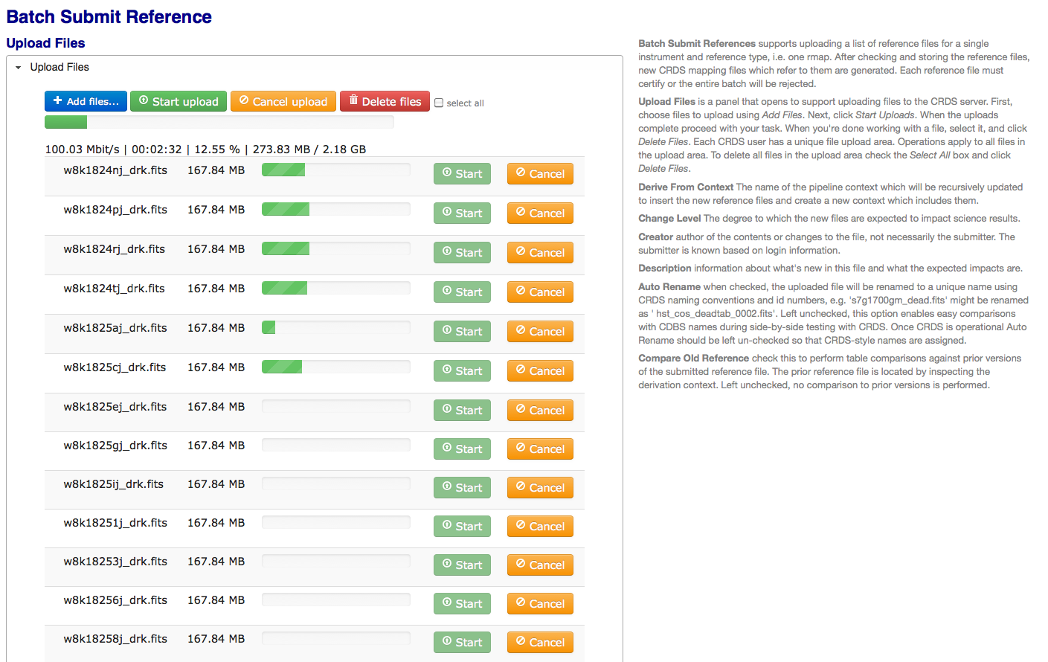
File Uploads
JWST references huge: some 4G – 64G file
Provides real time upload status
Robust selection of multiple files
Upload to ingest directory
Web view reflects file system
Also supports shell based file copies to ingest

Slide 30
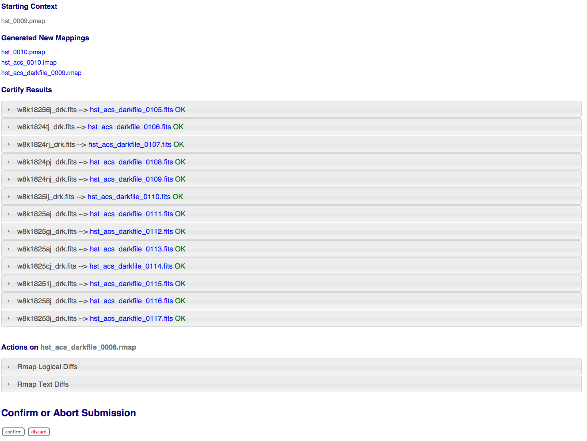
Submission Results (summary)

Slide 31
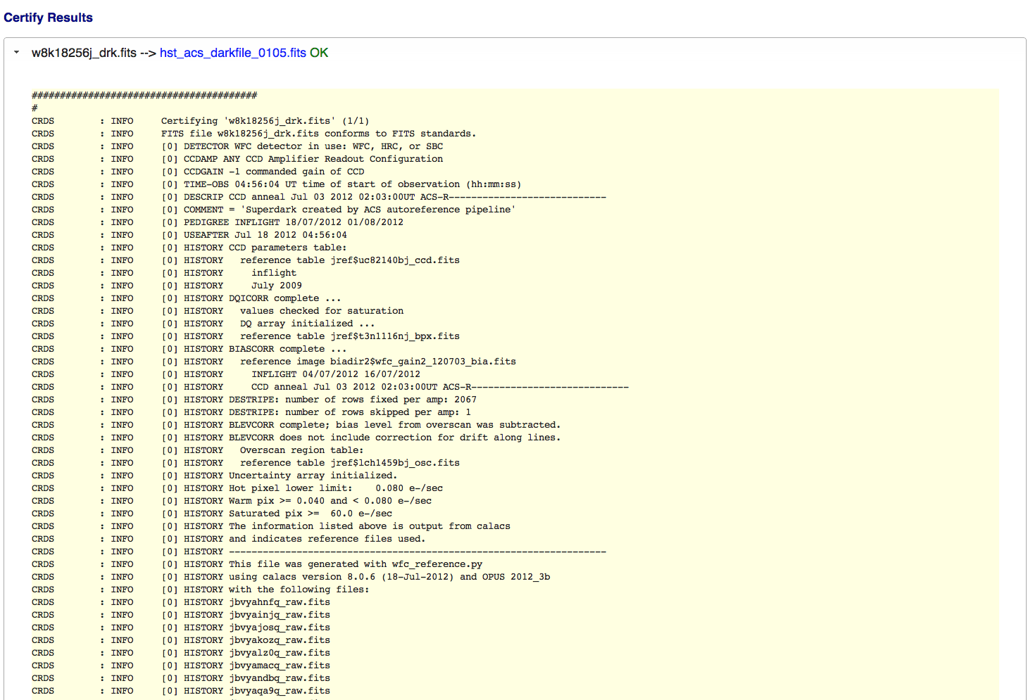
Submission Results (certify output)

Slide 32
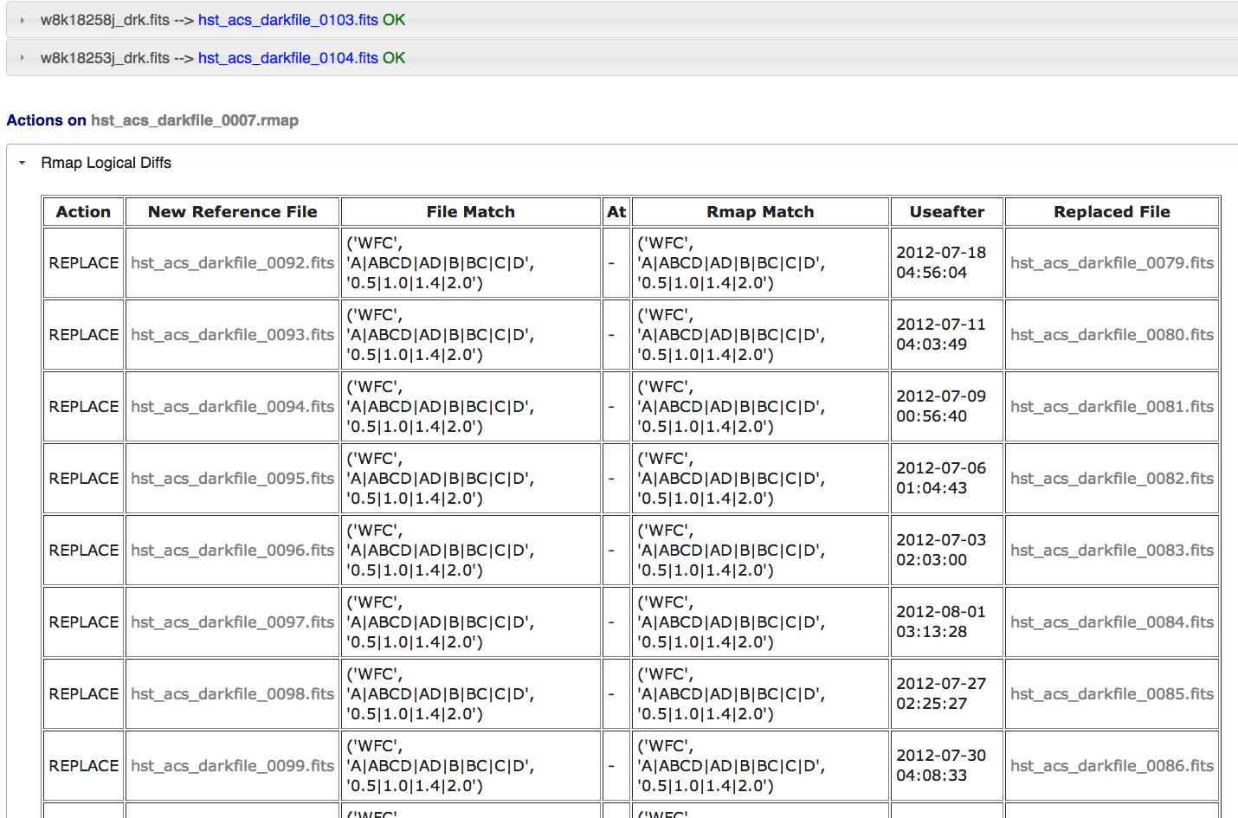
Submission Results (logical diffs)

Slide 33
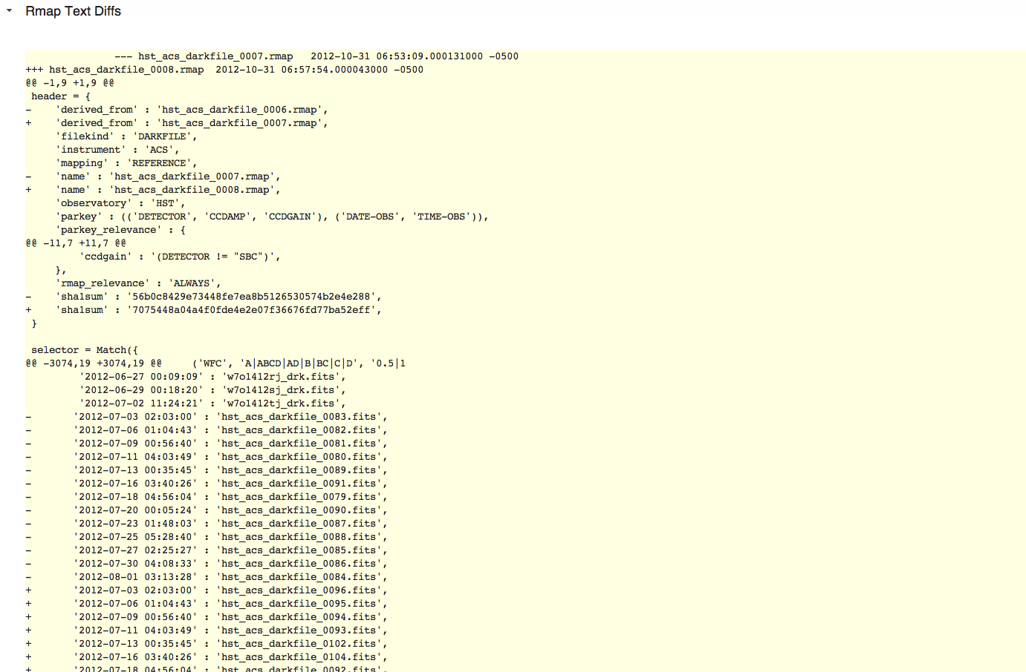
Submission Results (textual diffs)

Slide 34
Utilities divider
Utilities

Slide 35
Utilities Design
General Utilities (useful for more than one category)
Cache Synchronization (crds.sync)
synchronize local reference file directories to contain all reference files required by given list of pipeline contexts
Useful for Operations, WIT, and other projects (e.g., IDTs)
File Differencing (crds.diff)
Highlight all differences in rules and reference files between rmaps, instrument contexts or pipeline contexts
File Best References (crds.file_bestfrefs)
Determines best references for a data set FITS file and/or updates header
Database Best References (crds.db_bestrefs)
Determines best references based on catalog parameters and/or updates catalog

Slide 36
Utilities Design (cont 1)
Operational System Utilities
Reversion Detection (crds.reversions)
Detection of reversion of reference, rmap, or instrument context files when changing pipeline context
Prevents inadvertent undoing of previous updates by uncoordinated modifications
Affected Datasets (crds.reprocess)
Get list of datasets affected by pipeline context change
Identifies data sets needing reprocessing
One step beyond determining changed reference files:
Looks inside updated tables
Some tables have rows selected by additional criteria
When tables change, ignores differences in rows irrelevant to dataset
Considers severity of changes between reference file versions (moderate, severe, etc.)
Very difficult problem to do correctly and make practical
Awaiting well defined concept for how this should work before accepting as a requirement

Slide 37
Utilities Design (cont 2)
WIT Utilities
crds.uses
Which data sets or rules use a given reference file
file rejection
Mark reference file as bad, web function.
crds.matches
Show what selection criteria match a given reference file
crds.coverage
Show if an rmap update doesn’t cover the same cases as the previous rmap, or changes the set of selection criteria. Related to crds.diff
crds.info
Show current operational configuration
crds.certify
More sophisticated reference file comparison tool
E.g., capable of detecting insertions or deletions of rows in tables between two versions
Checks matching parameters for existence and valid values

Slide 38
Conclusion divider
Technologies, Progress, Schedule

Slide 39
S/W Technologies
Core Library
Python
Django-json-rpc (modified portions built into CRDS client)
Web Server
LAMP (Linux / Apache / MySQL / Python)
Django Python web framework
Javascript / jQuery
Django-json-rpc
Django-file-upload
HTML-5 for file access and uploads (Firefox, Chrome)

Slide 40
Completed Builds 1 & 2
Build-1 (January 2012)
Core best references library
Build-2 (September, November 2012)
Command Line
Integration with STPIPE
JWST build-1 rules and references
HST rules generation and test (for now)
HST file certification
Web
File browsing
File differencing
Interactive Web Best Reference prototypes
Simple File Submission
Batch File Submission (prototype, needs generalization)
Automatic Instrument, Pipeline Context Rules Updates
Reference File Retrieval Service

Slide 41
Future Builds 3 & 4
Build-3 (January 2013)
Web
Generalization of automatic rules updates to more Selector types.
Build-2 fixes and enhancements from feedback
Build-4 (April 2013)
Web
DMS-535 Ensure all files archived before use allowed
DMS-540 Web interface for querying what the best reference files are
Dataset Best References, Explore Best References, Service
Command line
DMS-545 Show which data sets in a list will use different references file due to changes in rules (crds.file_bestrefs)
DMS-547 Tool to show active reference files in use for given context(s) (crds.list)
DMS-548 Tool to show active files associated with specific instrument modes (crds.list)
HST-1 Detect file reversions on context change and supply warning (crds.reversions)
HST-2 Update local reference file directories with those needed by a context (or list of contexts) (crds.sync)
HST-4 Detect when new rule file doesn't cover modes covered in previous rule file
HST-15 Reject rules files with duplicate selection criteria for different files

Slide 42
Future Builds 5 & 6
Build-5 (July 2013)
HST-6 Ability to operate in parallel with CDBS
Build-6 (September 2013)
Web
DMS-543 Ability to mark reference file as bad (Set File Enable)
DMS-641 Ability to mark specific rule as bad (Set File Enable)
HST-11 User interface to display required selection criteria for type of reference file
HST-7 Ability to display current operations context
Command line
HST-3 Tool to list selection criteria that result in use of specified reference file (crds.matches)
HST-5 Tool to identify which datasets are affected by change in CRDS context (crds.db_bestrefs)
HST-9 FITS table comparison utility
HST-12 Tool to update dataset headers with appropriate reference file names (crds.file_bestrefs)
HST-13 Tool to compare selection criteria between versions of rules files (crds.diff)
HST-16 Tool to see if given dataset used different reference files than those recommended by given context (crds.db_bestrefs, crds.file_bestrefs)
HST-18 Tool to distribute text file to users that contain information on how reference files are selected
HST-19 Tool that indicates which instruments and modes are affected by a change in contexts or rules.

