Slide 1
Title Page
Calibration Reference Data System Design Todd Miller
Science Software Branch

Slide 2
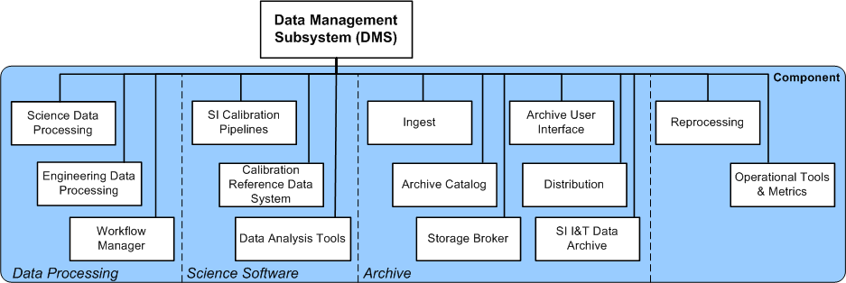
Calibration Pipeline Component
You are here

Slide 3
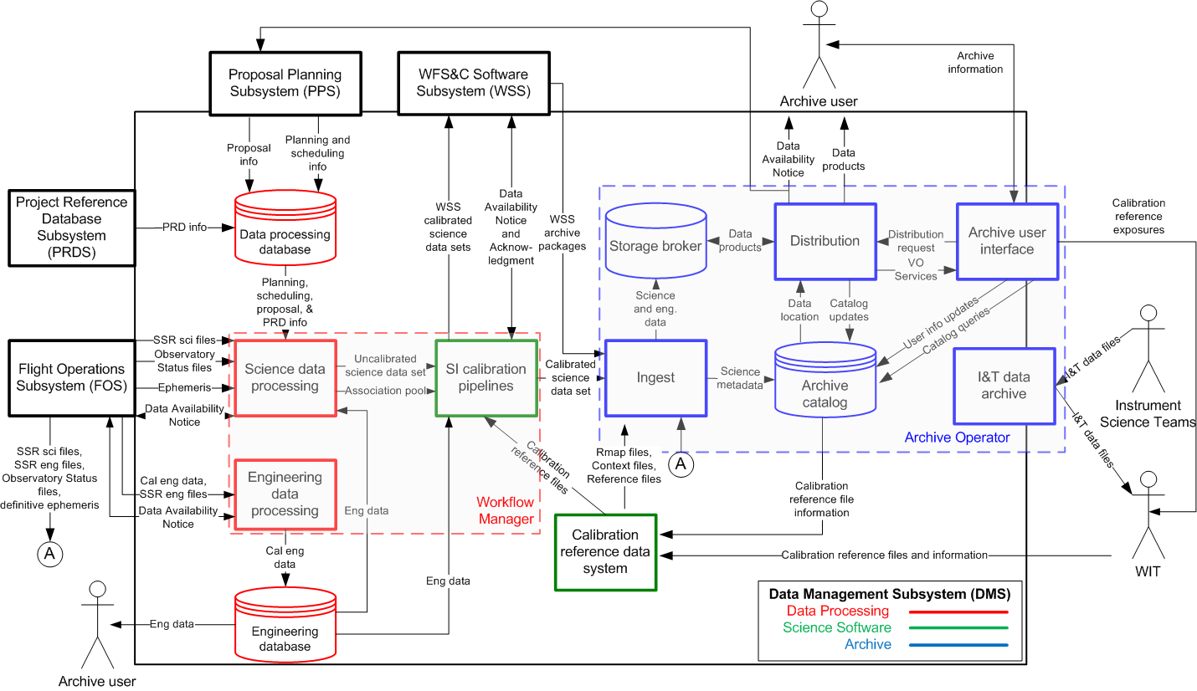
DMS Data Flow Diagram

Slide 4
CRDS Background (what it is)
Assigns reference files to specific datasets based on an instrument configuration and date.
CRDS is planned to replace CDBS for HST
CRDS is the baseline best reference system for JWST
Parallel schedule
JWST build-1 (Sept 2012) emphasizes best reference computation and file delivery. Directly integrated with pipeline.
HST CRDS build-2a (Sept 2012) emphasizes real HST rules
HST CRDS build-2b (Sept 2012) emphasizes web site new reference file submission process.
CRDS has generally common code between projects
Different rules hierarchies, instruments, types, parameters

Slide 5
CRDS Background (how it works)
CRDS Concept
Versioned text files (rules) replace CDBS database
Python( dataset, rules ) → best reference for dataset
Advantages:
Transparent: requires no database account or tool to view rules.
Repeatable: past results are determined by archived rules files
Core library is fast: O(100 bestrefs/sec) vs. O(1 bestref/sec)
Facilitates what-if processing
Facilitates exhaustive testing
Reprocesses ALL datasets for modern HST instruments < 1 hour.
Core library does not require network or database access to compute best references.
Use a web site to streamline new reference delivery tasks.
Offer best references as a web service.
Transparent delivery of needed reference files for JWST.

Slide 6
CRDS Rules File Hierarchy
Pipeline
Context
(.pmap)
Configuration entire system (versioned)
Instrument
Context
(.map)
Instrument
Context
(.map)
One per instrument (versioned)
One per instrument configuration (often dated)
Instrument
Context
(.imap)
Reference Files
(.fits)
Reference Files
(.fits)
Reference Files
(.fits)
Reference Files
(.fits)
Reference Files
(.fits)
Reference Files
(.fits)
Reference Files
(.fits)
Reference Files
(.fits)
Reference Files
(.fits)
Reference
Type Mapping
(.map)
Reference Files
(.fits)
Reference
Type Mapping
(.map)
Reference Files
(.fits)
Reference Files
(.fits)
Reference
Type Mapping
(.map)
Reference Files
(.fits)
Reference Files
(.fits)
One per reference type (versioned)
(~ Pipeline Step)
Reference
Type Mapping
(.map)
Reference Files
(.fits)
Reference Files
(.fits)
Reference
Type Mapping
(.map)
Reference
Type Mapping
(.rmap)
Reference Files
(.fits)
Reference Files
(.fits)
Reference
Type Mapping
(.map)
Reference Files
(.fits)
Reference
Type Mapping
(.map)
Reference Files
(.fits)
Reference
Type Mapping
(.rmap)
Reference Files
(.fits)
Reference Files
(.fits)

Slide 7
Pipeline Context (jwst_0000.pmap)
For all instruments
header = {
'derived_from' : 'cloning tool 0.03b (2012-09-11)',
'description' : 'rules from clone_directive.txt',
'mapping' : 'PIPELINE',
'name' : 'jwst_0000.pmap',
'observatory' : 'JWST',
'parkey' : ('META.INSTRUMENT.TYPE',),
'sha1sum' : '57523113da9ca4493e54ebe87d8621d9581d706b',
}
selector = {
'FGS' : 'jwst_fgs_0000.imap',
'MIRI' : 'jwst_miri_0000.imap',
'NIRCAM' : 'jwst_nircam_0000.imap',
'NIRISS' : 'jwst_niriss_0000.imap',
'NIRSPEC' : 'jwst_nirspec_0000.imap',
}
Pipeline Context files, like all CRDS mapping files, has a versioned name.
One Pipeline Context file (and the set of referred mappings) defines the configuration of CRDS, replacing the state of the CDBS database,

Slide 8
Instrument Context (jwst_miri_0000.imap)
For all reference types of MIRI
header = {
'derived_from' : 'cloning tool 0.03b (2012-09-11)',
'instrument' : 'MIRI',
'mapping' : 'INSTRUMENT',
'name' : 'jwst_miri_0000.imap',
'observatory' : 'JWST',
'parkey' : ('REFTYPE',),
'sha1sum’: '08e984a020ad8b617904b6bf18c6a1864f365270',
}
selector = {
'AMPLIFIER' : 'jwst_miri_amplifier_0000.rmap',
'DARK' : 'jwst_miri_dark_0000.rmap',
'FLAT' : 'jwst_miri_flat_0000.rmap',
'LINEARITY' : 'jwst_miri_linearity_0000.rmap',
'MASK' : 'jwst_miri_mask_0000.rmap',
'PHOTOM' : 'jwst_miri_photom_0000.rmap',
}

Slide 9
Reference Mapping (jwst_miri_dark_0000.rmap)
Matching MIRI DARK to specific reference files
header = {
'derived_from' : 'cloning tool 0.03b (2012-09-11)',
'filekind' : 'DARK',
'instrument' : 'MIRI',
'mapping' : 'REFERENCE',
'name' : 'jwst_miri_dark_0000.rmap',
'observatory' : 'JWST',
'parkey' : (('META.INSTRUMENT.DETECTOR', 'META.INSTRUMENT.FILTER', 'META.EXPOSURE.READPATT'),),
'sha1sum' : '2535d3be806c6e7f5f0da1f2dce64034f9028ddc',
}
selector = Match({
('MIRIFULONG', 'ANY', 'FAST') : 'jwst_miri_dark_0000.fits',
('MIRIFULONG', 'ANY', 'SLOW') : 'jwst_miri_dark_0001.fits',
('MIRIFUSHORT', 'ANY', 'FAST') : 'jwst_miri_dark_0002.fits',
('MIRIFUSHORT', 'ANY', 'SLOW') : 'jwst_miri_dark_0003.fits',
('MIRIMAGE', 'ANY', 'FAST') : 'jwst_miri_dark_0004.fits',
('MIRIMAGE', 'ANY', 'SLOW') : 'jwst_miri_dark_0005.fits',
})

Slide 10
Selectors
CRDS reference matching is done with a nested hierarchy of “Selectors”
The universal Selector pattern for HST is:
Match → UseAfter
This emulates the SQL queries of CDBS
Good for automated rmap generation from CDBS database
Baseline rules for JWST only Match() but will evolve.
When choose()’ing each Selector either:
Returns a simple string.
Locates a nested Selector and returns the choice from that.
Basic Selectors (emulate CDBS)
Match
UseAfter
Other Selectors (new possibilities)
SelectVersion, ClosestTime, GeometricallyNearest
Bracket

Slide 11
Selectors Nest
header = {
'derived_from' : 'generated from CDBS database 2012-10-24 17:13:14.151232',
'filekind' : 'DARKFILE',
'instrument' : 'STIS',
'mapping' : 'REFERENCE',
'name' : 'hst_stis_darkfile.rmap',
'observatory' : 'HST',
'parkey' : (('DETECTOR', 'CCDAMP', 'CCDGAIN'), ('DATE-OBS', 'TIME-OBS')),
}
selector = Match({
('CCD', 'A|B|C|D', '1|2|4|8') : UseAfter({
'1996-10-01 00:00:00' : 'h1v1208eo_drk.fits',
'1997-03-03 00:00:00' : 'hcg1440so_drk.fits',
'1997-03-13 00:00:00' : 'hcg1440to_drk.fits',
'1997-03-21 00:00:00' : 'hcg14410o_drk.fits',
'1997-03-24 00:00:00' : 'hcg14411o_drk.fits',
'1997-04-14 00:00:00' : 'hcg14412o_drk.fits',
'1997-04-29 00:00:00' : 'hcg1452lo_drk.fits',
'1997-05-05 00:00:00' : 'hcg14537o_drk.fits',
'1997-05-12 00:00:00' : 'hcg14538o_drk.fits',
'1997-05-19 00:00:00' : 'hcg14539o_drk.fits',
}),
(‘CCD’, ‘AC’, ‘16’) : UseAfter({
'1997-04-14 00:00:00' : 'hcg14712p_drk.fits',
'1997-04-29 00:00:00' : 'hcg14529q_drk.fits',
}),
….
Match
(instrument configuration)
UseAfter
(exposure date)

Slide 12
Match() Selector
Generally .rmap’s match several different instrument configurations
Each Match() has multiple choices
Each choice matches on several parameter patterns:
(’ABCD’, ‘*’, ‘1|2|3’, 1)
(’A|B|C’, ‘foo’, ‘4’, 1)
(‘N/A’, ‘bar’, ‘1|3’, 1)
Match() selectors “winnow” parameter-by-parameter over all choices:
Negative logic: discard what cannot be a match, return survivor
For each parameter of match:
For each surviving choice of match:
If choice does not match the dataset parameter:
Remove choice from possible solutions
Reduce surviving choices to a single choice
Choose highest weight choices first
Merge equal weight choices if needed/allowed (emulate CDBS)

Slide 13
Match() Parameter Expressions
Each Match() choice can specify multiple parameters
(’ABCD’, ‘*’, ‘1|2|3’, ‘N/A’, 1)
Individual parameters can be specified in several forms:
Parkey Expression Type | Example | Delta-Weight | Matches (e.g.)
Simple | 42 | +1 | 42
Glob | “*” “F*22” | +1 | “Anything” “FW122”
OR | “A|B|C|D” “1|2|3” | +1 | “B”
N/A | “N/A” | +0 | “Anything”

Slide 14
Matching details
Regular expression matching
Most parameter matchers in CRDS use regexes
All parameters are matched as strings
All numbers matched internally as standard format float strings
Generally case-insensitive, matched as upper case
Special value: N/A
Enables parameters to be ignored for a particular mode.
Always survives winnowing
Adds nothing to match weight.
Can be specified in Rmaps
Can be specified in Dataset headers

Slide 15
Changes Since Last Year
Best References
Integration with stpipe
Interface to CRDS common across all stpipe Steps
Calls crds.getreferences()
Stpipe command line overrides for reference files
Use STPIPE data model vocabulary for JWST CRDS rules
JSONRPC service also supports FITS keywords and maps to data model
Elaboration of CRDS client configurations
Instrument Specific Lookup Hooks
Relevance Expressions (Rmap, Parkey)
File Submission Refinements
Rmap Editing
Batch Submission
HST Catalog driven best reference testing
CRDS matches all CDBS recommendations: ~100%

Slide 16
Changes Since Last Year (cont)
Archiving
CRDS handles unique file naming
Rules
References
CRDS has local file storage for rules and references
Necessary for CRDS development and early STPIPE operations.
Storage space is not a short term issue

Slide 17
Relevance Expressions
Added to support HST, emulating CDBS
Rmap Relevance
Define when reference types don’t apply to a dataset
Provide a clear distinction between lookup errors and when results are not applicable at all.
Parkey Relevance
Sometimes not all parameters apply to all modes of a type.
Based on other parameters
In CDBS, some parameters are omitted from bestref SQL query
In CRDS, the same parameters are mapped to N/A before matching

Slide 18
Rmap Relevance
header = {
’filekind' : 'CCDTAB',
'instrument' : 'ACS',
'mapping' : 'REFERENCE',
'parkey' : (('DETECTOR',), ('DATE-OBS', 'TIME-OBS')),
'rmap_relevance' : '(DETECTOR != "SBC")',
}
selector = Match({
('HRC',) : UseAfter({
'1991-01-01 00:00:00' : 'j4d1435kj_ccd.fits',
'1992-01-01 00:00:00' : 'm711125gj_ccd.fits',
}),
('WFC',) : UseAfter({
'1991-01-01 00:00:00' : 'lch1556bj_ccd.fits',
'1992-01-01 00:00:00' : 'm1e1043gj_ccd.fits',
'2001-03-01 00:00:00' : 'm2j1057qj_ccd.fits’,
}),
})
Reference required
for this dataset?
or N/A?
Not all reference types are relevant to all instrument modes
If DETECTOR == “SBC” then reference type CCDTAB is N/A
Added for HST, useful in general
Prevents conflating irrelevant results with errors
Resolves ambiguity in testing

Slide 19
Parykey Relevance
header = {
'filekind' : 'DARKFILE',
'instrument' : 'STIS',
'mapping' : 'REFERENCE',
'parkey' : (('DETECTOR', 'CCDAMP', 'CCDGAIN'), ('DATE-OBS', 'TIME-OBS')),
'parkey_relevance' : {
'ccdamp' : '(DETECTOR == "CCD")',
'ccdgain' : '(DETECTOR == "CCD")',
},
}
selector = Match({
('CCD', 'A|B|C|D', '1|2|4|8') : UseAfter({
'1996-10-01 00:00:00' : 'h1v1208eo_drk.fits',
'1997-03-03 00:00:00' : 'hcg1440so_drk.fits',
'1997-03-13 00:00:00' : 'hcg1440to_drk.fits',
'1997-03-21 00:00:00' : 'hcg14410o_drk.fits',
'1997-03-24 00:00:00' : 'hcg14411o_drk.fits',
'1997-04-14 00:00:00' : 'hcg14412o_drk.fits',
'1997-04-29 00:00:00' : 'hcg1452lo_drk.fits',
'1997-05-05 00:00:00' : 'hcg14537o_drk.fits',
'1997-05-12 00:00:00' : 'hcg14538o_drk.fits',
'1997-05-19 00:00:00' : 'hcg14539o_drk.fits',
Does parameter matter
for this dataset / mode
or N/A?
Modifies incoming matching parameters
If DETECTOR != “CCD” then CCDAMP := N/A
Prevents irrelevant parameter values from affecting matching:
During best reference lookups
During automatic rules updates

Slide 20
Cache Configurations divider
Cache Configurations
And
File Service

Slide 21
Server Side File Supply
Transparent file delivery in STPIPE w/ CRDS client/server
Files are cached client-side to avoid repeat network transfers
Two protocols supported in client and server
HTTP GET
Actual file transfer can be redirected to any server, e.g. DMS Archive
Probably fastest
JSONRPC
File delivery restricted to CRDS Django server
Simple tunneling to a single non-public server
Network fallback mode supports “server-less mode”
CRDS Browse-able File Access
Browse reference metadata and CRDS rules
Browse-able best references
Download links
Per-file Reference or Rules links
Intended for single file basic access only
CRDS serves or redirects references and rules files only: no datasets
Redirect to DMS archive for high load file delivery using HTTP GET

Slide 22
Client/Server
Input Dataset
STPIPE
Default context
CRDS Server
JSONRPC
Rules Files
Web Functions
Master
Reference
File Cache
Working Set
Cache
Dataset Parameters
Best References
CRDS
CRDS
Best Reference Files
Calibrated Dataset
% setenv CRDS_PATH $HOME/crds
% setenv CRDS_SERVER_URL http://jwst-crds.stsci.edu

Slide 23
Client/Server With Archive
Input Dataset
STPIPE
Default context
CRDS Server
Rules Files
JSONRPC
Working Set
Cache
Dataset Parameters
Web Functions
Best Reference Names
Get reference file
CRDS
CRDS
HTTP Redirect
Archived
Rules &
References
Best Reference File Data
HTTP GET
Archive
Calibrated Dataset
% setenv CRDS_PATH $HOME/crds
% setenv CRDS_SERVER_URL http://jwst-crds.stsci.edu

Slide 24
Remote Fallback (laptop mode)
Input Dataset
User
STPIPE
Pre-synced
User
Cache
References,
Rules,
Default Context
CRDS
Best References
Calibrated Dataset
% setenv CRDS_PATH $HOME/crds
% setenv CRDS_SERVER_URL http://not-a-crds-server.stsci.edu

Slide 25
Server-less Configuration
Works by equating user and server file caches
All users share master read-only file cache with server
All user file cache fetches automatically “hit”
Same CRDS core library used in STPIPE and CRDS Server
Best references are computed directly by the stpipe process calling a local CRDS library function
Requires access to Central Store /grp/crds/jwst
Only one copy of reference files needed
The server does not have to be running

Slide 26
Server-less Configuration
Input Dataset
STPIPE
CRDS Server
JSONRPC
Default context
Master
CRDS
Cache
Default context
/grp/crds/jwst
Web Functions
Rules Files
Rules Files
Reference Files
Reference Files
CRDS
Best References
CRDS
optional
Calibrated Dataset
% setenv CRDS_PATH /grp/crds/jwst
% setenv CRDS_SERVER_URL http://not-a-crds-server.stsci.edu

Slide 27
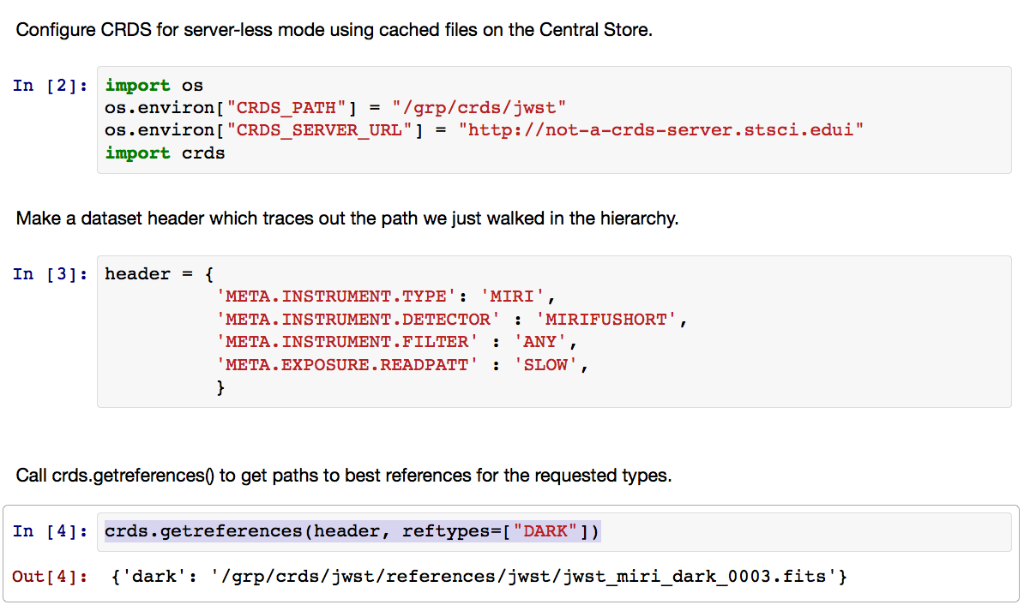
Calling getreferences()

Slide 28
JSON-RPC Services
Language agnostic JSON-RPC 1.0 access is defined for
Getting the default context
Getting best reference filenames for a parameter set
Getting reference or rules files by name
Simple CRDS HTTP GET
Mostly control oriented: blocks distribution of “rejected” files
Redirects to DMS Archive for high throughput data transport
http://jwst-crds.stsci.edu/get/<filename>

Slide 29
Web Reference File Submission
Web File
Browsing and
Submission

Slide 30
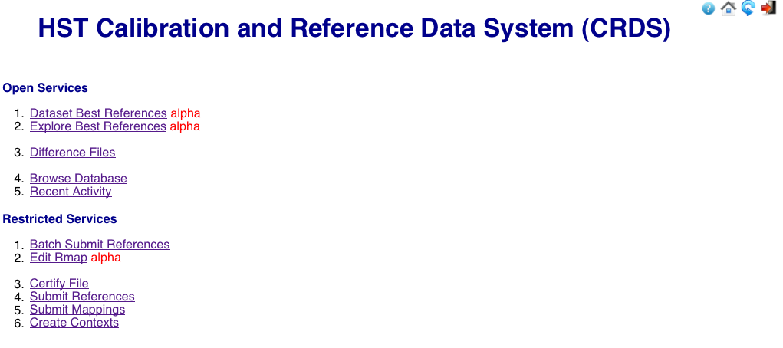
Website (home)
Informational
File Submission

Slide 31
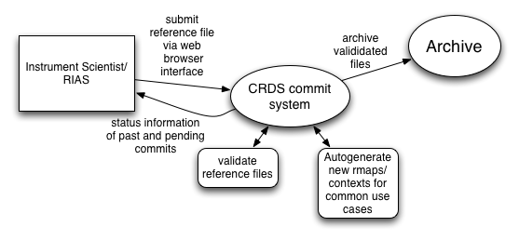
Committing Files to CRDS

Slide 32
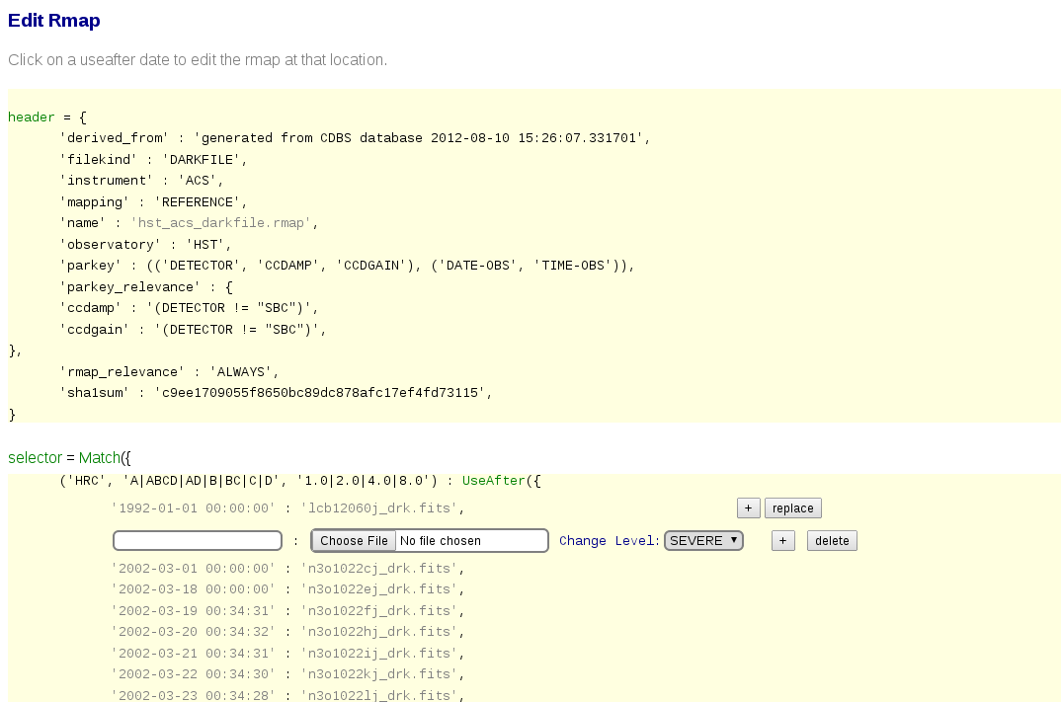
Rmap Editor
Predecessor to batch submission

Slide 33
Batch Submission
Intended for routine reference file submissions:
File replacements
Date specific insert/appends
Steps of File Submission
Upload new reference files for one type, e.g. MIRI DARK
Check new references
Allowed parameter values
FITS table mode coverage: mode additions and removals
Automatically update rules hierarchy
Insert / replace files in existing .rmap Match() cases
Currently limited to Match() -> UseAfter()
Automatically regenerate higher level contexts
Present results for review and confirmation
Currently finishing HST prototype
Needs generalization to support all JWST Selectors

Slide 34
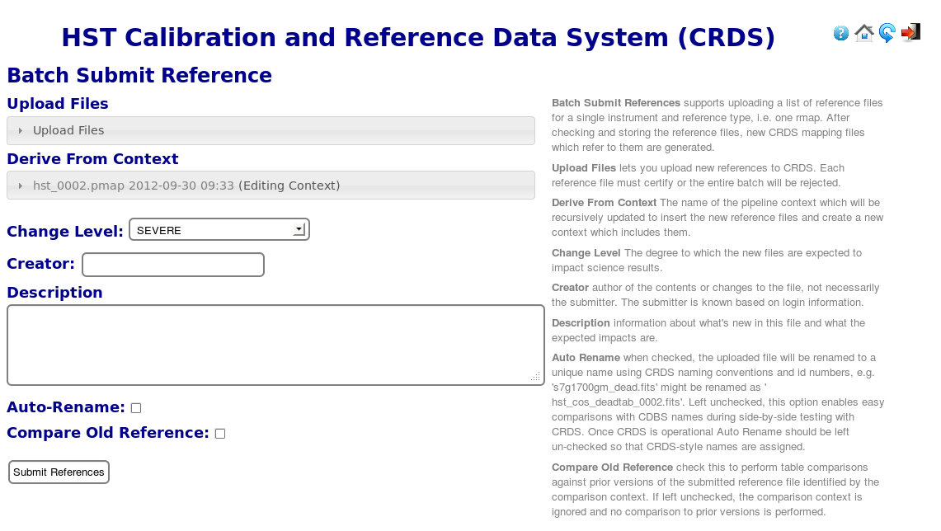
Batch Submission Inputs

Slide 35
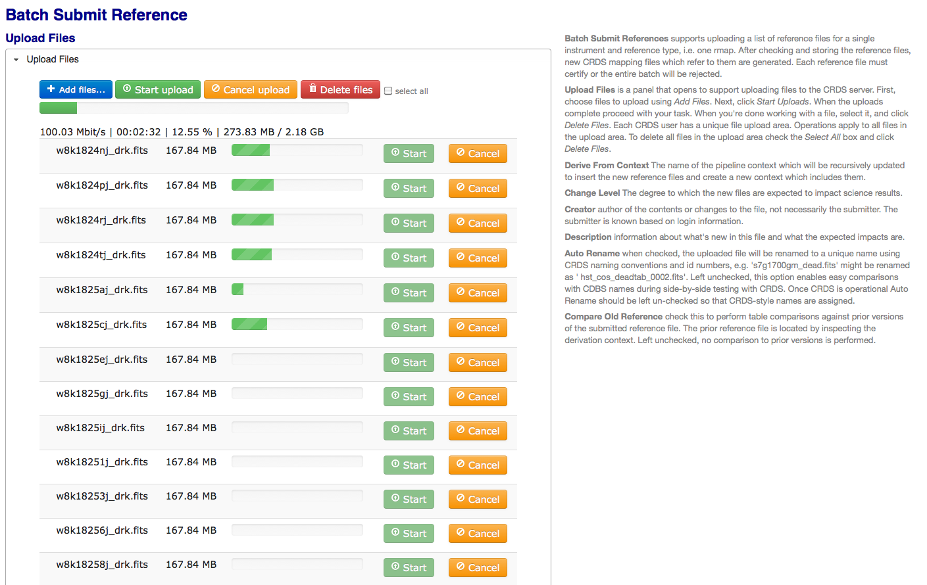
File Uploads
JWST references huge: some 4G – 64G file
Provides real time upload status
Robust selection of multiple files
Upload to ingest directory
Web view reflects file system
Also supports shell based file copies to ingest

Slide 36
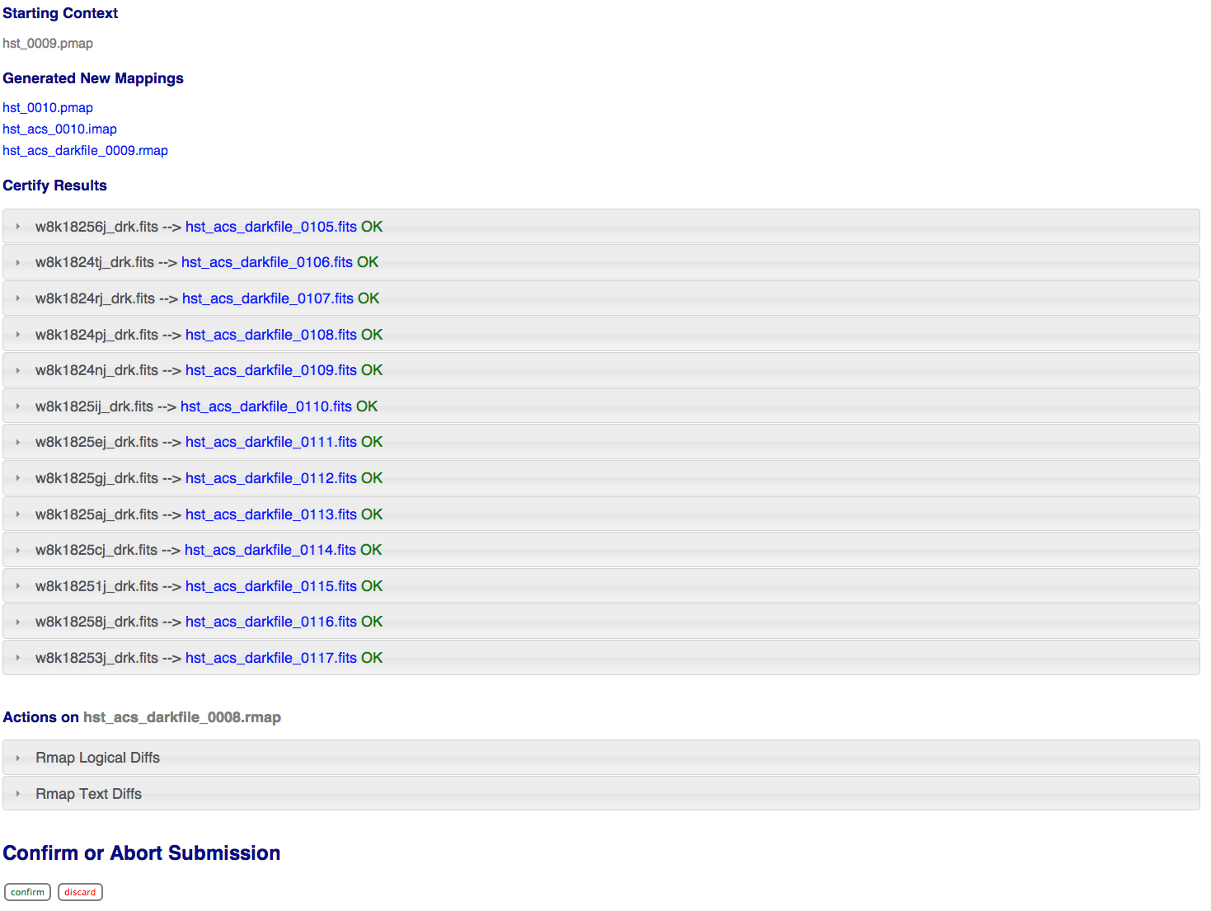
Submissions Results (summary)

Slide 37
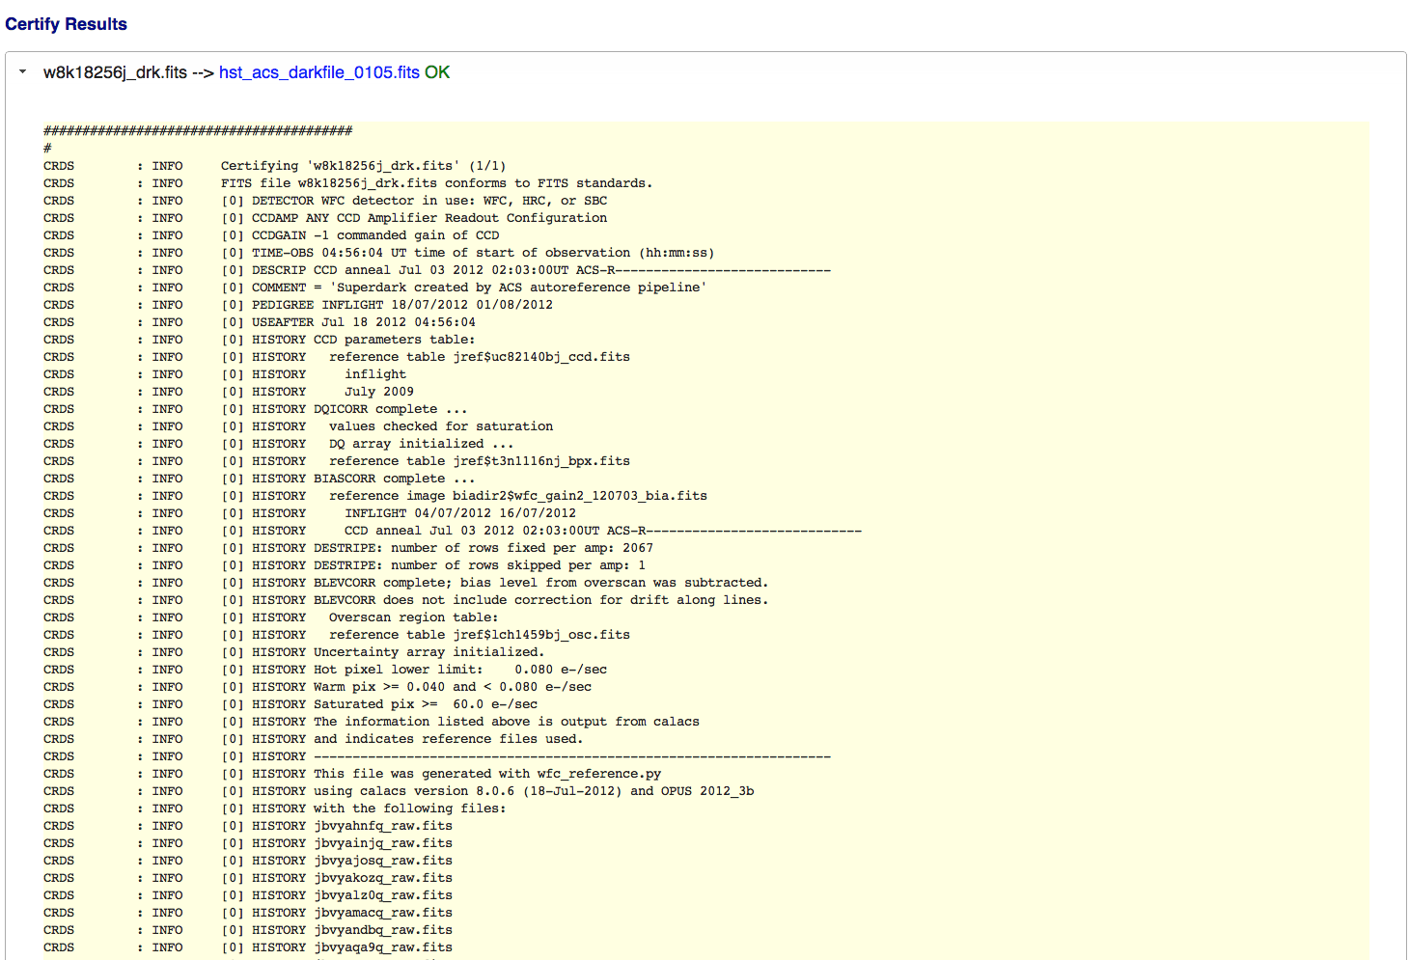
Submission Results (certify output)

Slide 38
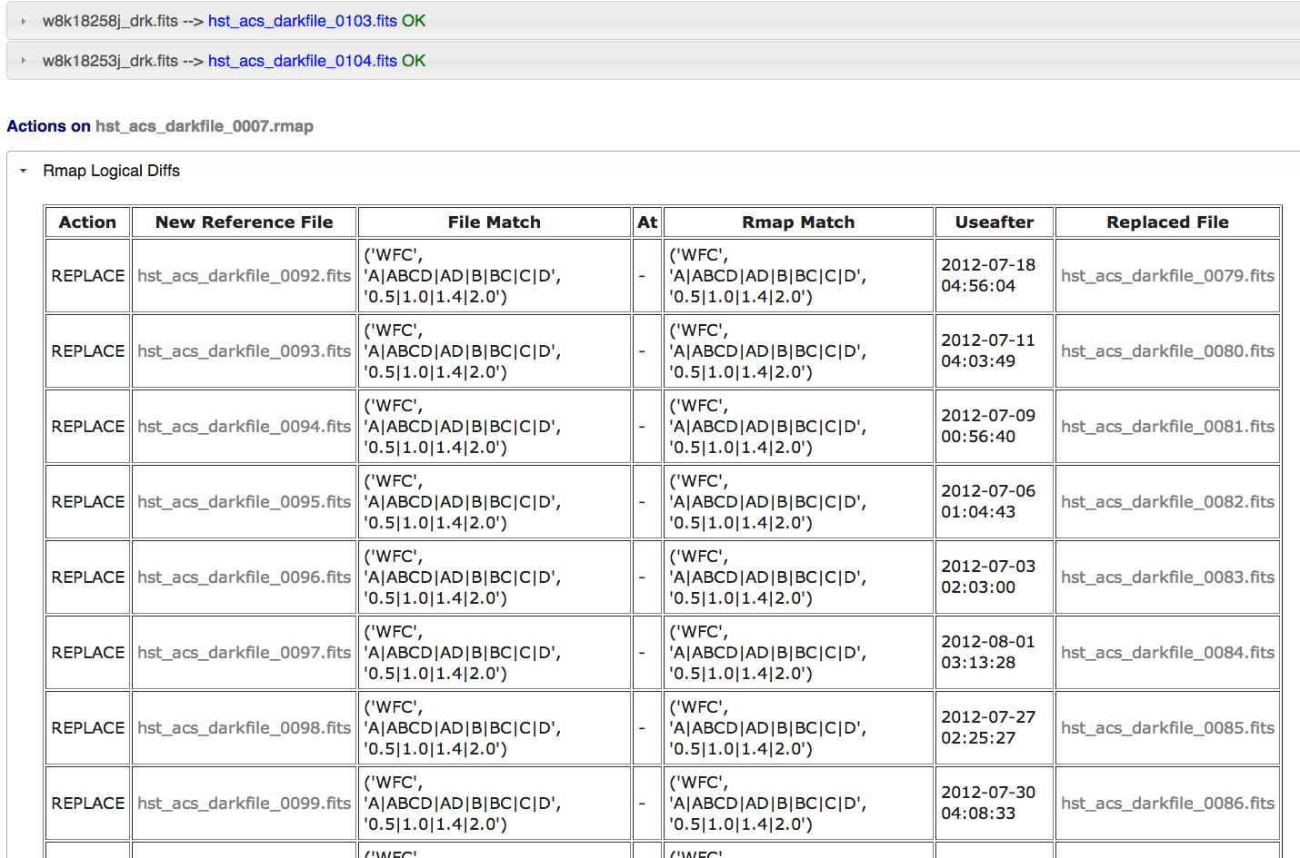
Submission Results (logical diffs)

Slide 39
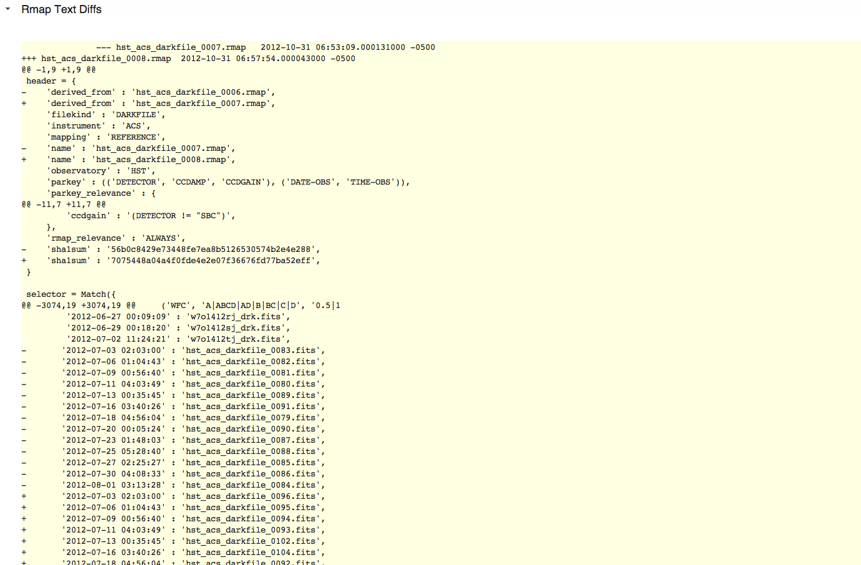
Submission Results (textual diffs)

Slide 40
Utilities divider
Utilities

Slide 41
Utilities Design
(Not a complete list)
General Utilities (useful for more than one category)
Cache Synchronization (crds.sync)
synchronize local reference file directories to contain all reference files required by given list of pipeline contexts
Useful for Operations, WIT, and other projects (e.g., IDTs)
File Differencing (crds.diff)
Highlight all differences in rules and reference files between rmaps, instrument contexts or pipeline contexts
File Best References (crds.file_bestfrefs)
Determines best references for a data set FITS file and/or updates header
Database Best References (crds.db_bestrefs)
Determines best references based on catalog parameters and/or updates catalog

Slide 42
Utilities Design (cont 1)
Operational System Utilities
Reversion Detection
Detection of reversion of reference, rmap, or instrument context files when changing pipeline context
Prevents inadvertent undoing of previous updates by uncoordinated modifications
Affected Datasets
Get list of datasets affected by pipeline context change
Useful for identifying data sets needing reprocessing
Design Issue: Some table reference files have rows selected by additional selection criteria. A change to the file does not necessarily affect all data sets that use that reference table. This utility must examine the contents of these tables to determine which data sets are affected (and store the selection criteria for the rows in rmaps for this utility to use in doing such checks)
Design Issue: Selection based on severity of change of reference file change. Some desire the ability of selecting only data sets for which the change in reference files is considered to be above some specified threshold (e.g., moderate, or severe).
Very difficult problem to do correctly and make practical
Awaiting well defined concept for how this should work before accepting as a requirement

Slide 43
Utilities Design (cont 2)
WIT Utilities
crds.uses
What data sets or contexts use a given reference file
file rejection
Mark reference file as bad, web function.
crds.matches
Show what selection criteria match a given reference file
Coverage
Show if an rmap update doesn’t cover the same cases as the previous rmap, or changes the set of selection criteria. Related to crds.diff
crds.info
Show current operational configuration
crds.certify
More sophisticated reference file comparison tool
E.g., capable of detecting insertions or deletions of rows in tables between two versions

Slide 44
Conclusion divider
Technologies, Progress, Schedule

Slide 45
S/W Technologies
Core Library
Python
Django-json-rpc (modified portions built into CRDS client)
Web Server
LAMP (Linux / Apache / MySQL / Python)
Django Python web framework
Javascript / jQuery
Django-json-rpc
Django-file-upload
HTML-5 for file access and uploads (Firefox, Chrome)

Slide 46
Completed So Far
Core best references library
Integration with STPIPE
HST rules generation (for now)
HST rules testing (for now)
HST file certification
JWST build-1 rules and references
File browsing
Web Best Reference prototypes
File differencing
Simple File Submission
Batch File Submission (prototype, needs generalization)
Instrument, Pipeline Context Updates
Reference File Retrieval Service

Slide 47
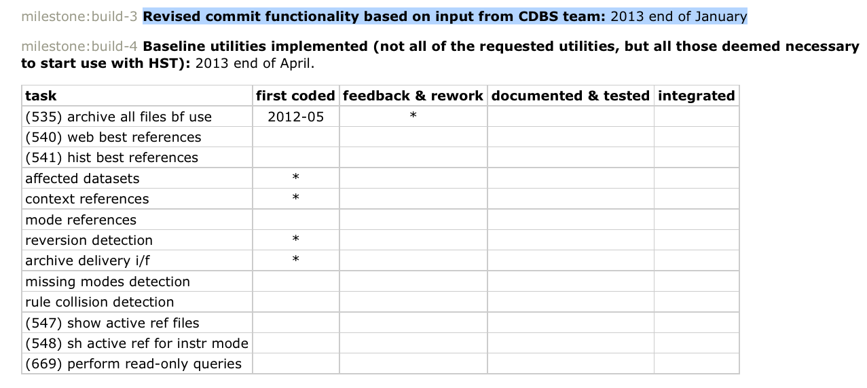
Schedule

Slide 48
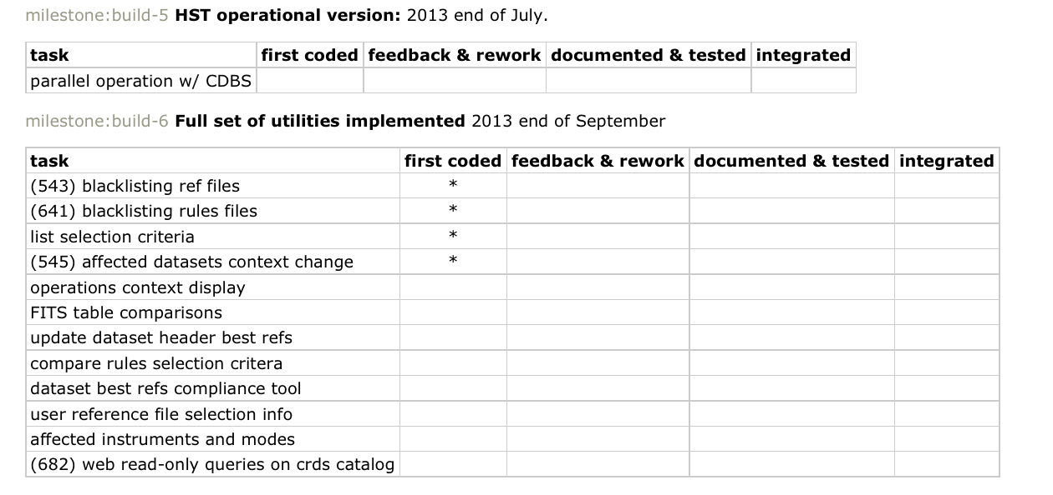
Schedule

