Slide 1



Jason Hunter
Online Store Project

Slide 2
Online Store Summary
The online store is an application that allows clients to browse products as a guest. A user can sign up or sign in to further access the store. When signed in a user can become a vip member, manage their wishlist, view products, and purchase the product. When a user is an admin they are able to manage users and products to ensure the end user’s experience is of utmost quality.

Slide 3
Epic <As a> user <I want to> become a vip <So That> I can access vip features

Slide 4

<As a> user, <I want to> pay to become a vip <so that> I can access vip features

Slide 5

<As a> user, <I want to> use a vip membership <so that> I can get a flat discount

Slide 6
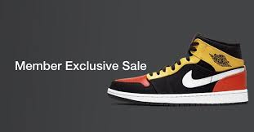
<As a> user, <I want to> access special deals <so that> I can save money

Slide 7
Epic <As a> user <I want to> have a wishlist <so that> I can save items for a later date

Slide 8
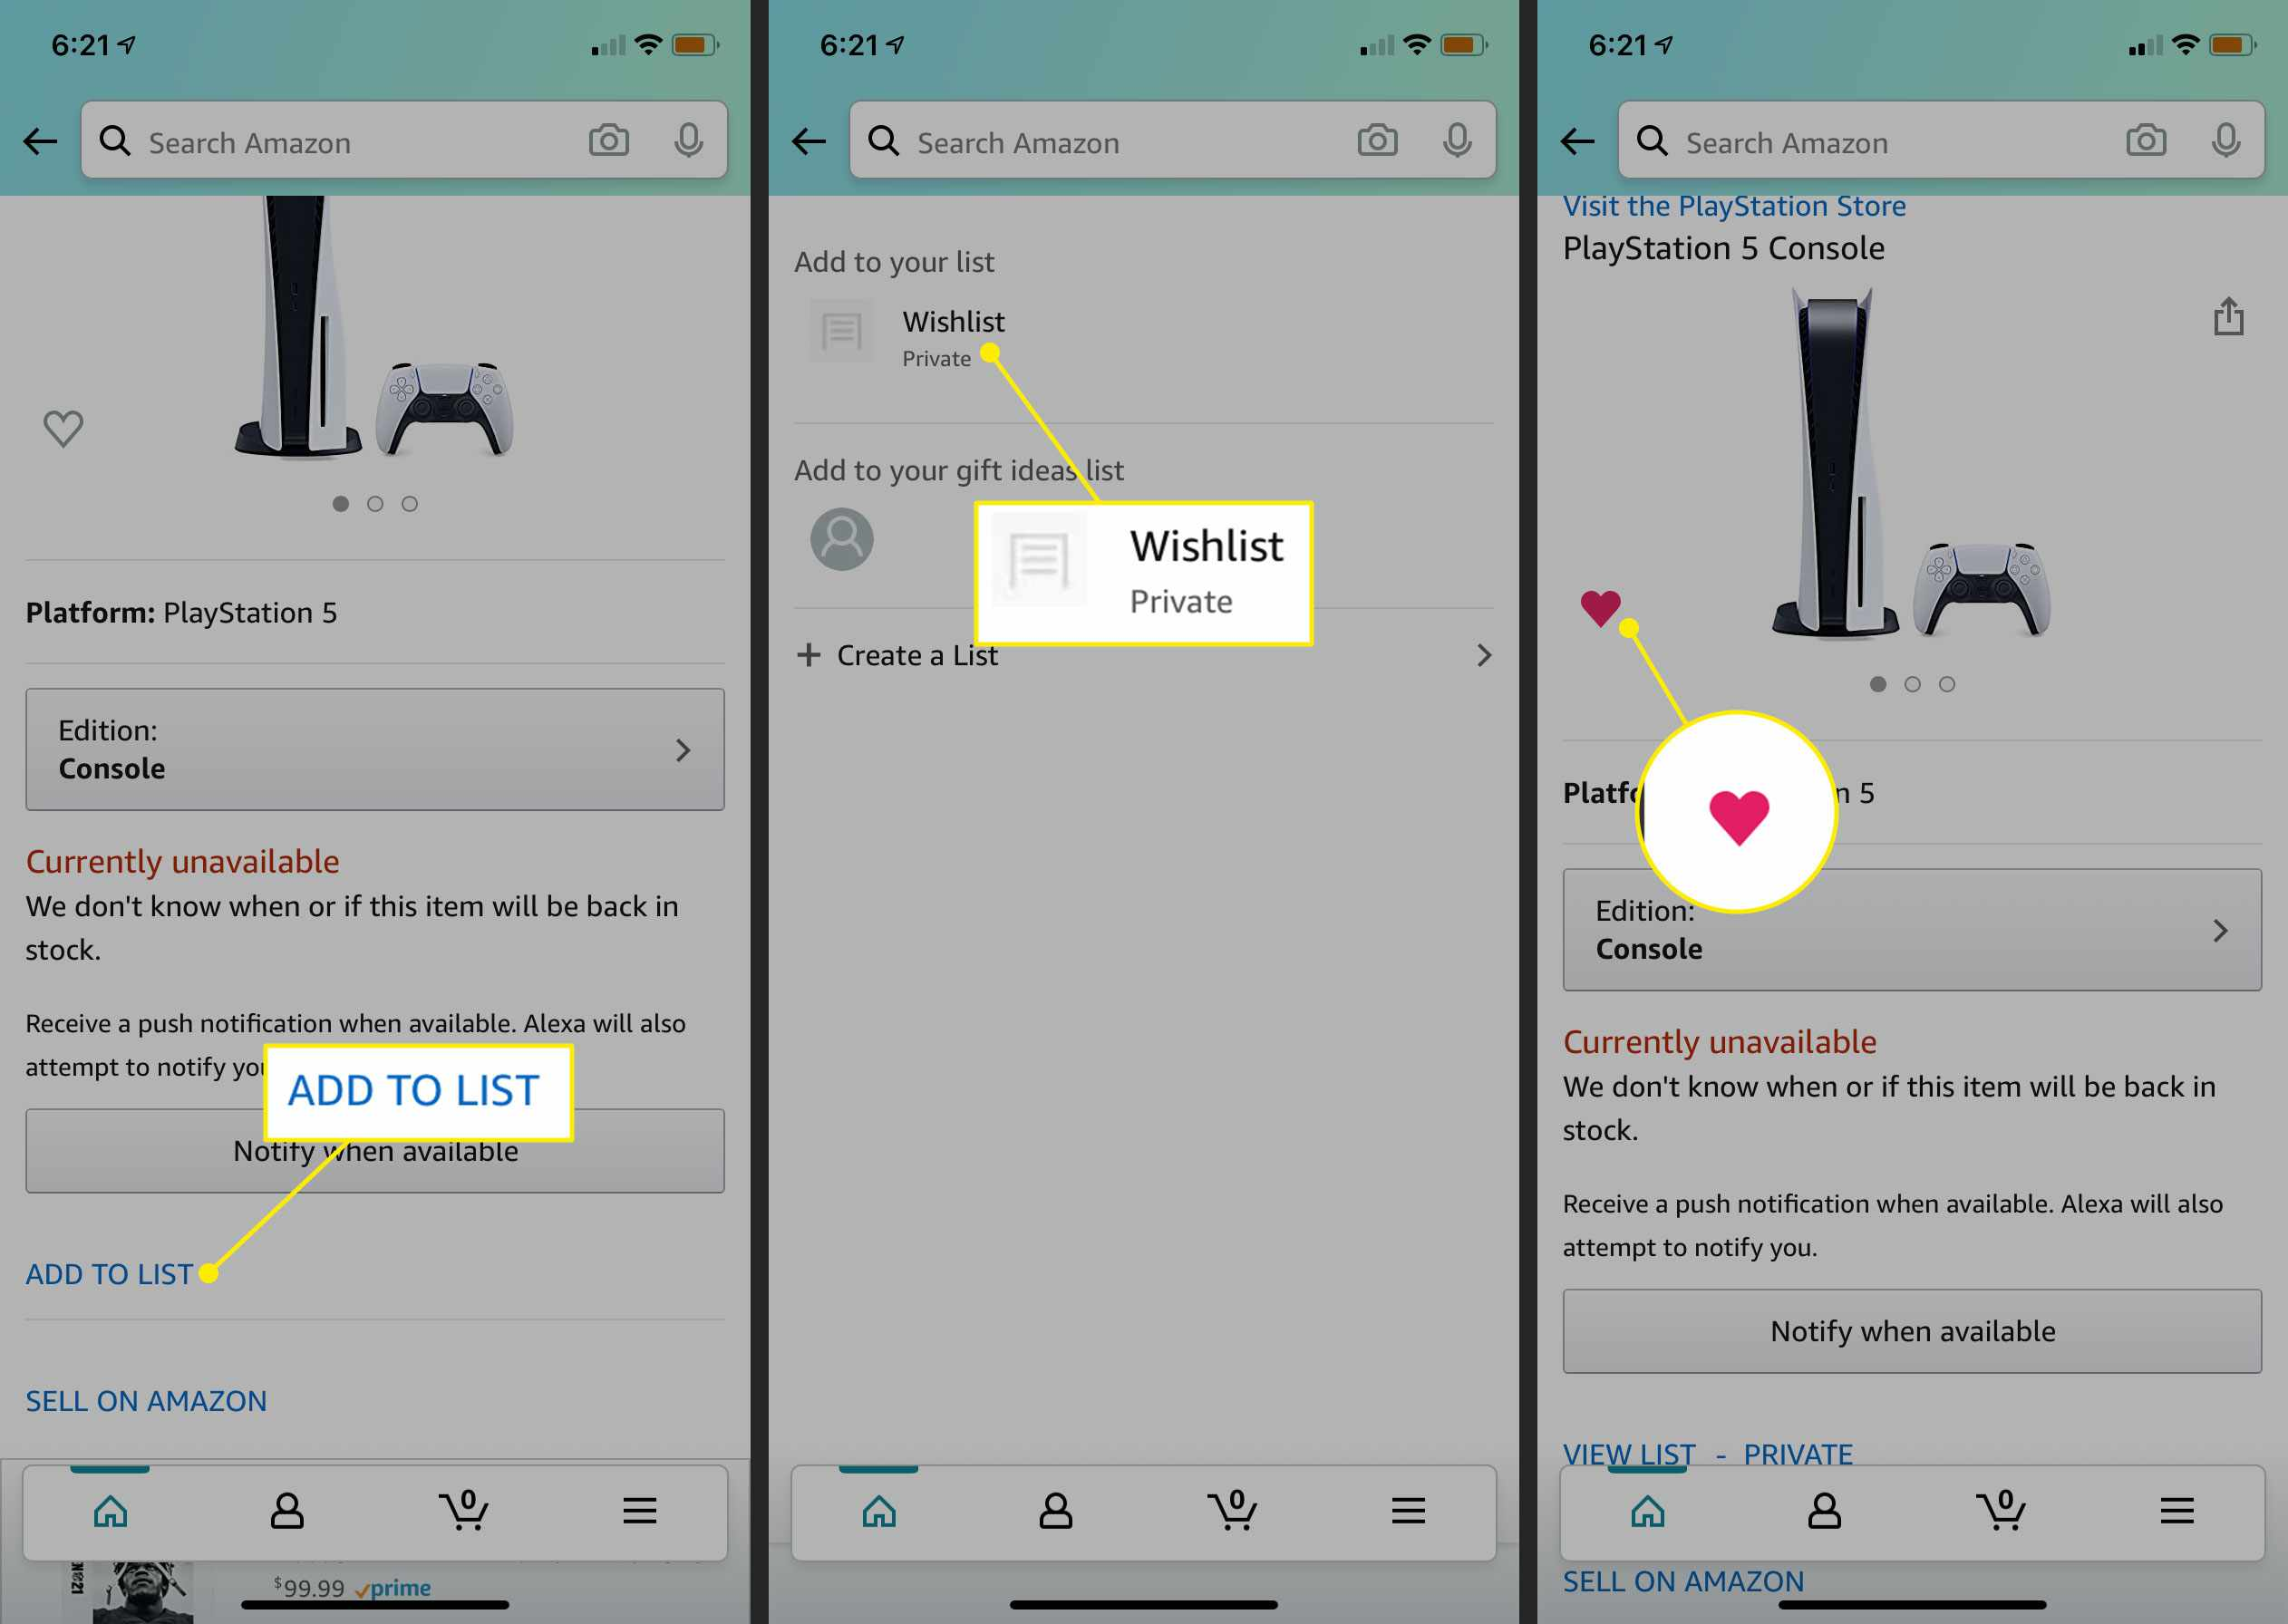
<As a> user, <I want to> add an item to my wishlist <so that> I can consider the purchase

Slide 9
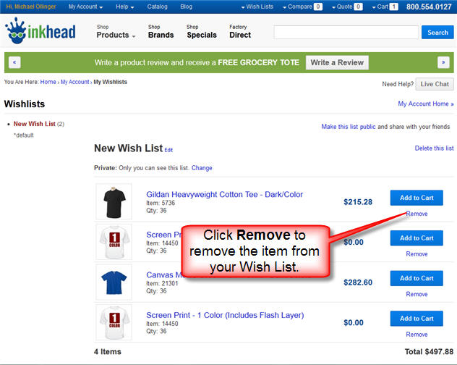
<As a> user, <I want to> remove an item from my wishlist <so that> I know I don’t want it anymore

Slide 10
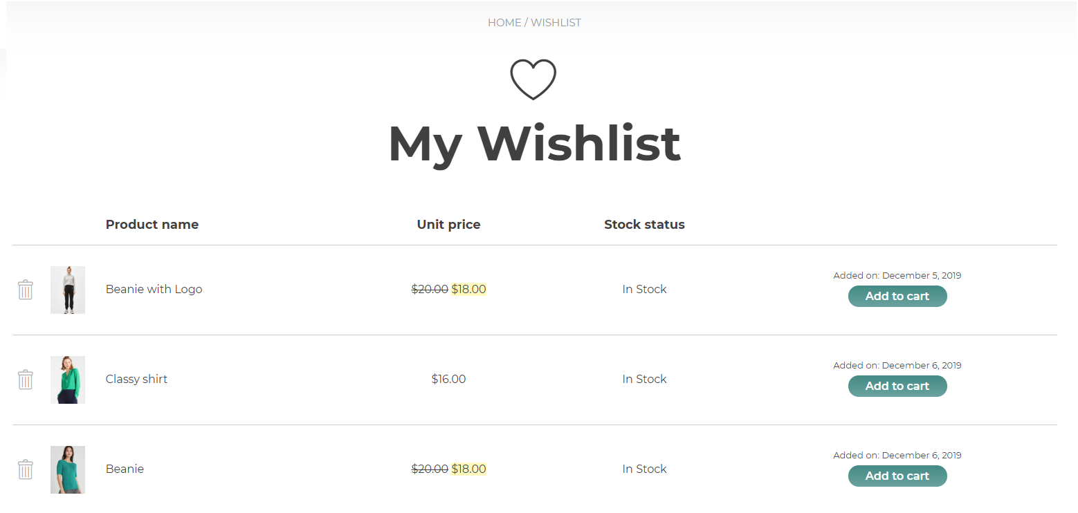
<As a> user, <I want to> add a wishlist item to my cart <so that> I can actually purchase the item

Slide 11
Epic <As a> user <I want to> have the ability to comment/review a product <so that> I can let others know about products I have fought

Slide 12
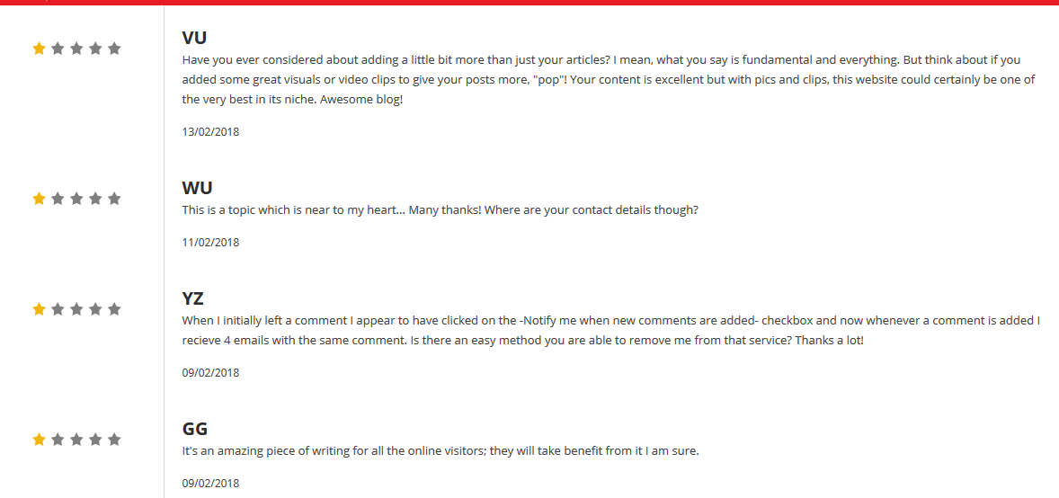
<As a> user <I want to> leave a comment <so that> I can review the product

Slide 13
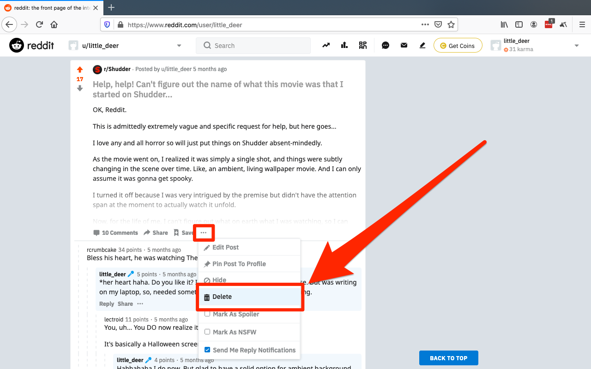
<As a> user <I want to> delete my comment <so that> the comment is no longer viewable

Slide 14
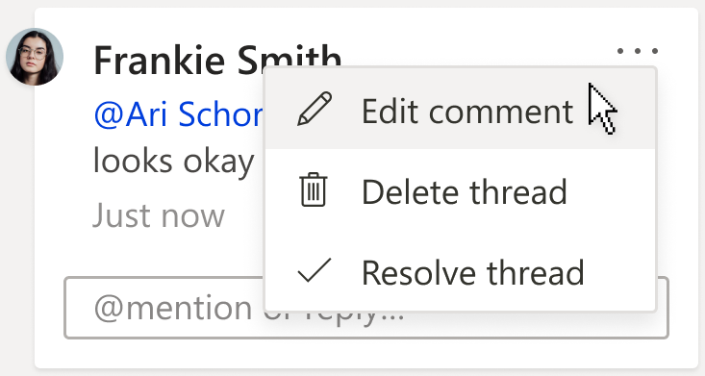
<As a> user <I want to> edit my comment <so that> the comment reflects my current thoughts or fix spelling errors

Slide 15
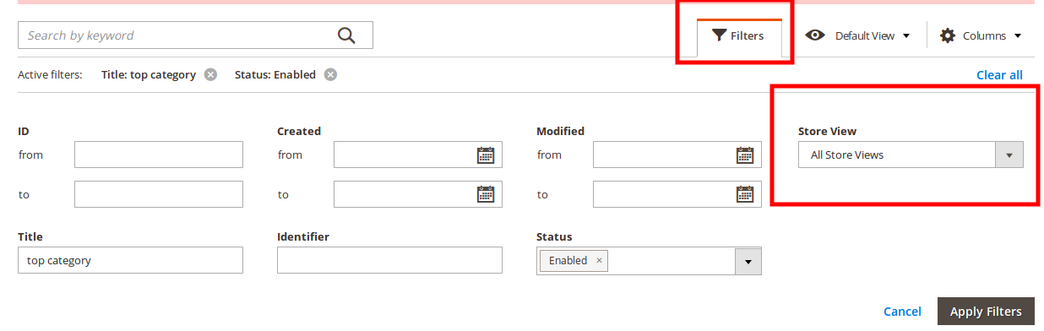
<As a> user <I want to> filter items <so that> I can manage what I see

Slide 16
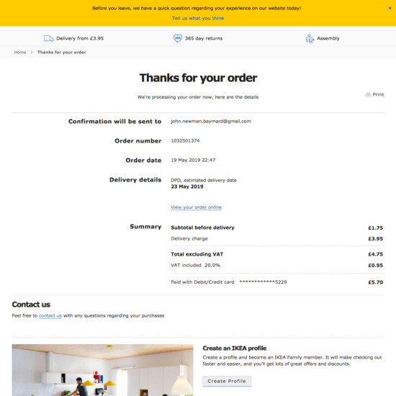
<As a> user <I want to> have a checkout confirmation page <so that> I can my sure my information is correct

Slide 17
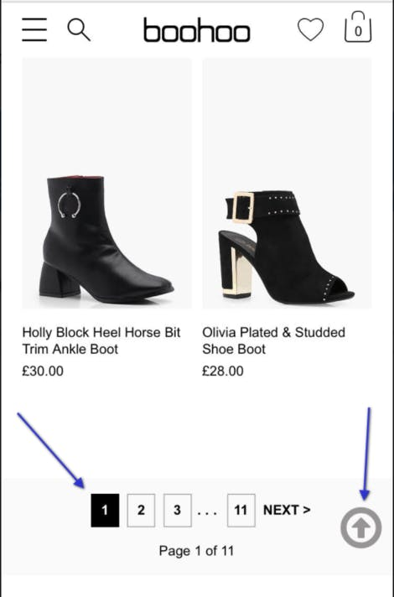
<As a> user <I want to> have products displayed throught pages <so that> the store looks nice and neat

Slide 18
Epic <As an> administrator <I want to> manage all user accounts <so that> I canedit and monitor user accounts for administrative purposes

Slide 19
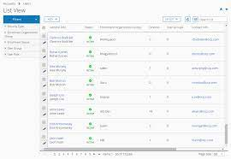
<As an> admin <I want to> show users in a list <so that> I can easily access them

Slide 20
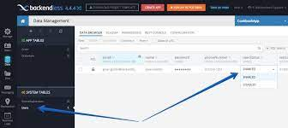
<As an> admin <I want to> disable/enable user <so that> they are no longer to shop at the store

Slide 21
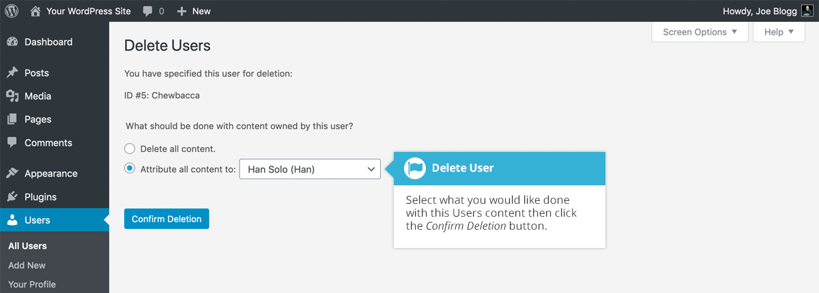
<as an> admin <I want to> delete a user <so that> I can maintain good online community

Slide 22
<As a> admin <I want to> delete comments <so that> I can maintain a good userbase

Slide 23
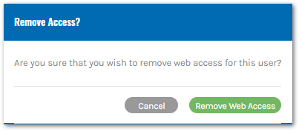
<As an> admin <I want to> remove vip status <so that> I can revoke priviledge for breaking rules

Slide 24
Epic <As an> admin, <I want to> manage products <So that> I can add,edit,remove for administrative purposes

Slide 25
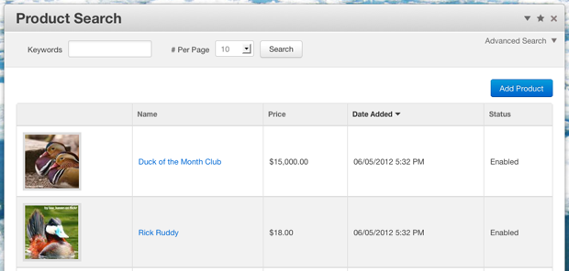
<as an> admin <I want to> add a product <so that> users can purchase or comment

Slide 26
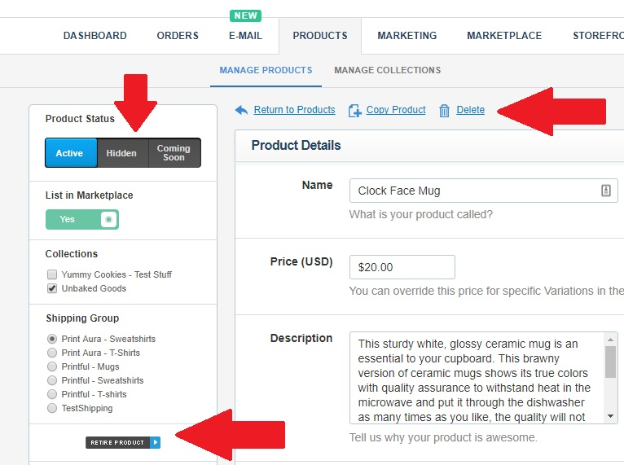
<as a> user <I want to> remove a product <so that> users can no longer purchase an item

Slide 27
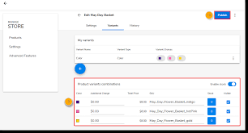
<as an> admin <I want to> edit products <so that> a product reflects the current price, description, and name

