Slide 1
Air Show Flight Path

Slide 2
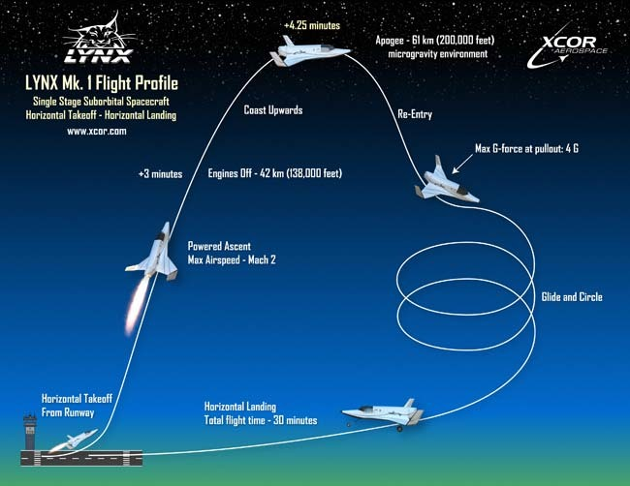
Maneuver

Slide 3
Contact Information
Call Sign | TN | URN | Frequency
TopDog01 | 11204 | 16777200 | 350
TakeOffTower01 | 20171 |  | 325
AirTower01 |  | 16777202 | 400
LandingTower01 | 14261 |  | 375
Broadcast | 77777 | 16777215 | 500

