Slide 1

Customized Hotel Recommendations
B10 Team Stats Trek
Xixi Chen | Jiahao Huo | Xiao Li | Jia Qi Wang | Aaron Yang

Slide 2

Our Goal
Provide return users with Customized Recommendations to increase booking rate
Method
Result
Feature Engineering
Cluster Analysis
Behavior Identification
Cluster | Days Prior to Travel | Number of Adults | Travel Time
International | 2.07 | 0.02 | 0.86
Business | -0.31 | -0.29 | -0.12
Family | -0.02 | 2.26 | -0.06
* All results are standardized

Slide 3
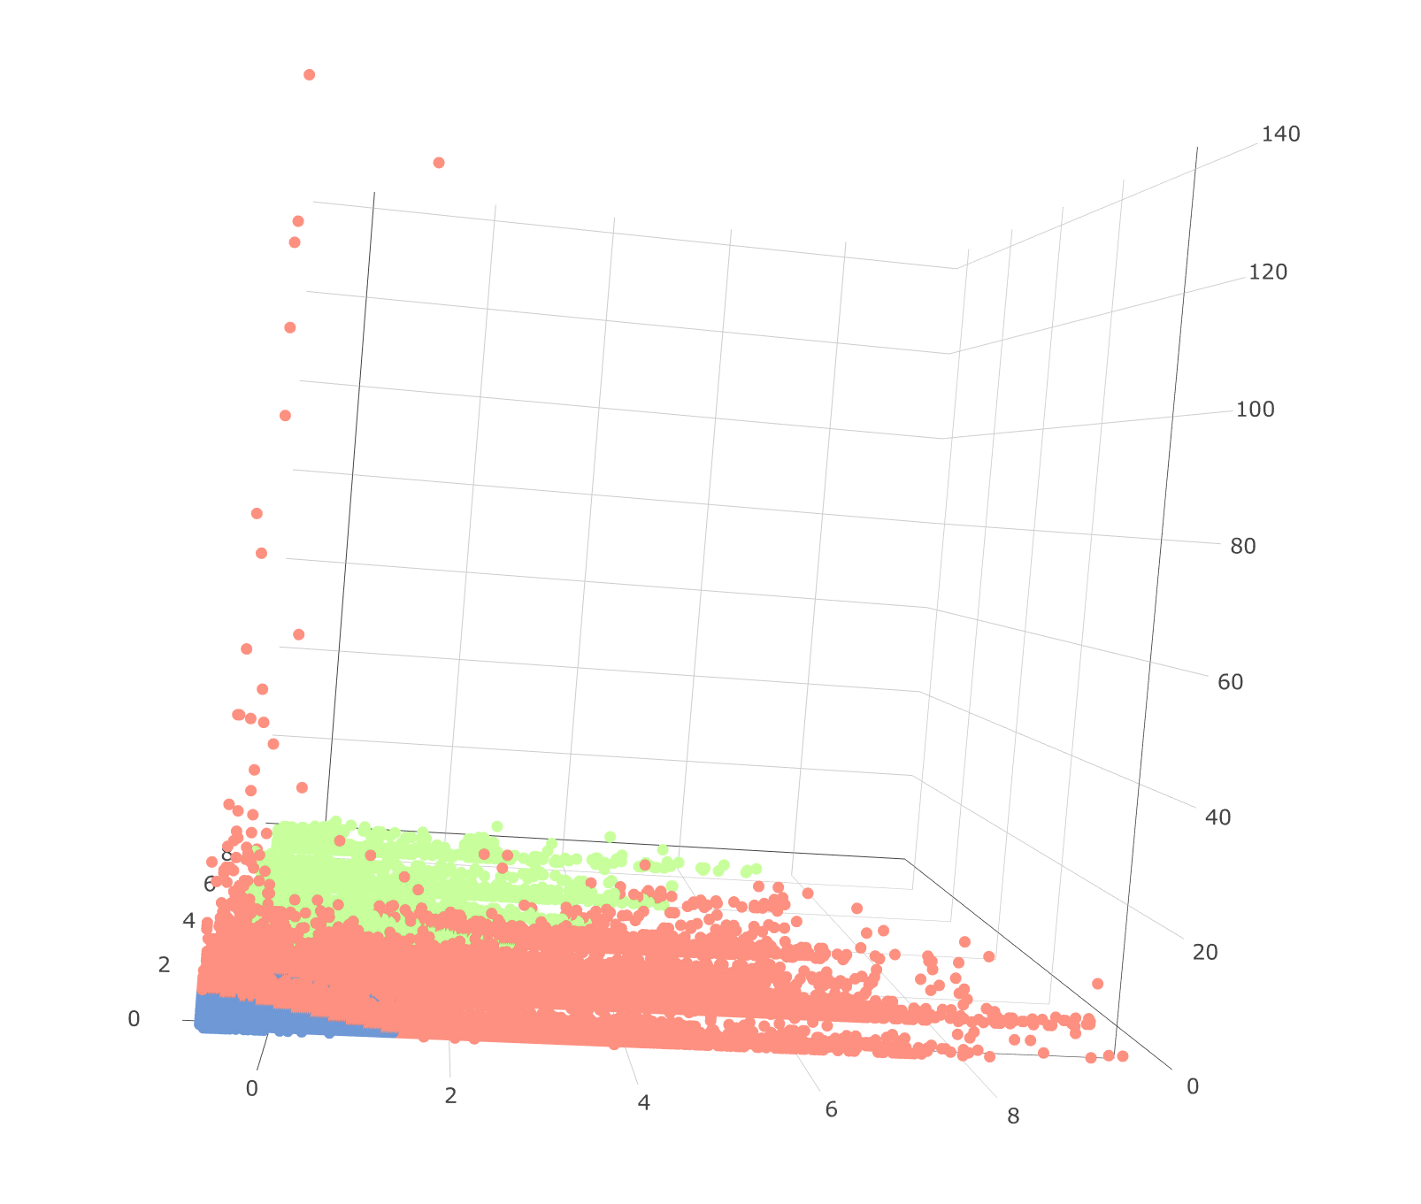

International
Business
Family
Recommendation
- High star rating
- Package Promotion
- Branded Hotel
- City Center
- Large Suite
- Family Activity
travel time
# of adults
days prior to travel

