Slide 1
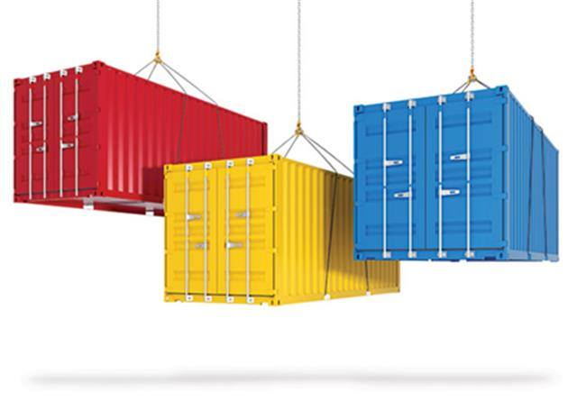
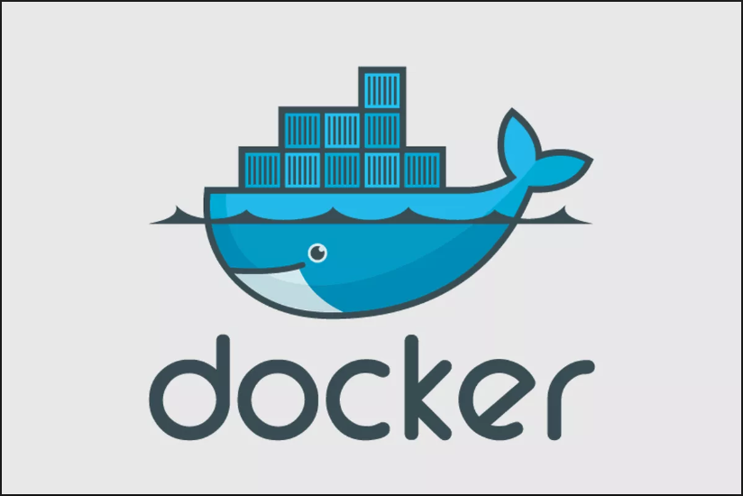

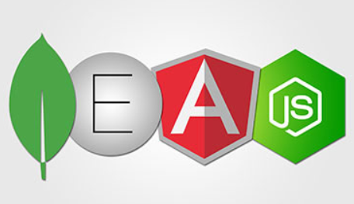

Containerization and Docker
Mike Sellers - Container Zealot and Senior Software Engineer
Ali Soylu – Developer and IT Architect
Johns Hopkins University
April 17, 2019

Slide 2
Agenda
OBJECTIVE: To share a baseline understanding of containerization technologies built on Docker along with the practical knowledge necessary to begin building, shipping and deploying MEAN (Mongo / Express / Angular / Node.js) applications in containers.
Part 1 – Containers Explained
What is containerization?
Why containers?
Hypervisors VS Docker Engines
Engine Orchestration Clusters
Industry Adoption
Part 2 – One MEAN Docker Demo

Slide 3
What is Containerization
“A container is a standard unit of software that packages up code and all its dependencies so the application runs quickly and reliably from one computing environment to another. A Docker container image is a lightweight, standalone, executable package of software that includes everything needed to run an application: code, runtime, system tools, system libraries and settings.” – Docker Inc. https://www.docker.com/resources/what-container
Containerization is the packaging applications into a container.
“Build, ship and run anywhere.” – Docker Inc.

Slide 4
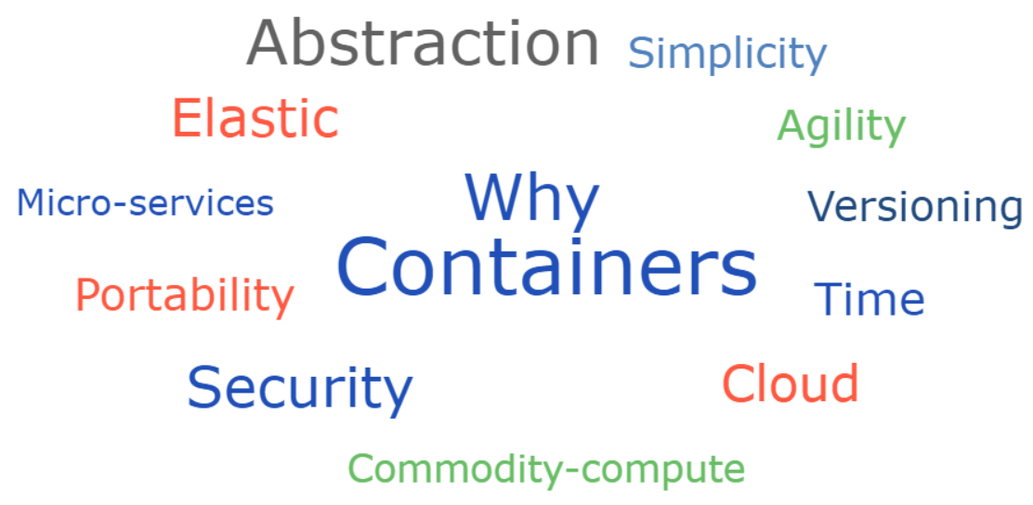

Slide 5
Hypervisors VS Docker Engines
Hypervisor / Virtual Machines
Docker Engine
“Virtual machines have a full OS with its own memory management installed with the associated overhead of virtual device drivers. In a virtual machine, valuable resources are emulated for the guest OS and hypervisor, which makes it possible to run many instances of one or more operating systems in parallel on a single machine (or host). Every guest OS runs as an individual entity from the host system.”
- https://devops.com/docker-vs-vms/
“Docker containers are executed with the Docker engine rather than the hypervisor. Containers are therefore smaller than Virtual Machines and enable faster start up with better performance, less isolation and greater compatibility possible due to sharing of the host’s kernel.”
- https://devops.com/docker-vs-vms/

Slide 6
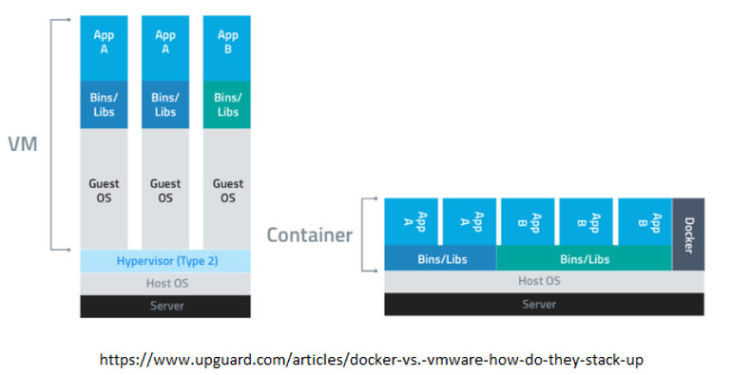
Hypervisors VS Docker Engines
Hypervisor / Virtual Machine
Docker Engine / Container

Slide 7
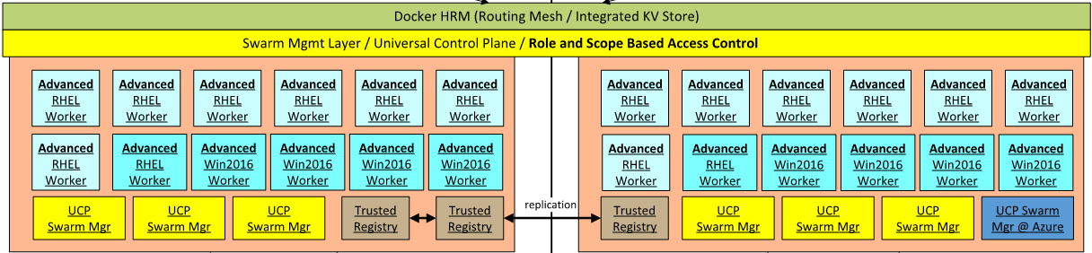
Docker Engine Orchestration Clusters
Docker Swarm
“A swarm is a group of machines that are running Docker and joined into a cluster. After that has happened, you continue to run the Docker commands you’re used to, but now they are executed on a cluster by a swarm manager. The machines in a swarm can be physical or virtual. After joining a swarm, they are referred to as nodes.”
- https://docs.docker.com/get-started/part4/

Slide 8
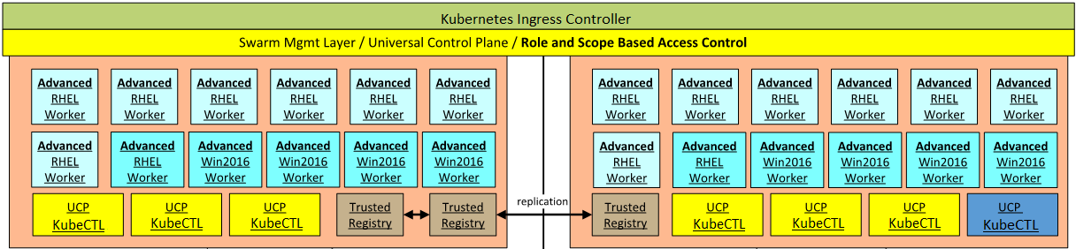
Docker Engine Orchestration Clusters
Kubernetes
“Kubernetes (commonly stylized as k8s^{[3]}) is an open-source container orchestration system for automating application deployment, scaling, and management.^{[4]} It was originally designed by Google, and is now maintained by the Cloud Native Computing Foundation. It aims to provide a "platform for automating deployment, scaling, and operations of application containers across clusters of hosts".^{[3]} It works with a range of container tools, including Docker.”
- https://en.wikipedia.org/wiki/Kubernetes

Slide 9
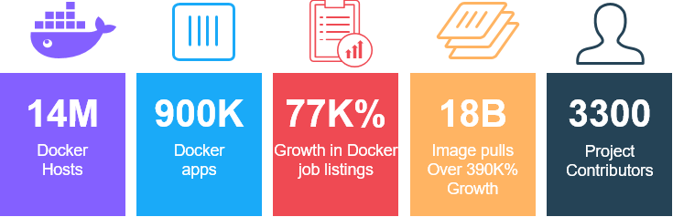
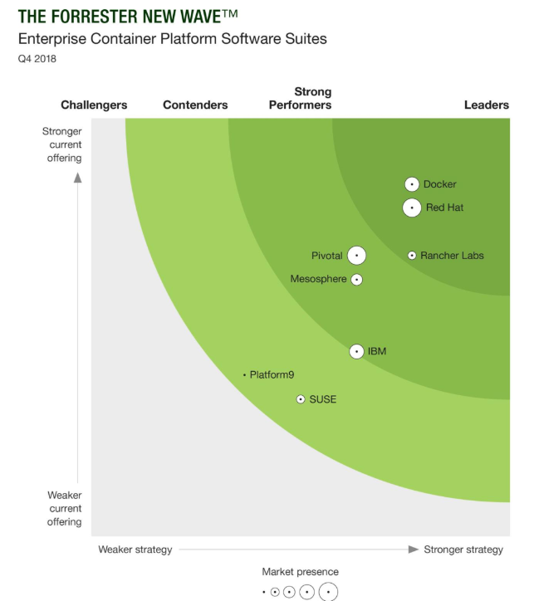
Industry Adoption of Containerization
Per Docker Inc. 2019
“Containers, which enable developers to manage and easily migrate software code, have become very popular. That is not going to change over the coming decade.
Forrester estimates that a third of enterprises are testing containers for use in production;
while 451 Research forecasts that the application containers market will grow 40% annually to $2.7 billion in 2020.
53% of organisations are either investigating or using containers in development or in production, according to a Cloud Foundry report.
The majority of businesses are leveraging containers to enable portability between cloud services from AWS, Microsoft Azure and Google Cloud as they firm up their DevOps strategies for more rapid software production.”
- https://www.cloudcomputing-news.net/news/2019/feb/21/cloud-2020-enterprise-compatibility-edge-computing-containers-and-serverless/
GitHub Stats (Open Source Docker Engine) 4-3-2019
36,603 Commits
11 Branches
226 Releases
1808 Contributors
Forrester New Wave ™: Enterprise Container Platform Software Suites, Q4 2018 report

Slide 10










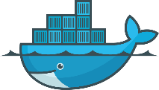













Industry Adoption of Containerization
Content Providers
Infrastructure & Service Providers
Networking
Dev Tools
Clustering & Scheduling
Operating Systems
Storage
Big Data
Management
Service Discovery
Security
Build / Continuous Integration
Monitoring & Logging
Configuration Management
Certified Container
Certified Plugins
Per Docker Inc. 2019

Slide 11
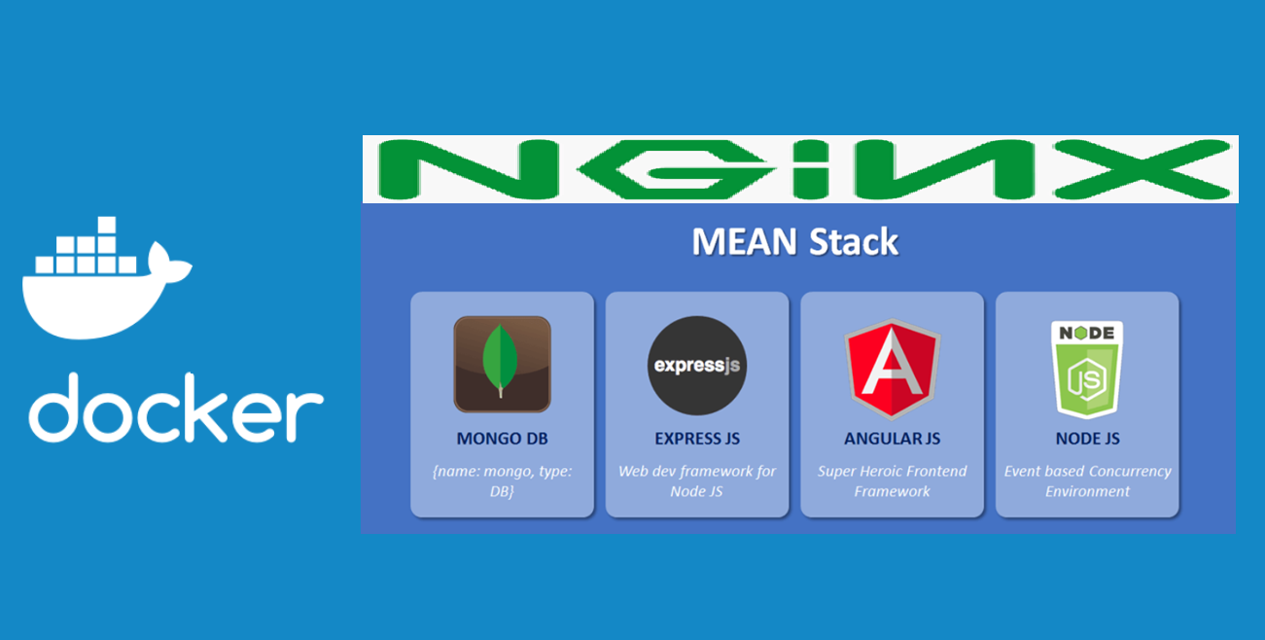
One MEAN Docker Demo

Slide 12
Live Docker Demonstration
Demo system specifications:
Windows 10 installed with Hyper-V active
Docker Desktop Installed
Git Installed (to clone the MEAN_Demo project)
https://github.com/jhuopensource/meandemo
Visual Studio Code Installed
Note: The demo project and all Docker projects can run on any system running a Docker engine.
MEAN Project Development can be performed in various ways:
Build and debug local -> package and run in container
Within docker container (see docker run node + volumes)
…

Slide 13
Docker Demonstration
Activities:
Configuring Docker Desktop for local filesystem access
Basic navigation / docker commands
docker info
docker ps
docker pull
docker run
docker exec
The dockerfile
a) RUN, COPY, EXPOSE, CMD
Build a Docker image
a) Docker build VS Docker-compose
b) --no-cache
Deploy Services on Docker
a) Docker run, Docker-compose UP
Interacting with deployed services and containers
Test the application leveraging a local browser
Initialize a single node Swarm and verify it is online - (Time Permitting)
Configure overlay network - (Time Permitting)
Deploying a stack - (Time Permitting)
Scaling Docker Services

Slide 14
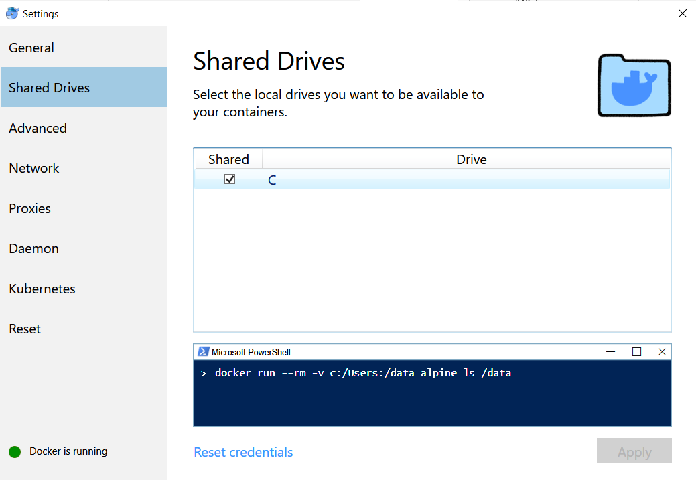
Docker Demonstration
Configuring Docker Desktop for local filesystem access:

Slide 15
Docker Demonstration
Basic navigation / docker commands
docker info
docker info
b) docker ps
docker ps –a
c) docker pull
docker pull node:10.15.3-alpine
d) docker run
docker run -it node:10.15.3-alpine ash
e) docker exec
docker exec -it 0ee8c4642c9e ls

Slide 16
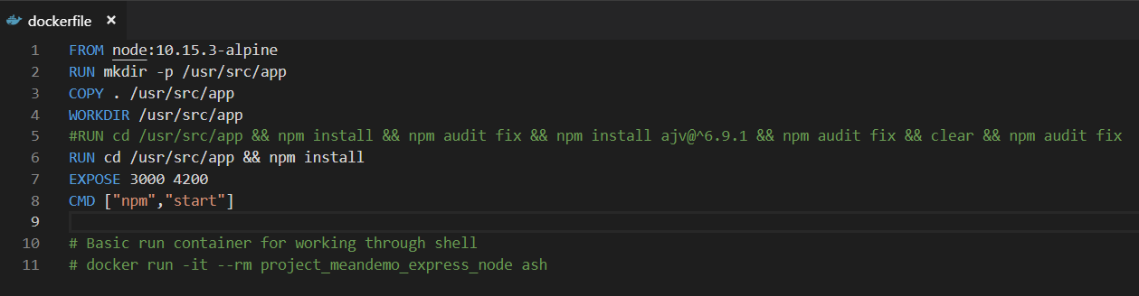
Docker Demonstration
The dockerfile – (image build specification)
RUN, COPY, EXPOSE, CMD

Slide 17
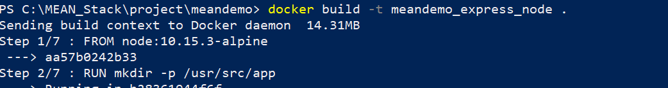
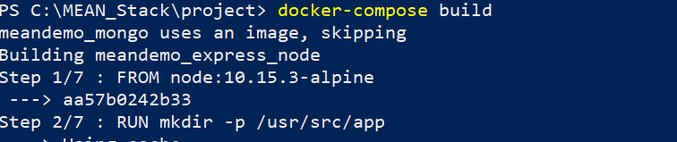
Docker Demonstration
Build a Docker image
docker build VS docker-compose build
a) docker build
docker build -t meandemo_express_node .
a) docker-compose build
docker-compose build

Slide 18
Docker Demonstration
Build a Docker image
docker build VS docker-compose build
a) docker build
docker build --nocache -t meandemo_express_node .
a) docker-compose build
docker-compose build --no-cache

Slide 19
Docker Demonstration
Deploy Services on Docker
Docker run, Docker-compose UP
a) docker-run
docker run -it node:10.15.3-alpine ash
b) docker-compose up
docker-compose -f docker-compose.yml up

Slide 20
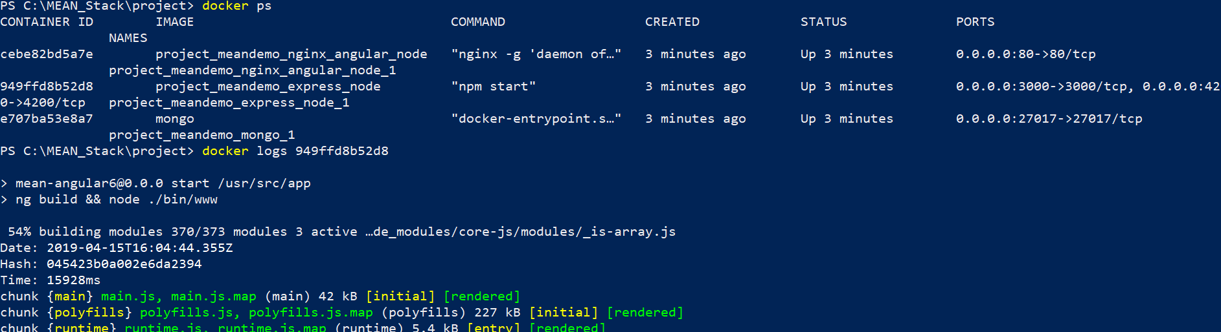
Docker Demonstration
Interacting with deployed services and containers
docker ps
docker logs
docker exec –it 275fc4b89d42 bash
cd /home && mongoimport --db mean-angular6 --collection entries /home/data.json

Slide 21
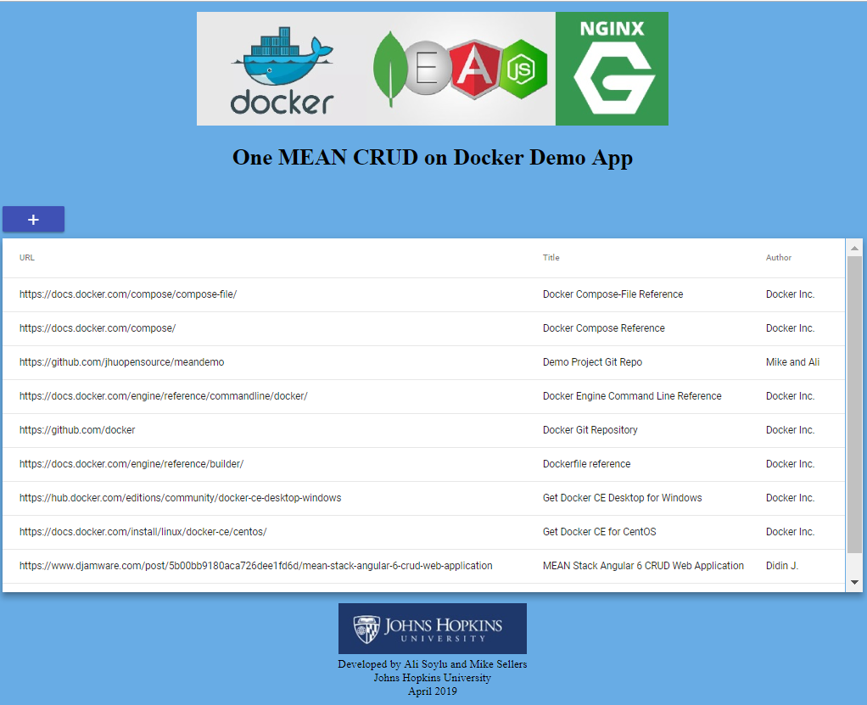
Docker Demonstration
Test the application using a local browser by browsing:
http://localhost:8080

Slide 22
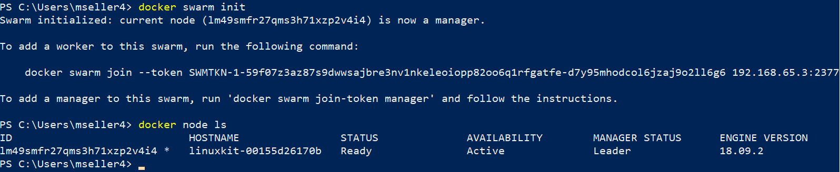
Docker Demonstration (optional)
Initialize a single node Swarm:
1 – Initialize the docker swarm
docker swarm init
2 – Verify swarm is active
docker node ls

Slide 23
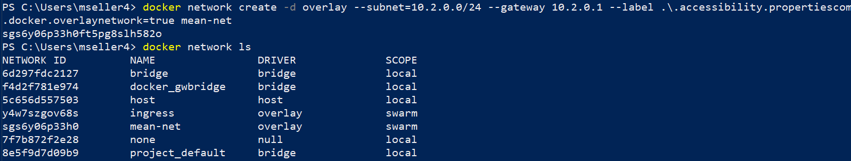
Docker Demonstration (optional)
Configure overlay network (Standard Class C internal network):
1 – Issue the following command to create an internal Class D overlay network for internal communications / physical network abstraction.
docker network create -d overlay --subnet=10.2.0.0/24 --gateway 10.2.0.1 --label com.docker.overlaynetwork=true mean-net
2 – Verify network creation
docker network ls

Slide 24
Docker Demonstration (optional)
Modify docker-compose-stack.yml to leverage the Swarm and deploy the stack:
1 – Edit the docker-compose-stack.yml
2 – Deploy the stack
docker stack deploy -c docker-compose-stack.yml mean_stack

Slide 25
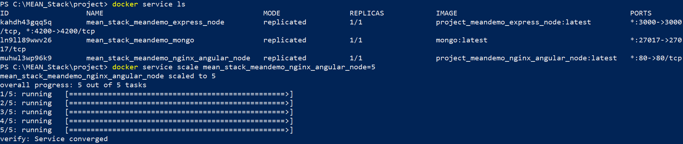
Docker Demonstration (optional)
Scaling a docker service:
1 – Issue the scale command and verify the result
docker service scale mean_stack_meandemo_nginx_angular_node=5

Slide 26
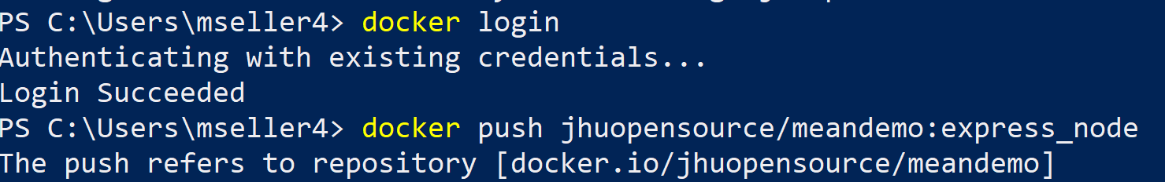
Docker Demonstration (optional)
SHIP - Docker (Trusted) Registry:
1 – Push and Pull Containers
docker push jhuopensource/meandemo:express_node
docker pull jhuopensource/meandemo:express_node

Slide 27
Useful URLs
----------------------------------------------------------------------------------------------------------
Demo Project Git Repo - https://github.com/jhuopensource/meandemo
-----------------------------------------------------------------------------------------------------------------------------
Docker Compose-File Reference - https://docs.docker.com/compose/compose-file/
Docker Compose Reference - https://docs.docker.com/compose/
Docker Engine Command Line Reference - https://docs.docker.com/engine/reference/commandline/docker/
Docker Git Repository – https://github.com/docker
Docker Hub – https://hub.docker.com
Dockerfile reference - https://docs.docker.com/engine/reference/builder/
Get Docker CE Desktop for Windows - https://hub.docker.com/editions/community/docker-ce-desktop-windows
Get Docker CE for CentOS - https://docs.docker.com/install/linux/docker-ce/centos/

Slide 28
Containerization and Docker
Thank you!
Mike Sellers - Container Zealot and Senior Software Engineer
Ali Soylu – Developer and IT Architect
Johns Hopkins University

